Slide 1

A Complete Security Proof of SQIsign
Marius A. Aardal, Andrea Basso, Luca De Feo, Sikhar Patranabis, Benjamin Wesolowski

Slide 2

Overview
Intro to isogenies & SQIsign
First attempt at proving security
New security proof

Slide 3

Intro to isogenies
& SQIsign

Slide 4


Isogenies
endomorphism
isogeny
$$φ$$
$$⟺$$
elliptic curve
endomorphism ring

Slide 5
Endomorphism rings
Isogenies “carry”
knowledge of the
endomorphism ring
Knowledge of
endomorphism rings
gives connecting isogeny

Slide 6



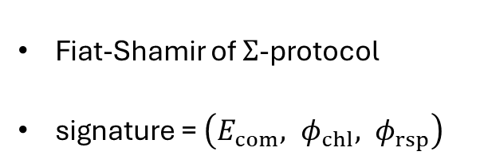



SQIsign
public key $E_{pk}$
Fiat-Shamir of $Σ$-protocol
signature = $\left({E_{com}, φ}_{chl}, φ_{rsp}\right)$
$$φ_{sk}$$
$$φ_{chl}=H(E_{com} || msg)$$
$$φ_{com}$$
$$φ_{rsp}$$
commitment $E_{com}$

Slide 7




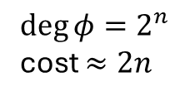
Computing isogenies
$\deg{φ}≈$ the length of $φ$
If degree is prime:
If degree is smooth:
If degree is not smooth and exp. large:
$$φ$$
cost $≈\deg{φ}$
$$\deg{φ}=2^{n}$$
cost $≈2n$
$n$ isogenies of degree 2
Need EndRing!

Slide 8
2. First attempt at proving security
(in the ROM)

Slide 9






Blueprint
$Σ$-protocol for a relation $R$
Check-list:
  Unpredictable commitments
  Exponential #chl
  $R$ is a hard relation
    Knowledge soundness
    Honest-verifier zero-knowledge
= Fiat-Shamir signature is EUF-CMA-secure
$$P(x,w)$$
$$V(x)$$
$$com$$
  
  
$$chl$$
  
  
$$rsp$$
  

Slide 10







Blueprint
public key $E_{pk}$
$Σ$-protocol for a relation $R_{EndRing}$
Check-list:
  Unpredictable commitments
  Exponential #chl
  $R_{EndRing}$ is a hard relation
    Knowledge soundness
    Honest-verifier zero-knowledge
= SQIsign is EUF-CMA-secure
$$φ_{sk}$$
  R
$$φ_{chl}$$
  
  R
$$φ_{com}$$
  
  R
  
  R
  
  
$$φ_{rsp}$$
commitment $E_{com}$

Slide 11







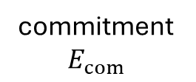
Honest-verifier zero-knowledge
Statement $E_{pk}$
public key $E_{pk}$
$$Simulator$$
degree not smooth!
$$φ_{chl}$$
$$φ_{rsp}$$
$$E_{chl}$$
$$(E_{com}, { φ}_{chl}, { φ}_{rsp})$$
commitment
$E_{com}$
Uniform distribution?

Slide 12

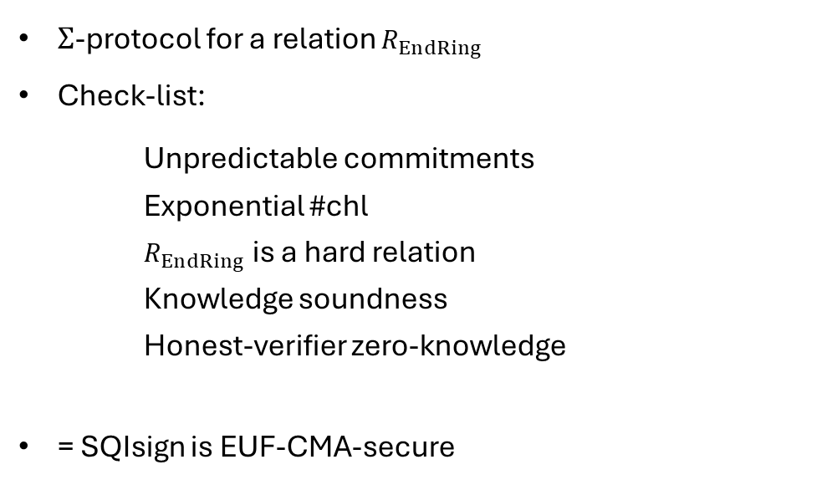
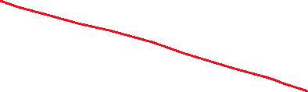
Blueprint
public key $E_{pk}$
$Σ$-protocol for a relation $R_{EndRing}$
Check-list:
  Unpredictable commitments
  Exponential #chl
  $R_{EndRing}$ is a hard relation
    Knowledge soundness
    Honest-verifier zero-knowledge
= SQIsign is EUF-CMA-secure
$$φ_{sk}$$
  R
$$φ_{chl}$$
  
  R
$$φ_{com}$$
  
  R
  
  R
  
  S
$$φ_{rsp}$$
  
commitment $E_{com}$

Slide 13

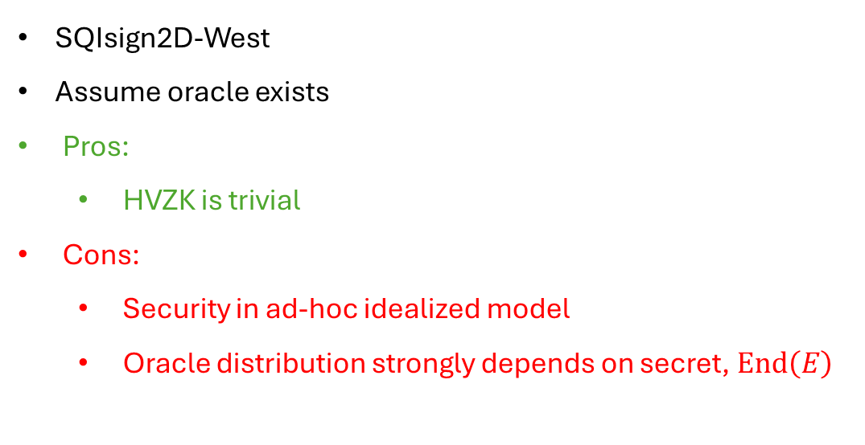


Previous approach
SQIsign2D-West
Assume oracle exists
Pros:
  HVZK is trivial
Cons:
  Security in ad-hoc idealized model
  Oracle distribution strongly depends on secret, $End\left(E\right)$
$$E$$
$$𝒪$$
$$E_{com}, { φ}_{rsp}:E→E_{com}$$

Slide 14
3. A security proof
(in the ROM)

Slide 15




Hint-assisted HVZK
Statement $x$
$$Simulator$$
Hint distribution $ℋ$
hint
Need not be efficient!
$$(com, chl, rsp)$$
Non-interactive!

Slide 16








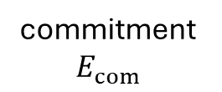

Hint distribution for SQIsign
$$E_{pk}$$
public key $E_{pk}$
Pushable
Hint distribution $ℋ$
$$hint$$
$$φ_{chl}$$
Random non-smooth isogeny from $E_{pk}$
$$E_{chl}$$
commitment
$E_{com}$
$$φ_{rsp}≔$$
$$hint’$$

Slide 17


Hint distribution for SQIsign
New computational assumption
hint-dist
Target curve of hint is
indist. from uniform random
Simulation:
Public key $E_{pk}$
$$φ_{chl}$$
$$E_{chl}$$
commitment
$E_{com}$
$$φ_{rsp}≔$$
$$hint’$$

Slide 18
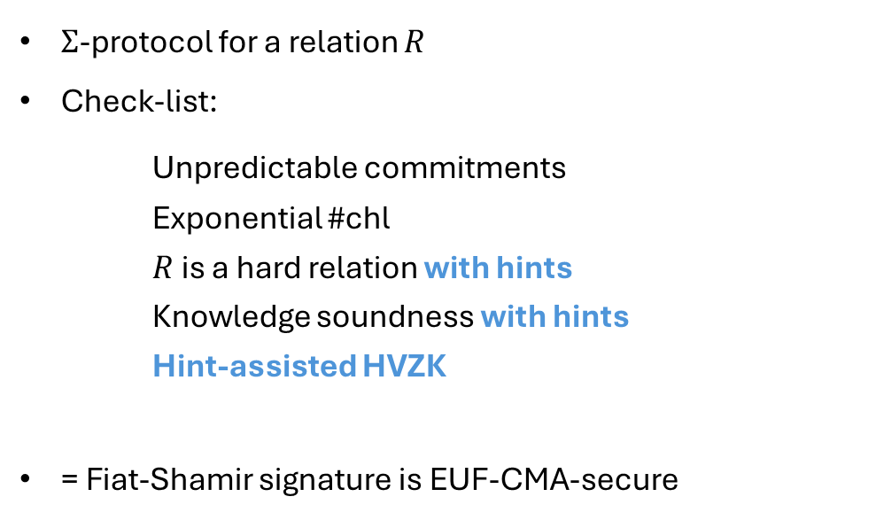
Fiat-Shamir with hints
$Σ$-protocol for a relation $R$
Check-list:
  Unpredictable commitments
  Exponential #chl
  $R$ is a hard relation with hints
    Knowledge soundness with hints
    Hint-assisted HVZK
= Fiat-Shamir signature is EUF-CMA-secure
$$P(x,w)$$
$$V(x)$$
$$com$$
  
  
$$chl$$
  
  
$$rsp$$
  

Slide 19
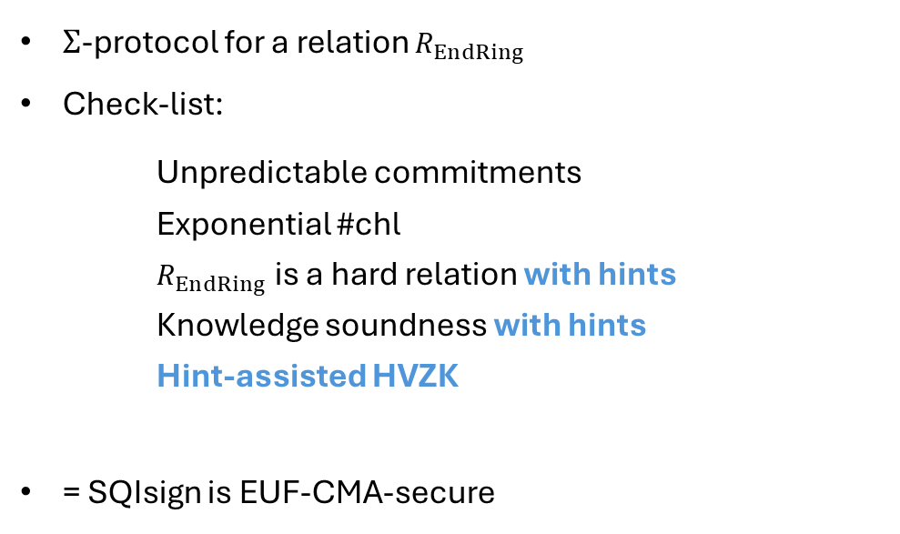
Fiat-Shamir with hints
public key $E_{pk}$
$Σ$-protocol for a relation $R_{EndRing}$
Check-list:
  Unpredictable commitments
  Exponential #chl
  $R_{EndRing}$ is a hard relation with hints
    Knowledge soundness with hints
    Hint-assisted HVZK
= SQIsign is EUF-CMA-secure
$$φ_{sk}$$
  R
$$φ_{chl}$$
  
  R
$$φ_{com}$$
  
  
  
  R
$$φ_{rsp}$$
  
(assuming hint-dist)
commitment $E_{com}$

Slide 20


EndRing with hints
Given: $poly(λ)$ hints
Goal: Compute EndRing
$$…$$
Intuition: Isogenies of non-smooth degree
do not provide more info than smooth degree ones

Slide 21

Fiat-Shamir with hints
public key $E_{pk}$
$Σ$-protocol for a relation $R_{EndRing}$
Check-list:
  Unpredictable commitments
  Exponential #chl
  $R_{EndRing}$ is a hard relation with hints
    Knowledge soundness with hints
    Hint-assisted HVZK
= SQIsign is EUF-CMA-secure
$$φ_{sk}$$
  R
$$φ_{chl}$$
  
  R
$$φ_{com}$$
  
  R
  
  R
  
  R
$$φ_{rsp}$$
  
(assuming hint-dist)
commitment $E_{com}$

Slide 22
Future work
public key $E_{pk}$
IdealToIsogeny
  Sub-procedure
  Need negligible failure probability
  Qlapoti?
QROM security?
$$φ_{sk}$$
$$φ_{chl}$$
$$φ_{com}$$
$$φ_{rsp}$$
commitment $E_{com}$

Slide 23
Conclusion
EndRing with hints + hint-dist
+ IdealToIsogeny negl. failure
= SQIsign is EUF-CMA secure in the ROM
https://ia.cr/2025/379

