Slide 1



High-Throughput Permissionless Blockchain Consensus
under
Realistic Network Assumptions
Sandro Coretti
Matthias Fitzi
Aggelos Kiayias
Giorgos Panagiotakos
Alexander Russell

Slide 2


High-Throughput Proof-of-Stake Blockchain: Challenges
Sequential / asymmetric resource allocation
Message bursts
Block equivocation
B
B
B
B
network load
B
B
B
B
B⁺
add new block here
B
B
B
B
B
⏳ download
B
B'
download second version of B

Slide 3
High-Throughput Proof-of-Stake Blockchain
Can throughput reach network capacity?
Yes ...
  BFT (committee-based)
    Marine-life series [DKSS22,SGSK22,...]
      Permissioned
      No adaptive security
  Nakamoto (a la Bitcoin)
    Prism (PoW) [BKTF+19]
      Unrealistic network
      Not good for PoS [NSYT+22]

Slide 4
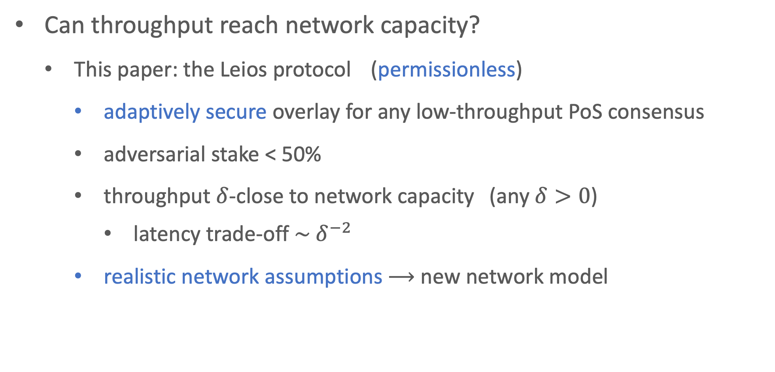
High-Throughput Proof-of-Stake Blockchain
Can throughput reach network capacity?
  This paper: the Leios protocol (permissionless)
    adaptively secure overlay for any low-throughput PoS consensus
    adversarial stake < 50%
    throughput $δ$-close to network capacity (any $δ>0$)
      latency trade-off $\sim { δ}^{−2}$
    realistic network assumptions ⟶ new network model

Slide 5
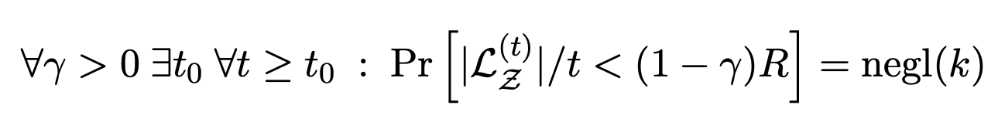
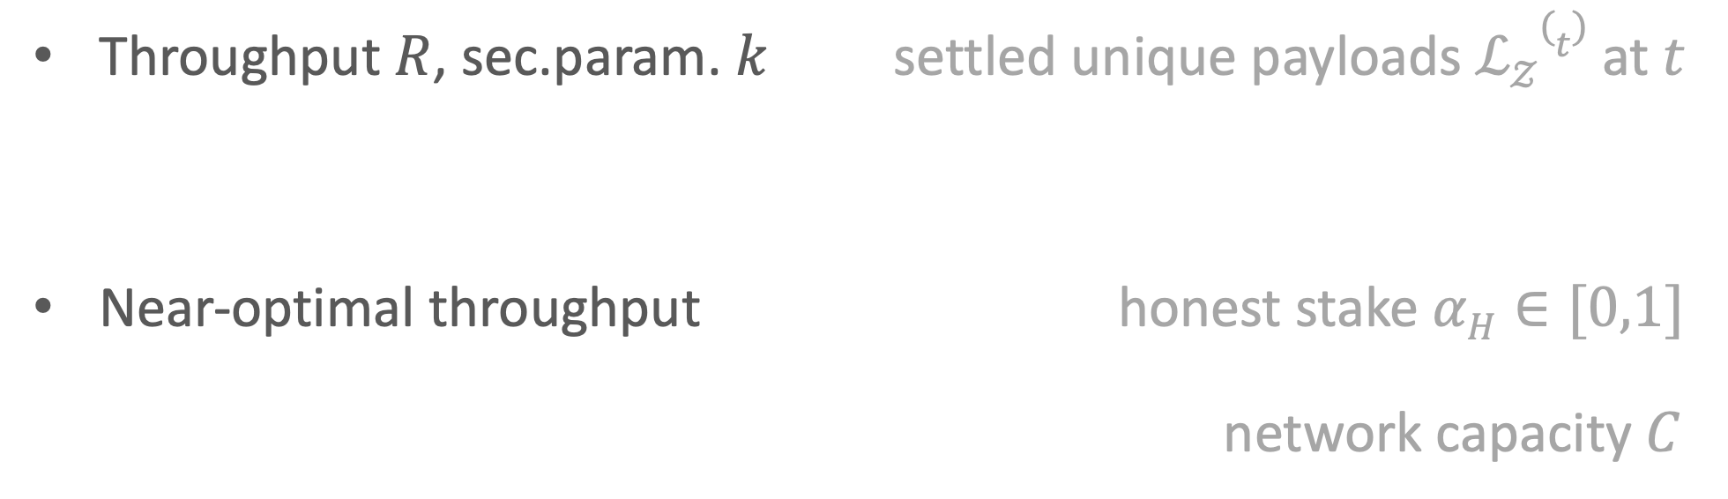

Defining Throughput
$$𝒵$$
Upon request
  Environment responds with globally unique payload
  idealized!
unique
block payload
Throughput $R$, sec.param. $k$ settled unique payloads $ℒ𝒵(t)$ at$t$
Near-optimal throughput honest stake $αH∈[0,1]$
network capacity $C$

Slide 6
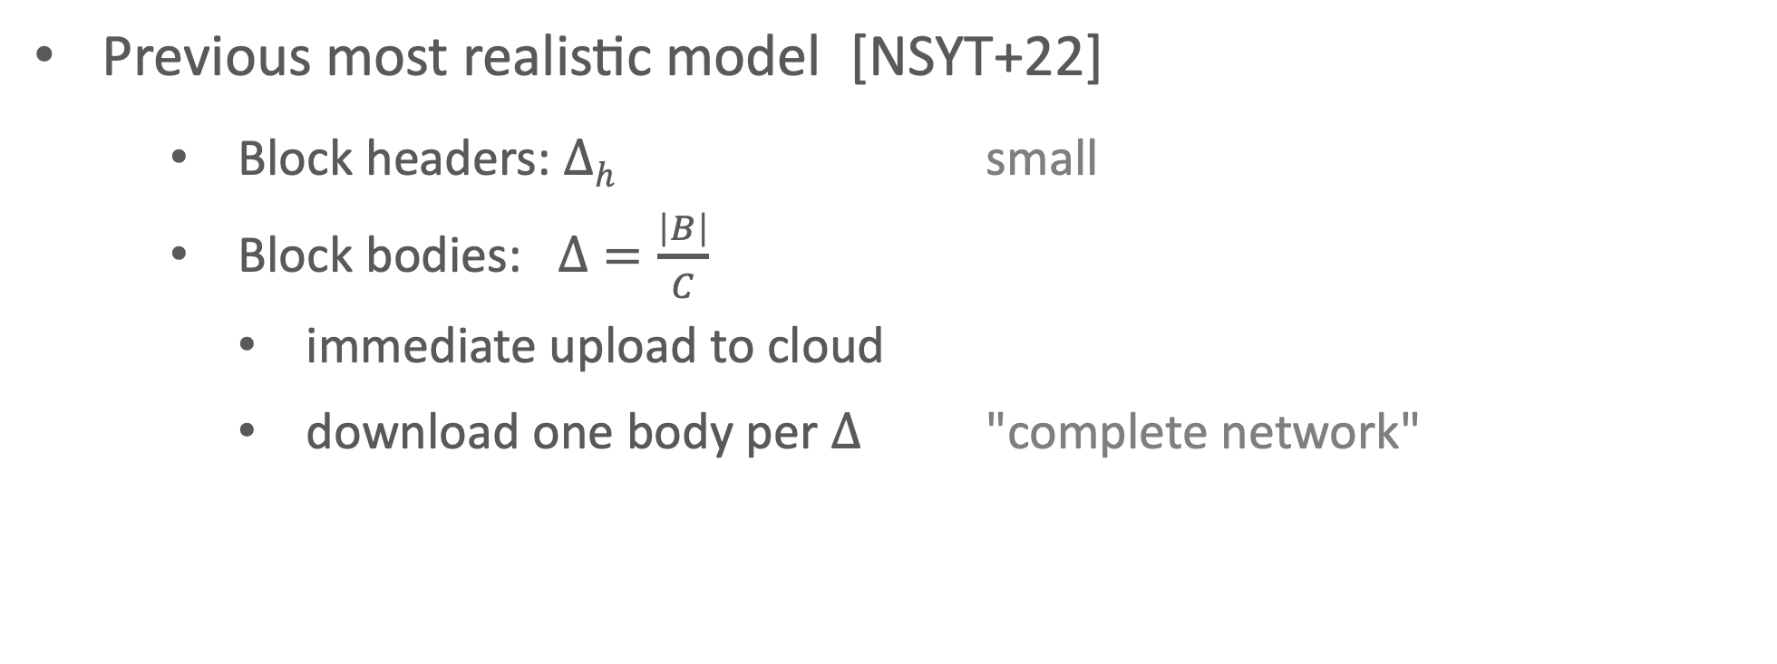



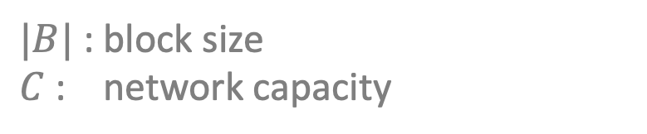
New Network Model
$$∞$$
$$C$$
$$Δ$$
Previous most realistic model [NSYT+22]
    Block headers: $Δh$ small
    Block bodies: $Δ=\frac{\left|B\right|}{C}$
      immediate upload to cloud
      download one body per $Δ$ "complete network"
$|B|$ : block size
$C$ : network capacity

Slide 7
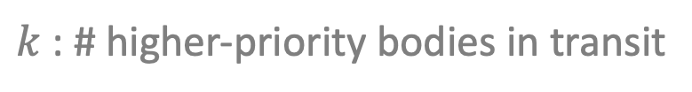

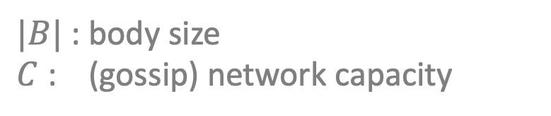
New Network Model
B
d=5
Gossip network with diameter d
Delays
  Block headers: $Δh$
  Block bodies ☀️ : $β≤d∙\frac{\left|B\right|}{C}$
    Queuing 🌧️ : $Δb ≤ β+k∙$ $\frac{\left|B\right|}{C}$
link delay
$|B|$ : body size
$C$ : (gossip) network capacity
$k$ : # higher-priority bodies in transit

Slide 8
The Leios Protocol
Re: sequential / asymmetric resource allocation
➝ Input Endorsers / Fruitchains [GKL15, PS17, BKTF+19]
  decouple payload generation from ordering (consensus)
  payload generation near capacity / slow ordering
B
B
B
B
network load
RB
RB
RB
RB
"ranking blocks" RB
by reference
IB
txs
IB
txs
IB
txs
IB
txs
IB
txs
IB
txs
IB
txs
"input blocks" IB
IB
txs
network load

Slide 9
The Leios Protocol
B
B
B
B
B⁺
add new block here
Re: Message bursts
decouple payload delivery from ordering (consensus)
  ➝ certify ✅ availability of payloads stake-based voting
  ➝ late payloads do not hinder consensus
B
B
B
B
B
⏳ download
RB
RB
RB
RB
RB⁺
"ranking blocks" RB
✅
✅
✅
✅
✅
✅
✅
✅
IB
txs
IB
txs
?
IB
txs
?
IB
txs
IB
txs
"input blocks" IB
IB
txs

Slide 10
The Leios Protocol
B
B
B
B
B⁺
add new block here
Re: Message bursts
decouple payload delivery from ordering (consensus)
  ➝ certify ✅ availability of payloads stake-based voting
  ➝ late payloads do not hinder consensus
  ➝ economical use of voting / certificates
B
B
B
B
B
⏳ download
RB
RB
RB
RB
RB⁺
"ranking blocks" RB
✅
✅
✅
✅
EB
EB
EB
EB
"endorser blocks" EB
IB
txs
IB
txs
?
IB
txs
?
IB
txs
IB
txs
"input blocks" IB
IB
txs

Slide 11
The Leios Protocol
Problem: Adversary could still pile up old IBs ...
  ... and congest good payloads for arbitrary time
  ➝ IBs expire (for voting)
  ➝ Freshest-first (FF) delivery similar to [NSYT+22]
  ‣ honest release of IB: timely delivery / certification
  ‣ adv. late release of IB: no effect on future blocks
Wed
Tue
Mon

Slide 12
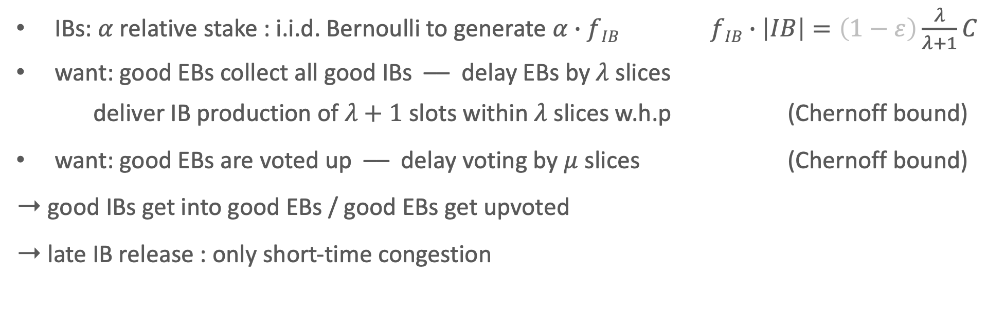



The Leios Protocol
Guarantee timely delivery under FF: production pipeline
$$Å$$
$$μ=Θ(λ2)$$
$$λ$$
...
vote
IBs
EBs
...
vote
IBs
EBs
IBs
EBs
...
vote
...
IBs: $α$ relative stake : i.i.d. Bernoulli to generate $α∙$ $fIB$ $fIB∙\left|IB\right|=\left(1−ε\right)\frac{λ}{λ+1}C$
want: good EBs collect all good IBs –– delay EBs by$λ$ slices
deliver IB production of $λ+1$ slots within $λ$ slices w.h.p (Chernoff bound)
want: good EBs are voted up –– delay voting by $μ$ slices (Chernoff bound)
➝ good IBs get into good EBs / good EBs get upvoted
➝ late IB release : only short-time congestion

Slide 13
The Leios Protocol
Guarantee timely delivery under FF: production pipeline
$$Å$$
$$μ=Θ(λ2)$$
$$λ$$
...
vote
IBs
EBs
...
vote
IBs
EBs
IBs
EBs
...
vote
...
want: good EB gets into base protocol (RB) per pipeline
  ... in spite of low base-chain quality (honest RBs are rare)
  ... only one certificate per RB
  ➝ paper
  handle block equivocations
          ➝ paper

Slide 14
A Note on Dynamic Participation
Protocols like Praos [DGKR18] work in the "sleepy model" [PS17]
  adversarial participation among active stake < 50%
  Leios voting requires honest > 50% of full stake
    high participation: high throughput
    low participation: throughput of base protocol

Slide 15
Conclusion
This paper: the Leios protocol
  adaptively secure overlay for any low-throughput PoS consensus
  throughput close to network capacity
  adversarial stake < 50%
  proven under new realistic network model
Also works for resources other than PoS (tweaks)

Slide 16
Extra Slides

Slide 17
The Leios Protocol
Base-Protocol Inclusion
  RB picks certified EB of recent pipeline
  Bad base-chain quality: avoid inclusion of multiple certificates!
  ➝ 2nd EB level in pipeline with bounded recursion
  ➝ Rare honest RBs cover all pipelines (one certificate per RB)
IBs
EBs
...
vote
✅
RB
RB
RB
RB

Slide 18

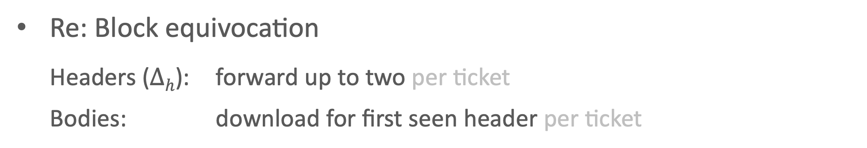



The Leios Protocol
B'
Re: Block equivocation
  Headers ($∆h$): forward up to two per ticket
  Bodies: download for first seen header per ticket
B
$$∆h$$
$$∆h$$
$$∆h$$
$$∆h$$
$$∆h$$
$$t$$
IB generation
IB
txs
IB header
seen
no second IB' header seen
EB inclusion iff
EB
IB header
seen
no second IB' header seen
vote EB iff
✅
any honest
first seen

