Slide 1



Enhancing provable security and efficiency of permutation-based DRBGs
Woohyuk Chung, Seongha Hwang, Hwigyeom Kim,
and Jooyoung Lee
KAIST
Notes:
Hello, my name is Woohyuk Chung.
In this presentation, I will talk about our paper on enhancing the provable security and efficiency of permutation-based random number generators

Slide 2
Deterministic Random Bit Generator (DRBG)
Notes:
First, I will begin by explaining what a Deterministic Random Bit Generator (DRBG) is.

Slide 3
Deterministic Random Bit Generator (DRBG)
Deterministic Random Bit Generator
  Deterministic and stateful algorithm
  Generates randomness using entropy inputs
  Entropy input: derived from unpredictable events, such as interrupt timings or the timing of keystrokes
Unpredictable Events
DRBG
Entropy Input
Pseudorandom Bits
Notes:
DRBG is a deterministic and stateful algorithm that generates random numbers using an entropy input.
As illustrated in the figure below, the entropy input is produced by processing unpredictable events—such as the timing of interrupts or keystroke. This entropy input is then fed into the DRBG, which accumulates the entropy into its internal state.
Then, the DRBG generates cryptographically secure pseudorandom bits using its state.

Slide 4
DRBG usage
A fundamental component for cryptographic protocols
  Generating cryptographic keys, initialization vectors (IVs)…
  Where cryptographically secure random strings are required, they are generated by a DRBG
Operating systems use DRBG
  Windows: CTR-based DRBG
  iOS: Fortuna
  Linux: custom-designed DRBG
Notes:
DRBGs are widely used in practice. They are a fundamental component for cryptographic protocols, for example, in generating cryptographic keys and initialization vectors (IVs). In cases where cryptographically secure random strings are required, these are often generated by a DRBG.
Given their broad range of applications, many operating systems implement a DRBG by default. For example, Windows employs a CTR-based DRBG, iOS uses Fortuna, and Linux incorporates its own custom-designed DRBG.

Slide 5



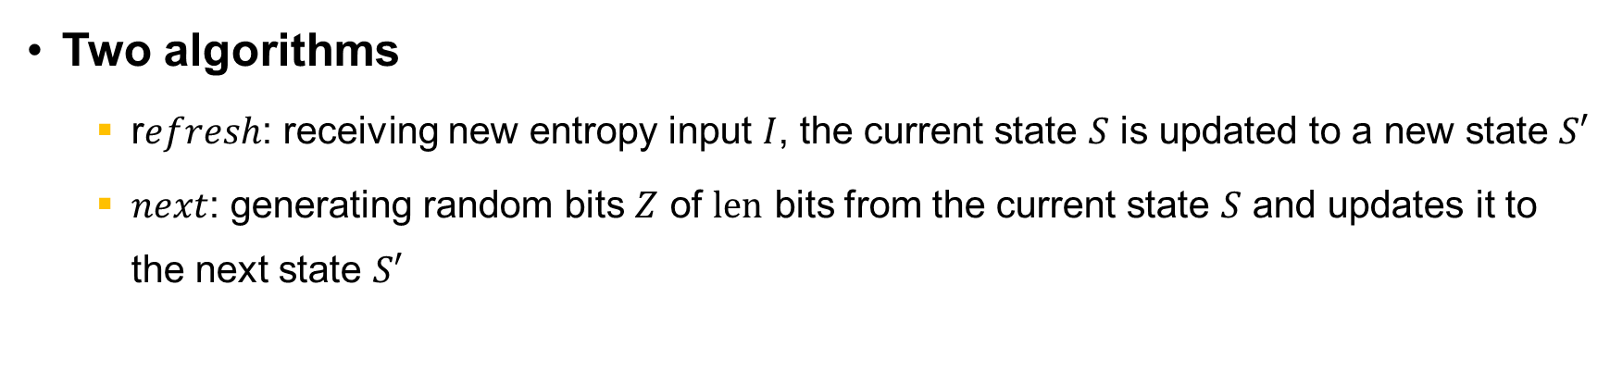




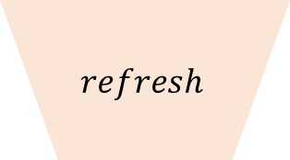

Components of a DRBG
$$S$$
$$I$$
$$S$$
$$len$$
$$refresh$$
$$next$$
$$S′$$
$$S′$$
$$Z$$
Two algorithms
  r$efresh$: receiving new entropy input $I$, the current state $S$ is updated to a new state $S′$
  $next$: generating random bits $Z$ of $len$ bits from the current state $S$ and updates it to the next state $S′$
Notes:
A DRBG consists of the following two algorithms.
The first is refresh. The refresh is a state updating algorithm. Using the current state S and entropy input I, the refresh function updates the state. By leveraging the entropy contained in I, the DRBG produces a next state S′ that is more random than the current state S.
The second is next. The next is a output generating algorithm. Given the current state S and the requested output length len, the next function produces a random output Z.

Slide 6

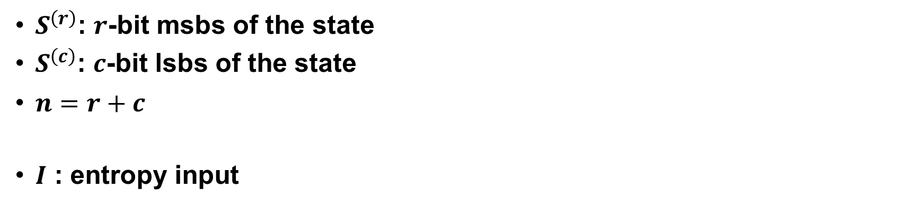


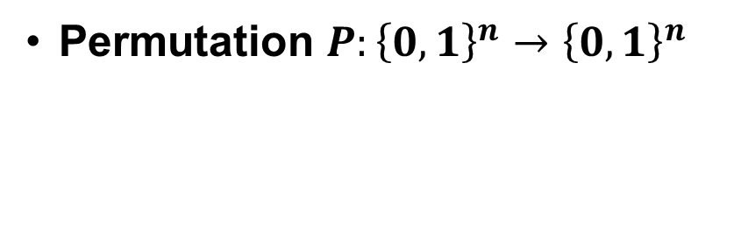



Sponge-DRBG: $refresh$
$$I$$
$$P$$
$$S^{(r)}$$
$$n$$
$$S′$$
$$S^{(c)}$$
$S^{\left(r\right)}$: $r$-bit msbs of the state
$S^{\left(c\right)}$: $c$-bit lsbs of the state
$n=r+c$
$I$ : entropy input
Permutation $P:{\left\{0,1\right\}}^{n}→{\left\{0,1\right\}}^{n}$
Notes:
One of the most representative permutation-based DRBG is Sponge-DRBG.
The figure illustrates the refresh algorithm of Sponge-DRBG. The state S is n bits in length, expressed as the sum of r (the sponge rate) and c (the sponge capacity). Accordingly, S^r refers to the r-bit most significant bits of the state S, while S^c denotes the c-bit least significant bits. So the state S is divided into two parts, Sr and Sc. The entropy input I is added to S^r, after which the permutation P is applied to mix the state, resulting in the next state S'.

Slide 7










Sponge-DRBG: $next$
$$Z_{1}$$
$$Z_{2}$$
$$Z_{ℓ}$$
$$P$$
$$P$$
$$P$$
$$S^{(r)}$$
$$…$$
$$S′$$
$$S^{(c)}$$
Notes:
This figure illustrates the next algorithm of Sponge-DRBG. It generates the requested output length by invoking the permutation P multiple times.

Slide 8



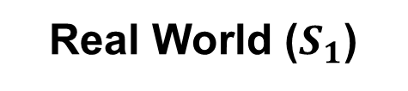



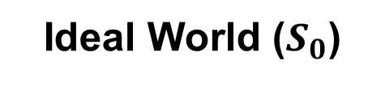


Robustness Model: Distinguishing Game
Ideal World ($S_{0}$)
Real World ($S_{1}$)
$$refresh,$$
$$get,$$
$set$,
$$P$$
$$refresh,$$
$$get,$$
$set$,
$$P$$
$$next^{∗}$$
$$next$$
$S_{0}$ ? $S_{1}$
Oracle queries
$S_{0}$ or $S_{1}$
Notes:
Such DRBGs are analyzed under the robustness security model. The robustness security model is essentially a distinguishing game. It is modeled as the problem of distinguishing between an ideal world, which always returns truly random bits, and a real world, which produces the actual output of the DRBG.
Through oracle queries, the adversary attempts to determine which world it is communicating with​.

Slide 9


Robustness Model: Oracle $get$ and $set$
Ideal World ($S_{0}$)
Real World ($S_{1}$)
$$refresh,$$
$$get,$$
$set$,
$$P$$
$$refresh,$$
$$get,$$
$set$,
$$P$$
$$next^{∗}$$
$$next$$
I can obtain/set DRBG’s state
$S_{0}$ ? $S_{1}$
Oracle queries
$S_{0}$ or $S_{1}$
Notes:
A key distinction of the robustness model is that the adversary is allowed to either obtain the DRBG state via a get oracle or set the state to any desired value via a set oracle.

Slide 10

Robustness Model: Oracle $next^{∗}$
Ideal World ($S_{0}$)
Real World ($S_{1}$)
$$refresh,$$
$$get,$$
$set$,
$$P$$
$$refresh,$$
$$get,$$
$set$,
$$P$$
$$next^{∗}$$
$$next$$
However, I need to provide sufficient entropy!
$S_{0}$ ? $S_{1}$
Oracle queries
$S_{0}$ or $S_{1}$
Notes:
However, the random bit generation oracle next* in the ideal world returns truly random bits only when the state contains sufficient entropy. If the state does not have enough entropy, it behaves like the real world. Therefore, for the adversary to distinguish between the two worlds, it must first supply sufficient entropy to the DRBG.
In summary, goal of the robustness game adversary is to distinguish between the two worlds considering these settings.

Slide 11
Contribution 1: POSDRBG
Notes:
Now, I will present the contributions of our work.
Our first contribution is the design of POSDRBG.

Slide 12


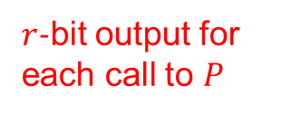










Motivation: Output rate of Sponge-DRBG
$r$-bit output for each call to $P$
$$Z_{1}$$
$$Z_{2}$$
$$Z_{ℓ}$$
$$P$$
$$P$$
$$P$$
$$r$$
$$S^{(r)}$$
$$n$$
$$…$$
$$S′$$
$$S^{(c)}$$
Notes:
Our motivation is that the Sponge-DRBG has a sub-optimal output-rate.
As previously shown, this figure illustrates the next function of Sponge-DRBG. Sponge-DRBG uses only r bits of output from each call to P. Therefore, Sponge-DRBG cannot utilize the full n-bit output of P, which leads to the sub-optimal output rate.

Slide 13
















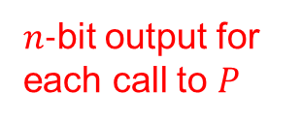


POSDRBG (Parallel-Output Sponge-based DRBG)
$$S^{(r)}$$
$$S^{(c)}$$
$$S^{(r)}+1$$
$$S^{(c)}$$
$$S^{(r)}+l$$
$$S^{(c)}$$
$$P$$
$$P$$
$$P$$
$$…$$
$$S^{′\left(r\right)}$$
$$S^{′\left(c\right)}$$
$$Z_{0}$$
$$Z_{1}^{\left(r\right)}$$
$$Z_{1}^{\left(c\right)}$$
$$Z_{ℓ}^{\left(r\right)}$$
$$Z_{ℓ}^{\left(c\right)}$$
$n$-bit output for each call to $P$
$$n$$
Notes:
To address this issue, we designed POSDRBG (Parallel-Output Sponge-based DRBG). This construction unfolds the next function of Sponge-DRBG into a parallel structure and incorporates a counter. This conversion can be viewed as a way analogous to the CBC and CTR modes of operation. By modifying the output structure in this way, the entire n-bit output of P can now be fully utilized as the DRBG’s output.

Slide 14
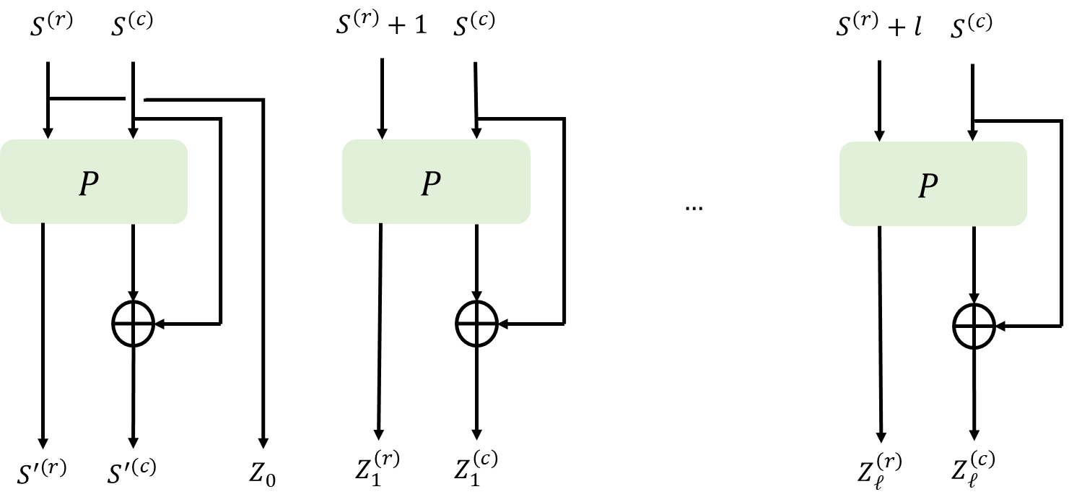
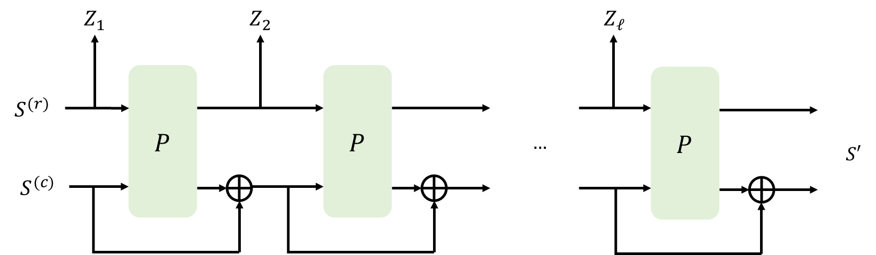
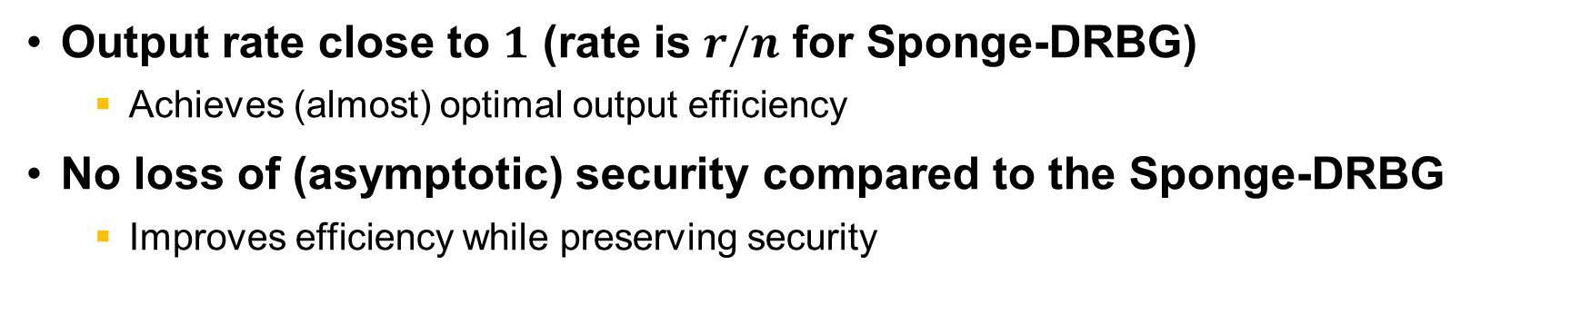
Contribution 1: POSDRBG
Output rate close to $1$ (rate is $r/n$ for Sponge-DRBG)
  Achieves (almost) optimal output efficiency
No loss of (asymptotic) security compared to the Sponge-DRBG
  Improves efficiency while preserving security
POSDRBG
Sponge-DRBG
Notes:
In summary, POSDRBG achieves almost optimal output rate of 1. While the output rate of the Sponge-DRBG is r over the n. This means, to generate the same amount of random bits, Sponge-DRBG requires n/r times more permutation calls than POSDRBG.
Also, interestingly, our security analysis confirms that POSDRBG attains asymptotically the same level of security as Sponge-DRBG. In other words, POSDRBG is the design that improves output efficiency while preserving security.

Slide 15
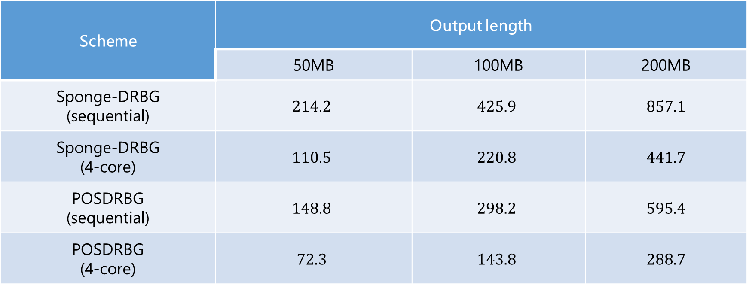
Comparison
Scheme | Output length
 | 50MB | 100MB | 200MB
Sponge-DRBG (sequential) | $$214.2$$ | $$425.9$$ | $$857.1$$
Sponge-DRBG (4-core) | $$110.5$$ | $$220.8$$ | $$441.7$$
POSDRBG (sequential) | $$148.8$$ | $$298.2$$ | $$595.4$$
POSDRBG (4-core) | $$72.3$$ | $$143.8$$ | $$288.7$$
Numbers in the table: time (in milliseconds) required to generate random numbers of each length
Only the execution time of the next function was measured
Notes:
This table compares the speeds of the next functions of the two DRBGs.
The vertical axis lists the names of the respective DRBGs, while the horizontal axis represents the required length of the output bits. The numbers in the table indicate the time required to generate the requested output length in milliseconds
Now, I’m going to looking at the experimental results in the sequential setting with a single core.

Slide 16
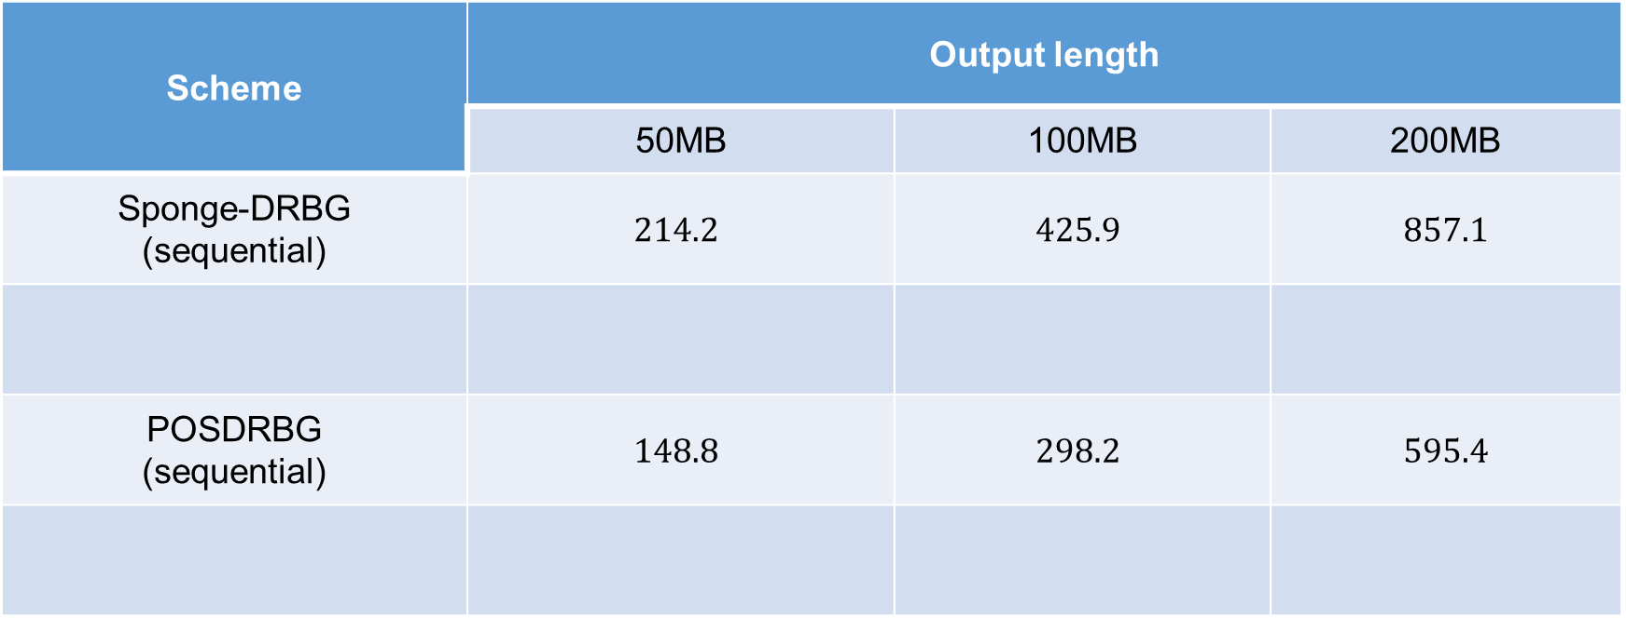
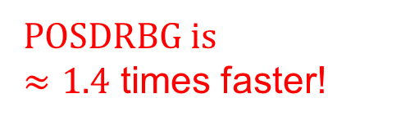
Comparison
Scheme | Output length
 | 50MB | 100MB | 200MB
Sponge-DRBG (sequential) | $$214.2$$ | $$425.9$$ | $$857.1$$
POSDRBG (sequential) | $$148.8$$ | $$298.2$$ | $$595.4$$
POSDRBG is
$≈1.4$ times faster!
We used a Keccak permutation with $\frac{n}{r}≈1.4$!
Notes:
We observe that Sponge-DRBG takes approximately 1.4 times longer than POSDRBG to generate the same amount of randomness.
Interestingly, in our experiments, we used the Keccak permutation, where the output size n was about 1.4 times larger than the sponge rate r.
Therefore, the difference in output rates is clearly reflected in this table. And the same difference happens in the 4-core setting, too.

Slide 17
Contribution 2 : New Security Reduction Technique M-Rec and
M-Pres
Notes:
Our second contribution is the introducing new reduction techniques, using M-Rec and M-Pres.

Slide 18












Example: Real world queries
$$refresh$$
$$refresh$$
$$next$$
$$next$$
$$refresh$$
$$next$$
…
…
$$get/set$$
$$refresh$$
$$next$$
$$get/set$$
$$refresh$$
$$next$$
Notes:
This slide illustrates an example, the sequence of queries made by the adversary. Note that, the adversary may issue any queries in any order. Therefore, this is just an example. For example, the adversary may call refresh, refresh, and then calling next.

Slide 19





Example: Ideal world queries
$$refresh$$
$$refresh$$
$$next^{∗}$$
$$next^{∗}$$
$$refresh$$
$$next^{∗}$$
…
…
$$get/set$$
$$refresh$$
$$next^{∗}$$
$$get/set$$
$$refresh$$
$$next^{∗}$$
Notes:
In the ideal world, when next is called, the response is returned from next* using the truly random values.

Slide 20


Real world -> Ideal world
$$refresh$$
$$refresh$$
$$next^{∗}$$
$$next$$
$$refresh$$
$$next$$
…
Rec Game $1$
…
$$get/set$$
$$refresh$$
$$next$$
$$get/set$$
$$refresh$$
$$next$$
Notes:
In the previous reduction techniques, an intermediate world is introduced to measure the distance between the real world and the ideal world. This is the first intermediate world. In this intermediate world, next* is returned only for the first next call, while all subsequent operations behave identically to those in the real world.
The distance between the real world and this intermediate world is then calculated by reducing it to the Rec game.

Slide 21

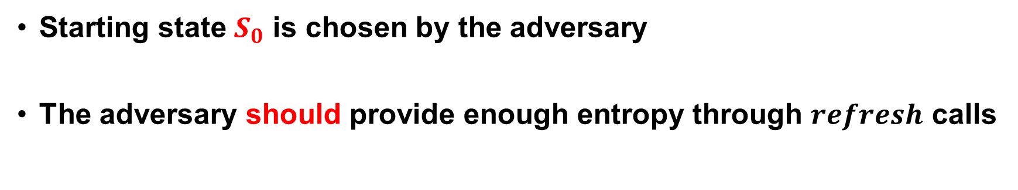






Rec game
Real
World
$$S_{0}$$
$$refresh$$
$$⋯$$
$$refresh$$
$$next$$
$$\left(S,Z\right)$$
Ideal
World
$$\left(S,Z\right)←_{\$}𝒮×\{0,1\}^{len}$$
Starting state $S_{0}$ is chosen by the adversary
The adversary should provide enough entropy through $refresh$ calls
Notes:
The Rec game is a distinguishing game. The adversary chooses the starting state S0, and the adversary must provide sufficient entropy through the refresh operation.
The adversary must distinguish between (S,Z) obtained from the real world—where S and Z are produced through refresh and next—and (S,Z) from the ideal world, where they are chosen truly at random.

Slide 22


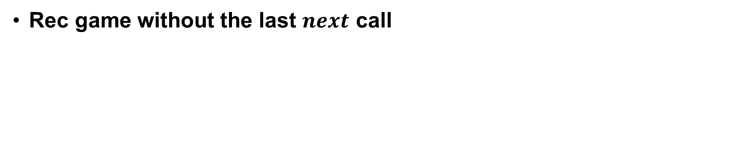
Ext game
Real
World
$$S_{0}$$
$$refresh$$
$$⋯$$
$$refresh$$
$$S$$
Ideal
World
$$S←_{\$}𝒮$$
Rec game without the last $next$ call
Notes:
The Ext game is almost identical to the Rec game, except that it does not include a final next call. Therefore, it only considers refresh queries

Slide 23




Real world -> Ideal world
$$refresh$$
$$refresh$$
$$next^{∗}$$
$$next^{∗}$$
$$refresh$$
$$next$$
…
Rec Game $1$
Pres Game $1$
$next^{∗}$ returns random state
…
$$get/set$$
$$refresh$$
$$next$$
$$get/set$$
$$refresh$$
$$next$$
Notes:
Next step is similar: another intermediate world is introduced, that world uses next* in the second call, too.
Note that the next* returns random state, so the setting is different from the Rec game. Therefore, another Pres game is required.

Slide 24
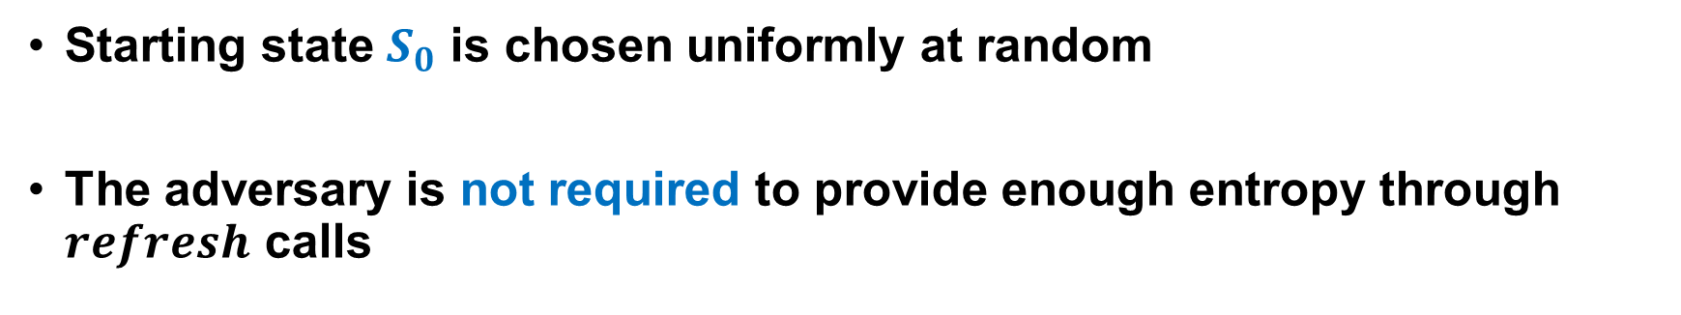

Pres game
Real
World
$$S_{0}$$
$$refresh$$
$$⋯$$
$$refresh$$
$$next$$
$$\left(S,Z\right)$$
Ideal
World
$$\left(S,Z\right)←_{\$}𝒮×\{0,1\}^{len}$$
Starting state $S_{0}$ is chosen uniformly at random
The adversary is not required to provide enough entropy through $refresh$ calls
Notes:
The Pres game is similar to the Rec game, but with two key differences: the S0 is now chosen uniformly at random, and the entropy requirement in the refresh operation is removed.

Slide 25






[CRYPTO 19] Real world -> Ideal world
$$refresh$$
$$refresh$$
$$next^{∗}$$
$$next^{∗}$$
$$refresh$$
$$next^{∗}$$
…
Rec Game $1$
Pres Game $1$
Pres Game $2$
…
$$get/set$$
$$refresh$$
$$next^{∗}$$
$$get/set$$
$$refresh$$
$$next^{∗}$$
Rec Game $i$
Rec Game $i+1$
Notes:
Repeating each steps, we can have this figure.
So, the sum of the distances between each pair of intermediate worlds is as an upper bound for the distance between the real world and the ideal world.

Slide 26

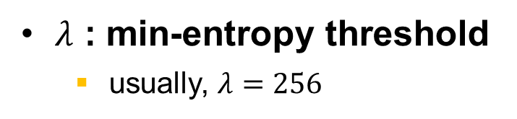
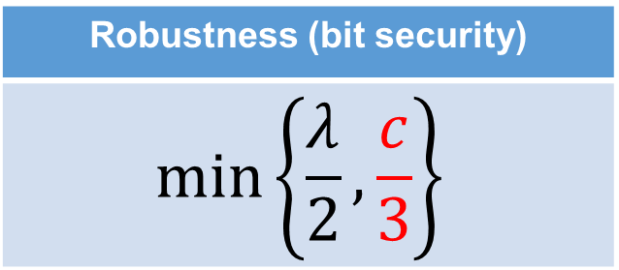
Problem 1: Security bound is not tight
$\frac{p^{2}}{2^{c}}$ term appears in a single Rec game
  There exists at most $q_{1}$ Rec games
  $\frac{q_{1}p^{2}}{2^{c}}$ leads to $\frac{c}{3}$ - bit security!
    $p≔$ number of primitive calls
    $q_{1}≔$ maximum number of $next$ calls
Robustness (bit security)
$$\min\left\{\frac{λ}{2},\frac{c}{3}\right\}$$
$λ$ : min-entropy threshold
  usually, $λ=256$
Notes:
The previous approach has the drawback of producing a non-tight security bound.
When reducing to the single Rec game, a term p square appears, where the p is the number of primitive calls. Since such a Rec game must occur q1​ times in total, where the q1 is the maximum number of next calls, the final result becomes q1 multiplied to p squared term, leading to c over 3 bits security.

Slide 27
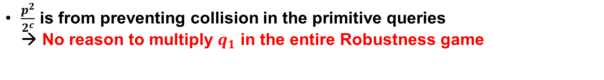
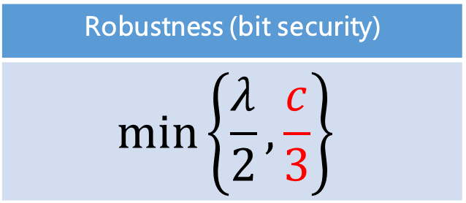
Problem 1: Security bound is not tight
$\frac{p^{2}}{2^{c}}$ term appears in a single Rec game
  There exists at most $q_{1}$ Rec games
  $\frac{q_{1}p^{2}}{2^{c}}$ leads to $\frac{c}{3}$ - bit security!
    $p≔$ number of primitive calls
    $q_{1}≔$ maximum number of $next$ calls
Robustness (bit security)
$$\min\left\{\frac{λ}{2},\frac{c}{3}\right\}$$
$λ$ : min-entropy threshold
  usually, $λ=256$
$\frac{p^{2}}{2^{c}}$ is from preventing collision in the primitive queries
→ No reason to multiply $q_{1}$ in the entire Robustness game
Notes:
The p squared term arises from preventing collisions in primitive queries. Therefore, even when considering the entire robustness game, there is no reason for the additional multiplication by q1.

Slide 28





[Asiacrypt 24] M-EXT technique
$$refresh^{∗}$$
$$refresh^{∗}$$
$$next^{∗}$$
$$next^{∗}$$
$$refresh^{∗}$$
$$next^{∗}$$
…
…
$$get/set$$
$$refresh^{∗}$$
$$next^{∗}$$
$$get/set$$
$$refresh^{∗}$$
$$next^{∗}$$
M-EXT Game
Notes:
In ASIACRYPT 24, our team previously proposed the M-EXT technique.
This approach handles every Ext game within a single M-EXT game. By handling them within a single game, we were able to avoid the multiplication of the q1 term, thereby establishing a tight security proof for Linux-DRBG.

Slide 29



Problem 2: Invertible $refresh$
$$I$$
$$P$$
$$S^{(r)}$$
$$S′$$
$$S^{(c)}$$
Adversary chooses
Return value
Notes:
However, that M-Ext game cannot be applied to Sponge-DRBG. This is because the refresh algorithm in Sponge-DRBG is invertible.
In the Ext game, the adversary can choose the initial state Sr and Sc. The returned state S′ is also revealed to the adversary.

Slide 30
Problem 2: Invertible $refresh$
$$I$$
$$P$$
$$S^{(r)}$$
$$S′$$
$$S^{(c)}$$
Notes:
Therefore, the adversary can compute the preimage of S’, and check whether the lower c bits of that preimage match Sc. Hence, the adversary can win with high probability.

Slide 31


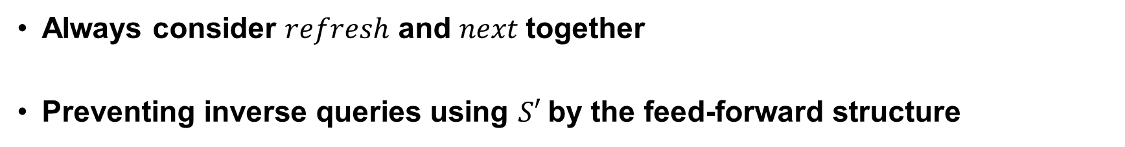







Observation: Rec Game
$$I$$
$$Z$$
$$P$$
$$P$$
$$S^{(r)}$$
$$n$$
$$S′$$
$$S^{(c)}$$
Always consider $refresh$ and $next$together
Preventing inverse queries using $S′$by the feed-forward structure
Notes:
We need a game that always consider refresh and next together. Actually it is already captured by the Rec game.
Now the inverse queries using S’ is prevented by the feed-forward structure. The adversary should guess the value of the blue line, to invert the permutation P.

Slide 32


Contribution 2: Our reduction
$$refresh$$
$$refresh$$
$$next^{∗}$$
$$next^{∗}$$
$$refresh^{∗}$$
$$next^{∗}$$
…
M-Pres
…
$$get/set$$
$$refresh$$
$$next^{∗}$$
$$get/set$$
$$refresh$$
$$next^{∗}$$
M-Rec Game
Notes:
Therefore, we created an M-Rec game that can handle multiple Rec games simultaneously. By handling them within a single M-Rec game, we were able to obtain tight security bounds for permutation-based DRBGs.

Slide 33
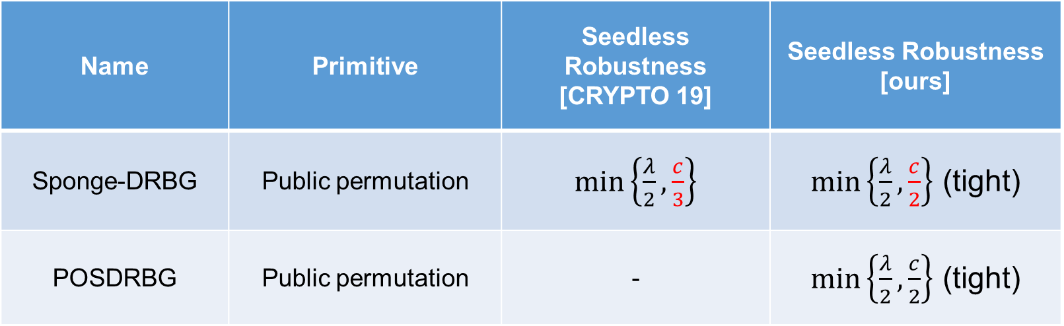
Security Bounds
Name | Primitive | Seedless Robustness [CRYPTO 19] | Seedless Robustness [ours]
Sponge-DRBG | Public permutation | $\min\left\{\frac{λ}{2},\frac{c}{3}\right\}$ | $\min\left\{\frac{λ}{2},\frac{c}{2}\right\}$ (tight)
POSDRBG | Public permutation | - | $\min\left\{\frac{λ}{2},\frac{c}{2}\right\}$ (tight)
Notes:
In conclusion, by introducing a new proof technique, we improved the previous bound for Sponge-DRBG from c over 3 to c over 2. Furthermore, we proposed POSDRBG, a construction that enhances the output efficiency of Sponge-DRBG while maintaining the same security level. Also, we provided the matching attacks, showing our bounds are tight.

Slide 34
Thank you!
Notes:
Thank you for your attention.

