Slide 1
On Witness Encryption and Laconic Zero-Knowledge Arguments
Yanyi Liu
Noam Mazor
Rafael Pass

Slide 2

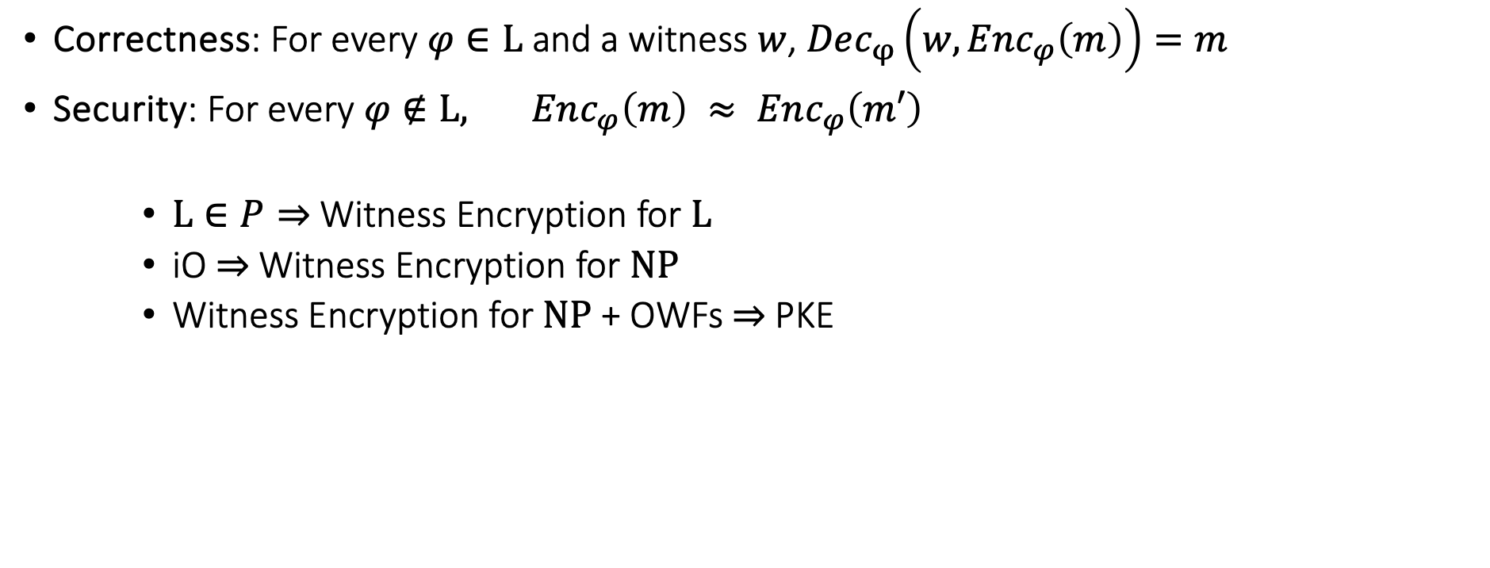




Witness Encryption
[Garg, Gentry, Sahai and Waters]
$$L∈NP$$
Enc
Dec
$$φ,m$$
$$φ,w$$
$$Enc_{φ}(m)$$
$$m$$
Question:
For what languages does WE exist, and under what hardness assumptions?
Correctness: For every $φ∈L$ and a witness $w$, $Dec_{φ}\left(w,Enc_{φ}\left(m\right)\right)=m$
Security: For every $φ∉L, Enc_{φ}\left(m\right) ≈ Enc_{φ}\left(m′\right)$
    $L∈P⇒$ Witness Encryption for $L$
    iO $⇒$ Witness Encryption for $NP$
    Witness Encryption for $NP$ + OWFs $⇒$PKE

Slide 3





Zero Knowledge
$$L∈NP$$
P
V
$$φ$$
$$w$$
$$r$$
$$Accept/reject$$
Completeness: For every $φ∈L$, $V$ accepts with probability $2/3$

Slide 4

Zero Knowledge
$$L∈NP$$
P*
V
$$φ$$
$$r$$
$$Accept/reject$$
Completeness: For every $φ∈L$, $V$ accepts with probability $2/3$
(Computational) soundness: For every $φ∉L$ and for any eff. $P^{∗}$, $V$ accepts with probability at most $1/3$

Slide 5

Zero Knowledge
$$L∈NP$$
P
V
$$φ$$
$$r$$
$$Accept/reject$$
Completeness: For every $φ∈L$, $V$ accepts with probability $2/3$
(Computational) soundness: For every $φ∉L$ and for any eff. $P^{∗}$, $V$ accepts with probability at most $1/3$
(Honest verifier) zero-knowledge: $∃$eff. simulator $S$, such that for every $φ∈L$, $S(φ)$ is indistinguishable from $V$’s view

Slide 6

Laconic Zero Knowledge
$$L∈NP$$
P
V
$$φ$$
$$r$$
Question:
For what languages does laconic ZK exist, and under what hardness assumptions?
$$Accept/reject$$
ZK protocol is laconic if the total prover to verifier communication is small ($O(\log{n})$)

Slide 7






Witness Encryption to Laconic HV-ZK
Observation: If $L∈NP$ has WE, then $L$ has laconic Honest-Verifier ZK argument
Two rounds
Deterministic prover
Negligible completeness error
Optimal soundness error: For $φ∉L$, $V$ rejects with probability $1−2^{−ℓ}−negl$
P
$$φ$$
V
$$w$$
$$m←{\left\{0,1\right\}}^{ℓ}$$
$$Enc_{φ}(m)$$
$$m$$

Slide 8
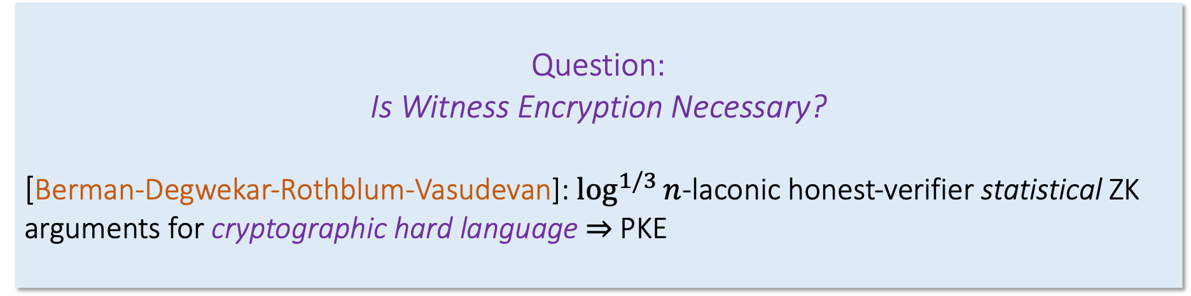


Witness Encryption to Laconic HV-ZK
Observation: If $L∈NP$ has WE, then $L$ has laconic Honest-Verifier ZK argument
Two rounds
Deterministic prover
Negligible completeness error
Optimal soundness error: For $φ∉L$, $V$ rejects with probability $1−2^{−ℓ}$
Question:
Is Witness Encryption Necessary?
[Berman-Degwekar-Rothblum-Vasudevan]: $\log^{1/3}{n}$-laconic honest-verifier statistical ZK arguments for cryptographic hard language $⇒$ PKE
P
$$φ$$
V
$$w$$
$$m←{\left\{0,1\right\}}^{ℓ}$$
$$Enc_{φ}(m)$$
$$ℓ$$

Slide 9

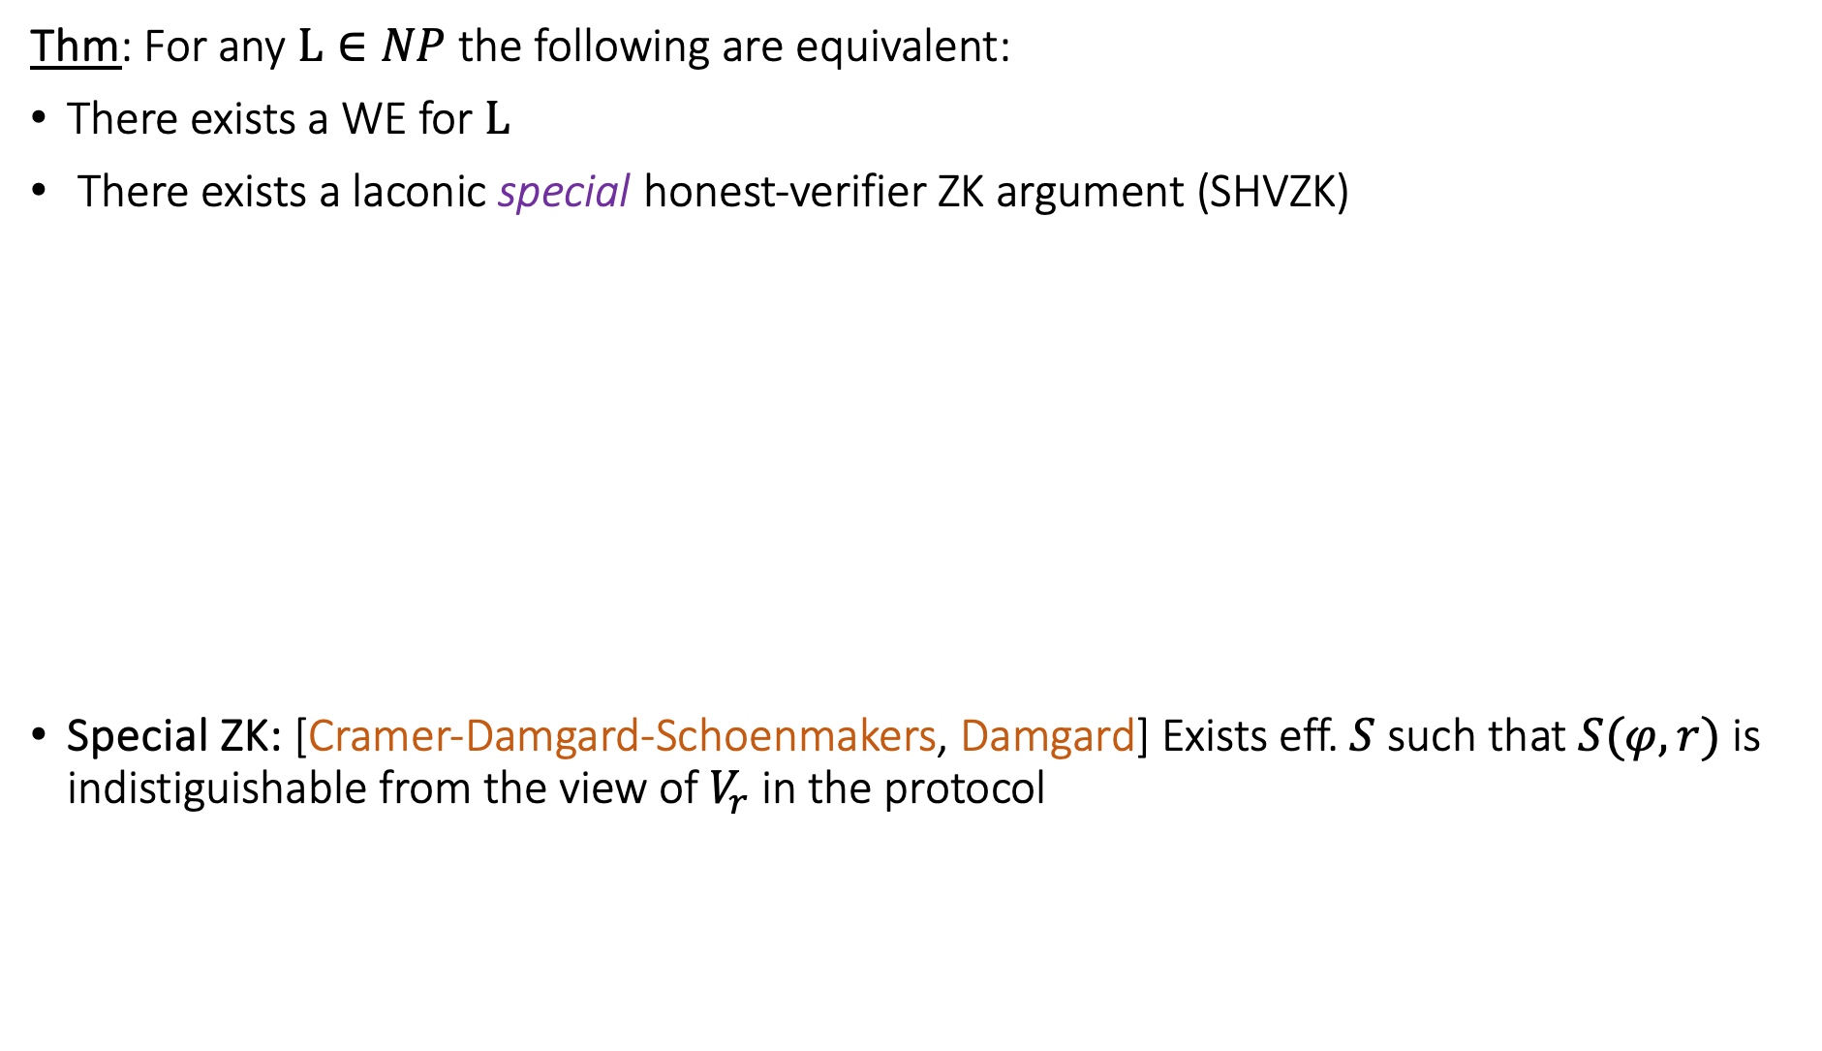
Our Results
Thm: For any $L∈NP$ the following are equivalent:
There exists a WE for $L$
There exists a laconic special honest-verifier ZK argument (SHVZK)
Special ZK: [Cramer-Damgard-Schoenmakers, Damgard] Exists eff. $S$ such that $S(φ,r)$ is indistiguishable from the view of $V_{r}$ in the protocol
P
V
$$φ$$
$$r$$

Slide 10
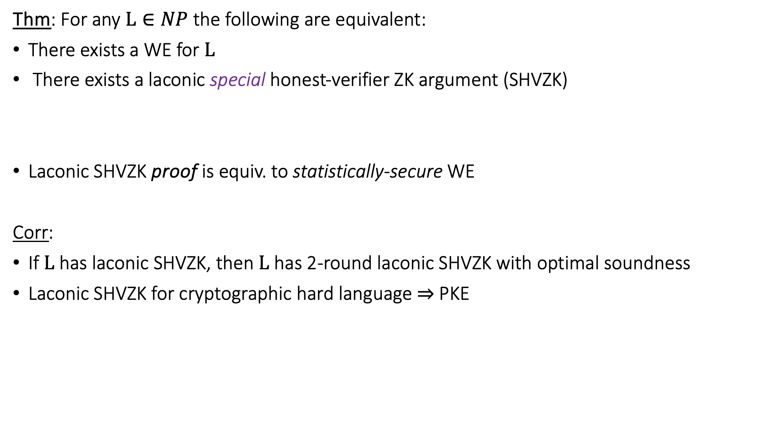
Our Results
Thm: For any $L∈NP$ the following are equivalent:
There exists a WE for $L$
There exists a laconic special honest-verifier ZK argument (SHVZK)
Laconic SHVZK proof is equiv. to statistically-secure WE
Corr:
If $L$ has laconic SHVZK, then $L$ has 2-round laconic SHVZK with optimal soundness
Laconic SHVZK for cryptographic hard language $⇒$PKE

Slide 11
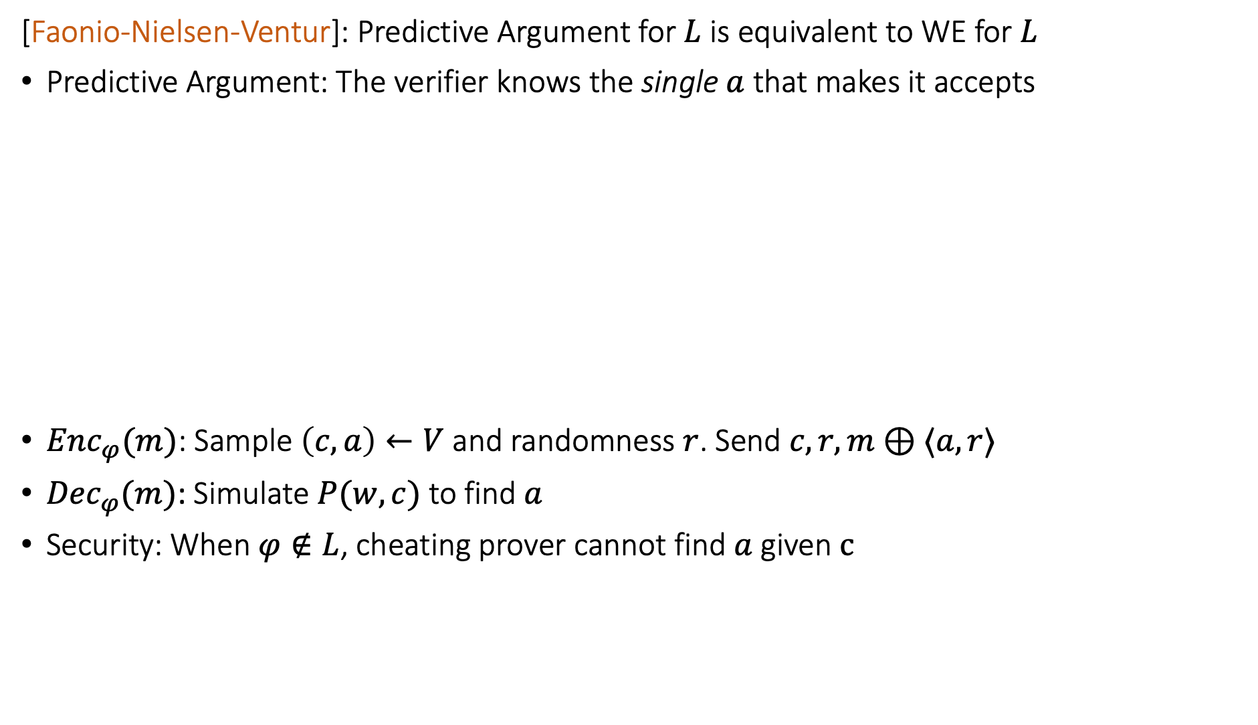


Previous Works: Predictive Arguments
[Faonio-Nielsen-Ventur]: Predictive Argument for $L$ is equivalent to WE for $L$
Predictive Argument: The verifier knows the single $a$ that makes it accepts
$Enc_{φ}(m)$: Sample $\left(c,a\right)←V$ and randomness $r$. Send $c,r,m⊕⟨a,r⟩$
${Dec}_{φ}(m)$: Simulate $P(w,c)$ to find $a$
Security: When $φ∉L$, cheating prover cannot find $a$ given $c$
P
$$φ$$
V
$$w$$
$$c$$
$$a$$

Slide 12

Previous Works: Predictive Arguments
[Faonio-Nielsen-Ventur]: Predictive Argument for $L$ is equivalent to WE for $L$
Predictive Argument: The verifier knows the single $a$ that makes it accepts
    [Bitansky-Choudhuri]: Deterministic-prover ZK
    [Kiyoshima]: Resettable statistical Zero-Knowledge
    [Boneh-Ishai-Sahai-Wu], [Barta-Ishai-Ostrovsky-Wu]: 1-bit laconic arguments and 1-group-element laconic arguments

Slide 13

Previous Works: Laconic Zero-Knowledge
[Cramer-Shoup]: 2-round HVZK with deterministic prover for cryptographic-hard $L$ $⇒$ PKE
[Berman-Degwekar-Rothblum-Vasudevan]: $\log^{1/3}{n}$-laconic honest-verifier statistical ZK arguments cryptographic hard language $⇒$ PKE
Cryptographic hard language: $∃D_{Yes}≈D_{No}$ with $Supp\left(D_{YES}\right)⊆L$, $Supp\left(D_{NO}\right)⊆\overline{L}$
Problem: There is no unique $a$ that makes the verfier accept

Slide 14

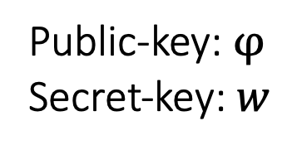

Previous Works: Laconic Zero-Knowledge
[Berman-Degwekar-Rothblum-Vasudevan]: $\log^{1/3}{n}$-laconic honest-verifier statistical ZK arguments cryptographic hard language $⇒$ PKE
Problem: There is no unique $a$ that makes the verfier accept
P
$$φ$$
V
Public-key: $φ$
Secret-key: $w$
$$w$$
$$c$$
$$\left(c,a\right)←S(φ)$$
$$a$$

Slide 15

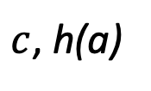
Previous Works: Laconic Zero-Knowledge
[Berman-Degwekar-Rothblum-Vasudevan]: $\log^{1/3}{n}$-laconic honest-verifier statistical ZK arguments cryptographic hard language $⇒$ PKE
Problem: There is no unique $a$ that makes the verfier accept
Solution: Add short hash of $a$ to make it (almost) unique
P
$$φ$$
V
Public-key: $φ$
Secret-key: $w$
$$w$$
$c$, h(a)
$$\left(c,a\right)←S(φ)$$
$$a$$

Slide 16

Previous Works: Laconic Zero-Knowledge
[Berman-Degwekar-Rothblum-Vasudevan]: $\log^{1/3}{n}$-laconic honest-verifier statistical ZK arguments cryptographic hard language $⇒$ PKE
P given w can sample from the (real) distribution of $a$
When $a$ short, P knows the distribution
Using h(a), P can find $a$
P
$$φ$$
V
Public-key: $φ$
Secret-key: $w$
$$w$$
$c$, h(a)
$$\left(c,a\right)←S(φ)$$
$$a$$

Slide 17

Previous Works: Laconic Zero-Knowledge
[Berman-Degwekar-Rothblum-Vasudevan]: $\log^{1/3}{n}$-laconic honest-verifier statistical ZK arguments cryptographic hard language $⇒$ PKE
h(a) should be long enough to describe $a$ uniquely, but short enough for soundenss
Simulator only works for Yes instances (not enough for WE)
P
$$φ$$
V
Public-key: $φ$
Secret-key: $w$
$$w$$
$c$, h(a)
$$\left(c,a\right)←S(φ)$$
$$a$$

Slide 18





Our Technique: WE from SHVZK
SHVZK: Exists eff. $S$ such that $S(φ,r)$ is indistiguishable from the view of $V_{r}$ in the protocol
The verifier message $c$ is always the same in any execution of $S(φ,r)$
(and it is the right distribution also for NO-instances)
$⇒$ The verifier can sample from the conditional distribution of $a$
P
$$φ$$
V
$$w$$
$$r$$
$$c$$
$$a$$

Slide 19


Our Technique: WE from SHVZK
SHVZK: Exists eff. $S$ such that $S(φ,r)$ is indistiguishable from the view of $V_{r}$ in the protocol
To make the prover predictable, the verifier also sends a random number $p←[0,1]$
Both sample $a$ from the known distribution of $a$ given $c$ using $p$
P
$$φ$$
V
$$w$$
$$r$$
$$c,p$$
$$a$$

Slide 20





Correlated Sampling
P
$$φ$$
V
$$w$$
$$r$$
$$c,p$$
$$a$$
$$a_{1}$$
$$a_{2}$$
$$a_{3}$$

Slide 21


Correlated Sampling
P
$$φ$$
V
$$w$$
$$r$$
$$c,p$$
$$a$$
$$a_{1}$$
$$a_{2}$$
$$a_{3}$$
$$Pr⁡[a=a_{2}]$$

Slide 22



Correlated Sampling
P
$$φ$$
V
$$w$$
$$r$$
$$c,p$$
Area = 1
$$a$$
$$a_{1}$$
$$a_{2}$$
$$a_{3}$$

Slide 23
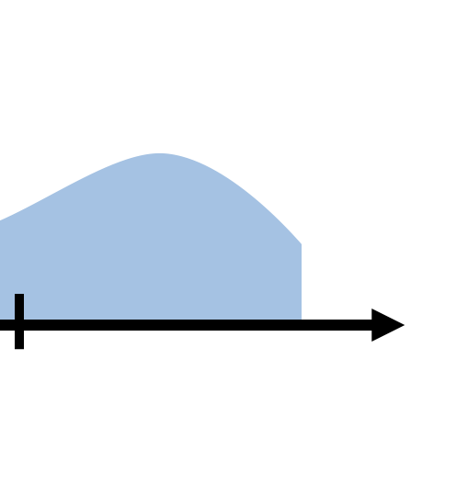
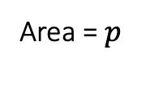
Correlated Sampling
P
$$φ$$
V
$$w$$
$$r$$
$$c,p$$
Area = $p$
$$a$$
$$a_{1}$$
$$a_{2}$$
$$a_{3}$$

Slide 24



Correlated Sampling
P and V agree on the same value whp even when the distributions are only close in statistical distance
P
$$φ$$
V
$$w$$
$$r$$
$$c,p$$
Area = $p$
$$a_{3}$$
$$a_{1}$$
$$a_{2}$$
$$a_{3}$$
$$a_{1}$$
$$a_{2}$$
$$a_{3}$$

Slide 25

Summary
Thm: For any $L∈NP$ the following are equivalent:
There exists a WE for $L$
There exists a laconic special honest-verifier ZK argument (SHVZK)
Open Questions:
WE from laconic HVZK?
Which languages have WE? Under which assumptions?
Thanks!

