Slide 1
Efficient randomized 2-source non-malleable extractor for any linear min-entropy
Divesh Aggarwal Pranjal Dutta Saswata Mukherjee Satyajeet Nagargoje Maciej Obremski
National University of Singapore
Notes:
Introduce leakage on 2 part memory
- add some justification like why it’s worth considering
Also another slide on extraction

Slide 2
INTRODUCTION AND MOTIVATION

Slide 3
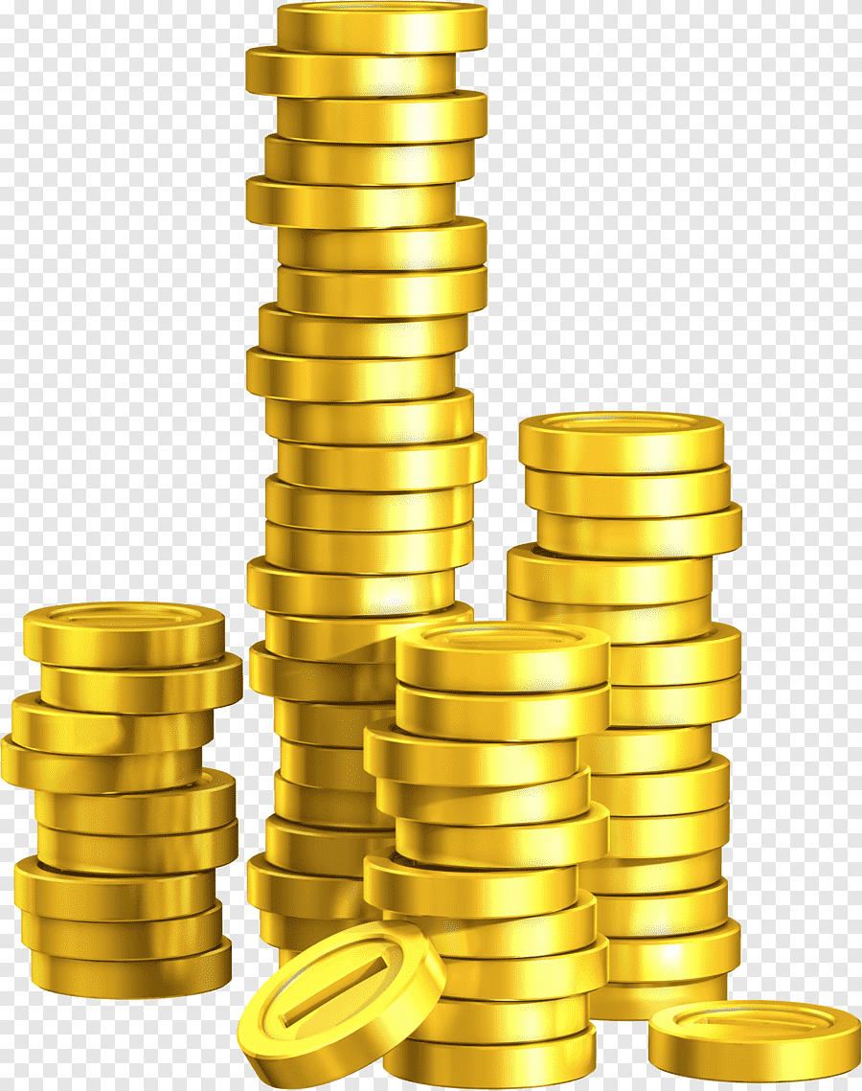
UNIFORM RANDOMNESS
Lots of applications
BPP algorithms
Cryptographic constructions
Distributed and Network Protocols
Etc
But can we generate uniform randomness?
Notes:
Introduce leakage on 2 part memory
- add some justification like why it’s worth considering
Also another slide on extraction

Slide 4

IDEAL WORLD
Pr[X_{i} = 0] = Pr[X_{i} = 1] = ½
Pr[X = x] = 1/2^{n}
Notes:
Introduce leakage on 2 part memory
- add some justification like why it’s worth considering
Also another slide on extraction

Slide 5

In reality..
Randomness is weak
- Timing attacks
-Side-channel attacks
-Differential analysis
Notes:
Introduce leakage on 2 part memory
- add some justification like why it’s worth considering
Also another slide on extraction

Slide 6
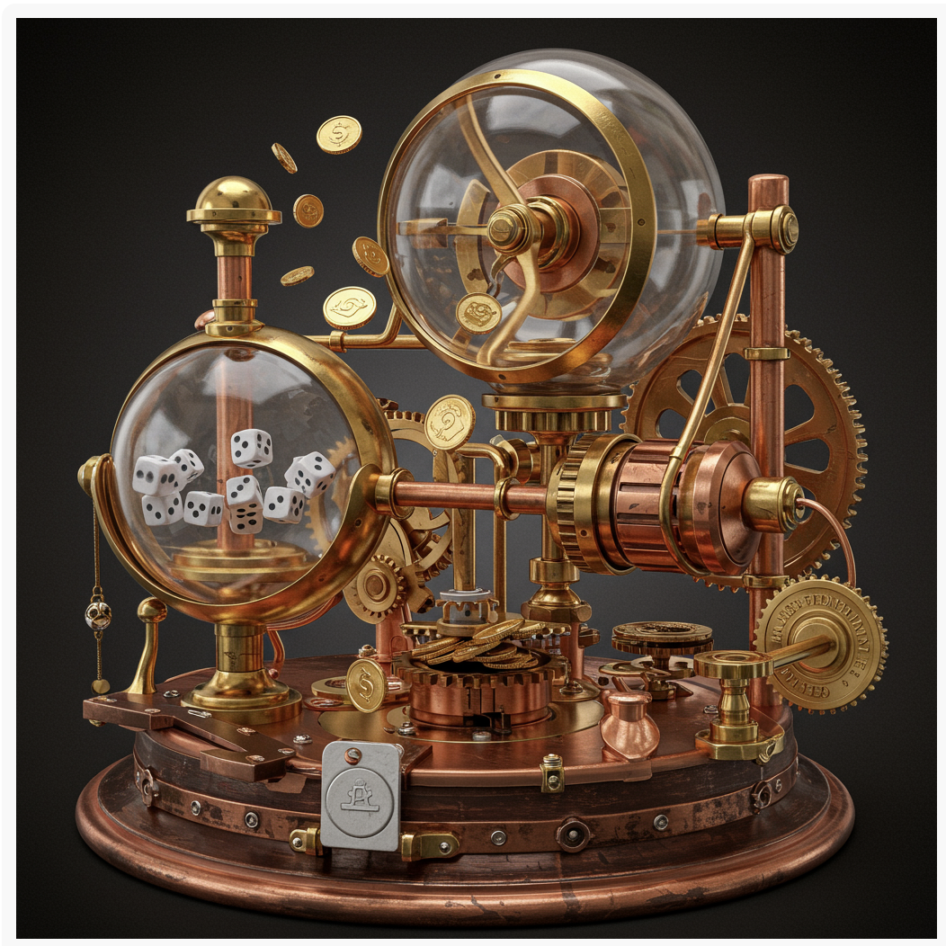
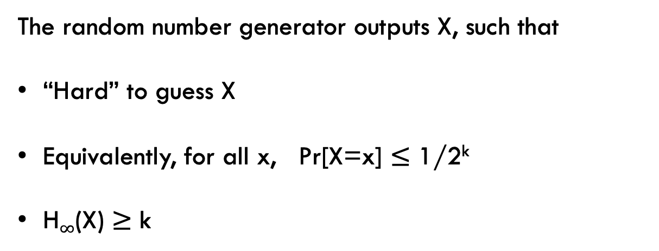
MINIMAL REAListic assumption
The random number generator outputs X, such that
“Hard” to guess X
Equivalently, for all x, Pr[X=x] $≤$ 1/2^{k}
H$∞$(X) $≥$ k
How can we use such a source for crypto applications?
Notes:
Introduce leakage on 2 part memory
- add some justification like why it’s worth considering
Also another slide on extraction

Slide 7
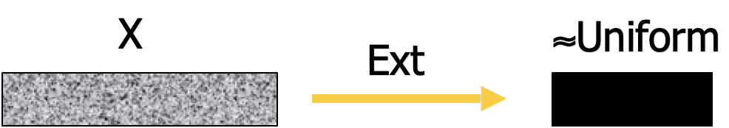
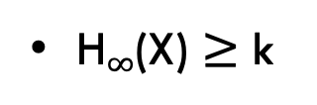
EXTRACTING UNIFORM RANDOMNESS
H$∞$(X) $≥$ k
Unfortunately, no deterministic extractor extracts from all such sources
Can we still build crypto primitives from weak random (min-entropy) sources?
Notes:
Introduce leakage on 2 part memory
- add some justification like why it’s worth considering
Also another slide on extraction

Slide 8
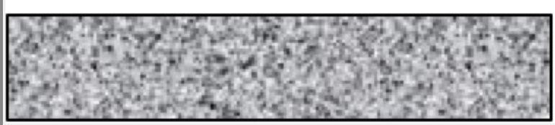

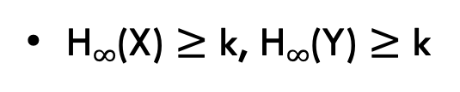
EXTRACTING from two independent sources
X
Y
H$∞$(X) $≥$ k, H$∞$(Y) $≥$ k
The Probabilistic Method shows that two-source extractors exist ☺
Efficient constructions come with many caveats ☹
Notes:
Introduce leakage on 2 part memory
- add some justification like why it’s worth considering
Also another slide on extraction

Slide 9
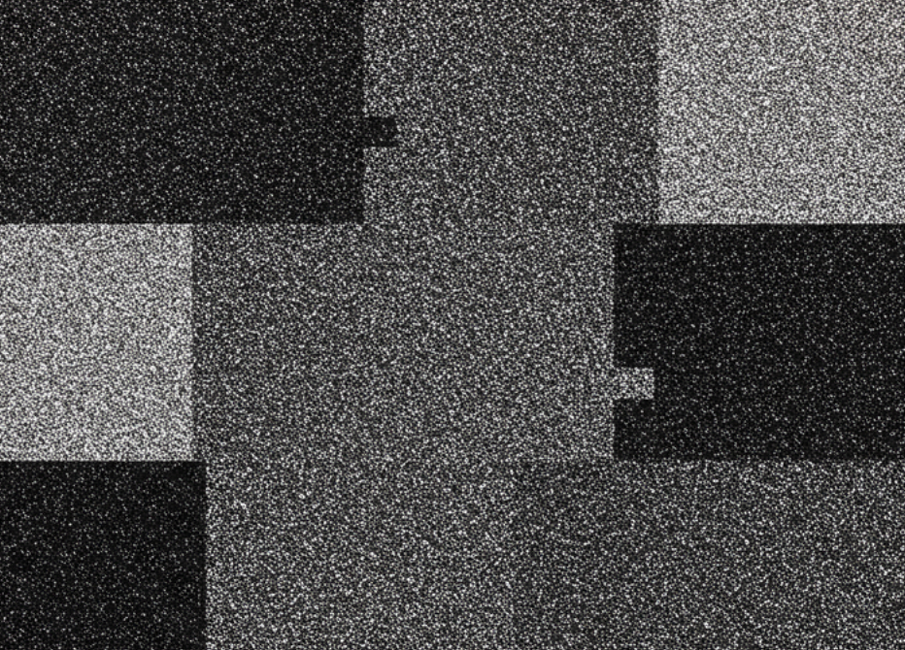
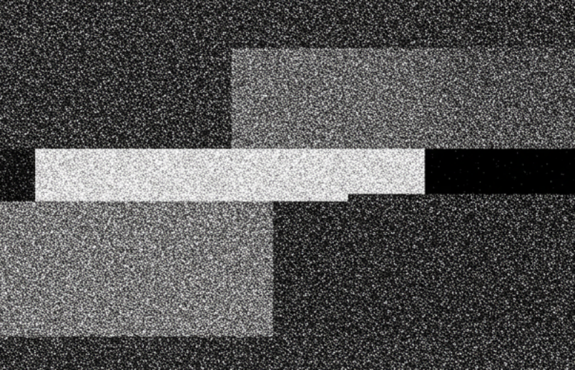

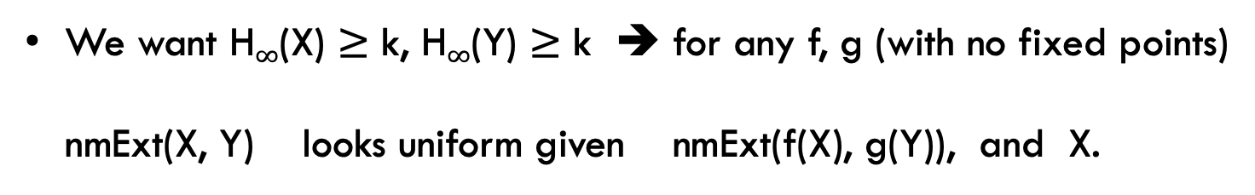
Two-source non-malleable extractors
X
nmExt
nmExt(X,Y)
Y
nmExt
nmExt(f(X),g(Y))
f(X)
g(X)
We want H$∞$(X) $≥$ k, H$∞$(Y) $≥$ k ➔ for any f, g (with no fixed points)
nmExt(X, Y) looks uniform given nmExt(f(X), g(Y)), and X.
The Probabilistic Method shows that two-source non-malleable extractors exist ☺
Efficient constructions come with even more caveats ☹
Notes:
Introduce leakage on 2 part memory
- add some justification like why it’s worth considering
Also another slide on extraction

Slide 10
Why two-source non-malleable extractors?
Applications in non-malleable cryptography including:
-Non-malleable codes
-Non-malleable commitments
-Network Extractors
-Non-malleable secret sharing
-Privacy amplification
Notes:
Introduce leakage on 2 part memory
- add some justification like why it’s worth considering
Also another slide on extraction

Slide 11



So what do we want:
Efficiency: NmExt is efficiently computable.
x
NmExt(x,y)
y
Security: Against computationally unbounded adversary, for H$∞$(X) $≥$ 0.01n, H$∞$(Y) $≥$ 0.01n
NmExt(f(X), g(Y))
I give up????
NmExt(X,Y)
Or U
Notes:
Introduce leakage on 2 part memory
- add some justification like why it’s worth considering
Also another slide on extraction

Slide 12
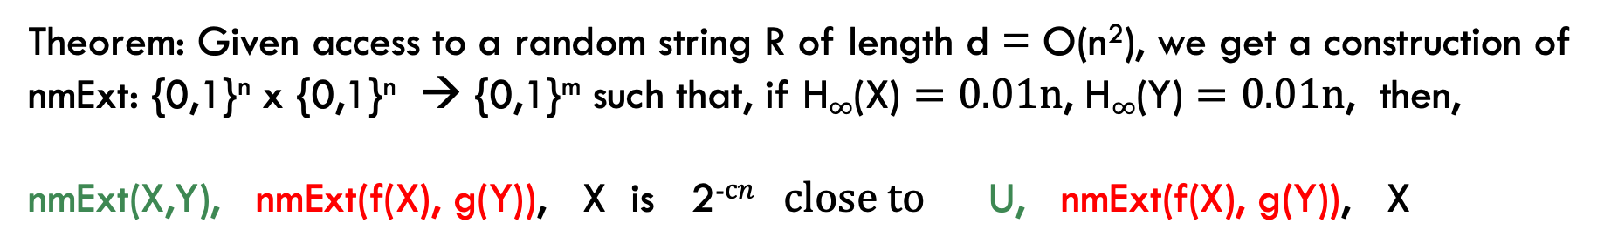

Our result
Theorem: Given access to a random string R of length d = O(n²), we get a construction of nmExt: {0,1}^{n} x {0,1}^{n} → {0,1}^{m} such that, if H$∞$(X) $=0.01n$, H$∞$(Y) $=0.01n$, then,
nmExt(X,Y), nmExt(f(X), g(Y)), X is 2⁻$cn$ close to $\text{U}\text{, }\text{nmExt}\text{(}\text{f}\text{(}\text{X}\text{), }\text{g}\text{(}\text{Y}\text{)}\text{)}\text{, }\text{X}$
Remarks:
X and Y can depend on R arbitrarily as long as they are independent given R.
Our construction works even if H$∞$(R) > 0.9d
We can sample R via a 2 party protocol, even if one of the two is malicious.
Notes:
Introduce leakage on 2 part memory
- add some justification like why it’s worth considering
Also another slide on extraction

Slide 13
PRIOR WORK AND THEIR CAVEATS

Slide 14
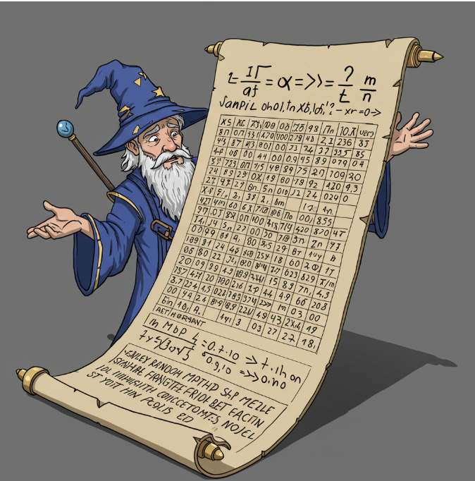

EXISTENTIAL RESULT
[DodisWichs09, CheragchiGuruswami13]. A random function
h: {0,1}^{n} x {0,1}^{n} → {0,1}^{m} is a 2-source non-malleable extractor.
Caveat: Not efficient at all.
How do I send this huge truth table to any user?
Notes:
Introduce leakage on 2 part memory
- add some justification like why it’s worth considering
Also another slide on extraction

Slide 15
HIGH Entropy regime
Two-source extractor constructions [ChorGoldreich88, Raz05, Bourgain05, Lewko19]
Two-source nmExt [ChattopadhyayGoyalLi16, Li17, AChungObremski23, Li23]
Caveat:
Two-source extractor only for entropy rate > 0.44
Two-source non-malleable extractors only for entropy rate above 2/3
Notes:
Introduce leakage on 2 part memory
- add some justification like why it’s worth considering
Also another slide on extraction

Slide 16

Large distance from uniform
[ChattopadhyayZuckerman16, Li16, Cohen17, Ben-AroyaDoronTa-Shma17,…,Li23]
Caveat: Distance from uniform is 1/poly(n).
One of Ext(X, Y) OR U
Guess with probability ½ + 1/poly(n)
Notes:
Introduce leakage on 2 part memory
- add some justification like why it’s worth considering
Also another slide on extraction

Slide 17
Computational assumption
[GargKalaiKhurana20, AggarwalObremskiRibeiroSimkinSiniscalchi22]
Caveat: Requires subexponential hardness of DDH
nmExt(f(X), g(Y)
Guess with probability ½ + 1/poly(n)
One of Ext(X, Y) OR U
Notes:
Introduce leakage on 2 part memory
- add some justification like why it’s worth considering
Also another slide on extraction

Slide 18

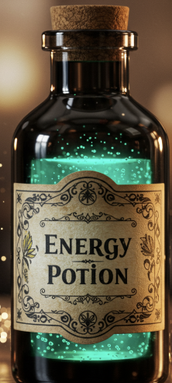

Computational assumption
[GargKalaiKhurana20, AggarwalObremskiRibeiroSimkinSiniscalchi22]
Caveat: Requires subexponential hardness of DDH
nmExt(f(X), g(Y)
Guess with probability ½ + 1/poly(n)
One of Ext(X, Y) OR U
Notes:
Introduce leakage on 2 part memory
- add some justification like why it’s worth considering
Also another slide on extraction

Slide 19
OUR CONSTRUCTION

Slide 20
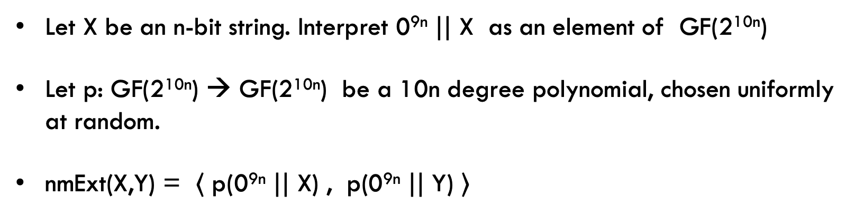
Our construction
Let X be an n-bit string. Interpret 0^{9n} $||$ X as an element of GF(2^{10n})
Let p: GF(2^{10n}) → GF(2^{10n}) be a 10n degree polynomial, chosen uniformly at random.
nmExt(X,Y) = 〈 p(0^{9n} $||$ X) , p(0^{9n} $||$ Y) ⟩
(Arguably Minor) Caveat: Requires O(n²) bits of randomness to sample p.
Notes:
Introduce leakage on 2 part memory
- add some justification like why it’s worth considering
Also another slide on extraction

Slide 21

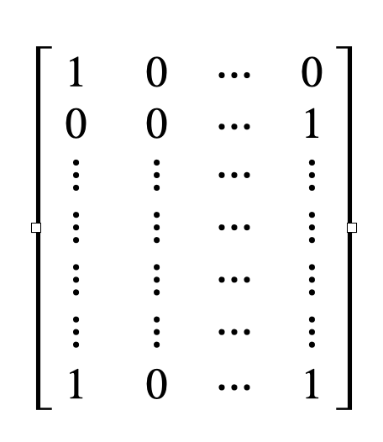
Key technical ingredients
We need a Boolean matrix with the following properties
10 n
Submatrix with any 2^{0.01n} rows has a rank greater than 5n.
2^{n}
N = 2^{n} random variables A₁, …, A_{N} in {0, 1}^{10n} that are O(n)-wise independent suffice.
Can be easily generated using O(n²) bits of randomness.
Notes:
Introduce leakage on 2 part memory
- add some justification like why it’s worth considering
Also another slide on extraction

Slide 22
Key technical ingredients
Recent breakthrough Polynomial Freiman Ruzsa Conjecture (now Theorem) [GowersGreenMannersTao24]
We need the Approximate Duality Conjecture (also theorem now) implied by PFR [Ben-SassonRon-Zewi14]
Notes:
Introduce leakage on 2 part memory
- add some justification like why it’s worth considering
Also another slide on extraction

Slide 23
So what do we Get:
Efficiency: NmExt is efficiently computable (Requires some public randomness).
x
NmExt(x,y)
y
Security: Against computationally unbounded adversary, for H$∞$(X) $≥$ 0.01n, H$∞$(Y) $≥$ 0.01n
NmExt(f(X), g(Y)
????
One of NmExt(X, Y) OR U
Notes:
Introduce leakage on 2 part memory
- add some justification like why it’s worth considering
Also another slide on extraction

Slide 24
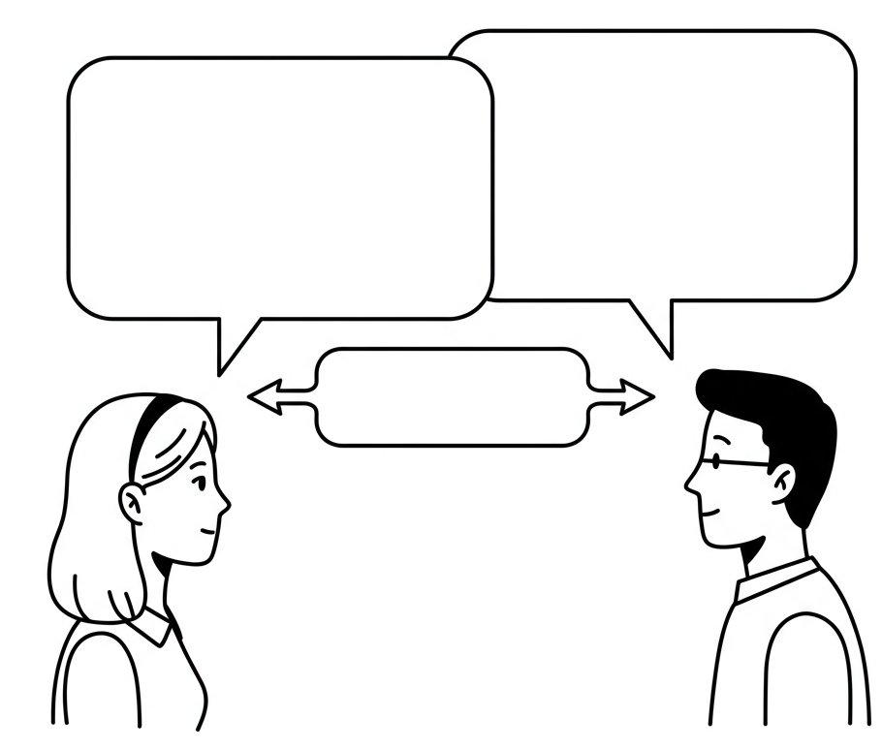
Two party computation
I don’t trust the random string you used to sample the polynomial
I could let you generate, but I don’t want to trust you either
How about 2PC!!
Notes:
Introduce leakage on 2 part memory
- add some justification like why it’s worth considering
Also another slide on extraction

Slide 25


Two party computation
Our construction is secure even if the random polynomial has entropy rate 0.9
q(x) of degree 100n
r(x) of degree 10n
p(x) = q(x) + r(x)
Observation 1: If Alice is honest, the polynomial p(x) has sufficient entropy given r(x)
Observation 2 : If Bob is honest, the polynomial p(x) is a random degree 10 n polynomial since r(x) is chosen independent of q(x)
Notes:
Introduce leakage on 2 part memory
- add some justification like why it’s worth considering
Also another slide on extraction

Slide 26
remarks
It is well known [Cleve86] that tossing a coin fairly in a 2 party computation setting is impossible.
[ChattopadhyayGurmukhaniRingach23] show that generating a random string of min-entropy rate 0.5 is impossible as well.
Notes:
Introduce leakage on 2 part memory
- add some justification like why it’s worth considering
Also another slide on extraction

Slide 27
OPEN QUESTION

Slide 28
EXPLICIT TWO-SOURCE EXTRACTOR
How to derandomize our construction – We want a matrix with the following properties
10 n
Submatrix with any 2^{0.01n} rows has a rank greater than 5n.
2^{n}
Notes:
Introduce leakage on 2 part memory
- add some justification like why it’s worth considering
Also another slide on extraction

Slide 29

Any R.n.g. will generate this matrix in its sleep
Notes:
Introduce leakage on 2 part memory
- add some justification like why it’s worth considering
Also another slide on extraction

Slide 30
Thank you!
Images generated by AI-Draw (AI-Know, National University of Singapore) using [OpenAI DALL-E/Google Imagen3].
Questions?

