Slide 1
Cryptographic Treatment of
Key Control Security
In Light of NIST SP 800-108
Ritam Bhaumik, Avijit Dutta, Akiko Inoue
Tetsu Iwata, Ashwin Jha, Kazuhiko Minematsu
Mridul Nandi, Yu Sasaki, Meltem Sönmez Turan Stefano Tessaro
Notes:
Good morning, everyone! First, I would like to thank the organizers for their kind invitation.
Karthikeyan

Slide 2
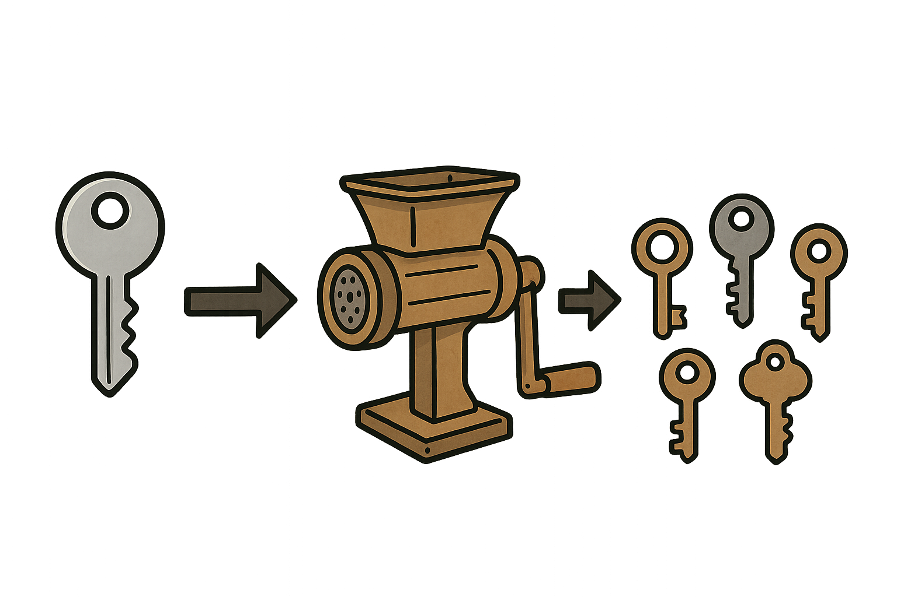
Key Derivation Functions
Goal: derive multiple keys from a single master key
Widely used in practice
  various OSs, HSM, cryptographic libraries, TEE, ...
Different variants, standards & popular designs
  HKDF [Kra10] and NIST SP 800-56C – multiple keys from high-entropy master secret (extract-then-expand)
  NIST SP 800-108 – multiple keys from uniform master key (expand only)
This talk

Slide 3
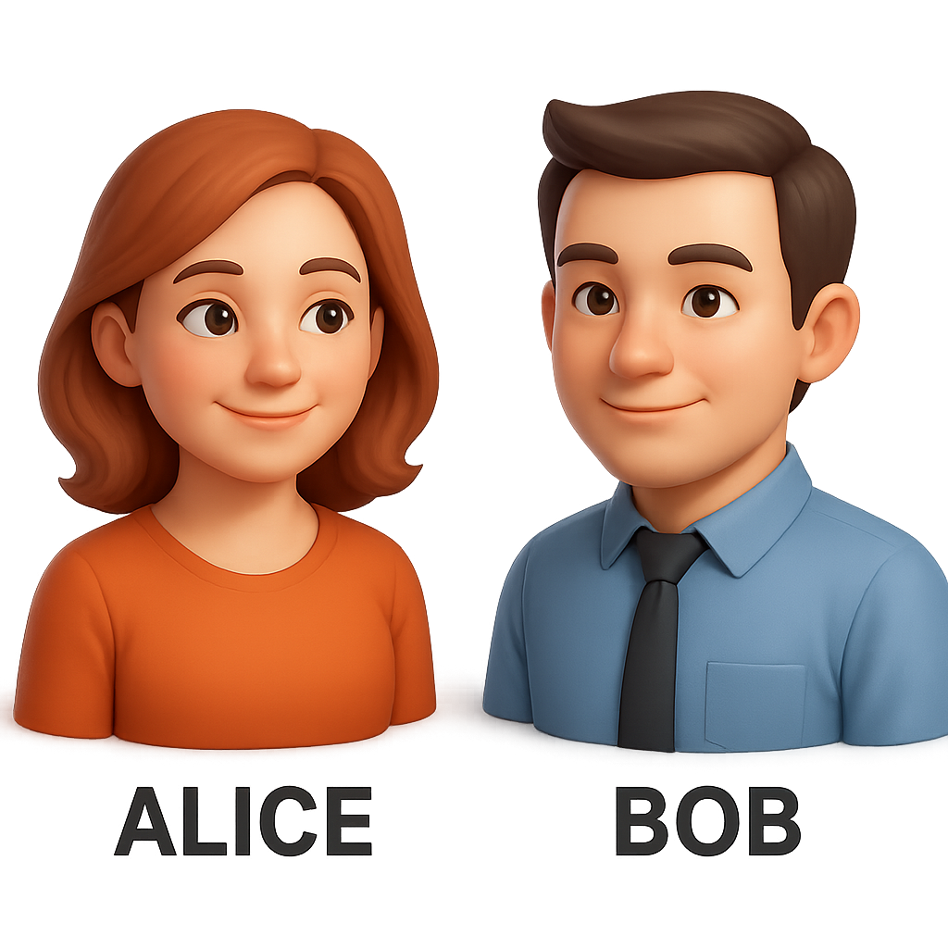
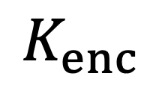
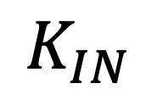

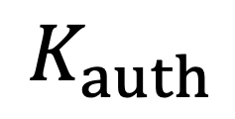
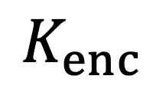

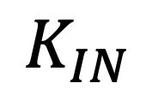
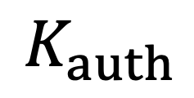
Key Derivation Functions
$$K_{IN}$$
Uniform bit-string
$$K_{IN}$$
$$K_{enc}$$
$$K_{auth}$$
$$…$$
$$K_{enc}$$
$$K_{auth}$$
$$…$$

Slide 4
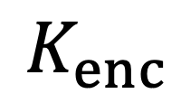
Key Derivation Functions
As standardized in NIST SP 800-108
$$K_{IN}$$
$$K_{IN}$$
KDF
Label = “encrypt”
Context = “Alice | Bob | Nonce”
Length = 128
$$K_{enc}$$

Slide 5
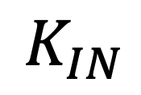
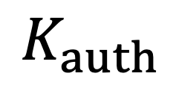
Key Derivation Functions
As standardized in NIST SP 800-108
$$K_{IN}$$
$$K_{IN}$$
KDF
Label = “auth”
Context = “Alice | Bob | Nonce’ ”
Length = 256
$$K_{enc}$$
$$K_{auth}$$

Slide 6
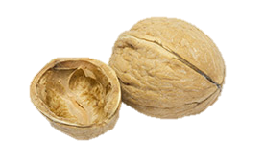
When are KDFs secure?
Security goal: KDF is a PRF
Derived keys computationally random & independent
PRF security of NIST SP 800-108 recently studied in [SWG25]
This work: Key-Control Security
New notion informally defined in NIST SP 800-108 Rev. 1 [Che22]
Security against known-key attackers choosing malicious contexts
Our contributions, in a nutshell:
Security definition for KCS
Analysis of KCS security of NIST SP 800-108
This Photo by Unknown Author is licensed under CC BY-SA-NC
Notes:
Yaobin Shen, Xiamen University, Xiamen, China
Lei Wang, Shanghai Jiao Tong University
Dawu Gu,

Slide 7
Agenda
Background: What is KCS?
Our definition of KCS
Analysis of NIST SP 800-108

Slide 8
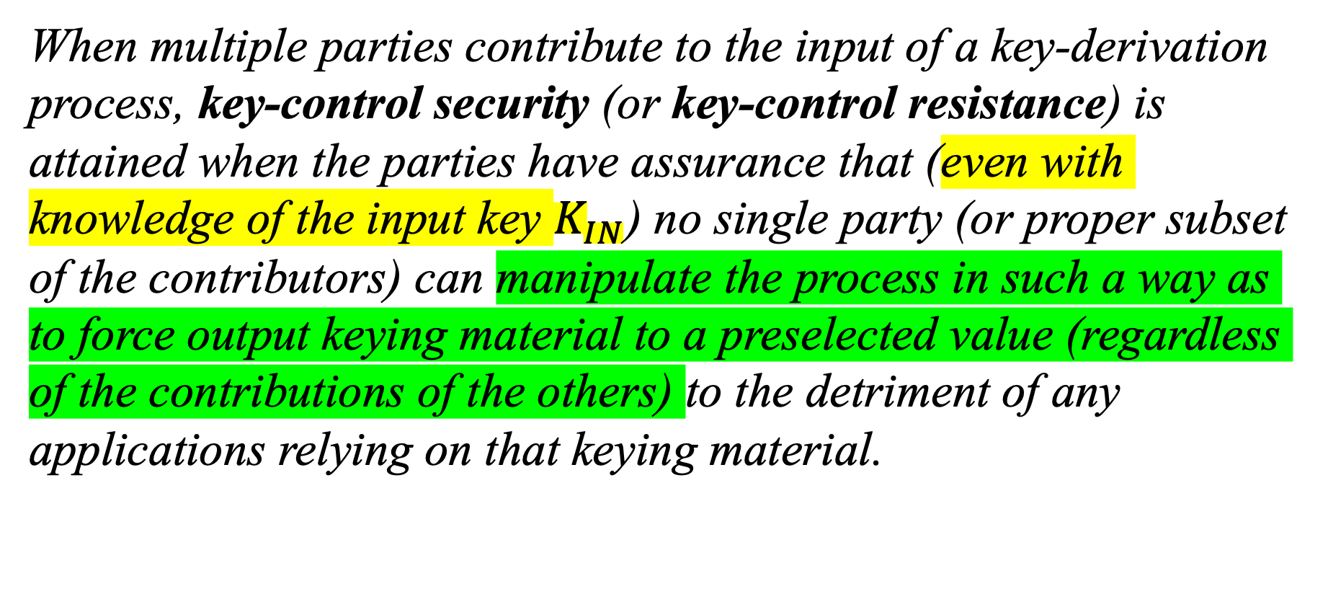
This work – Key Control Security (KCS)
When multiple parties contribute to the input of a key-derivation process, key-control security (or key-control resistance) is attained when the parties have assurance that (even with knowledge of the input key $K_{IN}$) no single party (or proper subset of the contributors) can manipulate the process in such a way as to force output keying material to a preselected value (regardless of the contributions of the others) to the detriment of any applications relying on that keying material.
NIST SP 800-108 Rev. 1

Slide 9
KCS Attack Scenario
Honest Bob chooses nonce correctly (e.g., randomly)
$$K_{IN}$$
$$K_{IN}$$
$$\text{Nonce}$$
$$K_{enc}=\text{KDF}\left(K_{IN},\text{“}\text{encrypt}\text{”}, \text{Nonce},128\right)$$

Slide 10


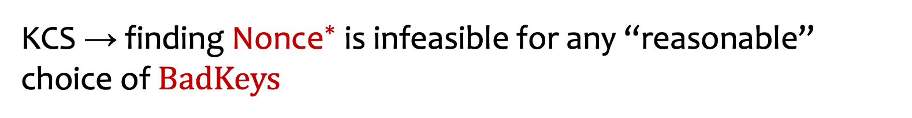
KCS Attack Scenario
Malicious Bob could pick bad nonce …
$$K_{IN}$$
$$K_{IN}$$
$${\text{Nonce}}^{∗}$$
Goal: $\text{KDF}\left(K_{IN},\text{“}\text{encrypt}\text{”},{\text{Nonce}}^{∗},128\right)∈BadKeys$
e.g. weak block cipher keys
KCS → finding ${\text{Nonce}}^{∗}$ is infeasible for any “reasonable” choice of $BadKeys$

Slide 11

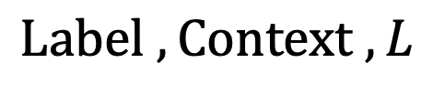

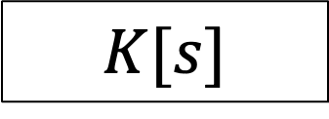

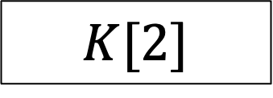

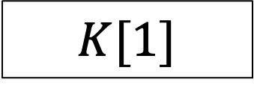

Example – CTR
NIST SP 800-108
$$Label , Context , L$$
KDF
$$K_{IN}$$
$$1$$
$$2$$
$$s$$
PRF
PRF
PRF
$$K[1]$$
$$K[2]$$
$$K[s]$$
$$K_{OUT}∈{\left\{0,1\right\}}^{L}$$

Slide 12


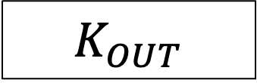


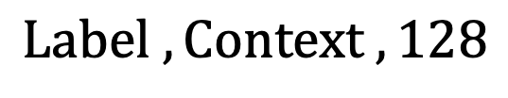

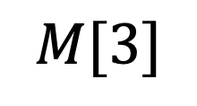
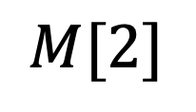
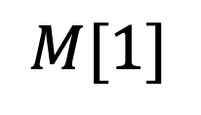
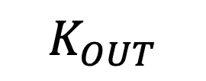
Example – CTR-CMAC
$$M\left[1\right]={\left[1\right]}_{2}∥Label∥0x00∥Context[1]$$
$$M\left[2\right]=Context\left[2\right]$$
$$M\left[3\right]=Context\left[3\right]∥{\left[128\right]}_{2}$$
$$Label ,Context , 128$$
$$M[1]$$
$$M[2]$$
$$M[3]$$
KDF
$$K_{IN}$$
$$1$$
$2⋅E_{K}\left(0^{128}\right)$
PRF
$E_{K}$
$E_{K}$
$E_{K}$
$$K_{OUT}$$
$$K=K_{IN}$$
$$K_{OUT}$$

Slide 13
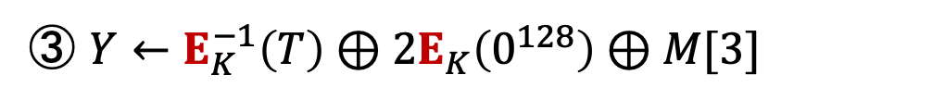
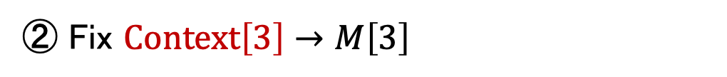


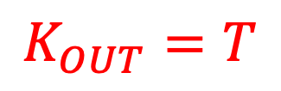
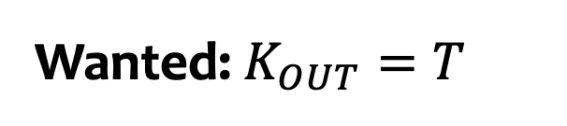

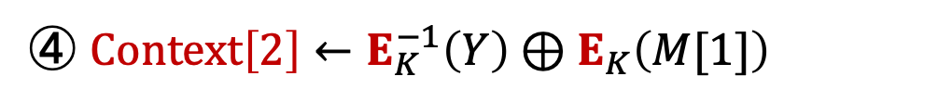
KCS Attack
$$M\left[1\right]={\left[1\right]}_{2}∥Label∥0x00∥Context[1]$$
Amazon’s feedback to NIST [ACKP22]
$$M\left[2\right]=Context\left[2\right]$$
$$M\left[3\right]=Context\left[3\right]∥{\left[128\right]}_{2}$$
Wanted: $K_{OUT}=T$
$$M[1]$$
$$M[2]$$
$$M[3]$$
① Fix $Context\left[1\right]→M\left[1\right]$
$2⋅E_{K}\left(0^{128}\right)$
② Fix $Context\left[3\right]→M\left[3\right]$
$E_{K}$
$E_{K}$
$E_{K}$
③ $Y←E_{K}^{−1}\left(T\right)⊕2E_{K}\left(0^{128}\right)⊕M[3]$
④ $Context\left[2\right]←E_{K}^{−1}\left(Y\right)⊕E_{K}\left(M[1]\right)$
$$Y$$
$$K=K_{IN}$$
$$K_{OUT}=T$$

Slide 14
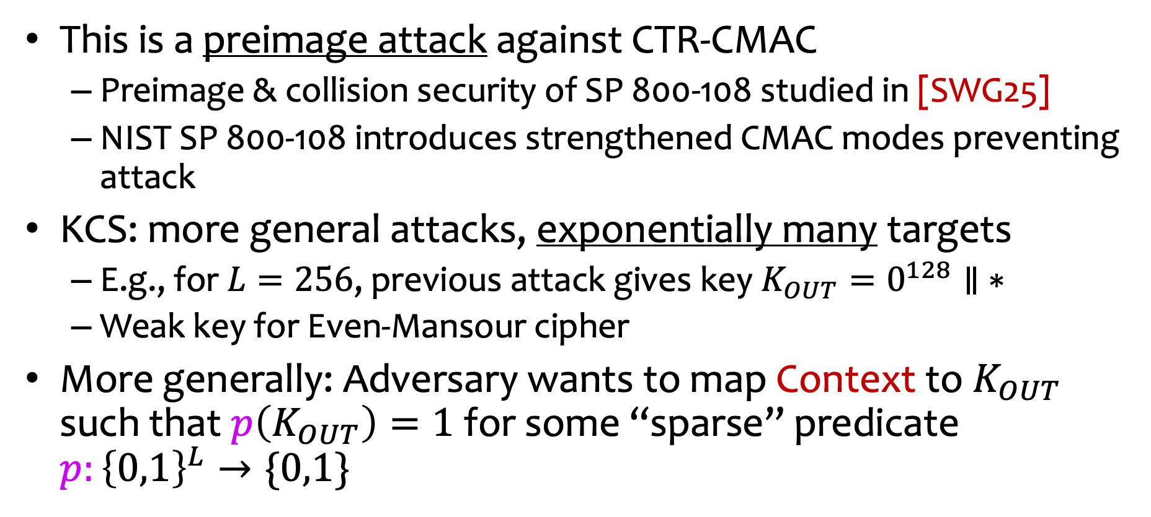
KCS Summary
This is a preimage attack against CTR-CMAC
  Preimage & collision security of SP 800-108 studied in [SWG25]
  NIST SP 800-108 introduces strengthened CMAC modes preventing attack
KCS: more general attacks, exponentially many targets
  E.g., for $L=256$, previous attack gives key $K_{OUT}=0^{128}∥ ∗$
  Weak key for Even-Mansour cipher
More generally: Adversary wants to map Context to $K_{OUT}$ such that $p\left(K_{OUT}\right)=1$for some “sparse” predicate $p:{\left\{0,1\right\}}^{L}→\{0,1\}$
Next: formal definition?

Slide 15
Agenda
Background: What is KCS?
Our definition of KCS
Analysis of NIST SP 800-108

Slide 16
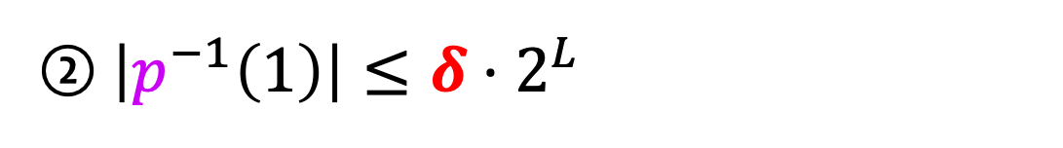
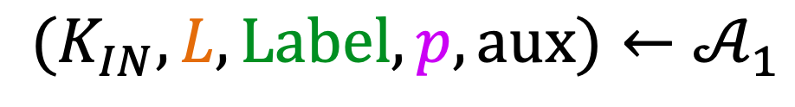
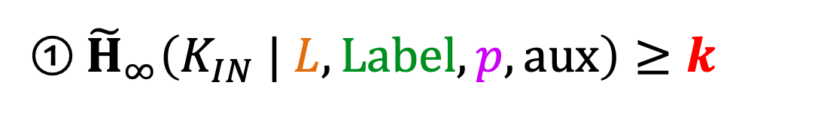
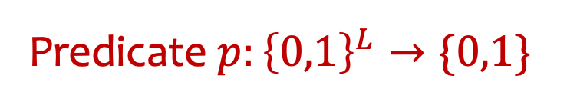
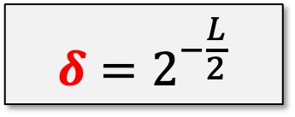
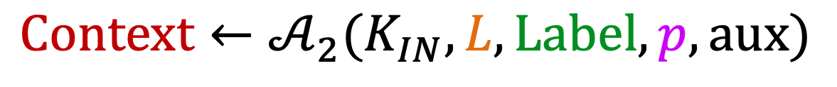
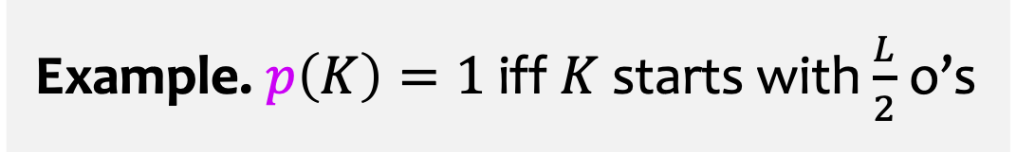
KCS Definition
Example. $p\left(K\right)=1$ iff $K$ starts with $\frac{L}{2}$ o’s
Predicate $p:{\left\{0,1\right\}}^{L}→\{0,1\}$
$$δ=2^{−\frac{L}{2}}$$
$$(K_{IN},L,Label,p,aux)←𝒜_{1}$$
$$Context←𝒜_{2}(K_{IN},L,Label,p,aux)$$
$\left(𝒜_{1},𝒜_{2}\right)$ wins iff $p\left(\text{KDF}\left(K_{IN},Label,Context,L\right)\right)=1$
To avoid trivial wins:
① ${\tilde{H}}_{∞}\left(K_{IN} | L,Label,p,aux\right)≥k$
② $\left|p^{−1}\left(1\right)\right|≤δ⋅2^{L}$

Slide 17

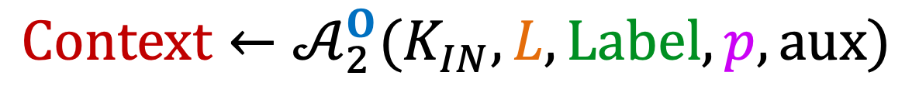
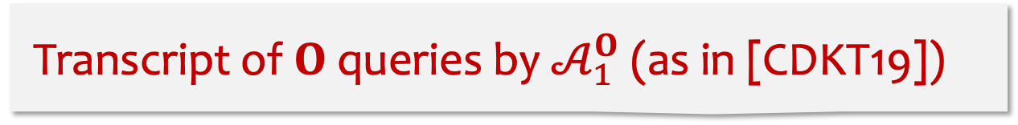
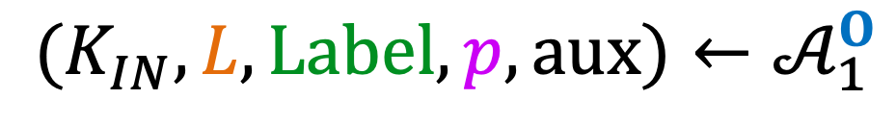
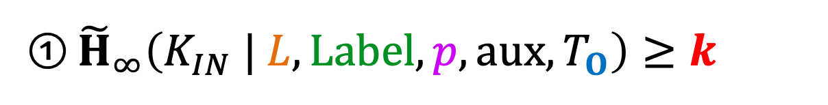
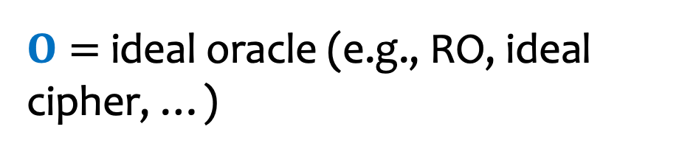
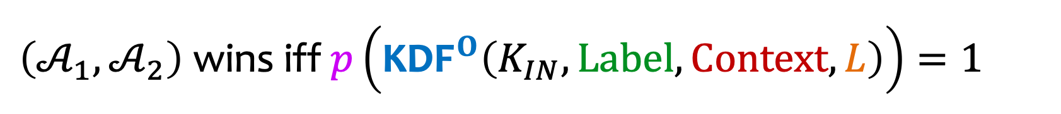

KCS Definition – Ideal Models
$O=$ ideal oracle (e.g., RO, ideal cipher, …)
$$(K_{IN},L,Label,p,aux)←𝒜_{1}^{O}$$
$$Context←𝒜_{2}^{O}(K_{IN},L,Label,p,aux)$$
$\left(𝒜_{1},𝒜_{2}\right)$ wins iff $p\left({\text{KDF}}^{O}\left(K_{IN},Label,Context,L\right)\right)=1$
Transcript of $O$queries by $𝒜_{1}^{O}$ (as in [CDKT19])
To avoid trivial wins:
① ${\tilde{H}}_{∞}\left(K_{IN} | L,Label,p,aux,T_{O}\right)≥k$
① ${\tilde{H}}_{∞}\left(K_{IN} | L,Label,p,aux\right)≥k$
② $\left|p^{−1}\left(1\right)\right|≤δ⋅2^{L}$

Slide 18
Agenda
Background: What is KCS?
Our definition of KCS
Analysis of NIST SP 800-108

Slide 19

























NIST SP-800-108 Constructions
$$Label , Context , L$$
$$Label , Context , L$$
CTR
DP
$$K_{IN}$$
$$1$$
$$2$$
$$s$$
PRF
PRF
PRF
PRF
PRF
PRF
$$K[1]$$
$$K[2]$$
$$K[s]$$
$$K_{OUT}∈{\left\{0,1\right\}}^{L}$$
$$K_{IN}$$
PRF
PRF
PRF
PRF $∈\{HMAC,CMAC\}$
$$Label , Context , L$$
$$K[1]$$
$$K[2]$$
$$K[s]$$
FB
$$IV$$
$$K_{IN}$$
$$1$$
$$2$$
$$s$$
$$K_{OUT}∈{\left\{0,1\right\}}^{L}$$
PRF
PRF
PRF
+ KDF = KMAC
$$K[1]$$
$$K[2]$$
$$K[s]$$
$$K_{OUT}∈{\left\{0,1\right\}}^{L}$$

Slide 20
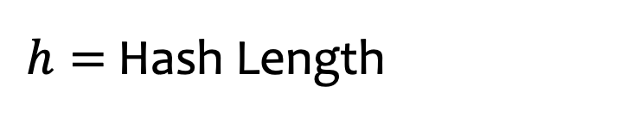
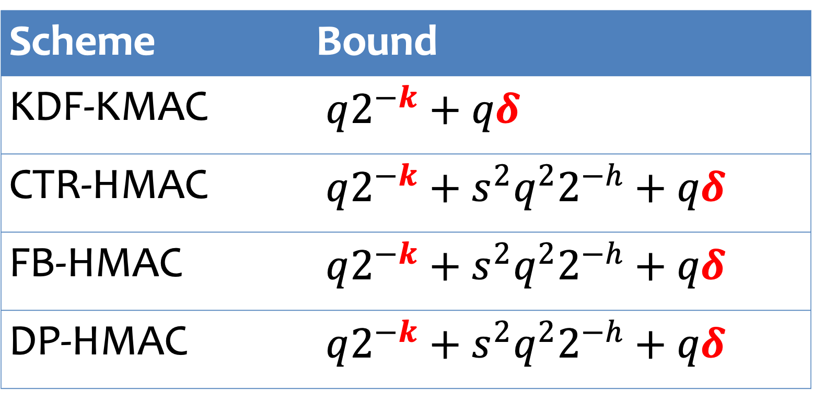
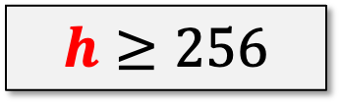
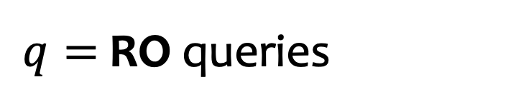

KMAC & HMAC – Security Proofs
$$s=\left\lceil \frac{L}{h}\right\rceil$$
$h=$ Hash Length
Good News!
Scheme | Bound
KDF-KMAC | $q2^{−k}+qδ$
CTR-HMAC | $q2^{−k}+s^{2}q^{2}2^{−h}+qδ$
FB-HMAC | $q2^{−k}+s^{2}q^{2}2^{−h}+qδ$
DP-HMAC | $q2^{−k}+s^{2}q^{2}2^{−h}+qδ$
$$h≥256$$
$q=$ RO queries
Here: HMAC = HMAC[RO] KMAC = KMAC[RO]

Slide 21

CMAC – Cryptanalysis
[Here: block length = 128]
With AES
Amazon’s feedback [ACKP22]
Scheme | Base | Strengthened
CTR-CMAC | $$1$$ | $$2^{72}$$
FB-CMAC | $$1$$ | $$2^{72}$$
DP-CMAC | $$2^{64}$$ | $$2^{72}$$
Birthday-style attack [This work]

Slide 22
Conclusions
New notion, many open questions!
Proofs for CMAC PRFs?
Best-possible constructions?
Analysis from simpler-than-RO primitives? (No indifferentiability!)
Real-world attacks leveraging KCS weaknesses?
…
Thank you!
https://eprint.iacr.org/2025/1123

