Slide 1
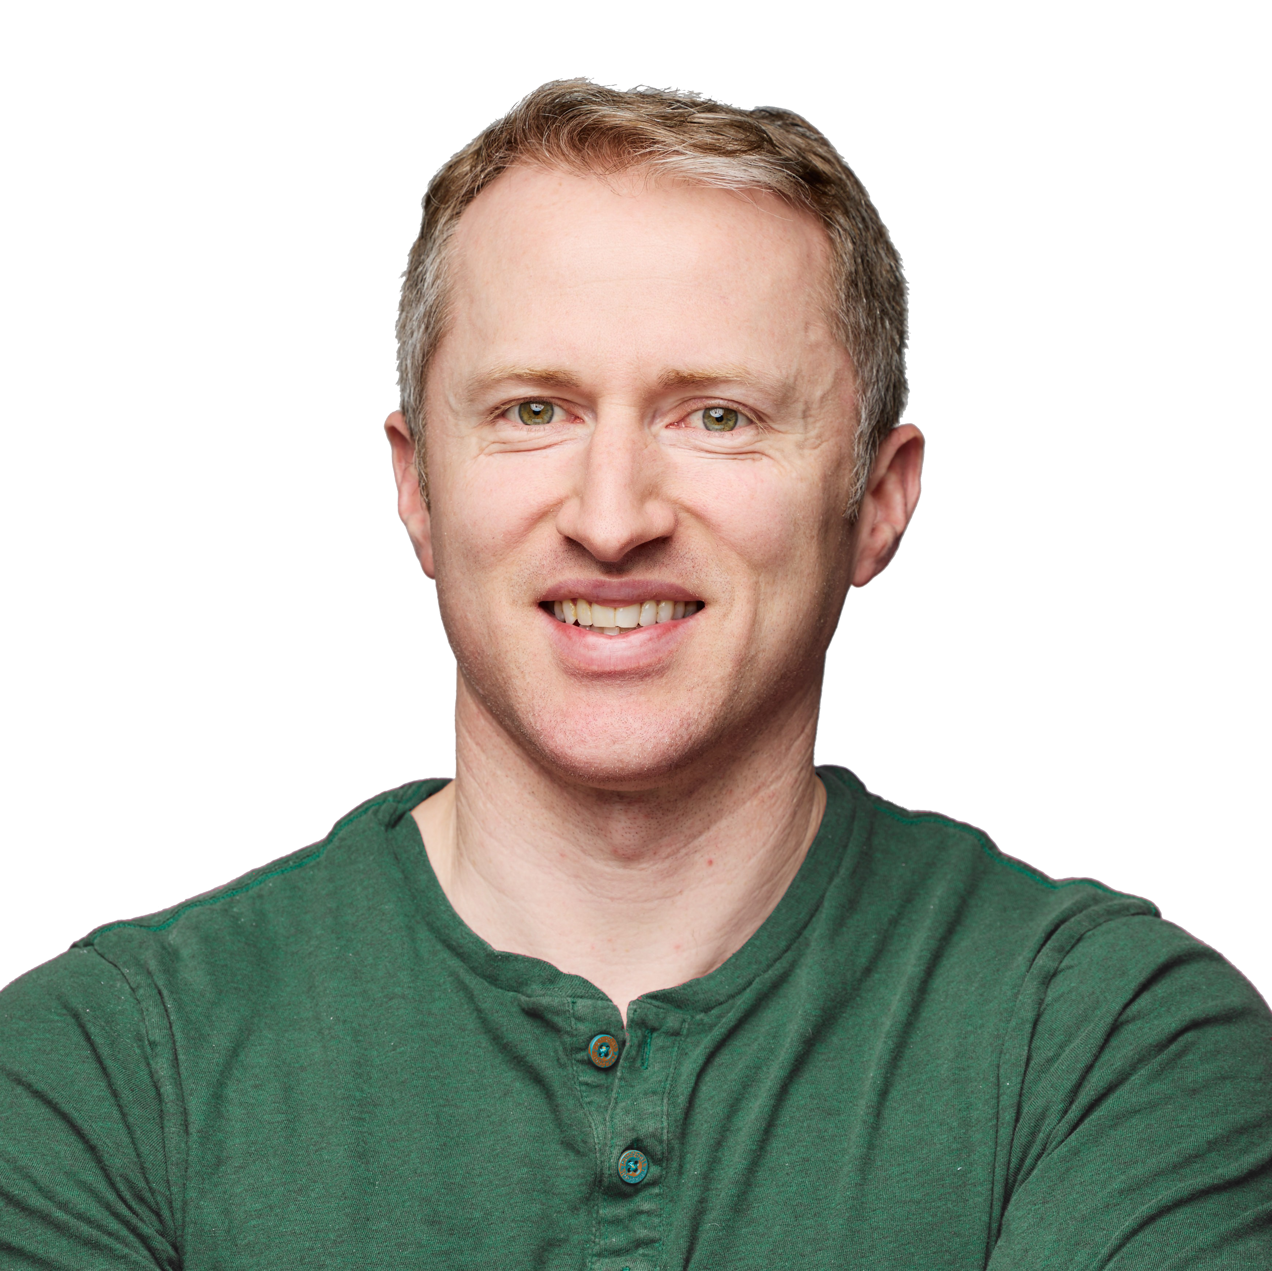
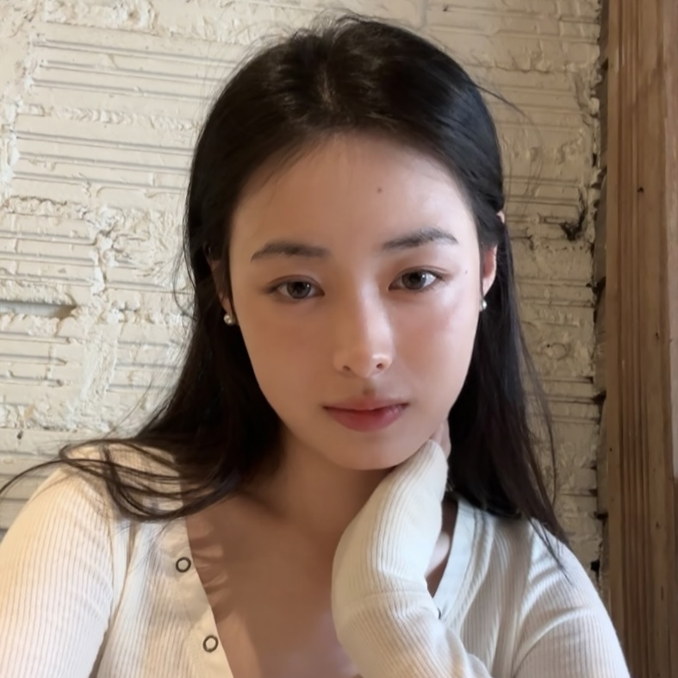
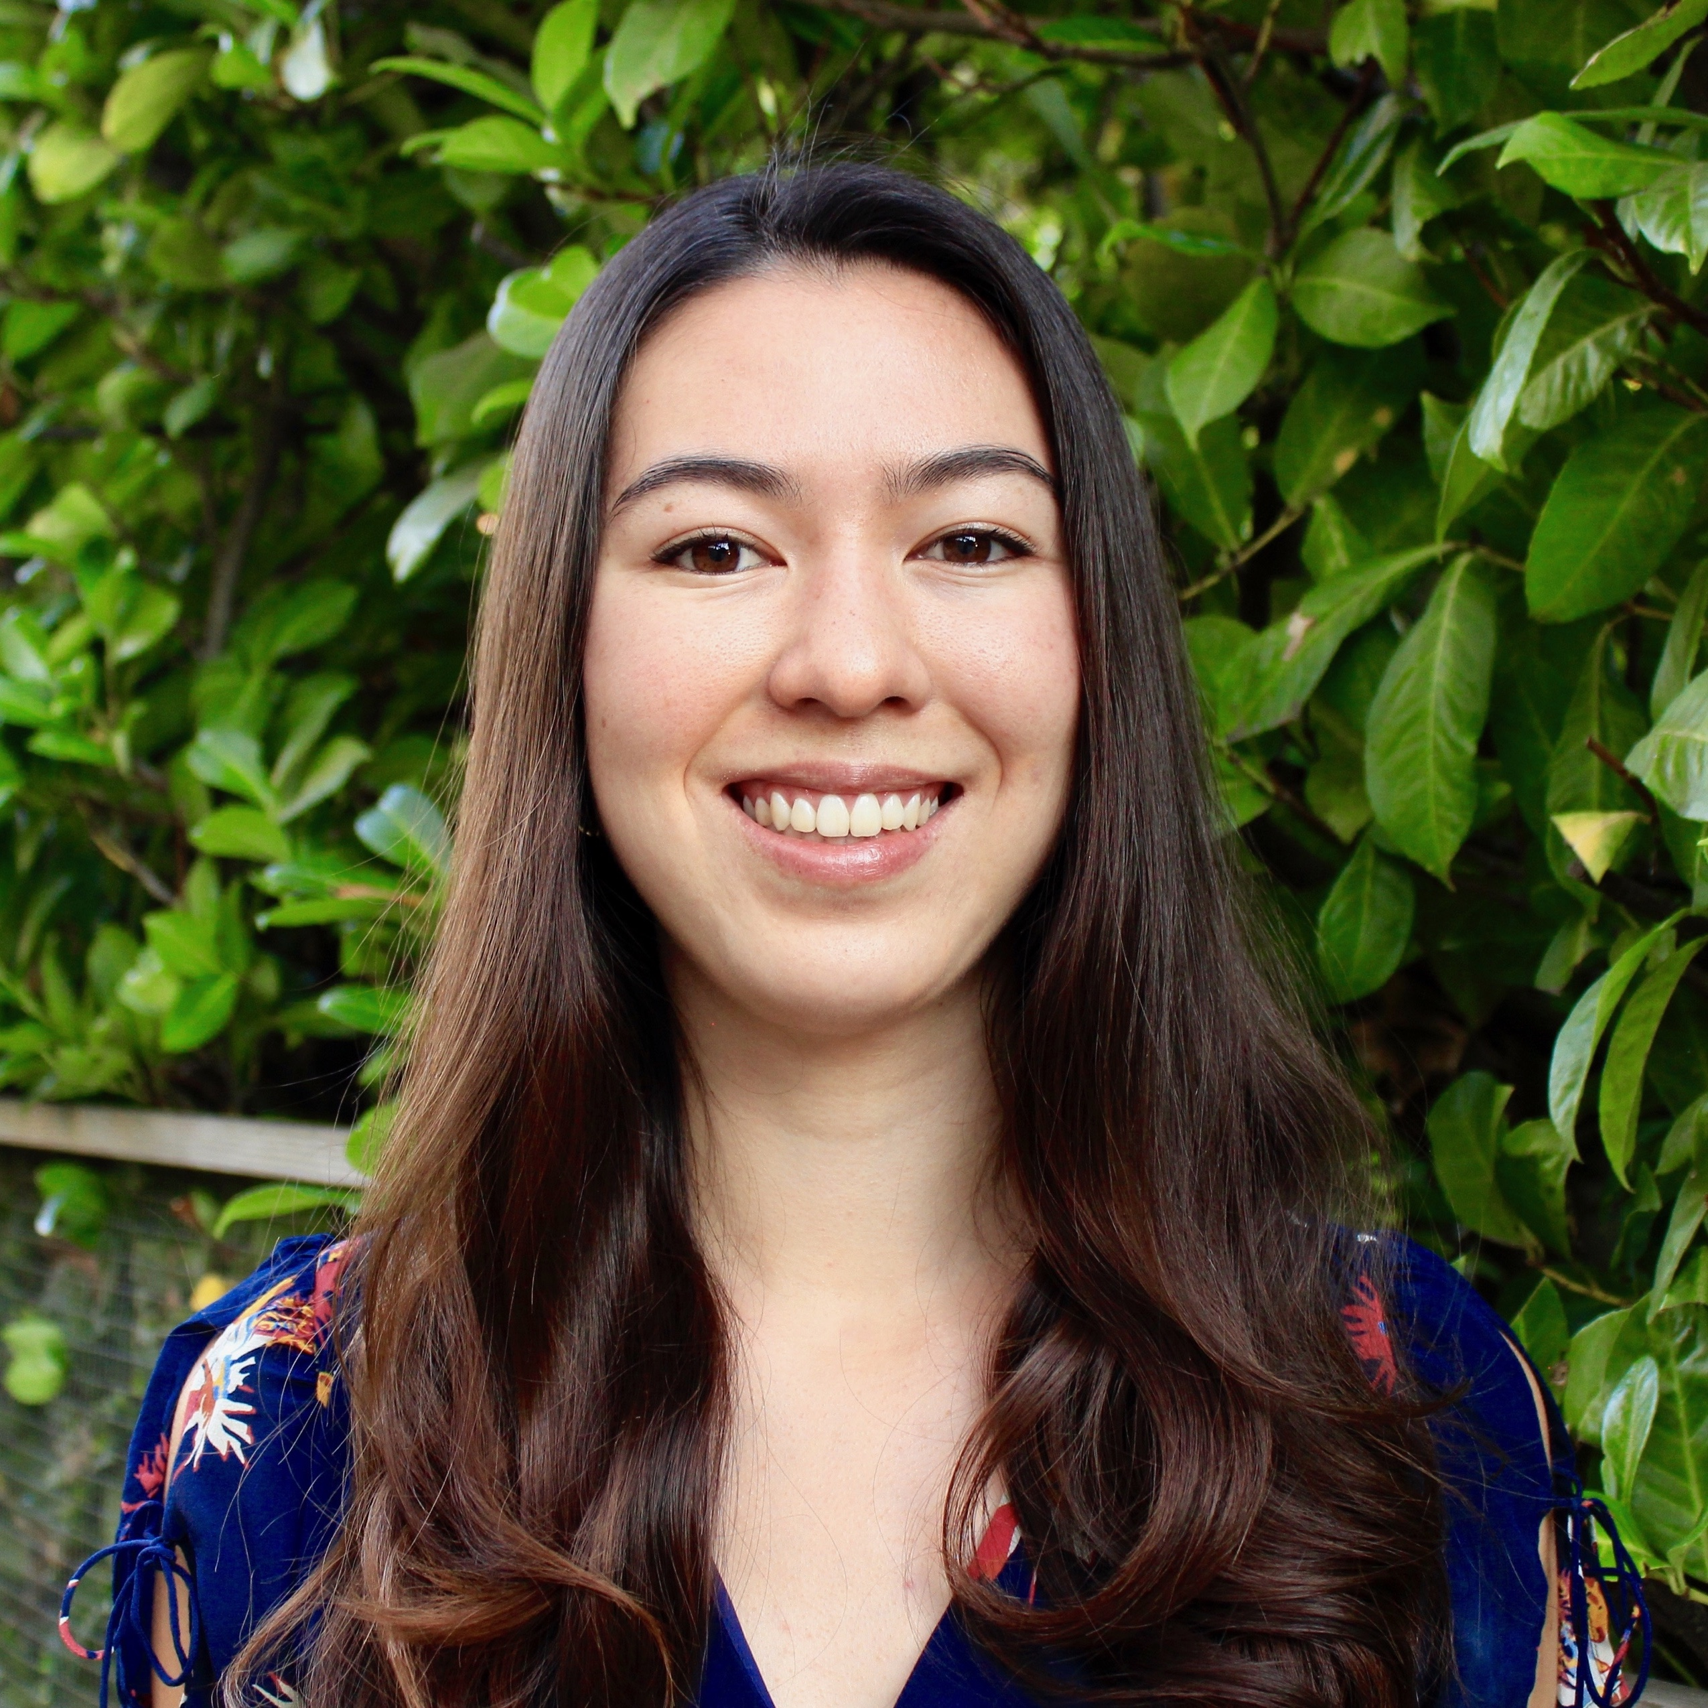

Merkle Mountain Ranges are Optimal:
On Witness Update Frequency for Cryptographic Accumulators
Joe Bonneau
NYU, a16z crypto
Jessica Chen
NYU
Miranda Christ
Columbia University
Ioanna Karantaidou
CNRF, IRIF, Université Paris Cité

Slide 2
The Problem
growing set S
Registered users
All x.509 certificates
All blockchain transactions
Notes:
Start with example
Mention that Merkle trees are often used to solve this problem

Slide 3
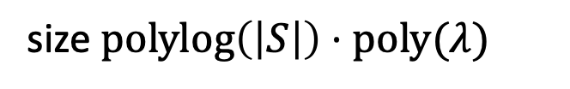
The Problem
size $polylog\left(\left|S\right|\right)⋅poly(λ)$
short commitment
growing set S
Registered users
All x.509 certificates
All blockchain transactions
Notes:
Start with example
Mention that Merkle trees are often used to solve this problem

Slide 4
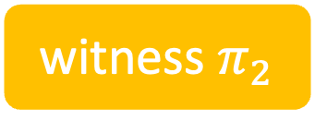
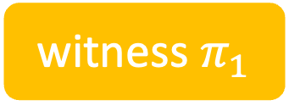

The Problem
short commitment
growing set S
witness $π_{1}$
witness $π_{2}$
witness $π_{k}$

Slide 5
The Problem
post commitment on public bulletin
short commitment
growing set S
witness $π_{1}$
witness $π_{2}$
witness $π_{k}$
distribute proofs to individual users

Slide 6
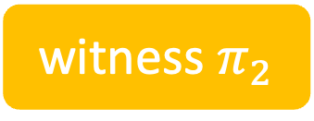
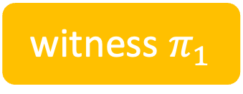

post commitment on public bulletin
short commitment
growing set S
witness $π_{1}$
witness $π_{2}$
distribute proofs to individual users
witness $π_{k}$

Slide 7


Verifying membership
Verification algorithm
$$x_{i}$$
witness $π_{i}$
true/false
commitment to S

Slide 8
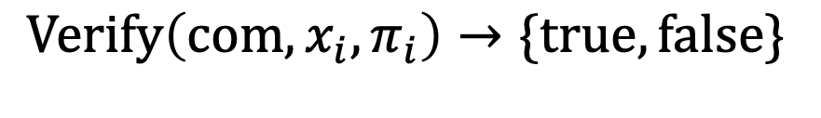
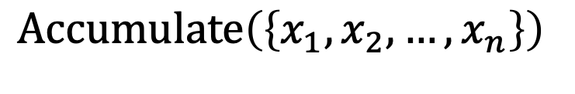
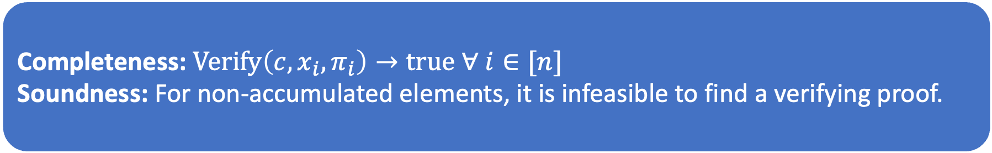
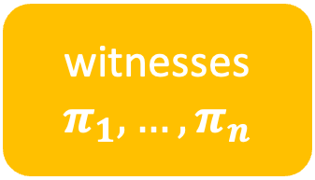

Cryptographic Accumulator
commitment
$$c$$
$$Accumulate\left(\left\{x_{1},x_{2},…, x_{n}\right\}\right)$$
witnesses$π_{1},…, π_{n}$
$$Verify\left(com, x_{i}, π_{i}\right)→\{true, false\}$$
Completeness: $Verify\left(c, x_{i}, π_{i}\right)→true ∀ i∈[n]$
Soundness: For non-accumulated elements, it is infeasible to find a verifying proof.

Slide 9



A partial solution: Merkle tree [Merkle79]
Store elements at the leaves
Commitment is the root
Membership witness of a leaf is its siblings along its path to the root
  Recompute hashes to verify
$$x_{3}$$
$$x_{1}$$
$$x_{2}$$

Slide 10






What happens when we add an element?
$$x_{3}$$
$$x_{1}$$
$$x_{2}$$
$$x_{1}$$
$$x_{2}$$
$$x_{3}$$
$$x_{4}$$

Slide 11

What happens when we add an element?
The membership witness of $x_{1}$ changes
$$x_{3}$$
$$x_{1}$$
$$x_{2}$$
$$x_{1}$$
$$x_{2}$$
$$x_{3}$$
$$x_{4}$$

Slide 12
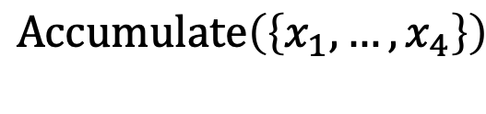
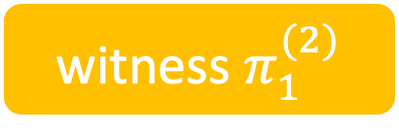
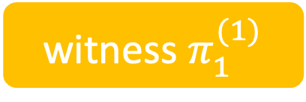
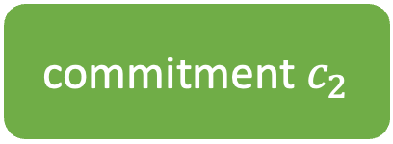

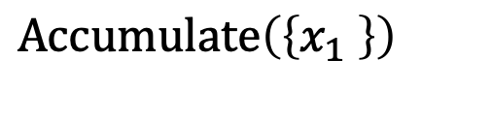
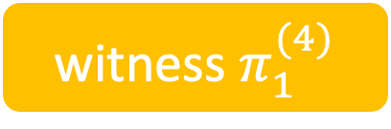
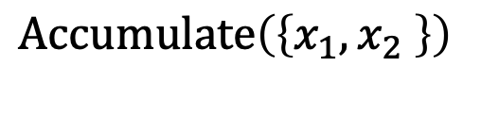
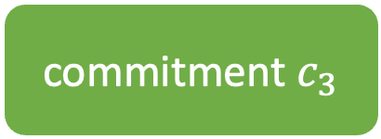
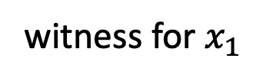
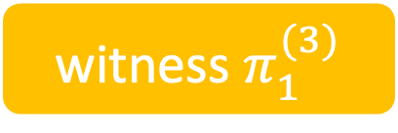
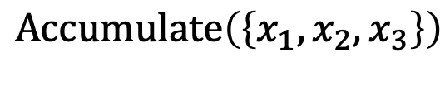
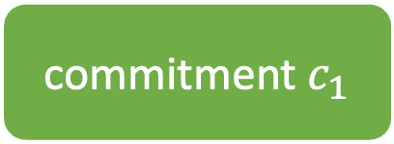
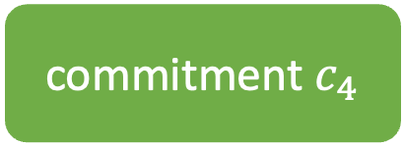

What is a witness change?
Element $x_{1}$ had 2 witness changes
witness for $x_{1}$
commitment
verifies
commitment $c_{1}$
witness $π_{1}^{(1)}$
$$Accumulate\left(\left\{x_{1} \right\}\right)$$
verifies
$$=$$
$$Accumulate\left(\left\{x_{1}, x_{2} \right\}\right)$$
commitment $c_{2}$
witness $π_{1}^{(2)}$
does not verify
commitment $c_{3}$
$$Accumulate\left(\left\{x_{1}, x_{2},x_{3}\right\}\right)$$
witness $π_{1}^{(3)}$
does not verify
commitment $c_{4}$
witness $π_{1}^{(4)}$
$$Accumulate\left(\left\{x_{1}, …, x_{4}\right\}\right)$$

Slide 13

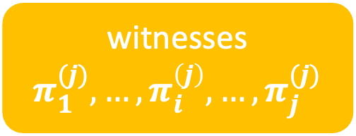



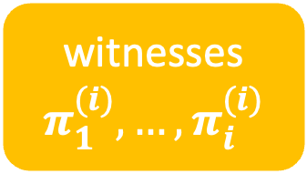
What is a witness change?
Imagine accumulating a sequence of elements:
$$Acc(\{x_{1},…, x_{i}\})$$
$$Acc(\{x_{1},…, x_{i}, …, x_{j}\})$$
…
witnesses $π_{1}^{(i)},…, π_{i}^{(i)}$
commitment
$$c_{j}$$
witnesses $π_{1}^{(j)},…, π_{i}^{\left(j\right)}, …, π_{j}^{(j)}$
commitment
$$c_{i}$$

Slide 14



What is a witness change?
We say $x_{i}$’s witness changes if
$Verify\left(c_{j}, x_{i}, π_{i}^{\left(i\right)}\right)→false$.
Imagine accumulating a sequence of elements:
$$Acc(\{x_{1},…, x_{i}\})$$
$$Acc(\{x_{1},…, x_{i}, …, x_{j}\})$$
…
witnesses $π_{1}^{(i)},…, π_{i}^{(i)}$
commitment
$$c_{j}$$
witnesses $π_{1}^{(j)},…, π_{i}^{\left(j\right)}, …, π_{j}^{(j)}$
commitment
$$c_{i}$$

Slide 15
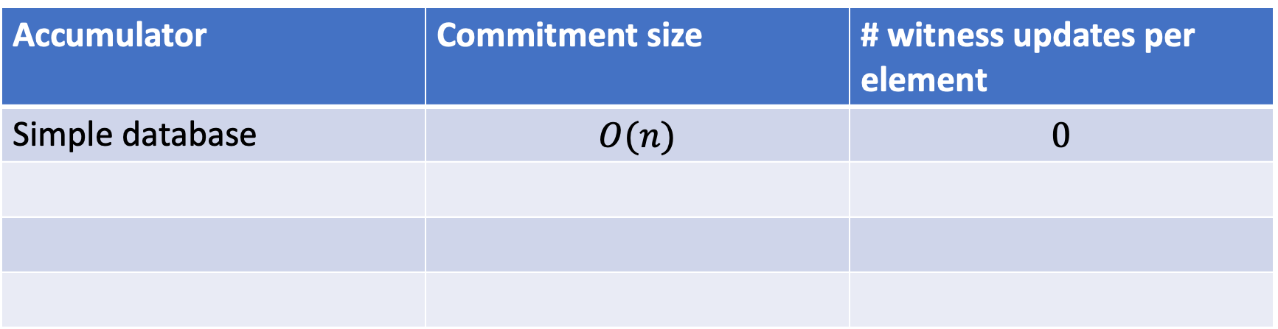
Simple solutions
Accumulator | Commitment size | # witness updates per element
Simple database | $$O(n)$$ | $$0$$

Slide 16
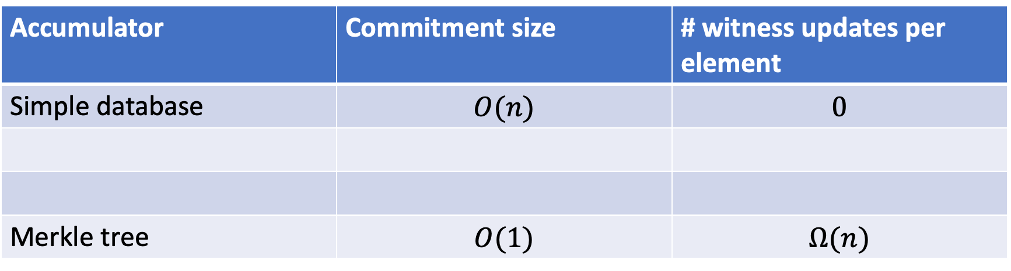
Simple solutions
Accumulator | Commitment size | # witness updates per element
Simple database | $$O(n)$$ | $$0$$
Merkle tree | $$O(1)$$ | $$Ω(n)$$

Slide 17
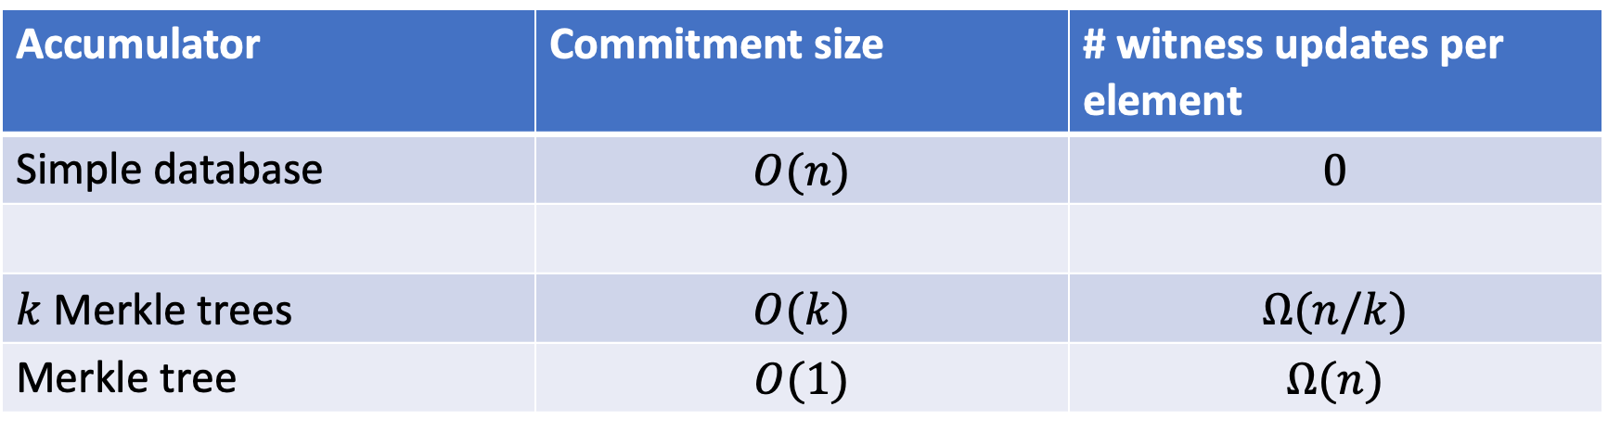
Simple solutions
Accumulator | Commitment size | # witness updates per element
Simple database | $$O(n)$$ | $$0$$
$k$ Merkle trees | $$O(k)$$ | $$Ω(n/k)$$
Merkle tree | $$O(1)$$ | $$Ω(n)$$

Slide 18
Simple solutions
Accumulator | Commitment size | # witness updates per element
Simple database | $$O(n)$$ | $$0$$
$k$ Merkle trees | $$O(k)$$ | $$Ω(n/k)$$
Merkle tree | $$O(1)$$ | $$Ω(n)$$
Can we have a small commitment and few updates per element?

Slide 19
Other accumulators
There are other clever accumulator constructions but they all suffer from frequent witness updates

Slide 20
Witness changes are costly in practice
Users must come online to update their witnesses
This problem has led to the (re)invention of the
Merkle Mountain Range
[Todd13], [Reyzin-Yakoubov16], [Garg-Hajiabadi-Mahmoody-Rahimi18]
blockchains
distributed PKI
registration-based encryption

Slide 21
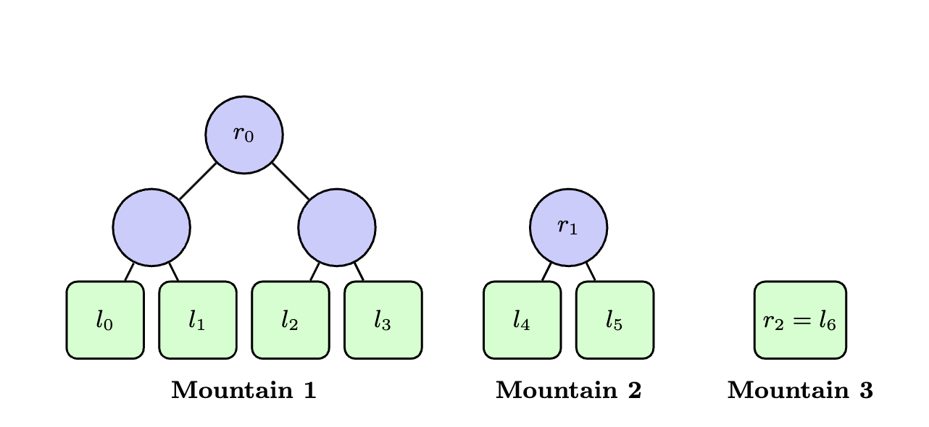
Merkle Mountain Range (MMR)
Elements are stored at leaves
Commitment is now a list of roots
Membership witnesses are still paths

Slide 22




Merkle Mountain Range (MMR)
Size 4
Size 2
Size 1
$$x_{1}$$
$$x_{2}$$
$$x_{3}$$
$$x_{4}$$
Elements are stored at leaves
Commitment is now a list of roots
Membership witnesses are still paths

Slide 23

Merkle Mountain Range (MMR)
Size 4
Size 2
Size 1
$$x_{1}$$
$$x_{2}$$
$$x_{3}$$
$$x_{4}$$
$$x_{5}$$
Elements are stored at leaves
Commitment is now a list of roots
Membership witnesses are still paths

Slide 24

Merkle Mountain Range (MMR)
Size 4
Size 2
Size 1
$$x_{1}$$
$$x_{2}$$
$$x_{3}$$
$$x_{4}$$
$$x_{5}$$
$$x_{6}$$
Elements are stored at leaves
Commitment is now a list of roots
Membership witnesses are still paths

Slide 25


Merkle Mountain Range (MMR)
Size 4
Size 2
Size 1
$$x_{1}$$
$$x_{2}$$
$$x_{3}$$
$$x_{4}$$
$$x_{5}$$
$$x_{6}$$
Elements are stored at leaves
Commitment is now a list of roots
Membership witnesses are still paths

Slide 26

Merkle Mountain Range (MMR)
Size 4
Size 2
Size 1
$$x_{1}$$
$$x_{2}$$
$$x_{3}$$
$$x_{4}$$
$$x_{5}$$
$$x_{6}$$
$$x_{7}$$
An element’s witness changes only when its tree is merged.

Slide 27
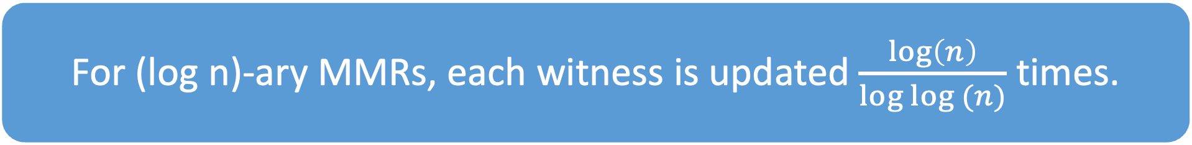
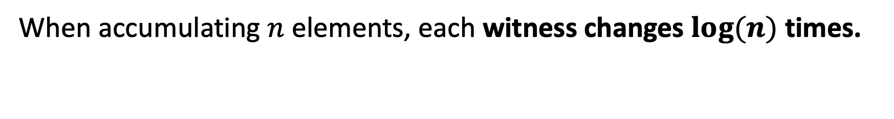
When accumulating $n$ elements, each witness changes $log⁡(n)$ times.
Size 4
Size 2
Size 1
$$x_{1}$$
$$x_{2}$$
$$x_{3}$$
$$x_{4}$$
$$x_{5}$$
$$x_{6}$$
$$x_{7}$$
For (log n)-ary MMRs, each witness is updated $\frac{log\left(n\right)}{log log (n)}$ times.

Slide 28
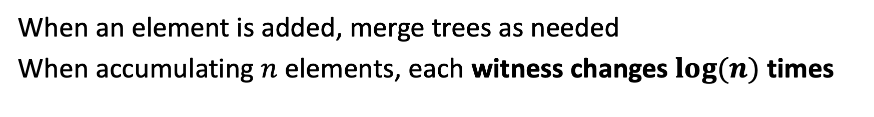
Merkle Mountain Range
When an element is added, merge trees as needed
When accumulating $n$ elements, each witness changes $log⁡(n)$ times

Slide 29

Merkle Mountain Range
For (log n)-ary MMRs, each witness is updated $\frac{log\left(n\right)}{log log (n)}$ times.

Slide 30
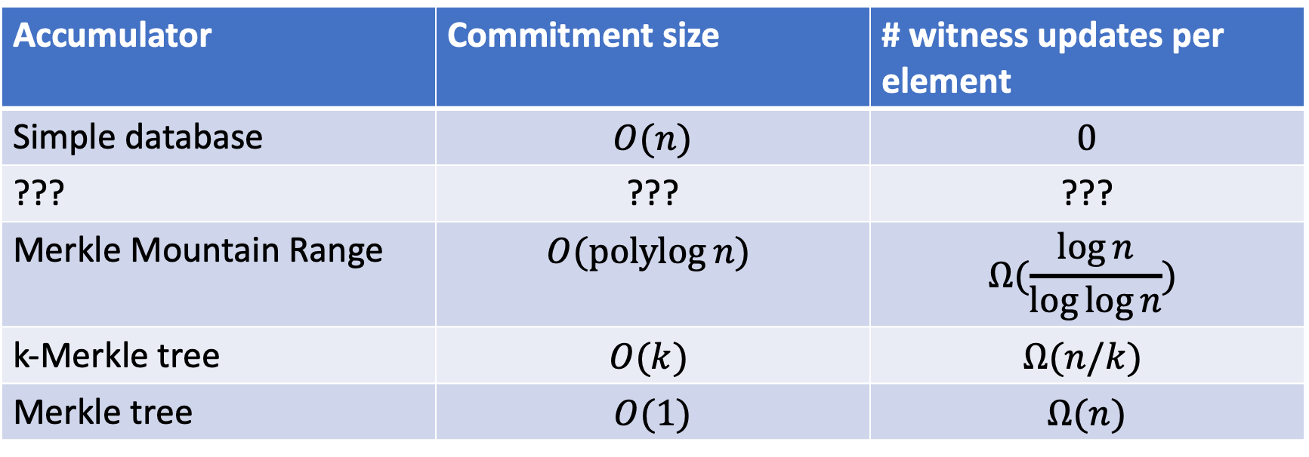
Solutions
Accumulator | Commitment size | # witness updates per element
Simple database | $$O(n)$$ | $$0$$
??? | ??? | ???
Merkle Mountain Range | $$O(\operatorname{polylog}{n})$$ | $$Ω(\frac{\log{n}}{\log{\log{n}}})$$
k-Merkle tree | $$O(k)$$ | $$Ω(n/k)$$
Merkle tree | $$O(1)$$ | $$Ω(n)$$

Slide 31

Can we do better than
Merkle Mountain Ranges?

Slide 32
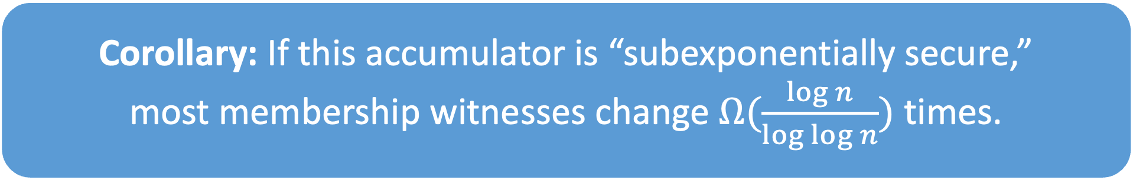
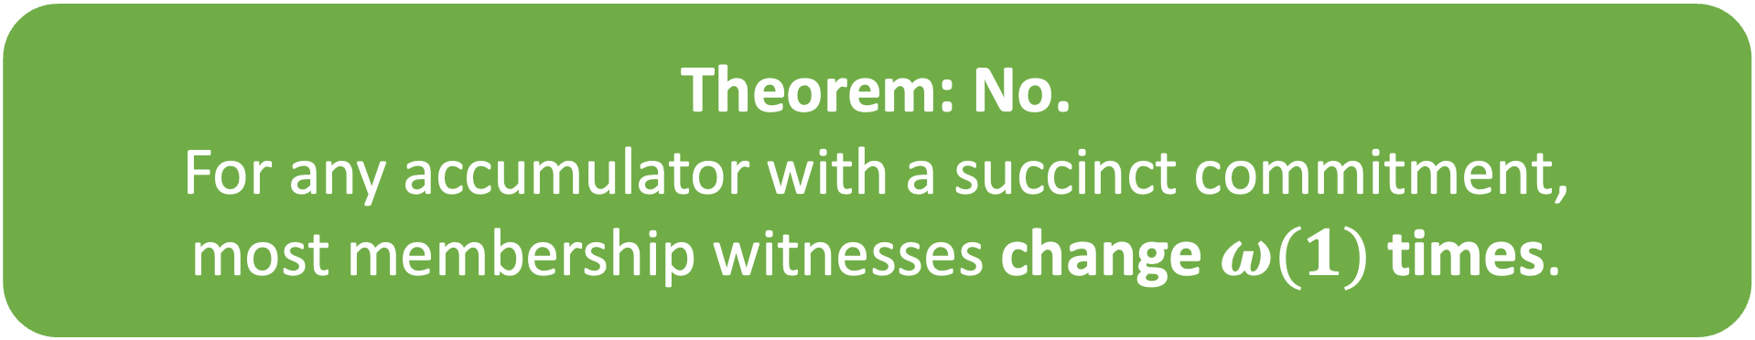
Can we do better?
Theorem: No.
For any accumulator with a succinct commitment,
most membership witnesses change $ω(1)$ times.
Corollary: If this accumulator is “subexponentially secure,”
most membership witnesses change $Ω(\frac{\log{n}}{\log{\log{n}}})$ times.
⇨ (log n)-ary MMRs are essentially optimal.

Slide 33


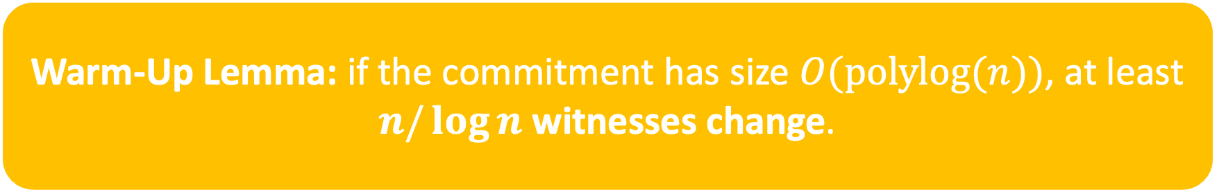
Proof sketch
Warm-Up Lemma: if the commitment has size $O(polylog(n))$, at least
$n/\log{n}$ witnesses change.
Show by a compression argument:
uses an accumulator to encode some info
Alice
Bob

Slide 34
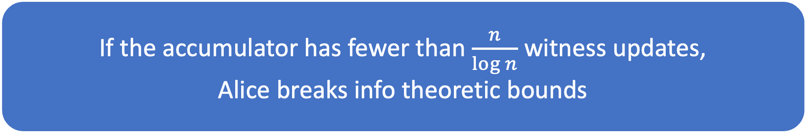
Proof sketch
If the accumulator has fewer than $\frac{n}{\log{n}}$ witness updates,
Alice breaks info theoretic bounds
Show by a compression argument:
uses an accumulator to encode some info
Alice
Bob

Slide 35


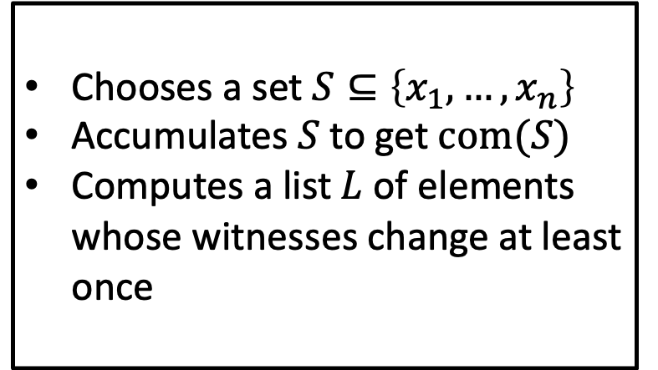
Proof sketch
What is $S$?
Alice
Bob
Chooses a set $S⊆\left\{x_{1},…, x_{n}\right\}$
Accumulates $S$ to get$com(S)$
Computes a list $L$ of elements whose witnesses change at least once
$$com\left(S\right), L$$

Slide 36
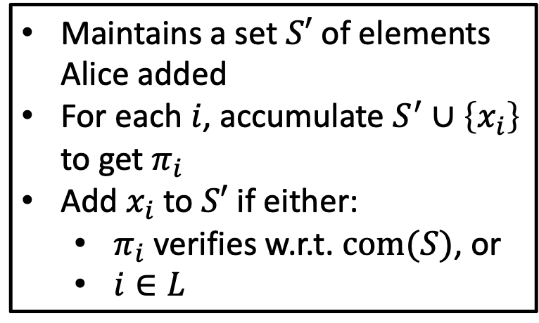
Proof sketch
What is $S$?
Alice
Bob
Chooses a set $S⊆\left\{x_{1},…, x_{n}\right\}$
Accumulates $S$ to get$com(S)$
Computes a list $L$ of elements whose witnesses change at least once
Maintains a set $S′$ of elements Alice added
For each $i$, accumulate $S^{′}∪\left\{x_{i}\right\}$ to get $π_{i}$
Add $x_{i}$ to $S′$ if either:
  $π_{i}$ verifies w.r.t. $com(S)$, or
  $i∈L$
$$com\left(S\right), L$$

Slide 37


What is $S$?
$$com\left(S\right), L$$
Alice
Bob
Soundness + completeness ⟹ Bob recovers $S$!
Communication:
Alice sends $\left|com\left(S\right)\right|+\left|L\right|≈\log{n}∗(\# witness changes)$ bits
and communicates $Ω(n)$ bits of info
⇨ (# witness changes) must be $Ω(\frac{n}{\log{n}})$

Slide 38
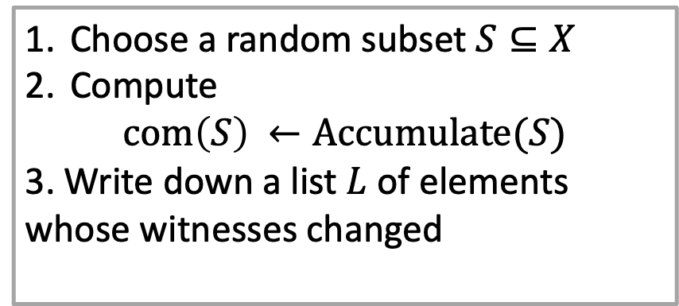
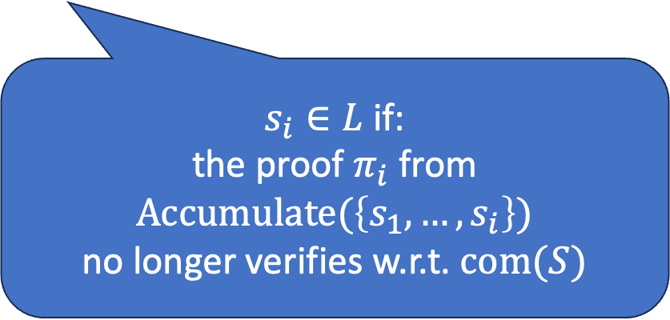


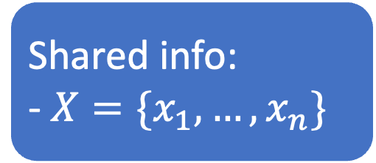
Shared info:
- $X=\{x_{1},…, x_{n}\}$
Choose a random subset $S⊆X$
Compute
$${com\left(S\right)}_{ }←Accumulate(S)$$
3. Write down a list $L$ of elements whose witnesses changed
$$com(S)$$
$$L$$
$s_{i}∈L$ if:
the proof $π_{i}$ from $Accumulate(\left\{s_{1}, …, s_{i}\right\})$
no longer verifies w.r.t. $com(S)$
Alice
Bob

Slide 39
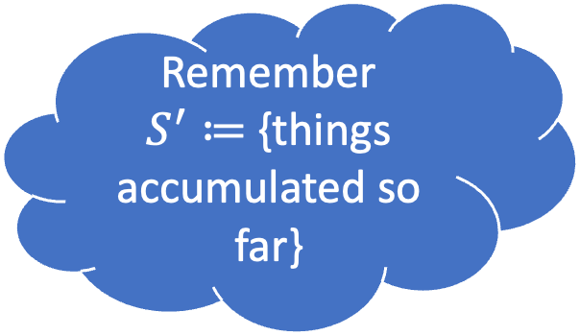


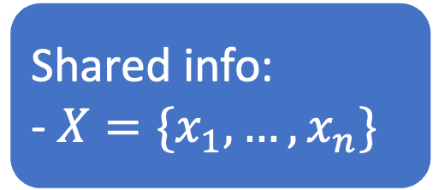
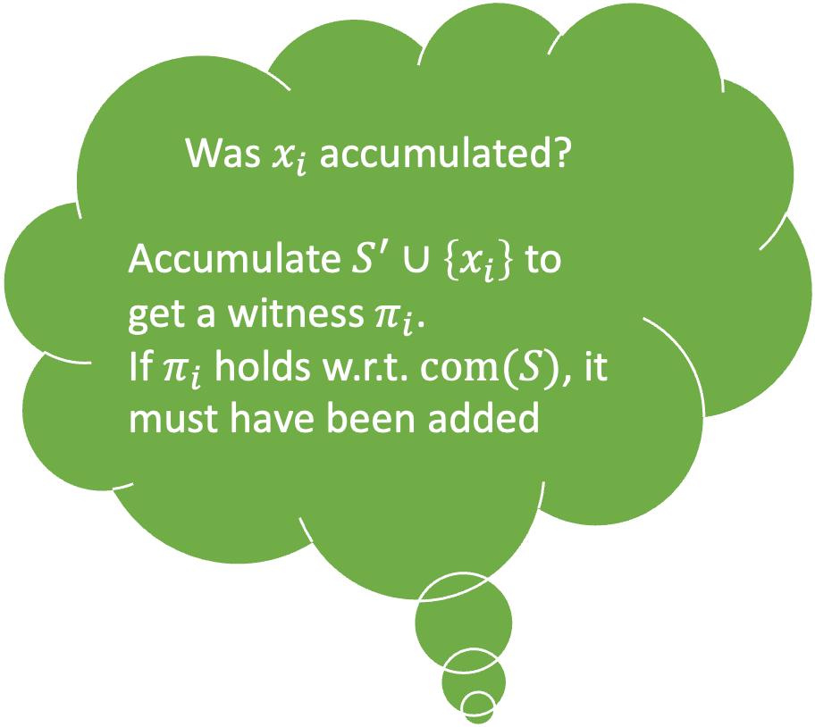
Was $x_{i}$ accumulated?
Accumulate $S^{′}∪\left\{x_{i}\right\}$ to get a witness $π_{i}$.
If $π_{i}$ holds w.r.t. $com(S)$, it must have been added
Shared info:
- $X=\{x_{1},…, x_{n}\}$
Choose a random subset $S⊆X$
Compute
$${com\left(S\right)}_{ }←Accumulate(S)$$
3. Write down a list $L$ of elements whose witnesses changed
$$com(S)$$
$$L$$
Remember
$S^{′}≔${things accumulated so far}
Alice
Bob

Slide 40

Was $x_{i}$ accumulated?
Accumulate $S^{′}∪\left\{x_{i}\right\}$ to get a witness $π_{i}$.
If $π_{i}$ holds w.r.t. $com(S)$, it must have been added
Shared info:
- $X=\{x_{1},…, x_{n}\}$
Choose a random subset $S⊆X$
Compute
$${com\left(S\right)}_{ }←Accumulate(S)$$
3. Write down a list $L$ of elements whose witnesses changed
$$com(S)$$
Problem: the witness of $x_{i}$ may have changed!
$$L$$
Remember
$S^{′}≔${things accumulated so far}
Alice
Bob

Slide 41

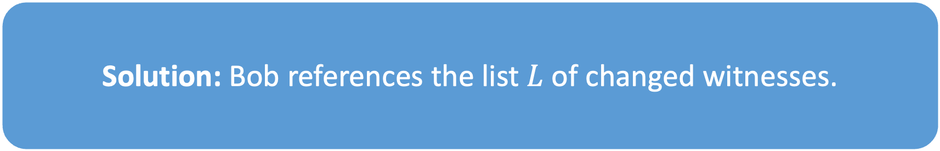
Was $x_{i}$ accumulated?
Accumulate $S^{′}∪\left\{x_{i}\right\}$ to get a witness $π_{i}$.
If $π_{i}$ holds w.r.t. $com(S)$, it must have been added
Shared info:
- $X=\{x_{1},…, x_{n}\}$
Choose a random subset $S⊆X$
Compute
$${com\left(S\right)}_{ }←Accumulate(S)$$
3. Write down a list $L$ of elements whose witnesses changed
$$com(S)$$
Problem: the witness of $x_{i}$ may have changed!
$$L$$
Remember
$S^{′}≔${things accumulated so far}
Solution: Bob references the list $L$ of changed witnesses.
Alice
Bob

Slide 42
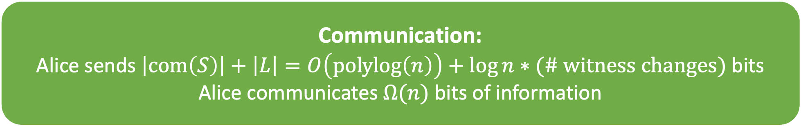
Proof sketch
High-level:
Bob accumulates elements one by one, checking if intermediate proofs still hold with end commitment.
Communication:
Alice sends $\left|com\left(S\right)\right|+\left|L\right|=O\left(polylog\left(n\right)\right)+\log{n}∗(\# witness changes)$ bits
Alice communicates $Ω(n)$ bits of information
⇨ (# witness changes) must be $Ω(\frac{n}{\log{n}})$

Slide 43


High-level:
Bob accumulates elements one by one, checking if intermediate proofs still hold with end commitment.
Shared info:
- $X=\{x_{1},…, x_{n}\}$
Let $S^{′}≔\{\}$
For each i:
Accumulate $S^{′}∪\{x_{i}\}$, get $π_{i}$
If $Verify\left({com\left(S\right), x_{i}, π}_{i}\right)→true:$
  Add $x_{i}$ to $S′$
If $x_{i}∈L$, add $x_{i}$ to $S′$
Choose a random subset $S⊆X$
Compute
$${com\left(S\right)}_{ }←Accumulate(S)$$
3. Write down a list $L$ of elements whose witnesses changed
$$com(S)$$
$$L$$
Communication:
Alice sends $\left|com\left(S\right)\right|+\left|L\right|=O\left(polylog\left(n\right)\right)+\log{n}∗(\# witness changes)$ bits
Alice
Bob

Slide 44
High-level:
Bob accumulates elements one by one, checking if intermediate proofs still hold with end commitment.
Shared info:
- $X=\{x_{1},…, x_{n}\}$
Let $S^{′}≔\{\}$
For each i:
Accumulate $S^{′}∪\{x_{i}\}$, get $π_{i}$
If $Verify\left({com\left(S\right), x_{i}, π}_{i}\right)→true:$
  Add $x_{i}$ to $S′$
If $x_{i}∈L$, add $x_{i}$ to $S′$
Choose a random subset $S⊆X$
Compute
$${com\left(S\right)}_{ }←Accumulate(S)$$
3. Write down a list $L$ of elements whose witnesses changed
$$com(S)$$
$$L$$
Alice
Bob

Slide 45
High-level:
Bob accumulates elements one by one, checking if intermediate proofs still hold with end commitment.
Shared info:
- $X=\{x_{1},…, x_{n}\}$
Let $S^{′}≔\{\}$
For each i:
Accumulate $S^{′}∪\{x_{i}\}$, get $π_{i}$
If $Verify\left({com\left(S\right), x_{i}, π}_{i}\right)→true:$
  Add $x_{i}$ to $S′$
If $x_{i}∈L$, add $x_{i}$ to $S′$
Choose a random subset $S⊆X$
Compute
$${com\left(S\right)}_{ }←Accumulate(S)$$
3. Write down a list $L$ of elements whose witnesses changed
$$com(S)$$
$$L$$
Communication:
Alice sends $\left|com\left(S\right)\right|+\left|L\right|=O\left(polylog\left(n\right)\right)+\log{n}∗(\# witness changes)$ bits
Alice
Bob

Slide 46
Proof sketch
We just saw:
“some witnesses change at least once”
Key technical challenge:
boost to “most witnesses change many times”

Slide 47

Key idea: iterate compression argument
In a nutshell:
Apply the argument we just saw to accumulating accumulators
⇨ each element participates in $ω(1)$ applications of the argument
⇨ must have $ω(1)$ witness changes
⇨ for subexponentially secure accumulators, can do $\log{n /\log{\log{n}}}$ applications of the argument
Very involved– see paper ☺

Slide 48

Thank you!
Merkle Mountain Ranges are essentially optimal:
Any accumulator with a succinct commitment has $ω(1)$ updates per witness.
https://ia.cr/2025/234

