Slide 1
Combining Outputs of a Random Permutation:
New Constructions and Tight Security Bounds by Fourier Analysis
Itai Dinur
Ben-Gurion University and Georgetown University
Eurocrypt 2025

Slide 2
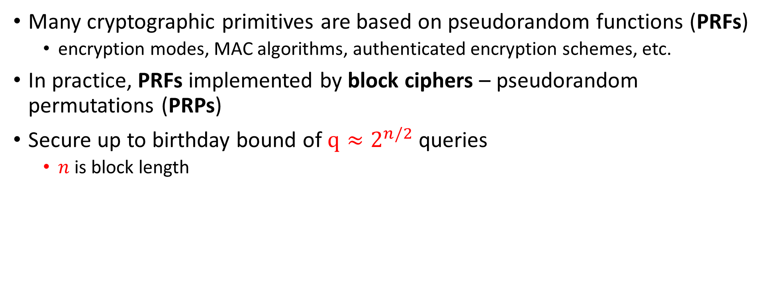
Birthday Bound Security
Many cryptographic primitives are based on pseudorandom functions (PRFs)
  encryption modes, MAC algorithms, authenticated encryption schemes, etc.
In practice, PRFs implemented by block ciphers – pseudorandom permutations (PRPs)
Secure up to birthday bound of $q≈2^{n/2}$ queries
  $n$ is block length

Slide 3

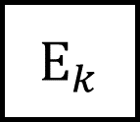
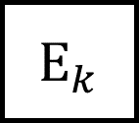
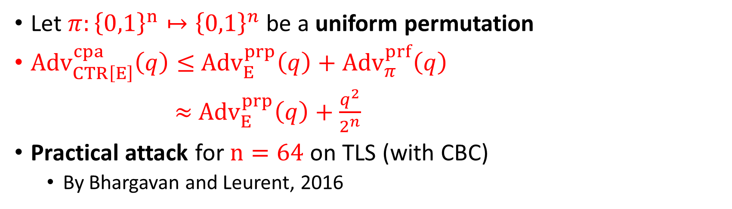






Example – Counter Mode
$ctr$
$ctr+1$
$E_{k}$
$E_{k}$
$$…$$
$$m_{1}$$
⊕
$$m_{2}$$
⊕
$c_{1}$
$c_{2}$
Let $π:{\left\{0,1\right\}}^{n}↦{\left\{0,1\right\}}^{n}$ be a uniform permutation
${Adv}_{CTR\left[E\right]}^{cpa}\left(q\right)≤$ ${Adv}_{E}^{prp}\left(q\right)+$ ${Adv}_{π}^{prf}\left(q\right)$
$≈$ ${Adv}_{E}^{prp}\left(q\right)+\frac{q^{2}}{2^{n}}$
Practical attack for $n=64$ on TLS (with CBC)
  By Bhargavan and Leurent, 2016

Slide 4

Beyond Birthday Bound Security
Goal of beyond birthday bound security:
Design efficient PRF using PRPs that is secure for $q≫2^{n/2}$
  “Luby-Rackoff backwards”

Slide 5
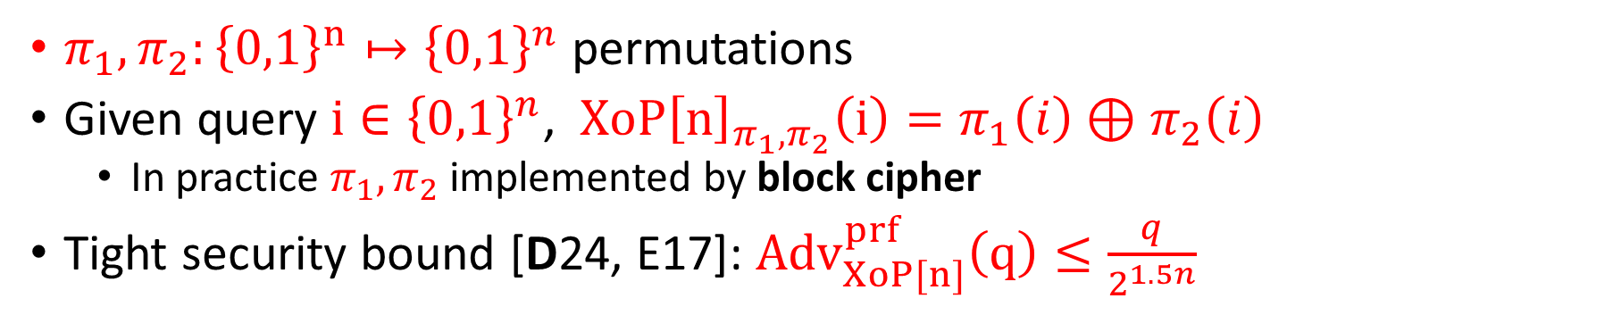




XoP (XOR of Permutations)
$π_{1},π_{2}:{\left\{0,1\right\}}^{n}↦{\left\{0,1\right\}}^{n}$ permutations
Given query $i∈{\left\{0,1\right\}}^{n}$, $XoP{\left[n\right]}_{π_{1},π_{2}}\left(i\right)=π_{1}\left(i\right)⊕π_{2}\left(i\right)$
  In practice $π_{1},π_{2}$ implemented by block cipher
Tight security bound [D24, E17]: ${Adv}_{XoP[n]}^{prf}\left(q\right)≤\frac{q}{2^{1.5n}}$
$i$
$$π_{1}(i)$$
$π_{2}(i)$
⊕
$$XoP{\left[n\right]}_{π_{1},π_{2}}\left(i\right)$$

Slide 6
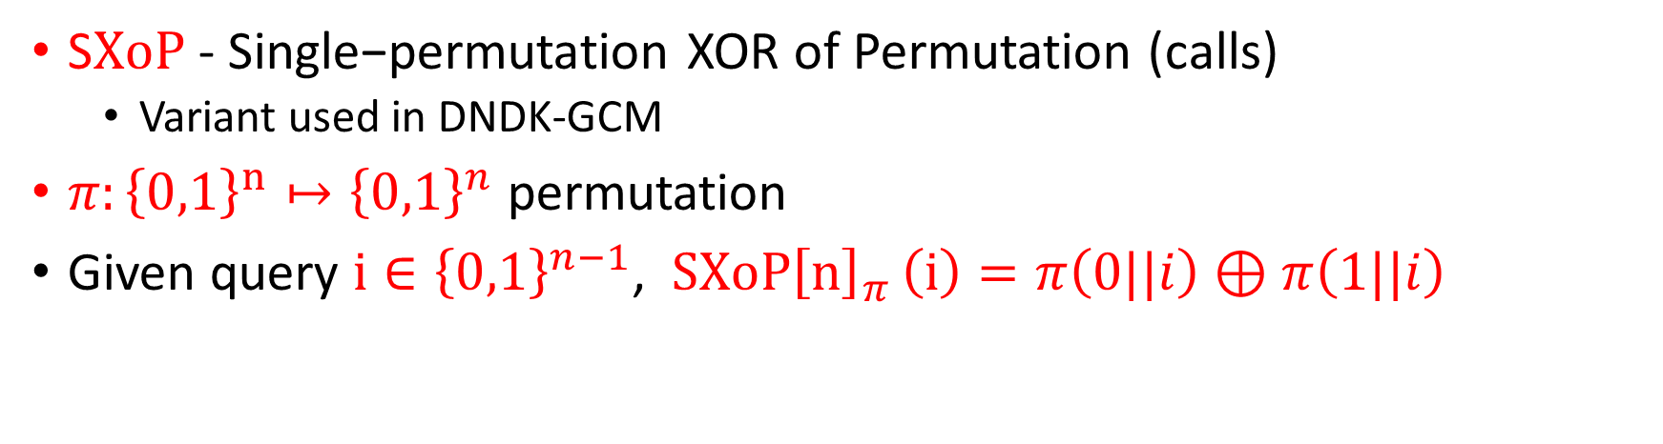



SXoP
$\text{S}XoP$- Single−permutation XOR of Permutation (calls)
  Variant used in DNDK-GCM
$π:{\left\{0,1\right\}}^{n}↦{\left\{0,1\right\}}^{n}$ permutation
Given query $i∈{\left\{0,1\right\}}^{n−1}$, $SXoP{\left[n\right]}_{π }\left(i\right)=π\left(0||i\right)⊕π\left(1||i\right)$
$i$
$$π(0||i)$$
$$π(1||i)$$
⊕
$$XoP{\left[n\right]}_{π }\left(i\right)$$
Notes:
DNDK - Double Nonce Derive Key AES-GCM

Slide 7
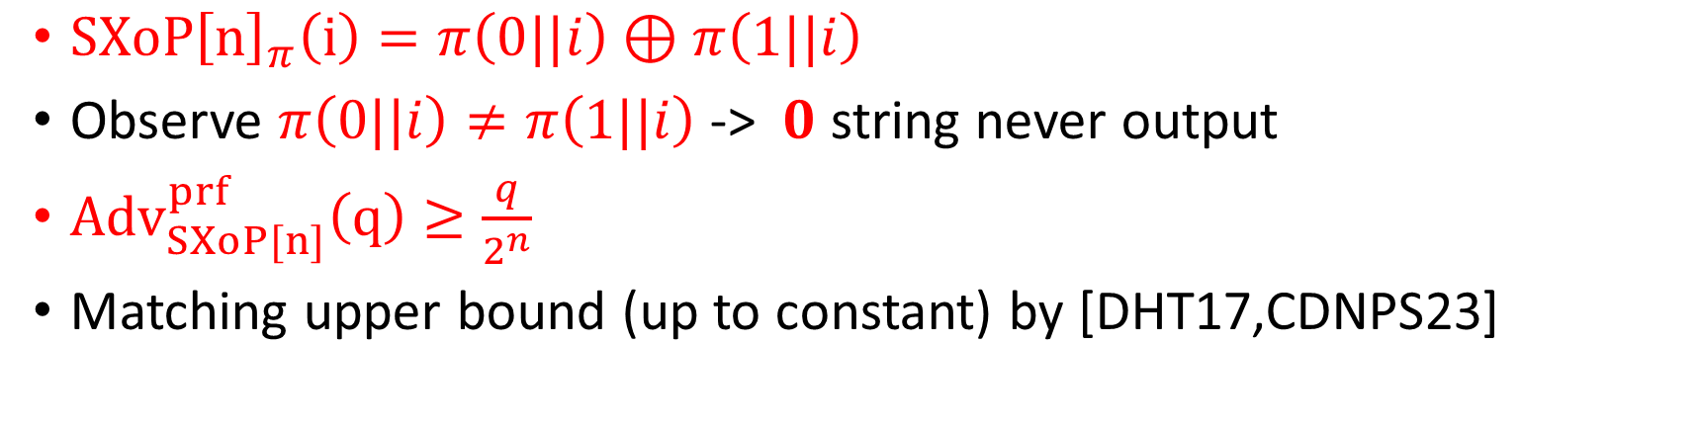
SXoP- Security Analysis
$SXoP{\left[n\right]}_{π}\left(i\right)=π\left(0||i\right)⊕π\left(1||i\right)$
Observe $π\left(0||i\right)≠π\left(1||i\right)$-> $0$ string never output
${Adv}_{SXoP[n]}^{prf}\left(q\right)≥\frac{q}{2^{n}}$
Matching upper bound (up to constant) by [DHT17,CDNPS23]
$i$
$$π(0||i)$$
$$π(1||i)$$
⊕
$$XoP{\left[n\right]}_{π }\left(i\right)$$
Notes:
Even thought it’s well-known, the variant that I’ll describe is not used in practice as far as I know
DNDK - Double Nonce Derive Key AES-GCM

Slide 8

XoP VS. SXoP
Recall:
  ${Adv}_{XoP[n]}^{prf}\left(q\right)=\frac{q}{2^{1.5n}}$
  ${Adv}_{SXoP[n]}^{prf}\left(q\right)=\frac{q}{2^{n}}$
However, $XoP$ requires 2 independent permutations
  In practice implemented by block cipher with 2 independent keys

Slide 9
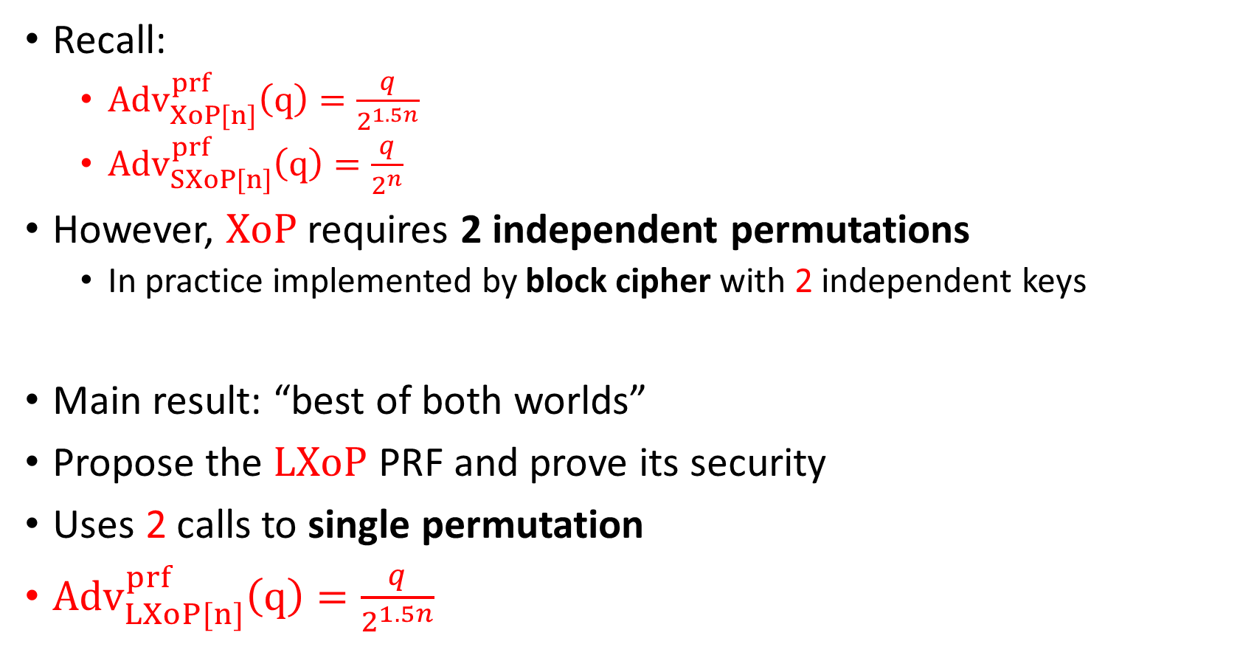
Main Result
Recall:
  ${Adv}_{XoP[n]}^{prf}\left(q\right)=\frac{q}{2^{1.5n}}$
  ${Adv}_{SXoP[n]}^{prf}\left(q\right)=\frac{q}{2^{n}}$
However, $XoP$ requires 2 independent permutations
  In practice implemented by block cipher with 2 independent keys
Main result: “best of both worlds”
Propose the $LXoP$ PRF and prove its security
Uses 2 calls to single permutation
${Adv}_{LXoP[n]}^{prf}\left(q\right)=\frac{q}{2^{1.5n}}$

Slide 10

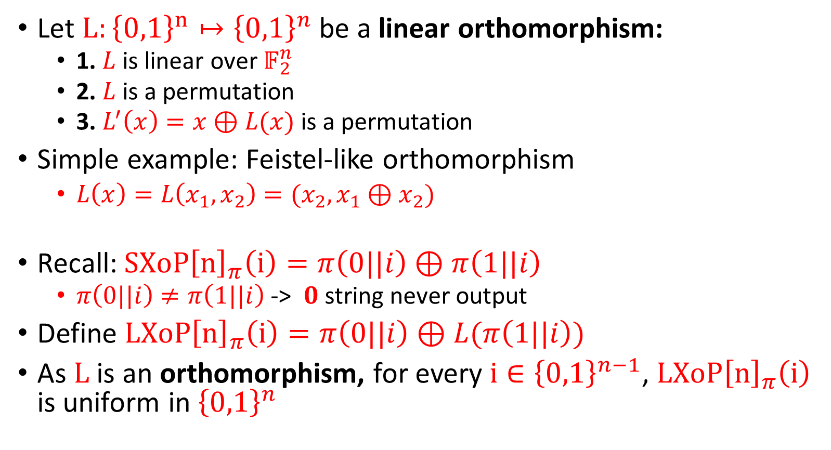




LXoP
Let $L:{\left\{0,1\right\}}^{n}↦{\left\{0,1\right\}}^{n}$ be a linear orthomorphism:
  1. $L$ is linear over $𝔽_{2}^{n}$
  2. $L$ is a permutation
  3. $L^{′}\left(x\right)=x⊕L(x)$is a permutation
Simple example: Feistel-like orthomorphism
  $L\left(x\right)=L\left(x_{1},x_{2}\right)=(x_{2},x_{1}⊕x_{2})$
Recall: $SXoP{\left[n\right]}_{π}\left(i\right)=π\left(0||i\right)⊕π\left(1||i\right)$
  $π\left(0||i\right)≠π\left(1||i\right)$-> $0$ string never output
Define $LXoP{\left[n\right]}_{π}\left(i\right)=π\left(0||i\right)⊕L(π\left(1||i\right))$
As $L$ is an orthomorphism, for every $i∈{\left\{0,1\right\}}^{n−1}$, $LXoP{\left[n\right]}_{π}\left(i\right)$ is uniform in ${\left\{0,1\right\}}^{n}$
$i$
$$π(0||i)$$
$$π(1||i)$$
$$L$$
⊕
$$LXoP{\left[n\right]}_{π}\left(i\right)$$

Slide 11







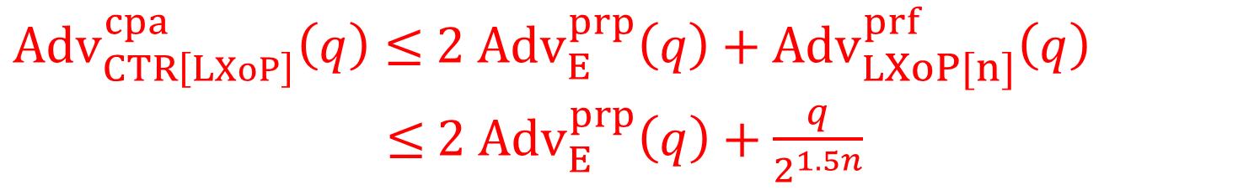










Example – LXoP-Based Counter Mode
$ctr$
$$ctr+1$$
$$0||ctr$$
$$1||ctr$$
$0||ctr+1$
$1||ctr+1$
$E_{k}$
$$E_{k}$$
$E_{k}$
$$E_{k}$$
$$…$$
$$L$$
$$L$$
⊕
⊕
$$m_{1}$$
⊕
$$m_{2}$$
⊕
$c_{1}$
$c_{2}$
${Adv}_{CTR\left[LXoP\right]}^{cpa}\left(q\right)≤$ ${2 Adv}_{E}^{prp}\left(q\right)+$ ${Adv}_{LXoP[n]}^{prf}\left(q\right)$
$≤$ ${2 Adv}_{E}^{prp}\left(q\right)+\frac{q}{2^{1.5n}}$

Slide 12
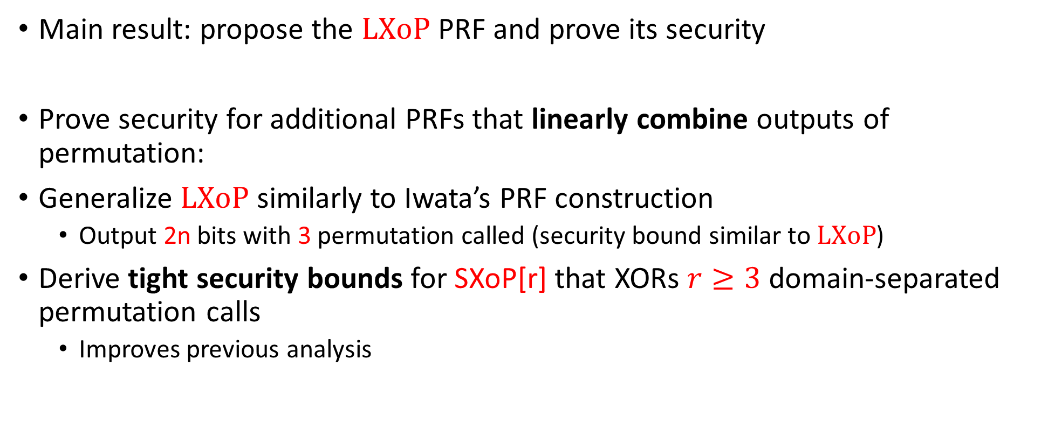
Additional Results
Main result: propose the $LXoP$ PRF and prove its security
Prove security for additional PRFs that linearly combine outputs of permutation:
Generalize $LXoP$ similarly to Iwata’s PRF construction
  Output 2n bits with 3 permutation called (security bound similar to $LXoP$)
Derive tight security bounds for SXoP[r] that XORs $r≥3$ domain-separated permutation calls
  Improves previous analysis

Slide 13
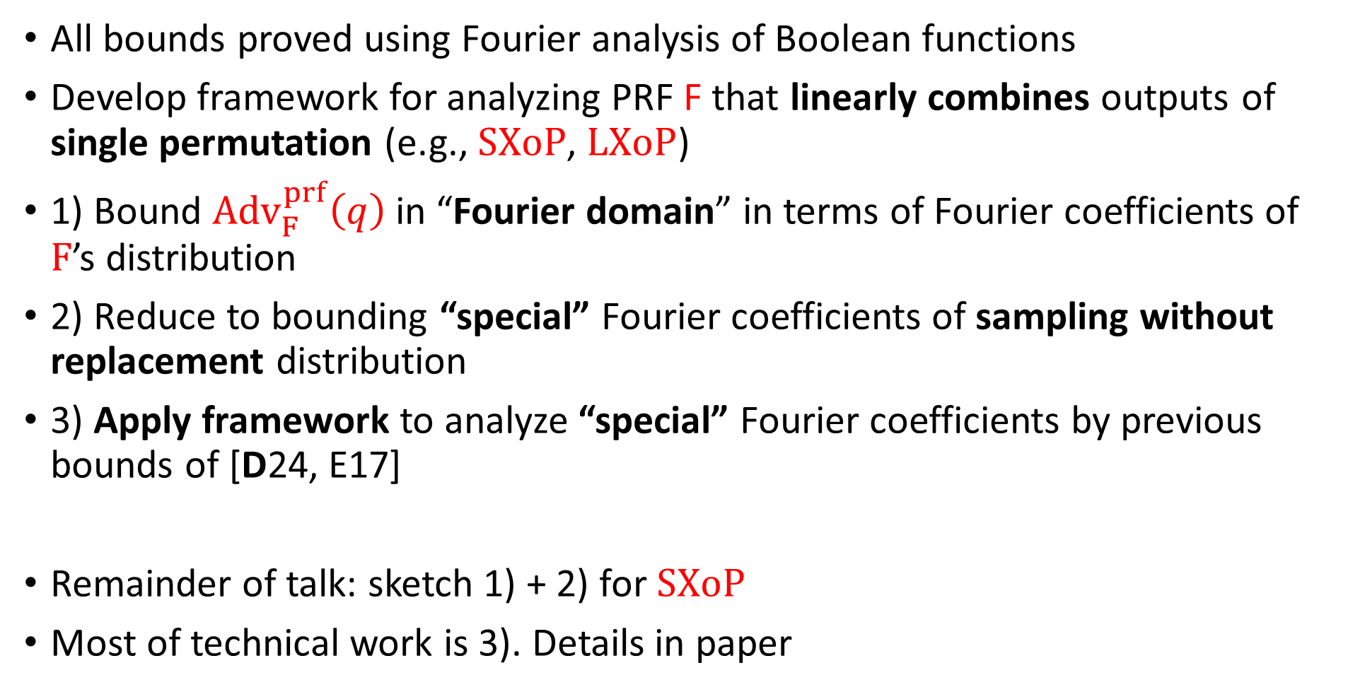
Security Proof Technique
All bounds proved using Fourier analysis of Boolean functions
Develop framework for analyzing PRF F that linearly combines outputs of single permutation (e.g., $SXoP$, $LXoP$)
1) Bound ${Adv}_{F}^{prf}\left(q\right)$ in “Fourier domain” in terms of Fourier coefficients of $F$’s distribution
2) Reduce to bounding “special” Fourier coefficients of sampling without replacement distribution
3) Apply framework to analyze “special” Fourier coefficients by previous bounds of [D24, E17]
Remainder of talk: sketch 1) + 2) for $SXoP$
Most of technical work is 3). Details in paper

Slide 14
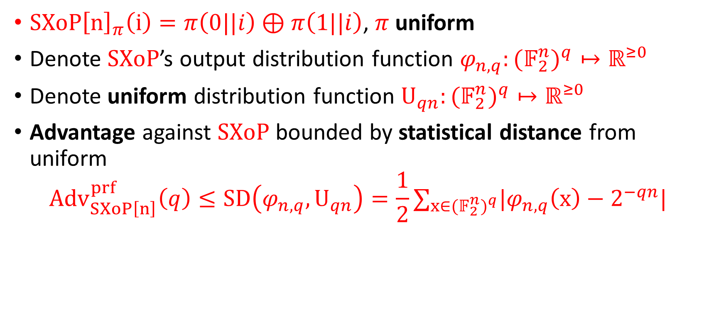
Bound by Statistical Distance
$SXoP{\left[n\right]}_{π}\left(i\right)=π\left(0||i\right)⊕π\left(1||i\right)$, $π$ uniform
Denote $SXoP$’s output distribution function $φ_{n,q}:{{(𝔽}_{2}^{n})}^{q}↦ℝ^{≥0}$
Denote uniform distribution function $U_{qn}:{{(𝔽}_{2}^{n})}^{q}↦ℝ^{≥0}$
Advantage against $SXoP$ bounded by statistical distance from uniform
$${Adv}_{SXoP\left[n\right]}^{prf}\left(q\right)≤SD\left(φ_{n,q},U_{qn}\right)=\frac{1}{2}∑_{x∈{{(𝔽}_{2}^{n})}^{q}}|φ_{n,q}\left(x\right)−2^{−qn}|$$

Slide 15
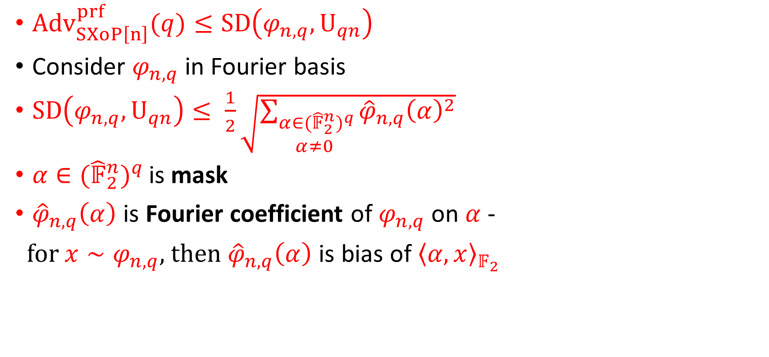
Fourier Analysis
${Adv}_{SXoP\left[n\right]}^{prf}(q)≤SD\left(φ_{n,q},U_{qn}\right)$
Consider $φ_{n,q}$ in Fourier basis
$SD\left(φ_{n,q},U_{qn}\right)≤ \frac{1}{2}\sqrt{\sum_{\begin{aligned}α∈{{(\hat{𝔽}}_{2}^{n})}^{q} \\ α≠0 \end{aligned}}{{\hat{φ}}_{n,q}{\left(α\right)}^{2}}}$
$α∈{{(\hat{𝔽}}_{2}^{n})}^{q }$is mask
${\hat{φ}}_{n,q}\left(α\right)$ is Fourier coefficient of $φ_{n,q}$ on $α$ -
for $x∼φ_{n,q}$, then ${\hat{φ}}_{n,q}\left(α\right)$ is bias of${ \left\langle α,x\right\rangle }_{𝔽_{2}}$
Notes:
Consider all linear expressions over the qn bits of the sample and sum their bias squared

Slide 16
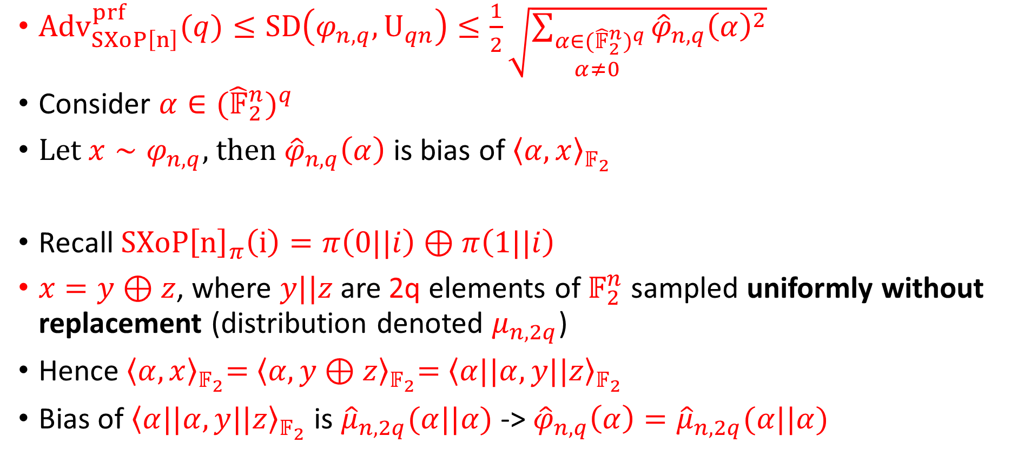
Reducing to Analysis of Sampling Without Replacement
${Adv}_{SXoP\left[n\right]}^{prf}(q)≤SD\left(φ_{n,q},U_{qn}\right)≤\frac{1}{2}\sqrt{\sum_{\begin{aligned}α∈{{(\hat{𝔽}}_{2}^{n})}^{q} \\ α≠0 \end{aligned}}{{\hat{φ}}_{n,q}{\left(α\right)}^{2}}}$
Consider $α∈{{(\hat{𝔽}}_{2}^{n})}^{q}$
Let $x∼φ_{n,q}$, then ${\hat{φ}}_{n,q}\left(α\right)$ is bias of${ \left\langle α,x\right\rangle }_{𝔽_{2}}$
Recall $SXoP{\left[n\right]}_{π}\left(i\right)=π\left(0||i\right)⊕π\left(1||i\right)$
$x=y⊕z$, where $y||z$are 2q elements of $𝔽_{2}^{n}$ sampled uniformly without replacement (distribution denoted $μ_{n,2q}$)
Hence${ \left\langle α,x\right\rangle }_{𝔽_{2}}={ \left\langle α,y⊕z\right\rangle }_{𝔽_{2}}={ \left\langle α||α,y||z\right\rangle }_{𝔽_{2}}$
Bias of ${\left\langle α||α,y||z\right\rangle }_{𝔽_{2}}$ is ${\hat{μ}}_{n,2q}(α||α)$ -> ${\hat{φ}}_{n,q}\left(α\right)={\hat{μ}}_{n,2q}(α||α)$

Slide 17
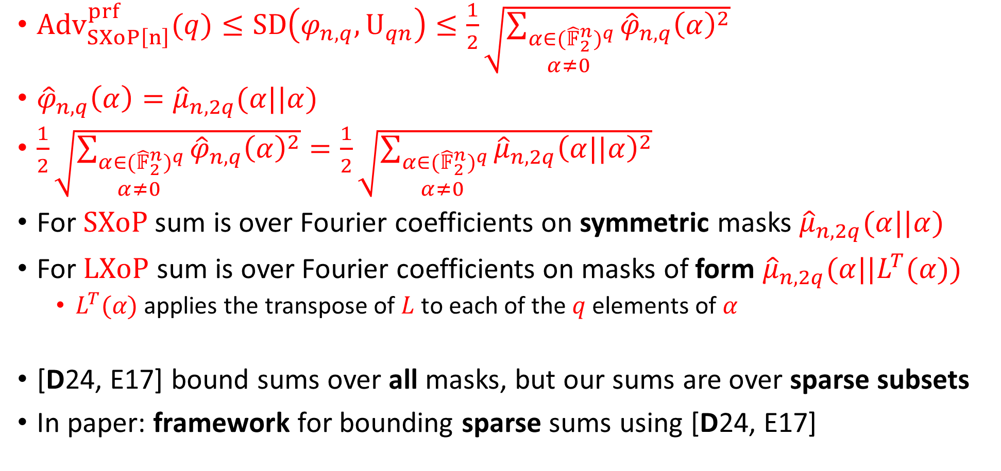
Reducing to Analysis of Sampling Without Replacement
${Adv}_{SXoP\left[n\right]}^{prf}(q)≤SD\left(φ_{n,q},U_{qn}\right)≤\frac{1}{2}\sqrt{\sum_{\begin{aligned}α∈{{(\hat{𝔽}}_{2}^{n})}^{q} \\ α≠0 \end{aligned}}{{\hat{φ}}_{n,q}{\left(α\right)}^{2}}}$
${\hat{φ}}_{n,q}\left(α\right)={\hat{μ}}_{n,2q}(α||α)$
$\frac{1}{2}\sqrt{\sum_{\begin{aligned}α∈{{(\hat{𝔽}}_{2}^{n})}^{q} \\ α≠0 \end{aligned}}{{\hat{φ}}_{n,q}{\left(α\right)}^{2}}}=\frac{1}{2}\sqrt{\sum_{\begin{aligned}α∈{{(\hat{𝔽}}_{2}^{n})}^{q} \\ α≠0 \end{aligned}}{{\hat{μ}}_{n,2q}{\left(α||α\right)}^{2}}}$
For $SXoP$sum is over Fourier coefficients on symmetric masks ${\hat{μ}}_{n,2q}(α||α)$
For $LXoP$ sum is over Fourier coefficients on masks of form ${\hat{μ}}_{n,2q}(α||L^{T}(α))$
  $L^{T}(α)$ applies the transpose of $L$ to each of the $q$ elements of $α$
[D24, E17] bound sums over all masks, but our sums are over sparse subsets
In paper: framework for bounding sparse sums using [D24, E17]
Notes:
We reduced the problem of analyzing SXoP to analyzing the distribution of sampling without replacement.

Slide 18
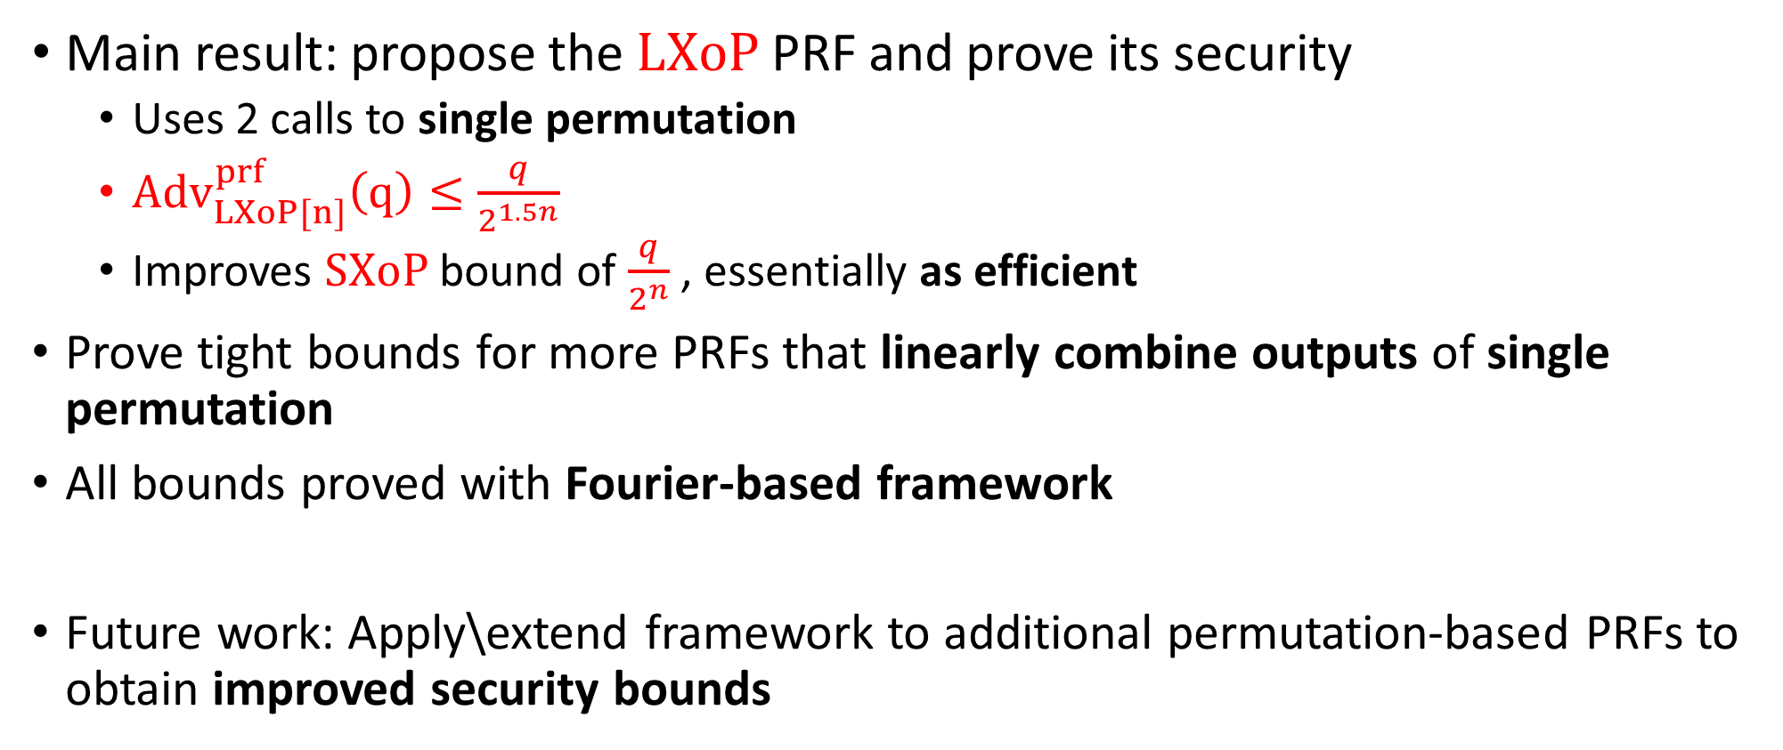
Conclusions and Future Work
Main result: propose the $LXoP$ PRF and prove its security
  Uses 2 calls to single permutation
  ${Adv}_{LXoP[n]}^{prf}\left(q\right)≤\frac{q}{2^{1.5n}}$
  Improves $SXoP$ bound of $\frac{q}{2^{n}}$ , essentially as efficient
Prove tight bounds for more PRFs that linearly combine outputs of single permutation
All bounds proved with Fourier-based framework
Future work: Apply\extend framework to additional permutation-based PRFs to obtain improved security bounds

Slide 19
Thanks for your attention!
Notes:
19

