Slide 1
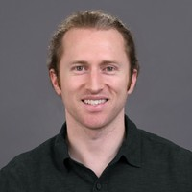
Good Things Come To Those Who Wait: Dishonest Majority Beacons imply Delay Functions
Miranda Christ
Columbia University
Joseph Bonneau
NYU, a16z Crypto
Benedikt Bünz
NYU
Yuval Efron
Columbia University
Thanks Yuval for some of the slides ☺

Slide 2
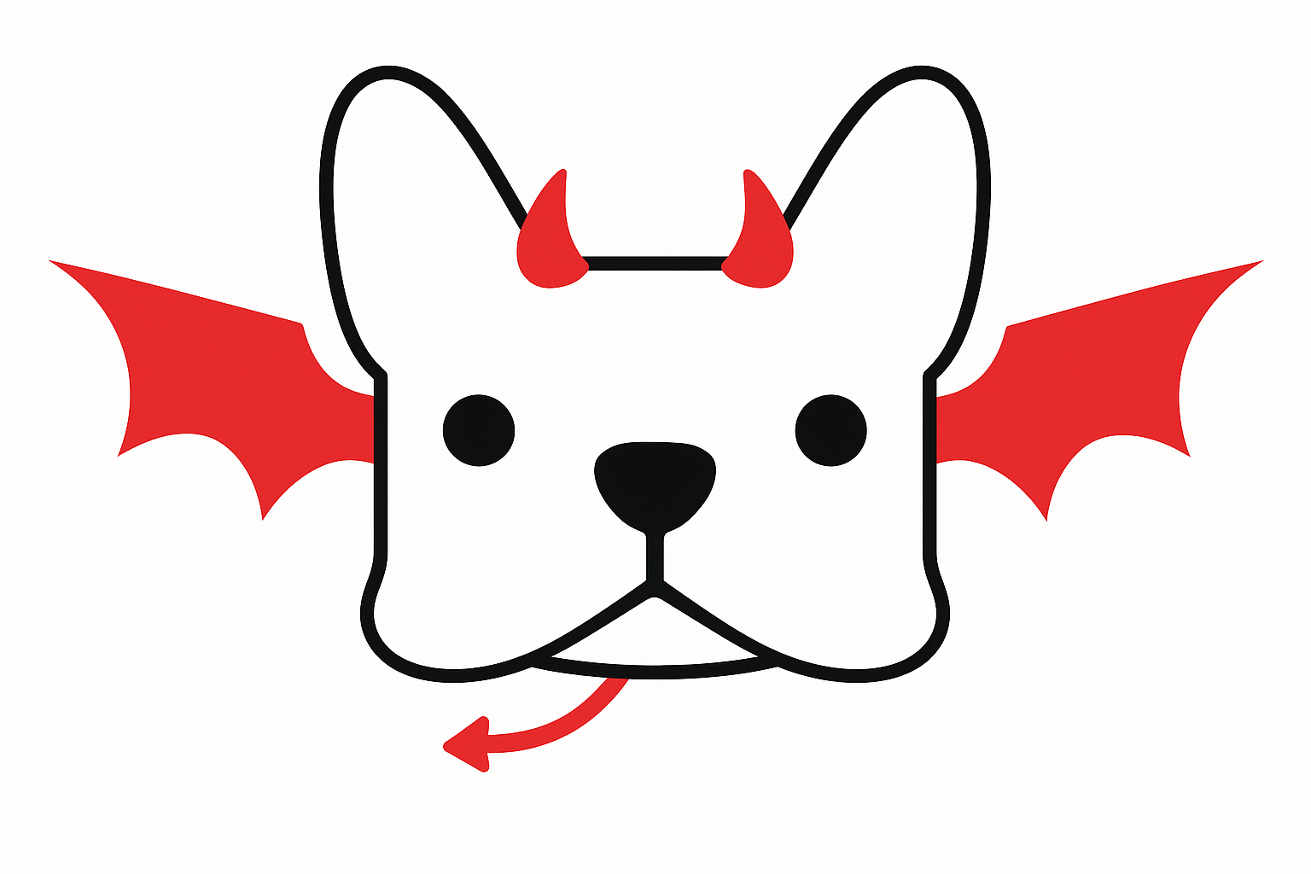
Alice and Bob want to agree on a random value
Coin flipping

Slide 3
First attempt
$$r_{A}←_{\$}\{0,1\}^{ }$$
$$r_{B}←_{\$}{\left\{0,1\right\}}^{ }$$
$$r_{A}⊕r_{B}$$

Slide 4
Second attempt
$${Commit(r}_{A})$$
$${Commit(r}_{B})$$
$$r_{A}$$

Slide 5
Cleve, STOC ‘86
A two-party coin-flipping protocol $Π$ is an interaction between Alice and Bob such that:
Honest parties always terminate and output some $b∈\{0,1\}$.
Honest parties agree on the output with decent probability.
Theorem: any two-party coin-flipping protocol can be non-negligibly* biased by a dishonest party.
*Amount of bias depends on the agreement probability and number of rounds.

Slide 6
Coin flipping- History
Significant amount of work since the 80s: [Blum 83][Luby, Micali, Rackoff 83][Dolev, Broder 84][Ben-Or, Linial 85][Canetti, Rabin 93] [Schoenmakers 99]
Work in dishonest majority setting focuses on minimizing bias
Newer blockchain-motivated work:
[Lenstra, Wesolowski 15][Cascudo, David 17] [Gilad, Hemo, Micali, Vlachos, Zeldovich 17][Qian 17][Kiayias, Russell, David, Oliynykov 17] [Azouvi, McCorry, Meiklejohn 18] [David, Gazi, Kiayias, Russell 18] [Schindler, Stifter, Weippl 20][Christ, Choi, Bonneau 24]
“Distributed randomness beacons”
Some have negligible bias, even with a dishonest supermajority
🤨

Slide 7
Example: Unicorn DRB [Lenstra, Wesolowski 2015]
Contribution $r_{i}$
$$R=H(r1 \left\|…\right\|r_{N})$$
Result $Ω=H(Eval\left(R\right))$
Broadcast Channel/
Public Bulletin
Negligible bias if any user is honest
Secure because nobody has time to compute $Eval$ before choosing their randomness.
$N$ users
Notes:
Unicorn doesn’t even cite Cleve!

Slide 8
Our question
All known dishonest-majority randomness beacons use time-based crypto.
VDFs: Unicorn [LW15], Randrunner [SJH+21], HeadStart [LSW+22], Bicorn [CATB23], Cornucopia [CCB24]
TLPs: [EFKP20], [ARS24]
What is the minimal object needed to circumvent Cleve?
Theorem: dishonest-majority beacons and delay functions are equivalent.

Slide 9
Our question
Theorem: dishonest-majority beacons and delay functions are equivalent.
Opening up Cleve’s proof
Amplification lemma
Dishonest-majority beacon
Weak delay function
Delay function
Essentially Unicorn

Slide 10
Dishonest-majority protocol $⇒$ weak delay function

Slide 11
Delay Functions
Heuristic example: $Eval\left(x\right)=H\left(H\left(…H\left(H\left(x\right)\right)\right)\right)$ for a hash function $H$.
A $t(⋅)$-delay function consists of algorithms $(Setup, SampleInput, Eval)$:
$Setup\left(1^{λ}\right)→pp$
$SampleInput\left(pp, 1^{λ}\right)→x∈{\left\{0,1\right\}}^{λ}$
$Eval\left(pp, 1^{λ},x\right)→y∈{\left\{0,1\right\}}^{λ}$
Properties:
Efficiency: $Eval$ is polynomial-time computable.
Sequentiality: No adversary running in fewer than $t(λ)$ sequential steps (eq. parallel time) can produce $y$ given $pp$ and $x$, except with negligible probability.
$q(⋅)$-Weak Sequentiality: Same as above, but can predict with at most probability $1 −1/q(λ)$.

Slide 12
Cleve’s Impossibility
Let’s bias an $r$-round protocol to output $b$.
💡Use the fact that honest parties must output a value.
Alice’s attack idea:
In each round, check if aborting would make the honest party output $b$.
Any problems?
$$
$$
.
.
.
.
.
.
Alice
Bob

Slide 13
Cleve’s Impossibility
Abort now, or send a message first?
Let’s make an $r$-round protocol output 1.
Alice can ask:
What default value would I output if Bob aborted?
Define $2r$ strategies for Alice.
In strategy $(i, b)$ for $i∈\left[r\right], b∈\{0,1\}$:
If Alice’s default value in round $i$ is $b$, abort.
Else, abort in round $i+1$.
.
.
.
Round $i$
Alice
Bob

Slide 14
Cleve’s Impossibility
Abort now, or send a message first?
Define $2r$ strategies for Alice.
In strategy $(i, b)$ for $i∈\left[r\right], b∈\{0,1\}$:
If Alice’s default value in round $i$ is $b$, abort.
Else, abort in round $i+1$.
Can define analogous strategies for Bob.
.
.
.
Round $i$
Alice
Bob
Theorem [Cleve86]: At least one of these strategies induces a bias of $≥\frac{ε}{4r+1}$.

Slide 15
Circumventing Cleve’s Impossibility
Theorem [Cleve86]: At least one of these strategies induces a bias of $≥\frac{ε}{4r+1}$.
$$⇓$$
For protocols avoiding Cleve’s attack, it must be infeasible to carry out this strategy.

Slide 16
Building a (weak) Delay Function
$Setup\left(1^{λ}\right):$ Compute the winning round $i$ and bit $b$.
$SampleInput\left(1^{λ}, i, b\right):$ Simulate both parties up to round $i$. Output transcript $tr$ and Alice’s internal state $s$.
$Eval\left(i, b, tr, s\right):$ Output whether Alice should abort immediately or after sending her message.
Any $t(λ)$-bounded adversary fails with non-negl. probability
$⇒$ this is a weak delay function!

Slide 17
Building a (weak) Delay Function
Suppose we have a dishonest-majority protocol that is unbiasable by adversaries of depth $t(λ)$.
Any adversary computing the “should I abort now or later?” function must fail with non-negl. probability.
💡Use this to build a delay function!

Slide 18
Weak $⇒$ “strong” delay function

Slide 19
Weak to “Strong” Delay Function
So far: Weak delay function $DF$
Goal: Amplify weak delay function to strong delay function.
Natural idea: $DF^{′}\left(x_{1},…,x_{ℓ}\right)=\left(DF\left(x_{1}\right),…,DF\left(x_{ℓ}\right)\right)$
Claim: $DF′$ is a Delay Function?
💡Adapt proof of amplification of weak OWF => strong OWF
Problem: the reduction must know when the OWF is correctly inverted
––analogously, must know when the delay function is correctly computed

Slide 20
Verifiability
Solution: make the delay function verifiable in low depth.
Challenge: this seems to require fancy cryptography?
💡Use high (but still polynomial) width.
💡Modify $DF′(x)$ to additionally output the values of the wires of its circuit on input $x$.
Can now adapt proof of weak => strong OWF.
Note: this verifiability is not efficient enough to yield a VDF.

Slide 21
Weak to “Strong” Delay Function
Natural idea: $DF^{′}\left(x_{1},…,x_{ℓ}\right)=\left(DF\left(x_{1}\right),…,DF\left(x_{ℓ}\right)\right)$
Claim: $DF′$ is a Delay Function.
Suppose $A^{′}\left(x_{1},…,x_{ℓ}\right)→\left(DF\left(x_{1}\right),…,DF\left(x_{ℓ}\right)\right)$ with non-negl. probability.
Can we use $A′$ to break weak unpredictability of $DF$?
Intuition: there must be some $i$ such that if we fix $x_{i}$ and choose random $x_{j}$’s, $A′$ predicts $DF(x_{i})$ with non-negl. prob. over the $x_{j}$’s.
Call this $A_{i}^{′}$; simply run $A_{i}^{′}$ with new $x_{j}$’s until it succeeds.
Problem: we can’t tell when $A′$ succeeds.
Output is too long to take a majority vote.

Slide 22
Delay function to DRB

Slide 23
Dishonest Majority DRB From Delay Function
Adapt Unicorn protocol.
Slight challenge: ensure Unicorn works with our weaker notion of a delay function.

Slide 24
Why bounded-depth adversaries?
In practice, powerful attackers can get more computers $→$ more parallelism.
Computations requiring size $s$ may be sped up arbitrarily.
But computations requiring depth $t$ cannot be sped up easily.
Bandwidth problems can be cured with money. Latency problems are harder because the speed of light is fixed--you can't bribe God.
(Attributed to David Clark, paraphrased)

Slide 25
Why not bound some other resource?
Weak to strong amplification fails.
Resource must be limited during protocol, but available after the protocol.

Slide 26
Thank you!
Theorem: dishonest-majority beacons against bounded-depth adversaries and delay functions are equivalent.
Dishonest-majority beacon
Weak delay function
Delay function
https://eprint.iacr.org/2024/1711

