Slide 1



Instance Compression, Revisited
Gal Arnon Shany Ben-David Eylon Yogev
Notes:
Say thank you at the beginning, and repeat the name and paper name
Talk fluently
Make more focus on succinctness and
Add 3 minutes to the introduction
Look at the audience most of the time
Export pdf
Take a clicker
***************************************************
Wait between slides, or repeat the same words.
Say what we saw and what we will see next.
Questions:
Why not defining completeness error such that it is hard to find bad randomness?
We get good results in information theoretic setting
And this is an interesting theoretical question

Slide 2

Notes:
CRHs are extremely powerful and widely used in cryptography,
One of the major open problems in cryptography is constructing CRH from the minimal assumption that OWFs exists.
In this talk we are going to focus on one promising path for achieving this goal

Slide 3

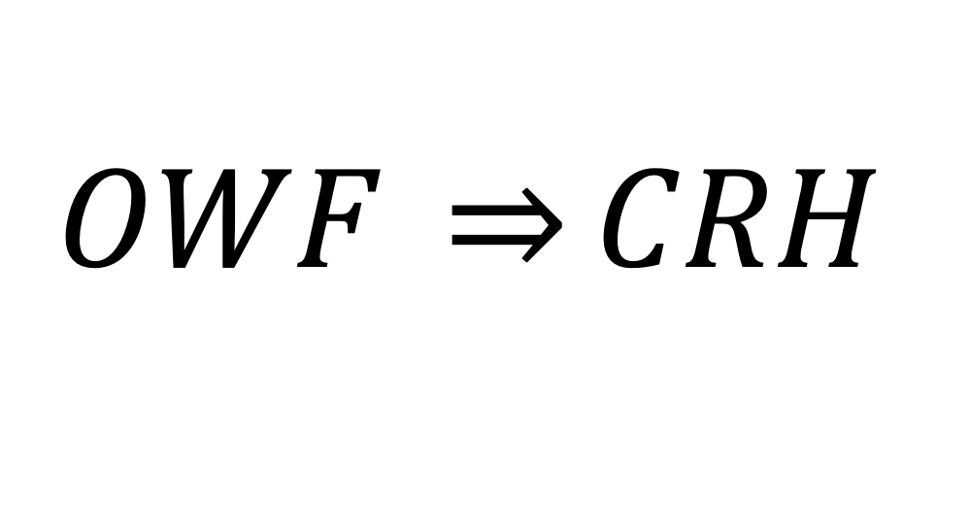
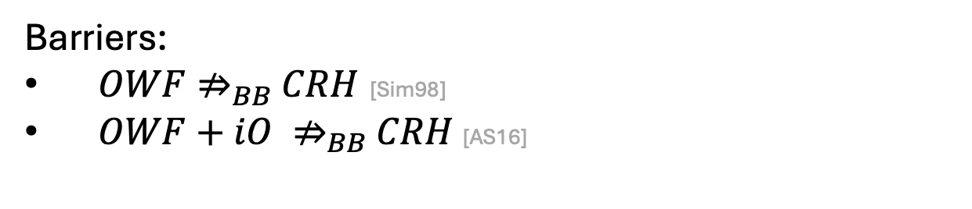
$$OWF \underset{⇒}{}CRH$$
Barriers:
$OWF⇏_{BB}$ $CRH$ [Sim98]
$OWF+iO ⇏_{BB}$ $CRH$[AS16]
Notes:
One way to frame this question is through Impagliazzo’s Five Worlds.
Impagliazzo described five hypothetical worlds, each corresponding to different assumptions in complexity theory and cryptography.
One of these worlds is Minicrypt, a world where OWFs exist
Thus, we can ask: If the real world is in Minicrypt, do CRHs exist?
Despite decades of research, no construction of collision-resistant hash functions (CRHs) from one-way functions (OWFs) is known. In fact, strong barriers indicate that any such construction would likely require non-black-box techniques.
The first black-box separation result was given by Simons in 1998.
Later, Asharov and Segev generalized these results, showing that even with powerful primitives like indistinguishability obfuscation (iO), it is impossible to construct CRHs using black-box methods.
One promising path toward addressing this problem, proposed by Harnik and Naor, involves instance compression.
In this talk, we will focus on this approach.

Slide 4














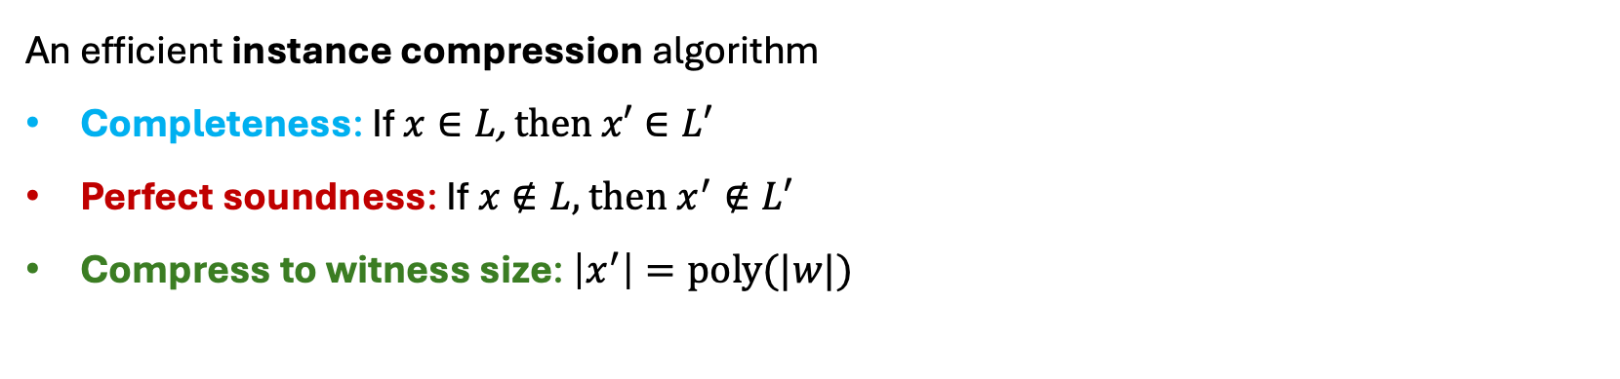



Instance Compression (IC) - for NP
[Harnik-Naor 06]
An efficient instance compression algorithm
Completeness: If $x∈L$, then $x′∈L′$
Perfect soundness: If $x∉L$, then $x^{′}∉L′$
Compress to witness size: $\left|x^{′}\right|=poly(|w|)$
$$IC$$
$$L⇒L′$$
$$IC$$
$$x$$
$$x′$$
No IC for NP!!
$${|x}^{′}|≪|x|$$
$$OWF+ IC { ⇒}_{NBB}CRH$$
$$\left[HN06\right]$$
$$x$$
$$x׳$$
$$L$$
$$L′$$
$$\overline{L}$$
$$x′$$
$$\overline{L′}$$
$$x$$
$$IC \text{for} \text{NP} ⇒ \text{PH} \text{collapses}$$
$$\left[FS08\right]$$
Notes:
Instance compression from an NP language L to another language L′ refers to a polynomial-time algorithm that, given an input instance x, compresses it into a new instance x′ while preserving the correctness relative to the language.
Formally…..
The goal is for x′ to be much smaller than x, and in particular, we want the x’ to be polynomial in the witness size. This compression parameter becomes meaningful in relations where instances are very large but witnesses are small.
For the compression parameter, we want the new instance to be significantly smaller than the original instance size, and specifically we aim to get new instance of size polynomial in the witness size. This compression target seems to strike a reasonable balance, it is not overly ambitious, and yet meaningful for relations where the instance is much larger than the witness. Note that we would not expect to compress too much, as if we compress too aggressively — say, to a single bit — we effectively decide the language, which is believed to be impossible for NP-complete problems..
*** conflicts ETH ***
We will encounter several definitions of instance compression. In all of them, we will maintain perfect completeness; the main variations will appear in the definition of soundness.
stronger version of IC – witness retrieval

Slide 5



$$OWF+ IC { ⇒}_{NBB}CRH$$
Does there a weaker version of IC that
is strong enough for CRH
exists under cryptographic assumptions
Notes:
We know that OWF+IC implies CRH using NBB techniques, which means that this bypass impossibility results.
In this work, we ask the question, does there exist a version of IC that is both strong enough for constructing CRH and exists under cryptographic assumoption.
Hopefully putting a milestone to get CRH from OWFs.
So the focus is going to be finding the right IC definition.
The first definition we had in mind that is weaker than IC and is enough for the HN construction is CIC with strong soundness

Slide 6









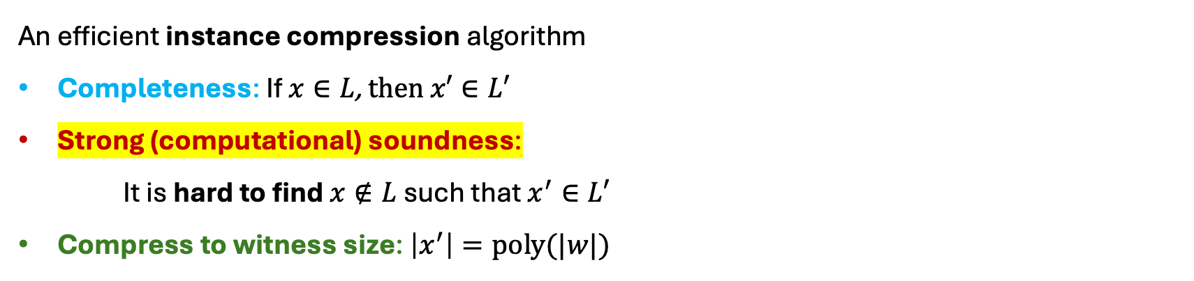




Computational Instance Compression (CIC)
An efficient instance compression algorithm
Completeness: If $x∈L$, then $x′∈L′$
Strong (computational) soundness:
It is hard to find $x∉L$such that $x^{′}∈L′$
Compress to witness size: $\left|x^{′}\right|=poly(|w|)$
$$IC$$
No CIC with strong soundness for NP!!
$$L⇒L′$$
$${IC}_{crs}$$
$$x$$
$$x′$$
$$\text{Theorem} \text{1}$$
If there exists CIC with strong soundness then PH collapses.
$${|x}^{′}|≪|x|$$
$$x$$
$$x׳$$
$$L$$
$$L′$$
$$\overline{L}$$
$$x′$$
$$\overline{L′}$$
$$x$$
Notes:
Computational instance compression with strong soundness from an NP language $L$
to $L^{′}$is a polynomial-time algorithm A that compresses instances
***The natural thing****
In this definition the compression algorithm uses CRS
For completeness, ….
For soundness, we say that given the CRS, it is computationally hard to find instance x that is such that the new instance x’ is not in the language
In other words, while there may exist instances not in L that are mapped to instances in L’, finding such instances is computationally hard.
The compression parameter stays the same, we want the new instance to be of size that is proportional to the witness size.

Slide 7














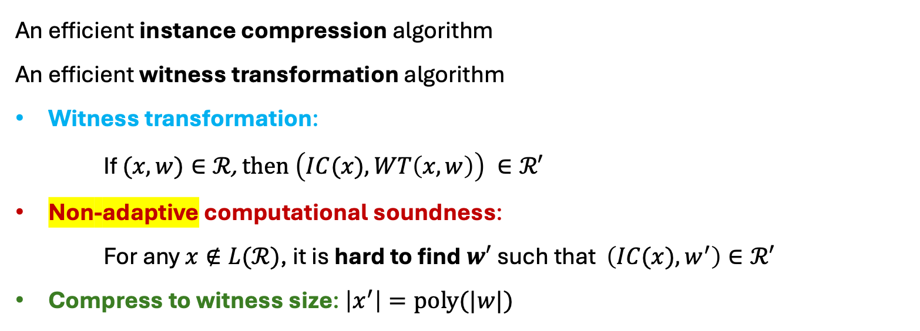



CIC with Witness Transformation
[Bronfman-Rothblum 22]
An efficient instance compression algorithm
An efficient witness transformation algorithm
Witness transformation:
If $(x,w)∈ℛ$, then $\left(IC(x),WT\left(x,w\right)\right) ∈ℛ′$
Non-adaptive computational soundness:
For any $x∉L(ℛ)$, it is hard to find $w′$ such that $\left(IC(x),w^{′}\right)∈ℛ′$
Compress to witness size: $\left|x^{′}\right|=poly(|w|)$
$$IC$$
$$ℛ ⇒ℛ′$$
$$WT$$
$$x$$
$${IC}_{crs}$$
$$x′$$
Not strong enough for CRH
$$(x,w)$$
$$WT_{crs}$$
$$w′$$
$${|x}^{′}|≪|x|$$
[BR22]: non-adaptive CIC from standard assumptions
$$x$$
$$x׳$$
$$L$$
$$L′$$
$$\overline{L}$$
$$x′$$
$$\overline{L′}$$
$$x$$
Notes:
Before this work, In 2022, BR defined computational instance compression from an NP relation R to a relation R’, shifting the focus from languages to relations.
In this setting, there are two algorithms: one that compresses the instance, and another, called the witness transformation (WT), that transforms witnesses.
The witness transformation takes x,w and outputs a new witness w’
As before, for completeness, we want that if x is in R than x’ is in R’. Additionally, we require that if x,w are in the relation, than the WT algorithm outputs a valid witness for the new instance x’.
For soundness we require that if x was not in the language, than it is computationally hard to find a wintness to the new instance. In particular, even if x is not in L and x’ is in L, it is computationally hard to find a witness for x’. Importantly, we do not require a "correct" mapping of instances — it is possible that instances are always mapped into L′; the key point is that finding a valid witness should be computationally hard when starting from an invalid x.
Overall, for completeness it is easy to find a correct witness to the new instance, and for soundness it is computationally hard.
This computational soundness is only non-adaptive, which means that security guarantee is for instances that are chosen independently of the CRS sampled.

Slide 8
Instance compression
[HN06]
[FS08]
PH collapses
CIC with
strong soundness
[Thm 1]
?
Collision resistant hash
Standard assumptions
via non-adaptive succinct PCA
Non-adaptive CIC
[BR22]
Notes:
BR also proved that non adaptive CIC can be constructed from standard assumptions by going through an object called succinct PCA, which is essentially PCP with computational security requiremenet. Both the PCA and the CIC defined has non-adpative soundness.
This deifnition is weak enough to exist under standard assumtions, but it is not clear how to construct CRH using this definition. With a closer look it seems that CRH needs an adaptive security notion.

Slide 9
CIC with Witness Transformation
[Bronfman-Rothblum 22]
An efficient instance compression algorithm
An efficient witness transformation algorithm
Witness transformation:
If $(x,w)∈ℛ$, then $\left(IC(x),WT\left(x,w\right)\right) ∈ℛ′$
Non-adaptive computational soundness:
For any $x∉L(ℛ)$, it is hard to find $w′$ such that $\left(IC(x),w^{′}\right)∈ℛ′$
Compress to witness size: $\left|x^{′}\right|=poly(|w|)$
$$IC$$
$$ℛ ⇒ℛ′$$
$$WT$$
$$x$$
$${IC}_{crs}$$
$$x′$$
$$(x,w)$$
$$WT_{crs}$$
$$w′$$
$${|x}^{′}|≪|x|$$
$$x$$
$$x׳$$
$$L$$
$$L′$$
$$\overline{L}$$
$$x′$$
$$\overline{L′}$$
$$x$$
Notes:
Before this work, In 2022, BR defined computational instance compression from an NP relation R to a relation R’, shifting the focus from languages to relations.
In this setting, there are two algorithms: one that compresses the instance, and another, called the witness transformation (WT), that transforms witnesses.
The witness transformation takes x,w and outputs a new witness w’
As before, for completeness, we want that if x is in R than x’ is in R’. Additionally, we require that if x,w are in the relation, than the WT algorithm outputs a valid witness for the new instance x’.
For soundness we require that if x was not in the language, than it is computationally hard to find a wintness to the new instance. In particular, even if x is not in L and x’ is in L, it is computationally hard to find a witness for x’. Importantly, we do not require a "correct" mapping of instances — it is possible that instances are always mapped into L′; the key point is that finding a valid witness should be computationally hard when starting from an invalid x.
Overall, for completeness it is easy to find a correct witness to the new instance, and for soundness it is computationally hard.
This computational soundness is only non-adaptive, which means that security guarantee is for instances that are chosen independently of the CRS sampled.

Slide 10


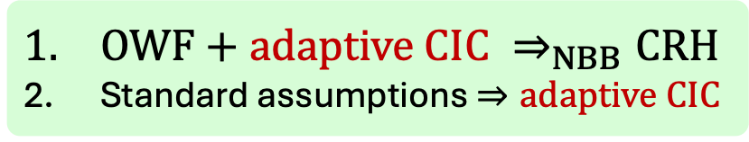
CIC with Witness Transformation
[Our work]
An efficient instance compression algorithm
An efficient witness transformation algorithm
Witness transformation:
If $(x,w)∈ℛ$, then $\left(IC(x),WT\left(x,w\right)\right) ∈ℛ′$
Adaptive computational soundness:
It is hard to find $(x,w^{′})$ such that $x∉L(ℛ)$ a$nd \left(IC(x),w^{′}\right)∈ℛ′$
Compress to witness size: $\left|x^{′}\right|=poly(|w|)$
$$IC$$
$$ℛ ⇒ℛ′$$
$$WT$$
$$x$$
$${IC}_{crs}$$
$$x′$$
Strong enough for CRH
&
Follows from standard assumptions!!!
$$(x,w)$$
$$WT_{crs}$$
$$w′$$
$${|x}^{′}|≪|x|$$
$$\text{Theorem}\text{ 2}$$
$$x$$
$$x׳$$
$$L$$
$$L′$$
$OWF+adaptive CIC ⇒_{NBB}CRH$
Standard assumptions$⇒adaptive CIC$
$$\overline{L′}$$
$$\overline{L}$$
$$x′$$
$$x$$
Notes:
In this work we defined CIC with adaptive soundness. This definition is the same as the BR CIC definition we just saw, only that the soundness holds even if the instance is chosen adaptively according to the CRS.
As part of the second main result of this work, we show that this strengthening — moving from non-adaptive to adaptive soundness — is sufficient for constructing collision-resistant hash functions (CRHs).
Specifically, we prove that: $OWF+adaptive CIC { ⇒}_{NBB}CRH$
In fact, the same CRH construction original proposed by HN, works with this relatively weak computational notion,
Thus, the main technical effort in our proof was devoted to carefully analyzing the construction under this new setting.
And finally, we also show that adaptive CIC isn't just enough — it's actually necessary for CRHs.
Meaning, if you already have a CRH, you can build adaptive CIC from it.
So in a sense, adaptive CIC and CRHs go hand-in-hand.

Slide 11

Instance compression
[HN06]
[FS08]
PH collapses
CIC with
strong soundness
[Thm 1]
SNARG
[WW24b]
$$iO$$
+ reOWF/Lossy
Pre-processing SNARG
[WW24,WZ24]
Adaptive CIC
[Thm 2]
Collision resistant hash
[Ben24]
Standard assumptions
via adaptive succinct PCA
via non-adaptive succinct PCA
Non-adaptive CIC
[BR22]
Notes:
We recognized the right IC notion for constructing CRH, now lets see what are the assumptions required for aCIC

Slide 12

Instance compression
[HN06]
[FS08]
$$OWF$$
$$(+iO)$$
PH collapses
CIC with
strong soundness
[Thm 1]
SNARG
[WW24b]
$$iO$$
+ reOWF/Lossy
Pre-processing SNARG
[WW24,WZ24]
Adaptive CIC
[Thm 2]
Collision resistant hash
[Ben24]
Standard assumptions
via adaptive succinct PCA
via non-adaptive succinct PCA
Non-adaptive CIC
[BR22]
Notes:
Recall the impossibility results we have for CRH from iO+OWF, so the additional assumptions kind of inherent. then a new works shows how to construct SNARG solely from iO. The missing part here is that this SNARG is not preprocessing.
Summup
So we have that adaptive CIC+OWF implies CRH using the NBB techniques used in HN, and we also know that CRH implies aCIC.
And we know that adaptive CIC exists under standard assumptions. The question of constructing adative CIC from io+OWF is left open.
At this point we got greedy and asked the question ”what else can we get from adaptive CIC”? What new paths that seems possible with IC can be possible with aCIC?
One other results HN had is using IC with additional property called WR to get OT and PKE. Simple IC does not exists, let alone IC with WR. So we ask the question, can we get aCIC with WR?

Slide 13


Instance compression
[HN06]
$$\left[HN06\right]$$
[FS08]
$$OWF+ {IC}^{+}⇒PKE$$
PH collapses
CIC with
strong soundness
[Thm 1]
?
Adaptive CIC
[Thm 2]
Collision resistant hash
[Ben24]
Standard assumptions
via adaptive succinct PCA
via non-adaptive succinct PCA
Non-adaptive CIC
[BR22]

Slide 14
Instance compression
[HN06]
$$\left[HN06\right]$$
[FS08]
$$OWF+ {IC}^{+}⇒PKE$$
PH collapses
CIC with
strong soundness
[Thm 1]
CIC with
witness retrieval
Adaptive CIC
[Thm 2]
Collision resistant hash
[Ben24]
Standard assumptions
via adaptive succinct PCA
via non-adaptive succinct PCA
Non-adaptive CIC
[BR22]

Slide 15






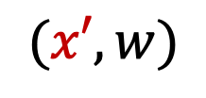

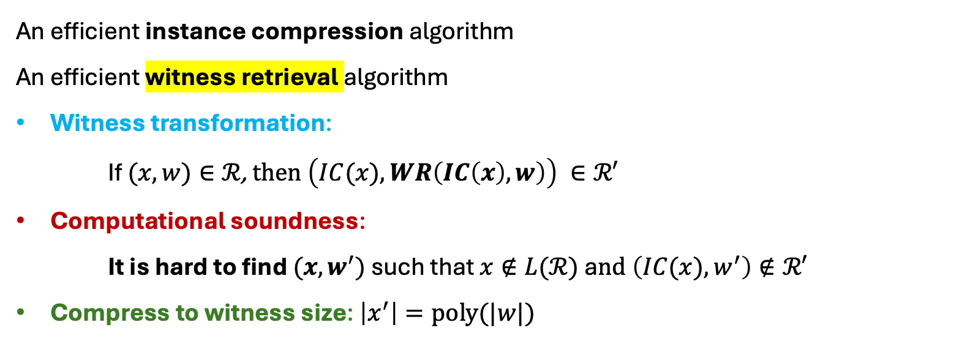


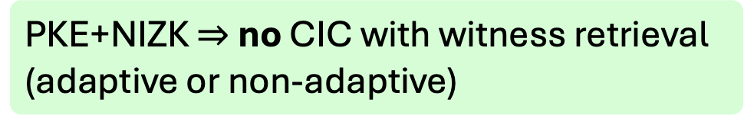
CIC with Witness Retrieval
An efficient instance compression algorithm
An efficient witness retrieval algorithm
Witness transformation:
If $(x,w)∈ℛ$, then $\left(IC(x),WR\left(IC\left(x\right),w\right)\right) ∈ℛ′$
Computational soundness:
It is hard to find $(x,w^{′})$ such that $x∉L(ℛ)$ a$nd \left(IC(x),w^{′}\right)∉ℛ′$
Compress to witness size: $\left|x^{′}\right|=poly(|w|)$
$$IC$$
$$ℛ ⇒ℛ′$$
$$WR$$
$$x$$
$${IC}_{crs}$$
$$x′$$
$$(x′,w)$$
$$WR_{crs}$$
$$w′$$
$$\text{Theorem}\text{ 3}$$
PKE+NIZK $⇒$ no CIC with witness retrieval
(adaptive or non-adaptive)

Slide 16
Instance compression
[HN06]
Summary
New definition of CIC
Use it to construct CRH from OWF
Stronger notions are not likely to exist
Main Open Problem
Construct (adaptive) CIC from OWF
[FS08]
PH collapses
CIC with
strong soundness
[Thm 1]
CIC with
witness retrieval
[Thm 3]
Incompressible PKE
PKE
contradicts
(+NIZK)
[GWZ22]
Adaptive CIC
[Thm 2]
Collision resistant hash
[Ben24]
Standard assumptions
via adaptive succinct PCA
via non-adaptive succinct PCA
Non-adaptive CIC
[BR22]
Notes:
Guan Whics Zhandry

Slide 17
Thank You!
CIC

