Slide 1
Snake-eye Resistant PKE from LWE for
Oblivious Message Retrieval and
Robust Encryption
Zeyu Liu
^{Yale University}
Katerina Sotiraki
^{Yale University}
Eran Tromer
^{Boston University}
Yunhao Wang
^{Yale University}

Slide 2
Agenda
Motivation
Define Snake-eye Resistance of PKE
Prove PVW is Snake-eye Resistant
LWEmongrass PKE Scheme
Applications to Oblivious Message Retrieval and Robust Encryption

Slide 3
OMR detection service
Anonymous message delivery
Recipient
Other recipients:
Decrypt to 1 with negligible probability
Not receive this message
Sender
Bulletin
Board
Trial decrypt
the CT’s
Payload₁ | CT₁
Payload₂ | CT₂
Payload₃ | CT₃
... | …
Payload_{N-1} | CT_{N-1}
Spamming:
Alway possible against a single recipient
Recipient
Trial decrypt
the CT’s
Generate
Payload_{N}
……
Obtained via PIR
Payload_{N}
Enc(1)
Enc(1)
Payload_{N}
Recipient
Trial decrypt
the CT’s
PKE.pk
Notes:
adjust distance

Slide 4
OMR detection service
Anonymous message delivery
Recipient
Other recipients:
Decrypt to 1 with negligible probability
Not receive this message
Bulletin
Board
Trial decrypt
the CT’s
Payload₁ | CT₁
Payload₂ | CT₂
Payload₃ | CT₃
... | …
Payload_{N-1} | CT_{N-1}
Spamming:
Alway possible against a single recipient
But can it get worse?
Recipient
Trial decrypt
the CT’s
Generate
Payload_{N}
……
Obtained via PIR
Payload_{N}
Enc(1)
Enc(1)
Payload_{N}
Yes!
Recipient
Trial decrypt
the CT’s
PKE.pk
Notes:
adjust distance

Slide 5
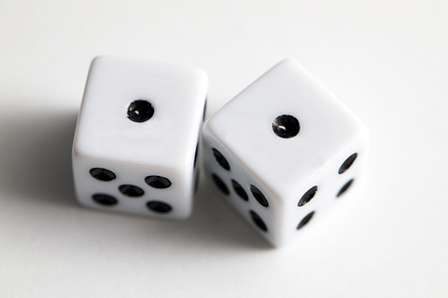
Amplified spamming attack
Why bad?
Cheap way to spam
- In some applications like in blockchains, spamming should be expensive
Cost recipients more resources
- Need to download & decrypt the payloads
Even worse
- Cause overflows in OMR
Recipient
Sender
Bulletin
Board
All recipients:
Decrypt to 1 with high probability
Retrieve and process this message
Trial decrypt
the CT’s
Payload₁ | CT₁
Payload₂ | CT₂
Payload₃ | CT₃
... | …
Payload_{N-1} | CT_{N-1}
Payload_{M}
Recipient
Trial decrypt
the CT’s
Generate
Payload_{M}
……
Payload_{M}
CT_{M}
Payload_{M}
CT_{M}
Recipient
How to prevent?
Make such CT impossible to generate
Snake-eye resistance property of PKE
Trial decrypt
the CT’s
Payload_{M}
Notes:
adjust distance

Slide 6
Agenda
Motivation
Define Snake-eye Resistance of PKE
Prove PVW is Snake-eye Resistant
LWEmongrass PKE Scheme
Applications to Oblivious Message Retrieval and Robust Encryption

Slide 7
δ-Snake-eye Resistance of PKE
PKE.KeyGen
sk₁
PKE.Dec
m
pk₁
ct
pk₂
PKE.KeyGen
sk₂
PKE.Dec
m
The adversary wins the game if the decryption lands to the same message.
This happens with probability δ + negl
Not directly implied standard notions like semantic security or key privacy.
Some PKE schemes are trivially snake-eye resistant (e.g., PKE with decryption being key-injective)
How about the lattice-based ones?
They are (1) post-quantum secure; (2) an important field; (3) much more suitable for OMR

Slide 8
PVW Encryption [PVW07], needed for OMR [LT22]
decryption:
PVW Public-Key Encryption for ℓ bits [PVW07]
Work over Z_{t}
a₁ | a₂ | a₃ | ... | a_{n}
a₁ | a₂ | a₃ | ... | a_{n}
PVW ciphertext
b₁ | ... | b_{ℓ}
b
inner product with
+
b
b₁
s¹₁ | s¹₂ | s¹₃ | ... | s¹_{n}
}
PVW secret key
s₁ | s₂ | s₃ | ... | s_{n}
...
ℓ
s₁ | s₂ | s₃ | ... | s_{n}
s¹₁ | s¹₂ | s¹₃ | ... | s¹_{n}
s^{ℓ}₁ | s^{ℓ}₂ | s^{ℓ}₃ | ... | s^{ℓ}_{n}
u₁ | u₂ | u₃ | ... | u_{ℓ}
A
B
PVW public key:
LWE samples
Plaintexts:
Range check:
0 if u_{i} ∈ [-β, β]
1 if u_{i} ∈ t/2 + [-β, β]
⊥ otherwise
w
0/1
0/1
...
0/1
n
Notes:
PVW07: Peikert Vaikuntanathan Waters
BFV12: Brakerski / Fan Vercauteren
Note: remember to draw attention of “RANGE CHECK” when presenting

Slide 9
Snake-eye Conjecture in [LT22]
sk₁
PVW.KeyGen
PVW.Dec
PVW.KeyGen
PVW.Dec
1^{ℓ}
pk₁
→
ct = (a, b)
→
→
a ≠ 0
pk₂
PVW.KeyGen
sk₂
PVW.Dec
1^{ℓ}
PVW.KeyGen
PVW.Dec
Adversary could trivially succeed with probability ((2β+1)/t)^{ℓ}.
A valid ciphertext under pk₁ decrypts to a random Z_{t} element under sk₂ before range check
Range check checks for range [-β, β] ⊆ Z_{t}
Claim: PVW is δ-snake-eye resistant, where δ = ((4β+1)/t)^{ℓ}. If ℓ is super-log in λ, δ is negligible.

Slide 10
Agenda
Motivation
Define Snake-eye Resistance of PKE
Prove PVW is Snake-eye Resistant
LWEmongrass PKE Scheme
Applications to Oblivious Message Retrieval and Robust Encryption

Slide 11
LWE with correlation (corLWE)
corLWE
B_{i}: either A_{i}s_{i} + e_{i} ∈ Z^{w}_{t}
or uniformly sampled
Standard LWE
B: either As + e ∈ Z^{w}_{t}
or uniformly sampled
A₁
B₁
w
A ←$ Z^{w×n}_{t}
B
w
Reduction
A₂
B₂
w
n
ℓ
ℓ
s₁ - s₂
s ← D^{w}, e ← χ^{w}
n’
Theorem (Informal): Standard LWE is at least as hard as corLWE under uniform, binary, and ternary secrets up to some small parameter loss.

Slide 12
Snake-eye resistance of PVW under corLWE (and thus LWE)
sk₁
Keygen
PVW.Dec
Regev05.KeyGe
Regev05.Dec
0
b + <a, sk₁> ∈ [-β, β]
R₁ or pk₁
ct = (a, b)
Valid CorLWE: Pr[<a, sk₁ - sk₂> ∈ [-2β, 2β]] >= δ + non-negl
→
Random sample: Pr[<a, sk₁ - sk₂> ∈ [-2β, 2β]] = (4β + 1)/t
a ≠ 0
R₂ or pk₂
Keygen
sk₂
PVW.Dec
Regev05.KeyGe
Regev05.Dec
0
b + <a, sk₂> ∈ [-β, β]
Checking whether <a, sk₁ - sk₂> ∈ [-2β, 2β] happens with a different probability depending on the corLWE challenge.

Slide 13
How about other schemes?
PVW has efficiency issues:
Public key size: ω(n·log²(t))
Error range β is ω(n·log(t)·σ), where errors are Gaussian errors with standard deviation σ
Makes ciphertext larger
Also makes the the homomorphic decryption circuit inefficient when used for OMR
Standard modulus switching is not possible
Can be used to reduce ciphertext size
Modulus switching error linear in |sk|

Slide 14
How about other schemes?
How about other much more efficient lattice-based PKE schemes, desirable for post-quantum resistance and for applications that compute it under FHE?
Ring-LWE, Crystals-Kyber, etc?
Unfortunately, they are no snake-eye resistant
This is because they have short keys:
For example, let’s suppose keys are ternary
Let a = 1, <a, sk> ∈ [-n, n]. Decrypts to 0 with probability 1 if β >= n
Such wildcard ciphertexts can be easily generalized to other forms
E.g., a = 2, a = (t/2 - 1, t/2 + 1, t/2 - 1 …)
The question is then: can we build a snake-eye resistant PKE scheme that enjoys the efficiency from the short keys?

Slide 15
Agenda
Motivation
Define Snake-eye Resistance of PKE
Prove PVW is Snake-eye Resistant
LWEmongrass PKE Scheme
Applications to Oblivious Message Retrieval and Robust Encryption

Slide 16
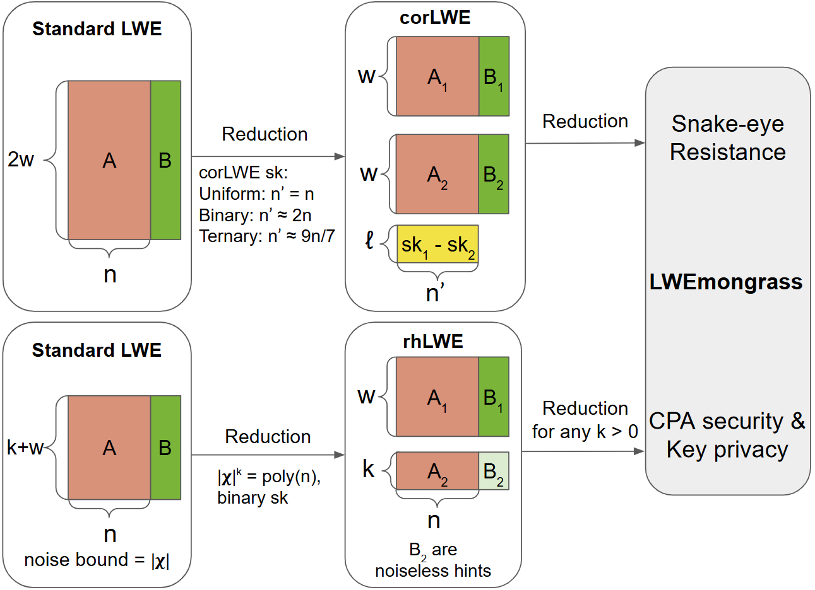
LWEmongrass Overview

Slide 17
LWEmongrass Overview

Slide 18
LWEmongrass Overview

Slide 19
LWEmongrass Overview

Slide 20
LWEmongrass
KeyGen
Enc
Encryption:
First samples x ← {-1, 0, 1}^{w}
Compute ct = (a, b)
a||b ← x(A||B) + e’
Also ensure a[1:k] ≠ 0^{k}
A ←$ Z_{t}^{w×n}
e
B
x
A
B
Analysis:
Both the pk and the Enc process rely on LWE:
w ≈ n
|pk| = O(nlog(t)), not ω(n·log²(t))
sk_{u}
sk_{s}
e’
k
n-k
k
Hybrid secret keys:
sk_{u} ←$ Z_{t}^{k}
sk_{s} ← {-1, 0, 1}^{n - k}
Snake-eye resistance
However:
Correctness breaks
Ciphertext error is not bounded
|e’|·|sk| + |e|·|x|
But sk_{u} is uniform
a
b
pk := (A, B ← A(sk_{s}||sk_{u})^{T} + e)
e is some Gaussian error
Efficiency

Slide 21
LWEmongrass
KeyGen
Enc
Encryption:
First samples x ← {-1, 0, 1}^{w}
Compute ct = (a, b)
a||b ← x(A||B) + e’
Also ensure a[1:k] ≠ 0^{k}
A ←$ Z_{t}^{w×n}
e
B
x
A
B
Analysis:
Error bound:
|e’|·|sk_{s}| + 0·|sk_{u}| + |e|·|x|
Now error is O(n·σ) improved upon ω(n·log(t)·σ) in PVW
sk_{u}
sk_{s}
0
e’
k
n-k
k
Hybrid secret keys:
sk_{u} ←$ Z_{t}^{k}
sk_{s} ← {-1, 0, 1}^{n - k}
a
b
pk := (A, B ← A(sk_{s}||sk_{u})^{T} + e)
e is some Gaussian error

Slide 22
Summary of LWEmongrass
δ-snake-eye-resistance
CPA secure & key private
Smaller public key size
Smaller error bound
Modulus switching is also possible
Under standard LWE with short secrets
Reduced from ω(n·log²(t)) to O(n·log(t))
Practically > 30x smaller
Reduced from ω(n·log(t)·σ) to O(n·σ)
Practically > 30x smaller
Without modulus switching the first k elements in a
Practically > 2x smaller (depending on parameters)

Slide 23
Agenda
Motivation
Define Snake-eye Resistance of PKE
Prove PVW is Snake-eye Resistant
LWEmongrass PKE Scheme
Applications to Oblivious Message Retrieval and Robust Encryption

Slide 24
OMR detection service
Anonymous message delivery
Recipient
Sender
Bulletin
Board
Trial decrypt
the CT’s
Payload₁ | CT₁
Payload₂ | CT₂
Payload₃ | CT₃
... | …
Payload_{N-1} | CT_{N-1}
Recipient
Trial decrypt
the CT’s
Generate
Payload_{N}
Obtained via PIR
……
Payload_{N}
Enc(1)
Enc(1)
Payload_{N}
Recipient
Trial decrypt
the CT’s
PKE.pk
Notes:
adjust distance

Slide 25
OMR detection service
Oblivious Message Retrieval
Bulletin
Board
Detector
Recipient
Sender
Homomorphically
decrypts & encodes
Payload₁ | CT₁
Payload₂ | CT₂
Payload₃ | CT₃
... | …
Payload_{N-1} | CT_{N-1}
Detector
Recipient
Payload_{N}
Generate
Homomorphically
decrypts & encodes
……
Payload_{N}
Enc(1)
Enc(1)
Payload_{N}
Detector
Recipient
Homomorphically
decrypts & encodes
PKE.pk
Notes:
adjust distance

Slide 26
Oblivious Message Retrieval (DoS Attack)
Bulletin
Board
Detector
Recipient
Payload_{N}
Homomorphically
decrypts & encodes
Payload₁ | CT₁
Payload₂ | CT₂
Payload₃ | CT₃
... | …
Payload_{N-1} | CT_{N-1}
Detector
Recipient
Payload_{N}
Generate
Homomorphically
decrypts & encodes
……
Payload_{M}
CT_{M}
CT_{M}
Payload_{M}
Detector
Recipient
Payload_{N}
Homomorphically
decrypts & encodes
Potentially cause overflow
When apply LWEmongrass to OMR
Provable DoS-resistance
Fast homomorphic decryption compared to using PVW
Notes:
adjust distance

Slide 27
(strong)-robustness of PKE [ABN10]
PKE.KeyGen
sk₁
PKE.Dec
Regev05.KeyGe
Regev05.Dec
non-⊥
pk₁
ct
pk₂
PKE.KeyGen
sk₂
PKE.Dec
Regev05.KeyGe
Regev05.Dec
non-⊥
In our work, we formally prove that our snake-eye resistance definition is equivalent to robustness, up to some small security loss.
Our construction also gives the first lattice-based robust encryption that is not based on the KEM-DEM paradigm.

Slide 28
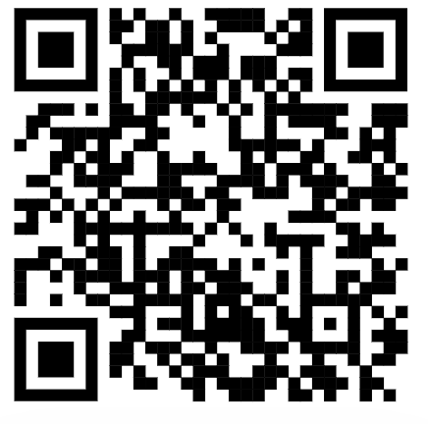
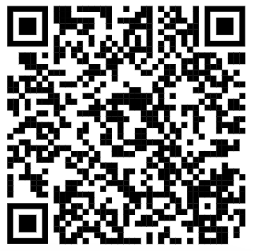
More in the paper
Security proof of LWEmongrass
From LWE to corLWE
From LWE to rhLWE
Applications to Oblivious Message Retrieval
Almost as fast as SOTA OMR vulnerable to the spamming attack
Application to Robust Encryption
Snake-eye resistance is equivalent to robustness up to some small efficiency loss
Generalization of snake-eye resistance
Thank you very much for your attention!
Paper: ia.cr/2024/510 @ Eurocrypt’25 Full-hour talk:

