Slide 1
PRF with Weak Programming Privacy and Applications to Private Information Retrieval
Bo Peng (Peking University)
joint work with
Ashrujit Ghoshal
Mingxun Zhou
Elaine Shi
Carnegie Mellon University

Slide 2
Information Retrieval Leaks User Privacy
Location of EC ’25 ?
Madrid, Spain
A cryptographer…

Slide 3
Private Information Retrieval [CGKS95]
Location of EC ’25 ?
Madrid, Spain
???

Slide 4
Recently...
Advance on Preprocessing PIR
[BIM00],[CK20],[KC21],[SACM21],[CHK22],[LP22],[LP22b],[HHCM+23],[ZLTS23],[LMW23],[LP23],[MIR23],[ZPSZ24],[HPPY24],[GZS24],[ISW24]
Many of them follow a common framework

Slide 5
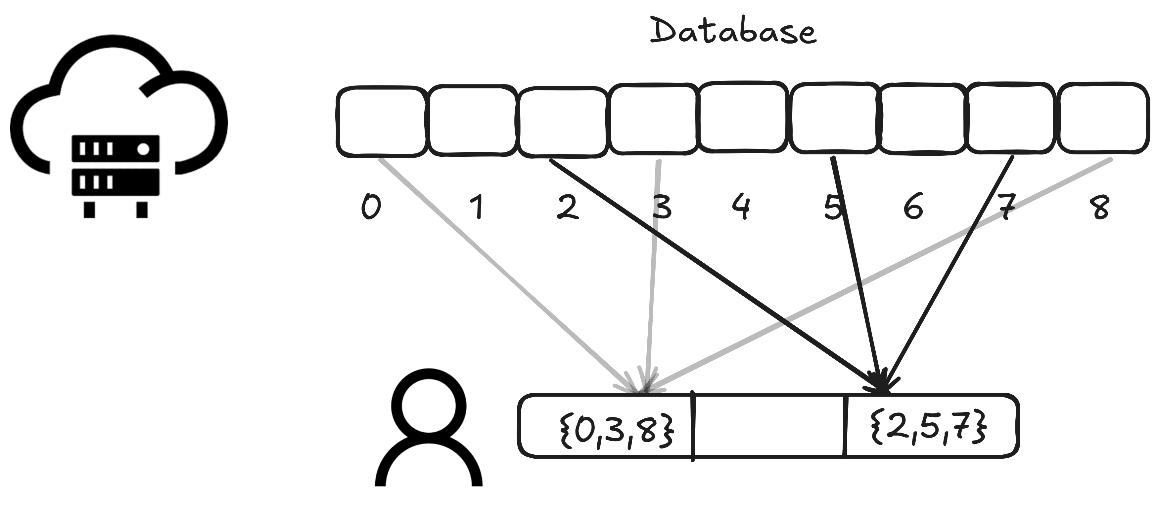
Preprocessing

Slide 6
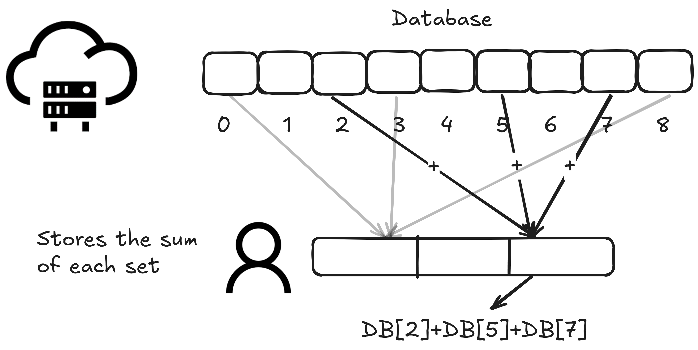
Preprocessing

Slide 7
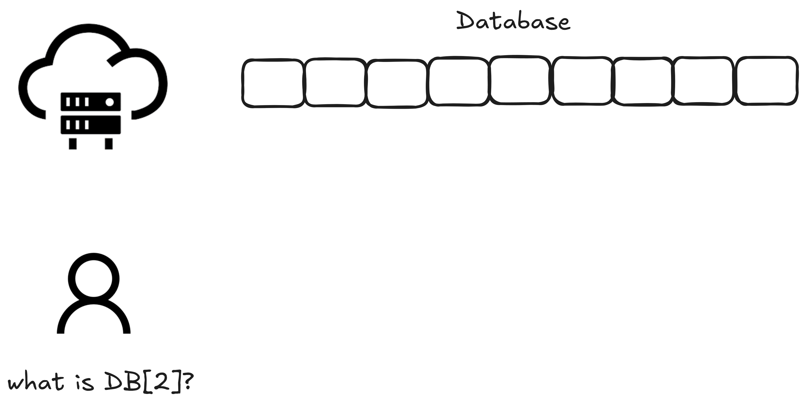
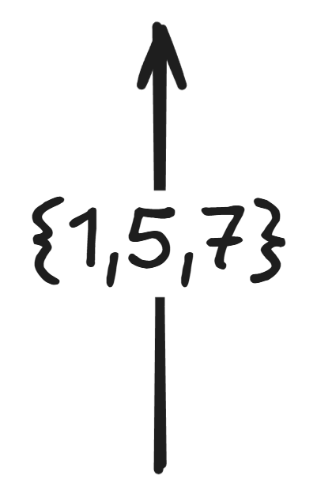
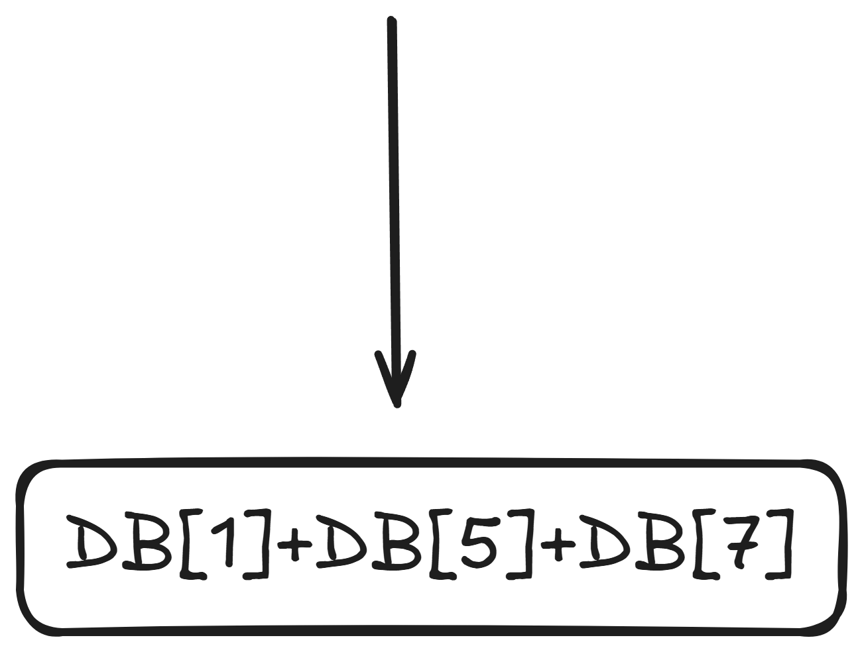
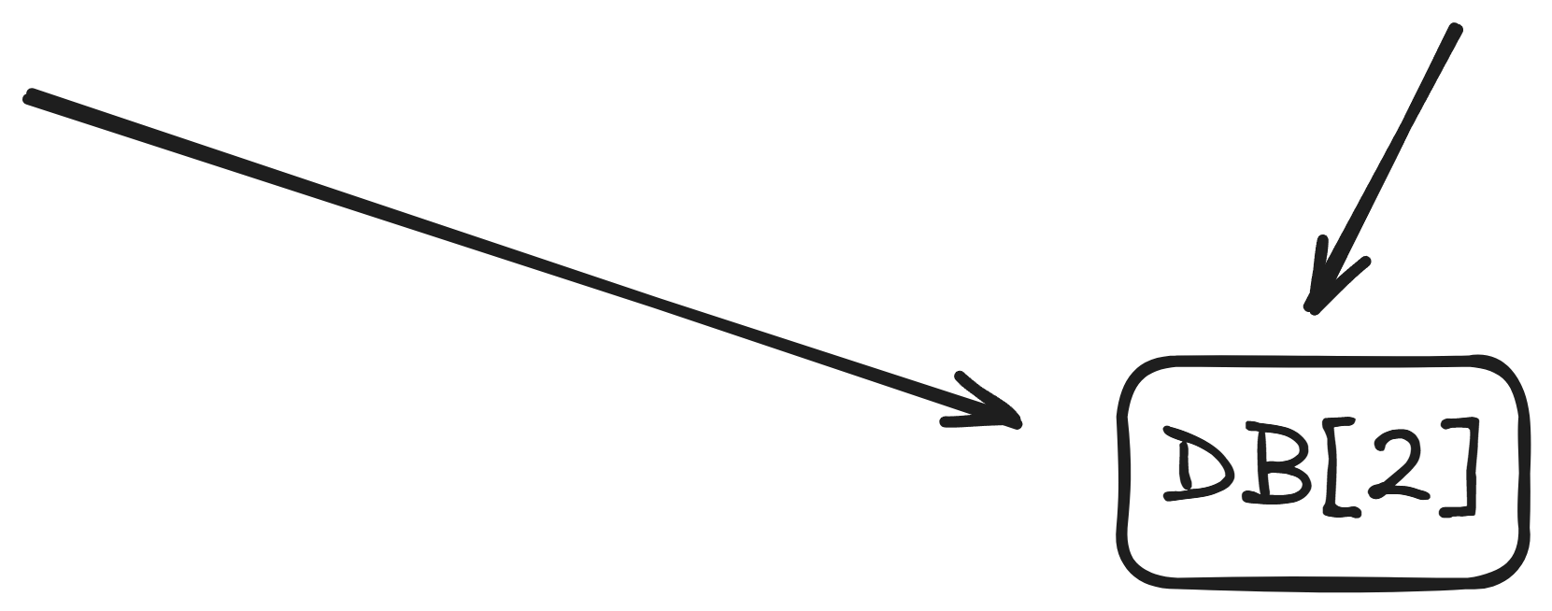
Query
Large communication!

Slide 8
Bottleneck
How to send the set in a succinct manner?
Recall: $\left\{1,5,7\right\}=\left\{2,5,7\right\}−\left\{2\right\}+\left\{1\right\}$
Transform a PRF key $msk$ into another key $psk$:
$Eval\left(msk,⋅\right)$ and $Eval\left(psk,⋅\right)$ differ at one position
$psk$ leaks no information about the differing position
Minimize $|psk|$
Privately Programmable PRF (PPPRF)

Slide 9
Puncturable PRF (pPRF)
Evaluation algorithm $Eval(msk, x)$
For any $y$, can generate a punctured key $psk_{y}$ from $msk$
Punctured evaluation algorithm $PEval(psk_{y}, x)$
Correctness: $Eval\left(msk,x\right)=PEval\left(psk_{y},x\right), ∀x≠y$
Security: given ${psk}_{y}$, $Eval\left(msk,y\right)≈_{c}random$
Can be constructed using classical GGM PRF

Slide 10
Privacy and Programmability
Ordinarily, a punctured key $psk_{y}$ reveals $y$
As is the case of GGM PRF
Privacy: $psk_{y}$ does not reveal anything about $y$
Programmability: can program ${psk}_{y}$ to a desired value at $y$
Applications: watermarking PRFs, MPC, PIR, …

Slide 11
How to construct a PPPRF?
Previous constructions: based on LWE or iO
All LWE constructions are similar to layered FHE [PS18, ...]
Strong assumption & Too slow!
Previous construction: based on OWF [BGIK22]
Evaluation time $Ω(n)$, where $n$ is the domain size
Too slow!
Can we construct PPPRF based on OWF, with efficient evaluation?

Slide 12
Strawman
Baseline: [BGIK22], evaluation time linear in domain size
Make the domain size smaller?
Divide the domain size $n$ into $n^{1/2}$ blocks
Assign each block a [BGIK22] key
Expand a single key during Eval/Prog

Slide 13
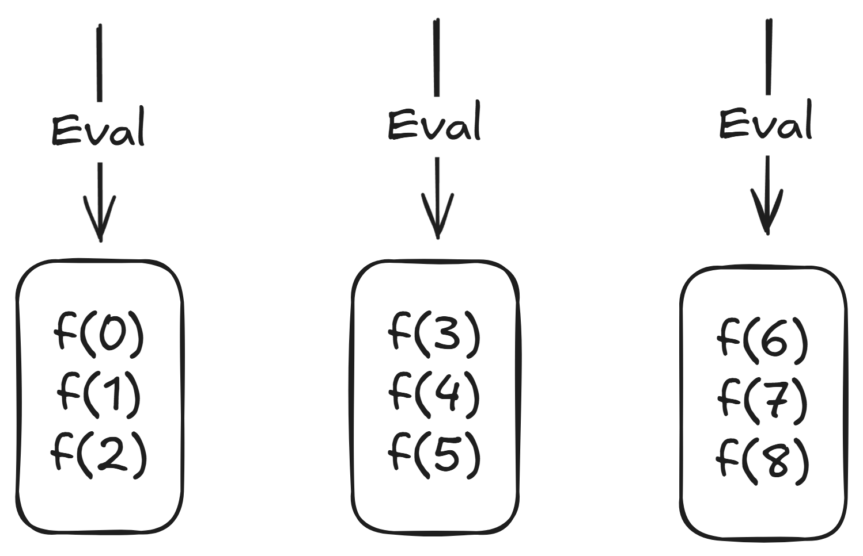

Slide 14
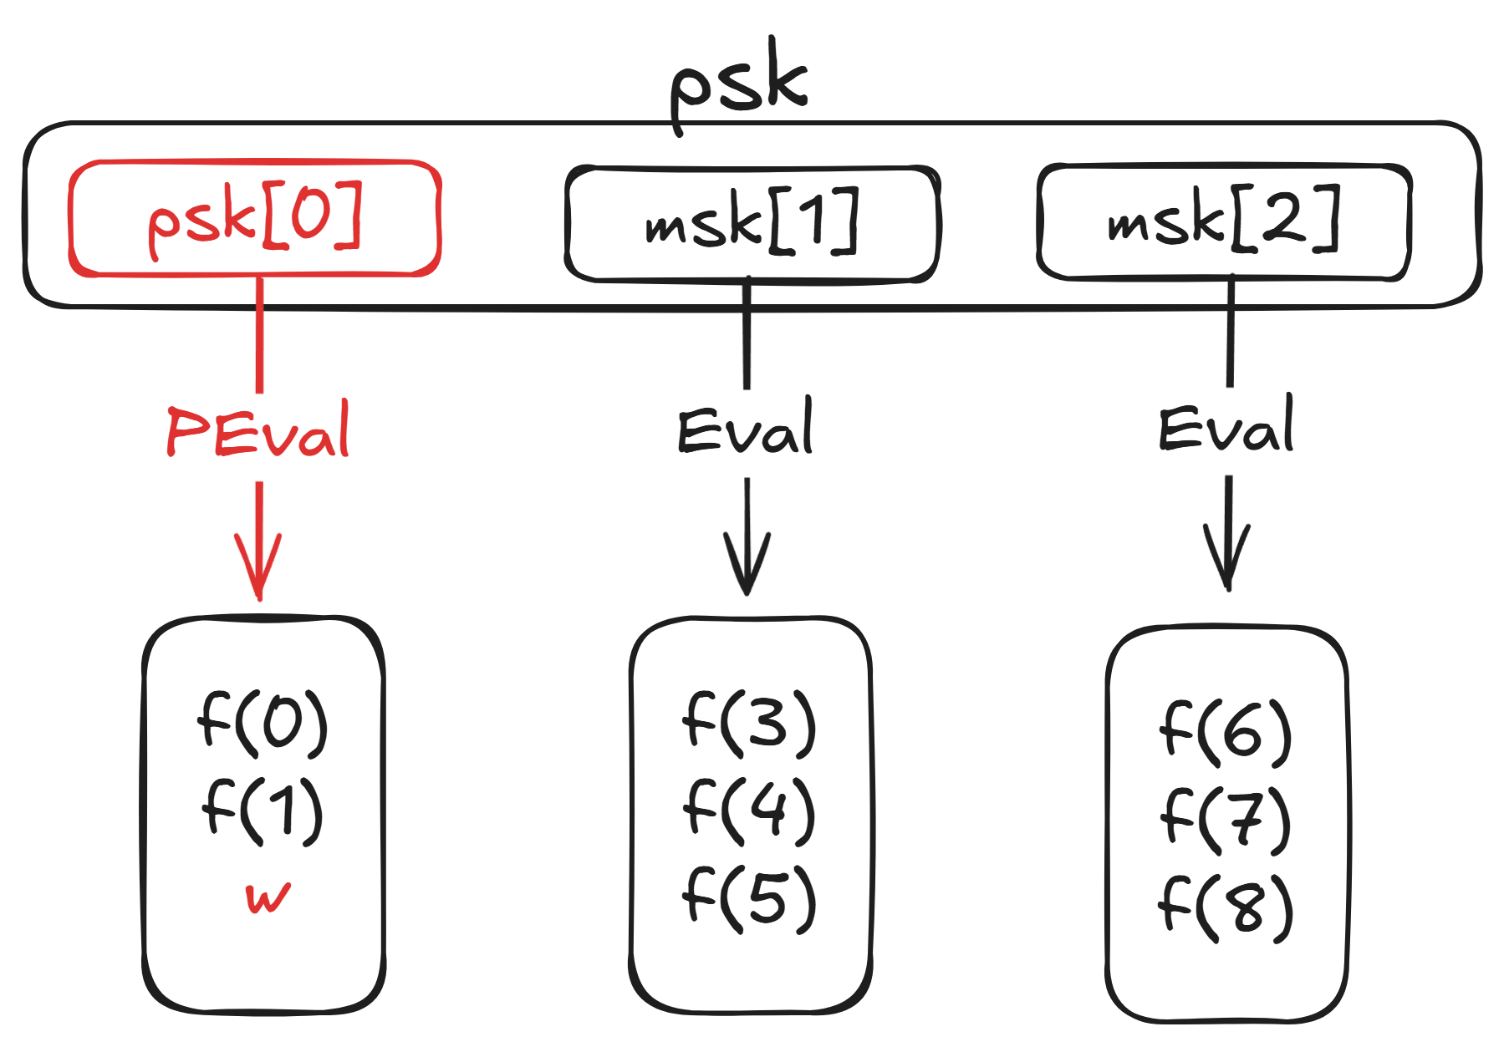

Slide 15
Strawman
Key size: $O_{λ}(n^{1/2})$
Eval/Prog: $O_{λ}(n^{1/2})$
Privacy?

Slide 16
Strawman: privacy
Easily identify the programmed block!
A generic solution: flooding
Assign each block $poly(λ)$ keys, each randomly normal or programmed
Program one of the normal keys
Can’t tell which block has one more programmed key

Slide 17
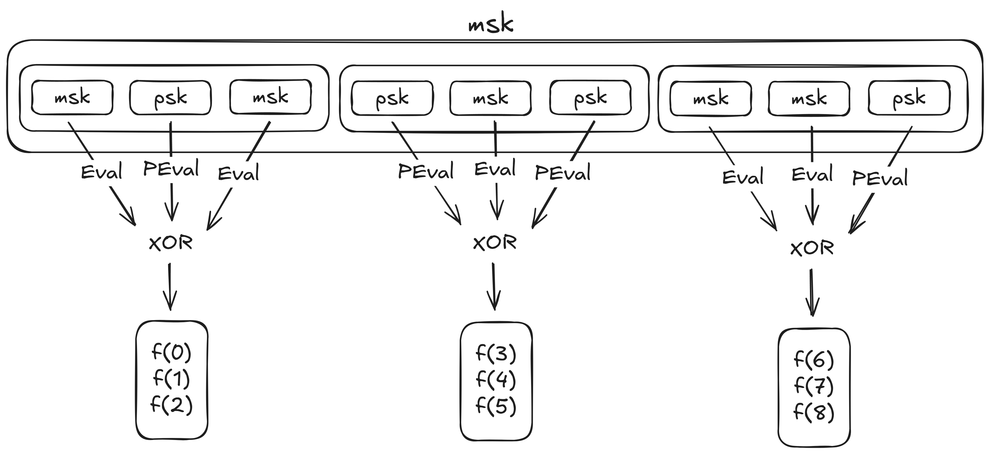

Slide 18
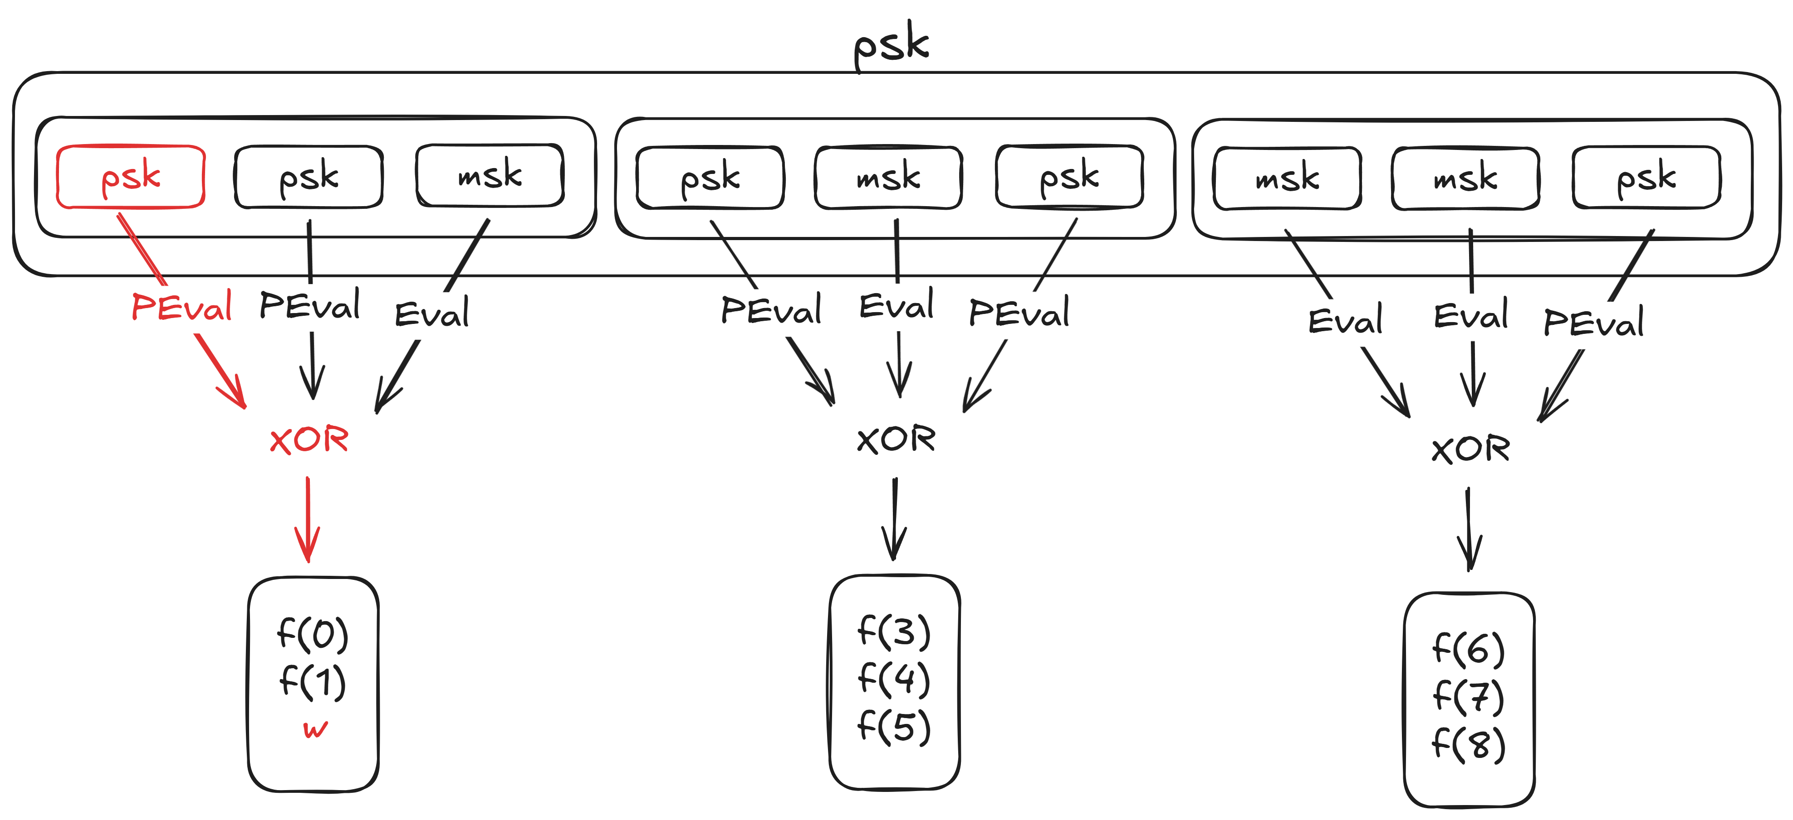
Same #normal-key

Slide 19
Strawman: privacy
Nevertheless, some information is leaked by #normal-key.
It achieves a notion of “weak” PPPRF:
Cannot distinguish $psk_{y}$ from ${psk}_{0}$ w.p. $>1/poly(λ)$
Relaxation of statistical distance
Intuitively, $psk_{y}$ leaks $y$ w.p. at most $1/poly(λ)$

Slide 20
Strawman
Key size: $O_{λ}(n^{1/2})$
Eval/Prog: $O_{λ}(n^{1/2})$
Privacy: $1/poly(λ)$
Drawback: key size is not $poly(λ)$
Observation: only used $O_{λ}(1)$ keys during Eval/Prog
Use a PPPRF to generate the keys!

Slide 21
Reducing the key size: Recursion!
Let $msk$ be a [BGIK22] key
Top-down evaluation:
Level 1: $msk$ expands into $n^{1/2}$ [BGIK22] keys
Level 2: each key expands into $n^{1/2}$ pseudorandom values
Like a GGM PRF, but with larger fan-out

Slide 22
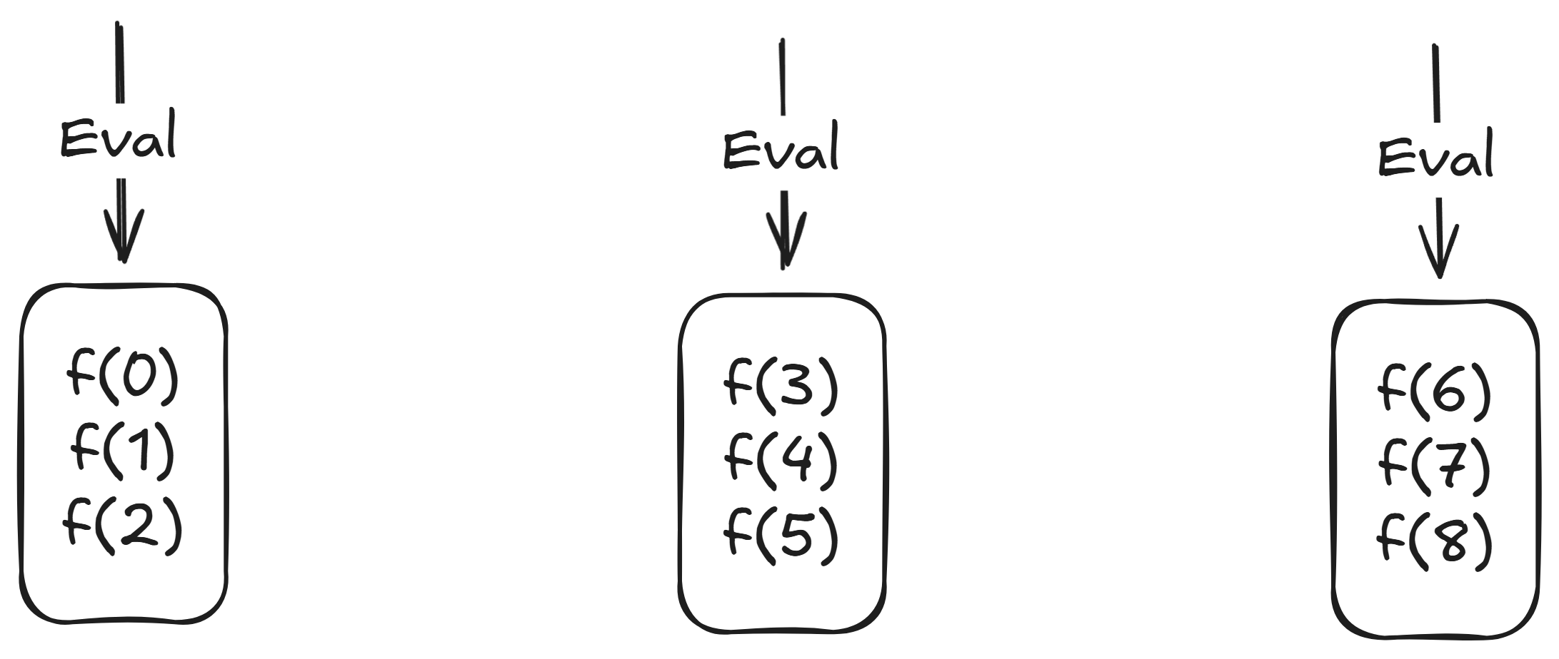

Slide 23
Bottom-up programming:
Level 2: program the level-2 key first
Level 1: program $msk$ to output the programmed level-2 key

Slide 24
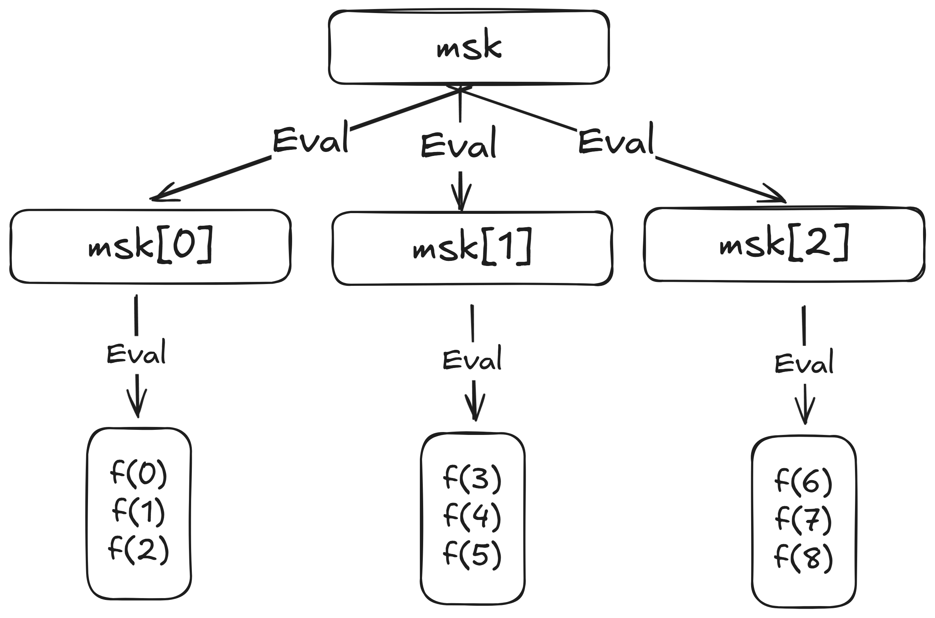

Slide 25
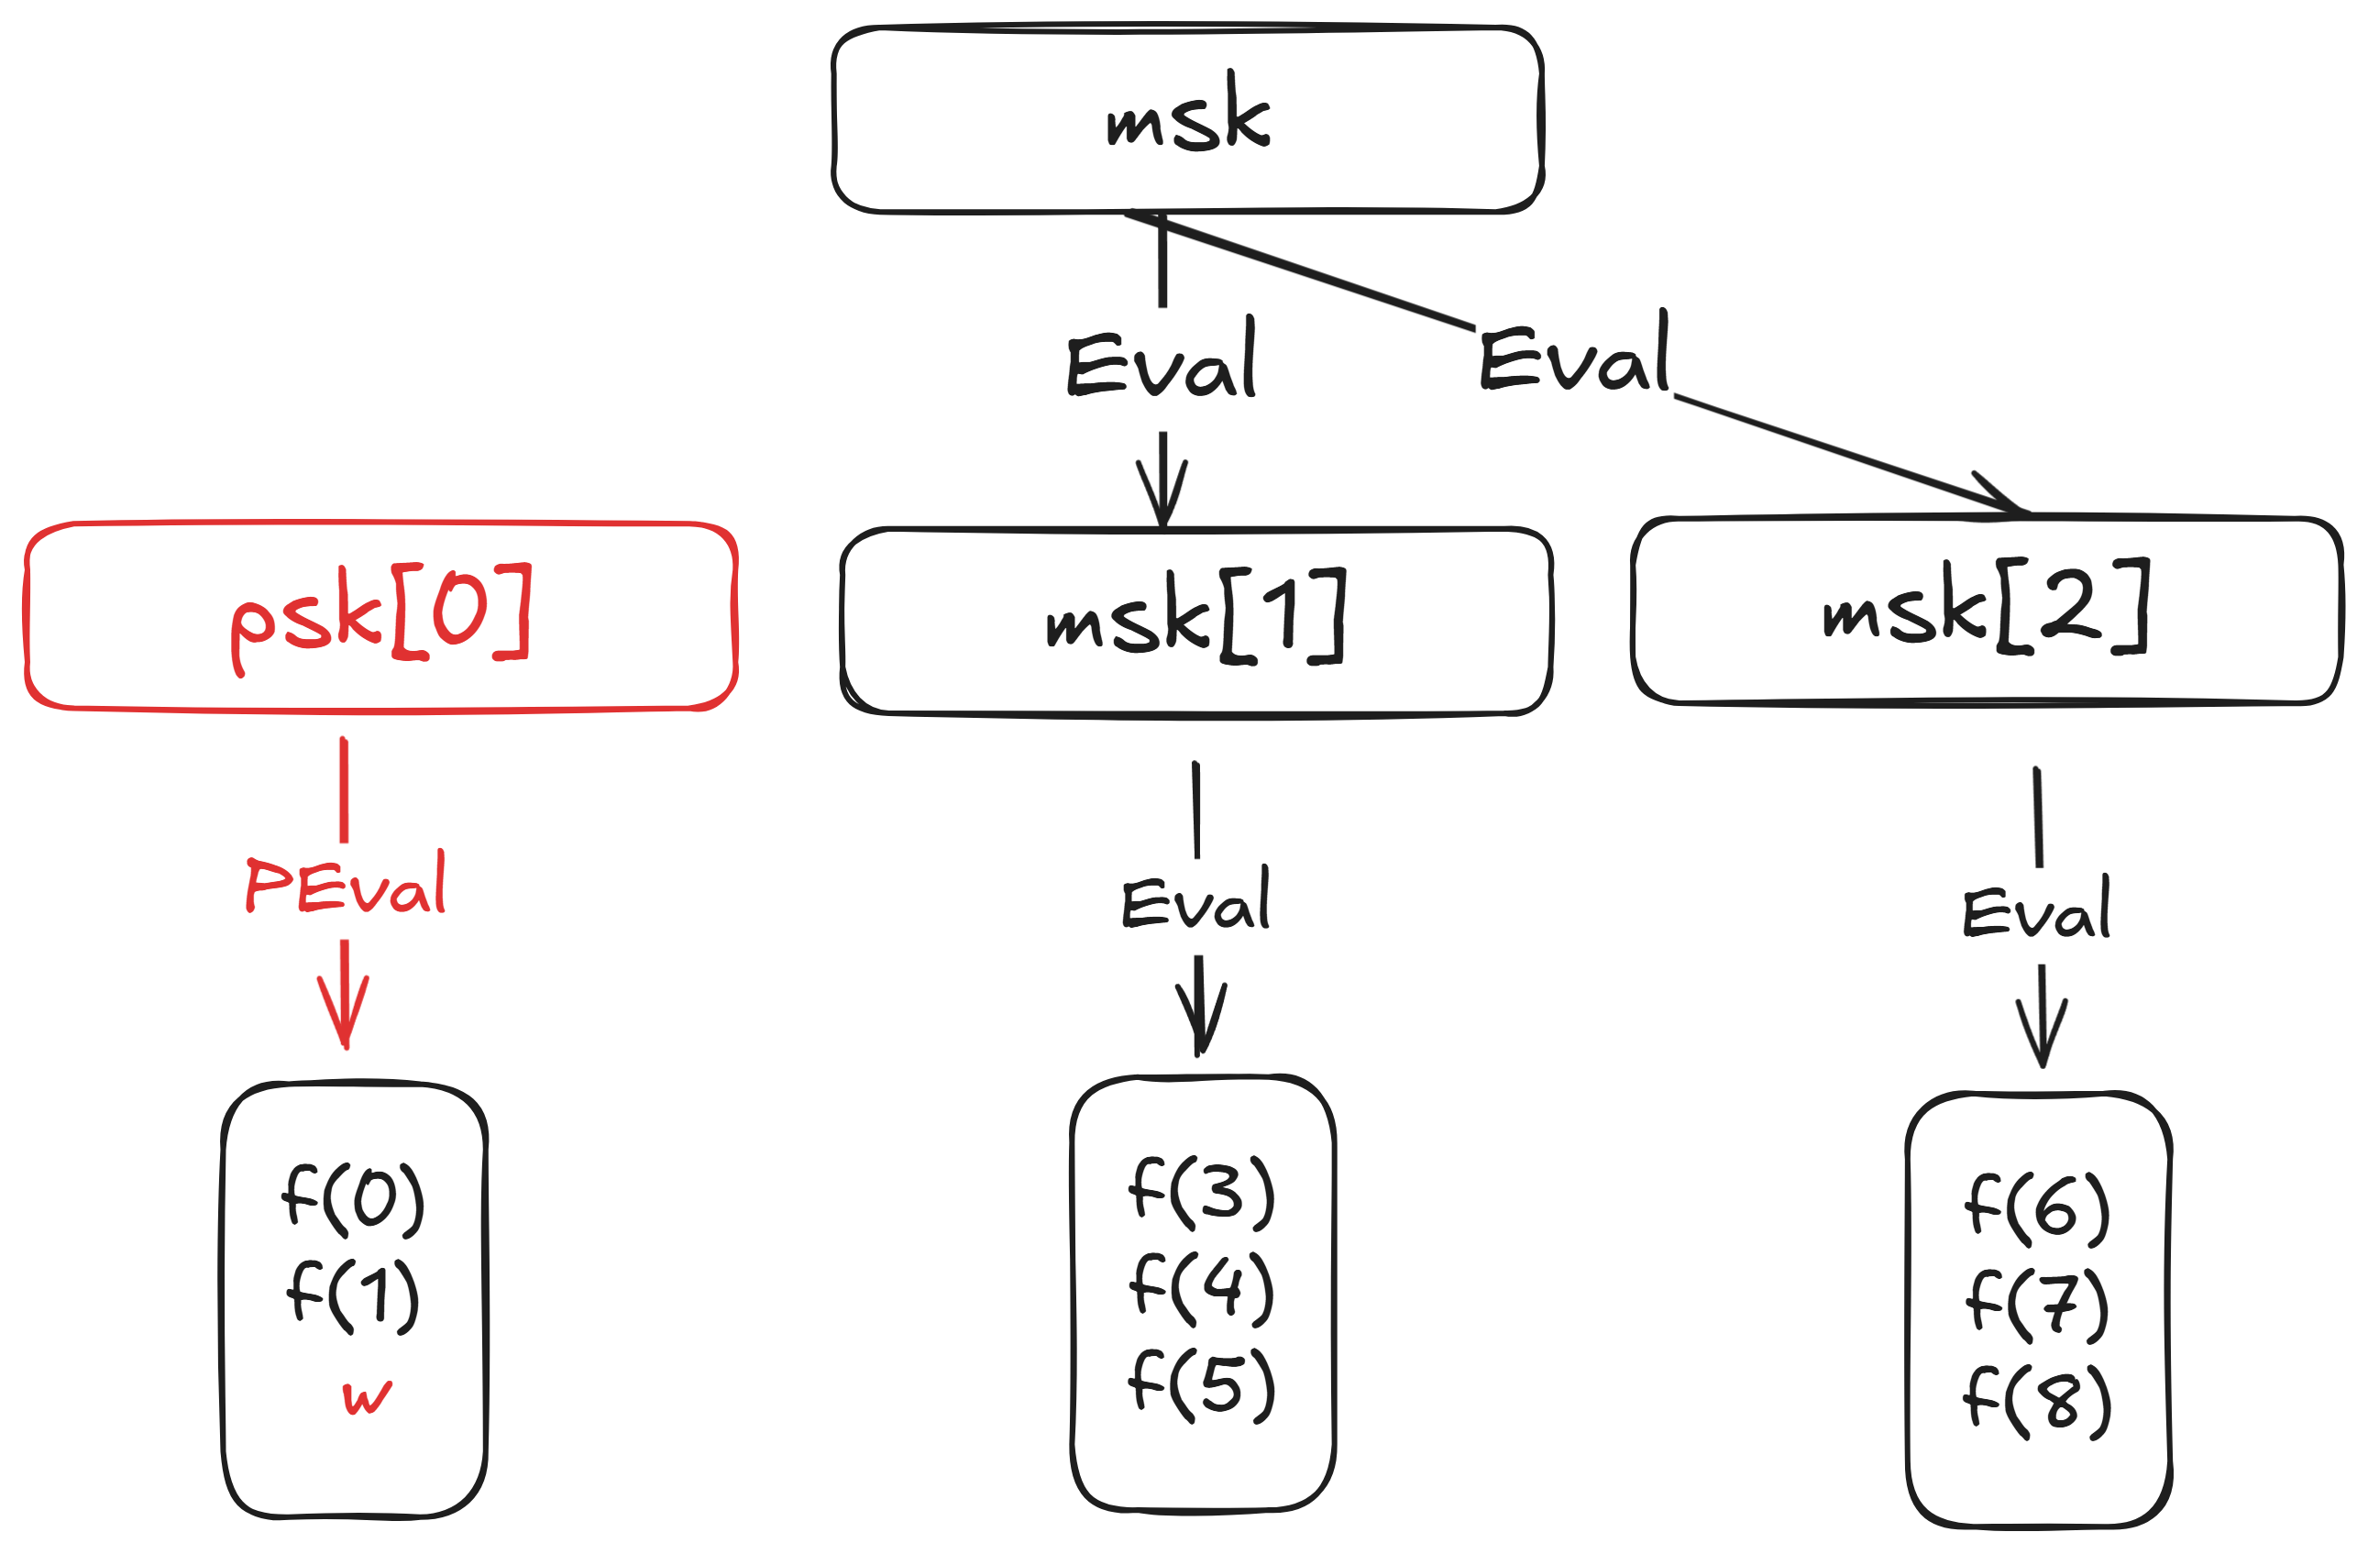

Slide 26
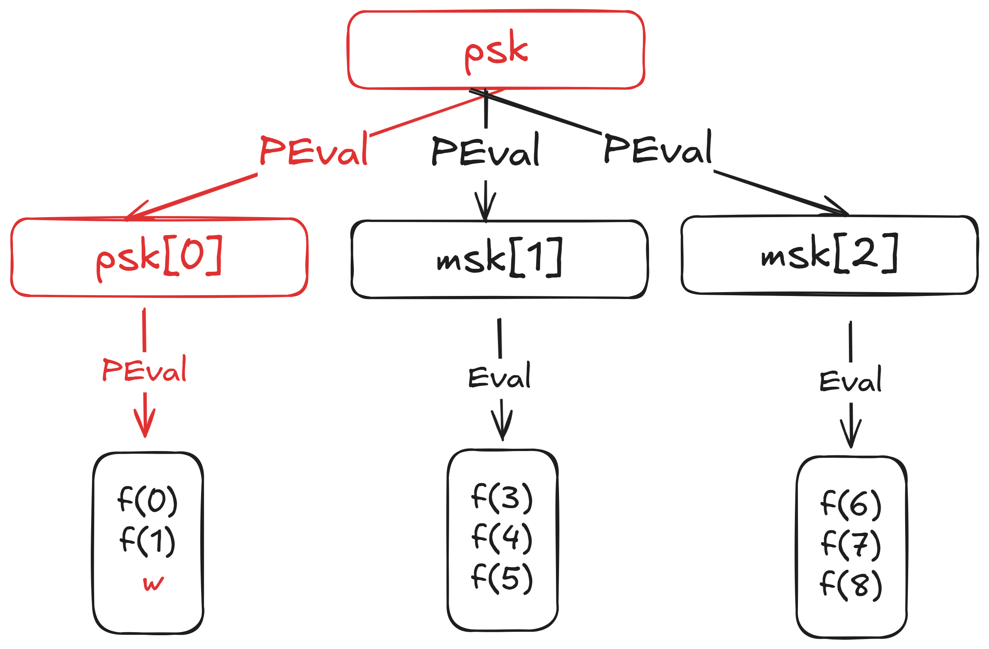

Slide 27
Reducing the key size: Recursion!
Key size: $O_{λ}(1)$
Eval/Prog: $O_{λ}(n^{1/2})$
Privacy?
Easily identify the programmed path!
Again, flooding with $O_{λ}(1)$ $msk$, programming one of them
See our paper for details
Can we do better?

Slide 28
We need to go deeper
Why stop at two levels?
No fundamental difference between 2 levels and 10 levels!
Key size: $O_{λ}(1)$
Eval/Prog: $O_{λ}(n^{1/10})$
Can we take it all the way to $log n$ levels?
Sadly, no, because key size blows up exponentially

Slide 29
Summarize
Assumption: OWF
For arbitrary constant $0<ε<1$:
Key size: $λ^{O(1/ε)}$
Eval/Prog: $O_{λ}(n^{ε})$
Security: $1/poly(λ)$

Slide 30
$1/poly\left(λ\right)$ Security
Why would anyone care about $1/poly\left(λ\right)$ security?
Security amplification by [BGIK22]: boost to negligible
Apply security amplification to PIR
See our paper for more details

Slide 31
Preprocessing PIR in Minicrypt
Assuming $O_{λ}(n^{1/2})$ storage,
where $0<ε<1$ is an arbitrary constant.
 | Online Comm. | Offline comm. | Computation
Prev. best [ZPSZ24] | $$O_{λ}(n^{1/4})$$ | $$O_{λ}(n^{1/2})$$ | $$O_{λ}(n^{1/2})$$
Ours | $$O_{λ}(1)$$ | $$O_{λ}(n^{1/2+ε})$$ | $$O_{λ}(n^{1/2+ε})$$

Slide 32
Future directions
Concretely efficient PPPRF, based on LWE?
More applications of security amplification?
More primitives based on OWF?
Read our paper:
ia.cr/2025/300
p-b-p-b.github.io
bo.peng@stu.pku.edu.cn
Applying for PhD this year ☺

