Slide 1
The 2Hash OPRF Framework and Efficient Post-Quantum Instantiations
Ward Beullens¹, Lucas Dodgson², Sebastian Faller^{1,2}, Julia Hesse¹
¹ IBM Research Europe
² ETH Zürich

Slide 2


Security
Client Privacy
- Server does not see x
Server Privacy
- Client does not see key
Pseudo-Random Output
- F is a PRF
Oblivious Pseudo-Random Functions (OPRF)
x
OPRF
PRF( . , . )
key
PRF(key,x)
Server
Client
2

Slide 3
OPRFs: The silver bullet for password-authentication
The 2Hash OPRF Framework
3

Slide 4
Problems:
Server sees the password attempt pw' in the clear
Conventional password-over-TLS
stores
salt, Hash(pw,salt)
pw'
TLS channel
Server
Client
check Hash(pw',salt) == Hash(pw,salt)
4

Slide 5
Problems:
Server sees the password attempt pw' in the clear
Conventional password-over-TLS
stores
salt, Hash(pw,salt)
TLS hijacking reveals the password attempt pw' in the clear
pw'
TLS channel
Server
Client
check Hash(pw',salt) == Hash(pw,salt)
5

Slide 6
Security
Server never sees pw' pw' not visible to network attackers
Better solution:
Authentication with an OPRF
pw'
OPRF
PRF( . , . )
key
PRF(key,pw')
Server
Client
PRF(key,pw') as good as a salted hash of pw'
6

Slide 7
Tons of other applications:
  WhatsApps End-to-End Encrypted Backups
  Securing your Bitcoin Wallet with a PIN (PPSS)
  Single-Sign-On
  Private Set Intersection
  ...
pw'
OPRF
PRF( . , . )
key
PRF(key,pw')
Server
Client
The 2Hash OPRF Framework
7

Slide 8
OPRFs are cool. But how expensive are they?
The 2Hash OPRF Framework
8

Slide 9
Efficiency
2HashDH [JKK14,JKKX16]
3 exponentiations ​
2 Hashes ​
Sending two group elements ~ 66 Bytes​
r ← ℤ_{p}
A = H₁(x)^{r}
A
B=A^{k}
B
Server
Client
y=H₂(x,B^{1/r})
9

Slide 10
Quantum-safe OPRFs?
  Not yet there....
The 2Hash OPRF Framework
10

Slide 11
Quantum-safe OPRFs
(shown are only construction with security for both parties)
2021
2023
2024
Lattice-based
[ADDS21]
Feasibility result.
~128 GB network traffic
FHE+Dark Matter
[ADDG24]
Based on new assumption
~3 MB network traffic
7 sec only running the server
Our work
Legendre Symbol assumption
~900 KB network traffic
~180ms whole protocol run
More constructions
Standard lattice assumptions [AG24]
~500 KB network traffic
From new (interactive) lattice assumptions
[ESTX24]
~200 KB network traffic
Legendre Symbol assumption
[YBHKR24]
~970 KB network traffic
The 2Hash OPRF Framework
11

Slide 12
A framework for building OPRFs
The 2Hash OPRF Framework
12

Slide 13
Ingredients:
2HashDH [JKK14,JKKX16]
Two hash functions
PRF uses H₁ and H₂
Inner function f is unpredictable
Blind-unblind to evaluate f
PRF( k, x ) = H₂(x, H₁(x)^{k} ))
Inner function f(k,h) = h^{k}
Oblivious Evaluation of inner function f:
r ← ℤ_{p}
A = H₁(x)^{r}
A
B = A^{k}
B
Server
Client
Output H₂(x,B^{1/r})
13

Slide 14



The 2Hash Framework
Unpredictable and key-collision resistant
Multi-Party Computation
2 Hash functions
For a secure OPRF you need:
f
We show two instantiations:
From block ciphers
From Legendre symbols
#
01000100111001
The 2Hash OPRF Framework
14

Slide 15
Unpredictability
Client output must be programmable. (Hash)
Pseudo-randomness must even hold for malicious keys. (key-collision resistance)
Weak key-collision resistance
Given x₁,…,x_{n} ← 𝔽_{p}
Hard to find k, k' such that for
one i:
f(k,x_{i}) = f(k',x_{i})
15

Slide 16
Instantiation from Legendre symbols
The 2Hash OPRF Framework
16

Slide 17
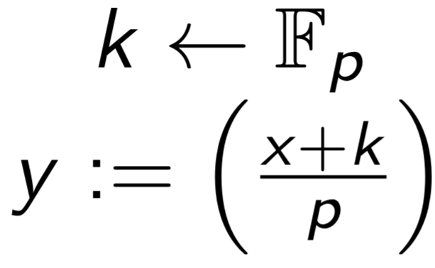

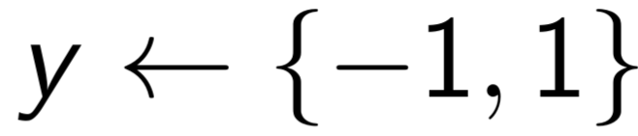




Decisional Shifted Legendre Symbol Assumption [Dam88,GRRSS16]
17

Slide 18
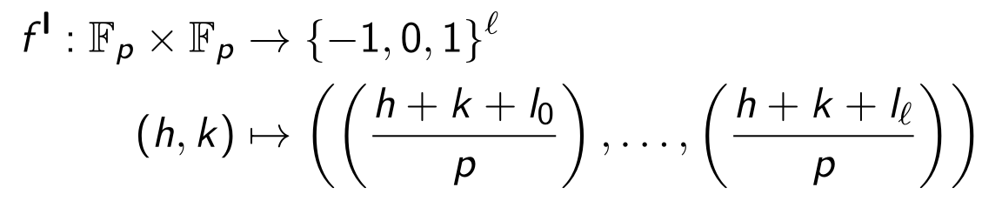
The inner function
18

Slide 19
The inner function
Function defined bitwise. Need to prevent overlap.
→ Offsets need to be random.
19

Slide 20
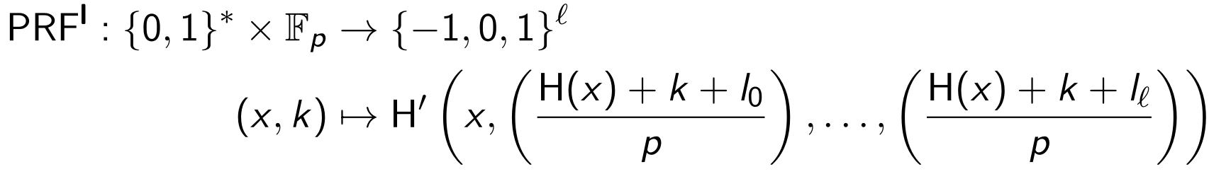
The outer function
Two hash functions
Inner function f(h,k)
20

Slide 21
Efficient MPC protocol for inner function
The 2Hash OPRF Framework
21

Slide 22
Add-and-blind
Random s² blinds k
Output e is square iff (x+k) is
Need to execute this in a batched way
Core idea: Computing one Legendre symbol
s ← 𝔽_{p}
x
Compute
s²(x + k)
s, k
e
Client
Server
(
e
)
output
p
22

Slide 23
VOLE and VOLE+
Suppose
u_{i} = (k + l_{i})s_{i}²
v_{i}= s_{i}²
h
VOLE
u,v
o = u + h · v
Client
Server
Then
o_{i} = u_{i} + h v_{i}
= (k + l_{i})s_{i}² + h s_{i}²
= (h + k + l_{i})s_{i}²
23

Slide 24
VOLE and VOLE+
r_{u},r_{v} ← 𝔽_{p}
h
VOLE+
u,v,r_{u},r_{v}
o = u + h · v
c_{u} = <u,γ>+r_{u}
c_{v} = <v,γ>+r_{v}
γ
γ
Client
Server
24

Slide 25
The OPRF protocol (simplified)
s_{i},r_{u},r_{v} ← 𝔽_{p}
u_{i} = (k + l_{i})s_{i}²
v_{i} = s_{i}²
Client(x)
Server(k)
h = H(x)
VOLE+
u,v,r_{u},r_{v}
o_{i} = u_{i} + h v_{i} = (k + l_{i})s_{i}² + h s_{i}² s_{i}²
o, c_{u}, c_{v},γ
γ
Prove in ZK
Same k for all u_{i}
v is squares
output
(
(
o₁
)
(
o_{l}
)
)
x,
, … ,
H'
p
p
25

Slide 26
Security: Relaxed OPRF definition
  Our functionality:
  Allows to delay extraction of malicious keys until first online execution
  No change for honest keys
  Provably sufficient for applications like OPAQUE and PPSS
The 2Hash OPRF Framework
26

Slide 27


Take-Aways
1
We show a generic framework for UC-secure OPRFs
Paper
2
We give two instantiations:
from block ciphers
from Legendre symbols
ia.cr/2024/450
Implementation
3
We achieve sufficient security for applications like OPAQUE and PPSS
github.com/2HashFramework/LegendreOPRF
The 2Hash OPRF Framework
27

Slide 28
References
[JKK14] https://ia.cr/2014/650
[JKKX16] https://ia.cr/2016/144
[Dam88] https://link.springer.com/chapter/10.1007/0-387-34799-2_13
[GSRR16] https://ia.cr/2016/542
28

Slide 29
We aim for UC security
(i.e., [JKKX16])
Client output must be programmable. (Hash)
Pseudo-randomness must even hold for malicious keys. (key-collision resistance)
Why not MPC-evaluate the whole PRF?
x
OPRF
PRF( . , . )
key
PRF(key,x)
Server
Client
29

