Slide 1


Polynomial Time Cryptanalytic Extraction of Deep Neural Networks in The Hard-Label Setting
Adi Shamir
Computer Science Dept, The Weizmann Institute, Israel
Joint work with
Nicholas Carlini (Google Mind), Jorge Chavez-Saab,
Anna Hambitzer, and Francisco Rodriguez-Henriquez (TII)

Slide 2
The problem we consider here
  Deep neural networks (DNNs) are highly valuable assets which can cost millions to train
  Developers allow the public to interact with black-box DNNs via a provided API
  Can you recover a Deep Neural Network from its answers to chosen inputs?
    How many queries?
    How much time?

Slide 3
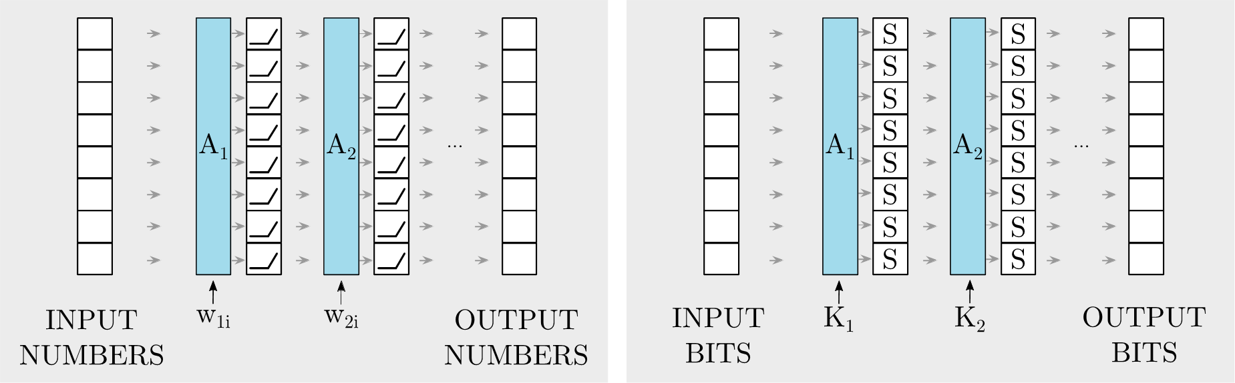
The similarity between DNNs and block ciphers
  DNNs operate on vectors of reals; Block ciphers on bits
  Each layer/round usually consists of some secret global linear mapping followed by some known local nonlinear mapping (ReLU(x):=max(x,0) in DNNs, Sboxes in block ciphers)
  The problem of recovering the weights from chosen input/output pairs is thus similar to key recovery attacks

Slide 4
This problem had been extensively studied for more than 30 years
  In 1993, Blum and Rivest showed that a variant of this problem is NP-hard
  In 1994 Charles Fefferman showed that all the parameters of a deep network with sigmoids are uniquely determined by its input/output behavior
  …
  The best previous attack was published at CRYPTO’20 and EC’24 showing that all the weights could be extracted in polynomial time using a polynomial number of queries

Slide 5
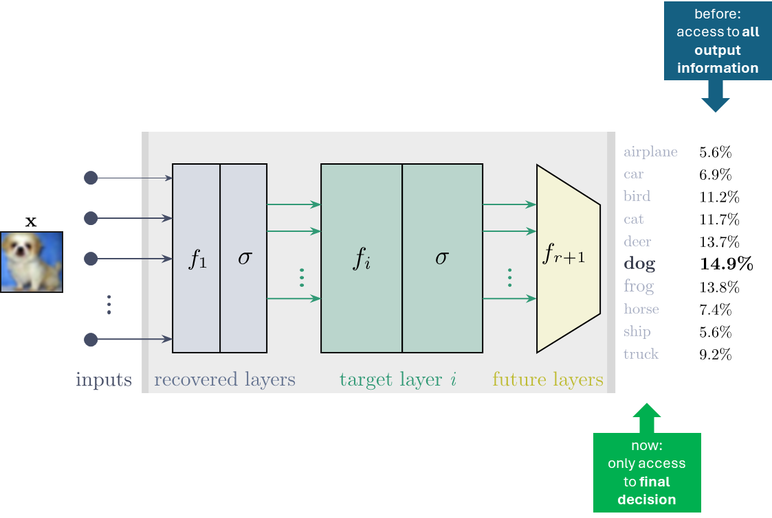
Comparing our EC’24 and EC’25 results
  Our previous EC’24 attack operates in the easiest attack setting, which assumes that the attacker knows the precise numerical outputs of the DNN
  Our new EC’25 attack operates in the hardest attack setting, which assumes that the attacker only knows the labels produced for chosen inputs

Slide 6
This hard-label setting:
  Was studied by Chen et al, who showed at AC’24 that it can be solved with polynomially many queries, but their algorithm required exponential time
  Here we finally solve this longstanding open problem with polynomial time and query complexities
  Our techniques demonstrate that all the parameters of a DNN classifier can be determined by just analyzing the geometric shape of its decision boundary

Slide 7
The basic tool of our EC’24 attack: Critical points in the input space
  A critical point is defined as a point x in the input space in which the input to some ReLU is 0
  In the vicinity of any non-critical point x, the DNN behaves as an affine function since the output of each ReLU in the network can be replaced by either its input or zero, and the whole input/output mapping is therefore just a composition of affine functions

Slide 8
How the input space is partitioned into cells by the DNN’s critical points
  We can segment the input space into convex regions (cells) where in each cell the DNN behaves as a different affine mapping. The boundaries are exactly the critical points of the DNN where some ReLU input switches its sign from + to – or vice versa

Slide 9
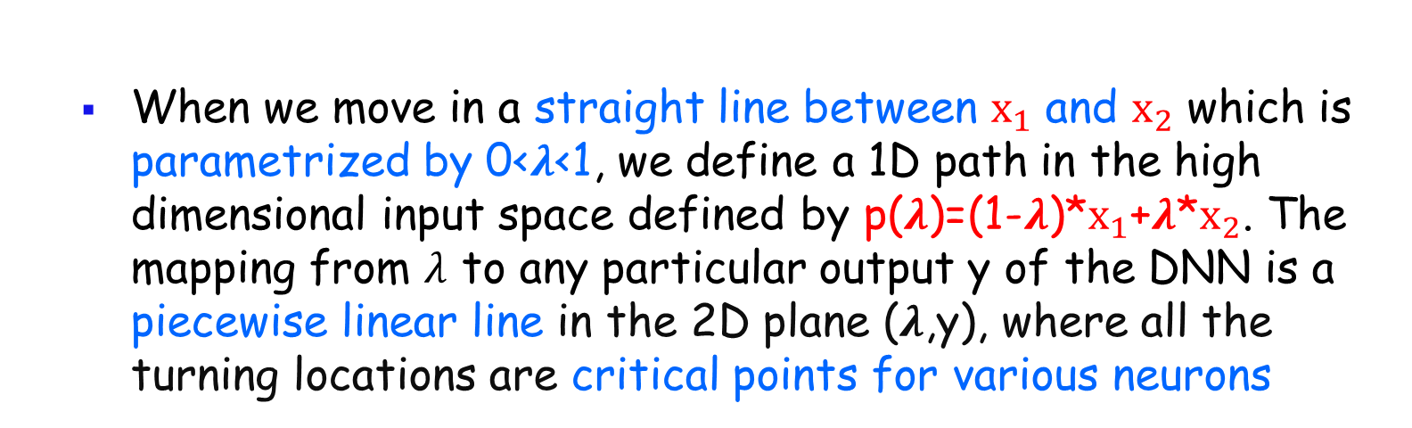
How the logits change as we move in a straight line between two inputs
  When we move in a straight line between $x_{1}$ and $x_{2}$ which is parametrized by 0<$λ$<1, we define a 1D path in the high dimensional input space defined by p($λ$)=(1-$λ$)*$x_{1}$+$λ$*$x_{2}$. The mapping from $λ$ to any particular output y of the DNN is a piecewise linear line in the 2D plane ($λ$,y), where all the turning locations are critical points for various neurons

Slide 10
How we use critical points in the attack
  Critical points provide the attacker with side-channel information, that deep in the network the input to some ReLU is exactly 0
  This kind of information leakage can provide the attacker with an affine equation in terms of the unknown parameters of the corresponding neuron
  Once we collect sufficiently many such affine equations for the same neuron, we can solve the system of equations and extract its parameters

Slide 11
Unfortunately, we can no longer use this technique in the hard-label setting
  In the hard-label setting we cannot compute numeric derivatives in order to find where the slope of the output changed, and thus cannot identify the critical points along chosen paths in the input space
  Consequently, we no longer have the side information leakage from internal neurons which was previously created whenever we passed through a critical point. The only information available is the point at which one logit surpasses another. These points lie on the classifier’s decision boundary, and are called the network’s decision points

Slide 12




In the hard-label setting we can only explore the decision boundary
  Decision points (eg $x_{2}$) and critical points (eg $x_{3}$ and $x_{4}$) are very different; only critical points leak side channel information about internal ReLU values, but they are not visible in the hard label scenario. Can we use decision points instead?
Path between two inputs
  New notion dual points

Slide 13
In the hard-label setting we can only explore the decision boundary
  We define a new notion of dual points, which are simultaneously decision points and critical points
  Dual points form a d-2 dimensional piecewise linear region, since they are the intersection of two d-1 dimensional regions: decision points & critical points
  The crucial observation: Dual points leak internal ReLU information since they are also critical points

Slide 14
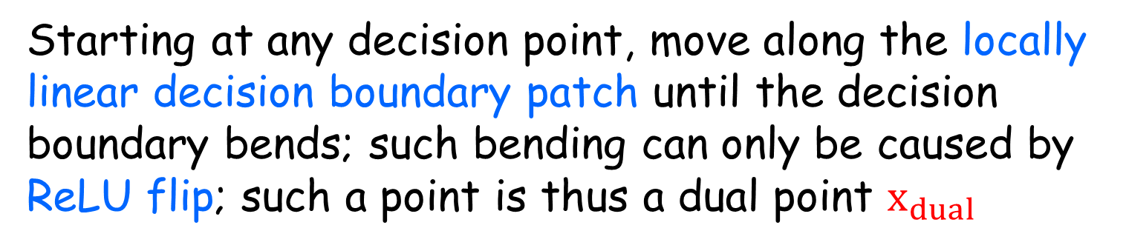
In the hard-label setting we can only explore the decision boundary
How to efficiently find a dual point:
Starting at any decision point, move along the locally linear decision boundary patch until the decision boundary bends; such bending can only be caused by ReLU flip; such a point is thus a dual point $x_{dual }$

Slide 15
The second part of the attack
  Dual points enable us to get multiple affine equations associated with various neurons
  Solving such systems of affine equations will yield the orientation (as weights) and displacement (as biases) of the local critical hyperplane of the neuron
  To complete the attack, we still have to find on which side of this hyperplane the ReLU’s input will be positive and on which side it will be negative. This is known as the sign determination of the neuron

Slide 16
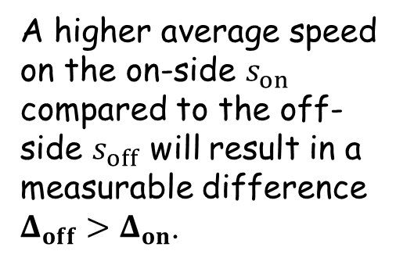
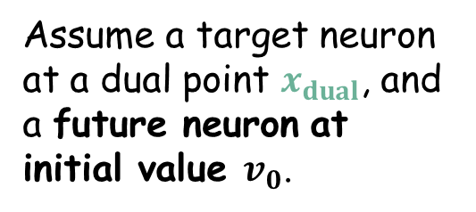
A new sign-finding idea: Compare the width of decision boundary patches
A green critical hyperplane of some neuron which changes the local orientation of two decision boundary patches on its two sides.
Assume a target neuron at a dual point $x_{dual}$, and a future neuron at initial value $v_{0}$.
A higher average speed on the on-side $s_{on}$ compared to the off-side $s_{off}$ will result in a measurable difference $Δ_{off}>Δ_{on}$.

Slide 17
Experimental verification of our new attack technique

Slide 18
Concluding remarks
  In this talk we developed the first polynomial time extraction attack on deep neural networks which are given as a black box via an API that only provides the label produced for each input
  We demonstrated its correctness by successfully extracting about one million parameters from normally trained CIFAR10 DNN’s
  However, it is unlikely that anyone will be able to use it in practice to extract the billions or trillions of parameters in frontier DNN models

