Slide 1
INDIANA – VERIFYING (RANDOM) PROBING SECURITY THROUGH INDISTINGUISHABILITY ANALYSIS
CHRISTOF BEIERLE, JAKOB FELDTKELLER, ANNA GUINET, TIM GÜNEYSU, GREGOR LEANDER,
JAN RICHTER-BROCKMANN, PASCAL SASDRICH
Notes:
presentation on “INDIANA” or how to practically verify probing and random probing security through indistinguishability analysis
joint work with Christof Beierle, Jakob Feldtkeller, Anna Guinet, Tim Güneysu, Gregor Leander and Jan Richter-Brockmann

Slide 2







MOTIVATION | PHYSICAL IMPLEMENTATION ATTACKS
SIDE-CHANNEL ANALYSIS
CRYPTOGRAPHIC
DEVICE
HARDWARE MASKING SCHEMES
PASSIVE OBSERVATION OF
PHYSICAL CHARACTERISTICS
IMPLEMENTATION OF HARDWARE MASKING SCHEMES IS A COMPLEX, DELICATE, AND ERROR-PRONE PROCESS.
Notes:
- a little bit of context and our motivation for this work.
we assume that we have some cryptographic operation that is performed by a hardware device
cryptographic implementations are susceptible to passive side-channel attacks
an attacker can observe physical characteristics of the device
runtime behavior
instantaneous power consumption
heat dissipation,
cryptographic hardware implementations can be protected by masking schemes
the implementation of hardware masking schemes is a non-trivial and mostly manual task.

Slide 3



MOTIVATION | FORMAL SECURITY REASONING
ADVERSARY
MODELS
SECURITY
PROPERTIES
ARCHITECTURAL & ENVIRONMENTAL CONDITIONS
AUTOMATED SECURITY REASONING TOOLS ALLOW PRE-MANUFACTURING VULNERABILITY DETECTION.
Notes:
- systematic approach: community has started formalized adversary models and architectural conditions.
- security properties can be used to reason about the security of the cryptographic implementation in a formal manner.
- new research directions on automated security reasoning tools

Slide 4

PRELIMINARIES | LEAKAGE MODELS
t-TRESHOLD PROBING MODEL [ISW03]
SECURITY
REDUCTION
p-RANDOM PROBING MODEL [DDF14]
CONVENIENCE FOR SECURITY REASONING
SECURITY
REDUCTION
NOISY LEAKAGE MODEL [PR13]
t variables leak
each variable leaks
with probability p
power consumption
$\sim$ $ℒ\left(x\right)+η$
REALISM OF SECURITY REASONING
STATE-OF-THE-ART REASONING TOOLS ARE RESTRICTED (FOR STRUCTURES AND/OR MODELS) OR INCOMPLETE.
Notes:
- three different adversary models to express information leakage.
the t-threshold probing model,
proposed in 2003 by Ishai, Sahai and Wagner
at most t variables leak information
particularly convenient for security proofs
its level of realism remains limited.
p-random probing model advances the threshold probing model
assuming that each variable leaks but only with a probability p
closer to reality
also more complex in terms of verification efforts.
noisy leakage model is the most realistic security model
assumes that the adversarial observation (power consumption) follows a Gaussian distribution (noisy components).
model is less convenient in comparison to the previous models
chain of security reductions that allow to reduce the security in the noisy leakage model to security in the t-threshold probing model, but with some loss in tightness
state-of-the-art reasoning tools are mostly restricted to the t-threshold while there are only very few tools that consider the p-random probing model
all the tools that consider the p-random probing model are either incomplete
hardware structures they support
not exact but may exhibit false positives or negatives in their security statements.

Slide 5
CONTRIBUTION | RESEARCH MISSION
DEVELOP
SOUND, ACCURATE AND EFFICIENT TOOLS
FOR VERIFYING THE SECURITY OF
ARBITRARY AND COMPLEX MASKED HARDWARE CIRCUITS
UNDER
MORE REALISTIC LEAKAGE MODELS

Slide 6
OUR CONTRIBUTIONS

Slide 7




THEORY | SECURITY DEFINITION
$$≈ … ≈$$
$$x = 0…0$$
$$x =1…1$$
INDISTINGUISHABILITY – PROBING SECURITY
For a fixed set of $t$ probes, an ADVERSARY cannot distinguish between different input values $x∈ 𝔽_{2}^{n_{i}}.$
$ℒ_{(Enc,A_{C},Ex)}\left(𝒫\right)=0$for all sets $𝒫⊆𝒲$ of up to $t$ probes
NEW
Notes:
went back to the t-probing model and its security notions
assume we have a hardware circuit that an attacker has access to
we model this access through probes that an adversary can place on the circuit wires
we can formulate the notion of probing security as follows:
A circuit is considered probing secure if for all sets of at most t probes the adversary cannot distinguish different values of the input x
the distribution of probed values is indistinguishable or
simply an attacker sees the same distribution for all processed values x.
we formally define this understanding of probing security and show that this is equivalent to existing definitions (statistical independence or simulatability)
We further formalize our indistinguishability analysis in terms of a leakage function
A circuit encoding that reflects the considered hardware masking scheme
An adversarial access to the circuit, that defines the probing scheme,
And an extension function that defines how the probes may be extended, for example, to consider unintentional physical effects such as glitches or transitions.
Next slides: explain how to practically derive this leakage function

Slide 8


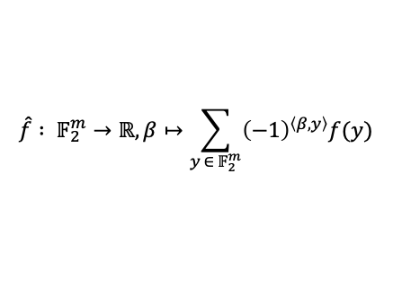








THEORY | DERIVING LEAKAGE FUNCTIONS
ADVERSARIAL OBSERVATIONS
FOURIER-HADAMARD TRANSFORM
LEAKAGE FUNCTION
$$…$$
$$x = 0…0$$
$$x =1…1$$
$$x = 0…0$$
$$x = 0…0$$
$$…$$
$$−$$
$$…$$
$$x =1…1$$
$$x =0…0$$
$$\hat{f} : 𝔽_{2}^{m}→ℝ, β↦\sum_{{y ∈ 𝔽}_{2}^{m}}{{\left(−1\right)}^{\left\langle β,y\right\rangle }f(y)}$$
$$D_{H,x} (y) := |H_{x}^{−1}(y)|−|H_{0}^{−1}(y)|$$
$$ℒ_{(Enc,A_{C},Ex)}\left(𝒫\right)$$
NEW
Computing the leakage function (efficiently) allows to detect leakage
in the probing and random probing models.
Notes:
start with the comparison of adversarial observations for all different inputs to each other
we simply compare all observations to a fixed observation
without loss of generality we compare all distributions to the distribution for the input value 0.
resulting difference function is then transformed based on the Fourier-Hadarmard transform
In our paper, we further show how this process links to the notion of t-resiliency.
we need to do some additional post-processing and extension
not going to explain this step in detail but refer you to our paper for more details.
conclusion for this slide:
the core operation of our verification process is the computation of the Fourier-Hadamard Transform
enables us to transform the adversarial observations into the corresponding leakage function
please note: leakagefunction is limited to the set of adversarial probes and is not the general leakage function of the entire circuit -- unless the adversary did probe all wires.
next question is: How to efficiently compute these steps in practice?

Slide 9


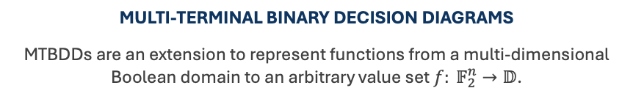







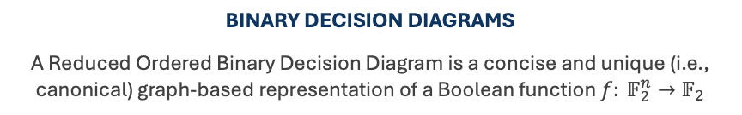


IMPLEMENTATION | GRAPH-BASED DECISION DIAGRAMS
$$f(x)$$
$$f(x)$$
$$x_{0}$$
$$x_{0}$$
$$x_{1}$$
$$x_{1}$$
$$x_{2}$$
$$x_{2}$$
0
1
$$d_{0}$$
$$d_{1}$$
…
$$d_{n}$$
BINARY DECISION DIAGRAMS
A Reduced Ordered Binary Decision Diagram is a concise and unique (i.e., canonical) graph-based representation of a Boolean function $f: 𝔽_{2}^{n}→𝔽_{2}$
MULTI-TERMINAL BINARY DECISION DIAGRAMS
MTBDDs are an extension to represent functions from a multi-dimensional Boolean domain to an arbitrary value set $f: 𝔽_{2}^{n}→𝔻$.
Notes:
rely two well-known data structures in computer science and functional verification
reduced ordered binary decision diagrams, or in short BDDs,
to store and process Boolean functions in terms of a graph-based representation
directed graph with two terminal nodes 0 and 1
for a given variable ordering, BDDs are a canonical representation for a Boolean function
second data structure are called Multi-Terminal Binary Decision Diagrams
an extension of binary BDDs
MTBDDs can represent functions from a multi-dimensional Boolean domain to an arbitrary value set
Consquently, our verification framework heavily relies on both data structures to express adversarial observations and compute leakage functions for arbitrary and complex masked hardware circuits.

Slide 10







IMPLEMENTATION | FROM THEORY TO PRACTICE
$$f(x)$$
$$x_{0}$$
$$x_{1}$$
$$x_{2}$$
$$d_{0}$$
$$d_{1}$$
…
$$d_{n}$$
(DISCRETE) PROBABILITY DISTRIBUTION
VECTOR OF OCCURENCES (FREQUENCIES)
Computing the Fourier-Hadamard Transform and the leakage function
maps to basic BDD and MTBDD operations.
NEW
Notes:
we use MTBDDs to express the probability distribution of the adversarial probes as a vector of occurrences or frequencies for each observed value
each combination of t probed wires which span a t-dimensional Boolean domain
we encode the number of occurrences for all observed values as terminal nodes in a MTBDD
using fundamental BDD and MTBDD operations, we can easily compute the Fourier-Hadamard Transform and derive the leakage function for the given set of probes. (more details in paper)

Slide 11
EVALUATION RESULTS

Slide 12
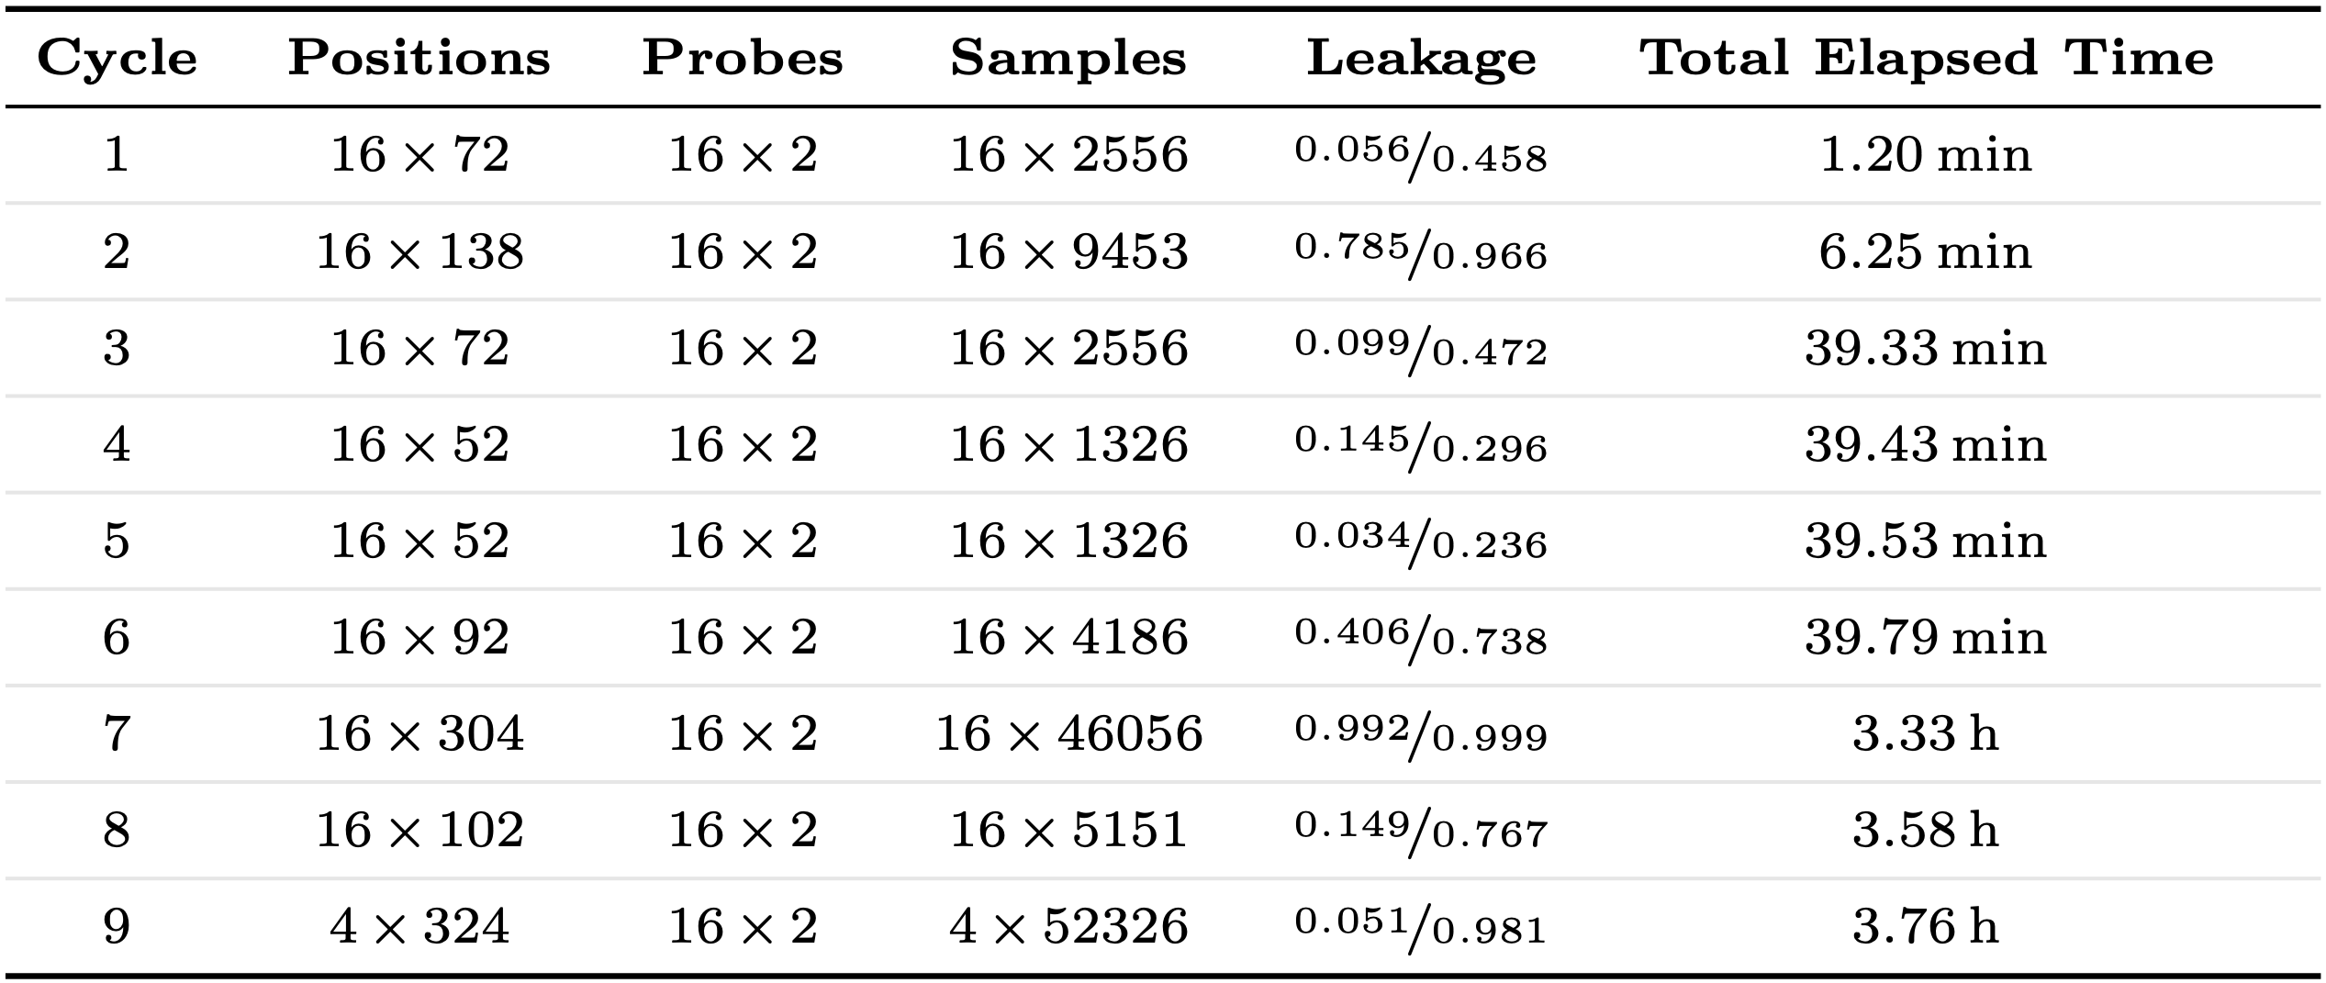
EVALUATION | AES ROUND (RANDOM PROBING)
Notes:
first case study: first-order masked AES round that implements 16 S-boxes in parallel in hardware
the entire round function has been pipelined and requires 9 clock cycles to compute the result
16 S-boxes process independent parts of the secret: optimized our tool to detect and process independent modules of the circuit individually
we perform the verification cycle-wise, as you can see by the results in the table
Now, you can read the results as follows:
16 independent modules in first cycle
each with 72 possible wires that an adversary could probe
For complexity reasons: we limited the verification to at most 2 probes per S-box
resulted in 2556 combinations that we had to check.
For all these combinations, we computed the FHT and accumulated the leakage functions.
This entire process took about 1 minute.
since the accumulated leakage function is not complete, we opted to compute an upper and lower bound for the leakage probability.
for the lower bound we assumed that all probe combinations that have been missed do not leak.
assumed that all remaining probe combinations in fact do leak when computing the upper bound for the leakage probability
proceeded with the next clock cycles in a similar fashion
clock cycle number 9 which implements the mix columns operation that combines the output of 4 S-boxes
now have only 4 individual modules that an attacker could probe and that process independent parts of the secret.
The verification process took less than 4 hours and revealed that cycle 7 has the highest leakage probability.
Since this cycle is still part of the S-box computation, our second case study evaluates a single S-box in more detail.

Slide 13
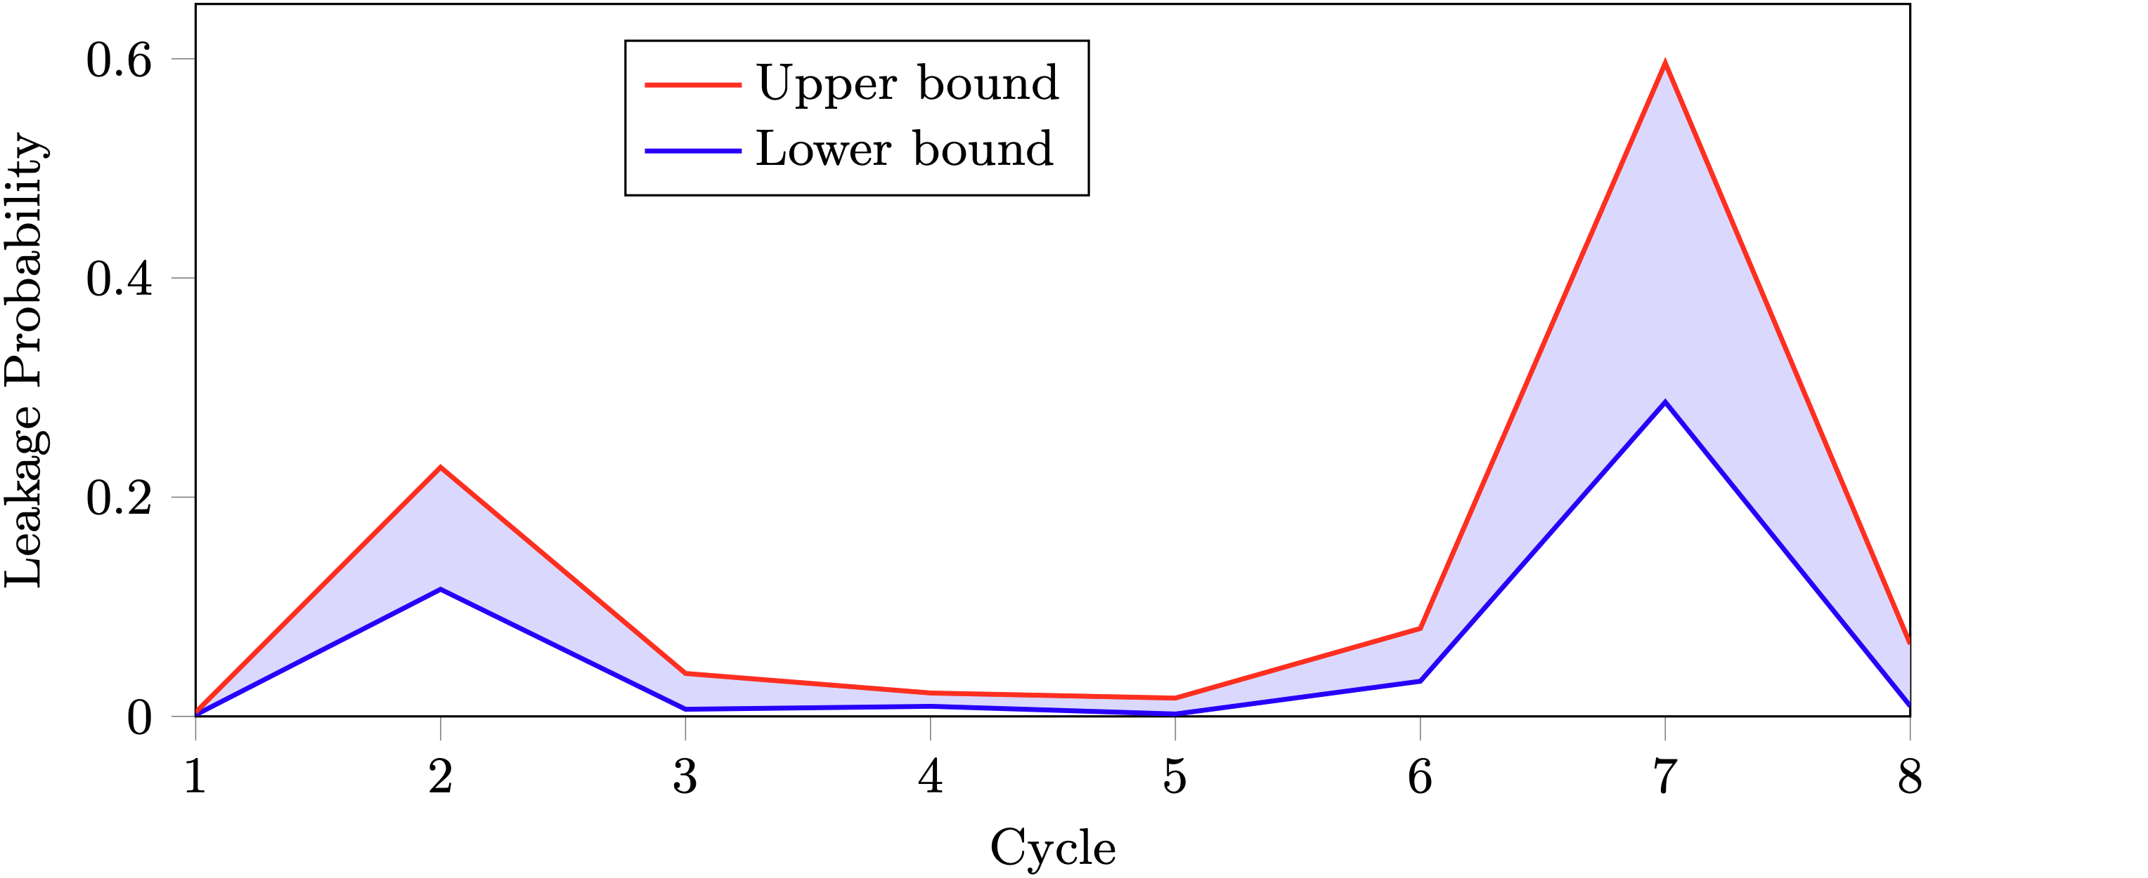
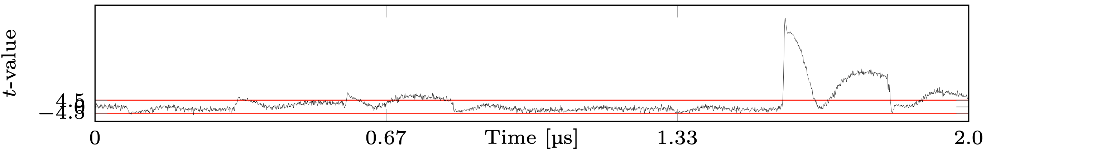
EVALUATION | FROM THEORY TO PRACTICE
VERIFICATION OF A SINGLE AES S-BOX IN THE RANDOM PROBING MODEL
PRACTICAL 2-ND ORDER TVLA RESULTS
Notes:
upper figure now shows the leakage probability for a single S-box across the 8 different clock cycles
cycle 7 and 2 are the parts of the hardware circuit that have the highest probability of leakage
two parts directly correlate with the non-linear operations of the Galois-field inversion that we implemented in hardware
also performed some practical leakage evaluation on our design
seem to confirm the verification results as indeed cycle 7 is the part of the hardware circuit that exhibits second-order side-channel leakage
still requires further investigation which we leave as future work

Slide 14


CONCLUSION | CONTRIBUTIONS
OUR CONTRIBUTIONS IN A NUTSHELL
Formalizing probing security in terms of indistinguishability.
Deriving leakage functions using the Fast Fourier-Hadamard Transformation.
Implementation of a versatile verification framework: https://github.com/Chair-for-Security-Engineering/INDIANA
TOOL
PAPER
THANK YOU – DO YOU HAVE ANY QUESTIONS?
pascal.sasdrich@rub.de
Notes:
we reexpressed and formalized probing security based on the notion of indistinguishability
allows us to efficiently derive leakage functions using the Fast Fourier-Hadarmard Transformation
we took this theoretical concept and implemented this in terms of a versatile verification framework that is publicly available on github.
And with this, I would like to conclude my talk, thank you for your attention and I am happy to answer any questions from the audience.

Slide 15
REFERENCES
[ISW03] | Yuval Ishai, Amit Sahai, David A. Wagner: Private Circuits: Securing Hardware against Probing Attacks. CRYPTO 2003: 463-481
[PR13] | Emmanuel Prouff, Matthieu Rivain: Masking against Side-Channel Attacks: A Formal Security Proof. EUROCRYPT 2013: 142-159
[DDF14] | Alexandre Duc, Stefan Dziembowski, Sebastian Faust: Unifying Leakage Models: From Probing Attacks to Noisy Leakage. EUROCRYPT 2014: 423-440

