Slide 1
Quasi-Linear Indistinguishability Obfuscation via Mathematical Proofs of Equivalence and Applications
Yaohua Ma, Chenxin Dai, Elaine Shi
CMU and Interdisciplinary Information Sciences, Tsinghua University; CMU
2025.5.7

Slide 2
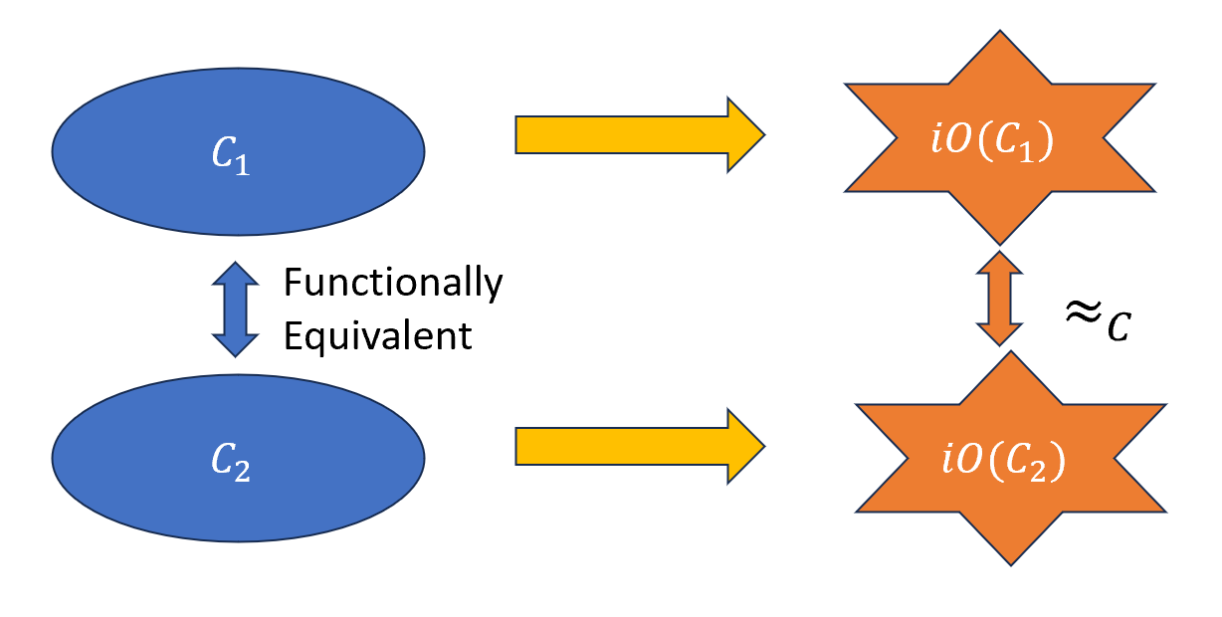
Indistinguishability Obfuscation (iO)
Definition For two functionally equivalent circuits $C_{1}$ and $C_{2}$, an indistinguishability obfuscator $iO(·)$generates a pair of computationally indistinguishable circuits:
$$iO\left(C_{1}\right)≈_{c}iO\left(C_{2}\right)$$

Slide 3
Indistinguishability Obfuscation (iO)

Slide 4
The Feasibility of iO
[GGHRSW’13]
Candidate iO
[JLS’ 22]
iO from well-founded
assumptions
Many Attempts

Slide 5
The Efficiency of iO
All of existing iO constructions have polynomial overhead!
Overhead measured in terms of:
Obfuscated program size
Evaluation time
Note: There are some papers called constant-overhead iO for RAM or TMs, but they are not actually constant overhead, they have polynomial dependency on input length.

Slide 6
The Input-Length Barrier
Conjectured Barrier [JJ’ 22]:
Security reduction for iO must check equivalence of programs
Adversary R “knows” proof of equivalence:
R must enumerate all inputs
# hybrids is exponential in input length
Security parameters $≥$ $poly\left(input length\right)$

Slide 7
Circumventing the Input-Length Barrier
Insight:
Programs to be obfuscated often have a succinct propositional logic proof of equivalence
Jain and Jin:
Sufficient for almost all known applications of iO

Slide 8
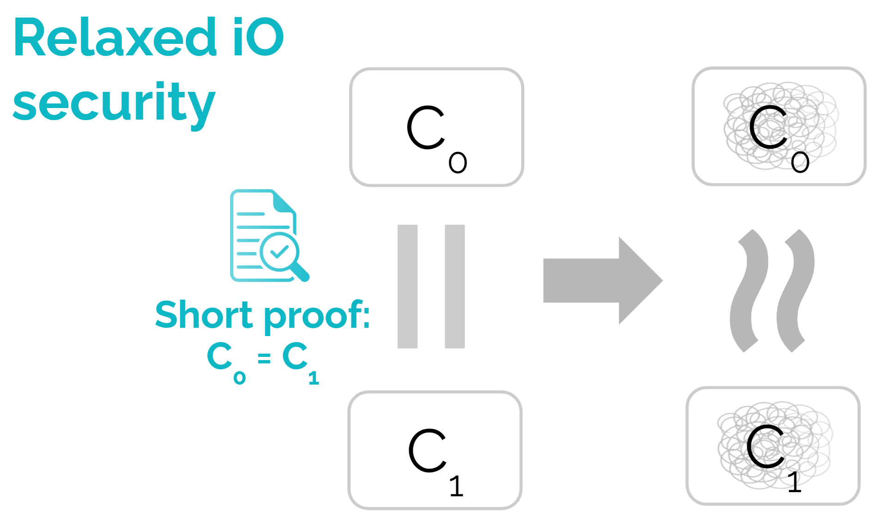
Circumventing the Input-Length Barrier
Insight:
Programs to be obfuscated often have a succinct propositional logic proof of equivalence

Slide 9
Circumventing the Input-Length Barrier
Insight:
Programs to be obfuscated often have a succinct propositional logic proof of equivalence
Assume propositional logic proof of equivalence
Construct quasi-linear iO?
[JJ’ 22]:
Avoids exponential in input-size blowup in security reduction
The instantiation is still inefficient

Slide 10
Our Result
Theorem Assume:
Polynomial (or subexponential) hardness of Learning with Error (LWE)
Sub-exponentially secure one-way functions (OWF)
Sub-exponentially secure iO for circuits of size ${\tilde{O}}_{λ}(1)$
Then, there exists a polynomially secure (or subexponentially secure) indistinguishability obfuscator such that for circuit families of size at most $N_{circ}$ with propositional proof of size at most $N_{proof}$, the obfuscated program size and evaluation time is quasi-linear:
$${\tilde{O}}_{λ}(N_{circ}+N_{proof})$$

Slide 11
Gate-by-Gate Obfuscation Approach
Obfuscating a large circuit with complicated functionality is a hard work!
Try to divide a large circuit into individual gates, and obfuscate them one by one
Advantage: Natural quasi-linear complexity

Slide 12
Gate-by-Gate Obfuscation Approach
Obfuscating a large circuit with complicated functionality is a hard work!
Try to divide a large circuit into individual gates, and obfuscate them one by one
$$Gate_{1}$$
$$Inp_{1}$$
$$Gate_{3}$$
$$Inp_{2}$$
$$Output$$
$$Gate_{2}$$
$$Inp_{3}$$

Slide 13
Gate-by-Gate Obfuscation Approach
Obfuscating a large circuit with complicated functionality is a hard work!
Try to divide a large circuit into individual gates, and obfuscate them one by one
$$Enc(Inp_{1})$$
$$iO(Gate_{1})$$
$$Enc(O_{1})$$
$$Enc(Inp_{2})$$
$$Enc(O_{1})$$
$$iO(Gate_{3})$$
$$Enc(Output)$$
$$Enc(Inp_{2})$$
$$Enc(O_{2})$$
$$iO(Gate_{2})$$
$$Enc(O_{2})$$
$$Enc(Inp_{3})$$

Slide 14
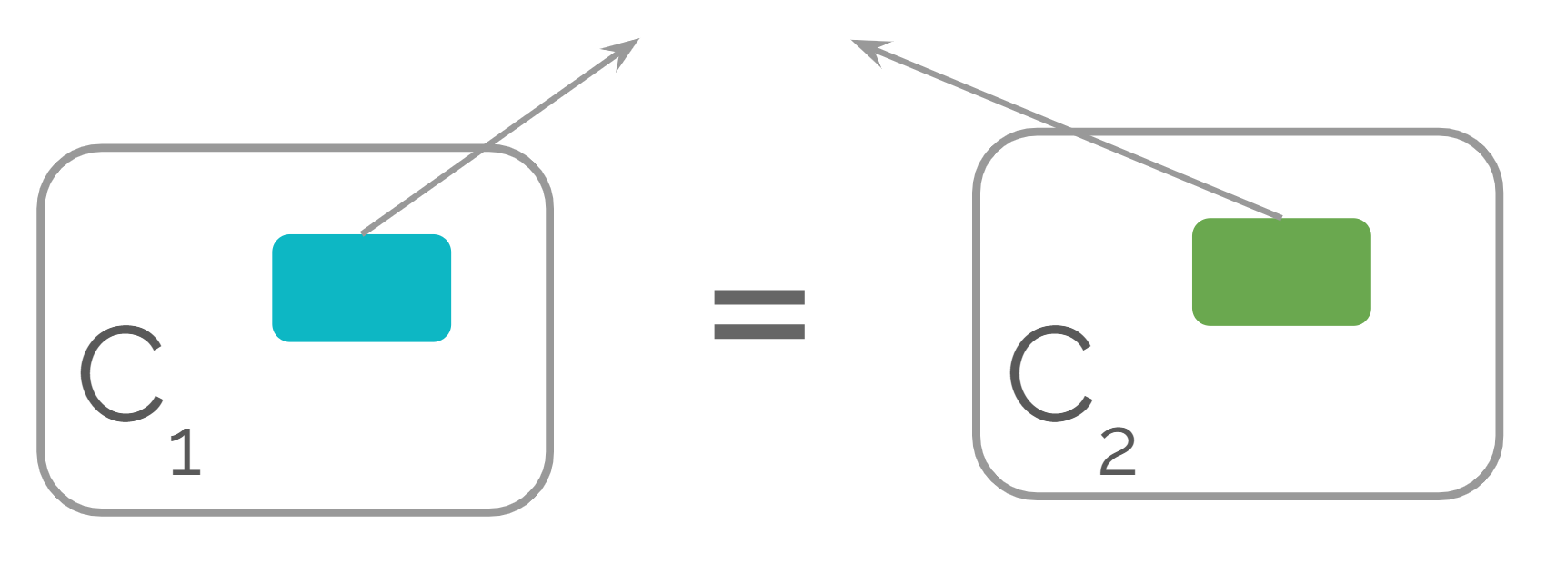
O(log n)-equivalent circuits
Define $O(\log{n})$-equivalent circuits:
Two functionally and topologically equivalent circuits
Differ only in a small subcircuit of at most $O(\log{n)}$ gates

Slide 15
Locally Indistinguishability Obfuscator (LiO)
Locally indistinguishability obfuscator (LiO):
Indistinguishable when obfuscates two $O(log⁡n)$-equivalent circuits:
Adopt a gate-by-gate obfuscation approach
Need to handle the mix-and-match attack

Slide 16
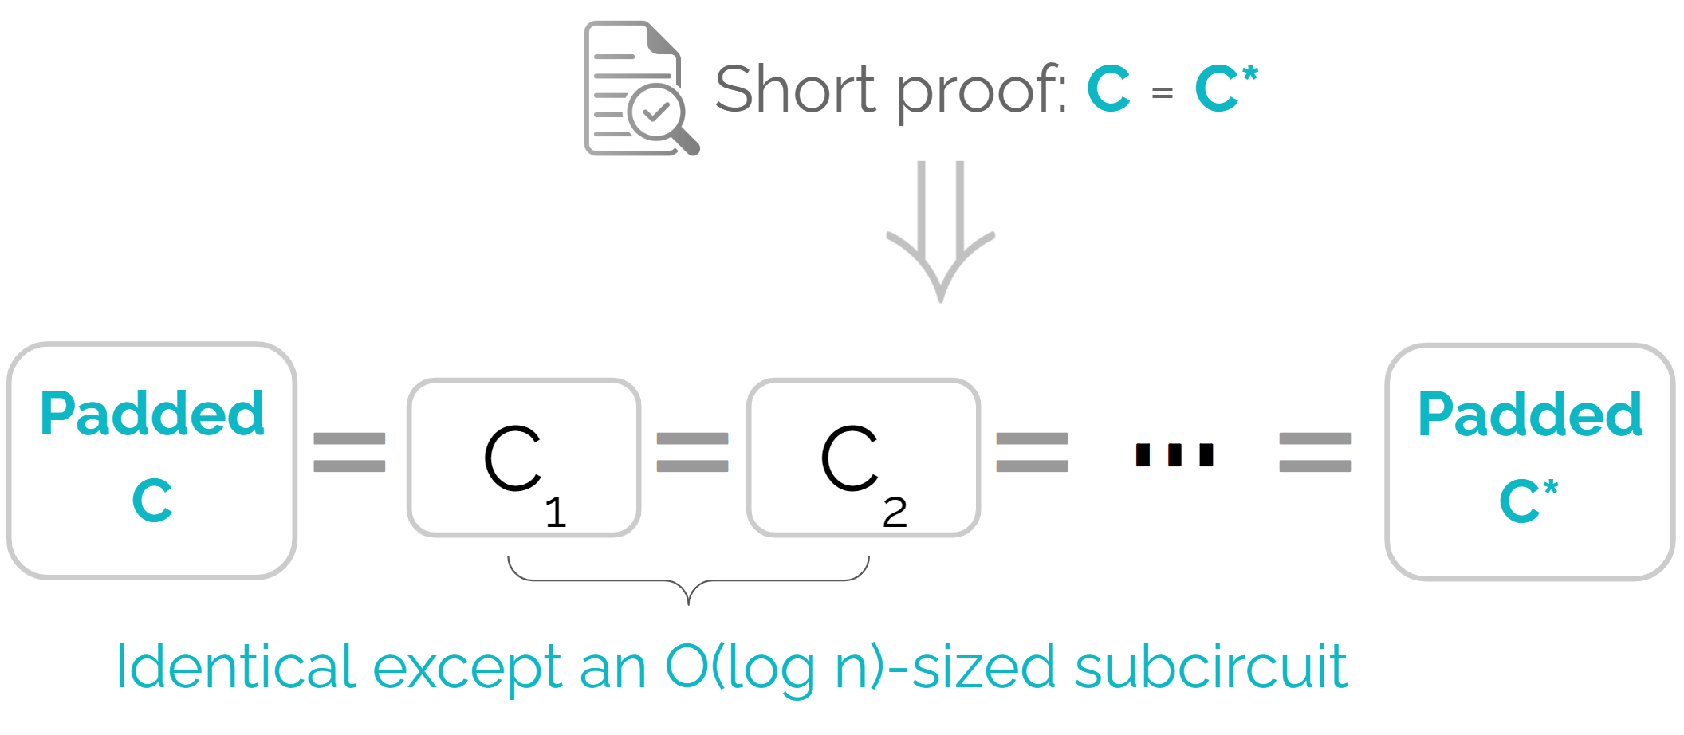
Jain and Jin’s Blueprint
Show that proof of equivalence ⇒ padded circuits can be transformed via sequence of $O(\log{n)}$-equivalent circuits

Slide 17
Jain and Jin’s Blueprint
Pad a circuit into fixed topology, depending on $N_{circ}$ and $N_{proof}$
Construct a locally indistinguishability obfuscator (LiO)
Final construction:
$$iO(·) := LiO(Pad(·, N_{circ}, N_{proof}))$$

Slide 18
Why Jain and Jin’s Construction is Inefficient
Padded circuit size is at least $O\left({\left(N_{circ}+N_{proof}\right)}^{2}\right)$
To prevent mix-and-match attacks:
For every gate $g$, hash all wire values that each input/output wire $g$ depends on
Called somewhere extractable hash (SEH)
Requires $O(N_{padded})$ BARG proofs for up to $N_{padded}$ circuits

Slide 19
Our Novel Ideas
A quasi-linear padding algorithm
An efficient SEH with prefix consistency proofs:
Observe that proving consistency on prefixes is sufficient
Construct SEH without relying on generic BARGs
Incremental algorithm for computing all hashes in quasi-linear time

Slide 20
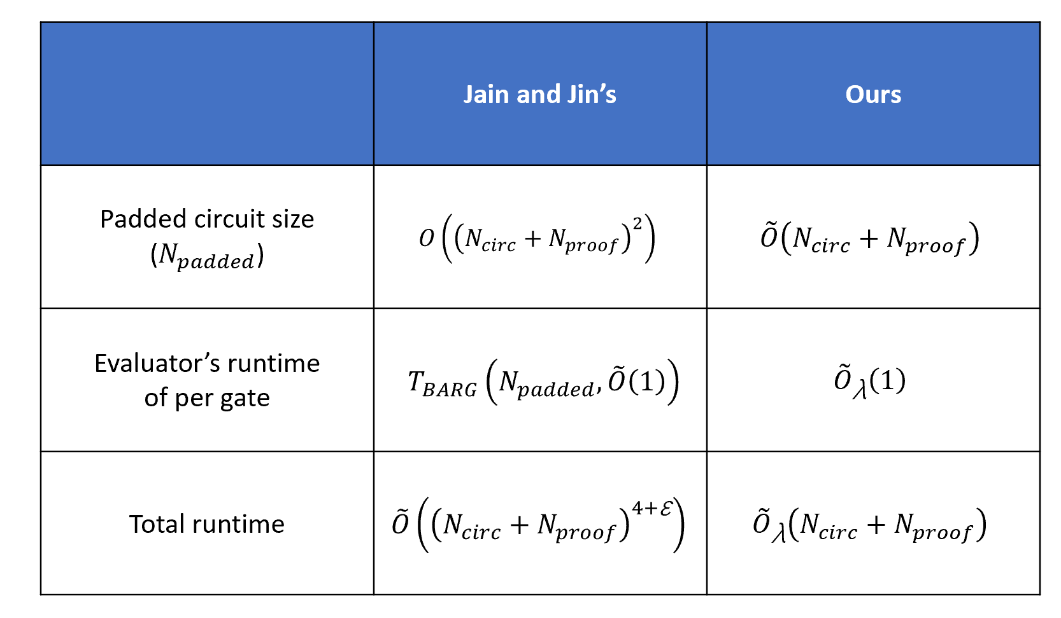
Comparison

Slide 21
Padsingle Algorithm
Takes a circuit $C$ with upper bound $N$ on gates
Converts to a circuit of fixed topology depending only on $N$
Output circuit size is $O(N\log^{2}{N})$

Slide 22
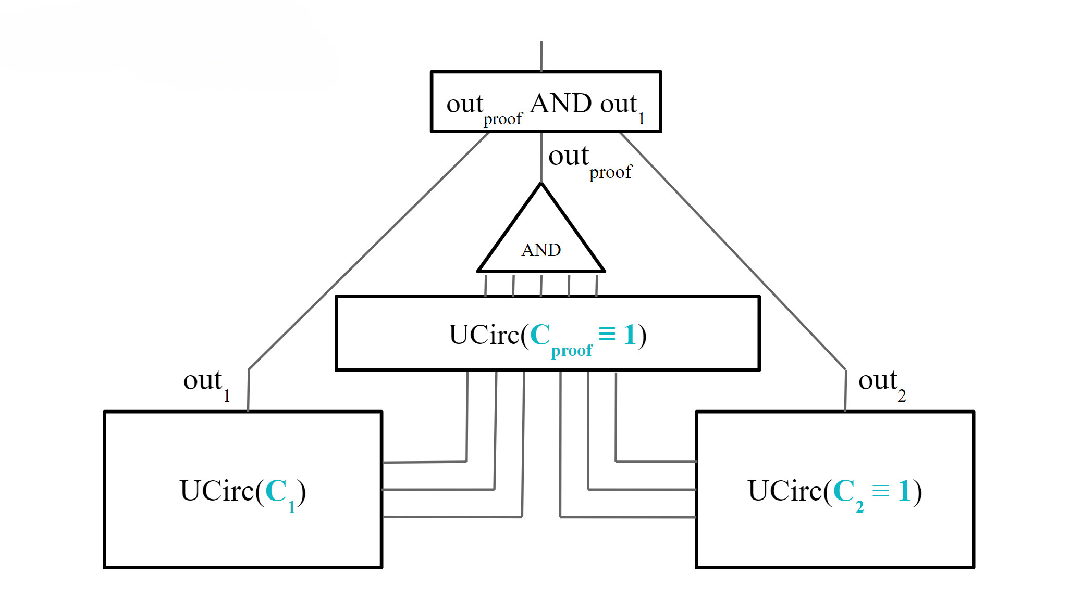
Pad Algorithm

Slide 23
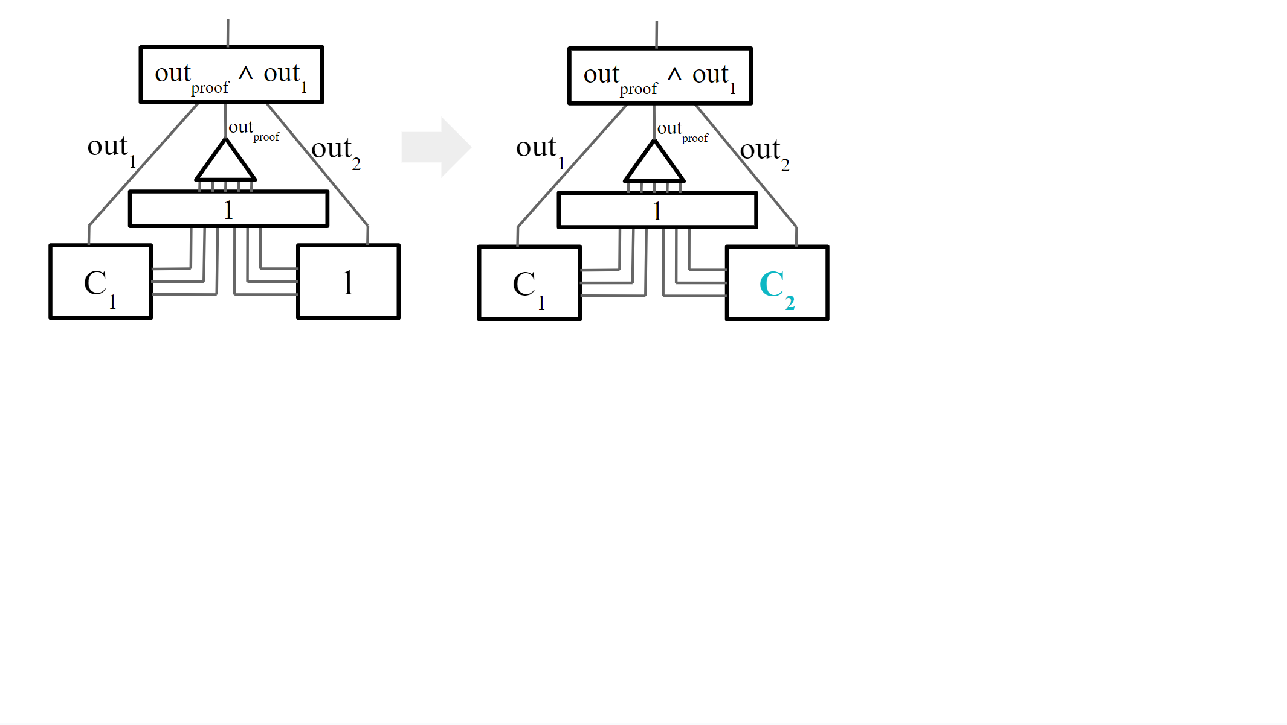
Pad Algorithm

Slide 24
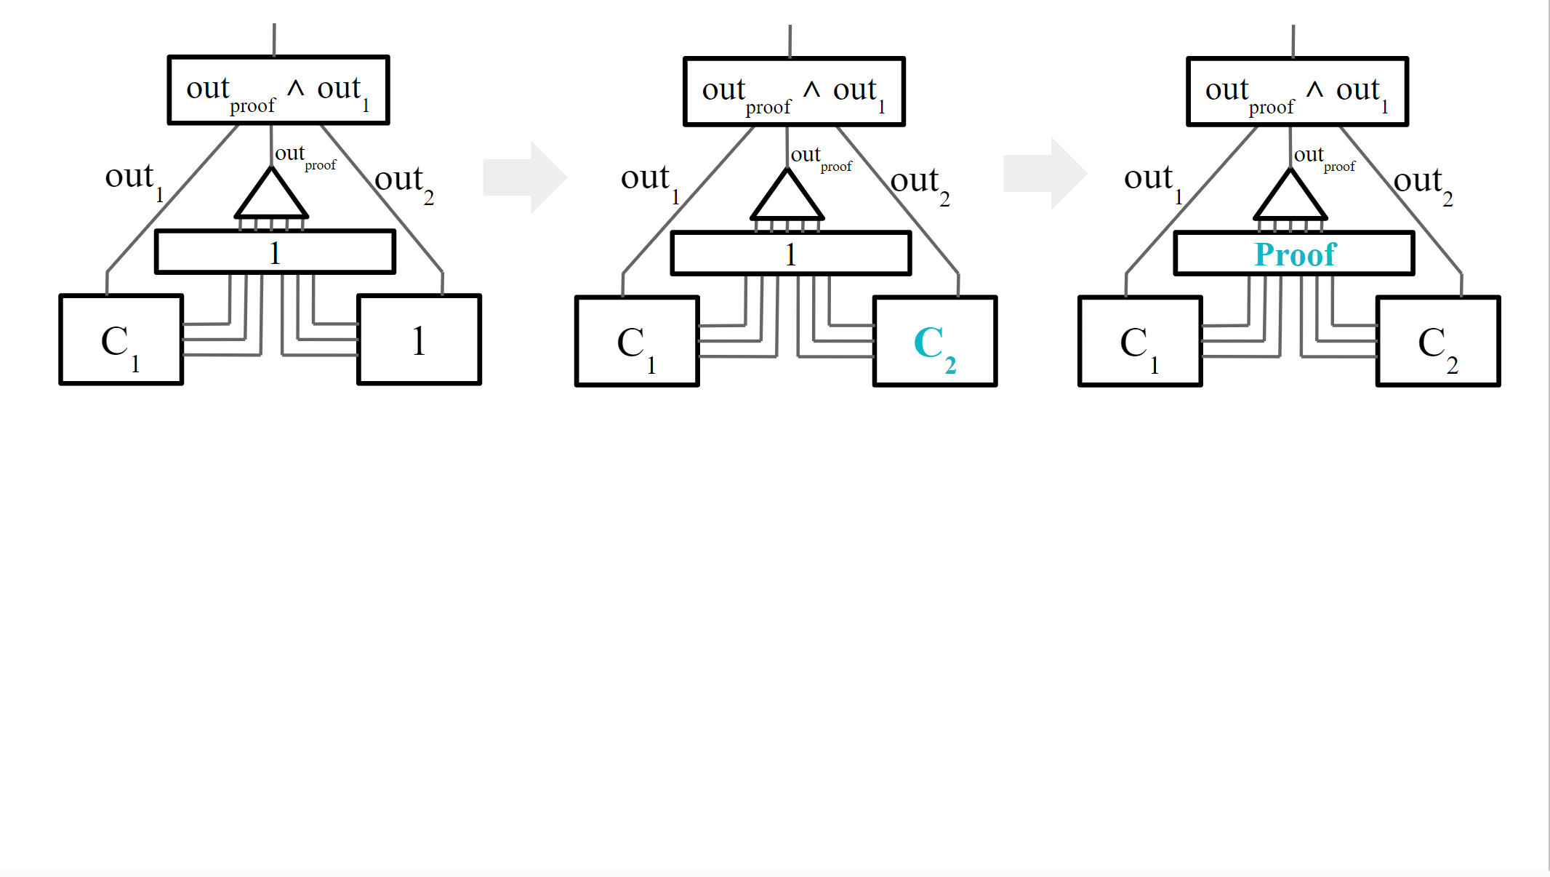
Pad Algorithm

Slide 25
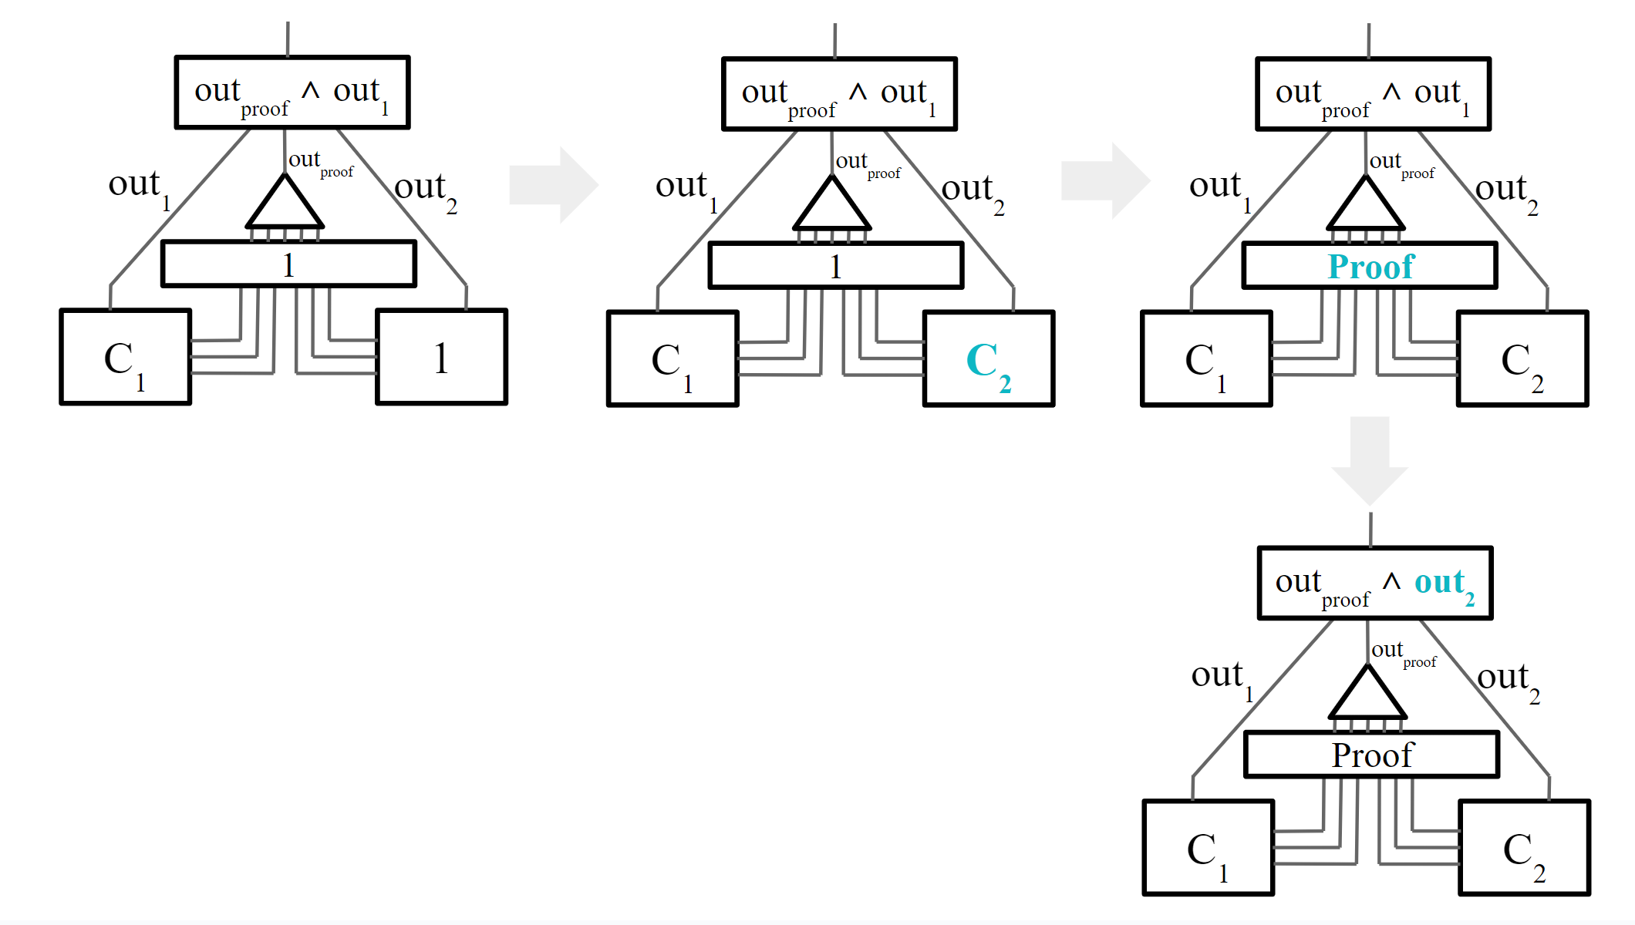
Pad Algorithm

Slide 26
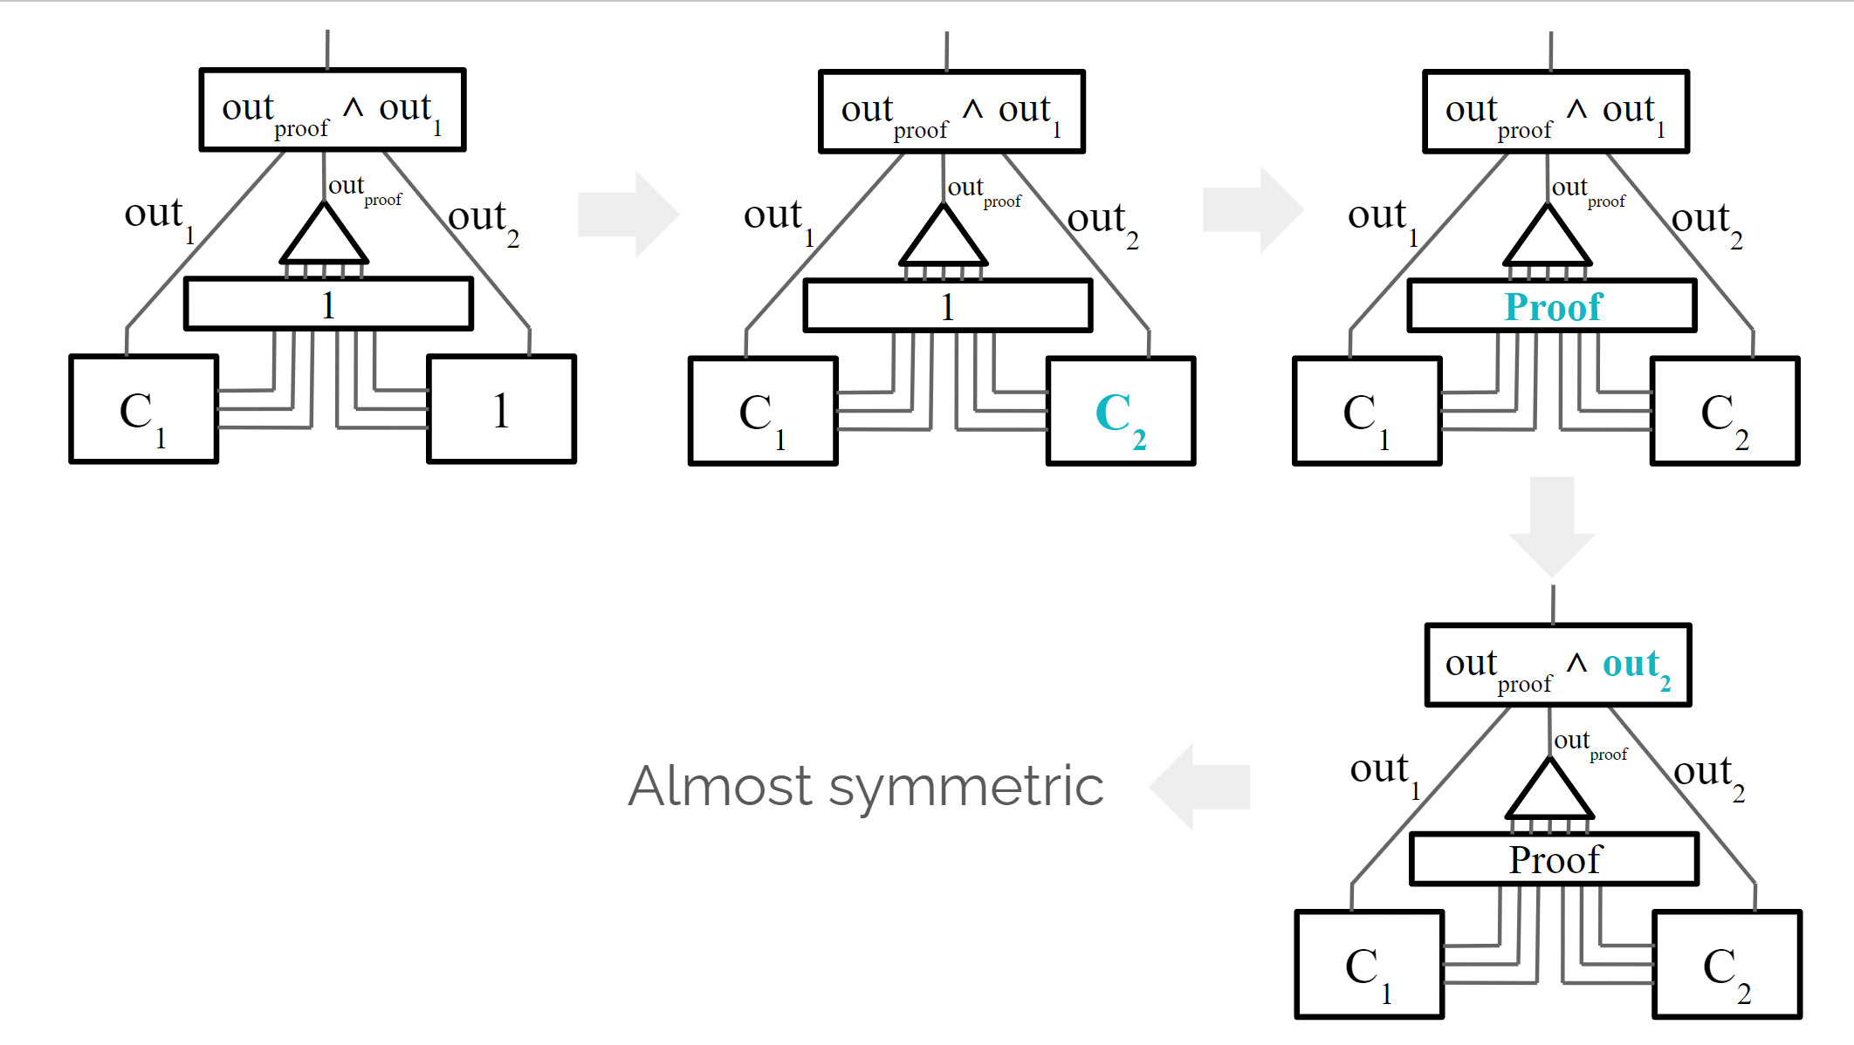
Pad Algorithm

Slide 27
Mix-and-Match Attack
$$ct_{1},σ^{1}$$
$$ct_{2},σ^{2}$$
Assert $σ^{1}, σ^{2}$ are valid MACs for $ct_{1}, ct_{2}$ using $K_{mac}^{1}, K_{mac}^{2}$
$m_{1}, m_{2}=Dec(ct_{1}, ct_{2})$using $K_{enc}^{1}, K_{enc}^{2}$
Compute $out=g(m_{1}, m_{2})$
Output ${ct}^{′}=Enc\left(out\right), σ’=MAC(ct’)$ using $K_{enc}^{out},K_{mac}^{out}$
Can mix $ct,σ$ from two evaluations!
An obfuscated gate via gate-by-gate approach

Slide 28
Mix-and-Match Attack – Jain and Jin’s Patch
$$ct_{1},h_{1},σ^{1}$$
$$ct_{2},h_{2},σ^{2}$$
$$h^{′}, π$$
Assert $π$ proves that $(ct_{1}, ct_{2}, h_{1}, h_{2})$ consistent with $h′$
Assert $σ^{1}, σ^{2}$ are valid MACs for $\left(ct_{1},h_{1}\right), (ct_{2},h_{2})$ using $K_{mac}^{1}, K_{mac}^{2}$
$m_{1}, m_{2}=Dec(ct_{1}, ct_{2})$using $K_{enc}^{1}, K_{enc}^{2}$
Compute $out=g(m_{1}, m_{2})$
Output ${ct}^{′}=Enc\left(out\right), σ’=MAC(ct’,h′)$ using $K_{enc}^{out},K_{mac}^{out}$
SEH Hash
BARG (All Dependencies)
An obfuscated gate via gate-by-gate approach

Slide 29
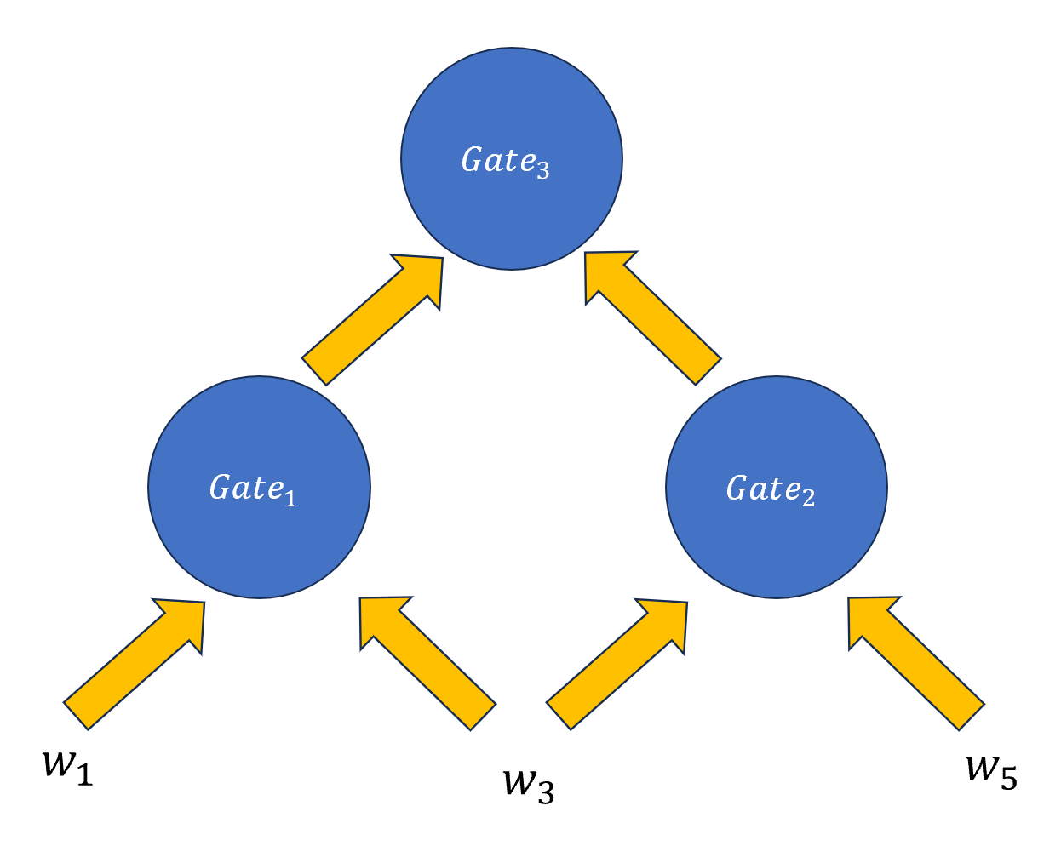
Our Improvement – Idea
$dep_{1}$: $w_{11},w_{13}$
$dep_{2}$: $w_{23},w_{25}$
$dep_{3}$: $w_{31},w_{33}, w_{35}$
$$Need to prove:$$
$$\left(w_{11},w_{13}\right)=(w_{31},w_{33})$$
$$\left(w_{23},w_{25}\right)=(w_{33},w_{35})$$

Slide 30
Our Improvement – Idea
$dep_{1}$: $w_{11},{w_{12},w}_{13},$Ø, Ø
$dep_{2}$: ${w_{21},w_{22},w}_{23},w_{24},w_{25}$
$dep_{3}$: $w_{31},{w_{32},w}_{33}, {w_{34},w}_{35}$
$$Need to prove:$$
$$\left(w_{11},{w_{12},w}_{13}\right)=(w_{31},{w_{32},w}_{33})$$
$$\left({w_{21},w_{22},w}_{23},w_{24},w_{25}\right)=(w_{31},{w_{32},w}_{33}, {w_{34},w}_{35})$$

Slide 31
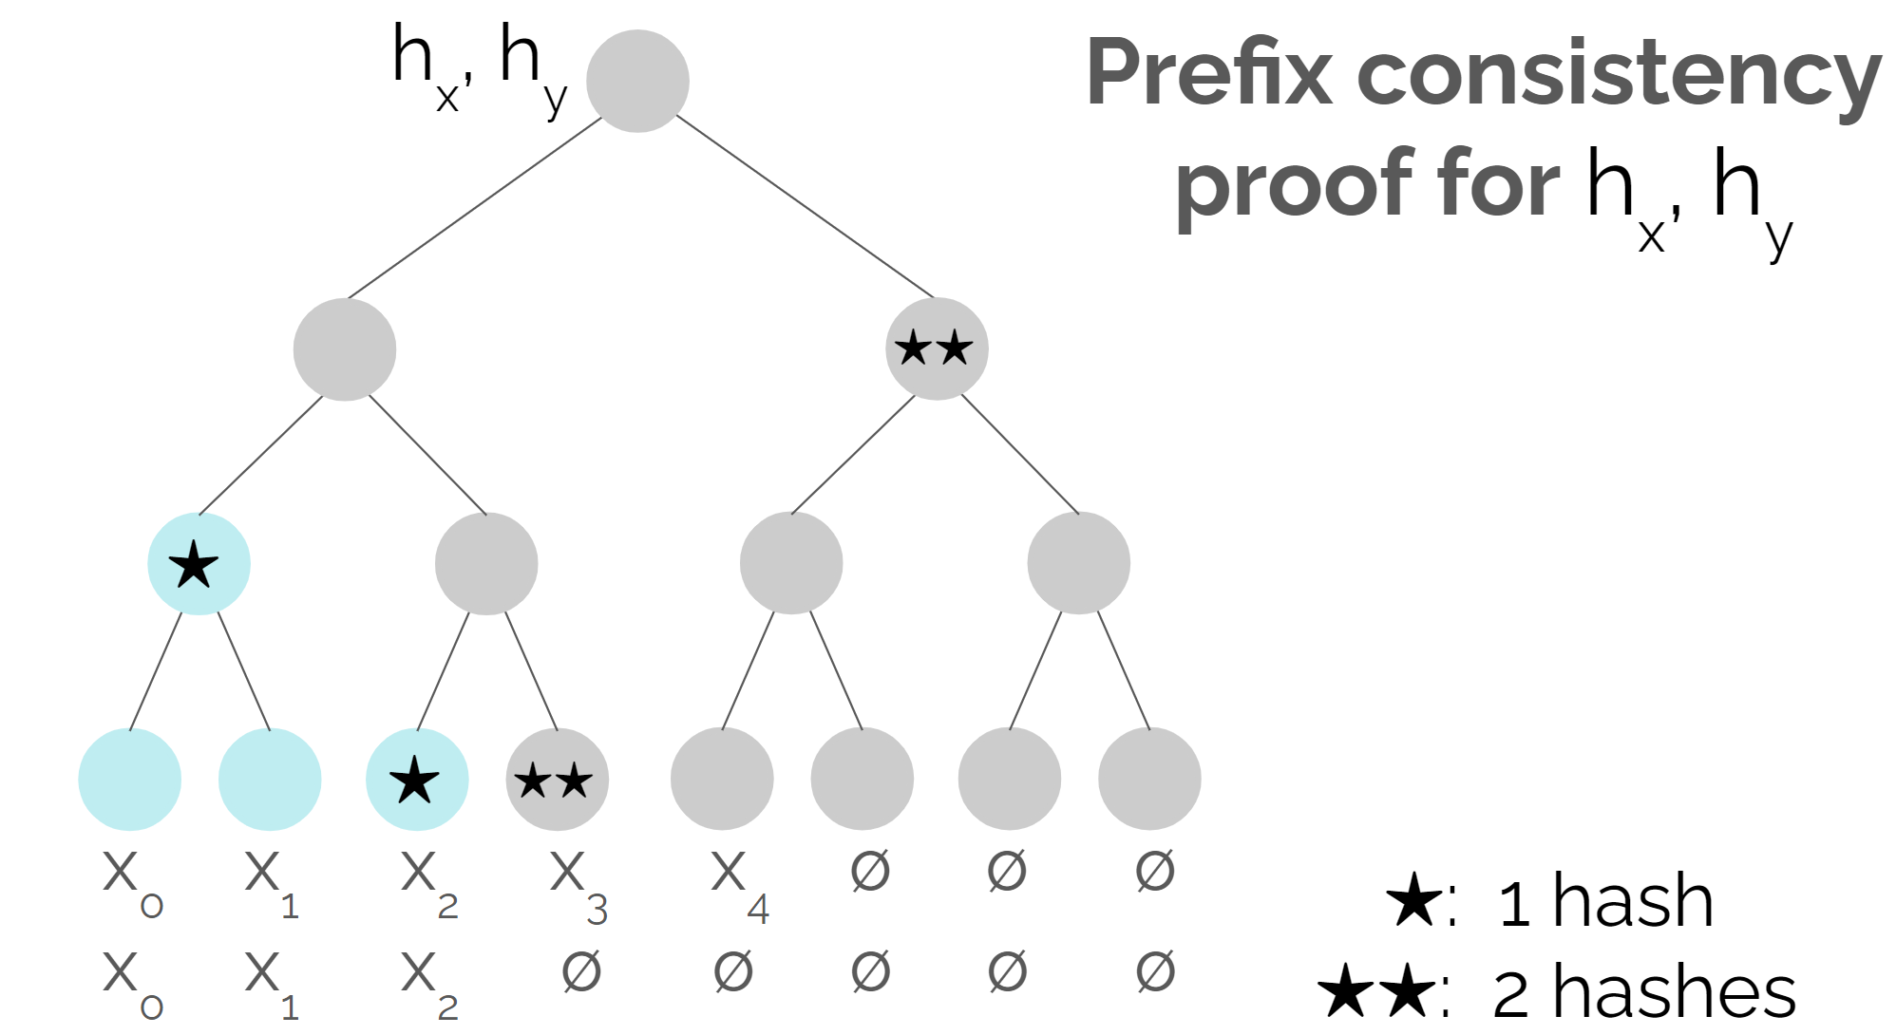
Our Improvement – SEH with prefix consistency proofs

Slide 32
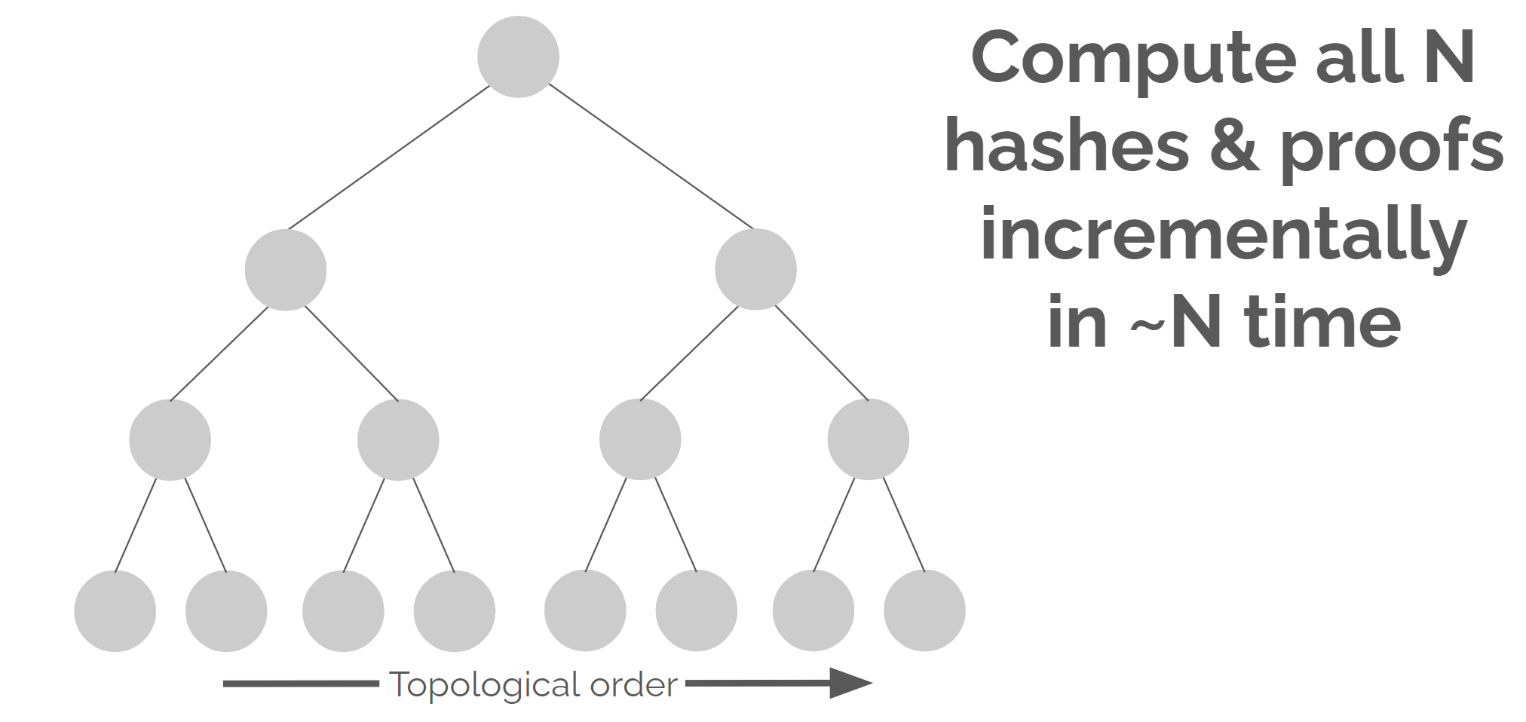
Our Improvement – SEH with prefix consistency proofs
Every wire: hash dependent wires Every gate: prove input hash consistent with output hash

Slide 33
Applications
Quasi-linear Multi-Input Functional Encryption (MIFE)
Quasi-linear iO for Turing Machines

Slide 34
Open Questions
Prove or disprove the input-length barrier
Construct an efficient polynomially secure iO from assumptions of polynomial hardness
Instantiate concretely efficient iO

Slide 35
Thanks for your listening！
ma-yh21@mails.tsinghua.edu.cn

