Slide 1
Binary Codes for Error Detection and Correction in a Computationally Bounded World
Jad Silbak Northeastern University
Daniel Wichs Northeastern University

Slide 2
Error Correction Codes and Cryptography
Cryptography
This Talk
Error Correction Codes
Secret Sharing and MPC,
Hardcore Bits,
Multi-Server PIR,
PCPs and Succinct Arguments,
Code-based Crypto (McEliece, LPN),
…
Notes:
This talk lies in the intersection of coding theory and cryptography.
Now we all know that coding theory is extremely important for theortical computer sceince and this is also true of of cource for cryptography.
It is used everywhere, and these are just some examples.
But this talk is about the other direction. Its about how we can use cryptography to get better error correcting codes.

Slide 3



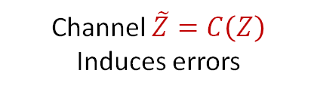

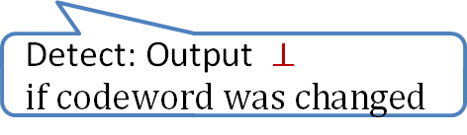

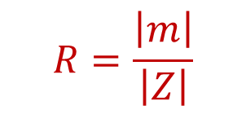
Binary Error Correcting Codes
$$R=\frac{\left|m\right|}{\left|Z\right|}$$
$$Z∈{\left\{0,1\right\}}^{n}$$
Channel $\tilde{Z}=C\left(Z\right)$
Induces errors
$$m$$
$$Z=Enc(m)$$
$$Dec(\tilde{Z})$$
$m$
$$\text{Detect}\text{:} \text{O}\text{utput} ⊥ \\ if codeword was changed$$
Hamming channels: Can change any $pn$ bits in $Enc\left(m\right)$.
The channel is an information theoretic adversary that depends on $Enc\left(m\right)$.
Notes:
Z is binary….

Slide 4
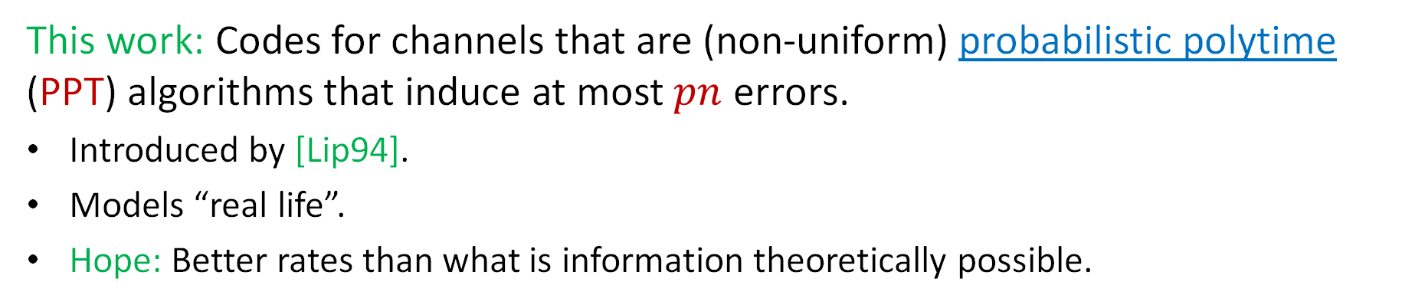
Computationally Bounded Adversaries
$$R=\frac{\left|m\right|}{\left|Z\right|}$$
$$Z∈{\left\{0,1\right\}}^{n}$$
Channel $\tilde{Z}=C\left(Z\right)$
Induces errors
$$m$$
$$Z=Enc(m)$$
$$Dec(\tilde{Z})$$
$m$
$$\text{Detect}\text{:} \text{O}\text{utput} ⊥ \\ if codeword was changed$$
Hamming channels: Can change any $pn$ bits in $Enc\left(m\right)$.
The channel is an information theoretic adversary that depends on $Enc\left(m\right)$.
This work: Codes for channels that are (non-uniform) probabilistic polytime (PPT) algorithms that induce at most $pn$ errors.
Introduced by [Lip94].
Models “real life”.
Hope: Better rates than what is information theoretically possible.

Slide 5






Limitations on bounded channels
Codes against nonuniform PPT channels
Codes against Information theoretic channel
Implies
Solution:
Encoding has access to randomness.
Decoding succeeds only with high probability.
$$Enc\left(m\right)=z$$
$$pn$$
$$pn$$
$$z⊕e=C\left(z\right)$$
$$y$$
$$z$$

Slide 6
Prior Work: Secret Setup
  [Lip94] Lipton: Shared secret key.
  [MPSW10] Micali, Peikert, Sudan, and Wilson: Public-key infrastructure.

Slide 7
Prior Work: More Recent Results
  Large alphabet: [SW24] optimal result under OWF/CRH without setup/CRS.
  Seeded codes: [GHY20] Grossman, Holmgren and Yogev
  Encoding and Decoding have access to a common reference string CRS.
  [GHY20] Constructed such codes form a strong form of two-input correlation intractability (instantiated in the random oracle model).
  This work: Binary seeded codes under standard assumptions.

Slide 8

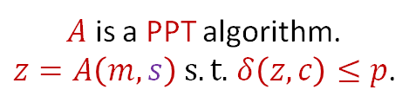




Seeded Codes
$s$ is uniformly chosen
$A$also receive $s$
$A$ is a PPT algorithm.
$z=A\left(m,s\right) s.t.$ $δ\left(z,c\right)≤p$.
$$c=Enc_{s}(m)$$
$$Dec_{s}(z)$$
$$m$$
$m$
Notes:
Say that there is no setup in both definitions!

Slide 9
Seeded Codes: Selective VS Adaptive
$s$ is uniformly chosen
$A$also receive $s$
$A$ is a PPT algorithm.
$z=A\left(m,s\right) s.t.$ $δ\left(z,c\right)≤p$.
$$c=Enc_{s}(m)$$
$$Dec_{s}(z)$$
$$m$$
$m$
Notes:
Say that there is no setup in both definitions!

Slide 10
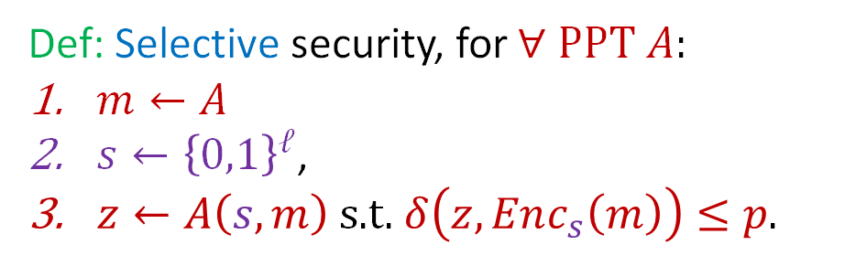
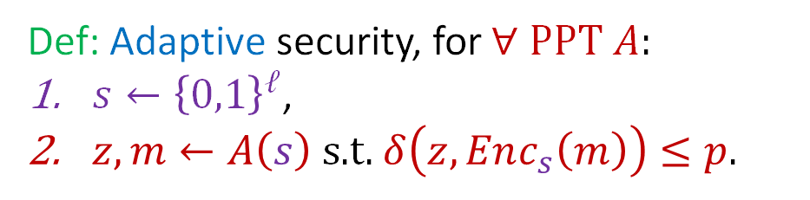
Seeded Codes: Selective VS Adaptive
$s$ is uniformly chosen
$A$also receive $s$
$A$ is a PPT algorithm.
$z=A\left(m,s\right) s.t.$ $δ\left(z,c\right)≤p$.
$$c=Enc_{s}(m)$$
$$Dec_{s}(z)$$
$$m$$
$m$
Def: Selective security, for$∀ \text{PPT} A\text{:}$
$m←A$
$s←{\left\{0,1\right\}}^{ℓ}$,
$z←A\left(s,m\right)$ s.t. $δ\left(z,Enc_{s}\left(m\right)\right)≤p$.
Def: Adaptive security, for$∀ \text{PPT} A\text{:}$
$s←{\left\{0,1\right\}}^{ℓ}$,
$z,m←A\left(s\right)$ s.t. $δ\left(z,Enc_{s}\left(m\right)\right)≤p$.
Correction: $Pr\left[Dec_{s}\left(z\right)=m\right]≥ 1 −neg\left(n\right)$
Detection: $Pr\left[Dec_{s}\left(z\right)=\{m,⊥\}\right]≥ 1 −neg\left(n\right)$
Notes:
Say that there is no setup in both definitions!

Slide 11
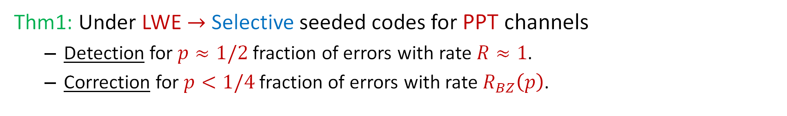
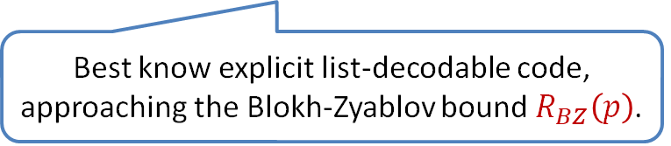
Main Result of This Work
Thm1: Under LWE $→$ Selective seeded codes for PPT channels
  Detection for $p≈1/2$fraction of errors with rate $R≈1$.
  Correction for $p<1/4$ fraction of errors with rate $R_{BZ}\left(p\right)$.
Best know explicit list-decodable code, approaching the Blokh-Zyablov bound $R_{BZ}\left(p\right)$.
Better than what is possible against information theoretic adversaries.
Example: For $p≈¼$, $R_{BZ}\left(p\right)≈0.037$ while in the information theoretic setting $R=0.$
Result can be extended given better explicit list-decodable codes (with a special property).

Slide 12
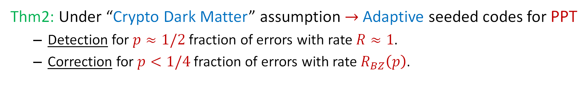
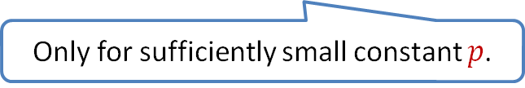
Main Result of This Work
Boneh, Ishai, Passelegue, Sahai, and Wu:
Compose linear operations over different moduli to get cryptographic hardness.
Thm2: Under “Crypto Dark Matter” assumption $→$ Adaptive seeded codes for PPT
  Detection for $p≈1/2$fraction of errors with rate $R≈1$.
  Correction for $p<1/4$ fraction of errors with rate $R_{BZ}\left(p\right)$.
Only for sufficiently small constant $p$.
Better than what is possible against information theoretic adversaries.
Example: For $p≈¼$, $R_{BZ}\left(p\right)≈0.037$ while in the information theoretic setting $R=0.$
Result can be extended given better explicit list-decodable codes (with a special property).

Slide 13
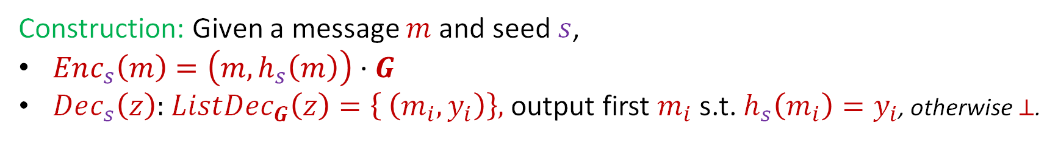
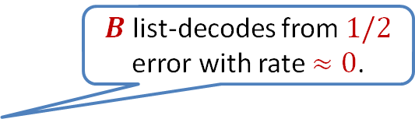
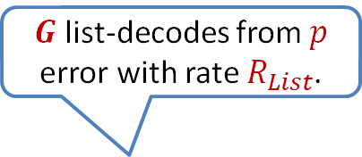
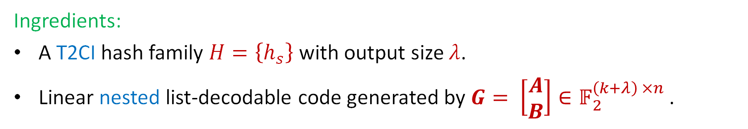
Construction for Selective Seeded Codes
A type of 2-input correlation intractability
$G$ list-decodes from $p$ error with rate $R_{List}$.
Ingredients:
A T2CI hash family $H=\left\{h_{s}\right\}$ with output size $λ$.
Linear nested list-decodable code generated by $G= \left[\begin{matrix}A \\ B\end{matrix}\right]∈𝔽_{2}^{\left(k+λ\right) ×n}$ .
$B$ list-decodes from $1/2$ error with rate $≈0$.
Construction: Given a message $m$ and seed $s$,
$Enc_{s}\left(m\right)=\left(m,h_{s}\left(m\right)\right)⋅G$
$Dec_{s}\left(z\right):$ $ListDec_{G}\left(z\right)=\left\{ \left(m_{i},y_{i}\right)\right\},$output first $m_{i}$s.t. $h_{s}\left(m_{i}\right)=y_{i}$, otherwise $⊥$.
Notes:
(which is chosen and published, once and for all, in a pre-processing stage).

Slide 14
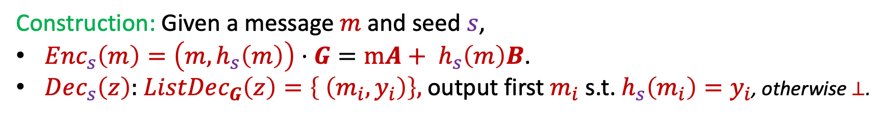
Construction for Selective Seeded Codes
A type of 2-input correlation intractability
$G$ list-decodes from $p$ error with rate $R_{List}$.
Ingredients:
A T2CI hash family $H=\left\{h_{s}\right\}$ with output size $λ$.
Linear nested list-decodable code generated by $G= \left[\begin{matrix}A \\ B\end{matrix}\right]∈𝔽_{2}^{\left(k+λ\right) ×n}$ .
$B$ list-decodes from $1/2$ error with rate $≈0$.
Construction: Given a message $m$ and seed $s$,
$Enc_{s}\left(m\right)=\left(m,h_{s}\left(m\right)\right)⋅G=mA+ h_{s}\left(m\right)B$.
$Dec_{s}\left(z\right):$ $ListDec_{G}\left(z\right)=\left\{ \left(m_{i},y_{i}\right)\right\},$output first $m_{i}$s.t. $h_{s}\left(m_{i}\right)=y_{i}$, otherwise $⊥$.
Notes:
(which is chosen and published, once and for all, in a pre-processing stage).

Slide 15
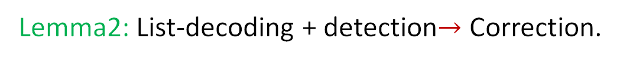
Construction for Selective Seeded Codes
A type of 2-input correlation intractability
$G$ list-decodes from $p$ error with rate $R_{List}$.
Ingredients:
A T2CI hash family $H=\left\{h_{s}\right\}$ with output size $λ$.
Linear nested list-decodable code generated by $G= \left[\begin{matrix}A \\ B\end{matrix}\right]∈𝔽_{2}^{\left(k+λ\right) ×n}$ .
$B$ list-decodes from $1/2$ error with rate $≈0$.
Construction: Given a message $m$ and seed $s$,
$Enc_{s}\left(m\right)=\left(m,h_{s}\left(m\right)\right)⋅G=mA+ h_{s}\left(m\right)B$.
$Dec_{s}\left(z\right):$ $ListDec_{G}\left(z\right)=\left\{ \left(m_{i},y_{i}\right)\right\},$output first $m_{i}$s.t. $h_{s}\left(m_{i}\right)=y_{i}$, otherwise $⊥$.
Lemma1: The code detects from ½-errors.
Lemma2: List-decoding + detection$→$ Correction.
Notes:
(which is chosen and published, once and for all, in a pre-processing stage).

Slide 16
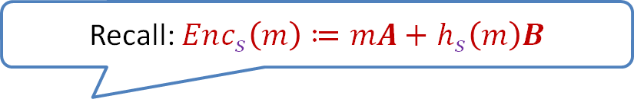
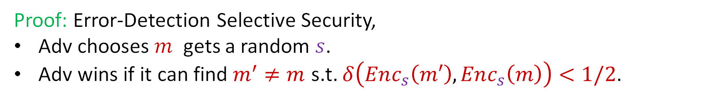
Selectively Secure Error Detection
Lemma1: The code detects from $1/2$-errors.
Recall: $Enc_{s}\left(m\right)≔mA+$ $h_{s}\left(m\right)B$
Proof: Error-Detection Selective Security,
Adv chooses $m$ gets a random $s$.
Adv wins if it can find $m^{′}≠m$ s.t. $δ\left(Enc_{s}\left(m′\right),Enc_{s}\left(m\right)\right)<1/2$.
$$δ\left(m′A+h_{s}\left(m′\right)B ,mA+h_{s}\left(m\right)B\right)<1/2$$
Notes:
(which is chosen and published, once and for all, in a pre-processing stage).

Slide 17
Selectively Secure Error Detection
Lemma1: The code detects from $1/2$-errors.
Recall: $Enc_{s}\left(m\right)≔mA+$ $h_{s}\left(m\right)B$
Proof: Error-Detection Selective Security,
Adv chooses $m$ gets a random $s$.
Adv wins if it can find $m^{′}≠m$ s.t. $δ\left(Enc_{s}\left(m′\right),Enc_{s}\left(m\right)\right)<1/2$.
$$δ\left(h_{s}\left(m′\right)B , mA+h_{s}\left(m\right)B−m′A\right)<1/2$$
Notes:
(which is chosen and published, once and for all, in a pre-processing stage).

Slide 18
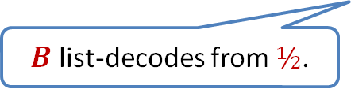

Selectively Secure Error Detection
Lemma1: The code detects from $1/2$-errors.
Recall: $Enc_{s}\left(m\right)≔mA+$ $h_{s}\left(m\right)B$
Proof: Error-Detection Selective Security,
Adv chooses $m$ gets a random $s$.
Adv wins if it can find $m^{′}≠m$ s.t. $δ\left(Enc_{s}\left(m′\right),Enc_{s}\left(m\right)\right)<1/2$.
$$δ\left(h_{s}\left(m′\right)B , mA+h_{s}\left(m\right)B−m′A\right)<1/2$$
    $$h_{s}\left(m^{′}\right)∈ ListDec_{B}\left(mA+h_{s}\left(m\right)B−m^{′}A\right)$$
$B$ list-decodes from $½$.
$$f(m,m^{′},h_{s}(m))$$
Notes:
(which is chosen and published, once and for all, in a pre-processing stage).

Slide 19


Selectively Secure Error Detection
Lemma1: The code detects from $1/2$-errors.
Proof: Error-Detection Selective Security,
Adv chooses $m$ gets a random $s$.
Adv wins if it can find $m^{′}≠m$ s.t. $δ\left(Enc_{s}\left(m′\right),Enc_{s}\left(m\right)\right)<1/2$.
Target 2-input correlation-intractable hash (T2CI):
$$h_{s}\left(m^{′}\right)∈f(m,m^{′},h_{s}\left(m\right))$$
$$δ\left(h_{s}\left(m′\right)B , mA+h_{s}\left(m\right)B−m′A\right)<1/2$$
    $$h_{s}\left(m^{′}\right)∈ ListDec_{B}\left(mA+h_{s}\left(m\right)B−m^{′}A\right)$$
$B$ list-decodes from $½$.
$$f(m,m^{′},h_{s}(m))$$
Notes:
(which is chosen and published, once and for all, in a pre-processing stage).

Slide 20
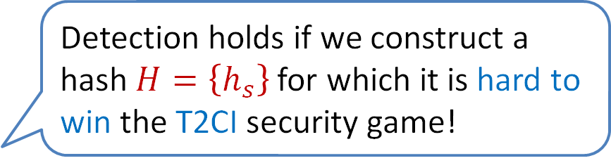
Selectively Secure Error Detection
Detection holds if we construct a hash $H=\left\{h_{s}\right\}$ for which it is hard to win the T2CI security game!
Lemma1: The code detects from $1/2$-errors.
Proof: Error-Detection Selective Security,
Adv chooses $m$ gets a random $s$.
Adv wins if it can find $m^{′}≠m$ s.t. $δ\left(Enc_{s}\left(m′\right),Enc_{s}\left(m\right)\right)<1/2$.
Target 2-input correlation-intractable hash (T2CI):
$$h_{s}\left(m^{′}\right)∈f(m,m^{′},h_{s}\left(m\right))$$
$$δ\left(h_{s}\left(m′\right)B , mA+h_{s}\left(m\right)B−m′A\right)<1/2$$
    $$h_{s}\left(m^{′}\right)∈ ListDec_{B}\left(mA+h_{s}\left(m\right)B−m^{′}A\right)$$
$B$ list-decodes from $½$.
$$f(m,m^{′},h_{s}(m))$$
Notes:
(which is chosen and published, once and for all, in a pre-processing stage).

Slide 21
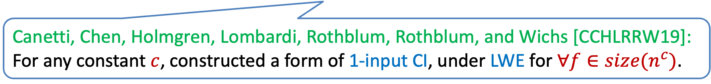
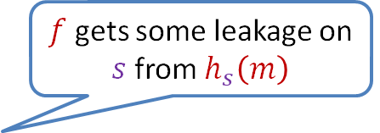
Target 2-input correlation-intractable hash
Selective notion of security!
Weaker than the “general” notion of 2-input CI.
$f$ gets some leakage on $s$ from $h_{s}\left(m\right)$
Proof: Error-Detection Selective Security,
Adv chooses $m$ gets a random $s$.
Adv wins if it can find $m^{′}≠m$ s.t. $δ\left(Enc_{s}\left(m′\right),Enc_{s}\left(m\right)\right)<1/2$.
Target 2-input correlation-intractable hash (T2CI):
$$h_{s}\left(m^{′}\right)∈f(m,m^{′},h_{s}\left(m\right))$$
Canetti, Chen, Holmgren, Lombardi, Rothblum, Rothblum, and Wichs [CCHLRRW19]:
For any constant $c$, constructed a form of 1-input CI, under LWE for $∀f∈size(n^{c})$.
Thm: Under LWE, for any fixed constant $c,$ we construct a hash family $H=\left\{h_{s}\right\}$, such that $∀f∈size(n^{c}),$ and $∀$ PPT adversary, the adversary wins with negligible probability.
Notes:
(which is chosen and published, once and for all, in a pre-processing stage).

Slide 22
Conclusions and Open Problems
This work (main results):
Uniquely decodable binary seeded codes against any PPT adversaries matching the rate of the best know list-decodable code.
  Selective security under LWE.
  Adaptive security under “crypto dark matter” assumption.
New notion: Target 2-input correlation-intractable hash (T2CI).
Open problems:
Adaptive seeded codes under standard assumptions?
Construct optimal binary codes without a seed/CRS.

