Slide 1
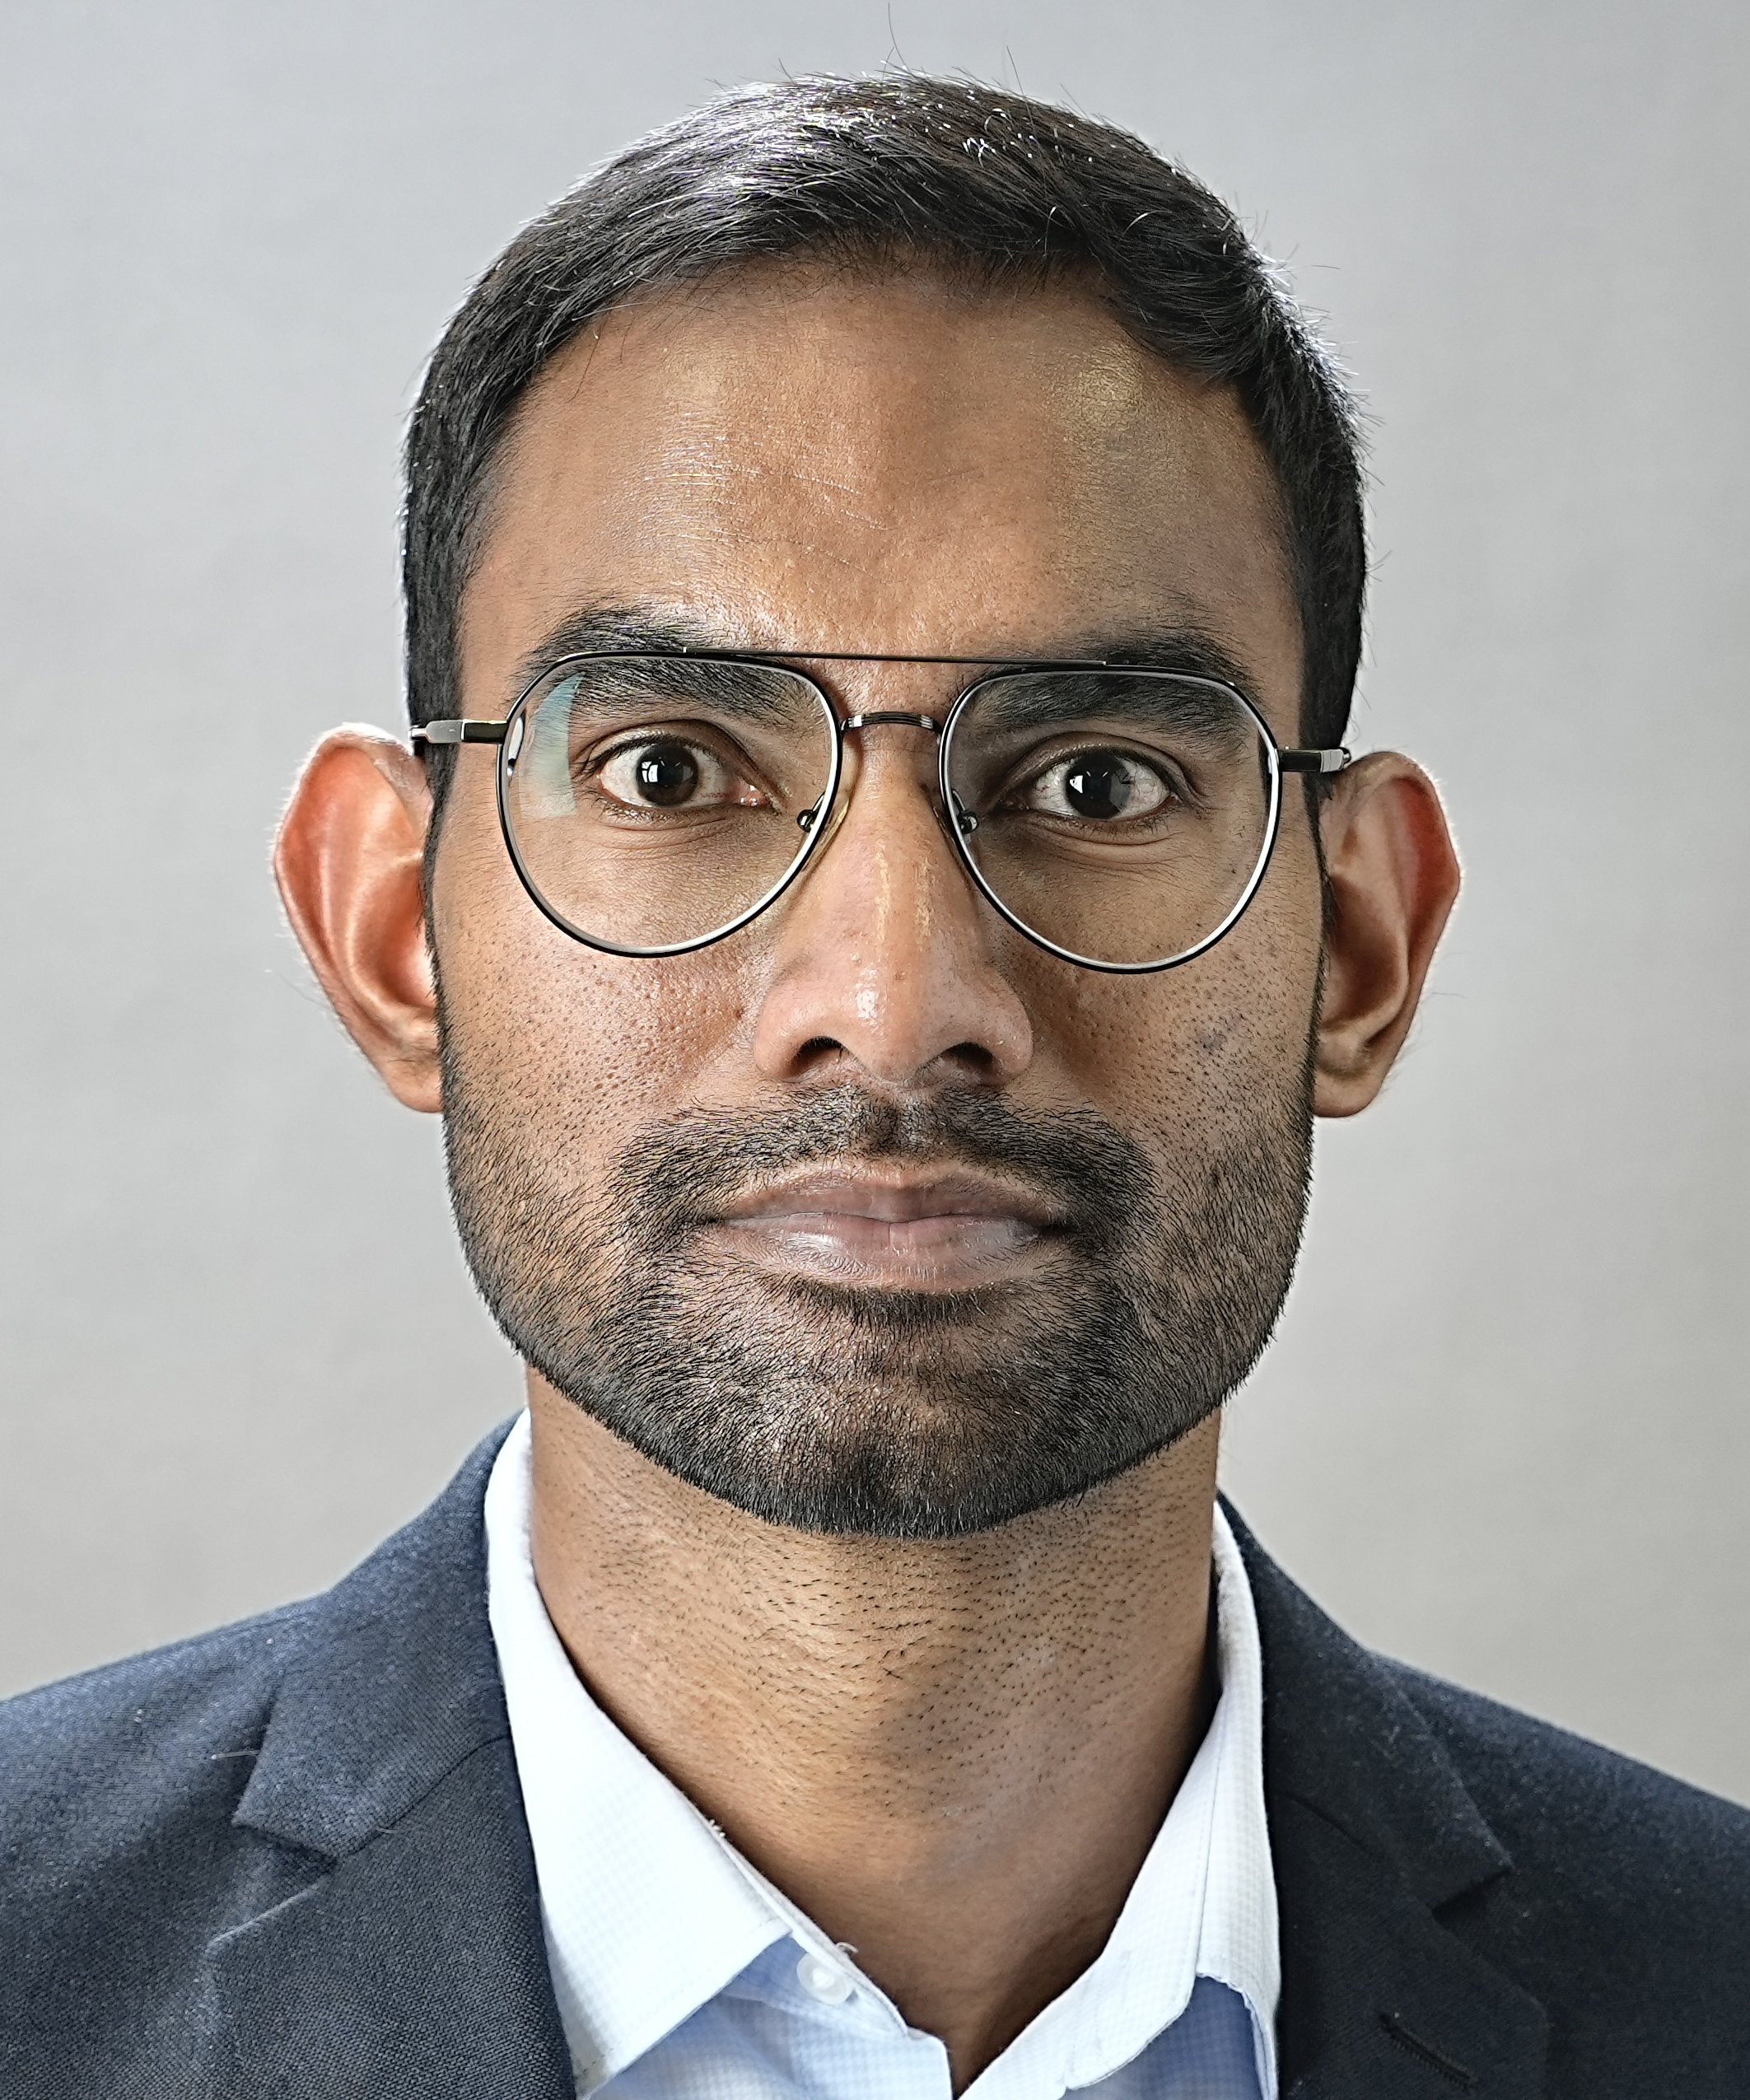
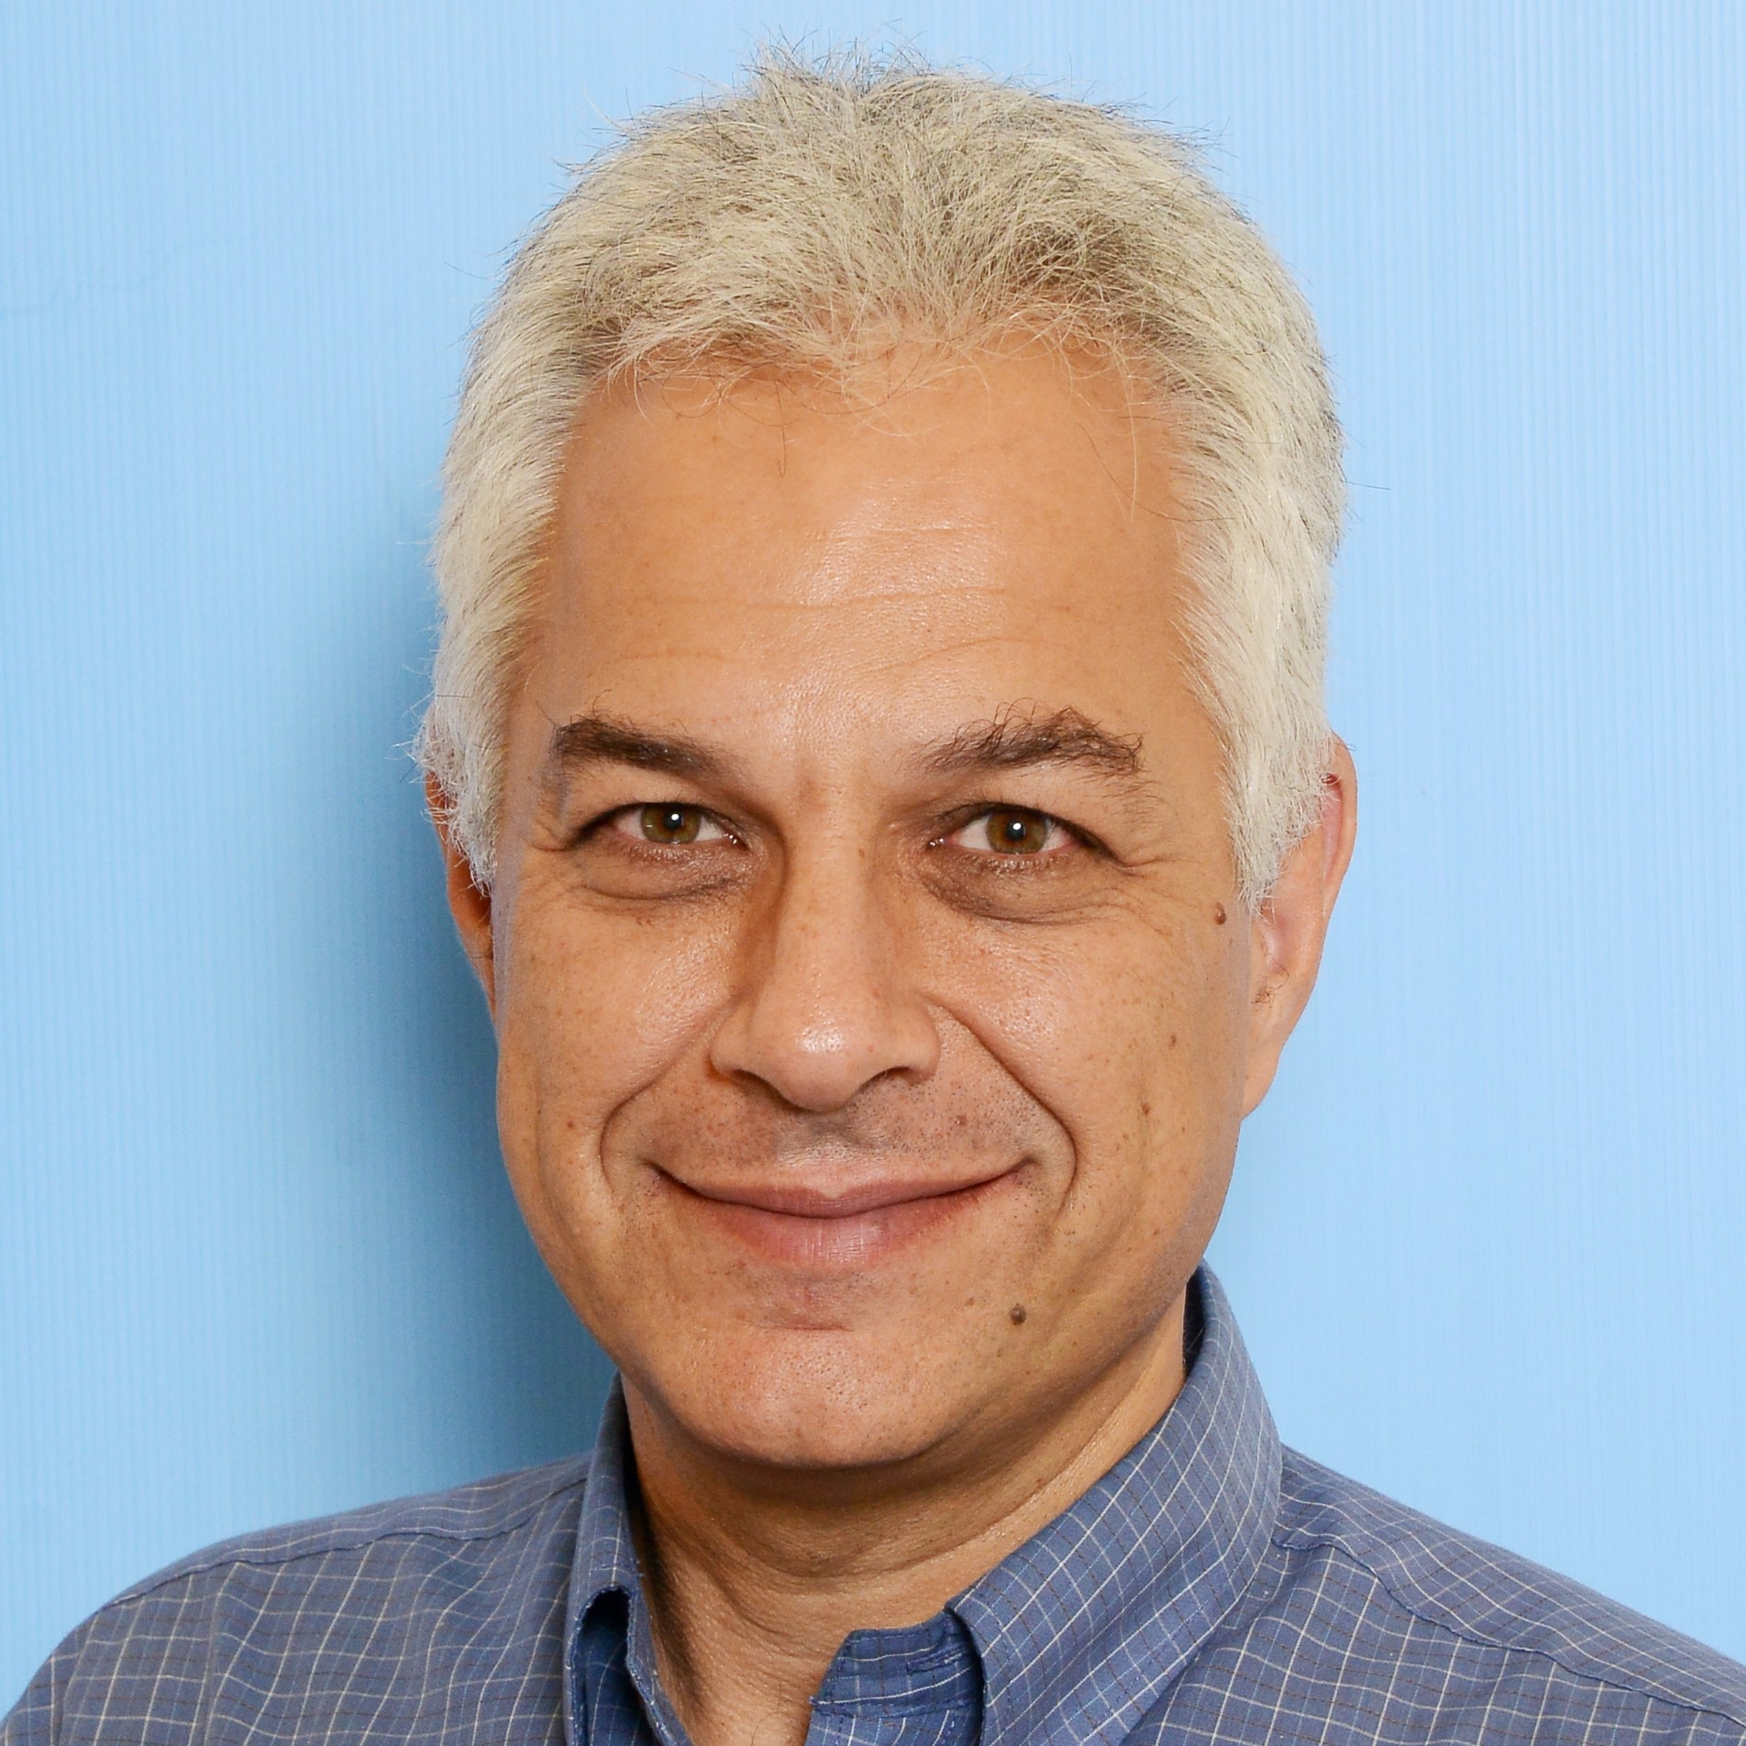
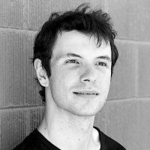




Distributed Randomness using weighted VUFs
Sourav Das
Benny Pinkas
Alin Tomescu
Zhuolun Xiang
souravd2@Illinois.edu
In production on Aptos blockchain since March 2024!

Slide 2
Problem Definitions
Notes:
Let’s start with the problem definitions

Slide 3







Randomness Beacon
$$ℱ_{rand}$$
$$r_{1}$$
…

Slide 4








Randomness Beacon
$$r_{1}$$
$$ℱ_{rand}$$
$$r_{1}$$
$$r_{1}$$
$$r_{1}$$
$$r_{1}$$
$$r_{1}$$
…
$$r_{1}$$
…
$$r_{1}$$

Slide 5



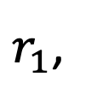
Randomness Beacon
$$r_{1},$$
$$ℱ_{rand}$$
$$r_{1},$$
$$r_{1},$$
…
$r_{1}$,

Slide 6










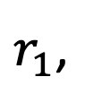

Randomness Beacon
$$r_{1},$$
$$r_{2},$$
$$ℱ_{rand}$$
$$r_{2}$$
$$r_{1},$$
$$r_{2},$$
$$r_{2}$$
$$r_{2}$$
$$r_{1},$$
$$r_{2},$$
…
$$r_{2}$$
…
$r_{1}$,
$$r_{2},$$

Slide 7

Randomness Beacon
$$r_{1},$$
$$r_{2},$$
$$ℱ_{rand}$$
$$r_{1},$$
$$r_{2},$$
$$r_{1},$$
$$r_{2},$$
…
$r_{1}$,
$$r_{2},$$

Slide 8



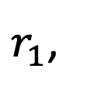





Randomness Beacon
$$r_{1},$$
$$r_{2},$$
$${⋯, r}_{i}$$
$$ℱ_{rand}$$
$$r_{i}$$
$$r_{1},$$
$$r_{2},$$
$${⋯, r}_{i}$$
$$r_{i}$$
$$r_{i}$$
$$r_{1},$$
$$r_{2},$$
$${⋯, r}_{i}$$
…
$$r_{i}$$
…
$r_{1}$,
$$r_{2},$$
$${⋯, r}_{i}$$

Slide 9








Applications of Randomness Beacon
$$B_{0}$$
$$B_{1}$$
$$⋯$$
$$B_{i}$$
Randomized jury
Consensus protocols
Clinical trials
Digital lotteries
Player/Team drafting

Slide 10


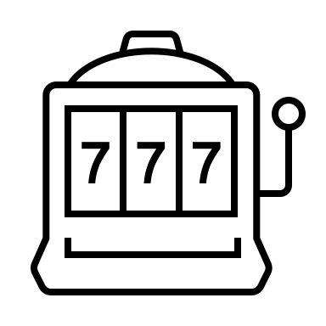




Randomness in Blockchains
$$B_{0}$$
$$B_{1}$$
$$⋯$$
$$B_{i}$$
MEV protection
Leader election
Games & lotteries
NFT minting & airdrops
and many more...
Notes:
Randomized leader election for consensus
Randomized games and lotteries
Randomized NFT minting and Airdrops

Slide 11
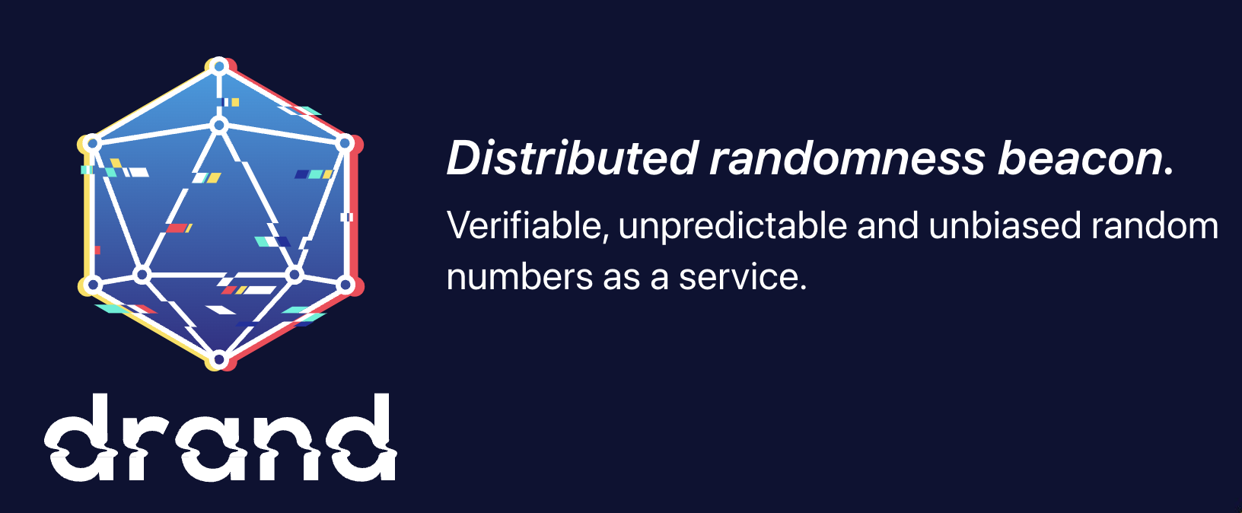


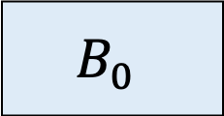
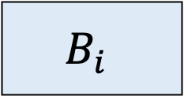

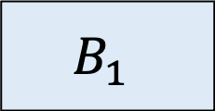

Randomness in Blockchain: Rely on external coin oracle
External sources of verifiable randomness!
$$r_{1}$$
$$r_{i}$$
$$B_{0}$$
$$B_{1}$$
$$⋯$$
$$B_{i}$$
Security:
Reliance on security of the oracle
Usability:
Hard to get the beacon output timing correct
Blockchain validators implement their own randomness beacon
Notes:
What properties do we want:
r is hidden until the block is committed.
Otherwise, adversary can bias the output.
We also want the randomness, immediately after the block is committed
Otherwise, we need to delay the transaction execution.
Usability issues:
Which output to use for which blockchain?
Guarantees in partial sync or async network situation?

Slide 12


Randomness Beacon from
Threshold Verifiable Random Functions (VRFs)
VRFs
$$⇐$$
Verifiable Unpredictable Functions (VUFs)
$$=$$
Unique Signatures
Notes:
Let’s start with the problem definitions

Slide 13
Boldyreva’s Boneh-Lynn-Shacham (BLS) Threshold Signatures
Notes:
Okay, now since all of you are expert in threshold secret sharing, let’s look at one very beautiful construction of threshold VUF, also known as the Boldyreva’s BLS threshold signatures.

Slide 14



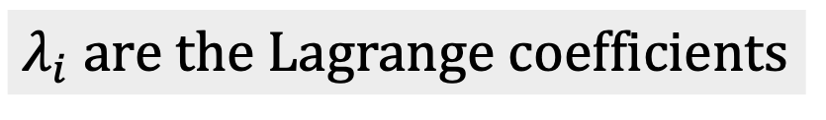


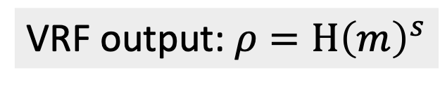

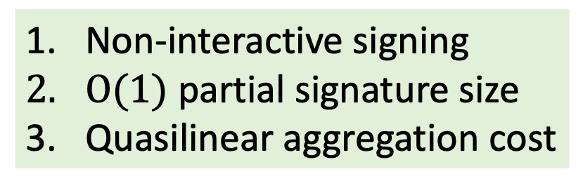

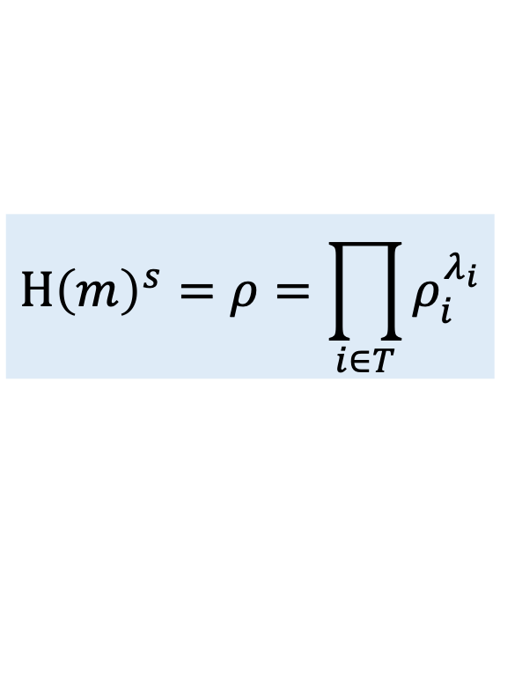
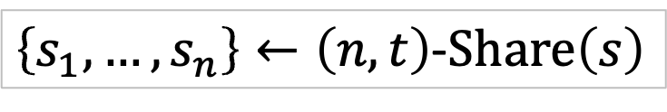

BLS (unique) threshold signature [Boldyreva’03]
$λ_{i}$ are the Lagrange coefficients
$$s_{1}$$
$$ρ_{1}=H{\left(m\right)}^{s_{1}}$$
$$H{\left(m\right)}^{s}=ρ=\prod_{i∈T}{ρ_{i}^{λ_{i}}}$$
$$s_{2}$$
$$ρ_{2}=H{\left(m\right)}^{s_{2}}$$
$$s_{3}$$
VRF output: $ρ=H{\left(m\right)}^{s}$
Aggregator
…
$$s_{n}$$
Non-interactive signing
$O(1)$ partial signature size
Quasilinear aggregation cost
$$ρ_{n}=H{\left(m\right)}^{s_{n}}$$
$\left\{s_{1},…,s_{n}\right\}←\left(n,t\right)$-$Share\left(s\right)$

Slide 15
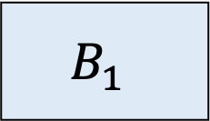
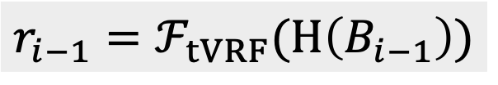
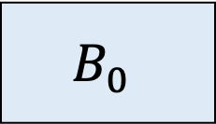
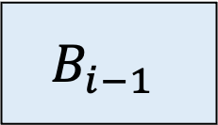
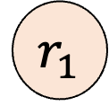

Randomness beacon using threshold VRFs
$$r_{1}$$
$$B_{0}$$
$$B_{1}$$
$$⋯$$
$$B_{i−1}$$
$$r_{i−1}=ℱ_{tVRF}(H\left(B_{i−1}\right))$$
Notes:
What properties do we want:
r is hidden until the block is committed.
Otherwise, adversary can bias the output.
We also want the randomness, immediately after the block is committed
Otherwise, we need to delay the transaction execution.
Usability issues:
Which output to use for which blockchain?
Guarantees in partial sync or async network situation?

Slide 16
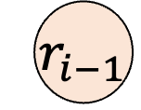
Randomness beacon using threshold VRFs
$$r_{1}$$
$$r_{i−1}$$
$$B_{0}$$
$$B_{1}$$
$$⋯$$
$$B_{i−1}$$
$$r_{i−1}=ℱ_{tVRF}(H\left(B_{i−1}\right))$$
Notes:
What properties do we want:
r is hidden until the block is committed.
Otherwise, adversary can bias the output.
We also want the randomness, immediately after the block is committed
Otherwise, we need to delay the transaction execution.
Usability issues:
Which output to use for which blockchain?
Guarantees in partial sync or async network situation?

Slide 17

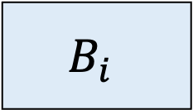
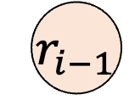
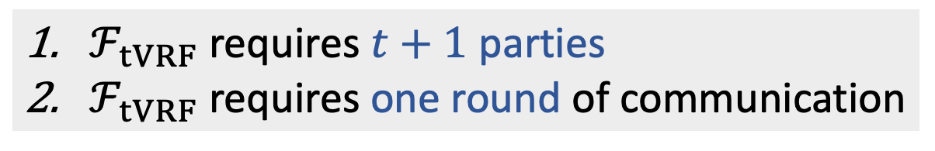
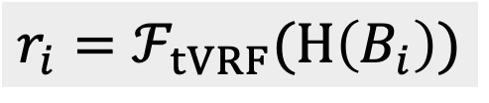
Randomness beacon using threshold VRFs
$$r_{1}$$
$$r_{i−1}$$
$$r_{i}$$
$$B_{0}$$
$$B_{1}$$
$$⋯$$
$$B_{i−1}$$
$$B_{i}$$
$$r_{i−1}=ℱ_{tVRF}(H\left(B_{i−1}\right))$$
$$r_{i}=ℱ_{tVRF}(H\left(B_{i}\right))$$
$ℱ_{tVRF}$ requires $t+1$ parties
$ℱ_{tVRF}$ requires one round of communication
Security:
Same as underlying blockchain
Usability:
Only one round of additional latency
Are we done?
No :(
Notes:
What properties do we want:
r is hidden until the block is committed.
Otherwise, adversary can bias the output.
We also want the randomness, immediately after the block is committed
Otherwise, we need to delay the transaction execution.
Usability issues:
Which output to use for which blockchain?
Guarantees in partial sync or async network situation?

Slide 18







Proof-of-Stake blockchains are weighted
$$⋯$$
$$w_{1}$$
$$w_{2}$$
$$w_{3}$$
$$w_{4}$$
$$w_{n−1}$$
$$w_{n}$$
Validators of combined weight at most $t$ (say 1/3rd) are malicious
Staking on Aptos blockchain (as of March 2024)
  880M stake, 129 validators
  14 validators with 15M-20M
  43 validators with 1M-1.3M
Weighted VRF for randomness in Proof-of-Stake blockchains
Notes:
Everything we have described so far works very well in the unweighted setting.
Or if the weights evenly distributed.
But proof of stake blockchains are weighted. And the trust assumption says at most 1/3rd of the total weighted
Consider the example of Aptos Labs
So, we need weighted VUF
About 880M tokens are staked by 129 validators
14 have stake in the range 15M-20M
43 have stake in the range 1M-1.3M

Slide 19







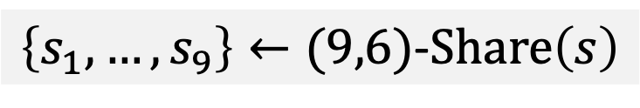






















Weighted VRF: Virtualization
$$w_{1}=1$$
$$s_{1}$$
$$m$$
$$⇒$$
$$ρ_{1}$$
$$w_{2}=3$$
$$s_{2}$$
$$s_{3}$$
$$s_{4}$$
$$m$$
$$⇒$$
$$ρ_{2}$$
$$ρ_{3}$$
$$ρ_{4}$$
$$w_{3}=2$$
$$⇒$$
$$s_{5}$$
$$s_{6}$$
$$m$$
$$ρ_{5}$$
$$ρ_{6}$$
$$w_{4}=3$$
$$s_{7}$$
$$s_{8}$$
$$s_{9}$$
$$m$$
$$⇒$$
$$ρ_{7}$$
$$ρ_{8}$$
$$ρ_{9}$$
$\left\{s_{1}, …,s_{9}\right\}←(9,6)$-$Share\left(s\right)$
19

Slide 20














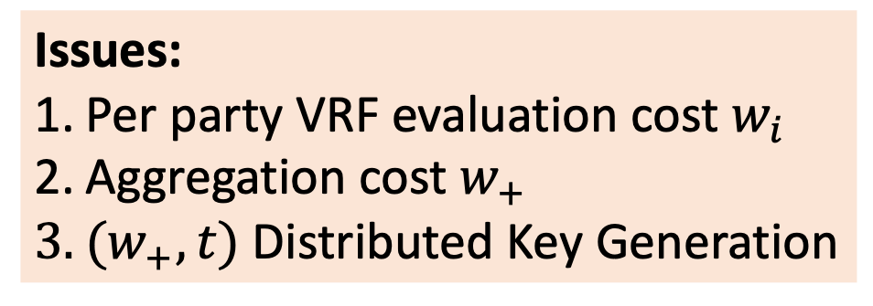





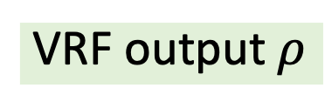
Weighted VRF: Virtualization
$$w_{1}=1$$
$$s_{1}$$
$$m$$
$$ρ_{1}$$
$$ρ_{1}$$
$$ρ_{2}$$
$$ρ_{3}$$
$$ρ_{4}$$
$$w_{2}=3$$
$$s_{2}$$
$$s_{3}$$
$$s_{4}$$
$$m$$
$$ρ_{5}$$
$$ρ_{6}$$
$$ρ_{7}$$
$$ρ_{8}$$
$$ρ_{9}$$
$$ρ_{2}$$
$$ρ_{3}$$
$$ρ_{4}$$
$$⇒$$
$$w_{3}=2$$
$$ρ_{5}$$
$$ρ_{6}$$
$$s_{5}$$
$$s_{6}$$
$$m$$
Aggregator
VRF output $ρ$
$$ρ_{7}$$
$$ρ_{8}$$
$$ρ_{9}$$
$$w_{4}=3$$
$$s_{7}$$
$$s_{8}$$
$$s_{9}$$
$$m$$
Issues:
Per party VRF evaluation cost $w_{i}$
Aggregation cost $w_{+}$
$(w_{+},t)$ Distributed Key Generation
$\left\{s_{1}, …,s_{9}\right\}←(9,6)$-$Share\left(s\right)$
20

Slide 21
Our weighted Verifiable Random Function
Notes:
Okay, now since all of you are expert in threshold secret sharing, let’s look at one very beautiful construction of threshold VUF, also known as the Boldyreva’s BLS threshold signatures.

Slide 22



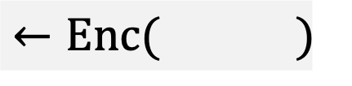


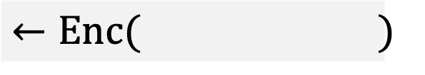







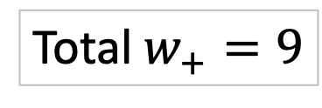
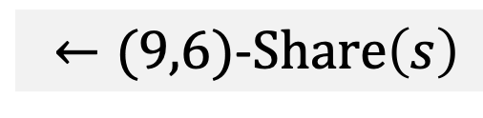














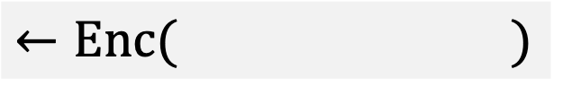



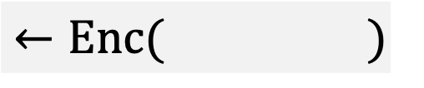






Our Weighted VRF
$$c_{1}$$
$$c_{2}$$
$$⋯$$
$$c_{9}$$
$$←Enc( )$$
$←(9,6)$-$Share\left(s\right)$
$$s_{1}$$
$$s_{2}$$
$$⋯$$
$$s_{9}$$
$$←Enc( )$$
$$←Enc( )$$
$$c_{5}$$
$$c_{6}$$
$$←Enc( )$$
$$c_{1}$$
$$k_{1}$$
$$s_{1}$$
$$c_{2}$$
$$c_{3}$$
$$c_{4}$$
$$k_{2}$$
$$s_{2}$$
$$s_{3}$$
$$s_{4}$$
$$k_{3}$$
$$s_{5}$$
$$s_{6}$$
$$w_{1}=1$$
$$k_{1}$$
$$c_{1}$$
$$c_{2}$$
$$⋯$$
$$c_{9}$$
$$w_{2}=3$$
$$k_{2}$$
$$w_{3}=2$$
$$k_{3}$$
Aggregator
$$w_{4}=3$$
$$k_{4}$$
Total $w_{+}=9$
22

Slide 23












Our Weighted VRF
$$c_{1}$$
$$c_{2}$$
$$⋯$$
$$c_{9}$$
$$←Enc( )$$
$←(9,6)$-$Share\left(s\right)$
$$s_{1}$$
$$s_{2}$$
$$⋯$$
$$s_{9}$$
$$←Enc( )$$
$$←Enc( )$$
$$c_{5}$$
$$c_{6}$$
$$←Enc( )$$
$$c_{1}$$
$$k_{1}$$
$$s_{1}$$
$$c_{2}$$
$$c_{3}$$
$$c_{4}$$
$$k_{2}$$
$$s_{2}$$
$$s_{3}$$
$$s_{4}$$
$$k_{3}$$
$$s_{5}$$
$$s_{6}$$
$$w_{1}=1$$
$$k_{1}$$
$$m$$
$$⇒$$
$$σ_{1}$$
$$c_{1}$$
$$c_{2}$$
$$⋯$$
$$c_{9}$$
$$w_{2}=3$$
$$k_{2}$$
$$m$$
$$⇒$$
$$σ_{2}$$
$$w_{3}=2$$
$$k_{3}$$
$$m$$
$$⇒$$
$$σ_{3}$$
Aggregator
$$w_{4}=3$$
$$k_{4}$$
$$m$$
$$⇒$$
$$σ_{4}$$
Total $w_{+}=9$
23

Slide 24







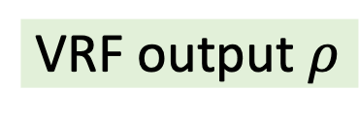






















Our Weighted VRF
$$c_{1}$$
$$c_{2}$$
$$⋯$$
$$c_{9}$$
$$←Enc( )$$
$←(9,6)$-$Share\left(s\right)$
$$s_{1}$$
$$s_{2}$$
$$⋯$$
$$s_{9}$$
$$←Enc( )$$
$$←Enc( )$$
$$c_{5}$$
$$c_{6}$$
$$←Enc( )$$
$$c_{1}$$
$$k_{1}$$
$$s_{1}$$
$$c_{2}$$
$$c_{3}$$
$$c_{4}$$
$$k_{2}$$
$$s_{2}$$
$$s_{3}$$
$$s_{4}$$
$$k_{3}$$
$$s_{5}$$
$$s_{6}$$
$$w_{1}=1$$
$$k_{1}$$
$$m$$
$$⇒$$
$$σ_{1}$$
$$c_{1}$$
$$ρ_{1}$$
$$σ_{1}$$
$$c_{1}$$
$$c_{2}$$
$$⋯$$
$$c_{9}$$
$$w_{2}=3$$
$$σ_{2}$$
$$c_{2}$$
$$c_{3}$$
$$c_{4}$$
$$⇒$$
$$ρ_{2}$$
$$ρ_{3}$$
$$ρ_{4}$$
$$k_{2}$$
$$m$$
$$σ_{2}$$
$$σ_{3}$$
$$c_{5}$$
$$c_{6}$$
$$⇒$$
$$ρ_{5}$$
$$ρ_{6}$$
$$w_{3}=2$$
$$k_{3}$$
$$m$$
$$σ_{3}$$
Aggregator
$$σ_{4}$$
$$c_{7}$$
$$c_{8}$$
$$c_{9}$$
$$⇒$$
$$ρ_{7}$$
$$ρ_{8}$$
$$ρ_{9}$$
$$σ_{4}$$
$$⇒$$
$$w_{4}=3$$
$$k_{4}$$
$$m$$
Yes. This is functional encryption!
VRF output $ρ$
Total $w_{+}=9$
24

Slide 25
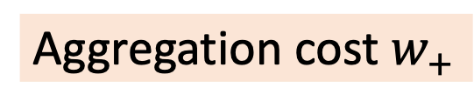
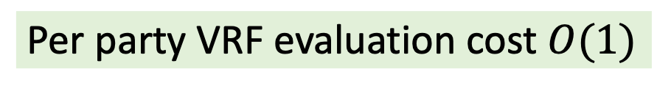
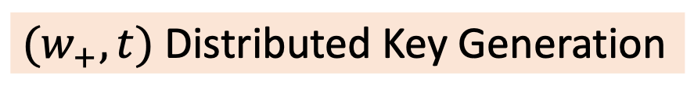
Our Weighted VRF: Properties
$$c_{1}$$
$$c_{2}$$
$$⋯$$
$$c_{9}$$
$$←Enc( )$$
$←(9,6)$-$Share\left(s\right)$
$$s_{1}$$
$$s_{2}$$
$$⋯$$
$$s_{9}$$
$$←Enc( )$$
$$←Enc( )$$
$$c_{5}$$
$$c_{6}$$
$$←Enc( )$$
$$c_{1}$$
$$k_{1}$$
$$s_{1}$$
$$c_{2}$$
$$c_{3}$$
$$c_{4}$$
$$k_{2}$$
$$s_{2}$$
$$s_{3}$$
$$s_{4}$$
$$k_{3}$$
$$s_{5}$$
$$s_{6}$$
$$w_{1}=1$$
$$k_{1}$$
$$m$$
$$⇒$$
$$σ_{1}$$
$$c_{1}$$
$$ρ_{1}$$
$$σ_{1}$$
$$c_{1}$$
$$c_{2}$$
$$⋯$$
$$c_{9}$$
$$w_{2}=3$$
$$σ_{2}$$
$$c_{2}$$
$$c_{3}$$
$$c_{4}$$
$$⇒$$
$$ρ_{2}$$
$$ρ_{3}$$
$$ρ_{4}$$
$$k_{2}$$
$$m$$
$$σ_{2}$$
$$σ_{3}$$
$$c_{5}$$
$$c_{6}$$
$$⇒$$
$$ρ_{5}$$
$$ρ_{6}$$
$$w_{3}=2$$
$$k_{3}$$
$$m$$
$$σ_{3}$$
Aggregator
$$σ_{4}$$
$$c_{7}$$
$$c_{8}$$
$$c_{9}$$
$$⇒$$
$$ρ_{7}$$
$$ρ_{8}$$
$$ρ_{9}$$
$$σ_{4}$$
$$⇒$$
$$w_{4}=3$$
$$k_{4}$$
$$m$$
VRF output $ρ$
Per party VRF evaluation cost $O(1)$
Aggregation cost $w_{+}$
$(w_{+},t)$ Distributed Key Generation
25

Slide 26
Evaluation Results: Macro results
Evaluation from production Aptos blockchain
Total weight | DKG (seconds) | Randomness (milliseconds)
821 | 20 | 160
2460 | 43 | 181
4053 | 64 | 203
Table: End-to-end latency with 112 validators
Longer DKG due to virtualization
Only once per epoch (every two hours)
[XDLMS25] The Latency Price of Threshold Cryptosystem in Blockchains, Financial Cryptography 2025.
Notes:
Few results such as signing time and signature size are pretty clear.
Per-party validation time is more expensive, we need to much fewer verifications (only proportional to the number of parties). Thus, the total aggregation time in our scheme is less.

Slide 27
Evaluation Results: Microbenchmarks
On a t2d-standard-32 Google Cloud virtual machine
Evaluation time/party
Verification time/party
VRF share size/party
Notes:
Few results such as signing time and signature size are pretty clear.
Per-party validation time is more expensive, we need to much fewer verifications (only proportional to the number of parties). Thus, the total aggregation time in our scheme is less.

Slide 28
Evaluation Results: Microbenchmarks
On a t2d-standard-32 Google Cloud virtual machine
Derivation time
Total aggregation time
Notes:
Few results such as signing time and signature size are pretty clear.
Per-party validation time is more expensive, we need to much fewer verifications (only proportional to the number of parties). Thus, the total aggregation time in our scheme is less.

Slide 29
Summary
Randomness beacon in the weighted setting
Weighted VUF with constant per party evaluation
New aggregatable PVSS and DKG
Running in production in the Aptos blockchain
Security assuming bilinear Diffie-Hellman assumption
Open Problems
DKG is still virtualization based
Secret key is group element
Improve aggregation costs and verification costs
Notes:
We design an on-chain randomness beacon protocol for weighted blockchains
Weighted VUF with constant signing time and signature size.
A full-fledged system
Proof security under bilinear Diffie-Hellman assumption

Slide 30



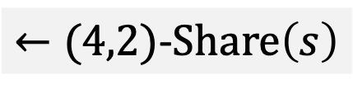





















Our VRF (unweighted)
$$s_{1}$$
$$s_{2}$$
$$s_{3}$$
$$s_{4}$$
$←(4,2)$-$Share\left(s\right)$
$$←Enc( )$$
$$h^{k_{3}{⋅s}_{3}}$$
$$h^{k_{1}{⋅s}_{1}}$$
$$k_{1}$$
$$s_{1}$$
$$←Enc( )$$
$$h^{k_{2}{⋅s}_{2}}$$
$$←Enc( )$$
$$k_{3}$$
$$s_{3}$$
$$k_{2}$$
$$s_{2}$$
$$w_{1}=1$$
$$k_{1}$$
$$w_{2}=1$$
$$k_{2}$$
$$w_{3}=1$$
$$k_{3}$$
$$w_{4}=1$$
$$k_{4}$$
30

Slide 31



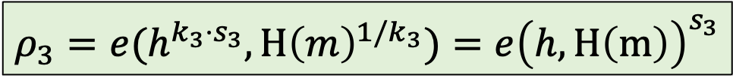



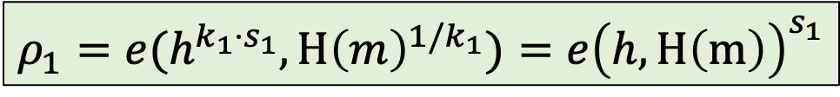


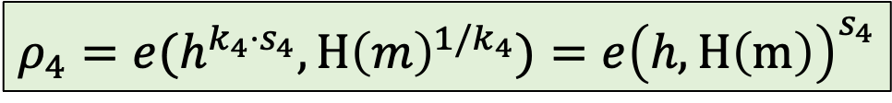






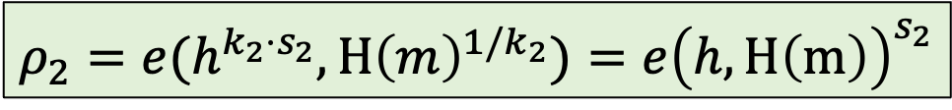





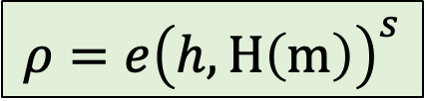
Our VRF (unweighted)
$$s_{1}$$
$$s_{2}$$
$$s_{3}$$
$$s_{4}$$
$←(4,2)$-$Share\left(s\right)$
$$←Enc( )$$
$$h^{k_{3}{⋅s}_{3}}$$
$$h^{k_{1}{⋅s}_{1}}$$
$$k_{1}$$
$$s_{1}$$
$$←Enc( )$$
$$h^{k_{2}{⋅s}_{2}}$$
$$←Enc( )$$
$$k_{3}$$
$$s_{3}$$
$$k_{2}$$
$$s_{2}$$
$$k_{1}$$
$$m$$
$$⇒$$
$$σ_{1}=H{\left(m\right)}^{1/k_{1}}$$
$$h^{k_{1}{⋅s}_{1}}$$
$$⇒$$
$$ρ_{1}=e(h^{k_{1}{⋅s}_{1}},H{\left(m\right)}^{1/k_{1}})=e{\left(h,H\left(m\right)\right)}^{s_{1}}$$
$$k_{2}$$
$$m$$
$$⇒$$
$$σ_{2}=H{\left(m\right)}^{1/k_{2}}$$
$$h^{k_{2}{⋅s}_{2}}$$
$$⇒$$
$$ρ_{2}=e(h^{k_{2}{⋅s}_{2}},H{\left(m\right)}^{1/k_{2}})=e{\left(h,H\left(m\right)\right)}^{s_{2}}$$
$$k_{3}$$
$$m$$
$$⇒$$
$$σ_{3}=H{\left(m\right)}^{1/k_{3}}$$
$$h^{k_{3}{⋅s}_{3}}$$
$$⇒$$
$$ρ_{3}=e(h^{k_{3}{⋅s}_{3}},H{\left(m\right)}^{1/k_{3}})=e{\left(h,H\left(m\right)\right)}^{s_{3}}$$
$$⇒$$
$$⇒$$
$$ρ_{4}=e(h^{k_{4}{⋅s}_{4}},H{\left(m\right)}^{1/k_{4}})=e{\left(h,H\left(m\right)\right)}^{s_{4}}$$
$$k_{4}$$
$$m$$
$$σ_{4}=H{\left(m\right)}^{1/k_{4}}$$
$$h^{k_{4}{⋅s}_{4}}$$
$$⇒$$
$$ρ=e{\left(h,H\left(m\right)\right)}^{s}$$
31

Slide 32


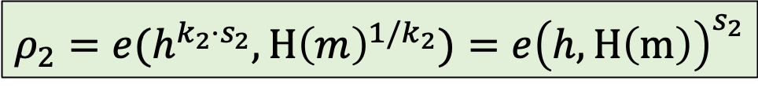


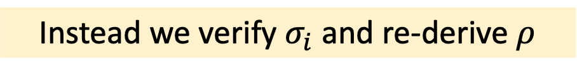







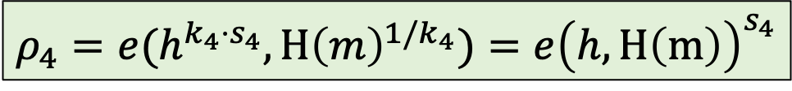
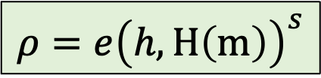












Our VRF (unweighted): Verification
$$k_{1}$$
$$m$$
$$⇒$$
$$σ_{1}=H{\left(m\right)}^{1/k_{1}}$$
$$h^{k_{1}{⋅s}_{1}}$$
$$⇒$$
$$ρ_{1}=e(h^{k_{1}{⋅s}_{1}},H{\left(m\right)}^{1/k_{1}})=e{\left(h,H\left(m\right)\right)}^{s_{1}}$$
$$k_{2}$$
$$m$$
$$⇒$$
$$σ_{2}=H{\left(m\right)}^{1/k_{2}}$$
$$h^{k_{2}{⋅s}_{2}}$$
$$⇒$$
$$ρ_{2}=e(h^{k_{2}{⋅s}_{2}},H{\left(m\right)}^{1/k_{2}})=e{\left(h,H\left(m\right)\right)}^{s_{2}}$$
$$k_{3}$$
$$m$$
$$⇒$$
$$σ_{3}=H{\left(m\right)}^{1/k_{3}}$$
$$h^{k_{3}{⋅s}_{3}}$$
$$⇒$$
$$ρ_{3}=e(h^{k_{3}{⋅s}_{3}},H{\left(m\right)}^{1/k_{3}})=e{\left(h,H\left(m\right)\right)}^{s_{3}}$$
$$⇒$$
$$⇒$$
$$ρ_{4}=e(h^{k_{4}{⋅s}_{4}},H{\left(m\right)}^{1/k_{4}})=e{\left(h,H\left(m\right)\right)}^{s_{4}}$$
$$k_{4}$$
$$m$$
$$σ_{4}=H{\left(m\right)}^{1/k_{4}}$$
$$h^{k_{4}{⋅s}_{4}}$$
$$⇒$$
Instead we verify $σ_{i}$ and re-derive $ρ$
$$ρ=e{\left(h,H\left(m\right)\right)}^{s}$$
Blockchain clients rely on weighted multi-signature on $ρ$ for verification!
We do not know how to verify $ρ$ directly
32

Slide 33












Our VRF (weighted)
$$h^{k_{1}{⋅s}_{1}}$$
$$h^{k_{1}{⋅s}_{2}}$$
$$h^{k_{1}{⋅s}_{3}}$$
$$←Enc( )$$
$$k_{1}$$
$$s_{1}$$
$$s_{2}$$
$$s_{3}$$
$$w_{1}=3$$
$$k_{1}$$
$$m$$
$$⇒$$
$$σ_{1}=H{\left(m\right)}^{1/k_{1}}$$
33

Slide 34






Our VRF (weighted)
$$←Enc( )$$
$$k_{1}$$
$$s_{1}$$
$$s_{2}$$
$$s_{3}$$
$$h^{k_{1}{⋅s}_{1}}$$
$$ρ_{1}=e(h^{k_{1}{⋅s}_{1}},H{\left(m\right)}^{1/k_{1}})=e{\left(h,H\left(m\right)\right)}^{s_{1}}$$
$$w_{1}=3$$
$$k_{1}$$
$$m$$
$$⇒$$
$$σ_{1}=H{\left(m\right)}^{1/k_{1}}$$
$$h^{k_{1}{⋅s}_{2}}$$
$$ρ_{2}=e(h^{k_{1}{⋅s}_{2}},H{\left(m\right)}^{1/k_{1}})=e{\left(h,H\left(m\right)\right)}^{s_{2}}$$
$$h^{k_{1}{⋅s}_{3}}$$
$$ρ_{3}=e(h^{k_{1}{⋅s}_{3}},H{\left(m\right)}^{1/k_{1}})=e{\left(h,H\left(m\right)\right)}^{s_{3}}$$
We can combine all $ρ_{i}$ to compute the VRF output
Open question:
Design such a functional encryption scheme for BLS!
34

