Slide 1
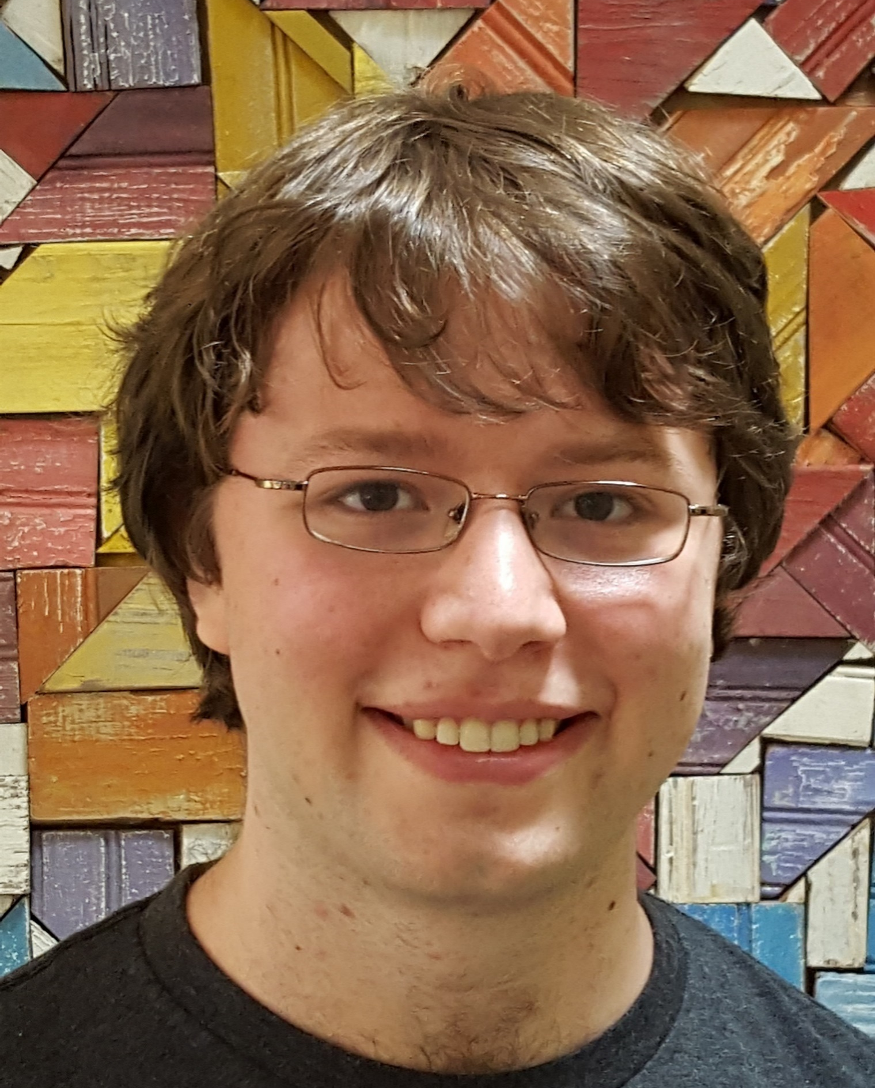
Fine-Grained Complexity in a World without Cryptography
Picture made by Josh using ChatGPT
Yizhi Huang (Columbia)
Joint work with Josh Alman (Columbia) and Kevin Yeo (Columbia & Google)

Slide 2
Contents
Motivation and background
Our results

Slide 3
Usual vs. fine-grained cryptography
Usual cryptography
Fine-grained cryptography
A protocol that runs in $O\left(n^{c}\right)$ time
Secure against $n^{d}$-time adversaries for any constant $d$
Can be built from a wide range of standard assumptions:
OWFs
Number theory problems (factoring, discrete log, RSA, ...)
Lattice problems (LPN, SVP, …)
Etc.
What if all these assumptions are false?
A protocol that runs in $O\left(n^{c}\right)$ time
Secure against $n^{d}$-time adversaries for some constant $d>c$
Might be possible even if P = NP
What assumptions should we use?
Assumptions from fine-grained complexity

Slide 4
Fine-grained complexity brief intro
Studies hardness of problems in P
Many problems are known to have $n^{c}$-time algorithm, but no $n^{c−Ω(1)}$-time algorithms are known
Fine-grained reductions to relate hardness of these different problems

Slide 5
$k$-SUM problem
Given $k$ lists of $n$ integers modulo $m$, find one integer from each list such that they sum to $0$.
E.g.
[22, 12, 5, 8] k = 3, n = 4, m = 29
[22, 8, 13, 10]
[8, 13, 16, 12]

Slide 6
$k$-SUM problem
Given $k$ lists of $n$ integers modulo $m$, find one integer from each list such that they sum to $0$.
E.g.
Best known algorithm: $\tilde{O}\left(n^{⌈\frac{k}{2}⌉}\right)$ time
$k$-SUM conjecture: cannot be solved in $n^{\left\lceil \frac{k}{2}\right\rceil −Ω(1)}$ time
Avg-$k$-SUM conjecture: even in average-case
[22, 12, 5, 8] k = 3, n = 4, m = 29
[22, 8, 13, 10]
[8, 13, 16, 12]

Slide 7
$k$-SUM conjecture applications
$k$-SUM Conjecture used to prove hardness of many problems through a web of fine-grained reductions
[Gajentaan, Overmars, `95] originally used in computational geometry
3 points on a line, separator line, motion planning, …
Problems about finding/listing triangles in a Graph [Vassilevska Williams, Williams, `09], [Pătraşcu, `10], [Kopelowitz, Pettie, Porat, `16], …
Dynamic Graph Problems [Abboud, Vassilevska Williams, `14], …
Etc.

Slide 8
Usual vs. fine-grained cryptography
Usual cryptography
Fine-grained cryptography
A protocol that runs in $O\left(n^{c}\right)$ time
Secure against $n^{d}$-time adversaries for any constant $d$
Can be built from a wide range of standard assumptions:
OWFs
Number theory problems (factoring, discrete log, RSA, ...)
Lattice problems (LPN, SVP, …)
Etc.
What if all these assumptions are false?
A protocol that runs in $O\left(n^{c}\right)$ time
Secure against $n^{d}$-time adversaries for some constant $d>c$
Might be possible even if P = NP
What assumptions should we use?
Assumptions from fine-grained complexity

Slide 9
Prior work on fine-grained cryptography
From Average-Case Fine-Grained Assumptions (such as $k$-SUM)
OWFs and Key Exchange [LaVigne, Lincoln, Vassilevska Williams, `19]
Fine-Grained Primitives from Worst-Case Fine-Grained Assumptions
Proof of Work [Ball, Rosen, Sabin, Vasudevan, `17 and `18]
Permissionless Consensus [Ball, Garay, Hall, Kiayias, Panagiotakos, `24]
Other Related Works
From Other Assumptions [Brzuska, Couteau, `22]
OWF and PRG against $NC^{1}$ and $AC^{0}$ adversaries [Degwekar, Vaikuntanathan, Vasudevan, `16]
Key Exchange in the Generic Group Model without Fine-Grained Assumptions [Afshar, Couteau, Mahmoody, Sadeghi, `23], [Bauer, Couteau, Sadeghi, `24]
$k$-XOR conjecture lets you construct PKE from weaker version of LPN [Agrawal, Saha, Schwartzbach, Vanukuri, Vasudevan, `24]
Numerous uses of $k$-SUM algorithms in cryptanalysis…

Slide 10
Theme of this talk
To summarize:
Even if there is no usual crypto, could still hope for fine-grained crypto
Constructions of fine-grained crypto based on fine-grained assumptions
Our main question:
What happens to fine-grained complexity if there is no usual crypto?
Our results:
If no OWF, then Avg-$k$-SUM conjecture is false (for sufficiently large $k$)
Faster discrete log algorithms iff there are certain fine-grained reductions

Slide 11
Contents
Motivation and background
Our results

Slide 12
Result 1
Theorem.
If no OWF, then Avg-$k$-SUM conjecture is false (for sufficiently large $k$)
Holds also for other fine-grained problems that have a “planting algorithm” (with certain properties)
E.g. Zero-$k$-Clique
Planting algorithm: an algorithm to generate YES instances that have a given solution
If no OWF, known fine-grained cryptography constructions have limitations in security
Fine-grained OWF in [LLV’19] is not secure against $O\left(n^{c}\right)$-time adversary for some constant $c$

Slide 13
Interpretation
Contrapositive: If Avg-$k$-SUM requires $n^{ω_{k}\left(1\right)}$ time, then OWF exist
Avg-$k$-SUM conjectured to require $n^{⌈k/2⌉}$ time!
Basing usual cryptography on fine-grained complexity problems

Slide 14
Result 2
Recall: Fine-grained complexity studies fine-grained reductions between various problems
Our result: Cryptography can give a barrier to fine-grained reductions

Slide 15
Variant of $k$-SUM: $k$-CYC^{G}
Given $k$ lists of elements of a cyclic group G, find one element from each list so that their product is $1$
Same structure as $k$-SUM with different underlying group
Generalization of $k$-SUM (where G is $ℤ_{m}$)
But unclear if they have same hardness

Slide 16
Result 2
Theorem.
The existence of the following two are equivalent:
A fine-grained reduction from $k$-CYC^{G} to $k$-SUM in time ${\left|G\right|}^{1/2−Ω(1)}$
An ${\left|G\right|}^{1/2−Ω(1)}$-time algorithm for discrete log over G.

Slide 17
Interpretation
A barrier for reducing $k$-CYC^{G} to $k$-SUM, if G is a group in which we believe discrete log is ${\left|G\right|}^{1/2−Ω\left(1\right)}$-hard
e.g. G is some elliptic curve group
Fine-grained equivalence between $k$-CYC^{G} and $k$-SUM implies faster-than-known DLOG^{G} algorithms
For $k$-SUM-like problems, the underlying group structure seems essential for understanding the hardness

Slide 18
Open questions
Can we further generalize these results?
Show more conjectures are false if there are no OWFs
Show more barriers to fine-grained reductions via crypto
Suppose $k$-SUM conjecture is false for all big enough $k$. Does this imply anything about $3$-SUM?
One version of this question: Suppose you can solve $k$-SUM in $O(n^{2})$ time for all $k$. Can you solve $3$-SUM in $O(n^{1.99})$ time?

