Slide 1
New Techniques for Preimage Sampling:
NIZKs and More from LWE
Brent Waters, Hoeteck Wee, and David Wu

Slide 2





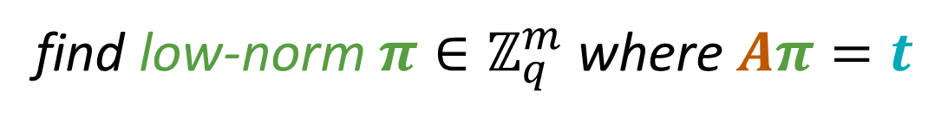
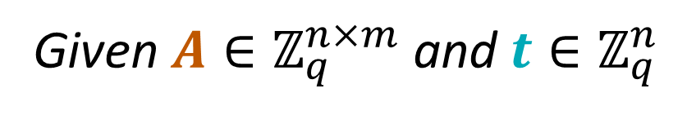

The Preimage Sampling Problem
Given $A∈ℤ_{q}^{n×m}$ and $t∈ℤ_{q}^{n}$
Problem is hard in general:
  Short integer solutions (SIS)
  Inhomogeneous SIS
$$A$$
$$t$$
But easy given a trapdoor for $A$
[Ajt96, GPV08, MP12]
Many applications!
find low-norm $π∈ℤ_{q}^{m}$ where $Aπ=t$
digital signatures, IBE, ABE, SNARGs, NIZKs
$$A$$
$$π$$
$$t$$

Slide 3



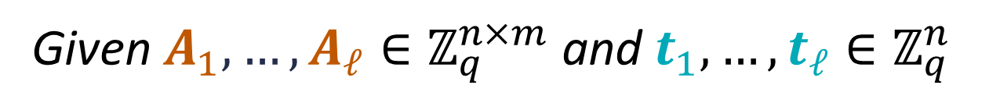


Shifted Multi-Preimage Sampling
Given $A_{1},…, A_{ℓ}∈ℤ_{q}^{n×m}$ and $t_{1},…,t_{ℓ}∈ℤ_{q}^{n}$
$$A_{ℓ}$$
$$t_{ℓ}$$
find $c∈ℤ_{q}^{n}$ and low-norm $π_{1},…,π_{ℓ}∈ℤ_{q}^{m}$ where $A_{i}π_{i}=t_{i}+c$ for all $i∈\left[ℓ\right]$
$$A_{i}$$
$$π_{i}$$
$$t_{i}$$
preimage

Slide 4

Shifted Multi-Preimage Sampling
Given $A_{1},…, A_{ℓ}∈ℤ_{q}^{n×m}$ and $t_{1},…,t_{ℓ}∈ℤ_{q}^{n}$
$$A_{ℓ}$$
$$t_{ℓ}$$
find $c∈ℤ_{q}^{n}$ and low-norm $π_{1},…,π_{ℓ}∈ℤ_{q}^{m}$ where $A_{i}π_{i}=t_{i}+c$ for all $i∈\left[ℓ\right]$
$$A_{i}$$
$$π_{i}$$
$$t_{i}$$
$$c$$
shift
preimage
Shift gives one degree of freedom

Slide 5
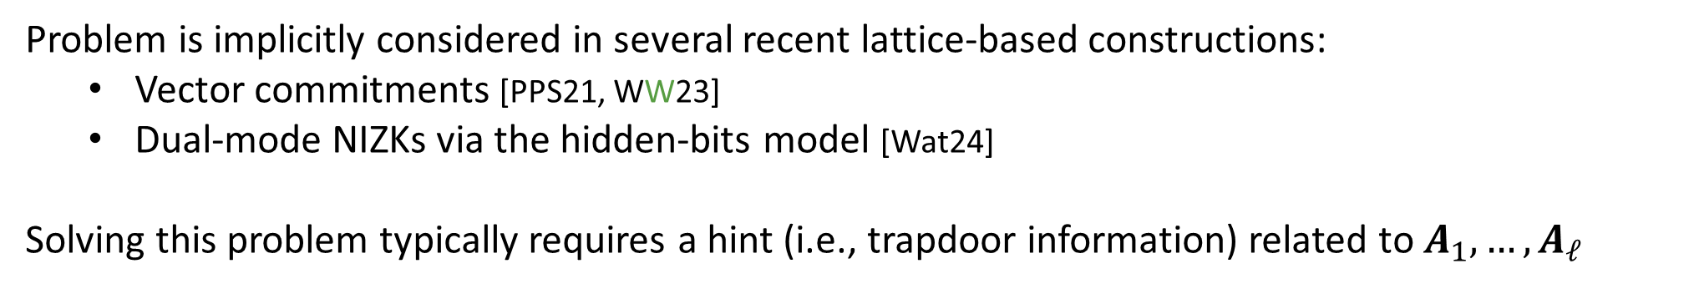
Shifted Multi-Preimage Sampling
Given $A_{1},…, A_{ℓ}∈ℤ_{q}^{n×m}$ and $t_{1},…,t_{ℓ}∈ℤ_{q}^{n}$,
find $c∈ℤ_{q}^{n}$ and low-norm $π_{1},…,π_{ℓ}∈ℤ_{q}^{m}$ where $A_{i}π_{i}=t_{i}+c$ for all $i∈\left[ℓ\right]$
Problem is implicitly considered in several recent lattice-based constructions:
  Vector commitments [PPS21, WW23]
  Dual-mode NIZKs via the hidden-bits model [Wat24]
Solving this problem typically requires a hint (i.e., trapdoor information) related to $A_{1},…,A_{ℓ}$
Trivial solution: $hint=\left({td}_{1},…,{td}_{ℓ}\right)$ where ${td}_{i}$ is trapdoor for $A_{i}$
Above applications require that SIS/LWE remains hard with respect to any $A_{i}$ even given the hint (rules out trivial solution)
Feasible only if we allow for the shift

Slide 6
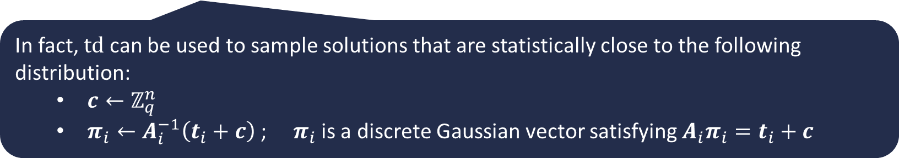
This Work
Given $A_{1},…, A_{ℓ}∈ℤ_{q}^{n×m}$ and $t_{1},…,t_{ℓ}∈ℤ_{q}^{n}$,
find $c∈ℤ_{q}^{n}$ and low-norm $π_{1},…,π_{ℓ}∈ℤ_{q}^{m}$ where $A_{i}π_{i}=t_{i}+c$ for all $i∈\left[ℓ\right]$
New approach to sample $A_{1},…,A_{ℓ}$ together with a trapdoor $td$ where:
$td$ can be used to solve the shifted multi-preimage sampling problem
In fact, $td$ can be used to sample solutions that are statistically close to the following distribution:
  $c←ℤ_{q}^{n}$
  $π_{i}←A_{i}^{−1}\left(t_{i}+c\right)$ ; $π_{i}$ is a discrete Gaussian vector satisfying $A_{i}π_{i}=t_{i}+c$

Slide 7
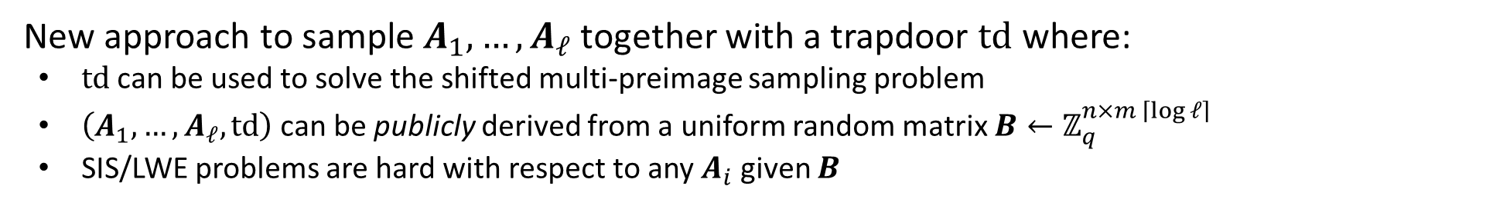
This Work
Given $A_{1},…, A_{ℓ}∈ℤ_{q}^{n×m}$ and $t_{1},…,t_{ℓ}∈ℤ_{q}^{n}$,
find $c∈ℤ_{q}^{n}$ and low-norm $π_{1},…,π_{ℓ}∈ℤ_{q}^{m}$ where $A_{i}π_{i}=t_{i}+c$ for all $i∈\left[ℓ\right]$
New approach to sample $A_{1},…,A_{ℓ}$ together with a trapdoor $td$ where:
$td$ can be used to solve the shifted multi-preimage sampling problem
$\left(A_{1},…,A_{ℓ},td\right)$ can be publicly derived from a uniform random matrix $B←ℤ_{q}^{n×m \left\lceil \log{ℓ}\right\rceil }$
SIS/LWE problems are hard with respect to any $A_{i}$ given $B$

Slide 8
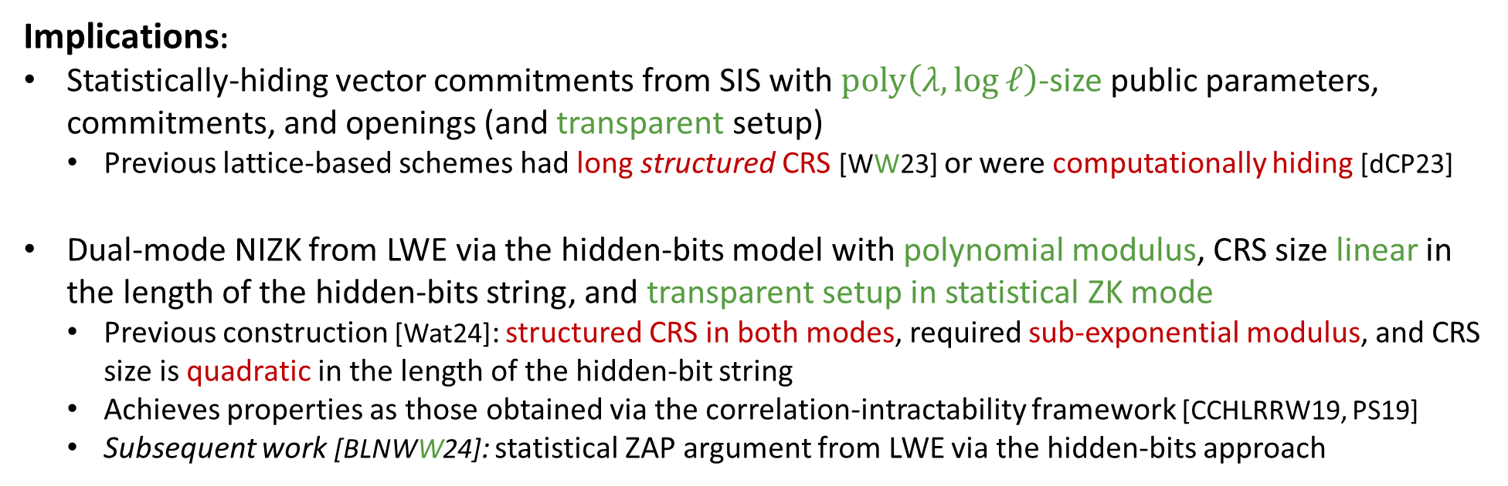
This Work
Given $A_{1},…, A_{ℓ}∈ℤ_{q}^{n×m}$ and $t_{1},…,t_{ℓ}∈ℤ_{q}^{n}$,
find $c∈ℤ_{q}^{n}$ and low-norm $π_{1},…,π_{ℓ}∈ℤ_{q}^{m}$ where $A_{i}π_{i}=t_{i}+c$ for all $i∈\left[ℓ\right]$
Implications:
Statistically-hiding vector commitments from SIS with $poly\left(λ,\log{ℓ}\right)$-size public parameters, commitments, and openings (and transparent setup)
  Previous lattice-based schemes had long structured CRS [WW23] or were computationally hiding [dCP23]
Dual-mode NIZK from LWE via the hidden-bits model with polynomial modulus, CRS size linear in the length of the hidden-bits string, and transparent setup in statistical ZK mode
  Previous construction [Wat24]: structured CRS in both modes, required sub-exponential modulus, and CRS size is quadratic in the length of the hidden-bit string
  Achieves properties as those obtained via the correlation-intractability framework [CCHLRRW19, PS19]
  Subsequent work [BLNWW24]: statistical ZAP argument from LWE via the hidden-bits approach
This talk

Slide 9
This Work
Given $A_{1},…, A_{ℓ}∈ℤ_{q}^{n×m}$ and $t_{1},…,t_{ℓ}∈ℤ_{q}^{n}$,
find $c∈ℤ_{q}^{n}$ and low-norm $π_{1},…,π_{ℓ}∈ℤ_{q}^{m}$ where $A_{i}π_{i}=t_{i}+c$ for all $i∈\left[ℓ\right]$
Concurrent work [BCDJMS25]: dual-mode NIZK in the hidden-bits model from LWE
  Polynomial modulus and transparent setup in statistical ZK mode
  CRS size is quadratic in the length of the hidden-bits string
  Multi-theorem zero-knowledge requires “or-proof” (need to apply NIZK to cryptographic language)
  Does not need lattice trapdoors
Implications:
Statistically-hiding vector commitments from SIS with $poly\left(λ,\log{ℓ}\right)$-size public parameters, commitments, and openings (and transparent setup)
  Previous lattice-based schemes had long structured CRS [WW23] or were computationally hiding [dCP23]
Dual-mode NIZK from LWE via the hidden-bits model with polynomial modulus, CRS size linear in the length of the hidden-bits string, and transparent setup in statistical ZK mode
  Previous construction [Wat24]: structured CRS in both modes, required sub-exponential modulus, and CRS size is quadratic in the length of the hidden-bit string
  Achieves properties as those obtained via the correlation-intractability framework [CCHLRRW19, PS19]
  Subsequent work [BLNWW24]: statistical ZAP argument from LWE via the hidden-bits approach
This talk

Slide 10


















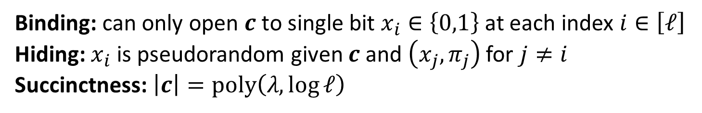

Dual-Mode Hidden-Bits Generators
Hidden-bits generator [FLS90, QRW19]
Used to compile (information-theoretic) NIZK in the hidden-bits model to NIZK in CRS model
common reference string (CRS)
$$x_{1}$$
$$x_{2}$$
$$x_{3}$$
$$x_{4}$$
$$x_{5}$$
$$x_{6}$$
$$x_{7}$$
$$x_{8}$$
$$x_{9}$$
$$c$$
0
1
0
0
1
0
1
1
1
short commitment $c$ determines a long pseudorandom string (length $ℓ$)
$$π_{1}$$
$$π_{2}$$
$$π_{3}$$
$$π_{4}$$
$$π_{5}$$
$$π_{6}$$
$$π_{7}$$
$$π_{8}$$
$$π_{9}$$
local openings for each bit $x_{i}$ with respect to $c$ and CRS
Binding: can only open $c$ to single bit $x_{i}∈\left\{0,1\right\}$ at each index $i∈\left[ℓ\right]$
Hiding: $x_{i}$ is pseudorandom given $c$ and $\left(x_{j},π_{j}\right)$ for $j≠i$
Succinctness: $\left|c\right|=poly\left(λ,\log{ℓ}\right)$

Slide 11
Dual-Mode Hidden-Bits Generators
Hidden-bits generator [FLS90, QRW19]
Used to compile (information-theoretic) NIZK in the hidden-bits model to NIZK in CRS model
common reference string (CRS)
$$x_{1}$$
$$x_{2}$$
$$x_{3}$$
$$x_{4}$$
$$x_{5}$$
$$x_{6}$$
$$x_{7}$$
$$x_{8}$$
$$x_{9}$$
$$c$$
0
1
0
0
1
0
1
1
1
short commitment $c$ determines a long pseudorandom string (length $ℓ$)
Dual mode if CRS can be sampled to be either statistically binding or statistically hiding
$$π_{1}$$
$$π_{2}$$
$$π_{3}$$
$$π_{4}$$
$$π_{5}$$
$$π_{6}$$
$$π_{7}$$
$$π_{8}$$
$$π_{9}$$
local openings for each bit $x_{i}$ with respect to $c$ and CRS
Binding: can only open $c$ to single bit $x_{i}∈\left\{0,1\right\}$ at each index $i∈\left[ℓ\right]$
Hiding: $x_{i}$ is pseudorandom given $c$ and $\left(x_{j},π_{j}\right)$ for $j≠i$
Succinctness: $\left|c\right|=poly\left(λ,\log{ℓ}\right)$

Slide 12





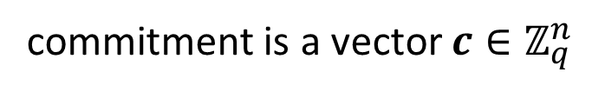


Dual-Mode Hidden-Bits Generators
The Waters [Wat24] (dual-mode) hidden-bits generator from LWE:
$$v_{1}$$
$$v_{2}$$
$$v_{ℓ}$$
$$aux$$
common reference string:
$$A_{1},…,A_{ℓ}$$
$$⋯$$
$ℓ$: length of hidden-bits string
commitment is a vector $c∈ℤ_{q}^{n}$
openings are low-norm vectors $π_{i}$ where $A_{i}π_{i}=c$ (sampled using $aux$)
hidden bits are $x_{1},…,x_{ℓ}∈\left\{0,1\right\}$ where $x_{i}=\left\lfloor v_{i}^{T}π_{i}\right\rceil$
Observe: $aux$ is used to solve the shifted multi-preimage sampling problem with respect to $A_{1},…,A_{ℓ}$ and targets $t_{1},…,t_{ℓ}=0$
Solution is $\left(π_{1},…,π_{ℓ},c\right)$ where $A_{i}π_{i}=t_{i}+c=c$

Slide 13




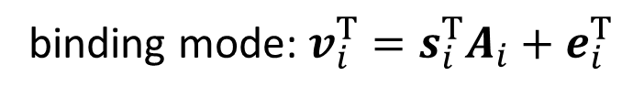


Dual-Mode Hidden-Bits Generators
Our dual-mode hidden-bits generator from LWE:
$$aux=td$$
$$v_{1}$$
$$v_{2}$$
$$v_{ℓ}$$
$$td$$
common reference string:
$$A_{1},…,A_{ℓ}$$
$$⋯$$
$ℓ$: length of hidden-bits string
commitment is a vector $c∈ℤ_{q}^{n}$
openings are low-norm vectors $π_{i}$ where $A_{i}π_{i}=c$ (via $td$ for shifted multi-preimage sampler)
hidden bits are $x_{1},…,x_{ℓ}∈\left\{0,1\right\}$ where $x_{i}=\left\lfloor v_{i}^{T}π_{i}\right\rceil$
binding mode: $v_{i}^{T}=s_{i}^{T}A_{i}+e_{i}^{T}$
essentially the same argument as in [Wat24]
value $x_{i}$ is essentially determined by CRS and $c:$
$$v_{i}^{T}π_{i}$$
$$=s_{i}^{T}A_{i}π_{i}+e_{i}^{T}π_{i}$$
$≈s_{i}^{T}c$ (since $e_{i}^{T}π_{i}$ is small)
value of $s_{i}$ (from CRS) and $c$ determine $x_{i}$

Slide 14
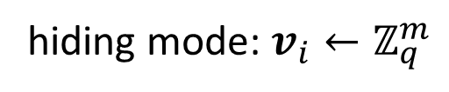
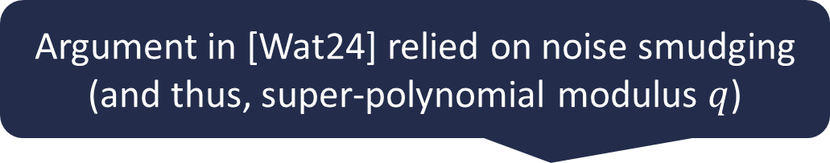
Dual-Mode Hidden-Bits Generators
Our dual-mode hidden-bits generator from LWE:
$$aux=td$$
$$v_{1}$$
$$v_{2}$$
$$v_{ℓ}$$
$$td$$
common reference string:
$$A_{1},…,A_{ℓ}$$
$$⋯$$
$ℓ$: length of hidden-bits string
commitment is a vector $c∈ℤ_{q}^{n}$
Argument in [Wat24] relied on noise smudging (and thus, super-polynomial modulus $q$)
openings are low-norm vectors $π_{i}$ where $A_{i}π_{i}=c$ (via $td$ for shifted multi-preimage sampler)
hidden bits are $x_{1},…,x_{ℓ}∈\left\{0,1\right\}$ where $x_{i}=\left\lfloor v_{i}^{T}π_{i}\right\rceil$
hiding mode: $v_{i}←ℤ_{q}^{m}$
different argument from [Wat24]
distribution of $\left(π_{1},…,π_{ℓ},c\right)$ is statistically close to sampling $c←ℤ_{q}^{n}$ and $π_{i}←A_{i}^{−1}\left(c\right)$
by leftover hash lemma (use $v_{i}$ to extract entropy from $π_{i}$), that $v_{i}^{T}π_{i}$ is uniform

Slide 15
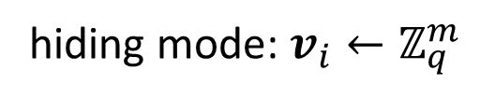
Dual-Mode Hidden-Bits Generators
Our dual-mode hidden-bits generator from LWE:
$$aux=td$$
$$v_{1}$$
$$v_{2}$$
$$v_{ℓ}$$
$$td$$
common reference string:
$$A_{1},…,A_{ℓ}$$
$$⋯$$
$ℓ$: length of hidden-bits string
commitment is a vector $c∈ℤ_{q}^{n}$
openings are low-norm vectors $π_{i}$ where $A_{i}π_{i}=c$ (via $td$ for shifted multi-preimage sampler)
hidden bits are $x_{1},…,x_{ℓ}∈\left\{0,1\right\}$ where $x_{i}=\left\lfloor v_{i}^{T}π_{i}\right\rceil$
binding mode: $v_{i}^{T}=s_{i}^{T}A_{i}+e_{i}^{T}$
hiding mode: $v_{i}←ℤ_{q}^{m}$
modes are indistinguishable if LWE holds with respect to $A_{i}$ (given $td,A_{1},…,A_{ℓ})$
(by hybrid argument)

Slide 16
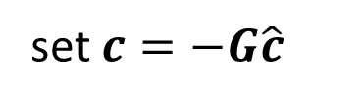
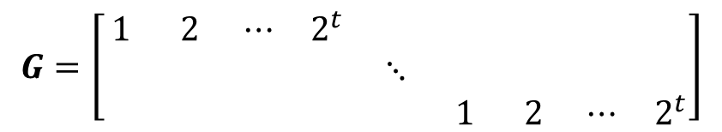
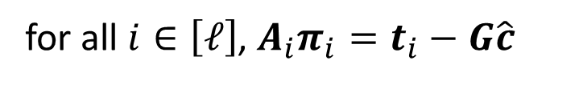
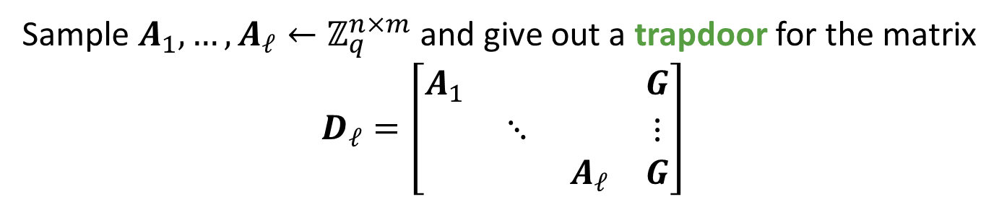
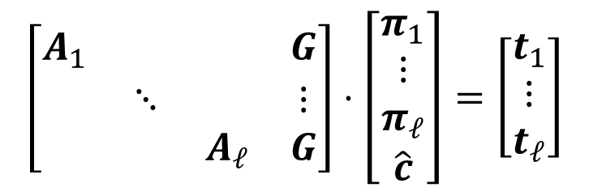

Constructing a Shifted Multi-Preimage Sampler
Given $A_{1},…, A_{ℓ}∈ℤ_{q}^{n×m}$ and $t_{1},…,t_{ℓ}∈ℤ_{q}^{n}$,
find $c∈ℤ_{q}^{n}$ and low-norm $π_{1},…,π_{ℓ}∈ℤ_{q}^{m}$ where $A_{i}π_{i}=t_{i}+c$ for all $i∈\left[ℓ\right]$
The Wee-Wu approach [WW23] for shifted multi-preimage sampling:
Sample $A_{1},…,A_{ℓ}←ℤ_{q}^{n×m}$ and give out a trapdoor for the matrix
$$D_{ℓ}=\left[\begin{matrix}A_{1} & & & G \\ & ⋱ & & ⋮ \\ & & A_{ℓ} & G\end{matrix}\right]$$
$$G=\left[\begin{matrix}1 & 2 & ⋯ & 2^{t} & & & & & \\ & & & & ⋱ & & & & \\ & & & & & 1 & 2 & ⋯ & 2^{t}\end{matrix}\right]$$
$$t=\left\lceil \log{q}\right\rceil −1$$
Using trapdoor for $D_{ℓ}$, can sample (Gaussian) solutions to the linear system
$$\left[\begin{matrix}A_{1} & & & G \\ & ⋱ & & ⋮ \\ & & A_{ℓ} & G\end{matrix}\right]⋅\left[\begin{matrix}π_{1} \\ ⋮ \\ π_{ℓ} \\ \hat{c}\end{matrix}\right]=\left[\begin{matrix}t_{1} \\ ⋮ \\ t_{ℓ}\end{matrix}\right]$$
for all $i∈\left[ℓ\right]$, $A_{i}π_{i}=t_{i}−G\hat{c}$
set $c=−G\hat{c}$
Limitation: trapdoor for $D_{ℓ}$ is a structured matrix (and size $ℓ^{2}$)

Slide 17










Constructing a Shifted Multi-Preimage Sampler
Given $A_{1},…, A_{ℓ}∈ℤ_{q}^{n×m}$ and $t_{1},…,t_{ℓ}∈ℤ_{q}^{n}$,
find $c∈ℤ_{q}^{n}$ and low-norm $π_{1},…,π_{ℓ}∈ℤ_{q}^{m}$ where $A_{i}π_{i}=t_{i}+c$ for all $i∈\left[ℓ\right]$
The Wee-Wu approach [WW23] for shifted multi-preimage sampling:
Sample $A_{1},…,A_{ℓ}←ℤ_{q}^{n×m}$ and give out a trapdoor for the matrix
$$D_{ℓ}=\left[\begin{matrix}A_{1} & & & G \\ & ⋱ & & ⋮ \\ & & A_{ℓ} & G\end{matrix}\right]$$
$$G=\left[\begin{matrix}1 & 2 & ⋯ & 2^{t} & & & & & \\ & & & & ⋱ & & & & \\ & & & & & 1 & 2 & ⋯ & 2^{t}\end{matrix}\right]$$
This work: set $A_{i}=B−u_{i}^{T}⊗G$ where $u_{i}$ is binary representation of $i$
$$B=$$
$$B_{1}$$
$$B_{2}$$
$$⋯$$
$$B_{ℓ}$$
$$A_{1}=$$
$$B_{1}−0⋅G$$
$$B_{2}−0⋅G$$
$$⋯$$
$$B_{ℓ}−1⋅G$$

Slide 18
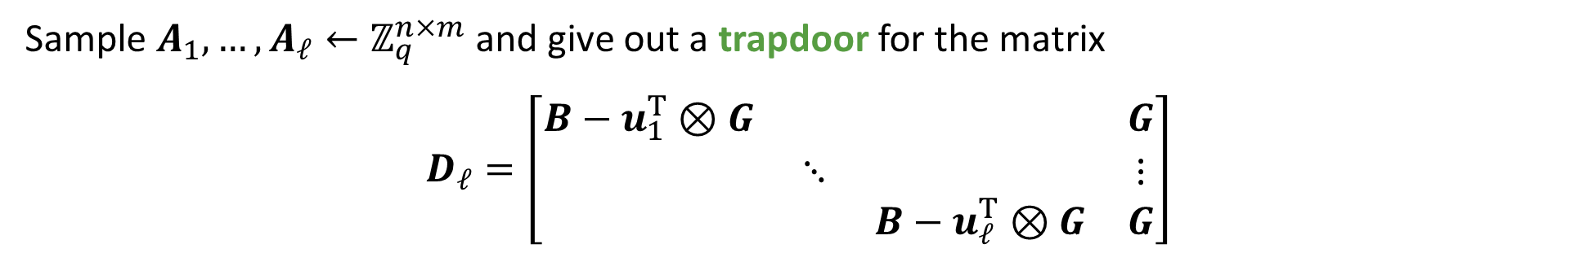
Constructing a Shifted Multi-Preimage Sampler
Given $A_{1},…, A_{ℓ}∈ℤ_{q}^{n×m}$ and $t_{1},…,t_{ℓ}∈ℤ_{q}^{n}$,
find $c∈ℤ_{q}^{n}$ and low-norm $π_{1},…,π_{ℓ}∈ℤ_{q}^{m}$ where $A_{i}π_{i}=t_{i}+c$ for all $i∈\left[ℓ\right]$
The Wee-Wu approach [WW23] for shifted multi-preimage sampling:
Sample $A_{1},…,A_{ℓ}←ℤ_{q}^{n×m}$ and give out a trapdoor for the matrix
$$D_{ℓ}=\left[\begin{matrix}B−u_{1}^{T}⊗G & & & G \\ & ⋱ & & ⋮ \\ & & B−u_{ℓ}^{T}⊗G & G\end{matrix}\right]$$
This work: set $A_{i}=B−u_{i}^{T}⊗G$ where $u_{i}$ is binary representation of $i$
Claim: The matrix $D_{ℓ}$ has a public trapdoor

Slide 19



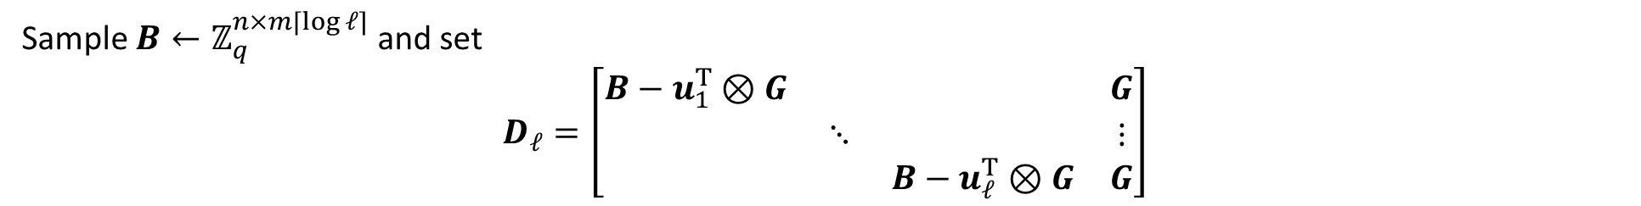


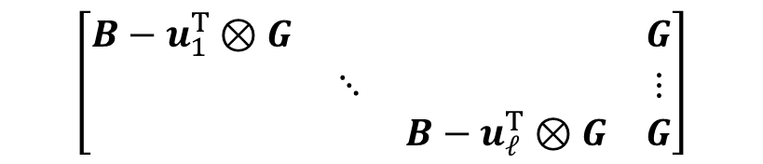










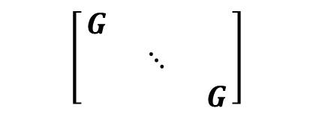

Constructing a Shifted Multi-Preimage Sampler
Sample $B←ℤ_{q}^{n×m⌈\log{ℓ}⌉}$ and set
$$D_{ℓ}=\left[\begin{matrix}B−u_{1}^{T}⊗G & & & G \\ & ⋱ & & ⋮ \\ & & B−u_{ℓ}^{T}⊗G & G\end{matrix}\right]$$
$u_{i}$: binary representation of $i$
Claim: The matrix $D_{ℓ}$ has a public trapdoor
Matrices $H_{i,j}$ and $V_{i}$ can be publicly derived using homomorphic evaluation techniques from [GSW13, BGGHNSVV14]
Idea: Define low-norm matrices $H_{i,j}$ and $V_{i}$ where
${\left(i,j\right)}^{th}$ block of product:
$$=\left\{\begin{aligned} \\ \end{aligned}\right.$$
$$−V_{j}+G$$
$$i=j$$
$$=\left\{\begin{aligned} \\ \end{aligned}\right.$$
$$G$$
$$\left(B−u_{i}^{T}⊗G\right)H_{i,j}$$
$$i=j$$
$${−V}_{j}$$
$$i≠j$$
$$\left(B−u_{i}^{T}⊗G\right)H_{i,j}+G⋅G^{−1}\left(V_{j}\right)$$
$$0$$
$$i≠j$$
$$\left[\begin{matrix}H_{1,1} & ⋯ & H_{1,ℓ} \\ ⋮ & ⋱ & ⋮ \\ H_{ℓ,1} & ⋯ & H_{ℓ, ℓ} \\ G^{−1}\left(V_{1}\right) & ⋯ & G^{−1}\left(V_{ℓ}\right)\end{matrix}\right]$$
$$\left[\begin{matrix}B−u_{1}^{T}⊗G & & & G \\ & ⋱ & & ⋮ \\ & & B−u_{ℓ}^{T}⊗G & G\end{matrix}\right]$$
$$\left[\begin{matrix}G & & \\ & ⋱ & \\ & & G\end{matrix}\right]$$

Slide 20
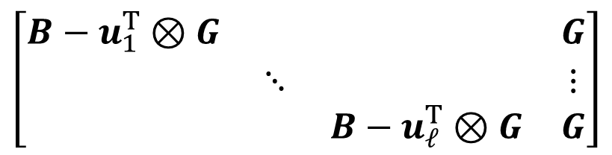
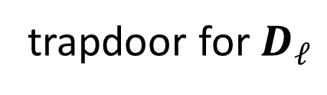

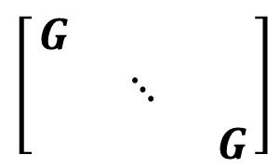
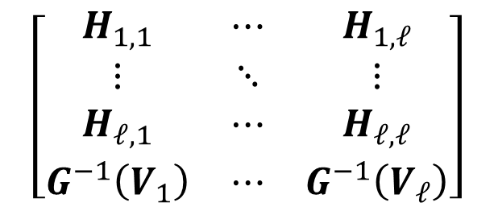
Constructing a Shifted Multi-Preimage Sampler
$$D_{ℓ}$$
trapdoor for $D_{ℓ}$
$$\left[\begin{matrix}H_{1,1} & ⋯ & H_{1,ℓ} \\ ⋮ & ⋱ & ⋮ \\ H_{ℓ,1} & ⋯ & H_{ℓ,ℓ} \\ G^{−1}\left(V_{1}\right) & ⋯ & G^{−1}\left(V_{ℓ}\right)\end{matrix}\right]$$
$$\left[\begin{matrix}B−u_{1}^{T}⊗G & & & G \\ & ⋱ & & ⋮ \\ & & B−u_{ℓ}^{T}⊗G & G\end{matrix}\right]$$
$$\left[\begin{matrix}G & & \\ & ⋱ & \\ & & G\end{matrix}\right]$$
Letting $A_{i}=B−u_{i}⊗G$, the trapdoor for $D_{ℓ}$ gives a solution to the shifted multi-preimage sampling problem for matrices $A_{1},…,A_{ℓ}$:
Observe: Matrix $D_{ℓ}$ and its trapdoor is completely specified by matrix $B$ (recall that $u_{i}$ is vector corresponding to binary representation of $i$)
Yields vector commitments and dual-mode NIZKs with transparent setup

Slide 21
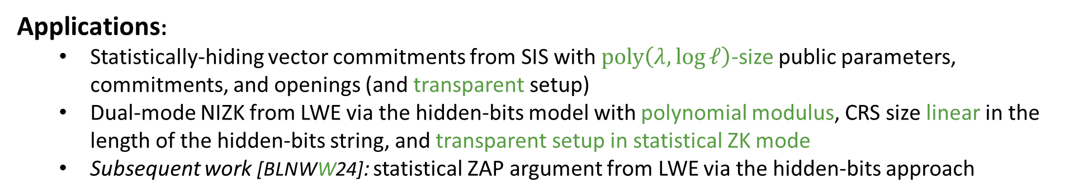
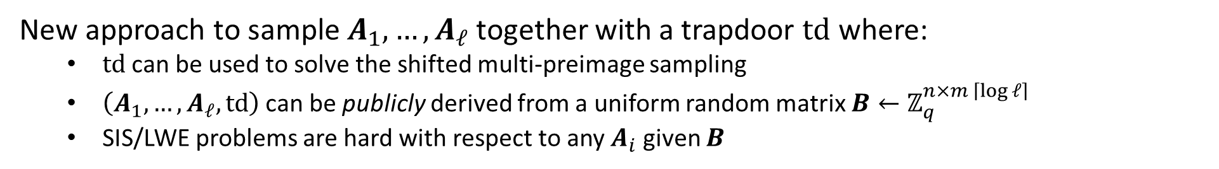
Summary
Given $A_{1},…, A_{ℓ}∈ℤ_{q}^{n×m}$ and $t_{1},…,t_{ℓ}∈ℤ_{q}^{n}$,
find $c∈ℤ_{q}^{n}$ and low-norm $π_{1},…,π_{ℓ}∈ℤ_{q}^{m}$ where $A_{i}π_{i}=t_{i}+c$ for all $i∈\left[ℓ\right]$
New approach to sample $A_{1},…,A_{ℓ}$ together with a trapdoor $td$ where:
  $td$ can be used to solve the shifted multi-preimage sampling
  $\left(A_{1},…,A_{ℓ},td\right)$ can be publicly derived from a uniform random matrix $B←ℤ_{q}^{n×m \left\lceil \log{ℓ}\right\rceil }$
  SIS/LWE problems are hard with respect to any $A_{i}$ given $B$
Applications:
  Statistically-hiding vector commitments from SIS with $poly\left(λ,\log{ℓ}\right)$-size public parameters, commitments, and openings (and transparent setup)
  Dual-mode NIZK from LWE via the hidden-bits model with polynomial modulus, CRS size linear in the length of the hidden-bits string, and transparent setup in statistical ZK mode
  Subsequent work [BLNWW24]: statistical ZAP argument from LWE via the hidden-bits approach

Slide 22
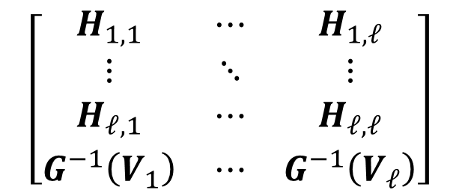
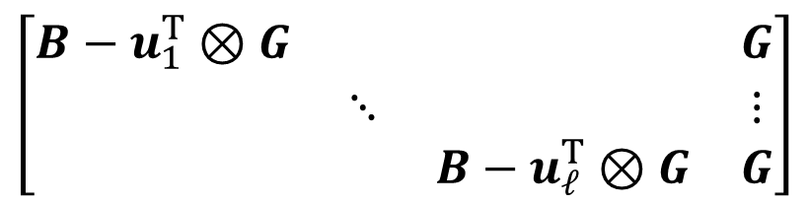
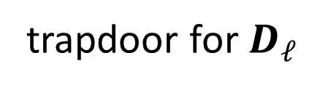

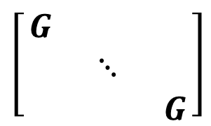
Summary
Given $A_{1},…, A_{ℓ}∈ℤ_{q}^{n×m}$ and $t_{1},…,t_{ℓ}∈ℤ_{q}^{n}$,
find $c∈ℤ_{q}^{n}$ and low-norm $π_{1},…,π_{ℓ}∈ℤ_{q}^{m}$ where $A_{i}π_{i}=t_{i}+c$ for all $i∈\left[ℓ\right]$
$$D_{ℓ}$$
trapdoor for $D_{ℓ}$
$$\left[\begin{matrix}H_{1,1} & ⋯ & H_{1,ℓ} \\ ⋮ & ⋱ & ⋮ \\ H_{ℓ,1} & ⋯ & H_{ℓ,ℓ} \\ G^{−1}\left(V_{1}\right) & ⋯ & G^{−1}\left(V_{ℓ}\right)\end{matrix}\right]$$
$$\left[\begin{matrix}B−u_{1}^{T}⊗G & & & G \\ & ⋱ & & ⋮ \\ & & B−u_{ℓ}^{T}⊗G & G\end{matrix}\right]$$
$$\left[\begin{matrix}G & & \\ & ⋱ & \\ & & G\end{matrix}\right]$$
Thank you!
https://eprint.iacr.org/2024/1401

