Slide 1
Re-Randomize and Extract: A Novel Commitment Construction Framework Based on Group Actions
Kaijie Jiang, Anyu Wang, Hengyi Luo, Guoxiao Liu, Tang Gang, Yanbin Pan, Xiaoyun Wang
Speaker：Kaijie Jiang
Tsinghua University
May 8, Eurocrypt2025, Madrid, Spain

Slide 2
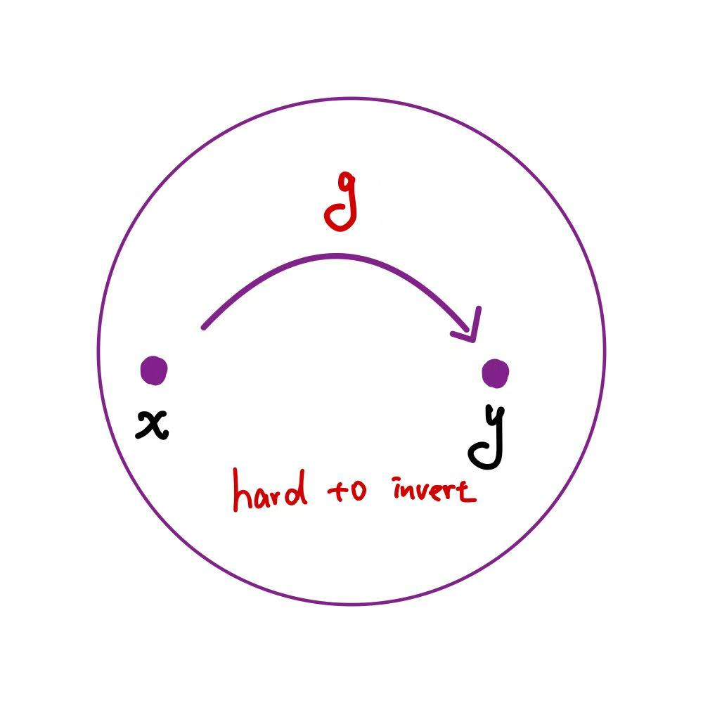
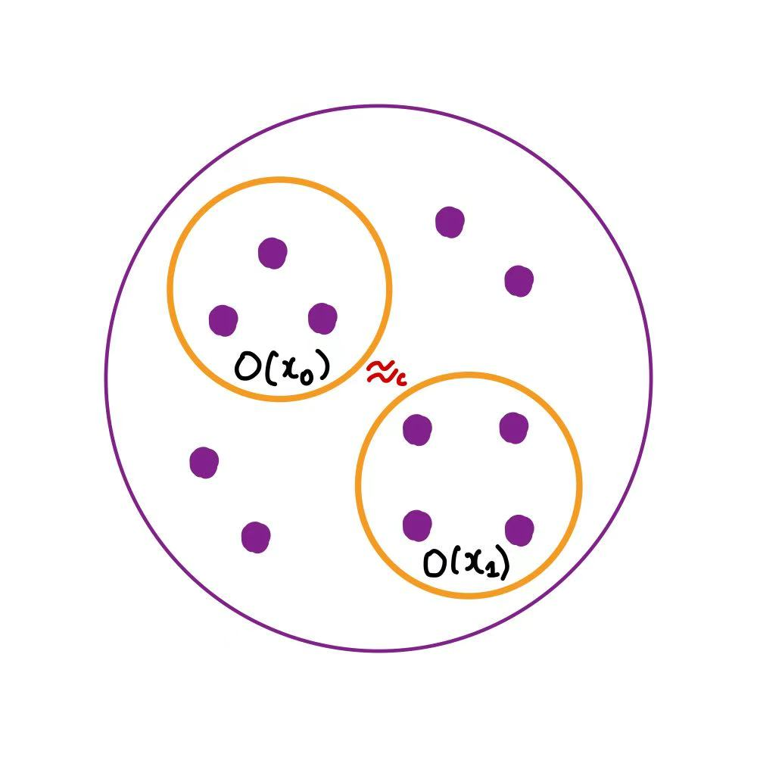
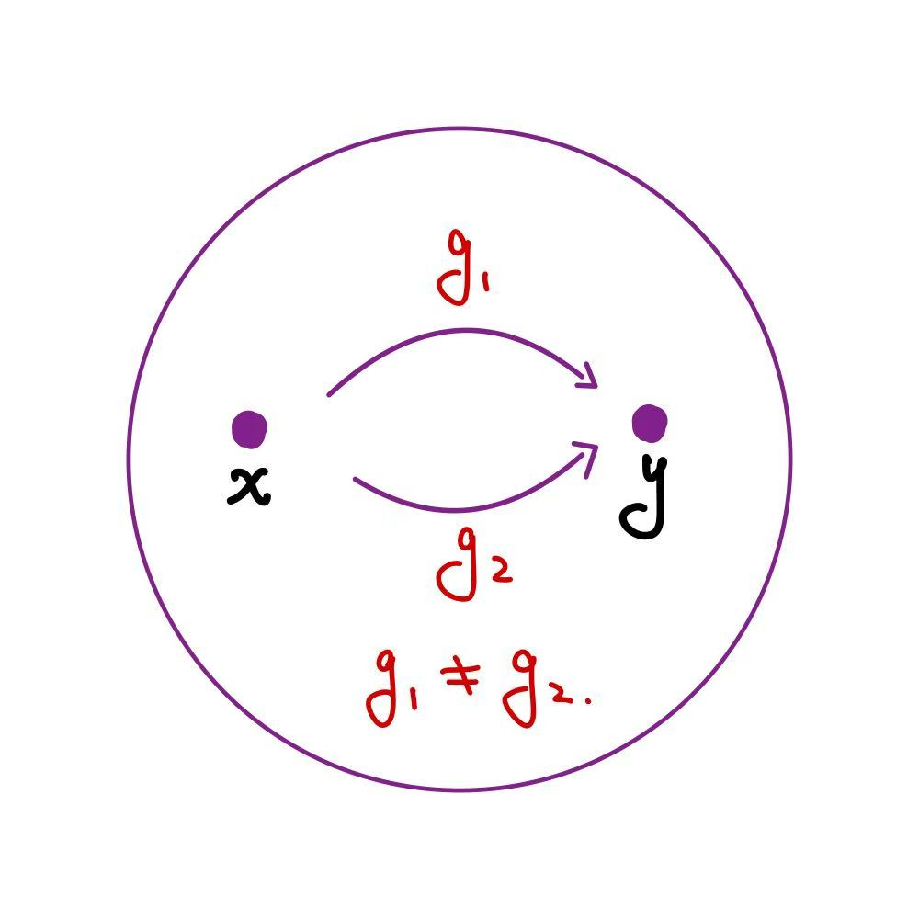
Cryptography Group Action
Group Action：
Let $G$ be a group, $X$ be a set and $∗≔G×X→X$ .$\left(G, X,∗\right)$ is a group action if $∗$ is compatible with the group operation : $e∗x=x, g∗\left(h∗x\right)=\left(gh\right)∗x.$
For $x∈X,$ $𝒪\left(x\right)≔\left\{g∗x:g∈G\right\}$ is defined as the orbit of $x$.
For $x∈X,$ Stab$\left(x\right)≔$ $\left\{g∈G:g∗x=x\right\}$ is defined as the stabilizer of $x$.
For $ℐ\left(x,y\right)≔$ $\left\{g∈G:g∗x=y\right\}$, $ℐ\left(x,y\right)=$ $g∙$Stab$\left(x\right)$, $g∈ℐ(x,y)$.
Cryptographic properties：
One-way
Pseudorandom ( Distinguish Orbits Problem )
Collision-resistance ( Search Stabilizer Problem )

Slide 3
Commitment Scheme
Commitment Scheme ：$Π_{com}=\left(Gen, Com, Open\right)$
Gen：Gen${(1}^{λ})→$Ck, generates the public commitment key Ck。
Sender
Sends $c$
Receiver
Commit Phase
Sends $d$
$${Com}_{Ck}\left(m\right)→\left(c,d\right)$$
$${Open}_{Ck}\left(c,d\right)→\tilde{m}$$
Open Phase
Security：
Can’t open $c$
to two different $m$, $m’$.
$c$ doesn’t disclose any information about $m$.
Binding
Hiding

Slide 4
Commitment Schemes based on Group Actions
Our Results：
Two key techniques for group actions: re-randomization and randomness extractors.
A novel framework to construct various commitments based on group actions： basic commitments, dual-mode commitment and enhanced-linkable commitment.
Instantiate all our proposed commitments using Lattices Isomorphism Problem (LIP) and Lattices Automorphism Problem (LAP).
Use LIP to provide a repair and improvement to the non-interactive commitment proposed by D’Alconzo, Flamini, and Gangemi (ASIACRYPT 2023).
Related Work：
Bit commitments from group action [Brassard-Yung91, Ji-Qiao-Song-Yun19, D’Alconzo-Flamini-Gangemi23].
Dual-Mode commitment from abelian group action [Kaafarani-Katsumata-Pintore20].
Linkable bit commitment from group action [D’Alconzo-Flamini-Gangemi23].

Slide 5
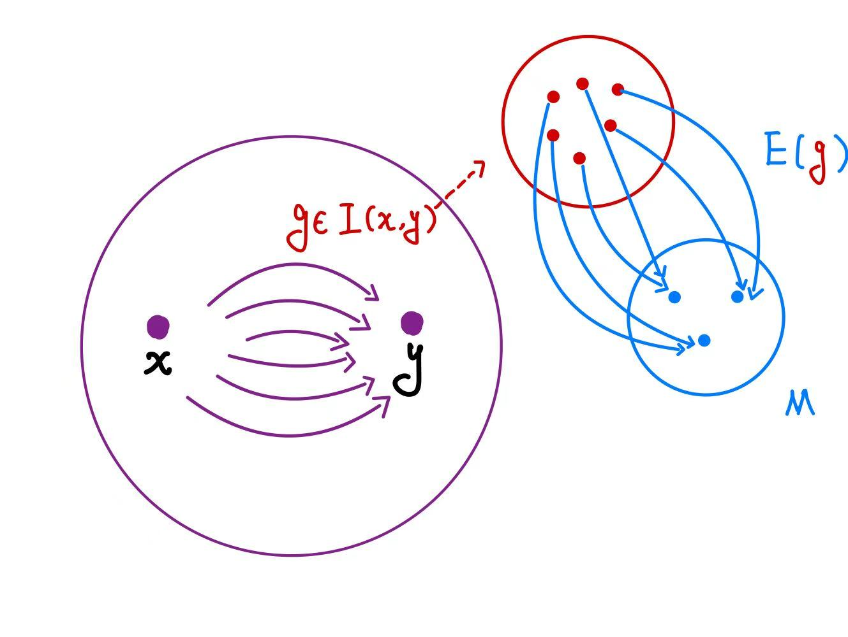
Key Techniques: Randomization and Extractor
Re-Randomized Algorithm：
For a group action ${\left(G,X,∗\right)}_{ }$, a re-ranomized algorithm $R$ takes $x∈X$ as input and outputs
$\left(g∗x,g\right)∈X×G$ according to a distribution, denoted as$R\left(x\right)$, such that：
$∀x∈X, x^{′}∈𝒪\left(x\right)$ and $\left(x^{′′},g\right)←R\left(x\right)$, the marginal distributions of the first variable are identical for $R(x)$ and $R\left(x^{′}\right)$ ; $g$ is uniformly distributed on $ℐ\left(x,x^{′′}\right)$。
Deterministic Extractor：
For a gourp action${\left(G,X,∗\right)}_{ }$with a distribution $𝒟_{G,X}^{ }$ on $G×X$, and M is a finite group. A deterministic extractor is a deterministic and efficient algorithm $E≔G→M$, such that：
For ${(h,x)←𝒟}_{G,X}^{ }$, and $∀y^{ },y′∈𝒪\left(x\right)$, it holds that $E\left(g\right)$ is uniformly distributed on M, where $g←ℐ\left(y,y^{′}\right).$

Slide 6
Basic Commitment I
Commitment Scheme ：$Π_{com}=\left(Gen, Com, Open\right)$
Gen${(1}^{λ})：Sample$ $\left(h,x\right)←𝒟_{G,X}^{ }, outputs Ck=y=h∗x.$
Sender
Send $c=\left(c_{1},c_{2}\right)$
Receiver
Commit Phase
Send $d=g$
${Com}_{y}\left(m\right)$: Re-randomize $\left(y′,g\right)←R\left(y\right)$ Compute$c=\left(c_{1},c_{2}\right)=\left(E\left(g\right)⋅m,y′ \right)$ Let $d=g$, outputs ($c$,$d$).
${Open}_{y}\left(c,d\right)$: If $d∗y=c_{2}$, outputs $\tilde{m}=E{\left(d\right)}^{−1}⋅c_{1}$;
Otherwise outputs $⊥.$
Open Phase
Security：
Perfectly Hiding and Computationally Binding based on the Search Stabilizer Problem.

Slide 7
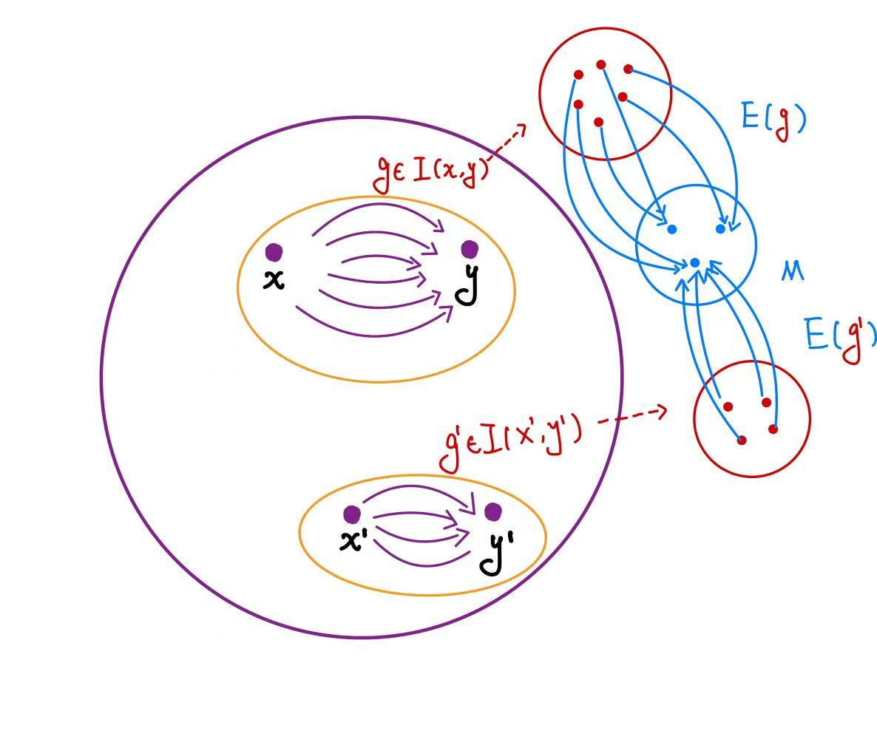
Basic Commitment II
Local Constant Extractor：
For a gourp ${\left(G,X,∗\right)}_{ }$with distributions $𝒟_{G,X}^{ }$, ${𝒟’}_{G,X}^{ }$ on $G×X$, and M is a finited group. A local constant extractor is a deterministic and efficient algorithm $E≔G→M$, such that：
For ${(h,x)←𝒟}_{G,X}^{ }$, and $∀y^{ },y′∈𝒪\left(x\right)$, it holds that $E\left(g\right)$ is uniformly distributed on M for $g←ℐ\left(y,y^{′}\right).$
For ${(h,x)←𝒟’}_{G,X}^{ }$, and $∀y^{ },y′∈𝒪\left(x\right)$, it holds that $E\left(g\right)$ is a constant on M for $∀g∈ℐ\left(y,y^{′}\right).$
Basic commitment I → Basic commitment II.
Deterministic extractor → Local constant extractor.
Ck from distribution $𝒟_{G,X}^{ }$ → Ck from distribution ${𝒟’}_{G,X}^{ }$.
Perfectly hiding → Perfectly binding.
Search Stabilizer Problem → Distinguish Orbits Problem.

Slide 8
New Commitment Primitive
New Commitment Primitive：Enhanced Linkable Commitment
In [D’Alconzo-Flamini-Gangemi23], the authors introduced the Linkable Commitment, which allows a sender to provide a short proof $d_{L}$ to prove two commitments have the same message without revealing it.
Homomorphic Commitment satisfies: ${Com}_{Ck}\left(m_{1};r_{1}\right)⋅$ ${Com}_{Ck}\left(m_{2};r_{2}\right)={Com}_{Ck}\left(m_{1}m_{2};r_{1}r_{2}\right)$, enables one to prove the value of $m_{1}m_{2}^{−1}$ without revealing any additional information.
Therefore, we proposed the Enhanced Linkable Commitment. It can provide a short proof $d_{L}$ for two commitments ${Com}_{Ck}\left(m_{1}\right)$ and ${Com}_{Ck}\left(m_{2}\right)$, proving the value of $m_{1}m_{2}^{−1}$ without revealing any additional information.
Homomorphic Commitment $⊆$ Enhanced Linkable Commitment $⊆$ Linkable Commitment.

Slide 9
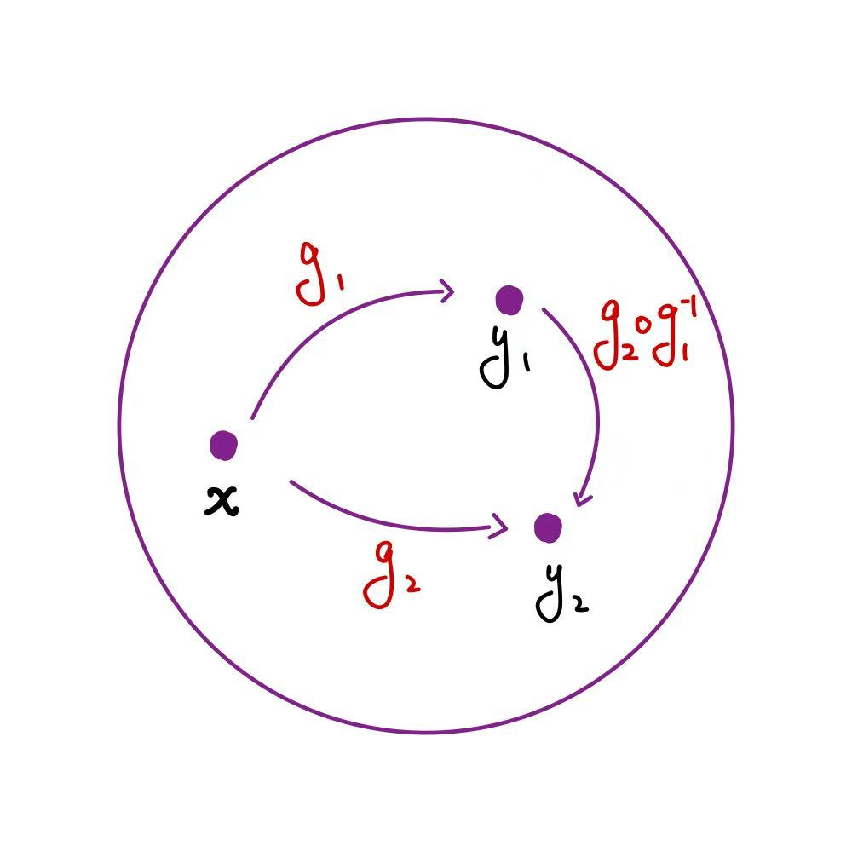
More Commitment Construcitons
Enhanced Linkable Commitemnt：
Replace the deterministic (local constant) extractor in the basic commitment with the following homomorphic extractor, that is, add the homomorphic property on the deterministic extractor:
$E≔G→M$ is a surjective group homomorphism, $∀g_{1},g_{2}∈G,E\left(g_{1}{⋅g}_{2}^{−1}\right)=E\left(g_{1}\right)⋅E{\left(g_{2}\right)}^{−1}$.
The short proof $d_{L}=g_{2}{⋅g}_{1}^{−1}$, for ${Com}_{y}\left(m_{i}\right)=( \left(E\left(g_{i}\right)⋅m_{i},y_{i} \right),g_{i}), i∈\{1,2\}.$
Note that ${(E\left(g_{2}\right)⋅m_{2})}^{−1}∙E(d_{L})∙E\left(g_{1}\right)⋅m_{1}={m_{2}}^{−1}m_{1}$.
Security：
Based on the Search Stabilizer Problem or Distinguish Orbits Problem.

Slide 10
More Commitment Construcitons
Dual Mode Commitemnt：
Replace the local constant extractor $E$ in the basic commitment II with the following trapdoor extractor $(E,F)$, that is, add the trapdoor property on the deterministic extractor:
For ${(h,x)←𝒟}_{G,X}^{ }$ and $∀ y^{′},y^{′′}∈𝒪\left(x\right),u∈M, g∈ℐ\left(y′,y^{′′}\right)$ $：F\left(u,g,y′,Stab(y′)\right)→g′$ satisfies $g^{′}∈ℐ\left(y^{′},y^{′′}\right), E\left(g^{′}\right)=u.$
For ${(h,x)←𝒟}_{G,X}^{ }, ∀ y^{′},y′′∈𝒪\left(x\right)$, the following two distributions are identical: $\left\{\left(E(g),g\right) \right|g← ℐ\left(y′,y^{′′}\right)\},$ $\left\{\left(u,g′\right) \right|u←M,g′←F\left(u,g,y′,Stab(y′)\right)\}$
Security：
Based on the Distinguish Orbits Problem.

Slide 11
Lattice Assumptions
Lattice Isomorphism Problem（Quadratic Form）：
Given two quadratic forms $Q_{1},Q_{2}$ associated with$ℒ_{1} and ℒ_{2}$, find a $U∈{GL}_{n}(ℤ)$ such that $U^{ }Q_{1}U^{t}=Q_{2}$.
Lattice Automorphism Problem（Quadratic Form）：
Given a quadratic form $Q_{ }$ associated with a lattice $ℒ_{ }$, find a $U∈{GL}_{n}(ℤ)$ such that $U≠±I_{n}$ and $U^{ }Q_{ }U^{t}=Q_{ }$.
Group Action Based on Lattices：
Let$Q∈{S_{n}^{>0}(ℤ)}^{ }$ be a quadratic form, $G=GL_{n}^{±}(ℤ)=GL_{n}(ℤ)/\{±I_{n}\}$,$X=[Q]=\{U{QU}^{t}:U∈GL_{n}(ℤ)/\{±I_{n}\}\}$, a group action $(GL_{n}^{±}(ℤ),[Q],∗)$ is defined as:
$V∗Q’=V⋅Q’⋅V^{t}$ for any $V∈GL_{n}^{±}(ℤ), Q’∈[Q]$.

Slide 12
Instantiation with LIP/LAP
Re-Randomized Algorithm ：
From the random self reduction of Lattice Isomorphism Problem [Ducas-van Woerden22].
For $Q∈{S_{n}^{>0}(ℤ)}^{ }$, there is a re-randomized algorithm $R\left(Q\right)⟶\left({Q’}^{ },U\right)$, where ${Q’}^{ }=U{QU}^{t}$.
Deterministic Extractor：
Let $Q$ be a quadratic form of an $n$ dimensional lattice $ℒ$ where $n$ is even and
$\#\{O:det(O)=1,O∈Aut(ℒ)\}=\#\{O:det(O)=−1,O∈Aut(ℒ)\}$ .
For the group action $(GL_{n}^{±}\left(ℤ\right),\left[Q\right],∗)$, define $𝒟_{GL_{n}^{±}\left(ℤ\right),\left[Q\right]}^{ }→\left(U,Q\right)$, where $\left(U{QU}^{t},U\right)←R\left(Q\right)$.
Let $M=\left(\left\{−1,1\right\} , ×\right)$ and $E:GL_{n}^{±}\left(ℤ\right)→M$ such that $E(U)↦det(U)$.
[see paper for details]

Slide 13
Open question and Future work
Explore the alternative assumptions for instantiation, such as code equivalence, Isogeny.
Utilize re-randomization and extractors to construct other primitives.
Construct a Homomorphic commitment based on general group actions.

Slide 14
Thanks for your attention!
Notes:
群作用，承诺，our result，4分半左右
两个基本组件 3 基础承诺方案，和它的对偶 3
Enhanced Linkable Commitment 的motivation ，高级承诺方案需要的提取器 5
格同构问题 实例化 2
总结和回顾，Open question 2
（如果还有多余的时间，就加上local constant 以及对应的实例化

