Slide 1
The Impact of Reversibility on Parallel Pebbling: Quantum Attacks on Memory-Hard Functions
Jeremiah Blocki
Blake Holman
Seunghoon Lee
Purdue University
Eurocrypt 2025

Slide 2
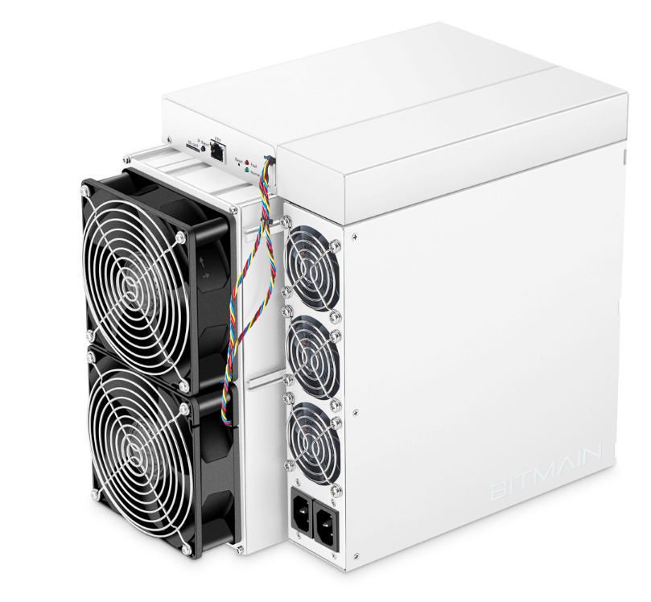
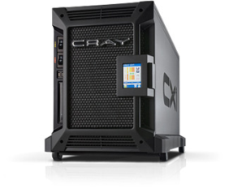
Memory Hard Functions (MHFs)
Brute force attackers use specialized, highly parallel hardware (like ASICs) to recover hashed passwords.
MHFs protect passwords from these brute force attacks.
Notes:
Low entropy secrets

Slide 3
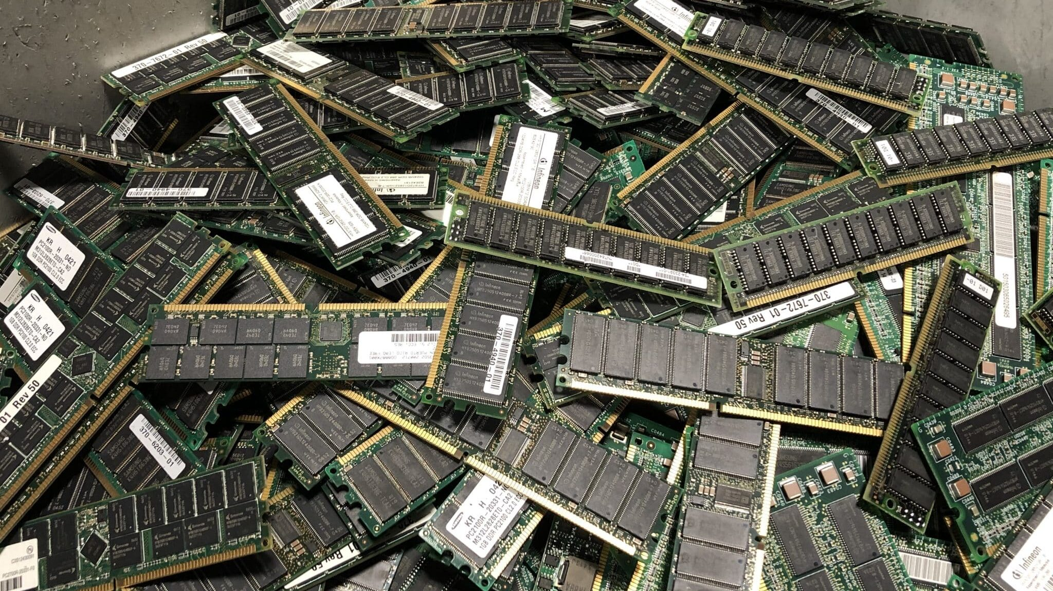
Memory Hard Functions (MHFs)
Intuition: computation costs dominated by memory costs
vs.
Goal: force attacker to lock up large amounts of memory for duration of computation
What’s the best way to measure “memory-hardness?”
Notes:
Two kinds (we talk about imhfs)

Slide 4
Memory-Hard Functions: Measuring Cost
Cumulative Complexity [AS15] is the standard measure of memory-hardness
Sum of space used over time
Equivalently: Average space usage $×$ time
$$T⋅s_{Avg}=\sum_{i}{s_{i}}$$
Cumulative Complexity
$$space(A_{f})$$
MHFs with high cumulative complexity minimize the attacker’s hardware advantage
Space
Time
Notes:
Captures amortized space-time complexity

Slide 5
Memory-Hard Functions: Construction
A memory-hard function $f_{G, H}$ is defined by:
A directed graph $G$ (encodes data-dependencies)
A hash function $H:{\left\{0,1\right\}}^{2w}→{\left\{0,1\right\}}^{w}$ (random oracle)
Each node has a label
Label for a node $v$ is $H(Parents\left(v\right))$
$f_{G, H}\left(X\right)$ is the label of the sink node
Output: $f_{G, H}\left(X\right)=L_{4}$
2
4
Input:
$$X=(pwd, salt)$$
1
3
$$L3=H(L2,L1)$$
$$L1=H(pwd,salt)$$

Slide 6
Memory-Hard Functions: Analysis
The (classical) parallel pebbling game is a primary tool for analyzing the cost of an MHF:
Pebbles represent chunks of memory
Placing a pebble on a node $v$ represents storing the label $L_{v}$
Removing a pebble on node $v$ represents unallocating the memory storing $L_{v}$
2
4
Available Memory
1
3
Notes:
Useful tool for cost of iMHFs

Slide 7
Memory-Hard Functions: Analysis
The (classical) parallel pebbling game is a primary tool for analyzing the cost of an MHF:
Each round:
Rule 1: Pebbles can be placed on any node $v$ if every parent of $v$ is pebbled
Rule 2: Any pebbles not placed in this round may be removed
$P_{1}=\left\{1\right\}$
$P_{2}=\left\{1, 2\right\}$
$P_{3}=\left\{2, 3\right\}$
$P_{4}=\{4\}$
2
4
Available Memory
1
3
Notes:
Parallel pebbling game, powerful tool to analyze cc of MHFs

Slide 8
Quantum Attacks: Coherently Evaluating MHFs
$$∑α_{x,y}|x,y⟩$$
A quantum attacker with query access to the MHF $f_{G,H}$ can crack passwords with quadratically fewer queries than a classical attacker
Need to implement $f_{G,H}\left|x\right\rangle \left|y\right\rangle =\left|x\right\rangle |y⊕f_{G,H}\left(x\right)⟩$
Coherent function evaluation could potentially be much more costly than classical function evaluation
Quantum circuit for $f$ must be reversible
$$U_{f}$$
$$∑α_{x,y}|x,y⊕f(x)⟩$$
Grover Search to find $f^{−1}(y)$
Can the classical pebbling game be used to analyze the CC of the coherent circuit?
Notes:
Ask question? Can the classical pebbling game be used to analyze the CC of coherent circuit?

Slide 9
Example: Iterative Functions (Classical)
Given a function $H:{\left\{0,1\right\}}^{w}→\{0,1\}^{w}$ and an input $x$, compute
$$f\left(x\right)=H^{N}(x)= H(H(H(⋯H(x))))$$
An (irreversible) classical machine can just compute $f\left(x\right)$ in place
1
2
3
4
Memory Block 1 | Memory Block 2 | Memory Block 3 | Memory Block 4 | Memory Block 5
$$f(x)$$
$$H^{4}(x)$$
$$000$$
$$000$$
$$000$$
$$x$$
$$000$$
$$H^{2}(x)$$
$$H(x)$$
$$H^{3}(x)$$

Slide 10
Example: Iterative Functions (Quantum)
Given a function $H:{\left\{0,1\right\}}^{w}→\{0,1\}^{w}$ and an input $x$, compute
$$f\left(x\right)=H^{N}(x)= H(H(H(H(x))))$$
Standard approach:
A quantum algorithm is reversible, so it can’t compute $f$ in place
To clear up memory, we must uncompute the intermediate values
1
2
3
4
Parallel Reversible Pebbling Game [BHL22]
Memory Block 1 | Memory Block 2 | Memory Block 3 | Memory Block 4 | Memory Block 5
$$\sum_{x}{α_{x}}$$
$$H^{2}(x)$$
$$H^{3}(x)$$
$$f(x)$$
$$H(x)$$
$$H^{4}(x)$$
$$x$$
$$000$$
$$000$$
$$000$$
$$000$$
$$⊕$$
$$⊕$$
$$⊕$$
$$H(x)$$
$$H^{2}(x)$$
$$H^{3}(x)$$

Slide 11
Example: Iterative Functions (Quantum)
Given a function $H:{\left\{0,1\right\}}^{w}→\{0,1\}^{w}$ and an input $x$, compute
$$f\left(x\right)=H^{N}(x)= H(H(H(H(x))))$$
Standard approach:
A quantum algorithm is reversible, so it can’t compute $f$ in place
To clear up memory, we must uncompute the intermediate values
Is this large overhead in cumulative complexity necessary?
Classical Algorithm: $O\left(N\right)$ CC
Quantum Algorithm: $Ω(N^{2})$ CC
Memory Block 1 | Memory Block 2 | Memory Block 3 | Memory Block 4 | Memory Block 5
$$\sum_{x}{α_{x}}$$
$$x$$
$$000$$
$$000$$
$$000$$
$$f(x)$$
Notes:
Insert before results: have parallel pebbling game, lots of analysis. Downside, it doesn’t capture the cost of quantum computation. We have reversible pebbling games but not a lot of pebboling analysis. We bridge some of these gaps

Slide 12
Classical vs Reversible Pebbling
Question: Is a large overhead in cumulative complexity necessary for coherent quantum circuits for MHFs?
Classical cumulative complexity $≤$ Reversible (pebbling) cumulative complexity
Idea: Can we show that reversible cumulative complexity is always close to the classical cumulative complexity?
Classical Parallel Pebbling:
Longstanding, vast body of techniques for analyzing classical evaluation of MHFs
Does not suffice for analyzing reversible circuits
Reversible Parallel Pebbling:
New to MHFs; few techniques
Reversible pebblings correspond to cost-equavlent quantum circuits

Slide 13
Results
Cumulative Complexity preserving map from irreversible Pebblings $P$to reversible pebblings $R$with small overhead
Classical/Reversible CC separation for Line Graph on $N$ nodes:
$Reversible CC≥N^{\frac{\sqrt{2}}{log N }}× Classical CC$
$$CC\left(R\right)≈CC\left(P\right)⋅δ(P)$$
$$δ\left(P\right)≤time{\left(P\right)}^{o(1)}$$
Quantum Attacks on Memory-Hard Functions
Efficient, low CC quantum circuits for evaluating Memory-Hard Functions
Argon2i, PBKDF2, DRSample, . . .
Tighter CC upper bounds for specific MHFs.
Coherent Quantum MHF Attack
Classical MHF Attack
Reversible Pebbling
Notes:
Is necessary? Upper bound no, Also say lower bound yes. Focus on upper bound. See paper for tighter bounds for many imhfs of interests

Slide 14
From Classical to Reversible Pebblings
2
4
$$G=$$
$P=(P_{1},…, P_{t})$ is a pebbling for a graph $G$
Goal: map pebbling $P$ to reversible pebbling $R$
while preserving cumulative complexity $CC\left(P\right)={space}_{avg}\left(P\right)×time\left(P\right)$
Idea: classical pebbling as line graph
Intuitively, the pebbling $P$ represents an iterative function: $P_{i}↦P_{i+1}$
Placing a pebble on node $v$ in $LineGraph\left(P\right)$ corresponds to placing pebbles on all $u∈P_{v}$
Removing a pebble from node $v$ in $LineGraph\left(P\right)$ corresponds to removing all pebbles $u∈P_{v}$ that are not being used by other configurations
1
3
$$P_{1}$$
$$P_{2}$$
$$P_{3}$$
$$⋯$$
$$P_{t}$$
2
4
1
3
$$P_{2}=\left\{1, 2\right\}$$
Notes:
Write P_2={2,3}

Slide 15
From Classical to Reversible Pebblings
2
4
$$G=$$
$P=(P_{1},…, P_{t})$ is a pebbling for a graph $G$
1
3
If $L$ is a reversible pebbling of $LineGraph\left(P\right)$ then $R=L∘P$ is a reversible line graph pebbling of $G$
$$P_{1}$$
$$P_{2}$$
$$P_{3}$$
$$⋯$$
$$P_{t}$$
Cost
$$time\left(R\right)=time(L)$$
$$space\left(R\right)≤space\left(L\right)×space(P)$$
Reversible Pebbling $R$ of $G$
$$time\left(R\right)=t$$
$$space\left(R\right)≤space\left(P\right)×t^{o\left(1\right)}$$
$$CumulativeComplexity\left(R\right)=???$$
Could be that ${space}_{avg}\left(P\right)≪space(P)$
Reversible Line Graph Pebbling (TCC 2022)
$$time\left(L\right)=t$$
$$space\left(L\right)≤t^{o\left(1\right)}$$
Notes:
Might be useful to show why space avg can be much less than space

Slide 16
From Classical to Reversible Pebblings
2
4
$$G=$$
If reversible pebbling $L$ for $LineGraph\left(P\right)$ keeps a pebble on node $P_{T_{1}}$ for $Ω\left(t\right)$ steps
Then ${space}_{avg}\left(R\right)≥space\left(P\right)≫{space}_{avg}(P)$
1
3
$$P_{1}$$
$$P_{2}$$
$$P_{3}$$
$$⋯$$
$$P_{t}$$
Pebbling $P$
S₁
Reversible Pebbling $R$ of $G$
$$time\left(R\right)=t$$
$$space\left(R\right)≤space\left(P\right)×t^{o\left(1\right)}$$
$$CumulativeComplexity\left(R\right)=???$$
Could be that ${space}_{avg}\left(P\right)≪space(P)$
space
T₁
time

Slide 17
Reversible Simulation of Irreversible Pebblings (Sketch)
Weighted line graph represents irreversible computation $P_{1},…,P_{t }$
$wt\left(v\right)=\left|P_{v}\right|$
Classify nodes as light, medium, or heavy
Reversible weighted line graph pebbling $L$
Space usage at time $t$: $\sum_{v∈L_{i}}{wt(v)}$
Idea: apply our parallel reversible line graph pebbling the light nodes
Recursively pebble/unpebble the heavier nodes as needed
1
2
3
4
5
6
7
8
1
6
8
2
3
4
5
2
5
7
3
4

Slide 18
Reversible Simulation of Irreversible Pebblings (Sketch)
Weighted line graph represents irreversible computation $P_{1},…,P_{t}$
$wt\left(v\right)=\left|P_{v}\right|$
Classify nodes as light, medium, or heavy
Reversible weighted line graph pebbling $L$
Space usage at time $t$: $\sum_{v∈L_{i}}{wt(v)}$
Idea: apply our parallel reversible line graph pebbling the light nodes
Recursively pebble/unpebble the heavier nodes as needed
1
2
3
4
5
6
7
8
Classical/Reversible Cumulative Complexity Transformation
$$Cumulative Complexity\left(L\right)=Cumulative Complexity\left(P\right)×δ\left(P\right)$$
$$δ\left(C_{f}\right)=time{\left(P\right)}^{\frac{O\left(1\right)}{\sqrt[4]{time(P)}}}$$
Notes:
Say somewhere tha this is an over simplied sketch

Slide 19
Summary
Cumulative complexity preserving map from irreversible pebblings to reversible pebblings with small overhead
Open Problem:
Do reversible pebbling bounds hold in the QROM?
Applications of low CC quantum circuits?
$$CC\left(R_{f}\right)≈CC\left(C_{f}\right)⋅δ(C_{f})$$
$$δ\left(C_{f}\right)≤time{\left(C_{f}\right)}^{o(1)}$$
Quantum Attacks on Memory-Hard Functions
Efficient, low CC quantum circuits for evaluating Memory-Hard Functions
Argon2i, PBKDF2, DRSample, . . .
Questions?
Blake@purdue.edu
Coherent Quantum MHF Attack
Classical MHF Attack
Reversible pebbling
ePrint: 2024/334

Slide 20
Parallelism and Space-Time Complexity
Algorithm $A_{f}$ computes $f$
Space-Time Complexity: $T⋅\max_{i} s_{i}$
Not adequate for parallel machines
Space-time complexity of a function doesn’t scale in parallel
Cumulative Complexity: $T⋅s_{Avg}=\sum_{i}{s_{i}}$
S₃
S₁
space
time
T₁
T₃
ST₁ = S₁ × T₁ ≈ S₃ × T₃ = ST₃
Space-Time Complexity
Cumulative Complexity
$$space(A_{f})$$
$$space(A_{f})$$
cost of computing
f once
cost of computing
f three times
Space
Space
$$time (A_{f})$$
$$time (A_{f})$$
$3×$ AST₁ = AST₃
Time
Time

