Slide 1
A Generic Approach to Adaptively-Secure Broadcast Encryption in the Plain Model
Yao-Ching Hsieh
Brent Waters
David J. Wu

Slide 2
Broadcast Encryption ([Fiat-Naor 93])
Master public key
$$mpk$$
Message
$$m$$
Target Set
$$S$$
Central server
Secret key
$${sk}_{i}$$
Content Distributer
Ciphertext ${ct}_{S}\left(m\right)$
User $1\sim N$
Succinctness:
$$=$$
$+$ “Short”

Slide 3
Broadcast Encryption – Formal Syntax
N: number of users
$Setup\left(1^{λ}, 1^{N}\right)→ mpk, msk$
$KeyGen\left(msk, i∈\left[N\right]\right)→{sk}_{i}$
$Enc\left(mpk, S⊆\left[N\right], m\right)→{ct}_{S}\left(m\right)$
$Dec\left(mpk,{sk}_{i}, {ct}_{S}\left(m\right)\right)→m/⊥$

Slide 4
Broadcast Encryption – Formal Syntax
N: number of users
Succinctness
$\left|{ct}_{S}\left(m\right)\right|≤o(\left|S\right|)$
For this talk, $\left|{ct}_{S}\left(m\right)\right|=O_{λ}(1)$
Correctness
Honest ciphertext always decrypts for users in the set.
Security
${ct}_{S}\left(m\right)$ hides $m$ if no ${sk}_{i}$ where $i∈S$ is given.
$Setup\left(1^{λ}, 1^{N}\right)→ mpk, msk$
$KeyGen\left(msk, i∈\left[N\right]\right)→(i, {sk}_{i})$
$Enc\left(mpk, S⊆\left[N\right], m\right)→(S, {ct}_{S}\left(m\right)$)
$Dec\left(mpk,i,{sk}_{i}, S,{ct}_{S}\left(m\right)\right)→m/⊥$
Short

Slide 5
Security: Adaptive vs. Selective
N: number of users
Adaptive Game
Selective Game
$$1^{N}$$
$$1^{N}, S⊆[N]$$
$$mpk,msk←Setup(1^{λ},1^{N})$$
$$mpk,msk←Setup(1^{λ},1^{N})$$
$$mpk$$
$$mpk$$
$$i∈[N]$$
$$i∈\left[N\right]∖S$$
$${sk}_{i}←KeyGen\left(msk,i\right)$$
$$𝒬←i$$
$${sk}_{i}←KeyGen\left(msk,i\right)$$
$${sk}_{i}$$
$${sk}_{i}$$
$$S⊆\left[N\right]∖𝒬, m_{0},m_{1}$$
$$m_{0},m_{1}$$
$$b←\left\{0,1\right\}$$
$$b←\left\{0,1\right\}$$
$${ct}_{S}←Enc(mpk,S, m_{b})$$
$${ct}_{S}←Enc(mpk,S, m_{b})$$
$${ct}_{S}$$
$${ct}_{S}$$
Guess $b$
Guess $b$

Slide 6
Construction: Adaptive vs. Selective
$O_{λ}(1)$-sized secret key + ciphertext only
Adaptive Secure
Selective Secure
$O(N)/O\left(1\right)$-sized mpk
$q$-type pairing ([Gentry-Waters09])
LWE+generic pairing ([Agarwal-Yamata20]…)
Witness Encryption ([Freitag –Waters-Wu23])
$ℓ$-succinct LWE / Decomposable LWE ([Wee24], [Wee25],[Abram- Malavolta- Roy25])
Strong/complex constructions
iO/Mmap ([Zha14]), Positional WE ([Goyal-Vusirikala-Waters19]), …
$O(1)$-sized mpk
Candidate lattice construction
Witness Encryption (Secret-coin Evasive LWE) ([Freitag –Waters-Wu23])
$ℓ$-succinct LWE / Decomposable LWE ([Wee24], [Champion-Wu24], [Wee25],[Abram- Malavolta- Roy25])
Dual system encryption ([Waters09],…)
$\text{Simple} \text{assumption}\text{ (}\text{k}\text{−}\text{Lin}\text{)}$
$O(N^{2})$-sized mpk
No lattice adaptation
Search pairing assumption
Search $q$-Diffie-Hellman Exponent ([Gentry-Waters09])

Slide 7
Importance of Adaptiveness
Adaptive security is the right notion for security.
Complexity leveraging does not work for broadcast encryption.
$O\left(N\right)$-efficiency loss on all components. Violates succinctness!
Alternative route ([Gentry-Waters09])
Adaptive security using random oracle
Semi-Static Secure Broadcast + Random Oracle => Adaptive Broadcast

Slide 8
Semi-Static Security
N: number of users
Adaptive Game
Selective Game
$$1^{N}$$
$$1^{N}, S⊆[N]$$
$$mpk,msk←Setup(1^{λ},1^{N})$$
$$mpk,msk←Setup(1^{λ},1^{N})$$
$$mpk$$
$$mpk$$
$$i∈[N]$$
$$i∈\left[N\right]∖S$$
$${sk}_{i}←KeyGen\left(msk,i\right)$$
$$𝒬←i$$
$${sk}_{i}←KeyGen\left(msk,i\right)$$
$${sk}_{i}$$
$${sk}_{i}$$
$$S⊆\left[N\right]∖𝒬, m_{0},m_{1}$$
$$m_{0},m_{1}$$
$$b←\left\{0,1\right\}$$
$$b←\left\{0,1\right\}$$
$${ct}_{S}←Enc(mpk,S, m_{b})$$
$${ct}_{S}←Enc(mpk,S, m_{b})$$
$${ct}_{S}$$
$${ct}_{S}$$
Guess $b$
Guess $b$

Slide 9
Semi-Static Security
N: number of users
Adaptive Game
Semi-Static Game
Selective Game
$$1^{N}$$
$$1^{N}, S^{∗}⊆[N]$$
$$1^{N}, S⊆[N]$$
$$mpk$$
$$mpk$$
$$mpk$$
$$i∈[N]$$
$$i∈\left[N\right]∖S^{∗}$$
$$i∈\left[N\right]∖S$$
$${sk}_{i}$$
$${sk}_{i}$$
$${sk}_{i}$$
$$S⊆\left[N\right]∖𝒬, m_{0},m_{1}$$
$$S⊆S^{∗}, m_{0},m_{1}$$
$$m_{0},m_{1}$$
$${ct}_{S}$$
$${ct}_{S}$$
$${ct}_{S}$$
Honest users / Queryable keys are predetermined
(like selective security)
Challenge set can be adaptively chosen
(like adaptive security)

Slide 10
Semi-Static Constructions
$O_{λ}(1)$-sized secret key + ciphertext only
Semi-Static Secure
Selective Secure
$O(N)$-sized mpk
$q$-type pairing ([Gentry-Waters09])
Witness Encryption ([Freitag –Waters-Wu23])
$O(N)/O\left(1\right)$-sized mpk
$q$-type pairing ([Gentry-Waters09])
LWE+generic pairing ([Agarwal-Yamata20]…)
Witness Encryption ([Freitag –Waters-Wu23])
$ℓ$-succinct LWE / Decomposable LWE ([Wee24], [Wee25],[Abram- Malavolta- Roy25])
[GW09]: Semi-static + Random oracle $⇒$ Adaptive
Q: Can we not rely on random oracle?
Candidate lattice construction
Witness Encryption (Secret-coin Evasive LWE) ([Freitag –Waters-Wu23])
Candidate lattice construction
Witness Encryption (Secret-coin Evasive LWE) ([Freitag –Waters-Wu23])
$ℓ$-succinct LWE / Decomposable LWE ([Wee24], [Champion-Wu24], [Wee25],[Abram- Malavolta- Roy25])
Yes!!
Search pairing assumption
Search $q$-Diffie-Hellman Exponent ([Gentry-Waters09])
Search pairing assumption
Search $q$-Diffie-Hellman Exponent ([Gentry-Waters09])

Slide 11
This work: GW transformation without RO
Adaptive broadcast with $O\left(N\right)$ sized mpk + $O(1)$-sized sk/ct without iO.
Adaptive broadcast from lattices. (LWE+witness encryption)
Paring-based adaptive broadcast from search assumption.
Semi-Static BE
RSA
This work:
Publicly-Sampleable Projective PRG
CDH
[GW]:
RO
CBDH
LWE
Adaptive BE
All results extend to Distributed Broadcast Encryption!

Slide 12
GW Transformation – Two-Key Technique
$2N$-user SS Broadcast $⇒$ $N$-user Adp Broadcast
Dummy identity $$\left(i,1−u_{i}\right)$$
Real identity $$\left(i,u_{i}\right)$$
KeyGen: Random 2-out-of-1 identity mapping
Encrypt: Random bipartition and encrypt to both sets
Decryption: For the adaptive key for user $i∈S$, the real identity $\left(i,u_{i}\right)$ falls in either $S_{0}$ (if $u_{i}=v_{i}$) or $S_{1}$ (if $u_{i}≠v_{i}$).
Notes:
Start the slide with “GW uses two-key technique, were every key (has two key…)”

Slide 13
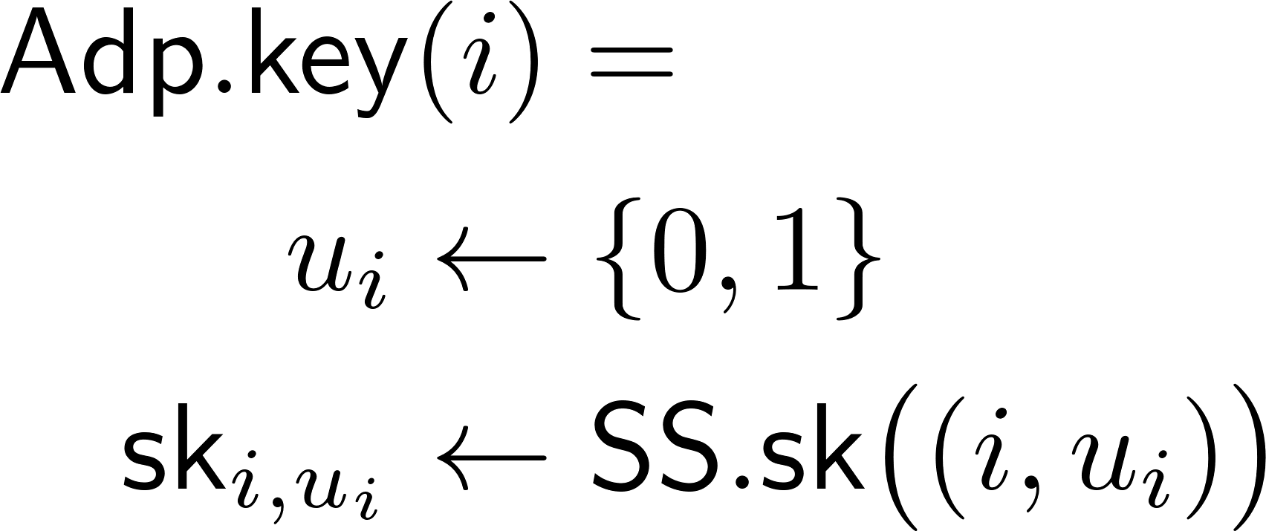
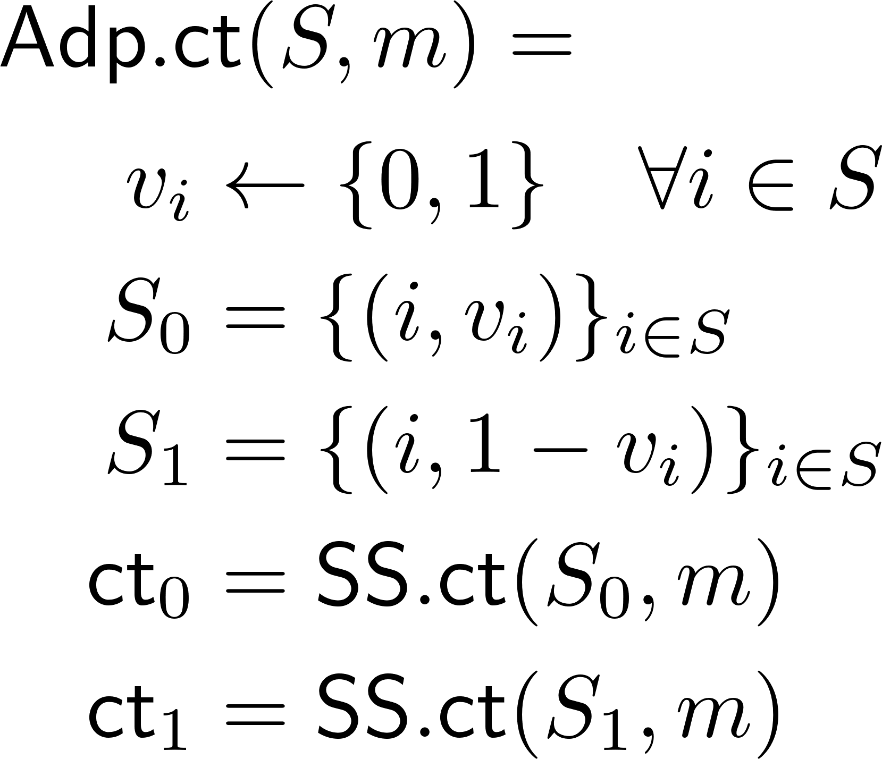
GW Transformation – Two-Key Technique
Adaptive to Semi-Static Reduction:
Initialization:
Sample identity bits $u_{i}←\left\{0,1\right\}$.
Declare honest set $S^{∗}={\left\{\left(i,1−u_{i}\right)\right\}}_{i∈[N]}$ as all the dummy identities.
$$\left(i,0\right)$$
$$\left(i,1\right)$$

Slide 14
GW Transformation – Two-Key Technique
Adaptive to Semi-Static Reduction:
Initialization:
Sample identity bits $u_{i}←\left\{0,1\right\}$.
Declare honest set $S^{∗}={\left\{\left(i,1−u_{i}\right)\right\}}_{i∈[N]}$ as all the dummy identities.
Key queries:
Query semi-static key for $\left(i,u_{i}\right)∉S^{∗}$.
$$\left(i,0\right)$$
$$\left(i,1\right)$$

Slide 15
GW Transformation – Two-Key Technique
Adaptive to Semi-Static Reduction:
Initialization:
Sample identity bits $u_{i}←\left\{0,1\right\}$.
Declare honest set $S^{∗}={\left\{\left(i,1−u_{i}\right)\right\}}_{i∈[N]}$ as all the dummy identities.
Key queries:
Query semi-static key for $\left(i,u_{i}\right)∉S^{∗}$.
Challenge query on S, set $v_{i}=u_{i}$ for all $i∈S$!
$S_{1}$ contains only dummy identity, $S_{1}⊆S^{∗}$.
$$\left(i,0\right)$$
$$\left(i,1\right)$$

Slide 16
GW Transformation – Two-Key Technique
Adaptive to Semi-Static Reduction:
Initialization:
Sample identity bits $u_{i}←\left\{0,1\right\}$.
Declare honest set $S^{∗}={\left\{\left(i,1−u_{i}\right)\right\}}_{i∈[N]}$ as all the dummy identities.
Key queries:
Query semi-static key for $\left(i,u_{i}\right)∉S^{∗}$.
Challenge query on S, set $v_{i}=u_{i}$ for all $i∈S$!
$S_{1}$ contains only dummy identity, $S_{1}⊆S^{∗}$.
Semi-static security guarantees ${ct}_{1}$ hides $m$.
$$\left(i,0\right)$$
 |  | $$S_{1}$$ |  |  | $$S_{1}$$ | $$S_{0}$$
 |  | $$S_{0}$$ |  |  | $$S_{0}$$ | $$S_{1}$$
$$\left(i,1\right)$$

Slide 17
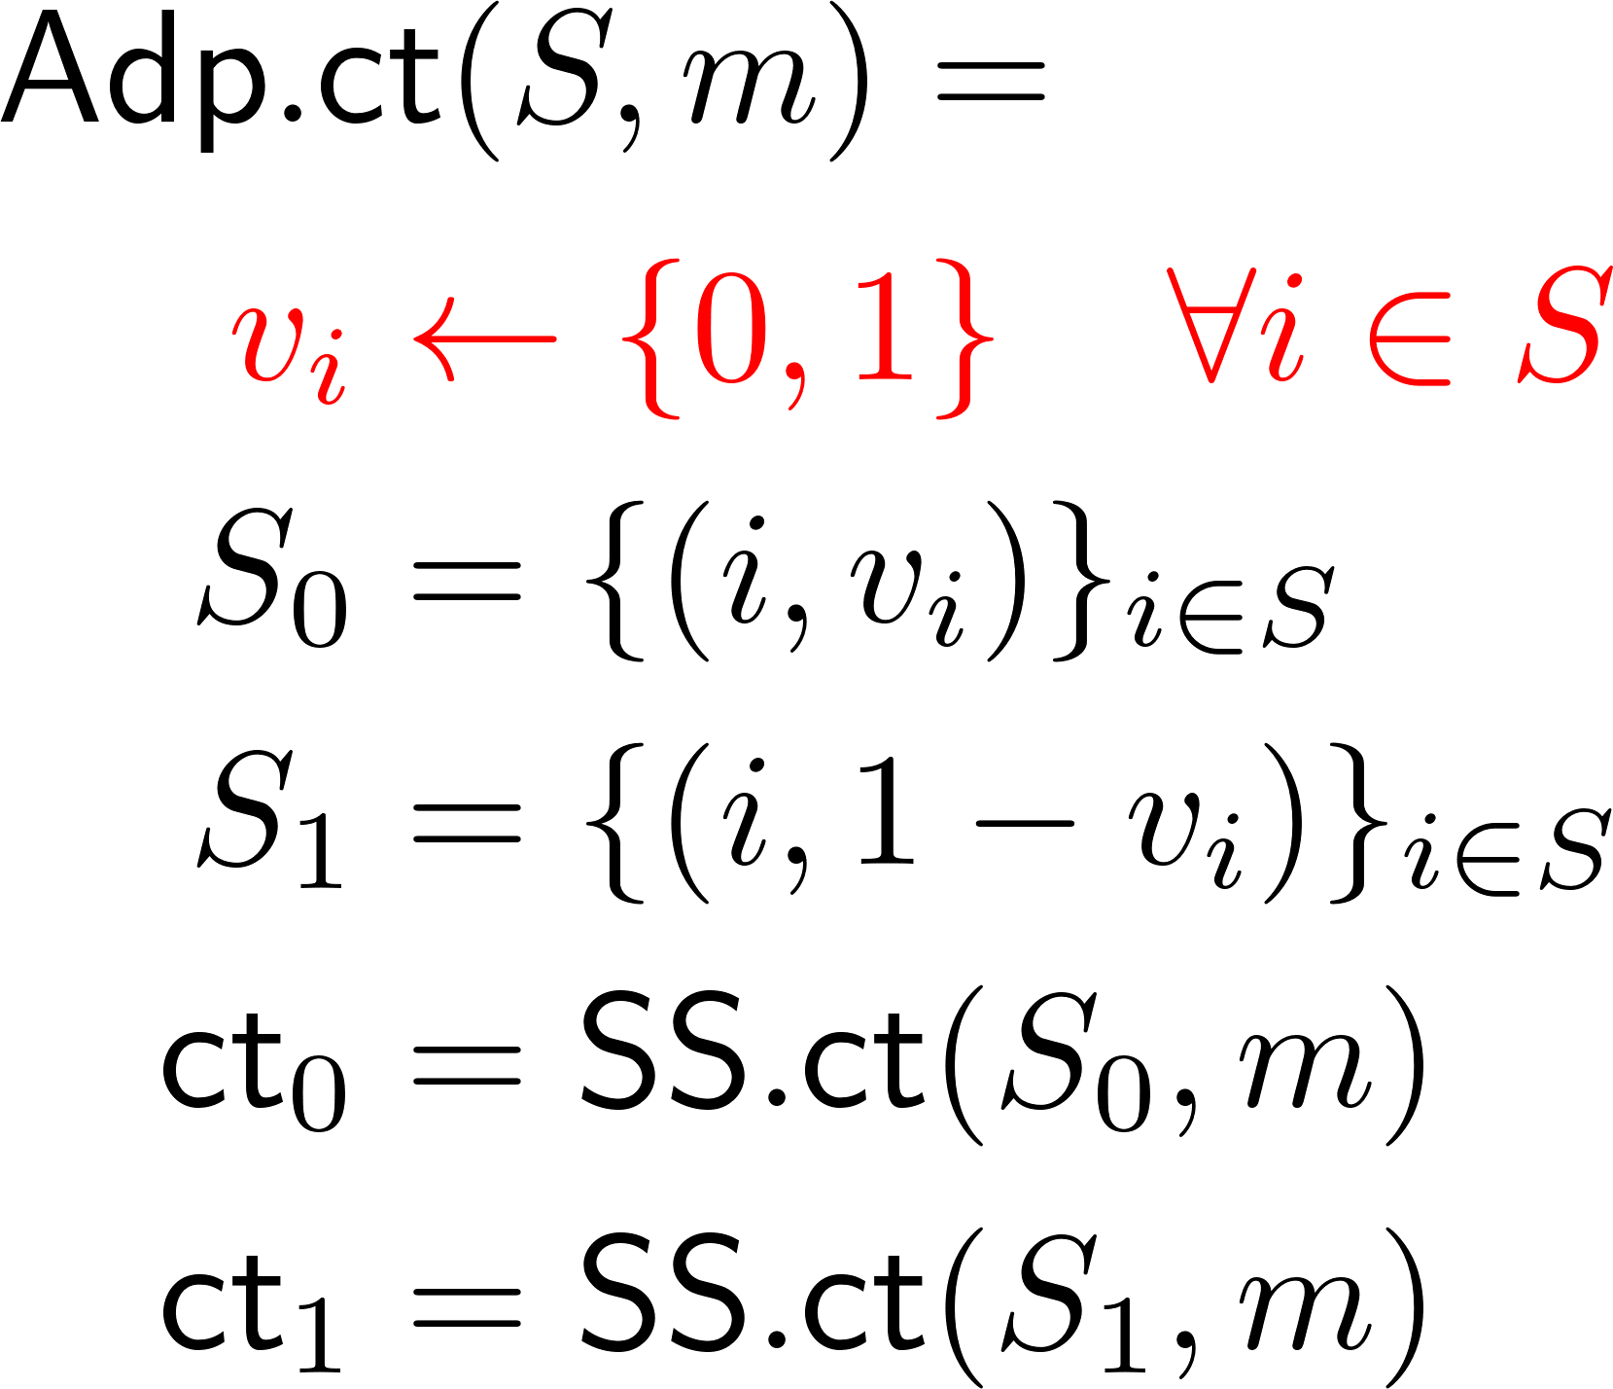
GW Transformation – Two-Key Technique
Adaptive to Semi-Static Reduction:
Initialization:
Sample identity bits $u_{i}←\left\{0,1\right\}$.
Declare honest set $S^{∗}={\left\{\left(i,1−u_{i}\right)\right\}}_{i∈[N]}$ as all the dummy identities.
Key queries:
Query semi-static key for $\left(i,u_{i}\right)∉S^{∗}$.
Challenge query on S, set $v_{i}=u_{i}$ for all $i∈S$!
$S_{1}$ contains only dummy identity, $S_{1}⊆S^{∗}$.
Semi-static security guarantees ${ct}_{1}$ hides $m$.
Secure, but not succinct!
$$\left(i,0\right)$$
 |  | $$S_{1}$$ |  |  | $$S_{1}$$ | $$S_{0}$$
 |  | $$S_{0}$$ |  |  | $$S_{0}$$ | $$S_{1}$$
$$\left(i,1\right)$$

Slide 18
GW Transformation
First approach:
$ρ_{S}={\left\{v_{i}\right\}}_{i∈S}$
Reduction Steps:
Sample $u_{i}$ randomly for all $i∈[N]$.
On given challenge set $S$, set $v_{i}=u_{i}$ for all $i∈S$.
Publish $ρ_{S}$ such that
$ρ_{S}$ reveals $v_{i}$ for all $i∈S$, and nothing else.
$\left|ρ_{S}\right|≪\left|S\right|$.
Notes:
State the “properties” we want immediately

Slide 19
Transformation Instantiation
First approach:
$ρ_{S}={\left\{v_{i}\right\}}_{i∈S}$
GW transformation in ROM:
$u_{i}←\{0,1\}$ for all $i∈\left[N\right]$
Sample $ρ_{S}←{\left\{0,1\right\}}^{λ}$
$v_{i}=H\left(ρ_{S},i\right)$
Reduction Steps:
Sample $u_{i}$ randomly for all $i∈[N]$.
On given challenge set $S$, set $v_{i}=u_{i}$ for all $i∈S$.
Publish $ρ_{S}$ such that
$ρ_{S}$ reveals $v_{i}$ for all $i∈S$, and nothing else.
$\left|ρ_{S}\right|≪\left|S\right|$.

Slide 20
Transformation Instantiation
First approach:
$ρ_{S}={\left\{v_{i}\right\}}_{i∈S}$
GW transformation in ROM:
$u_{i}←\{0,1\}$ for all $i∈\left[N\right]$
Sample $ρ_{S}←{\left\{0,1\right\}}^{λ}$
Program $H\left(ρ_{S},i\right)←u_{i}$ for all $i∈S$.
Note: For $i∉S$, $ρ_{S}$ and $u_{i}$ are independent!
$v_{i}=H\left(ρ_{S},i\right)$
Reduction Steps:
Sample $u_{i}$ randomly for all $i∈[N]$.
On given challenge set $S$, set $v_{i}=u_{i}$ for all $i∈S$.
Publish $ρ_{S}$ such that
$ρ_{S}$ reveals $v_{i}$ for all $i∈S$, and nothing else.
$\left|ρ_{S}\right|≪\left|S\right|$.
Can we achieve this with PRG/PRF instead?

Slide 21
Transformation Instantiation
PRG – Naïve approach:
$\left(u_{1},…, u_{N}\right)←PRG(k)$, where $k←{\left\{0,1\right\}}^{λ}$
Set $v_{i}=u_{i}$ for all $i∈S$.
Publish $ρ_{S}=k$.
PRG seed $k$ leaks $u_{i}$ for $i∉S$.
Want : A “weaker” key $k_{S}$ leaking only indices in $S$.
Reduction Steps:
Sample $u_{i}$ randomly for all $i∈[N]$.
On given challenge set $S$, set $v_{i}=u_{i}$ for all $i∈S$.
Publish $ρ_{S}$ such that
$ρ_{S}$ reveals $v_{i}$ for all $i∈S$, and nothing else.
$\left|ρ_{S}\right|≪\left|S\right|$.
Projective PRG [Applebaum-Beimel-Ishai-Kushilevitz-Liu-Vaikuntanathan 23]:
PRG with key projection: $k_{S}=Project(k,S)$.
$k_{S}$ is short and allows evaluating $u_{i}$ for $i∈S$.
$u_{i}$ for $i∉S$ is pseudorandom even given $k_{S}$.
Construction from CDH/LWE/RSA in the CRS model.

Slide 22
Transformation Instantiation
Projective PRG:
$\left(u_{1},…, u_{N}\right)←PRG(k)$, where $k←{\left\{0,1\right\}}^{λ}$
Set $v_{i}=u_{i}$ for all $i∈S$.
Project seed $k_{S}=Project(k,S)$.
Publish $ρ_{S}=k_{S}$.
Reduction Steps:
Sample $u_{i}$ randomly for all $i∈[N]$.
On given challenge set $S$, set $v_{i}=u_{i}$ for all $i∈S$.
Publish $ρ_{S}$ such that
$ρ_{S}$ reveals $v_{i}$ for all $i∈S$, and nothing else.
$\left|ρ_{S}\right|≪\left|S\right|$.
Technical issue: Projection needs private seed $k$, cannot be done in a public encryption procedure.
Solution: Publicly sampleable projective PRG.
Projected seed $k_{S}$ can be publicly simulated.
Technical issue 2: Need adaptive secure PPRG.
Solution: Same construction, refined proof

Slide 23
Constructing Publicly sampleable PPRG
 | DDH | LWE | RSA
[ABIKLV23]: Projective PRG | $O\left(N^{2}\right)$ crs | $O(N)$ crs | $O(1)$ crs
Small tweak on construction
 | CDH | LWE | RSA
Ours: Publicly sampleable Projective PRG | $O\left(N^{2}\right)$ crs | $O(N)$ crs | $O(1)$ crs
Compressing technique
([Boyen-Waters10])
$O(N)$ sized-crs from pairing (Computational-bilinear-Diffie-Hellman)

Slide 24
New Adaptive Broadcast Constructions
Publicly sampleable Projective PRG
$O\left(1\right)$ crs from RSA
$O\left(N\right)$ crs from LWE
$O\left(N\right)$ crs from CBDH
New Adaptive BE
$O\left(N\right)$ mpk from Decisional pairing assumption.
$O\left(N\right)$ mpk from WE + LWE
$O\left(N^{1+o(1)}\right)$ mpk from Search pairing assumption
$O\left(N\right)$ mpk from Decisional pairing assumption. ([Gentry-Waters09])
$O\left(N\right)$ mpk from WE ([Freitag –Waters-Wu23])
$O\left(N^{1+o(1)}\right)$ mpk from Search pairing assumption (This work)
PPRG crs becomes part of mpk
Semi-Static BE

Slide 25
Open problems
Better group-based broadcast.
Adaptive broadcast from this work:
$O\left(N\right)$-sized mpk from decisional assumption.
$O\left(N^{1+o\left(1\right)}\right)$-sized mpk from search assumption.
Best of both worlds?
Better lattice-based broadcast.
The only semi-static secure lattice construction in the plain model is from witness encryption / secret-coin evasive LWE ([Freitag –Waters-Wu23])
[Champion-Hsieh-Wu25] construct semi-static secure broadcast from $ℓ$-succinct LWE with random oracle.
Adaptive broadcast with $O\left(1\right)$-sized mpk without iO?

Slide 26
Thank You!
eprint.iacr.org/2025/323

