Slide 1

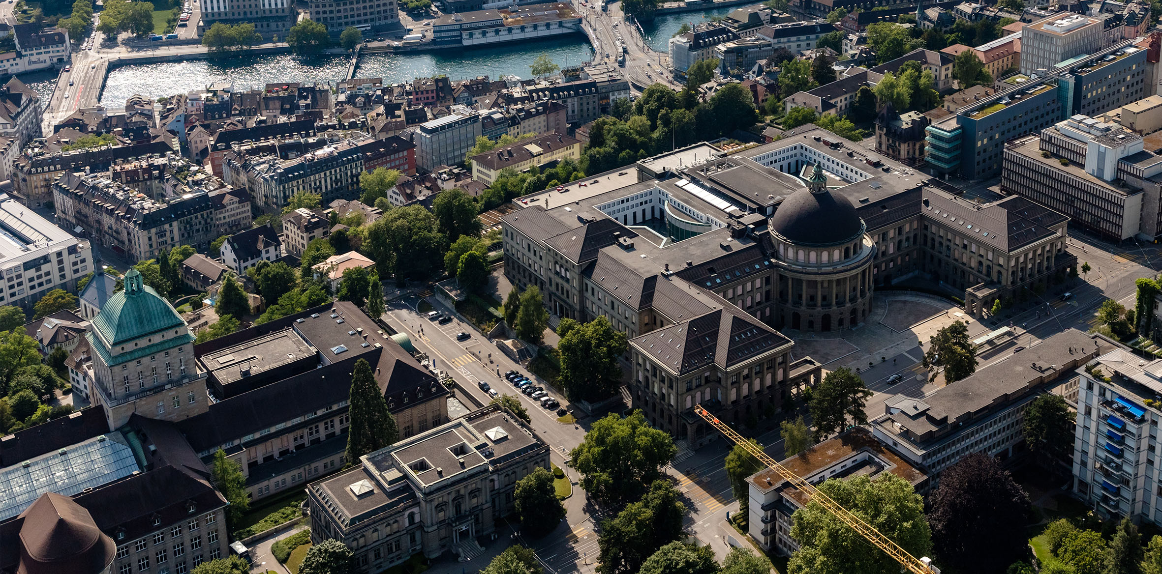
Understanding Cryptography, Backwards
Kenny Paterson
Applied Cryptography Group
ETH Zurich
IACR Distinguished Lecture
6 May 2025

Slide 2
  Overview
On distinguished lectures
Origin story
A different kind of toolbox
On serendipity
On creativity
On pivoting
Back to the future
Closing remarks

Slide 3
  Overview
On distinguished lectures
Origin story
A different kind of toolbox
On serendipity
On creativity
On pivoting
Back to the future
Closing remarks

Slide 4

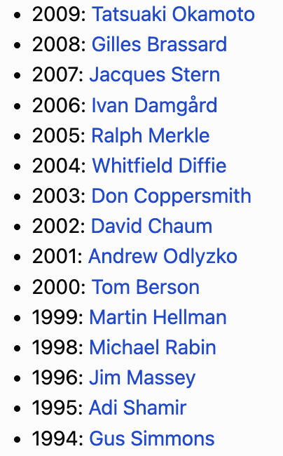
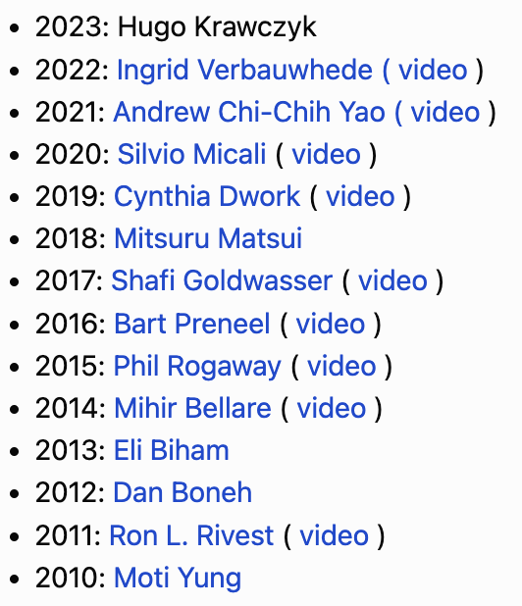
  On Distinguished Lectures
2024: Paul Kocher
https://www.iacr.org/publications/dl/

Slide 5
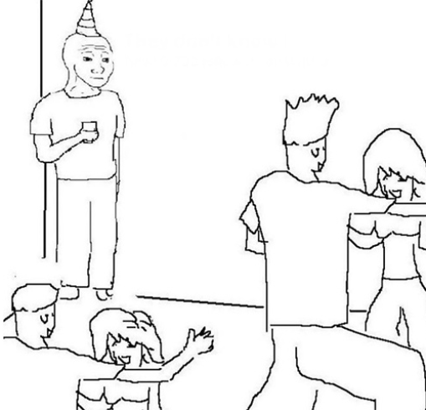
  Imposter Syndrome
The feeling that you do not really deserve whatever success you have had, and that you will soon be found out.
Possible sources:
Everything you do looks trivial to you in retrospect.
Things that other people do look complicated and ingenious.
(Other factors best left to the realm of psychoanalysis.)
Can be managed through:
Faking it till you make it
Passage of time leading to acceptance: “I'm still here”.
Talking to people about it.

Slide 6
  The Three Types of Distinguished Lecture
Here’s where I think cryptography is going.
Here’s an issue we should grapple with as a community.
Here’s some great research I did.

Slide 7
  Parallel Universe (Or: What This Talk is Not About)
Cryptography in the wild – but see Eurocrypt 2024 lecture!
Why QKD is a bad idea.
Why CRQCs are unlikely to ever exist.
The E2EE debate.
How to reform our publishing system.
The current geo-political situation and how we should react to that – but come to the community meeting on Wednesday afternoon!

Slide 8
Four!
  The Three Types of Distinguished Lecture
Here’s where I think cryptography is going.
Here’s an issue we should grapple with as a community.
Here’s some great research I did.
Here’s some reflections on my personal journey through cryptographic research and some of the things I learned along the way.

Slide 9
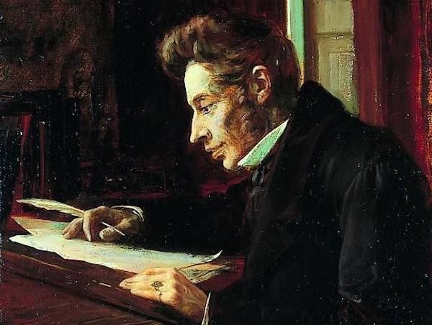
Four!
  The Three Types of Distinguished Lecture
Life must be lived forwards, but can only be understood backwards.
Søren Kierkegaard (1813 - 1855)

Slide 10
Four!
  The Three Types of Distinguished Lecture
It is really true what philosophy tells us, that life must be understood backwards.
But with this, one forgets the second proposition, that it must be lived forwards.
A proposition which, the more it is subjected to careful thought, the more it ends up concluding precisely that life at any given moment cannot really ever be fully understood;
Exactly because there is no single moment where time stops completely in order for me to take position [to do this]: going backwards.
Søren Kierkegaard (1813 - 1855)
https://homepage.math.uiowa.edu/~jorgen/kierkegaardquotesource.html

Slide 11
  Overview
On distinguished lectures
Origin story
A different kind of toolbox
On serendipity
On creativity
On pivoting
Back to the future
Closing remarks

Slide 12
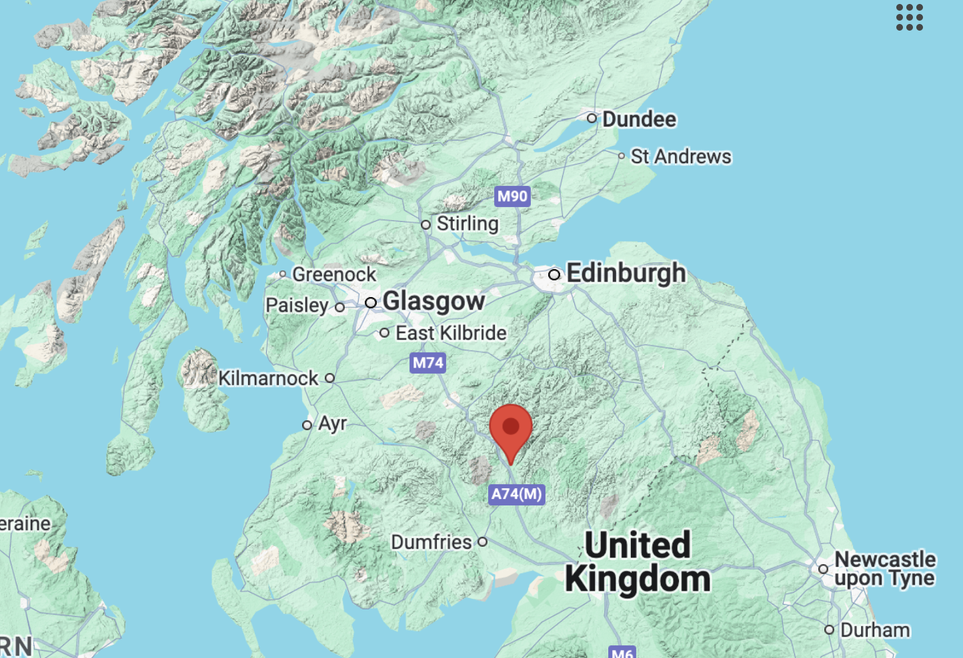
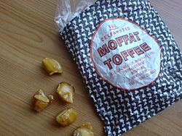
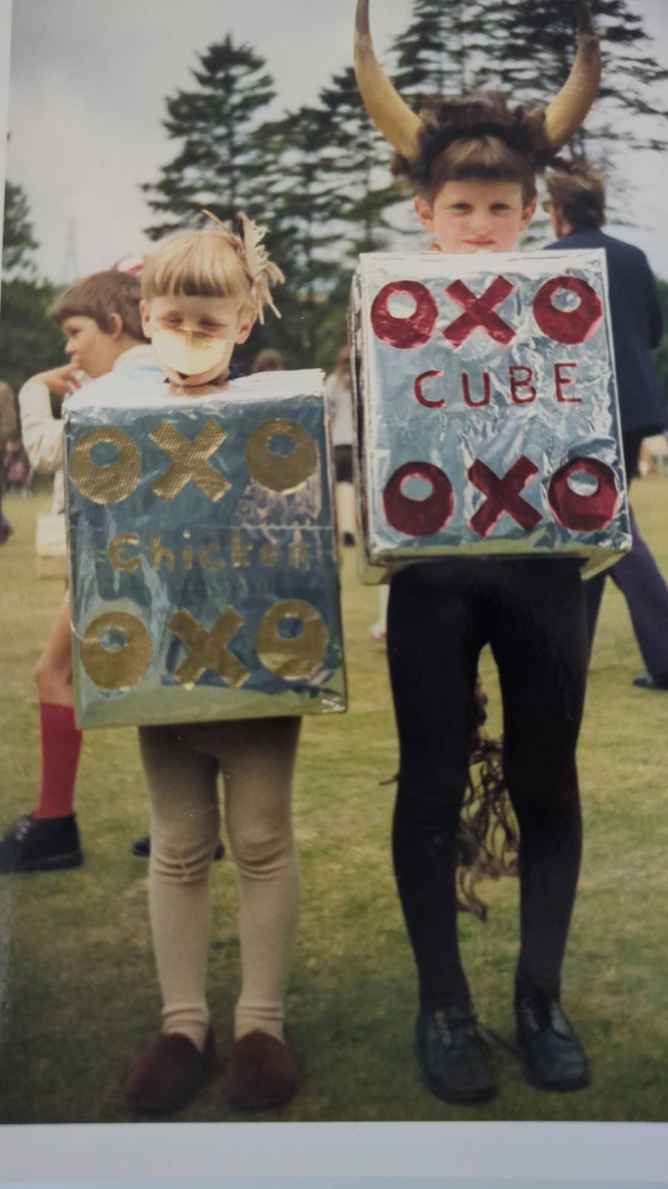

  Origin Story
Moffat

Slide 13
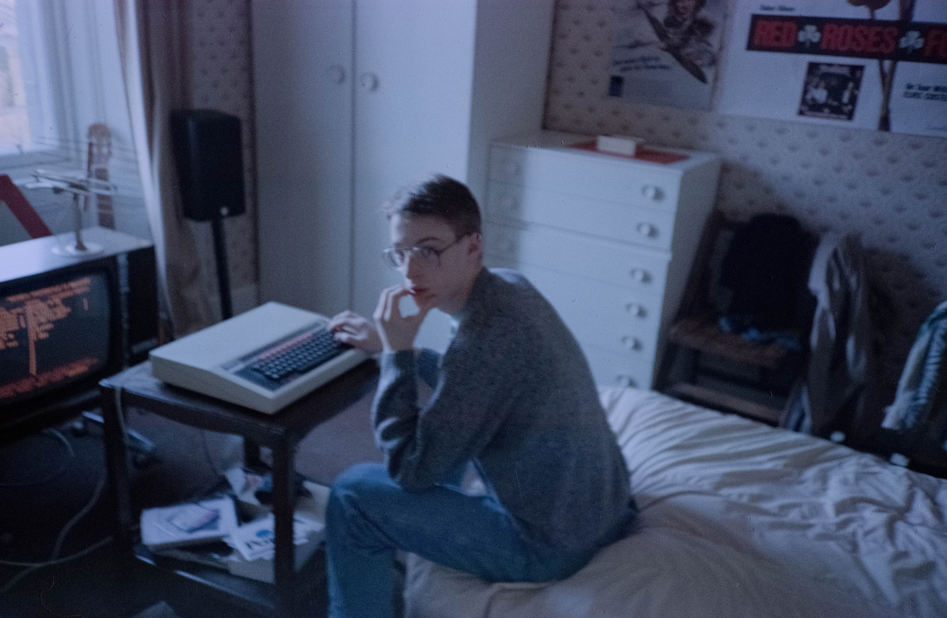
  Origin Story: First Exposure to Computing
Photo taken circa 1987-88, first or second year at University of Glasgow.
BBC Micro Model B
  32k RAM!
  8-bit 6502 CPU!
  2 MHz!
  Cassette tapes!
  BASIC interpreter, assembly language compiler
  Fully-documented OS interfaces to hardware

Slide 14
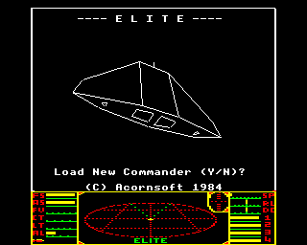
  Origin Story: First Exposure to Computing
Control flow
Procedural programming
Data structures
3D wireframe graphics
Sprites
Assembly language programming
Breaking copy protection mechanisms
Also: CS is too easy to be worth studying!

Slide 15
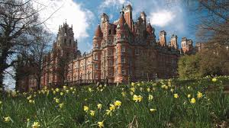
  Origin Story: Selecting a PhD Programme
A chance meeting at a party led me to:
Royal Holloway
“London’s country campus”.
Industry collaboration: HP European Research Labs, Bristol, UK.
SERC scholarship + industry top up = circa GBP 7k per year.
Notes:
Wanted to do something useful with Mathematics.
Lucky meeting with Keith Martin at my brother’s flat-warming party.
Visited Royal Holloway on a warm, breezy Spring day.
It’s not only KU Leuven that has a castle.

Slide 16
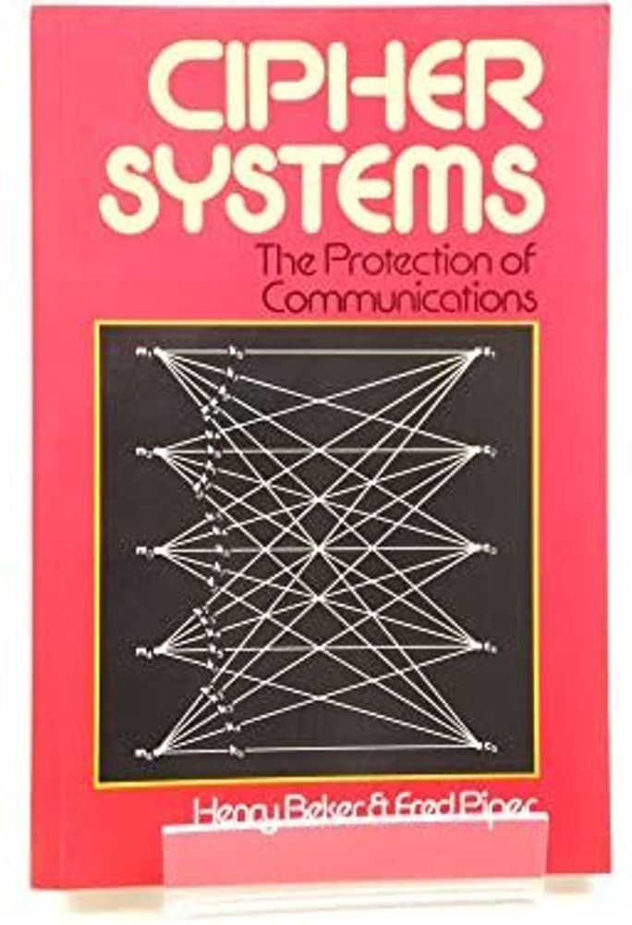
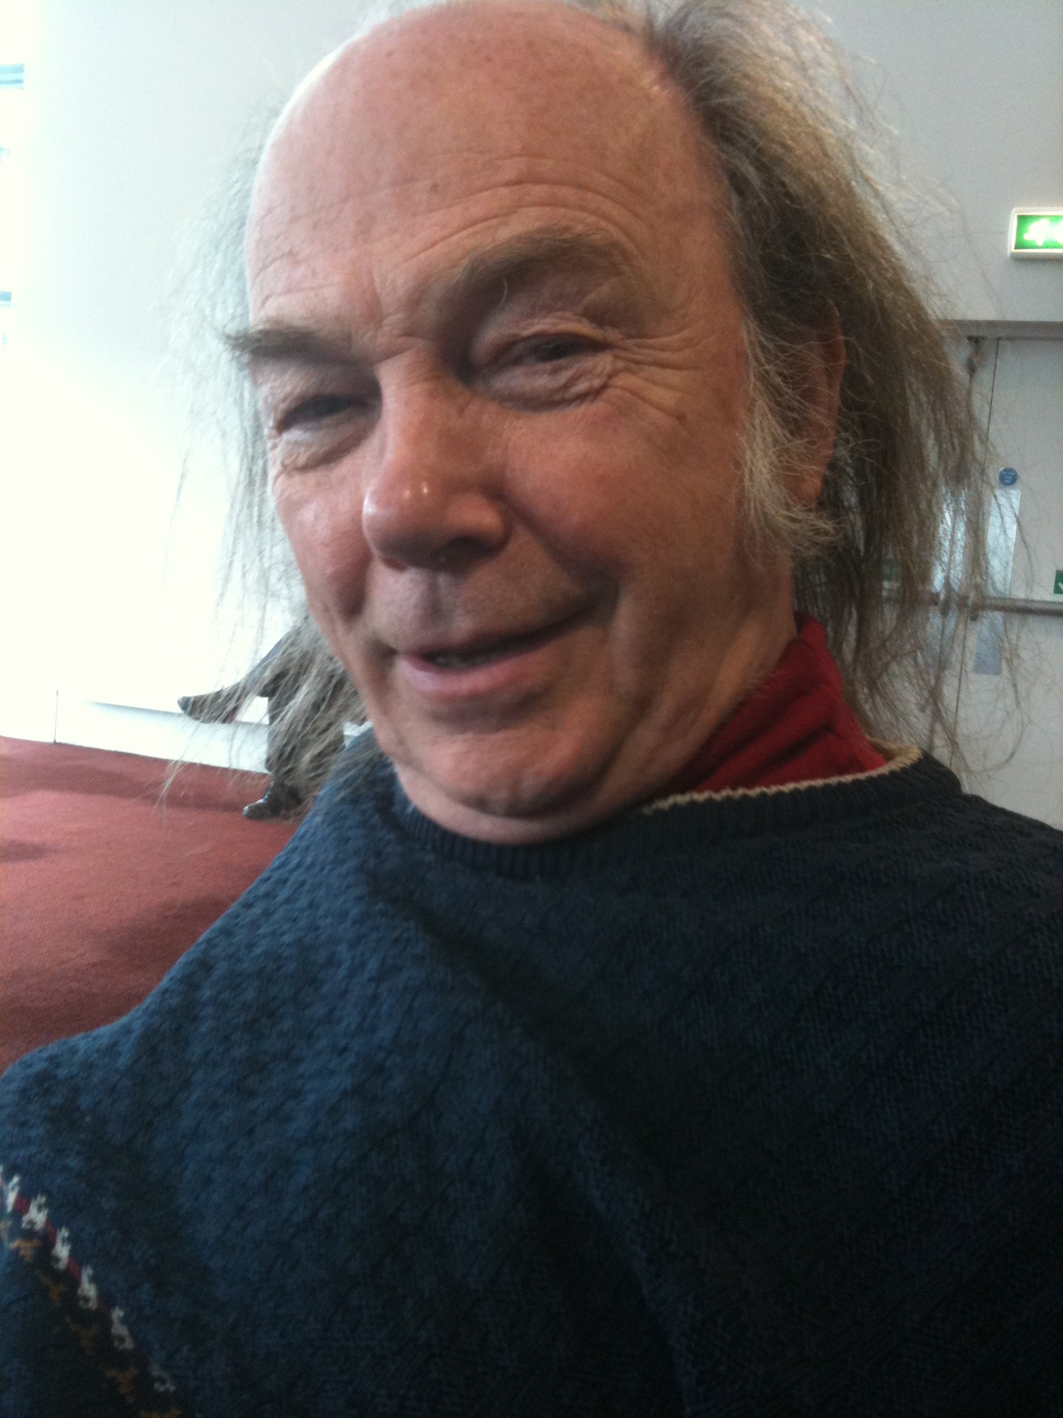
  Origin Story: Starting my PhD
Fred Piper (1940-2024)
Notes:
It’s about creating an environment, and creating opportunities for others to succeed.
He was very busy working with industry partners and governments.
He never published

Slide 17
  Overview
On distinguished lectures
Origin story
A different kind of toolbox
On serendipity
On creativity
On pivoting
Back to the future
Closing remarks

Slide 18
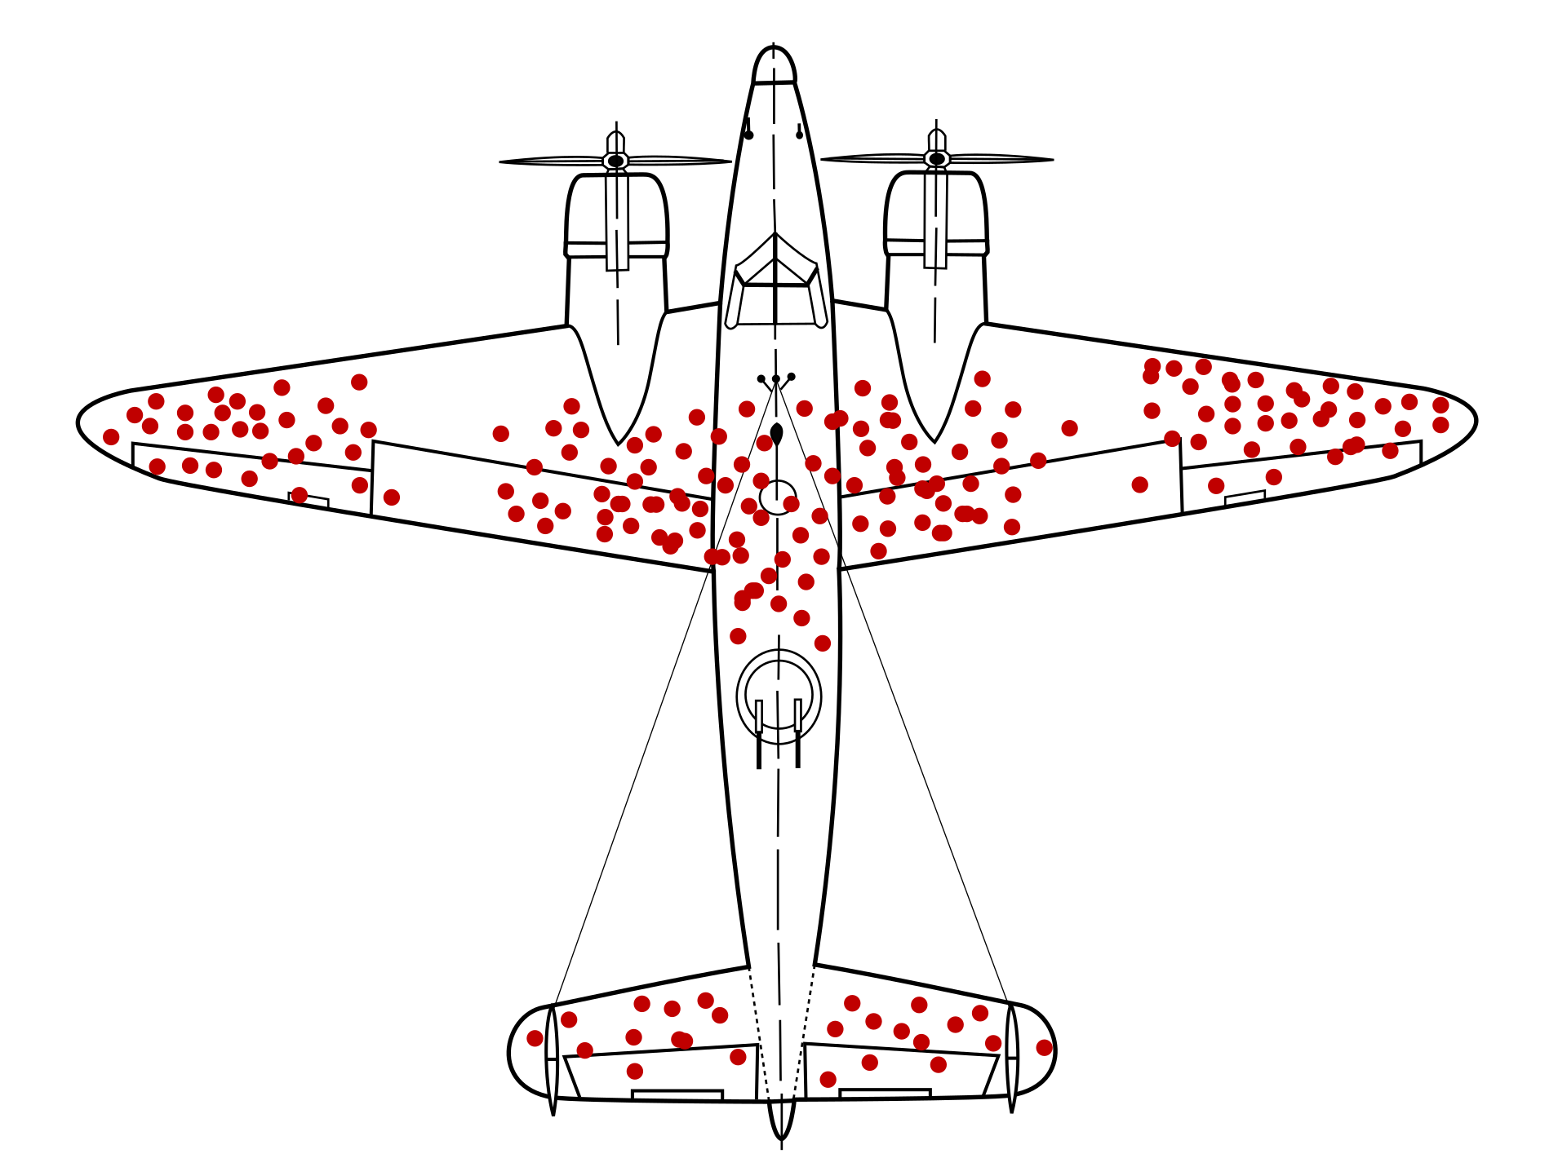
  Warning: Survivor Bias Ahead!
Martin Grandjean (vector), McGeddon (picture), US Air Force (hit plot concept) - Own work

Slide 19
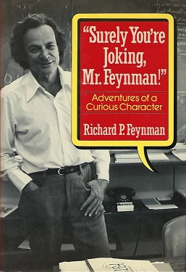
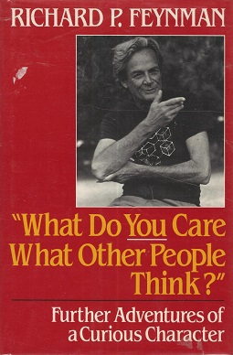
  A Different Kind of Toolbox
So I got a great reputation for doing integrals, only because my box of tools was different than everyone else's, and they had tried all their tools on it before giving the problem to me.

Slide 20
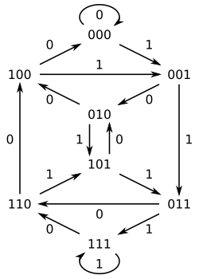
  A Different Kind of Toolbox
de Bruijn graph DB(2,3)
Find a binary sequence s such that:
  Every “window” of n consecutive bits in s is unique.
  There is an efficient algorithm that, given a window w as input, outputs the position in s where the window w is located.
  The position decoding problem.
Not cryptography!
But crypto-adjacent….
Hamiltonian cycle in DB(2,3) → span 3 de Bruijn sequence: every window of length 3 occurs exactly once in 10111000101…
Notes:
Problem posed to me on arrival at HP Labs:

Slide 21
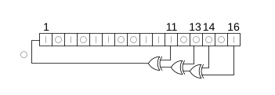
  A Different Kind of Toolbox
de Bruijn sequences pack as many different windows as possible into s
But they don’t necessarily lend themselves to efficient decoding.
Insight:
  Maximal-length LFSR sequences (m-sequences) have the window property and are almost as long as de Bruijn sequences (2^{n}-1 instead of 2^{n}).
  The decoding problem for m-sequences can be reduced to a discrete logarithm problem in GF(2^{n}).
  n = 20 would give a resolution of 1mm over 1km!
f(x) = x¹⁶ + x¹⁴ + x¹³ + x¹¹ + 1
If f(x) is primitive of degree n then the LFSR generates maximal-length sequences of period 2^{n}-1

Slide 22
  A Different Kind of Toolbox
People at HP Labs were very excited and impressed.
  Their mathematicians had tried and failed to come up with solutions.
  I was able to solve it on day one of my internship thanks to my toolbox.
I wrote it up and submitted to IEEE Transactions on Information Theory as my first paper!
Reviewer comment:
  “I have a feeling I’ve seen this result somewhere before, but I can’t remember where. I checked with a colleague and he said it was also familiar to him.”
Paper rejected.
(The reviewer was not completely wrong – results can be derived from:
  J.L. Massey and R. Liu, Equivalence of Nonlinear Shift-Registers, IEEE IT-10, pp. 378-379, Oct. 1964.)

Slide 23
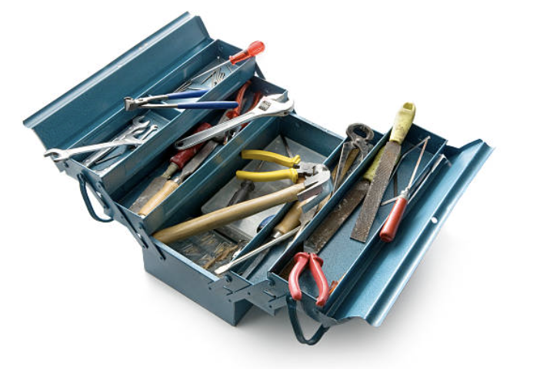
  A Different Kind of Toolbox: Lessons Learned
Don’t hate your reviewers (too much).
We’ve been unhappy with the review system for a long time.
Become resilient.
Keep expanding your toolbox with new tools (and keep the tools sharp).
Notes:
At that time, LFSRs were important in stream cipher design.
I’d learned all about LFSRs and m-sequences in my Bachelor’s degree, and seen them again in Fred Piper’s book.
This kind of problem was perfect for me: making maths useful!

Slide 24
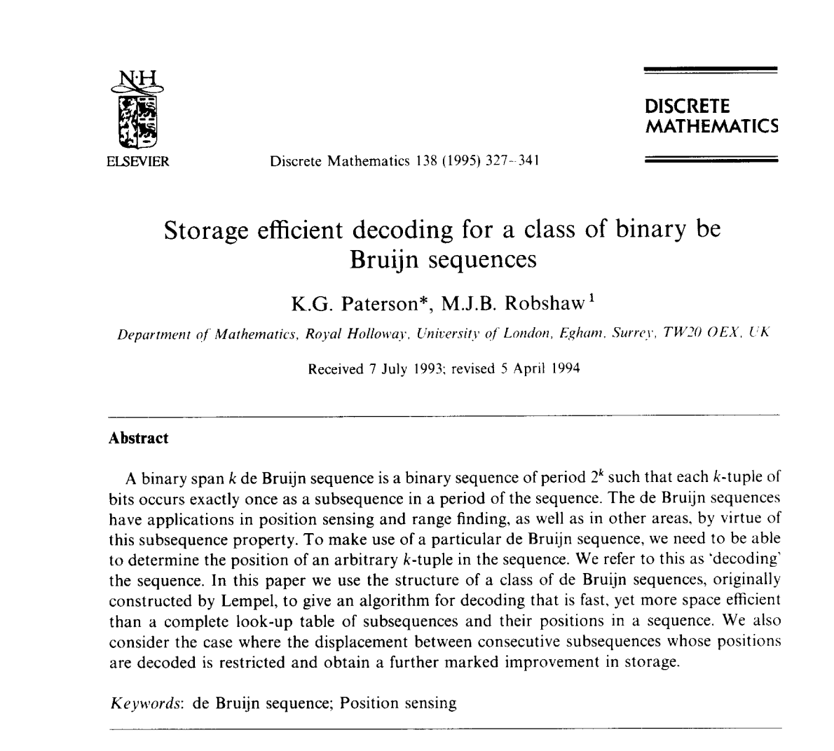
  A Different Kind of Toolbox
Eventually we found ways of decoding de Bruijn sequences.
We used Lempel’s homomorphism, a graph homomorphism that maps DB(2,n) onto DB(2,n-1) via “discrete differentiation”:
  s₀,s₁,s₂,… → s₀⊕s₁,s₁⊕s_{2,…}
More later!

Slide 25
  A Different Kind of Toolbox: Lessons Learned – II
Check your camera-ready proofs.
  Especially these days, here’s looking at you Springer!
This was all great fun but I eventually realised that the community of researchers who cared about these results was really small.
Problem selection:
  It has to be interesting to you.
  But it also has to be interesting to sufficiently many other people that you will get a job.
  It matters that there is an audience for your results (at least until you have tenure).
It was time for me to make a pivot…

Slide 26
  Overview
On distinguished lectures
Origin story
A different kind of toolbox
On serendipity
On creativity
On pivoting
Back to the future
Closing remarks

Slide 27

  On Serendipity
Serendipity: the occurrence and development of events by chance in a happy or beneficial way.

Slide 28
  On Serendipity
In the 1990s, cryptography was not as a big a deal as it is today.
I did not magically predict how important it would become.
I was just doing whatever I thought was interesting at the time, shaped by the environment in which I found myself.
This has always been, and continues to be, my approach.
It has obvious strengths and weaknesses.
(Perhaps I should have watched Tom Berson’s 2000 Distinguished Lecture: “Cryptography Everywhere”!)

Slide 29
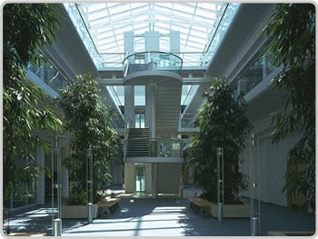
  On Serendipity
In 2001, I moved from HP Labs back to Royal Holloway as a Lecturer (≈ Assistant Professor).
I was asked to teach network security.
But I knew nothing about networks, and even less about security.
From guest lecturers, I learned all about:
  TCP/IP, routing, network layering,…
  Firewalls, IDS,…
  And these weirdly complex protocols with exotic names like SSL/TLS, SSH, IPsec.
  Beginning of my journey into “Cryptography in the Wild”.

Slide 30
  On Serendipity: SSH
In the early 2000s, SSH used an Encode-then-Encrypt&MAC construction.
SSH packets form a stream of bytes on a TCP connection.
Packet length field measures total size of the SSH packet on the wire in bytes and is encrypted to hide the true length of the SSH packet.
RFC 4253 mandates 3DES-CBC and recommends AES-CBC.

Slide 31
  On Serendipity: SSH
The decryption process can’t know where the MAC should be in the byte stream without first decrypting the packet length field.
So decryption has to be done in an online manner!
The specification says the packet length field should be sanity checked.
If no failure there, then eventually the MAC field will be reached and the MAC will be checked.

Slide 32
  On Serendipity: SSH
Part of decryption process depends on unauthenticated data: the packet length field.
And that process leaks information about that field, as does the number of bytes processed before a MAC error arises.
Now we can play CBC “cut and paste” games to learn plaintext from a chosen ciphertext block by placing it as the “packet length block” of a new SSH packet.

Slide 33
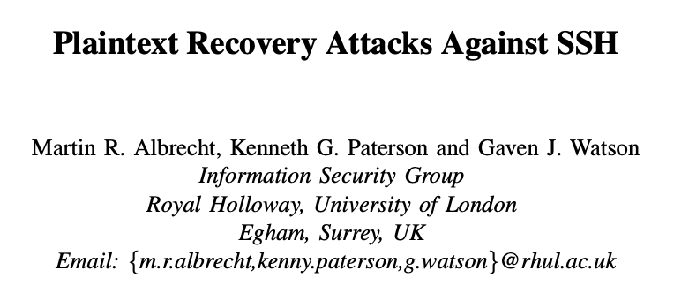
  On Serendipity: SSH
IEEE S&P 2009
But why were we even looking at SSH?
We were actually writing a paper about formally modelling padding oracle attacks…
… and we wanted to say something like “our paper is the first to consider multiple, distinct error messages”.

Slide 34
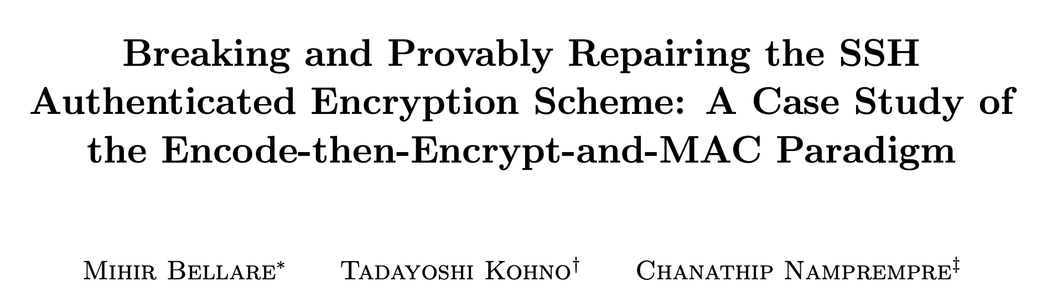
  On Serendipity: SSH according to [BKN02]
ACM CCS 2022, ACM TISSEC 2004, eprint 2002/078
Stateful encryption and decryption for atomic secure channels!
Precise, game-based security definitions!
Detailed pseudo-code analysis of a real-world protocol!

Slide 35
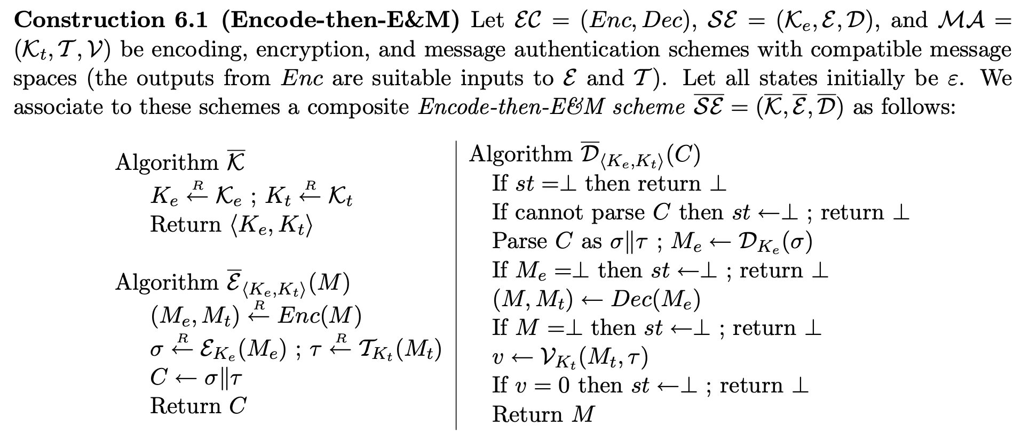
  On Serendipity: SSH according to [BKN02]

Slide 36
  On Serendipity: SSH according to [BKN02]
The BKN description assumes that each SSH packet is decrypted in an atomic fashion.
It cannot accurately reflect what is actually going on in the code.
After realising this, and then looking at OpenSSH source code for 10 minutes, we found the attack.

Slide 37
  On Serendipity: an Aside on SSH
Remarks from the IEEE S&P 2009 reviewers:
“I disagree with the recommendation that the best fix is to switch to SSH-CTR or similar modes, this is the sort of suggestion that only a cryptographer would make.”
“…the network and attacker simulations could be improved; the fact that the attacker was a thread inside the target program is particularly troubling, since it in theory has direct access to the decryption key and the plaintext.”

Slide 38
  On Serendipity: SSL/TLS prior to TLS 1.3
Plaintext
SQN || HDR
Payload
MAC
Plaintext
MAC tag
Padding
Payload
Encrypt
HDR
Ciphertext
MAC
HMAC-MD5, HMAC-SHA1, HMAC-SHA256
Encrypt
CBC-AES128, CBC-AES256, CBC-3DES, RC4-128 (plus AEAD)
Padding
“00” or “01 01” or “02 02 02” or …. or “FF FF….FF”

Slide 39
  SSL/TLS Record Protocol Algorithms in Use
From: Kotzias et al., Coming of Age: A Longitudinal Study of TLS Deployment, IMC 2018

Slide 40
  On Serendipity: SSL/TLS prior to TLS 1.3
Plaintext
SQN || HDR
Payload
MAC
Plaintext
MAC tag
Padding
Payload
Encrypt
HDR
Ciphertext
MAC
HMAC-MD5, HMAC-SHA1, HMAC-SHA256
Encrypt
CBC-AES128, CBC-AES256, CBC-3DES, RC4-128 (plus AEAD)
Padding
“00” or “01 01” or “02 02 02” or …. or “FF FF….FF”

Slide 41
  On Serendipity: SSL/TLS prior to TLS 1.3
From the TLS 1.1 and 1.2 specifications, in response to [CHHV03]:
…implementations MUST ensure that record processing time is essentially the same whether or not the padding is correct. In general, the best way to do this is to compute the MAC even if the padding is incorrect, and only then reject the packet.
For instance, if the pad appears to be incorrect, the implementation might assume a zero-length pad and then compute the MAC.
This leaves a small timing channel, since MAC performance depends to some extent on the size of the data fragment, but it is not believed to be large enough to be exploitable, due to the large block size of existing MACs and the small size of the timing signal.

Slide 42
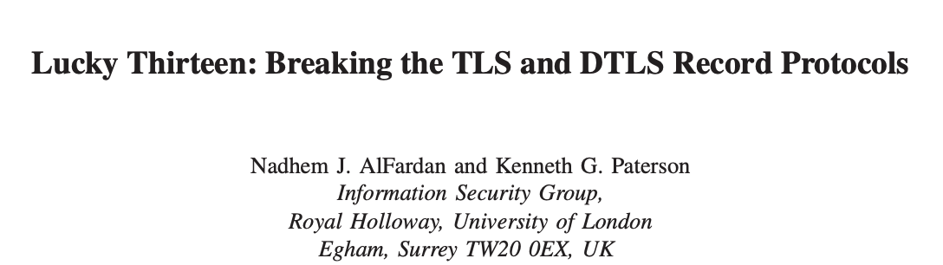
  On Serendipity: SSL/TLS prior to TLS 1.3
IEEE S&P 2013
Timing attack on CBC-mode in SSL/TLS‘s MAC-Encode-Encrypt (MEE) construction.
Exploits exactly those timing difference highlighted in the TLS 1.1 and 1.2 specifications.
We did not know about this text until after we found the attack!
(In fact, I gave talk in 2009 quoting some of this text, but apparently forgot all about it…)

Slide 43
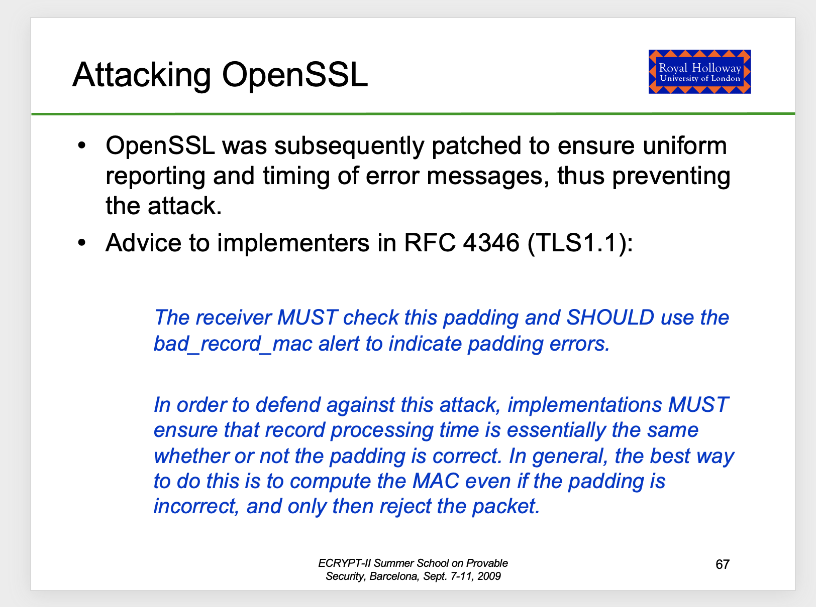

Slide 44
  Lucky 13 Distinguishing Attack – Choose Plaintexts
288 byte plaintext
R
R R …..……….………R 00 01
IV
C
288 byte plaintext
R
FF FF………………………….FF
IV
C
Notes:
Two message are in green.

Slide 45
  Lucky 13 Distinguishing Attack – Maul
R
R R …..……….………R 00 01
IV
C
R
FF FF………………………….FF
IV
C

Slide 46
  Lucky 13 Distinguishing Attack – Decryption I
R
R R …..……….………R 00 01
invalid padding
IV
C’
R
FF FF………………………….FF
256-byte valid padding
20-byte MAC
12-byte message
IV
C’

Slide 47
  Lucky 13 Distinguishing Attack – Decryption II
R
R R …..……….……..R
R R …..……….………R 00 01
invalid padding
IV
C’
R
256-byte valid padding
20-byte MAC
12-byte message
IV
C’

Slide 48
  Lucky 13 Distinguishing Attack – MAC Verification
SQN||HDR
R
R R …..……….………R 00 01
Slow MAC
verification
301 bytes
SQN||HDR
R
Fast MAC
verification
25 bytes
Timing difference: 4 SHA-1 compression function evaluations

Slide 49
  On Serendipity: SSL/TLS prior to TLS 1.3
Sometimes it helps to forget things and then rediscover them only later…
The Lucky13 paper was actually one in a line of papers:
  DTLS
  padding oracles
  IPsec
  SSH
  …
I had been teaching SSL/TLS for several years.
I had studied the BEAST and CRIME attacks (but still didn‘t understand “Javascript in the browser” as an attack model).

Slide 50
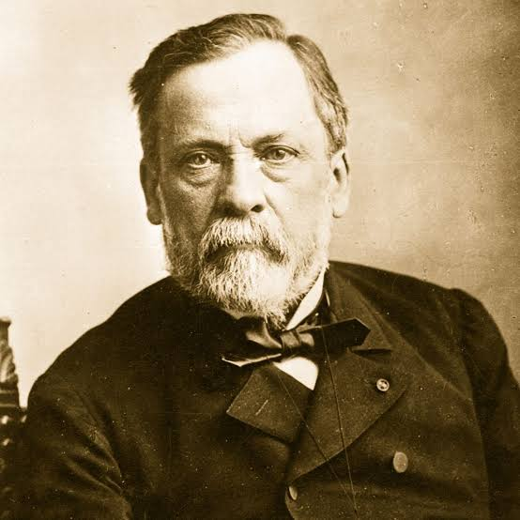
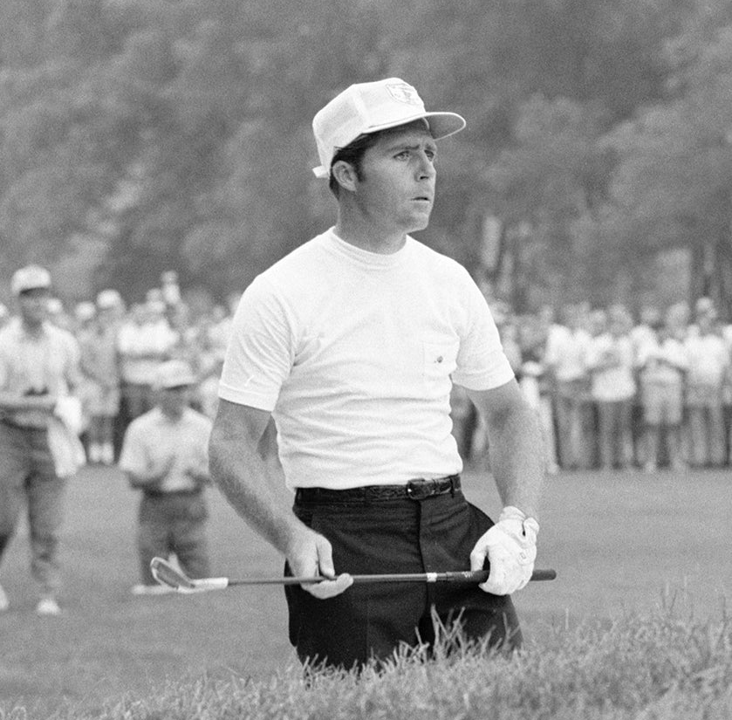
  On Serendipity: SSL/TLS prior to TLS 1.3
To misquote Louis Pasteur:
Fortune favours the prepared mind.
To quote Gary Player:
The harder I practice, the luckier I get.
Luck is important but it’s probably not enough to sustain a whole career….
Preparation is at least as important.

Slide 51
  Overview
On distinguished lectures
Origin story
A different kind of toolbox
On serendipity
On creativity
On pivoting
Back to the future
Closing remarks

Slide 52

  On Creativity (Or: How to Prepare The Mind)
Immerse yourself deeply in the problem and then walk away.
Possibly for several years!
Find the creative circumstances that work for you, and deliberately replicate them.
  Hiking
  Walking the dog
  Washing up
  Showering
  Driving
  Day-dreaming at the whiteboard
  …

Slide 53
  Overview
On distinguished lectures
Origin story
A different kind of toolbox
On serendipity
On creativity
On pivoting
Back to the future
Closing remarks

Slide 54
  On Pivoting (Or: How to get Unstuck)
Learning to pivot is a skill.
Pivot too late: you over-invest time in one idea or topic without results.
Pivot too early: you’ll never find anything interesting.
And if you never get stuck– congratulations!
  But then maybe think about pivoting to harder problems?
Pivoting is not cost-free.
Pivoting also applies more widely in life, e.g. research areas, career-planning.
Notes:
My personal sequence of pivots:
Glasgow → RHUL → ETH → RHUL → HP Labs → RHUL → ETH
86-90 90-93 93-94 94-96 96-01 01-19 19-34?

Slide 55

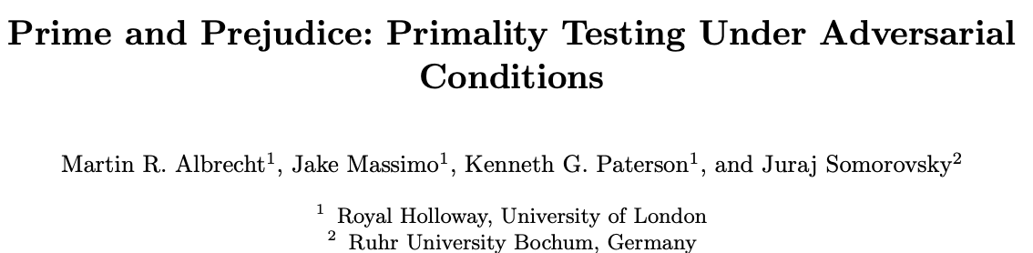
  On Pivoting: Telegram to Primality-testing
ACM CCS 2018 and eprint 2018/749
2017:
Client gets its DH parameters from server.
Can we abuse this to create weak parameters for the E2EE key exchange?
No! Telegram official clients do careful DH parameter validation.
2018:
Widely-deployed crypto libraries have primality tests that give wrong answers when presented with adversarially-generated inputs!

Slide 56
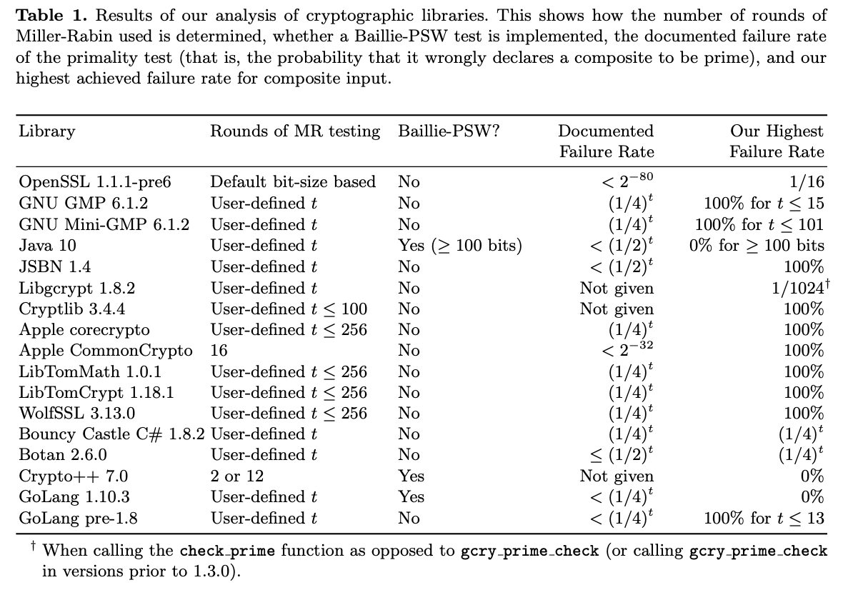
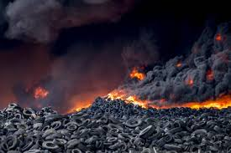
  On Pivoting: Telegram to Primality-testing
ACM CCS 2018 and eprint 2018/749

Slide 57
  A Diversion on Primality Testing
Jake Masimo gave a rump-session talk about the work at Crypto in 2018.
  https://www.youtube.com/watch?v=qwd_SRwLulw&list=PLeeS-3Ml-rpox3Bf0mumVUzAaUMlIhFNy&index=17
After the talk, a very animated, very senior member of the community grabbed me:
“Kenny, why are you working on this stuff? Everybody knows this already!”
“Well, there’s a trillion dollar company who got it wrong. So not everybody knows this”

Slide 58
  A Diversion on Primality Testing
ACM CCS 2018 and eprint 2018/749

Slide 59
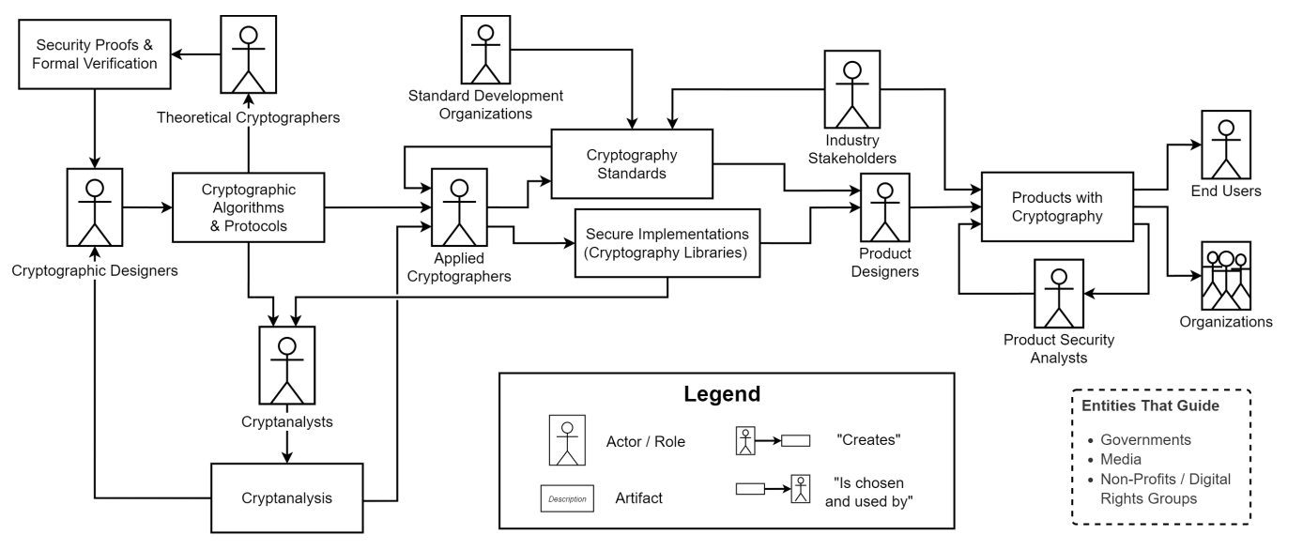
  A Diversion on Primality Testing
“Everybody who knows this”
“Everybody else”
Source: The Challenges of Bringing Cryptography from Research Papers to Products: Results from an Interview Study with Experts, Fischer et al., USENIX Security 2024

Slide 60
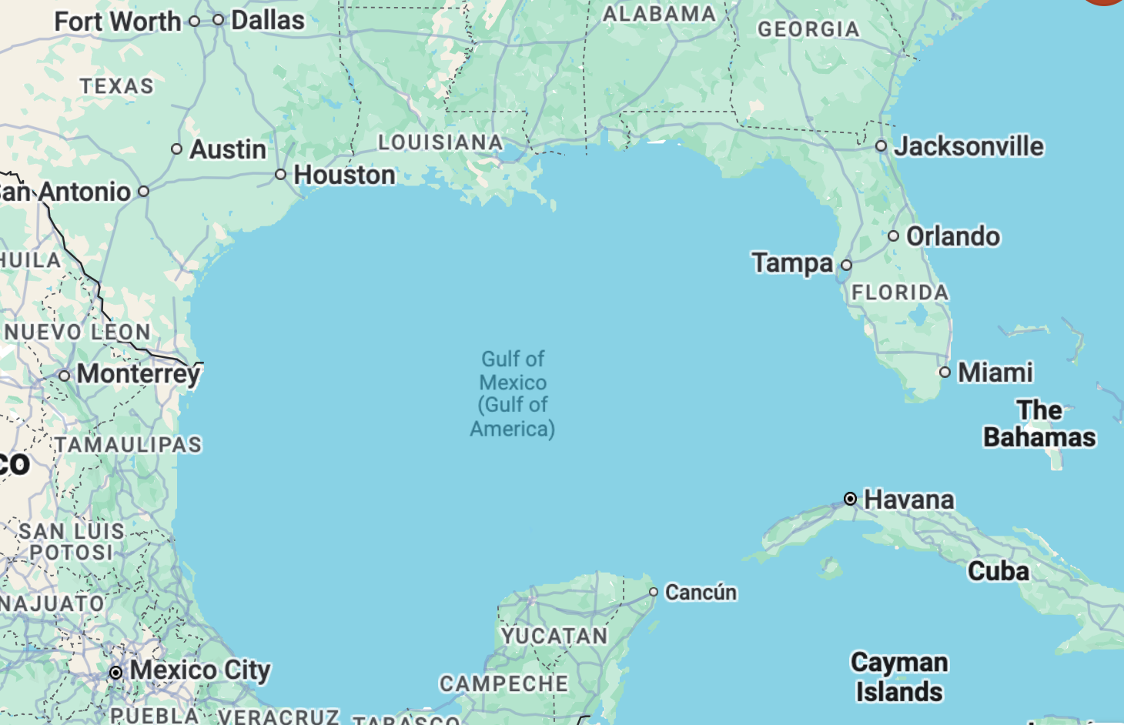
  A Diversion on Primality Testing
There is a gulf in understanding between what we write in papers and how the rest of the world sees cryptography.
This is a challenge that we should try to address as a community.
Mostly, we are not as relevant as we like to think we are.

Slide 61
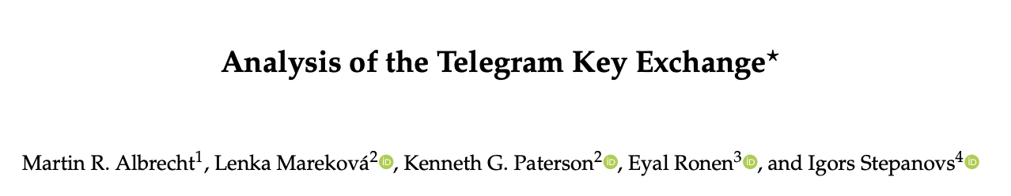
  Pivoting Back to Telegram
Eurocrypt 2025
https://eprint.iacr.org/2025/451
Curious to learn more?
Then come to Lenka’s talk in the “Real World Crypto” session on Thursday

Slide 62
  Overview
On distinguished lectures
Origin story
A different kind of toolbox
On serendipity
On creativity
On pivoting
Back to the future
Closing remarks

Slide 63
  Back to the Future: Using the Toolbox
I was head of the CS department at ETH Zurich in 2023 and 2024.
Some of my doctoral students and postdocs learned to nerd-snipe me.
Kien Tuong Truong and Simon-Philipp Merz:
We have this cool idea for an attack on Tarsnap’s encrypted back-up.
All we need is a binary sequence s containing as windows about 2²⁶ distinct pairs of the form {0w, 1w} where w is of length 33.
Oh, and s should be as short as possible!
Oh, and the elements of the pairs should be far apart in the sequence.

Slide 64
  Back to the Future: Using the Toolbox
Recursive construction:
  Start with cycle 0⁹1⁹ in DB(2,9).
  Apply the inverse Lempel homomorphism and cycle joining 25 times to build a cycle in DB(2,34).
    i.e. do “discrete integration” over, and merging of, cycles in de Bruijn graphs.
    Each step doubles the cycle length.
  We obtain a sequence s of period 9⋅2²⁶ = 576 Mbit with the required properties.
    “Efficiency” 2/9, i.e. 2/9 of all “windows” in s are located in one of the pairs.
  Some of the tools I learned to use 30+ years ago are still relevant today ☺
de Bruijn graph DB(2,3)

Slide 65
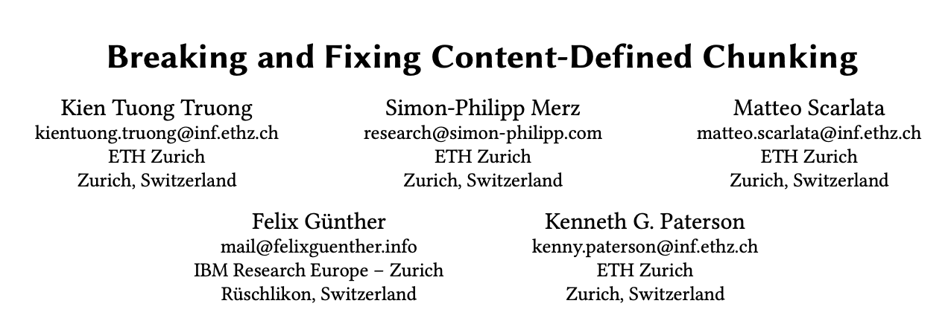
  Back to the Future: Using the Toolbox
https://eprint.iacr.org/2025/558
Analysis of Borg, Bupstash, Duplicacy, Restic, and Tarsnap using:
  linear algebra
  lattice attacks
  de Bruijn graphs
  and more!

Slide 66
  Overview
On distinguished lectures
Origin story
A different kind of toolbox
On serendipity
On creativity
On pivoting
Back to the future
Closing remarks

Slide 67
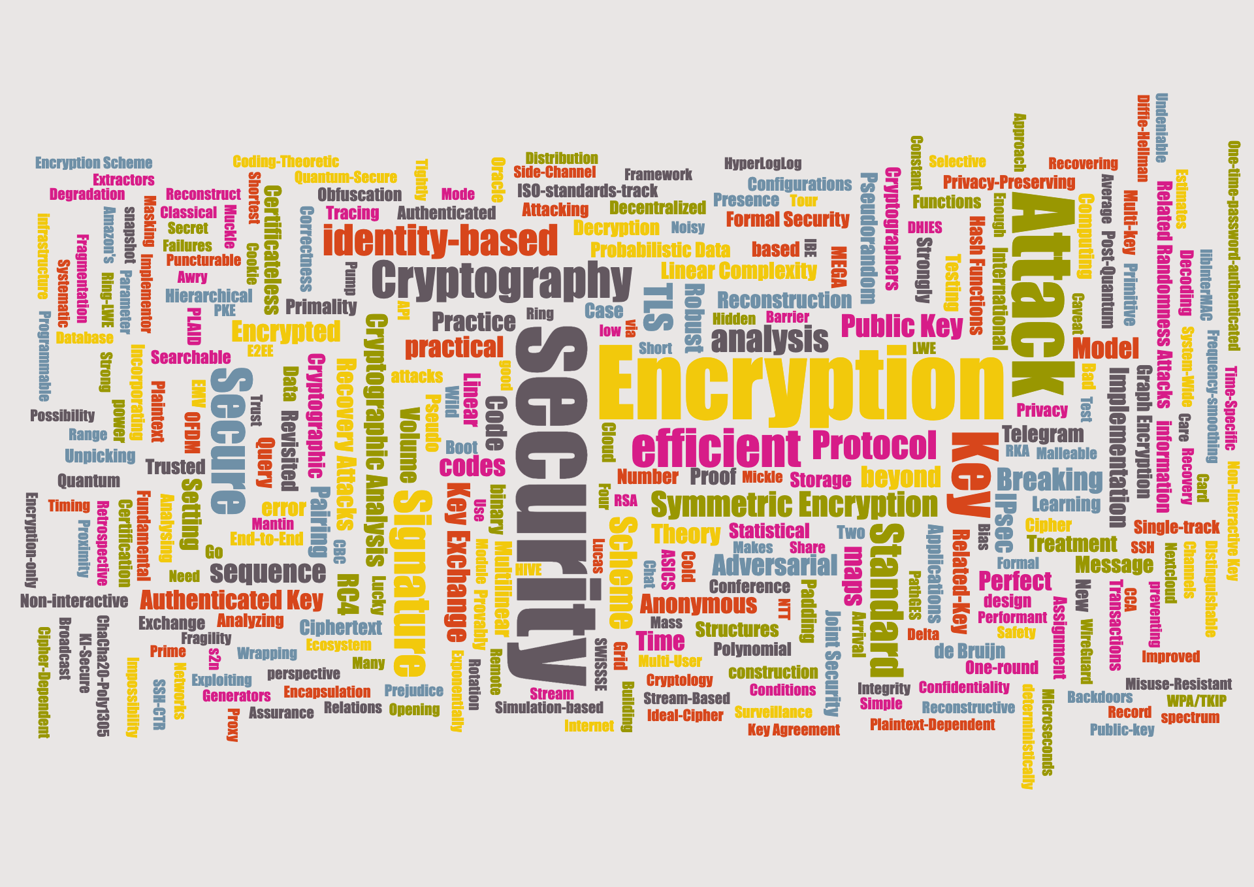
  Closing Remarks

Slide 68
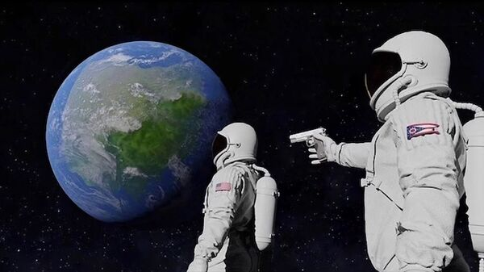
  Closing Remarks
Always has been
⊕
It’s all bit flipping!

Slide 69
  Some Survivor Biases
It’s OK to have imposter syndrome, try not to let it rule your life.
Build your toolbox.
Be lucky.
But prepare for luck to strike.
Create the conditions to be creative.
Learn to pivot.
Work on what excites you: because research is hard, so you might as well take as much enjoyment from it as you can.

Slide 70
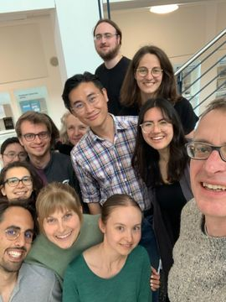
  A Few Words of Thanks
IACR Board and President Michel Abdalla for the invitation to give this lecture.
My parents, for their foresight in buying us a BBC Micro.
All of my mentors and research collaborators over the years.
All of you for listening.
https://appliedcrypto.ethz.ch/

Slide 71
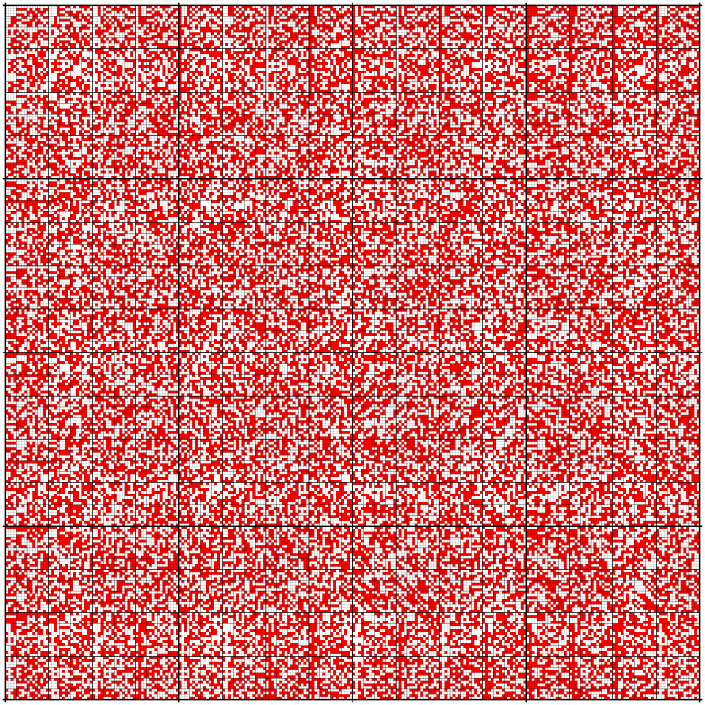
  A Different Kind of Toolbox
A (256,256,4,4) binary de Bruijn array: every possible 4 x 4 window appears exactly once (with wrap-around).
Main result of PhD thesis:
An (s,t,u,v) binary de Bruijn array exists if and only if:
  st = 2^{uv};
  s > u or s=u=1; and
  t > v or t=v=1.
Image from T. Piesk, licence CC BY 3.0

Slide 72
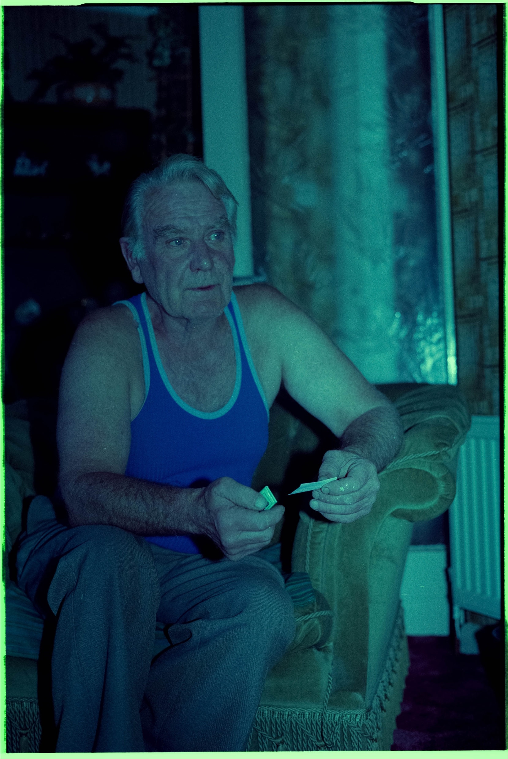
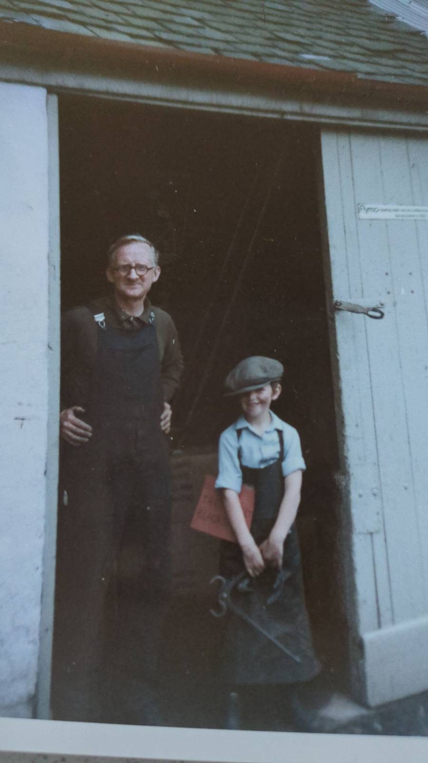
  Origin Story: Two Generations Ago
William Paterson (1923 - 1990)
William Donaldson (1915-1995)
Notes:
Tools were central to their working lives.
Joiner/carpenter; blacksmith.
Literally got their hands dirty. “Clean dirt”.

Slide 73
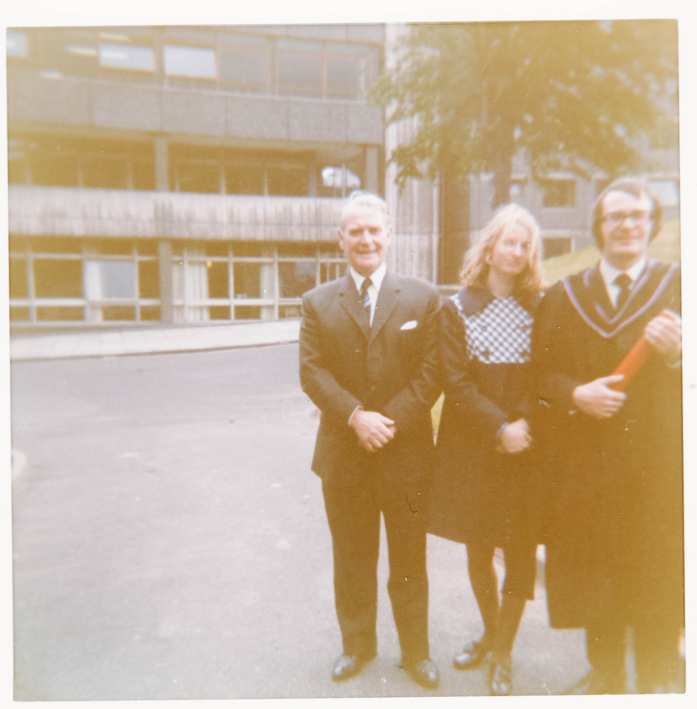
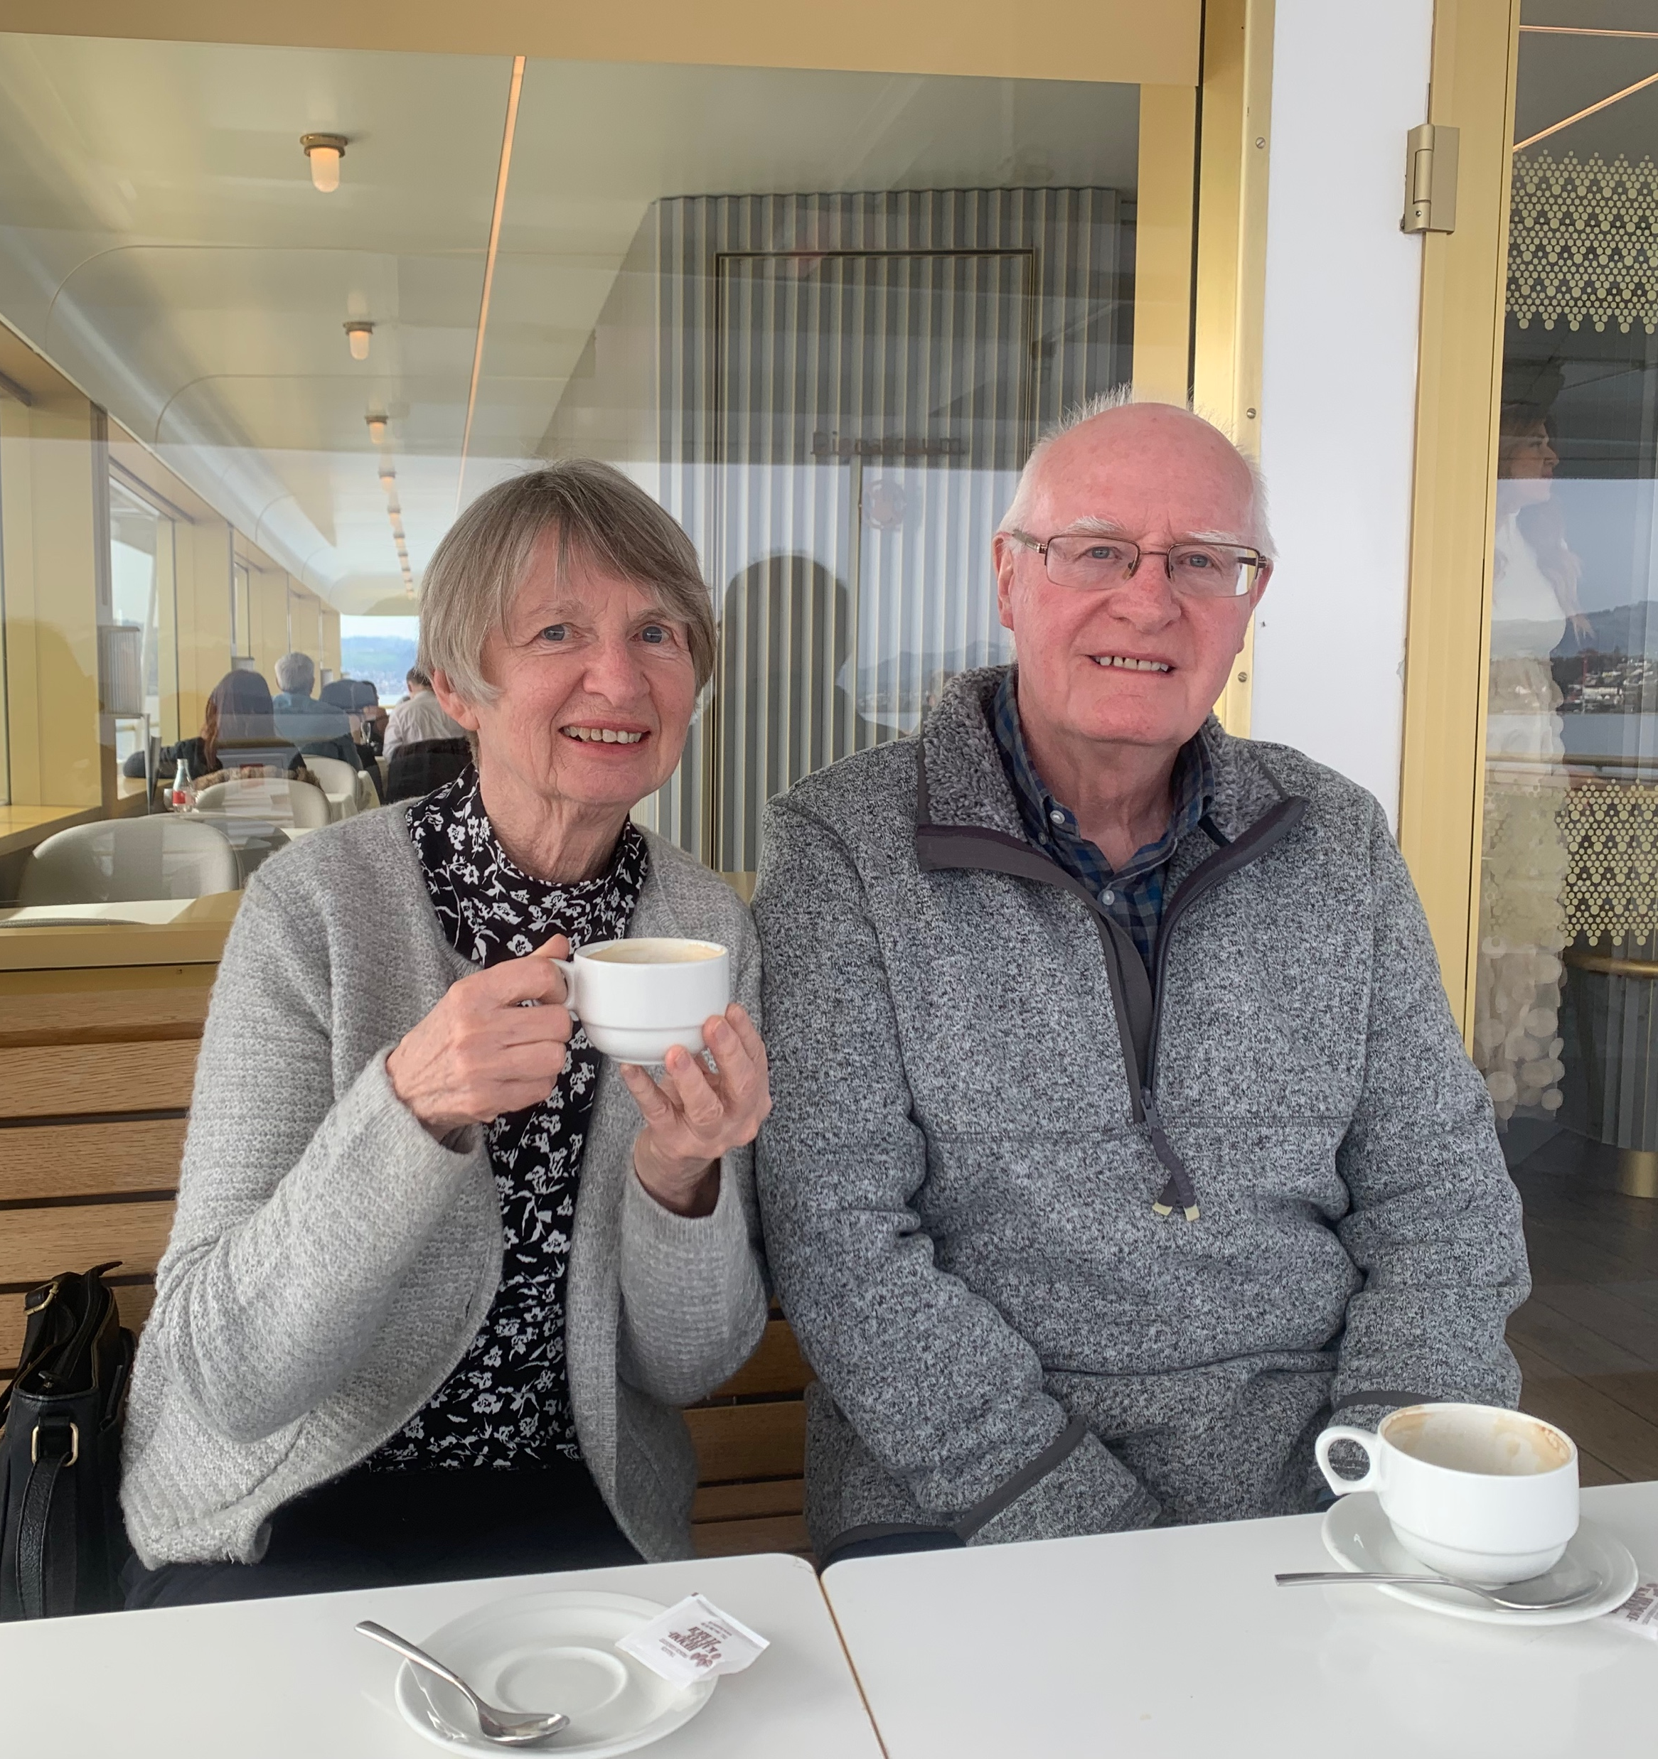
  Origin Story: One Generation Ago
Glasgow, 1973?
Zurich, 2025

