Slide 1
$Π:$ A Unified Framework for Computational Verifiable Secret Sharing
PKC 2025 - Røros, Norway 12-15 May 2025
ia.cr/2023/1669
Karim Baghery
KU Leuven, Belgium
karim.baghery@kuleuven.be

Slide 2
Shamir Secret Sharing: A Toy Example
Initial
Share
Reconstruct
Given a secret $f_{0}$ a trusted dealer $P_{0}$ shares it with $n≥2t+1$ parties $\{P_{i}\}_{i=1}^{n},$ s.t.,
$t+1$ shareholders can reconstruct the secret $f_{0}$
$t$ shareholders cannot reconstruct the secret $f_{0}$
$$f_{X}−f_{1}=\frac{f_{2}−f_{1}}{2−1}\left(X−1\right)$$
$$f_{1}$$
Reconstruction
Share
$$f_{1}$$
$$f_{i}$$
$$f_{0}=\frac{f_{2}−f_{1}}{2−1}\left(0−1\right)+f_{1}$$
$$f_{2}$$
$$f_{2}$$
$$f_{0}$$
Given a secret $f_{0}$ and ($n, t=1$)
Sample a degree $t=1$ polynomial $f(X)$ s.t. $f\left(0\right)=f_{0}$
Compute $f_{i}=f\left(i\right)$ for $i=1, 2, 3$
$$(1,f_{1})$$
$$f_{3}$$
$$f_{1}$$
$$f_{2}$$
$$(2,f_{2})$$
$$f_{3}$$
$$(3,f_{3})$$
$$f_{3}$$
$$0$$
$$1$$
$$2$$
$$3$$
$$X$$
Notes:
mention sigma protocols = 3-round protocols

Slide 3
Computational Verifiable Secret Sharing (VSS) Based on Homomorphic Commitments

Slide 4
VSS from Homomorphic Commitments:
Feldman [Fel87]
Given a secret $f_{0}$ a trusted dealer $P_{0}$ shares it with $n≥2t+1$ parties $\{P_{i}\}_{i=1}^{n},$ s.t.,
$t+1$ shareholders can reconstruct the secret $f_{0}$
$t$ shareholders cannot reconstruct the secret $f_{0}$
Initial - Share
Verify - Reconstruct
$$g^{f_{i}}=\prod_{j=0}^{t}{c_{j}^{i^{j}}}$$
Share
Verify
Given a secret $f_{0}$ and ($n, t$)
Sample a degree $t$ polynomial $f\left(X\right)=f_{0}+a_{1}X+ …+a_{t}X^{t}$
Compute $f_{i}=f\left(i\right)$ for $i=1, …, n$
$$f_{1}$$
$$g^{f_{1}}=c_{0}^{1^{0}}×c_{1}^{1^{1}}×…×c_{t}^{1^{t}}$$
$=g^{f_{0}}×g^{a_{1}}×…×g^{a_{t}}$
$=g^{f(1)}$
Reconstruct
$$f_{1}$$
$$f_{1}$$
$$f_{2}$$
secret $f_{0}$
Sets $c_{0}=g^{f_{0}}, c_{1}=g^{a_{1}},…,c_{t}=g^{a_{t}}$
Publish $π=(c_{0}, …, c_{t+1})$ and send privatly $f_{i}$ to party $P_{i}$
$$g^{f_{2}}=c_{0}^{2^{0}}×c_{1}^{2^{1}}×…×c_{t}^{2^{t}}$$
$=g^{f_{0}}×g^{2a_{1}}×…×g^{{2^{t}a}_{t}}$
$=g^{f(2)}$
Verify
Interpolation
$$f_{2}$$
$$…$$
$π=(c_{0}, …, c_{t+1})$
$$f_{t+1}$$
Add. Homomorphic Commitments:
$$f_{n}$$
$$f_{n}$$
$$com\left(a_{1}\right)×com\left(a_{2}\right)=com(a_{1}+a_{2})$$
$$g^{f_{n}}=c_{0}^{n^{0}}×c_{1}^{n^{1}}×…×c_{t}^{n^{t}}$$
$=g^{f_{0}}×g^{na_{1}}×…×g^{{n^{t}a}_{t}}$
$=g^{f(n)}$
e.g., $g^{a_{1}}×g^{a_{2}}=g^{a_{1}+a_{2}}$
[Fel87] Paul Feldman. A practical scheme for non-interactive verifiable secret sharing. In 28th Annual Symposium on Foundations of Computer Science, 1987.
Notes:
mention sigma protocols = 3-round protocols

Slide 5
VSS from Homomorphic Commitments: Pedersen [Ped91]
Pedersen VSS: $t$ of shareholders (information theoretically) learns nothing about $f_{0}$
Pedersen Commitment: $com\left(f, r\right)=g^{f}h^{r}$ (Perfectly Hiding + Computationally Binding)
Share
Verify
$$g^{f_{i}}h^{r_{i}}=\prod_{j=0}^{t}{c_{j}^{i^{j}}}$$
Given a secret $f_{0}$ and ($n, t$)
Sample a degree $t$ polynomial $f\left(X\right)=f_{0}+a_{1}X+ …+a_{t}X^{t}$
Sample another degree $t$ polynomial $r\left(X\right)=r_{0}+b_{1}X+ …+b_{t}X^{t}$
Set $f_{i}=f\left(i\right)$ and $r_{i}=r\left(i\right)$ for $i=1, …, n$
Sets $c_{0}=g^{f_{0}}h^{r_{0}},c_{1}=g^{a_{1}}h^{b_{1}}$, …, $c_{t}=g^{a_{t}}h^{b_{t}}$
Publish $π=(c_{0}, …, c_{t+1})$ and send privatly ($f_{i}$, $r_{i}$) to party $P_{i}$
$f_{1}$, $r_{1}$
$$g^{f_{1}}h^{r_{1}}=c_{0}^{1^{0}}×c_{1}^{1^{1}}×…×c_{t}^{1^{t}}$$
$=g^{f_{0}}h^{r_{0}}×…×g^{a_{t}}h^{b_{t}}$
$=g^{f(1)}h^{r(1)}$
Reconstruct
$$f_{1}$$
$f_{2}$, $r_{2}$
$f_{1}$, $r_{1}$
secret $f_{0}$
$$g^{f_{2}}h^{r_{2}}=c_{0}^{2^{0}}×c_{1}^{2^{1}}×…×c_{t}^{2^{t}}$$
$=…=g^{f(2)}h^{r(2)}$
Verify
Interpolation
$f_{2}$, $r_{2}$
$$…$$
$f_{n}$, $r_{n}$
$$f_{t+1}$$
$f_{n}$, $r_{n}$
$π=(c_{0}, …, c_{t+1})$
$$…$$
Pedersen Commitment:
$$com\left(f, r\right)×com\left(f′, r′\right)=g^{f}h^{r}×g^{f^{′}}h^{r^{′}}$$
$=g^{f+f^{′}}h^{r+r^{′}}=$ $com\left(f+f^{′}, r+r′\right)$
[Ped’91] Torben P. Pedersen. Non-interactive and information-theoretic secure verifiable secret sharing. Advances in Cryptology – CRYPTO’91.
Notes:
mention sigma protocols = 3-round protocols

Slide 6
A PQ Secure Computational VSS Based on Hash Functions

Slide 7
ZK Proofs Over Secret Shared Data: [BBC+19]
Involves a prover and $n≥2t+1$ verifiers, which allows the parties to communicate in synchronous rounds.
The prover holds an $n$-distributed input $x≔x_{1}∥…∥$ $x_{n}$ and a witness $w$, and each $V_{i}$ holds an input piece $x_{j}$.
$$x_{1}$$
Completeness: If $x∈L$, honest prover will convince honest verifiers.
$x≔x_{1}∥…∥$ $x_{n}$
Soundness against prover and $t$ verifiers: If $x∉L$, honest verifiers will reject the proof, except for a negligible probability, even if up to $t$ of verifiers collude with the prover.
$(x$, $w)∈R_{L}$
$$x_{2}$$
Proof
Threshold Zero-Knowledge (TZK): any subset of the verifiers up to $t$, should learn no additional information about $x$, beyond their own shares and the fact that $x∈L$.
$$…$$
$$x_{n}$$
Positive Result: We can build NI-TZK proof schemes for $n≥2t+1$ [BBC+19].
[BBC+19]: Dan Boneh, Elette Boyle, Henry Corrigan-Gibbs, Niv Gilboa, Yuval Ishai. Zero-Knowledge Proofs on Secret-Shared Data via Fully Linear PCPs.
Notes:
mention sigma protocols = 3-round protocols

Slide 8
[ABCP23]: A PQ-Secure NI-TZK Proof for Shamir Relation
A hash-based NI-TZK proof scheme for Shamir $n$-distributed relation,
$R_{i}=\left\{\left(f_{i}, f\left(X\right)\right) | f\left(i\right)=f_{i}\right\}$ for $i=1, …, n$.
Using the proposed NI-TZK proof scheme, we construct a PQ secure VSS scheme.
DL: Discrete Logarithm, BC: Broadcast, PV: Private, $n$: Number of parties, $t$: Number of malicious parties, $E_{G}$: Exponentiation in $G$, $PE$: Degree-$d$polynomial evaluations, $H$: Hashing, $|X|$: $X$ element size.
VSS Scheme | High-Entropy Secret? | Assumption | Sharing | Dealer’s Communication | Veriy
Feldman [Fel87] | Yes | DL (Plain) | $$0.5n E_{G} + n PE$$ | PV: $n \left|Z_{q}\right|$ & BC: $t≈0.5n |G|$ | $$t≈0.5n E_{G}$$
Pedersen [Ped91] | No | DL (Plain) | $$1n E_{G}+2n PE$$ | PV: $2n |Z_{q}|$ & BC: $t≈0.5n |G|$ | $$t≈0.5n E_{G}$$
[ABCP23] | No | Hash (QROM) | $$2n H+ 2n PE$$ | PV: $2n |Z_{q}|$ & BC: $2n \left|H\right|+ 0.5n |Z_{q}|$ | $$1 PE+3 H$$
☺ Considerably faster Verify (& Reconstruct) ☺ Faster sharing (lightweight operations) ☺ PQ secure
😐 Slightly higher communication (~$5x$) 😐 Not IT-Simulatable (like [Ped91])
[ABCP23]: Shahla Atapoor, Karim Baghery, Daniele Cozzo, Robi Pedersen. VSS from Distributed ZK Proofs. ASIACRYPT 2023.
Notes:
mention sigma protocols = 3-round protocols

Slide 9
Our Contribution:
Our Construction From [ABCP23] Can be Optimized and Generalized

Slide 10
General Construction of $Π$: Share, Verify, Reconstruct
Let $Com(., .)$be a (vector) commitment scheme, and $(Q)ROM$ be a (Quantum) ROM
Shareholder $V_{i}$
($f_{i},γ_{i})$
Verify
In practice we can omit $γ_{i}$if $f_{0}$ has enough entropy
Dealer
$$f_{0}$$
$$…$$
Share
Given $(f_{0},n, t)$: sample a degree-$t$ $f\left(X\right)$ s.t., $f\left(0\right)=f_{0}$ & set $f_{i}=f\left(i\right)$ for $i=1, …, n$
Sample a degree-$t$ polynomial $r\left(X\right)$ & set $r_{i}=r\left(i\right)$ for $i=1, …, n$
For $i=1, …, n$: sample random values $γ_{i}$, and set $C_{i}=Com\left(\left(f_{i}, r_{i}\right), γ_{i}\right)$
Set $d=(Q)ROM\left(C_{1}, …, C_{n}\right)$
Set $z\left(X\right)=r\left(X\right)+df\left(X\right)$and $π=\left(z\left(X\right), C_{1}, …, C_{n}\right)$.
Publish $π=(C_{1}, …, C_{n}, z(X))$ and send privatly $\left(f_{i}, γ_{i}\right)$ to participant $V_{i}$
Reconstruct
1) Party $V_{i}→$outputs accept/reject:
- If $deg\left(z\left(X\right)\right)≤t$
- Set $d=(Q)ROM(C_{1}, …, C_{n})$
- If $C_{i}==Com(\left(f_{i},z\left(i\right)−df_{i}\right), γ_{i})$ outputs accept, otherwise, reject.
If $V_{j}$ complains, dealer publish $(f_{j},γ_{j})$, s.t., other parties can check them.
At the end, the honest parties either reject, or get sure that they have received a valid share.
$$\left(f_{i}, γ_{i}\right)$$
$$π$$
$$f_{1}$$
$f_{1}$, $γ_{1}$
secret $f_{0}$
Verify
Interpolation
$f_{n}$,$γ_{n}$
$$f_{t+1}$$
Note: In Turkish, 'Pay' (pronounced [paɪ]) is a noun for Share, and 'Payla' means Share it.
Notes:
mention sigma protocols = 3-round protocols

Slide 11
Security and Instantiations of $Π$:
Let the (vector) commitment scheme $C(\left(., .\right), .)$ is perfectly (resp. computationally) hiding and computationally (resp. perfectly) binding, and $RO$ is a random oracle. Then, the generic construction $Π$ constitutes a secure VSS scheme in the honest-majority setting ($n≥2t+1$), that satisfies completeness, verifiability and perfect (resp. computational) simulatability.
$C\left(\left(m, r\right), γ\right)=g_{1}^{m} g_{2}^{r} g_{3}^{γ} \underset{⇒}{ }$an alternative to Pedersen VSS [Ped91], named $Π_{P}$
Complete, Verifiable, and (Perfectly) Simulatable
$C\left(m, r\right)=g_{1}^{m} g_{2}^{r} \underset{⇒}{ }$ an alternative to Feldman VSS [Fel87], named $Π_{F}$
Complete, Verifiable, and (Computationally) Unpredictable
Requires a high-entropy secret
$C\left(\left(m, r\right), γ\right)=Hash\left(m, r, γ\right) \underset{⇒}{ }$an alternative to [ABCP23] VSS, named $Π_{LA}$
Complete, Verifiable, and Computationally Simulatable
In case of sharing a high-entropy secret, the randomizer $γ$can be omitted.
$…$
Instantiations
Note: In Turkish, 'Pay' (pronounced [paɪ]) is a noun for Share, and 'Payla' means Share it.
Notes:
mention sigma protocols = 3-round protocols

Slide 12
Performance of New VSS Schemes: Asymptotic Costs
Abbreviations: DL: Discrete Logarithm, (Q)ROM: (Quantum) Random Oracle Model, BC: Broadcast, PV: Private, $n$: # parties, $E_{G}$: Exponentiation in $G$, $PE$: Degree-$t$polynomial evaluations, $H$: Hashing, $|X|$: $X$ element size.
VSS Scheme | High-Entropy Secret? | Assumption | Sharing | Dealer’s Communication | Verification | Reconstruction
Feldman [Fel87] | Yes | DL (Plain) | $$0.5n≈t E_{G}$$ $$n PE$$ | PV: $n |Z_{q}|$ BC: $t≈0.5n |G|$ | $$t E_{G}+t M_{G}$$ | $$t^{2} E_{G}+t^{2} M_{G}$$
$Π_{F}$ ($C_{i}=g_{1}^{f_{i}}g_{2}^{r_{i}}$) | Yes | DL (ROM) | $$2n E_{G}$$ $$2n PE$$ | PV: $n |Z_{q}|$ BC: $n \left|G\right|+0.5n |Z_{q}|$ | $$2 E_{G}+1 PE+1 H$$ | $$2t E_{G}+t PE+t H$$
Pedersen [Ped91] | No | DL (Plain) | $$1n≈2t E_{G}$$ $$2n PE$$ | PV: $2n |Z_{q}|$ BC: $t≈0.5n |G|$ | $$t E_{G}+t M_{G}$$ | $$t^{2} E_{G}+t^{2} M_{G}$$
$Π_{P}$ ($C_{i}=g_{1}^{f_{i}}g_{2}^{r_{i}}g_{3}^{γ_{i}}$) | No | DL (ROM) | $$3n E_{G}$$ $$2n PE$$ | PV: $2n |Z_{q}|$ BC: $n \left|G\right|+0.5n |Z_{q}|$ | $$3 E_{G}+1 PE+1 H$$ | $$3t E_{G}+t PE+t H$$
[ABCP23] | Yes (or No) | Hash function (QROM) | $$2n H$$ $$2n PE$$ | PV: $1n \left|Z_{q}\right|$(or $2n |Z_{q}|)$ BC: $2n \left|H\right|+ 0.5n |Z_{q}|$ | $$1 PE+3 H$$ | $$t PE+3t H$$
$Π_{LA}$ ($C_{i}=Hash(f_{i}$, $r_{i}$, $γ_{i}$) | Yes (or No) | Hash function (QROM) | $$n H$$ $$2n PE$$ | PV: $1n \left|Z_{q}\right|$(or $2n |Z_{q}|)$ BC: $n \left|H\right|+ 0.5n |Z_{q}|$ | $$1 PE+2 H$$ | $$t PE+2t H$$
Note: In Turkish, 'Pay' (pronounced [paɪ]) is a noun for Share, and 'Payla' means Share it.
Notes:
mention sigma protocols = 3-round protocols

Slide 13
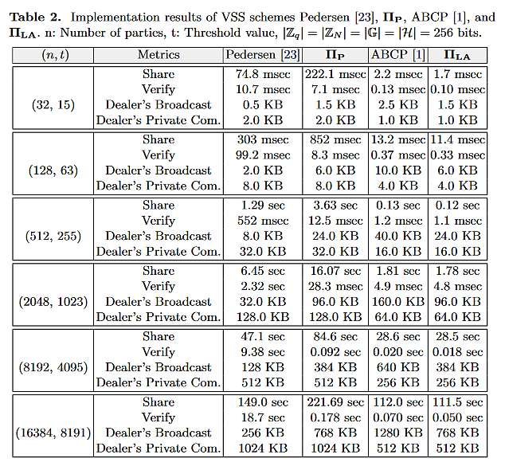
Empirical Performance: [Ped91, ABCP23] vs. $Π_{P}$ & $Π_{LA}$
For both commitment and (quantum) random oracle, we used the SHA256 hash function.
For the implementation of Pedersen and $Π_{P}$ VSS schemes, we have used Curve 25519.
Laptop: Ubuntu 22.04 LTS, a 11th Gen Intel(R) Core i9-11950H at base frequency 2.60GHz, & 128GB of memory.
Shamir
0.7 msec
(2.4$×$)
5.2 msec
(2$×$)
2$×$
2$×$
2$×$
2$×$
Our codes are available on github.com/Baghery/VSS-Pi
as well as github.com/KULeuven-COSIC/Pi-VSS
Can be run by scanning the QR-code
Notes:
mention sigma protocols = 3-round protocols

Slide 14
Our Contribution:
Generalizing DL Assumption Over Polynomials
&
$Π_{S}$: An Efficient Publicly Verifiable Secret Sharing (PVSS) Protocol Based on $Π_{F}$ VSS Scheme

Slide 15
Publicly Verifiable Secret Sharing (PVSS):
Roughly speaking, in a Shamir-based VSS scheme a Prover (so called dealer) who knows a secret degree-$t$ polynomial $f\left(X\right)$generates a threshold ZK proof for the following $n$-distributed relation,
$R_{i}=\left\{\left(f_{i}, f\left(X\right)\right) | f\left(i\right)=f_{i}\right\}$ for $i=1, …, n.$
The threshold ZK proof is designated and can only be verified by at least $t+1$distinct values of $"f_{i}"$s.
Common VSS schemes → have happy and unhappy paths → 1 (happy) or 3 (unhappy) rounds
[Fel87, Ped91, ABCP23] and all the schemes built by $Π$ → 1 (happy) or 3 (unhappy) rounds
In a Shamir-based PVSS scheme, given the public keys $\{pk_{i}\}_{i=1}^{n}$, the Prover encrypt the Shamir shares and proves that the sharing and encryption are done correctly. E.g., it generates a NIZK proof for
$R_{PVSS}=\left\{\left(C_{i}, pk_{i}, f\left(X\right)\right) | C_{i}=Enc(f\left(i\right), pk_{i})\right\}$ for $i=1, …, n.$
PVSS schemes require a single (online) round and usually the secret is set to be either $f_{0}$ or $g^{f_{0}}$.
Parties register their public keys $\{{pk}_{i}\}_{i=1}^{n}$ and store the secret keys for the reconstruction phase.
Notes:
mention sigma protocols = 3-round protocols

Slide 16
Generalizing DL Assumption Over Polynomials:
Discrete Logarithm (DL) Problem: Given $(g, F=g^{f_{0}})$ its computationally hard to recover $f_{0}$.
$$g,f_{0}$$
$$F=g^{f_{0}}$$
$$g$$
Prover
Verifier
$$r←Z_{q}, R=g^{r}$$
$$d=ℋ(F, R)$$
$$z=r+df_{0}$$
Schnorr’s $∑$-Protocol: Allows a prover to prove knowledge of $f_{0}$ for $R_{DL}=\left\{\left((g, F),f_{0}\right) | F=g^{f_{0}}\right\}$.
$z, d$
$$d=ℋ(F, \frac{g^{z}}{F^{d}})$$
Polynomial Discrete Logarithm (PDL) Problem: Let $(n,t)$ be integer values s.t., $n>t$, and $x_{1}, …, x_{n}$ be public distinct elements from $Z_{q}$. Given $(g, x_{i}, F_{i}=g^{f(x_{i})})$ for $i=1, …, n$, it's computationally hard to recover the secret polynomial $f\left(X\right)∈Z_{q}{\left[X\right]}_{t}$ of degree (up to) $t$.
We show that the hardness of PDL problem can be reduced to that of DL problem.
DL ⬄ PDL
Generalizing Schnorr’s $∑$-Protocol: Allows a prover to prove knowledge of $f(X)$ for $R_{PDL}$ defined as,
$R_{PDL}=\left\{\left((g, x_{i}, F_{i}),f(X)\right) | F_{i}=g^{f(x_{i})}\right\}$ for $i=1, …, n$ and $n>t$.
Notes:
mention sigma protocols = 3-round protocols

Slide 17
$Π_{S}$: An Efficient PVSS Scheme Based on $Π_{F}$ VSS
Dealer: In $Π_{S}$, given $(n, t, pk_{1}=g^{s_{1}}, …,pk_{n}=g^{s_{n}},f_{0})$, the dealer acts as follows:
Does Shamir secret sharing using $f(X)$ and obtains the shares ${\left\{f_{i}=f\left(i\right)\right\}}_{i=1}^{n}$.
It sets $C_{i}={pk}_{i}^{f_{i}}$ for $i=1, …, n$. Then, it uses a variant of the generalized Schnorr protocol, and generates a NIZK proof $π_{share}$.
Samples $r\left(X\right)$ and Sets $Γ_{i}={pk}_{i}^{r(i)}$ for $i=1, …, n$.
Computes $d=RO(C_{1}, …, C_{n}, Γ_{1}, …,Γ_{n})$ and $z\left(X\right)=r\left(X\right)+df(X)$.
Broadcasts $π_{share}≔(z\left(X\right), d)$ as the proof and $C_{i}={pk}_{i}^{f_{i}}$ for $i=1, …, n$ as the encrypted shares.
Shamir SS $f_{0}$
$Π_{F}$VSS $f_{0}$
$Π_{S}$PVSS $g^{f_{0}}$
Verifier: Given $(n, t, pk_{1}, …,pk_{n},C_{1}, …,C_{n}, z\left(X\right), d)$, a public verifier checks if the followings hold,
$\deg\left(z\left(X\right)\right)≤t and d=RO(C_{1}, …, C_{n}, \frac{pk_{1}^{z\left(1\right)}}{C_{1}^{d}}, …,\frac{pk_{n}^{z\left(n\right)}}{C_{n}^{d}})$
We show that the new PVSS scheme satisfies Completeness, Verifiability and Secrecy under PDL and DDH assumptions in the RO model.
Reconstruction: As in [Sch99], a qualified set Q of parties decrypt their encrypted shares and obtain their shares ${\left\{D_{k}≔g^{f_{k}}=C_{k}^{1/s_{k}}\right\}}_{k∈Q }$. They, also attach a proof for the correctness of decryption. Then, given any $t+1$ of valid shares ${\left\{D_{k}=g^{f_{k}}\right\}}_{k∈Q }$, one can obtain the secret $g^{f_{0}}$ by Lagrange interpolation.
Notes:
mention sigma protocols = 3-round protocols

Slide 18
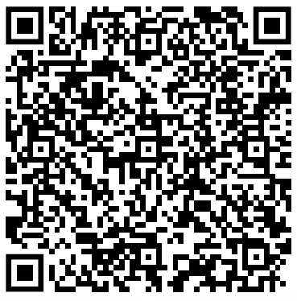
Performance of $Π_{S}$ & Implementations by Dock Network:
PPVSS | Assumption | Sharing | Dealer’s Com. | Verification | Reconstruction
[Sch99] | DDH, RO | $$4.5n E_{G}+n PE$$ | $$1.5n \left|G\right|+n |Z_{q}|$$ | $$nt+4n E_{G}+2.5n M_{G}$$ | $$5t E_{G}+t M_{G}$$
[CD17] | DBS, Plain | $$2n E_{G}+n PE$$ | $$2n \left|G\right|$$ | $$2n P_{G}+n E_{G}+n M_{G}$$ | $$2t P_{G}+t E_{G}+t M_{G}$$
[CD17] | DDH, RO | $$4n E_{G}+n PE$$ | $$2n \left|G\right|+n |Z_{q}|$$ | $$5n E_{G}+3n M_{G}$$ | $$5t E_{G}+t M_{G}$$
$Π_{S}$ , [CD22] | DDH, PDL, RO | $$2n E_{G}+2n PE$$ | $$n \left|G\right|+0.5n |Z_{q}|$$ | $$2n E_{G}+n PE+n M_{G}$$ | $$5t E_{G}+t M_{G}$$
The PVSS scheme $Π_{S}$ and our proposed VSS scheme $Π_{LA}$ was recently implemented in Rust by the developers of Dock Network, www.dock.io,
Their open-source implementations for $Π_{S}$ are publicly available on:
Their open-source implementations for $Π_{LA}$are publicly available on:
https://github.com/docknetwork/crypto/tree/main/secret_sharing_and_dkg/src/baghery_pvss
https://github.com/docknetwork/crypto/blob/main/secret_sharing_and_dkg/src/baghery_vss.rs
Notes:
mention sigma protocols = 3-round protocols

Slide 19
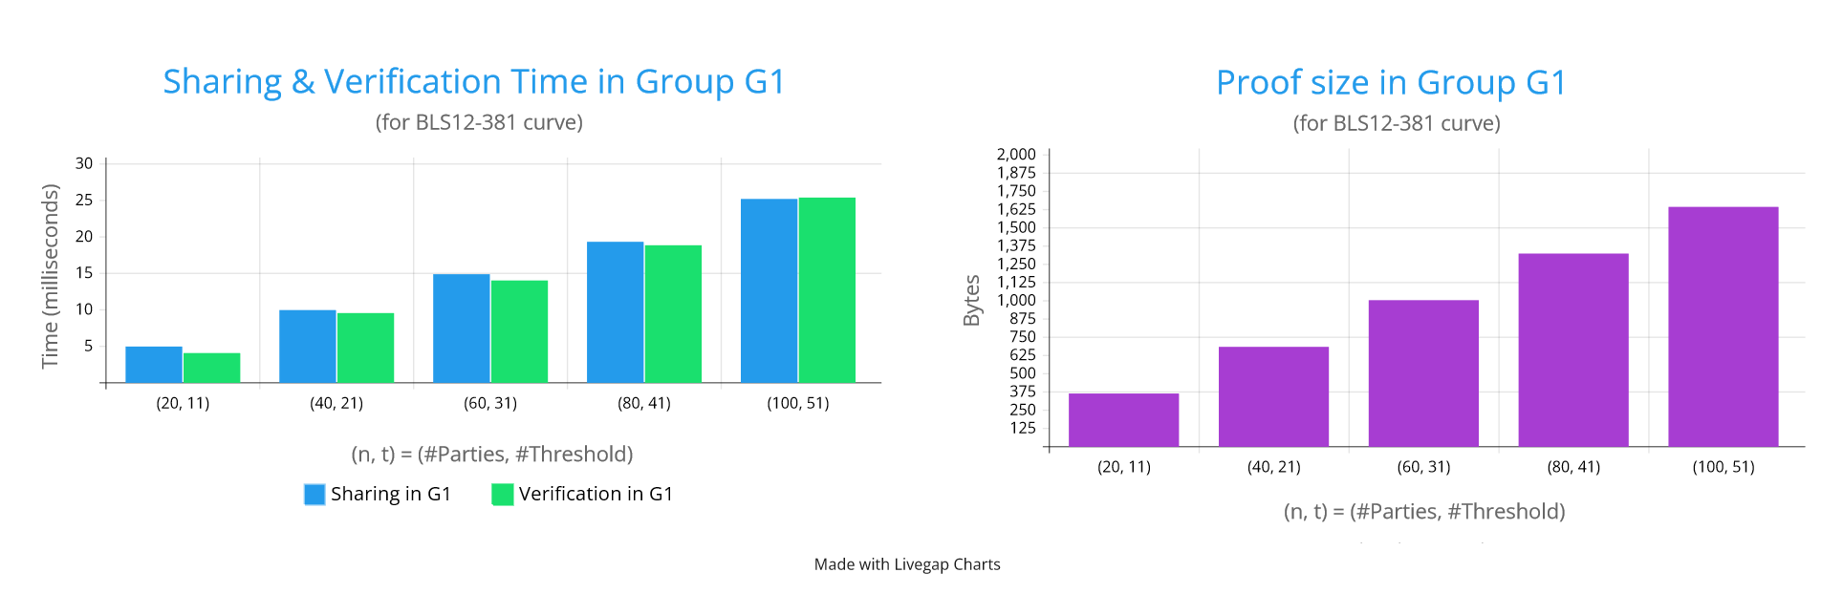
Performance of $Π_{S}$: Run by the Developers of Dock Network
Performance of $Π_{S}$ over BLS12-381 curve (by Dock Network, www.dock.io)
https://github.com/docknetwork/crypto/tree/main/secret_sharing_and_dkg/src/baghery_pvss
“This primitive is useful for sharing secrets on a blockchain as the blockchain can verify the proof.”
— Git Page of DOCK Network
Notes:
mention sigma protocols = 3-round protocols

Slide 20
Conclusions and Future Research:
We presented a simple and general construction to build computational VSS schemes in the honest-majority setting.
It is general engough to be employed in various contexts such as lattices, isogenies, codes, and so on.
New VSS schemes can be used in various threshold protocols
In many cases, $Π_{F}$ and $Π_{LA}$ can be used instead of Feldman VSS.
Similarly, $Π_{P}$ can be used instead of Pedersen VSS.
$Π_{LA}$is PQ-secure and assomptetically only 1x slower than standard Shamir!
New PVSS scheme $Π_{S}$ can be used in various applicaitons.
Recently, we used a variant of it to revisit various applicaitons presented in [Sch99], and improved their performance. Our new results will be presented at ACNS 2025 (ia.cr/2025/576). New!
In practice, when using the new VSS schemes, one may need to construct a variant of them that commits to the main secret as well, which can be achieved in all schemes with minimal modification. See section 4 of [ABCP23] as an example.

Slide 21
Thank You!
ia.cr/2023/1669
karim.baghery@kuleuven.be

Slide 22
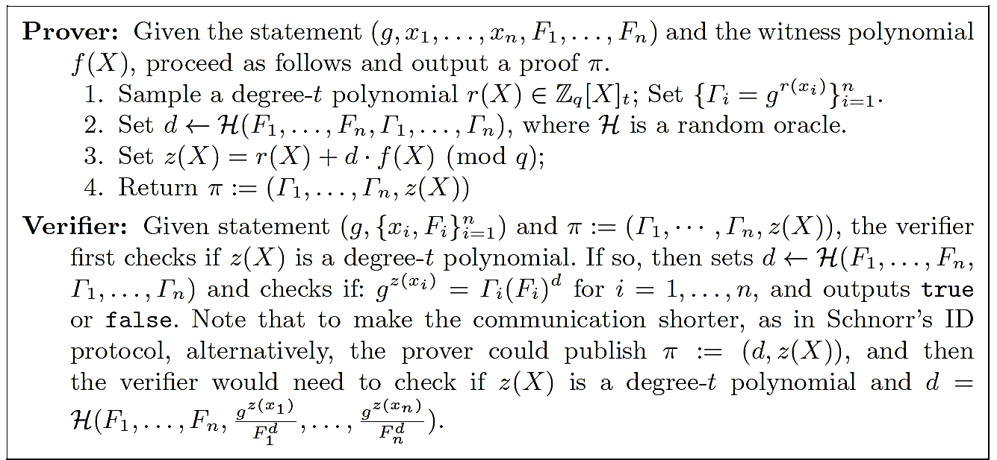
An Efficient NIZK Proof of Knowledge for $R_{PDL}$:
Generalization of Schnorr’s Protocol:
It allows a prover to prove knowledge of a witness polynomial $f(X)$ for the $R_{PDL}$ relation:
$R_{PDL}=\left\{\left((g, x_{i}, F_{i}),f(X)\right) | F_{i}=g^{f(x_{i})}\right\}$ for $i=1, …, n$ and $n>t$.
$$g,f_{0}$$
$$F=g^{f_{0}}$$
$$g$$
Prover
Verifier
$$r←Z_{q}, R=g^{r}$$
$$d=ℋ(F, R)$$
$$z=r+df_{0}$$
$z, d$
$$d=ℋ(F, \frac{g^{z}}{F^{d}})$$
We prove that the generalized protocol satisfies Completeness, Special Sound, HVZK under PDL problem, and can be made non-interactive in the RO model.
Notes:
mention sigma protocols = 3-round protocols

Slide 23
Schoenmakers’ PVSS Scheme:
In some PVSS schemes the main secret is $g^{f_{0}}$ [Sch99] and in some others it is $f_{0}∈ Z_{q}$ [Gro21].
In CRYPTO’99, Schoenmakers [Sch99]:
Proposed an efficient PVSS protocol based on [Fel87] VSS scheme.
In his PVSS scheme, the secret is $g^{f_{0}}$ and parties obtain $g^{f_{i}}$ as a share of $g^{f_{0}}$.
In his scheme, given the public key $\{{pk}_{i}=g^{s_{i}}\}_{i=1}^{n}$ and the secret value $f_{0}$, the dealer runs Feldman VSS and obtains the shares $\{f_{i}\}_{i=1}^{n}$ and the proof $π_{Feldman}$. Then, the prover encrypts the shares as $C_{i}={pk}_{i}^{f_{i}}$ and generates another NIZK proof that the encrypted values are valid Shamir shares.
Shamir SS $f_{0}$
Feldman VSS $f_{0}$
[Sch99] PVSS $g^{f_{0}}$
He also introduced several practical applications for his PVSS scheme, e.g., a universally verifiable e-voting protocol, threshold PKI, ...
PVSS Scheme | Assumption | Sharing | Dealer’s Communication | Verification | Reconstruction
[Sch99] | DDH & RO | $$4.5n E_{G}+$$ $$n PE$$ | PV: $−$ BC: $1.5n \left|G\right|+n |Z_{q}|$ | $$nt+4n E_{G}+2.5n M_{G}$$ | $$5t E_{G}+t M_{G}$$
[Sch99] Berry Schoenmakers. A Simple Publicly Verifiable Secret Sharing Scheme and its Application to Electronic Voting. CRYPTO’99.
Notes:
mention sigma protocols = 3-round protocols

