Slide 1

Chosen Ciphertext Security via BARGs
PKC 2025 @ Røros
2025/5/12 ~ 15
Takahiro Matsuda ( )
https://eprint.iacr.org/2023/1957
1
1
Notes:
1

Slide 2
Background & Motivation
CCA secure PKE is one of the most important, fundamental, and intensively studied cryptographic primitives
Long-standing Open Problem on PKE:
To gain insights, we would like to find what additional assumptions/primitives are sufficient, as many as possible
CPA
PKE
??
CCA
PKE
+
CPA
PKE
α
(additional assumption
and/or primitive)
CCA
PKE

Slide 3
Main Result
+
CPA
PKE
BARG
CCA
PKE
BARG = Batch ARGument
= Non-interactive argument system in which the correctness of
multiple NP statements can be proved in one shot
Requirement 1: (Semi-adaptive) Soundness
Requirement 2: Succinctness of Proof Size:
When proving k statements, the bit-length |π| of the proof π must be
non-trivially smaller than just sending k witnesses
  Presumably, |π| = poly(λ, n)・o(k),
  and ideally, |π| = poly(λ, n, log k)
  Shorter |π| = stronger requirement
n: Bit-length of each statement + witness
λ: Security parameter

Slide 4
Relations to Existing Works
Our
Work
BARG
No implications or separations between BARG
and other primitives
[DDN91]
NIZK
+
CPA
PKE
[KMT19,
KM20]
KDM-secure
SKE
CCA
PKE
[HKW21]
Randomness
Recoverability
[Dac14, MH16]
Simulatability
+ Plaintext-
awareness

Slide 5
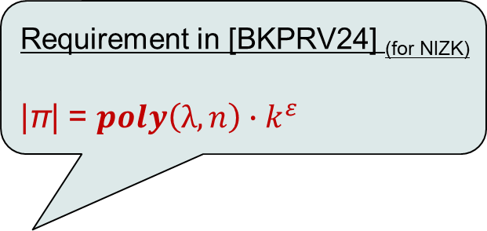
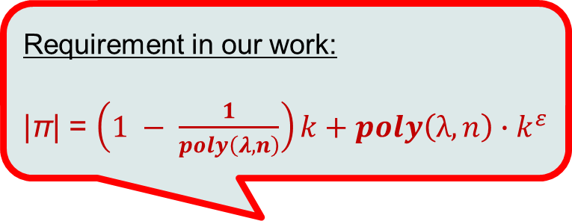
Relations with Recent
“NIZK from BARG” Results
[BKPRV24], [BWW24] (c.f. [CW23])
Naor-Yung
paradigm
CCA
PKE
BARG
+ OWF
NIZK
At the time our paper first appeared in ePrint (Dec. 2023), yes ☹
But in the PKC 2025 version, no ☺
Is our result implied by these works?
Requirement in our work:
|π| = $\left(1 − \frac{1}{poly\left(λ,n\right)}\right)k+poly\left(λ, n\right)∙k^{ε}$
Requirement in [BKPRV24] _{(for NIZK)}
|π| = $poly\left(λ, n\right)∙k^{ε}$
(ε < 1)
(ε < 1)
Succinctness
requirement
in terms of
#statements k
Sending
k witnesses
(trivial)
O(k)
with <k
o(k)
k^{ε} (ε <1)
Polylog(k)
Not known to imply NIZKs
k: #statements
n: Bit-length of each statement + witness
λ: Security parameter

Slide 6
Technical Overview
Actual Proposed Construction:
Equivocal
（tag-based）
Bit-
Commitment
Weak CCA
Tag-Based
Encryption
(TBE)
+
+
CPA
PKE
BARG

Slide 7



Tag-Based Encryption (TBE)
= PKE in which Enc/Dec uses an additional input called “tag”
[CHK04, Kiltz06]
(Selective-tag) Weak CCA security
(pk, sk) ⬅ TKG(1^{λ})
c ⬅ TEnc(pk, t, m)
m or $⊥$ ⬅ TDec(sk, t, c)
pk
t*
b⬅{0,1}
m₀, m₁
Challenge Oracle
c* ⬅ TEnc(pk, t*, m_{b})
c*
A
t $≠$ t*
t, c
Decryption Oracle
m = TDec(sk, t, c)
m
b’
$∀$PPT A: |Pr[b’ = b] $−$ 1/2| = neg.
+
Weak-CCA
TBE
One-time
Signature
CCA
PKE

Slide 8

(Tag-Based)
Equivocal Bit-Commitment
Normal mode and EQ mode
= Bit-commitment with two modes of operation
Can be constructed from
a one-way function (based on Naor’s bit commitment)
Two modes are
indistinguishable
Equivocability
∀m, t* :
{ (ck, com, ρ) } { (ck~, com~, ρ~_{m}) }
ck ⬅ CKG(1^{λ})
com ⬅ Com(ck, t, m; ρ)
(ck~, com~, ρ~₀, ρ~₁)⬅EQSetup(t*)
  s.t. com~ = Com(ck~, t*, 0; ρ~₀)
  = Com(ck~, t*, 1; ρ~₁)
$$≈$$
Statistical Binding
∀t* :
Pr[ ]
= neg.
Under tags t ≠ t*, com~ can’t
be opened to both m=0 and m=1
∃ t ≠ t* and ρ₀, ρ₁ s.t.
Com(ck~, t, 0; ρ₀) = Com(ck~, t, 1; ρ₁)

Slide 9
Technical Overview
Actual Proposed Construction:
Equivocal
（tag-based）
Bit-
Commitment
+
+
CPA
PKE
BARG
Weak CCA
TBE
Our approach: Koppula-Waters-style construction [KW19, KMT19],
with a ciphertext validity check using a BARG
CPA
PKE
Step 1
“Base”
(1-bit)
TBE
Step 2
Weak CCA
TBE
Equivocal
（tag-based）
Bit-
Commitment
BARG

Slide 10

Step 1: “Base” 1-Bit TBE
+
CPA
PKE
Equivocal
（tag-based）
Bit-Commitment
“Base”
(1-bit)
TBE
(pk₀,sk₀), (pk₁, sk₁):
key pairs of CPA PKE
ck: commitment key
PK_{base} = (pk₀, pk₁, ck), SK_{base} = sk₀
Encrypting s ∊ {0,1} under tag t :
r₀, r₁ , ρ₀, ρ₁ ⬅ random
com ⬅ Com(ck, t, s; ρ_{s})
c_{s} ⬅ Enc(pk_{s}, ρ_{s} ; r_{s} )
c_{1-s} ⬅ Enc(pk_{1-s}, ⊥ ; r_{1-s})
Ciphertext C = (c₀, c₁, com)
Decrypting C:
s = 0 if Dec(sk₀, c₀) = ρ ⋀
Com(ck, t, 0; ρ) = com
1 otherwise
Why the bit s is hidden?
By the Equivocability of Com
and CPA security of CPA PKE,
C = (c₀, c₁, com) C~ = (c~₀, c~₁, com~)
where (ck~, com~, ρ~₀, ρ~₁)⬅EQSetup(t*)
and c~_{v} = Enc(pk_{v}, ρ~_{v}; r_{v}) for both v ∈{0,1}
➔ C = (c₀, c₁, com) looks independent of s
$$≈$$

Slide 11
Step 1: “Base” 1-Bit TBE
+
CPA
PKE
Equivocal
（tag-based）
Bit-Commitment
“Base”
(1-bit)
TBE
(pk₀,sk₀), (pk₁, sk₁):
key pairs of CPA PKE
ck: commitment key
PK_{base} = (pk₀, pk₁, ck), SK_{base} = sk₀
Encrypting s ∊ {0,1} under tag t :
r₀, r₁ , ρ₀, ρ₁ ⬅ random
com ⬅ Com(ck, t, s; ρ_{s})
c_{s} ⬅ Enc(pk_{s}, ρ_{s} ; r_{s} )
c_{1-s} ⬅ Enc(pk_{1-s}, ⊥ ; r_{1-s})
Ciphertext C = (c₀, c₁, com)
Decrypting C:
s = 0 if Dec(sk₀, c₀) = ρ ⋀
Com(ck, t, 0; ρ) = com
1 otherwise
Existence of the alternative decryption procedure
By the statistical binding of Com, if C is good,
namely, ∃ witness (s, r, ρ) satisfying
Enc(pk_{s}, ρ; r) = c_{s} ⋀ Com(ck, t, s; ρ) = com,
then decryption with sk₀ and that with sk₁ agree
Confidentiality (hiding of s) continues to hold even if an adversary is given
(1) a dec oracle that only decrypts good CT’s; &
(2) the witness (s, r, ρ) for the challenge CT
Alternaltive Decryption using sk₁:
s = 1 if Dec(sk₁, c₁) = ρ ⋀
Com(ck, t, 1; ρ) = com
0 otherwise

Slide 12
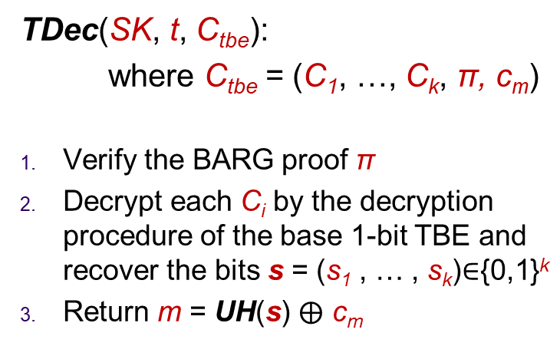

Step 2: Combining with BARG
+
“Base”
(1-bit)
TBE
BARG
Weak CCA
TBE
CRS of BARG
Universal hash
PK = (PK_{base}, crs, UH), SK = SK_{base}
TEnc(PK, t, m):
s = (s₁ , … , s_{k}) ⬅ {0,1}^{k}
Encrypt each bit s_{i} using the base 1-bit TBE and get ciphertexts C₁, …, C_{k}
π ⬅ Generate a BARG proof that
every C_{i} is good
c_{m} ⬅ UH(s) $⨁$ m
Return C_{tbe} = (C₁, …, C_{k}, π, c_{m})
TDec(SK, t, C_{tbe}):
where C_{tbe} = (C₁, …, C_{k}, π, c_{m})
Verify the BARG proof π
Decrypt each C_{i} by the decryption procedure of the base 1-bit TBE and recover the bits s = (s₁ , … , s_{k})∈{0,1}^{k}
Return m = UH(s) $⨁$ c_{m}
In the actual construction, the commitment key ck has to be generated for each position i ∈ [k].

Slide 13

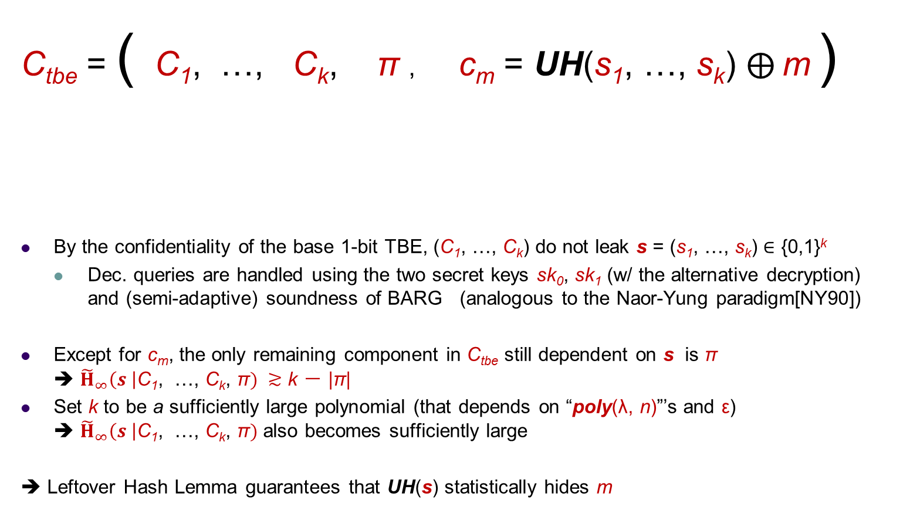
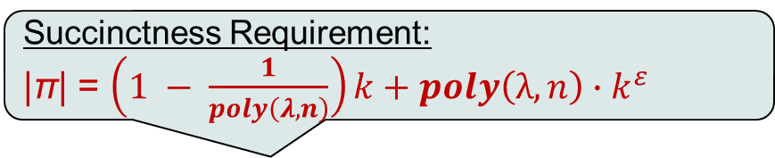
Ideas for Security Proof
Succinctness Requirement:
|π| = $\left(1 − \frac{1}{poly\left(λ,n\right)}\right)k+poly\left(λ, n\right)∙k^{ε}$
(ε < 1)
C_{tbe} = ( C₁, …, C_{k}, π , c_{m} = UH(s₁, …, s_{k}) $⨁$ m )
By the confidentiality of the base 1-bit TBE, (C₁, …, C_{k}) do not leak s = (s₁, …, s_{k}) ∈ {0,1}^{k}
  Dec. queries are handled using the two secret keys sk₀, sk₁ (w/ the alternative decryption)
  and (semi-adaptive) soundness of BARG (analogous to the Naor-Yung paradigm[NY90])
Except for c_{m}, the only remaining component in C_{tbe} still dependent on s is π
➔ ${\tilde{H}}_{∞}\left(s \right|\text{C}\text{1}\text{, …, }\text{C}\text{k}\text{, }\text{π}) ≳$ k － |π|
Set k to be a sufficiently large polynomial (that depends on “poly(λ, n)”’s and ε)
➔ ${\tilde{H}}_{∞}\left(s \right|\text{C}\text{1}\text{, …, }\text{C}\text{k}\text{, }\text{π})$ also becomes sufficiently large
➔ Leftover Hash Lemma guarantees that UH(s) statistically hides m
Each C_{i} encrypts
the bit s_{i}
A BARG proof
that every C_{i} is good
Universal hash

Slide 14
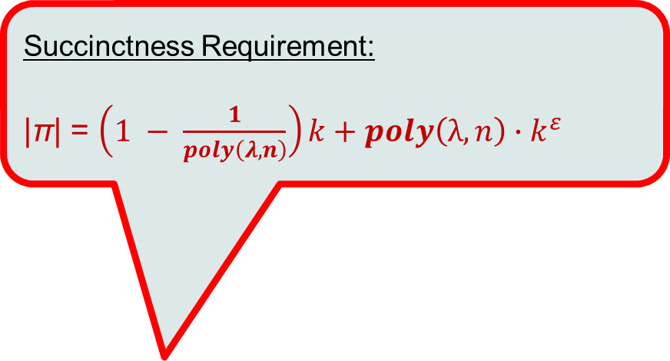
Summary & Open Problems
Our main result:
Open
Problems
+
CPA
PKE
BARG
CCA
PKE
Succinctness Requirement:
|π| = $\left(1 − \frac{1}{poly\left(λ,n\right)}\right)k+poly\left(λ, n\right)∙k^{ε}$
(ε < 1)
Is a BARG with the above succinctness easier to construct than one that implies NIZKs?
Can we weaken
the requirement ?
Succinctness
requirement
in terms of
#statements k
Can we construct a NIZK from BARGs with the above succinctness?
Sending
k witnesses
(trivial)
O(k)
with <k
o(k)
k^{ε} (ε <1)
Polylog(k)
https://eprint.iacr.org/2023/1957

Slide 15
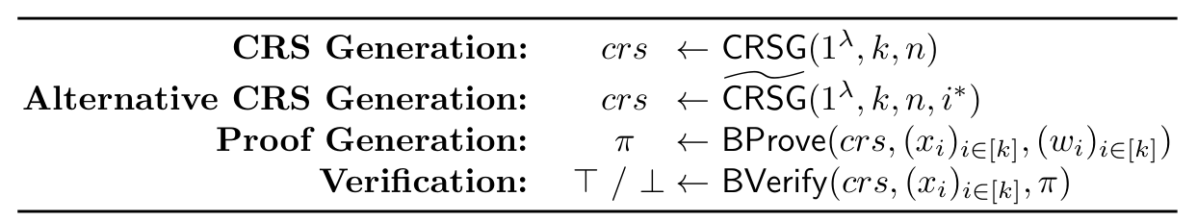
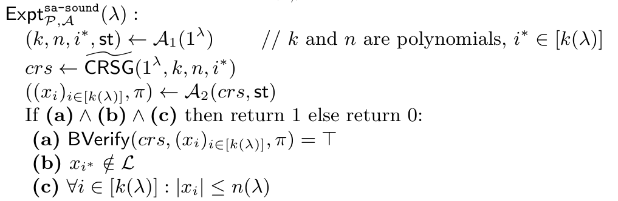
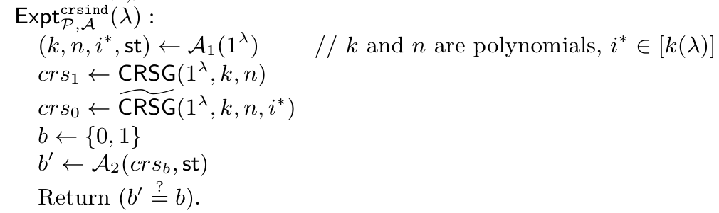
Appendix:
BARG Security Definitions
Semi-adaptive Soundness

