Slide 1
Privacy-Preserving Multi-Signatures: Generic Techniques and Constructions Without Pairings
PKC, 12.05.2025
Calvin Abou Haidar¹, Dipayan Das², Anja Lehmann³, Cavit Özbay³, Octavio Pérez-Kempner¹
¹ NTT Social Informatics Laboratories ² Department of Mathematics and Statistics, Florida Atlantic University
³ Hasso Plattner Institute | University of Potsdam
Notes:
Thanks for the introduction.

Slide 2
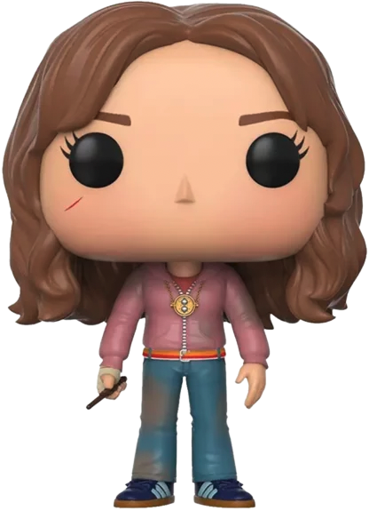
Signing as a Group | Threshold Signatures
$$pk_{A}$$
 | Long-Term Keys | Privacy
Threshold Sig.
$$pk_{B}$$
$$sk_{A}$$
$$sk_{A,1}$$
$$pk_{C}$$
Seperate secret key per group
No long-term keys
Untraceable between groups groups
$$sk_{B}$$
DKG
$$pk_{A,B}$$
$$sk_{B,1}$$
$$sk_{B,2}$$
$$sk_{C}$$
DKG
$$sk_{C,2}$$
$$pk_{B,C}$$

Slide 3
Signing as a Group | Multi-Signatures with KAg
$$pk_{A}$$
 | Long-Term Keys | Privacy
Multi-Sig.
$$pk_{B}$$
$$sk_{A}$$
$$pk_{C}$$
Lehmann & Özbay (PKC ‘24)
KAg.
Deterministic (MSdKA)
Verifiable (MSvKA)
Group Unforgeability
$$sk_{B}$$
KAg.
$$pk_{A,B}$$
$$sk_{C}$$
KAg.
$$pk_{B,C}$$

Slide 4
Syntax | Multi-Signatures with KAg
Deterministic Key Aggregation
Verifiable Key Aggregation
$$Pg\left(λ\right)→pp$$ | Output public parameters.
$$Kg\left(pp\right)→(sk,pk)$$ | Generate key pairs.
$$KAg\left(PK\right)→(apk,π)$$ | Aggregate keys and output the proof $π$.
$$VfKAg\left(PK,apk,π\right)→b$$ | Verify that $apk$ corresponds to $PK$.
$$MulSign\left(sk_{i},PK,apk,m\right)→s_{i}$$ | Sign the message $m$ with the group $PK$.
$$Combine\left(PK,{π, \left\{s_{i}\right\}}_{pk_{i}∈PK}\right)→σ$$ | Combine individual signatures.
$$Vf\left(apk,σ,m\right)→b$$ | Verify a signature on the message $m$.
$$Pg\left(λ\right)→pp$$ | Output public parameters.
$$Kg\left(pp\right)→(sk,pk)$$ | Generate key pairs.
$$KAg\left(PK\right)→(apk,π)$$ | Aggregate keys and output the proof $π$.
$$VfKAg\left(PK,apk,π\right)→b$$ | Verify that $apk$ corresponds to $PK$.
$$MulSign\left(sk_{i},PK,apk,m\right)→s_{i}$$ | Sign the message $m$ with the group $PK$.
$$Combine\left(PK,{π, \left\{s_{i}\right\}}_{pk_{i}∈PK}\right)→σ$$ | Combine individual signatures.
$$Vf\left(apk,σ,m\right)→b$$ | Verify a signature on the message $m$.

Slide 5
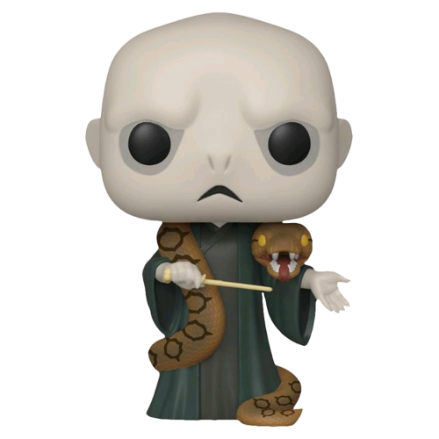
Privacy | Multi-Signatures with KAg
$$pk_{A}$$
If there is no leak of information on the underlying signing group:
Full Privacy
π is private to the group (outsider privacy)
$$pk_{B}$$
$$sk_{A}$$
KAg.
π_{A,B}
$$pk_{C}$$
$$sk_{B}$$
KAg.
$$pk_{A,B}$$
π_{A,B}
If signatures and aggregated key leak the group size or the fact that they are aggregates:
Set / Membership Privacy
π_{B,C}
$$sk_{C}$$
$$pk_{B,C}$$
π_{B,C}
$$σ_{A,B}, m$$

Slide 6
Group Unforgeability | Multi-Signatures with KAg
What is considered as fresh forgery for $MulSign\left(sk_{i},PK,apk,m\right)$ ?
Fresh $m$?
Fresh $(m,PK,apk)$?
Unforgeability
$$pp←Pg\left(λ\right),\left(pk^{∗},sk^{∗}\right)←Kg\left(pp\right)$$ $$\left(σ,m,apk,π,PK\right)←𝒜^{𝒪MulSign}\left(pp,pk^{∗}\right)$$ return $1$ if $VfKAg\left(PK,apk,π\right)$ and $Vf\left(apk,σ,m\right)$ and $pk^{∗}∈PK$ and the forgery is fresh
Group Unforgeability
Infeasible to forge a signature on $m$ for a group key $apk$ that $pk^{∗}$ did not mean to sign together.
Weakest Unforgeability
$π$ can be chosen maliciously

Slide 7
Flexible group signing with long-term keys
Privacy-Preserving Multi-Signatures
 | Simple Vrfy | Dynamic | Key Re-Use | Group Unf. | Privacy
Threshold Signatures
Silent Threshold Signatures
Multi-Signatures with Deterministic KAg. (MSdKA)
Multi-Signatures with Verifiable Kag. (MSvKA)
BLS construction from LÖ24
Either simple to verify or group unf. but not both

Slide 8
Departure Point
Prior to this work, only one construction based on BLS was known [LÖ24, BDN18]
$$Pg\left(λ\right)→pp$$ | $$\left(e,g,\hat{g},𝔾,\hat{𝔾},p\right)$$
$$Kg\left(pp\right)→(sk,pk)$$ | $sk←ℤ_{p}^{∗}$ and $pk≔{\hat{g}}^{sk}$
$$KAg\left(PK\right)→(apk,π)$$ | $$π←{\left\{0,1\right\}}^{λ},apk≔\prod_{pk∈PK}{pk^{H_{1}(pk,PK,π)}}$$
$$VfKAg\left(PK,apk,π\right)→b$$ | $$apk=\prod_{pk∈PK}{pk^{H_{1}(pk,PK,π)}}$$
$$MulSign\left(sk_{i},PK,apk,m\right)→s_{i}$$ | $$s_{i}≔H_{0}{\left(m\right)}^{sk_{i}}$$
$$Combine\left(PK,{π, \left\{s_{i}\right\}}_{pk_{i}∈PK}\right)→σ$$ | $$σ≔\prod_{pk_{i}∈PK}{s_{i}^{H_{1}(pk_{i},PK,π)}}$$
$$Vf\left(apk,σ,m\right)→b$$ | $$e\left(H_{0}\left(m\right),apk\right)=e(σ,\hat{g})$$
 | Group Unf. | Privacy
randBLS-1
$$Vf\left(apk,σ,m\right)→b$$

Slide 9
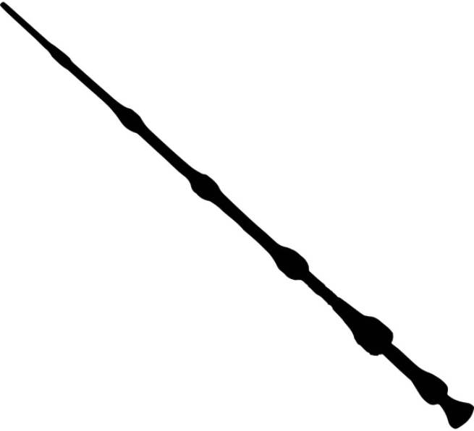
Our Goal: New Constructions!
Avada Kedavra!
Known Parties
Unknown Party
$(pkA,sk$_{A})
$(pkB,sk$_{B})
$(pkC,sk$_{C})
$(pkD,sk$_{D})
Our Contribution
Generic technique for parties to emulate the uknown party Simple constructions for Schnorr-type signatures
KAg
Avada Kedavra!
Is this privacy-preserving?
$$apk$$

Slide 10
Our Generic Technique in One Slide
KAg. samples a seed and a PRF key, which are part of π.
Parties derive a dummy key pair (dsk,dpk) using the seed.
The PRF key is used to derive the random coins of the signing algorithms for dsk.
Signers run an extra round to sample nonces nonce_{i} for each signer i in the signing session.
The random tape of the dummy signer is ρ₁, . . . , ρ_{ℓ} ← F_{k}(nonce₁∥ . . . ∥nonce_{|P K|}).

Slide 11
Privacy for Schnorr-type Multi-Signatures
Schnorr
R$←$g^{r} , for random r c $←H\left(R,pk,m\right)$ s $←$ r + c ⋅ sk mod p $σ$ $←\left(R,s\right)$ check g^{s} = R ⋅ pk^{c}
$${com}_{A}←MulSign1(sk_{A},m)$$
$${com}_{A}$$
$${com}_{B}$$
$${com}_{A}$$
$${com}_{C}$$
$${com}_{C}$$
$${com}_{B}$$
$${com}_{B}←MulSign1(sk_{B},m)$$
$${com}_{C}←MulSign1(sk_{C},m)$$

Slide 12
Privacy for Schnorr-type Multi-Signatures
Schnorr is key-randomizable
$σ$ $=\left(R,s\right)$ dpk = g^{dsk}, for random dsk s’ $←$ s + c ⋅ dsk pk’ $←$ pk ⋅ dpk check g^{s’} = R ⋅ pk’^{c}
c $←H\left(R,pk,m\right)$
$$σA←MulSign2(sk_{A},{com}_{A},{com}_{B},{com}_{C})$$
$$σA$$
$$σB$$
$$σA←MulSign2(sk_{A},{com}_{A},{com}_{B},{com}_{C})$$
$$σC←MulSign2(sk_{A},{com}_{A},{com}_{B},{com}_{C})$$
$$σ_{A,B,C}←Cmb(\left\{σ_{A},σ_{B},σC\right\})$$

Slide 13
MuSig2 | Two-round Schnorr
$MulSign1$(sk_{i},PK,apk,m): Output (R_{i,1}, R_{i,2}, st⁽¹⁾)
$MulSign2$(st⁽¹⁾,in⁽¹⁾):
Aggregate all R’s
R₁ $←$ $\prod_{PK}{Ri1 ;\text{R}\text{2} ← \prod_{PK}{Ri2}}$ ; b $←$ H(R₁, R₂, apk,m); R $←$ $R1R2b$
Set c $←$ H(R,apk,m)
Output $σ$_{i} $←$ c ⋅ H(pk_{i}, PK) ⋅ sk_{i} + r_{i1} + r_{i2} ⋅ b and (R_{i,1}, R_{i,2})
Cmb({$σ$_{i}, R_{i,1}, R_{i,2}}$pk∈PK$):
R₁ $←$ $\prod_{PK}{Ri1 ;\text{R}\text{2} ← \prod_{PK}{Ri2}}$ ; R $←$ $R1R2\text{H}\text{(}\text{R}\text{1, }\text{R}\text{2, }\text{apk}\text{,}\text{m}\text{)}$
Output $σ$ $←$ $ΣPK$ $σ$_{i}

Slide 14
Privacy-Preserving MuSig2 | Our Tweak
KAg. adds dpk to the deterministic computation of apk from PK
MulSign1 and MulSign2 remain unchanged
We correct (adapt) the signature shares in Cmb
Cmb({$σ$_{i}, R_{i,1}, R_{i,2}}$pk∈PK$, π=dsk):
R₁ $←$ $\prod_{PK}{Ri1 ;\text{R}\text{2} ← \prod_{PK}{Ri2}}$ ; R $←$ $R1R2\text{H}\text{(}\text{R}\text{1, }\text{R}\text{2, }\text{apk}\text{,}\text{m}\text{)}$
Output $σ$ $←$ $ΣPK$ $σ$_{i} + c ⋅ dsk
We achieve Full Privacy and Group Unf. without any overhead

Slide 15
Final Comments | Lattice Case
We built a privacy-preserving variant of DualMS [Chen23]
Requires all group members to know π and use it in MulSign
Small increase in parameters’ size to correct rejection sampling
Signature’s distribution leaks the group size
We achieve a relaxed notion of Set Privacy (weak Set Privacy)

Slide 16
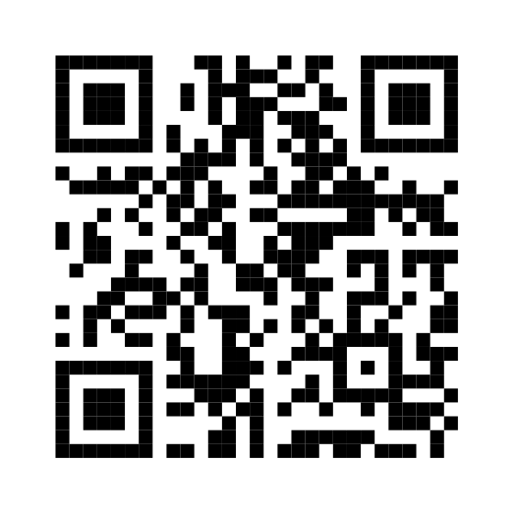
Conclusion & Future Work
Generic Technique to lift standard multi-signatures to privacy-preserving ones.
Variants for Schnorr-type signatures without overhead
Applies to popular schemes such as MuSig2
First post-quantum realization from lattice
Privacy against insiders remains an open problem
Extend our ideas to other post-quantum multi-signatures
Check out our eprint!

Slide 17
References
[BDN18] Boneh, D., Drijvers, M., Neven, G. (2018). Compact Multi-signatures for Smaller Blockchains. ASIACRYPT 2018.
[LÖ24] Lehmann, A., Özbay, C. (2024). Multi-Signatures for Ad-hoc and Privacy-Preserving Group Signing. PKC 2024.
[Chen23] Chen, Y. (2023). Efficient lattice-based two-round multi-signature with trapdoor-free simulation. CRYPTO 2023.

