Slide 1
Commit-and-Prove System for Vectors and
Applications to Threshold Signing
14.05.2025 | PKC’25, Røros
Anja Lehmann, Cavit Özbay
Hasso Plattner Institute, University of Potsdam

Slide 2
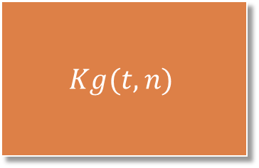

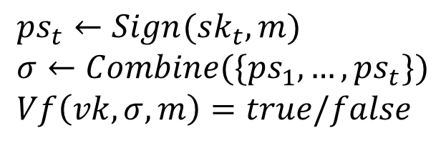


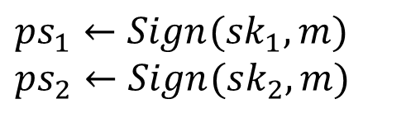

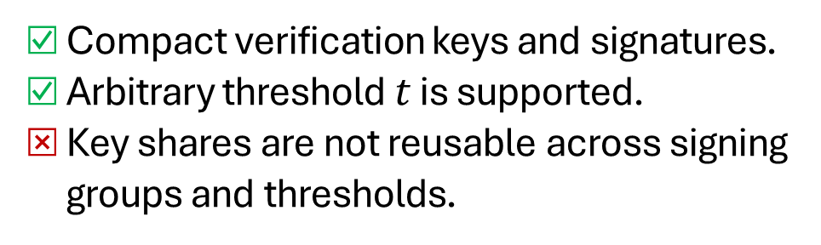
Threshold Signatures vs Multi-Signatures
Threshold Signature
$ps_{1}←Sign(sk_{1},m)$
$ps_{2}←Sign(sk_{2},m)$
$$sk_{1}$$
$$vk$$
$$Kg(t,n)$$
…
$$sk_{2}$$
Verifiable Secret Sharing
$ps_{t}←Sign(sk_{t},m)$
$σ←Combine(\{ps_{1},…,ps_{t}\})$
$Vf\left(vk,σ,m\right)=true/false$
…
$$sk_{n}$$
Compact verification keys and signatures.
Arbitrary threshold $t$ is supported.
Key shares are not reusable across signing groups and thresholds.
Notes:
Threshold signatures distribute the signing capability of a digital signature to n signers.
For that, they employ a potentially interactive key generation algorithm, which outputs a secret key share to each signers, and a group verification key.
Later on, a signer can sign a message m by creating a partial signature on it.
t partial signatures can be combined into a final signature, which verifies with the group verification key.
Many traditional schemes rely on a verifiable secret sharing protocol to set up key shares and achieve compact verification keys and signatures.
The drawback of this approach is that the key shares are dedicated to a specific threshold and a signing group.
If a signer wants to create threshold signatures with different co-signers, or a signing group wants to create threshold signatures with a different threshold t’, they have to perform another key generation protocol, and store both key shares in parallel.

Slide 3




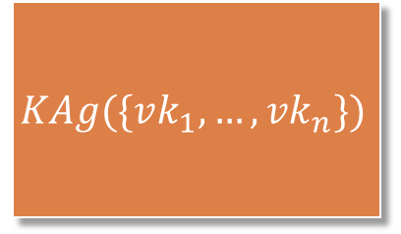
Threshold Signatures vs Multi-Signatures
Threshold Signature
Multi-Signature
$$sk_{1}$$
$$vk$$
$$vk$$
$$\left(sk_{1},vk_{1}\right)←MS.Kg()$$
$$Kg(t,n)$$
$$KAg(\{vk_{1},…,vk_{n}\})$$
$$sk_{2}$$
$$(sk_{2},vk_{2})$$
Verifiable Secret Sharing
…
…
$$sk_{n}$$
$$(sk_{n},vk_{n})$$
Compact verification keys and signatures.
Arbitrary threshold $t$ is supported.
Key shares are not reusable across signing groups and thresholds.
Compact verification keys and signatures.
Reusable keys across groups.
Only 𝑛-out-of-𝑛 threshold is supported.
Notes:
Threshold signatures distribute the signing capability of a digital signature to n signers.
For that, they employ a potentially interactive key generation algorithm, which outputs a secret key share to each signers, and a group verification key.
Later on, a signer can sign a message m by creating a partial signature on it.
t partial signatures can be combined into a final signature, which verifies with the group verification key.
Many traditional schemes rely on a verifiable secret sharing protocol to set up key shares and achieve compact verification keys and signatures.
The drawback of this approach is that the key shares are dedicated to a specific threshold and a signing group.
If a signer wants to create threshold signatures with different co-signers, or a signing group wants to create threshold signatures with a different threshold t’, they have to perform another key generation protocol, and store both key shares in parallel.

Slide 4
Threshold Signatures with Reusable Secret Keys
Primitive | Compact vk & sig. | Reusable sk Across Groups | Threshold Support
Threshold Signatures | ☑ | ⮽ | ☑
Multi-Signatures | ☑ | ☑ | ⮽
[DCX+23,GJM+24] | ☑ | ☑ | ☑
[DCX+23,GJM+24] propose threshold signatures with reusable secret keys across groups & thresholds.
Informal construction idea: commit-and-prove SNARKs (CP-SNARKs)+ multi-signatures.
We identified a flaw in the proof of [DCX+23].
[DCX+23] Das et al. Threshold Signatures from Inner Product Argument: Succinct, Weighted, and Multi-threshold, (CCS '23).
[GJM+24] Garg et al. hinTS: Threshold Signatures with Silent Setup, (S&P’24).

Slide 5
Our Contribution
Generic construction of a threshold signature with reusable secret keys.
A definitional framework for commit-and-prove SNARKs.
Adapted the CP-SNARK construction by [DCX+23] and instantiated the generic construction.
Notes:
These works proposed concurrently by garg et al. And das et al.
They both implicitly use CP-SNARKs and multi-signatures as building blocks, which will be explained in more detail.
At this point our question is whether we can obtain such threshold key generation mechanism in a generic manner form underlying building blocks. When we look at the existing three Works following this method, only Das et al. Aims for a generic construction.
We identified a flaw in their proof and we realize that fixing the flaw in a generic manner requires to define non-standard properties of the underlying building blocks, CP-SNARKs in particular. We analyzed the necessary properties and adapted the Das et al.’s construction to satisfy these properties.

Slide 6
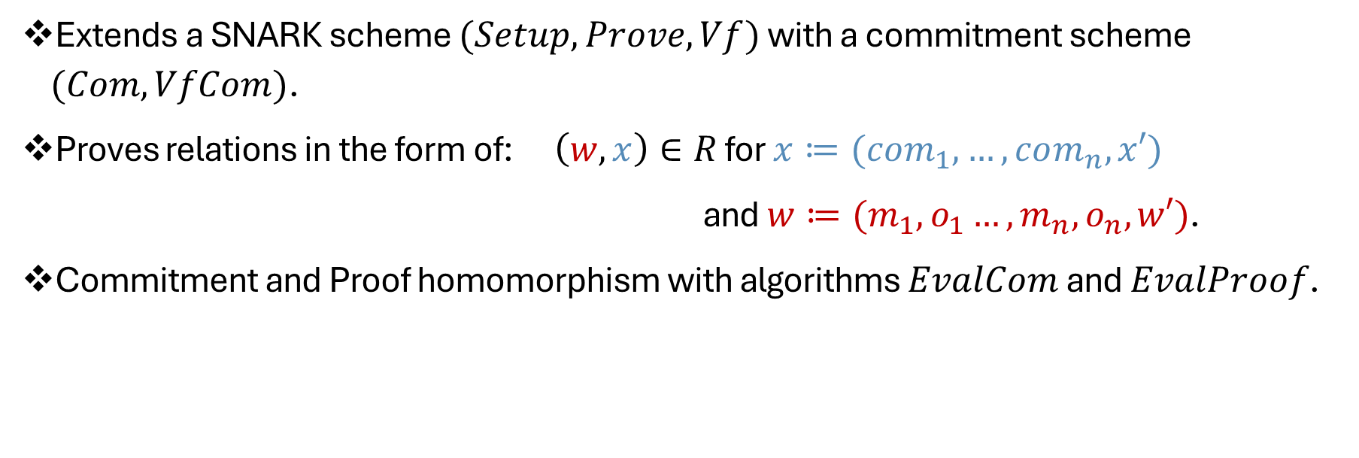
Commit-and-Prove SNARKs
Extends a SNARK scheme $(Setup,Prove,Vf)$ with a commitment scheme $(Com,VfCom)$.
Proves relations in the form of:$\left(w,x\right)∈R$ for $x≔(com_{1},…,com_{n},x′)$
and $w≔(m_{1},o_{1}…,m_{n},o_{n},w′)$.
Commitment and Proof homomorphism with algorithms $EvalCom$ and $EvalProof$.

Slide 7


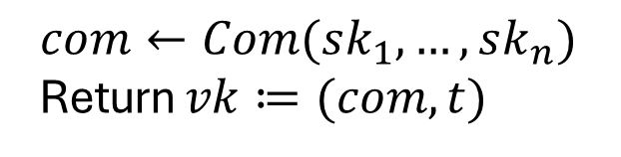
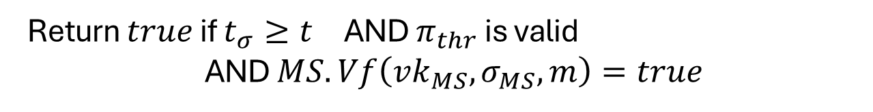
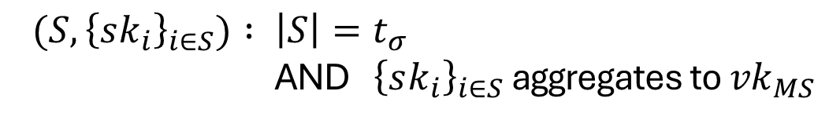
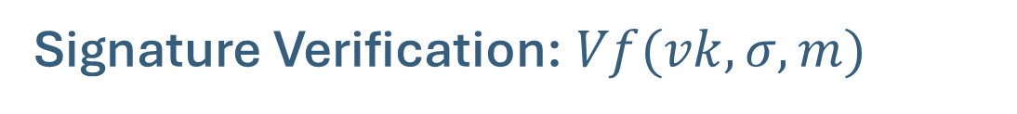
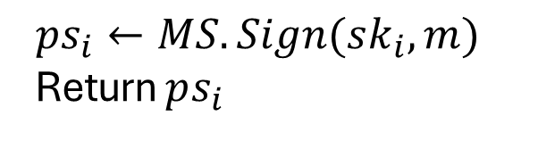

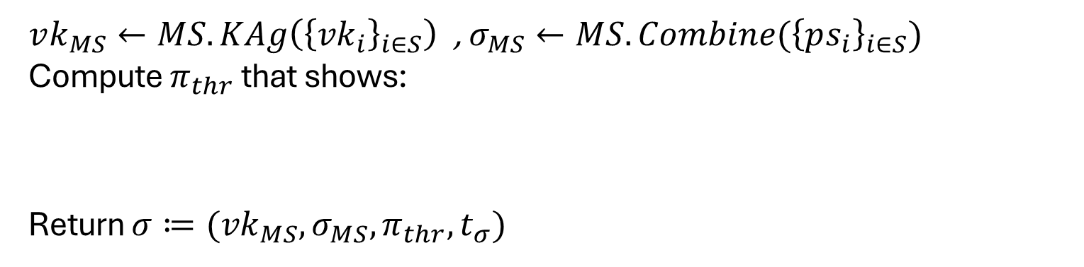

How to Construct?
Requires knowing all secret keys. How to compute?
Individual Kg
Group Kg:
Sign:
$$\left(sk_{1},vk_{1}\right)←MS.Kg()$$
$com←Com(sk_{1},…,sk_{n})$
Return $vk≔(com,t)$
$ps_{i}←MS.Sign(sk_{i},m)$
Return $ps_{i}$
$$(sk_{2},vk_{2})$$
Combine: $Combine\left(S,{\left\{ps_{i}\right\}}_{i∈S}\right)$ // $\left|S\right|=t_{σ}$
…
$vk_{MS}←MS.KAg\left({\left\{{vk}_{i}\right\}}_{i∈S}\right)$ , $σ_{MS}←MS.Combine({\left\{ps_{i}\right\}}_{i∈S})$
Compute $π_{thr}$ that shows:
Return $σ≔({vk}_{MS},σ_{MS},π_{thr},t_{σ})$
$$(sk_{n},vk_{n})$$
{
}
${(S,\left\{sk_{i}\right\}}_{i∈S}) : \left|S\right|=t_{σ}$
AND ${\left\{sk_{i}\right\}}_{i∈S}$ aggregates to ${vk}_{MS}$
$$ℛ_{thr}=$$
Signature Verification: $Vf(vk,σ,m)$
Return $true$ if $t_{σ}≥t_{}$ AND $π_{thr}$ is valid AND $MS.Vf\left(vk_{MS},σ_{MS},m\right)=true$
Notes:
During the individual key generation, each signer creates a multi-signature key pair. Also they commit to their secret keys and compute a proof showing that the committed secret key aggregates to their own individual verification key vk_1.
This proof is trivial at this stage, but later on it will be used for proving more complex statements in signature combination.
In the group key generation, we evaluate the homomorphic properties of the commitments and obtain a commitment to all secret keys as a vector. This is set as the group verification key. Also the proofs from the signers are stored to be used during the signature combination.
The signature combination takes t’ partial signatures for some t’. It will result in a signature which verifies for any t<= t’.
It creates t’-out-of-t’ aggregated multi-signatures key and the multi-signatures. Then it computes a proof showing that t’ keys which are aggregated in apk_MS were committed in vk. This is done by using the homomorphic proofs that the signers computed before. Note that we cannot compute such proof from scratch during the signature combination as the signers cannot reveal their secret keys.
In the final signature, we also have the satisfied threshold t’ so that we can verify a single signature for different thresholds.
Finally, the signature verification, the verifier checks that the wished threshold is satisfied, the multi-signature verifies, and the proof showing the correct key aggregation holds.

Slide 8

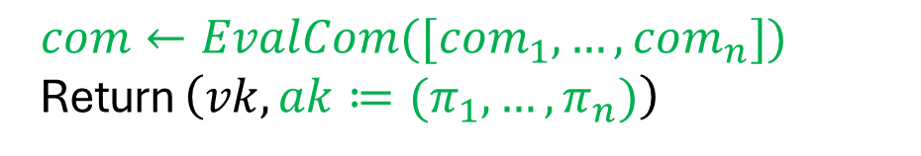
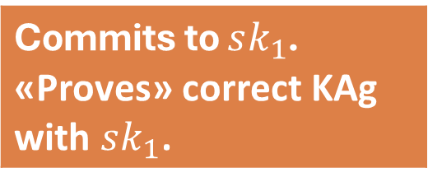

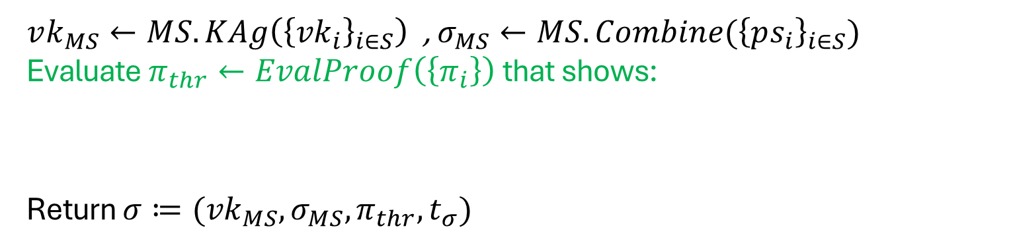

How to Construct?
Individual Kg
Group Kg:
Sign:
$$\left(sk_{1},vk_{1}\right),com_{1},π_{1}$$
$com←EvalCom([{com}_{1},…,{com}_{n}])$
Return $\left(vk,ak≔(π_{1},…,π_{n})\right)$
$ps_{i}←MS.Sign(sk_{i},m)$
Return $ps_{i}$
$$(sk_{2},vk_{2}),com_{2},π_{2}$$
Combine: $Combine\left(S,{\left\{ps_{i}\right\}}_{i∈S}\right)$ // $\left|S\right|=t_{σ}$
…
$vk_{MS}←MS.KAg\left({\left\{{vk}_{i}\right\}}_{i∈S}\right)$ , $σ_{MS}←MS.Combine({\left\{ps_{i}\right\}}_{i∈S})$
Evaluate $π_{thr}←EvalProof\left(\left\{π_{i}\right\}\right)$ that shows:
Return $σ≔({vk}_{MS},σ_{MS},π_{thr},t_{σ})$
$$(sk_{n},vk_{n}),com_{n},π_{n}$$
{
}
${(S,\left\{sk_{i}\right\}}_{i∈S}) : \left|S\right|=t_{σ}$
AND ${\left\{sk_{i}\right\}}_{i∈S}$ aggregates to ${vk}_{MS}$
$$ℛ_{thr}=$$
Commits to $sk_{1}$. «Proves» correct KAg with $sk_{1}$.
Signature Verification: $Vf(vk,σ,m)$
Return $true$ if $t_{σ}≥t_{}$ AND $π_{thr}$ is valid AND $MS.Vf\left(vk_{MS},σ_{MS},m\right)=true$
Notes:
During the individual key generation, each signer creates a multi-signature key pair. Also they commit to their secret keys and compute a proof showing that the committed secret key aggregates to their own individual verification key vk_1.
This proof is trivial at this stage, but later on it will be used for proving more complex statements in signature combination.
In the group key generation, we evaluate the homomorphic properties of the commitments and obtain a commitment to all secret keys as a vector. This is set as the group verification key. Also the proofs from the signers are stored to be used during the signature combination.
The signature combination takes t’ partial signatures for some t’. It will result in a signature which verifies for any t<= t’.
It creates t’-out-of-t’ aggregated multi-signatures key and the multi-signatures. Then it computes a proof showing that t’ keys which are aggregated in apk_MS were committed in vk. This is done by using the homomorphic proofs that the signers computed before. Note that we cannot compute such proof from scratch during the signature combination as the signers cannot reveal their secret keys.
In the final signature, we also have the satisfied threshold t’ so that we can verify a single signature for different thresholds.
Finally, the signature verification, the verifier checks that the wished threshold is satisfied, the multi-signature verifies, and the proof showing the correct key aggregation holds.

Slide 9
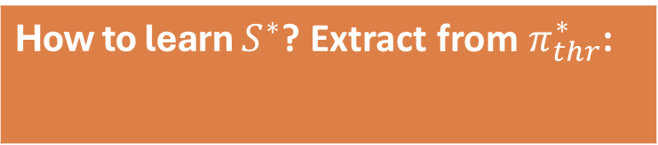

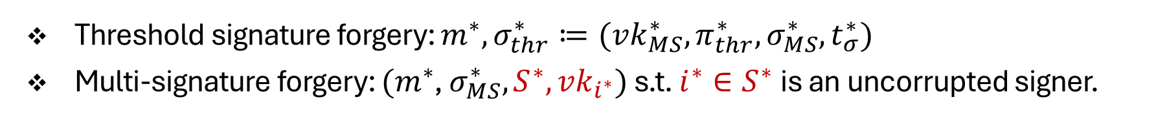

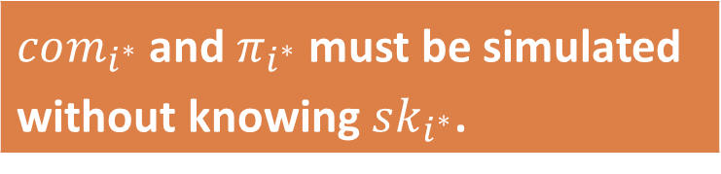
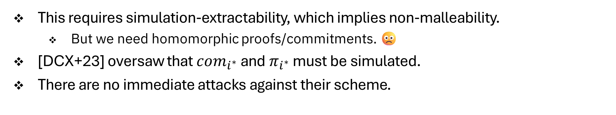
Now, How to Prove It’s Secure?
Threshold signature forgery: $m^{∗},σ_{thr}^{∗}≔(vk_{MS}^{∗},π_{thr}^{∗},σ_{MS}^{∗},t_{σ}^{∗})$
Multi-signature forgery: $(m^{∗}$, $σ_{MS}^{∗},S^{∗},vk_{i^{∗}})$ s.t. $i^{∗}∈S^{∗}$is an uncorrupted signer.
How to learn $S^{∗}$? Extract from $π_{thr}^{∗}$:
$com_{i^{∗}}$ and $π_{i^{∗}}$ must be simulated without knowing $sk_{i^{∗}}$.
{
}
$$ℛ_{thr}=$$
${(S^{∗},\left\{sk_{i}\right\}}_{i∈S}) :$ ...
This requires simulation-extractability, which implies non-malleability.
  But we need homomorphic proofs/commitments. 🙁
[DCX+23] oversaw that $com_{i^{∗}}$ and $π_{i^{∗}}$ must be simulated.
There are no immediate attacks against their scheme.

Slide 10



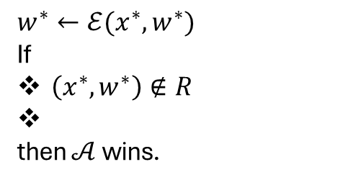

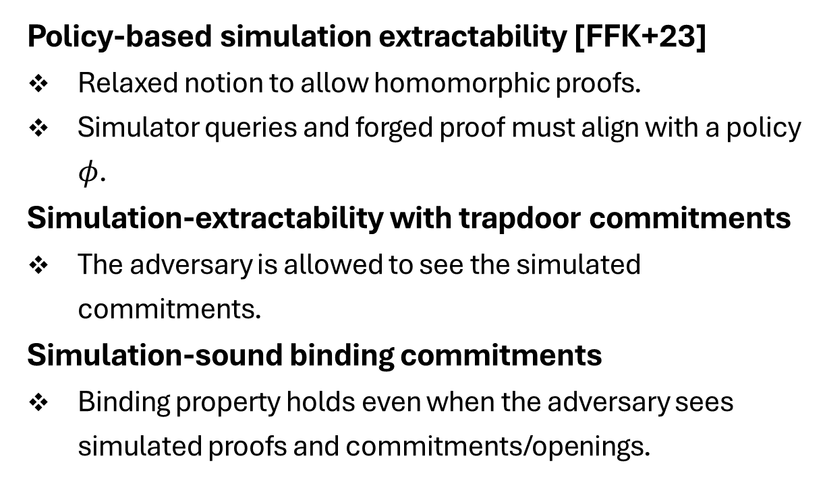







Simulation Extractability of CP-SNARKs
Policy-based simulation extractability [FFK+23]
Relaxed notion to allow homomorphic proofs.
Simulator queries and forged proof must align with a policy $φ$.
Simulation-extractability with trapdoor commitments
The adversary is allowed to see the simulated commitments.
Simulation-sound binding commitments
Binding property holds even when the adversary sees simulated proofs and commitments/openings.
SIM-EXT
$$crs$$
$$crs←Sim.Setup(λ)$$
$$x$$
$$π←Sim.Prove(x)$$
$$π$$
$$⊥/m$$
$$π←Sim.Com/Open$$
$$com/o$$
$$x^{∗},π^{∗}$$
$w^{∗}←ℰ(x^{∗},w^{∗})$
If
$\left(x^{∗},w^{∗}\right)∉R$
then $𝒜$ wins.
$φ$ holds
${(x}^{∗},π^{∗})$ is fresh
[FFK+23] Faonio et al. From Polynomial IOP and Commitments to Non-malleable zkSNARKs, (TCC’23).

Slide 11
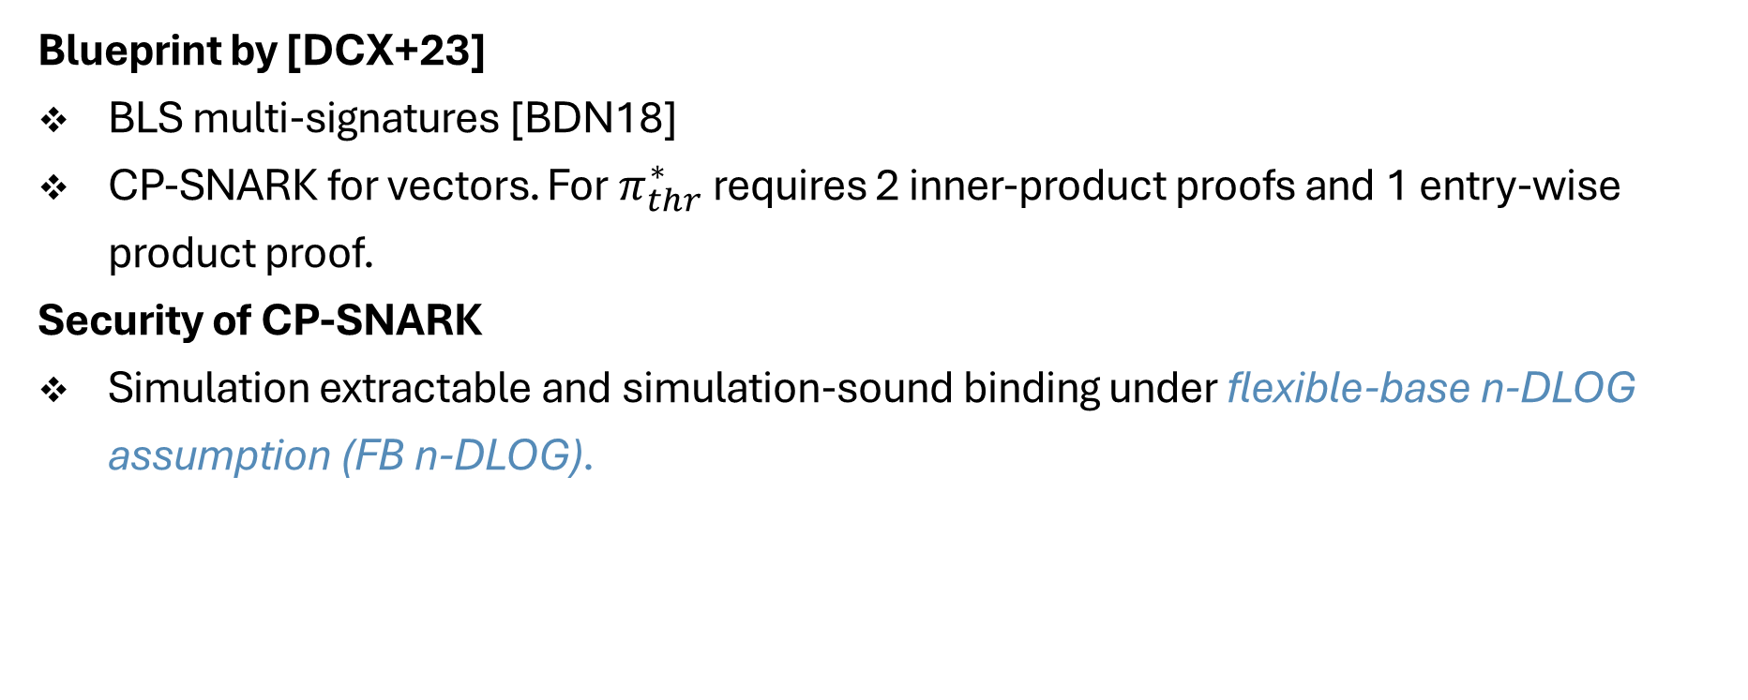
How to Instantiate?
Blueprint by [DCX+23]
BLS multi-signatures [BDN18]
CP-SNARK for vectors. For $π_{thr}^{∗}$ requires 2 inner-product proofs and 1 entry-wise product proof.
Security of CP-SNARK
Simulation extractable and simulation-sound binding under flexible-base n-DLOG assumption (FB n-DLOG).
[BDN18] Boneh et al. Compact Multi-Signatures for Smaller Blockchains, (ASIACRYPT’18).

Slide 12
Conclusion
Our framework can be used in future schemes with a similar threshold key generation approach.
  Threshold encryption [GKPW24]
  Committee-based threshold signatures [KMSS25]
Our framework can be used in future works relying on simulation-extractable CP-SNARKs.
Check the eprint: ia.cr/2025/355
[GKPW24] Garg et al. Threshold Encryption with Silent Setup, (CRYPTO’24).
[KMSS25] Kate et al. Dyna-hinTS: Silent Threshold Signatures for Dynamic Committees, (Crypto Valley’25).

