Slide 1
Dazzle: Improved Adaptive Threshold Signatures from DDH
Yanbo Chen
University of Ottawa

Slide 2








Threshold Signature
Distribute $sk$ among $n$ users
$t$ users can jointly sign
$t−1$ users cannot
$$sk$$
$$pk$$
$$sk_{1}$$
$$sk_{2}$$
$$sk_{3}$$
$$sk_{4}$$
$$sk_{5}$$

Slide 3

Security Models
Static model
  Corrupt $t−1$ users
  Then scheme is initiated
Adaptive model
  Scheme is initiated
  Then adaptively corrupt and interact

Slide 4
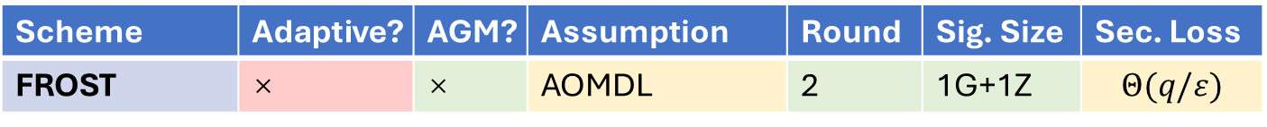
TS in Pairing-Free DL Setting
FROST [Komlo-Goldberg’20]
  Threshold Schnorr
  Statically secure from interactive assumption
Scheme | Adaptive? | AGM? | Assumption | Round | Sig. Size | Sec. Loss
FROST | × | × | AOMDL | 2 | 1G+1Z | $$Θ(q/ε)$$

Slide 5
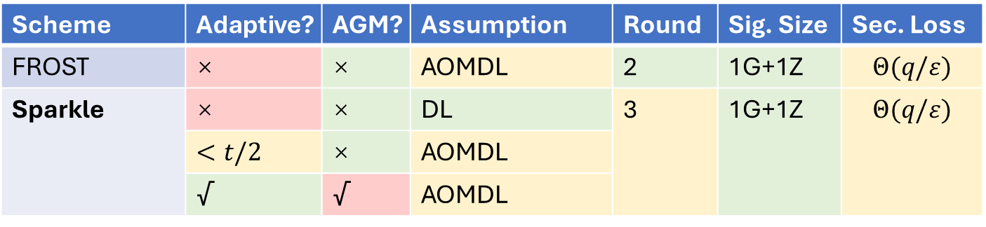
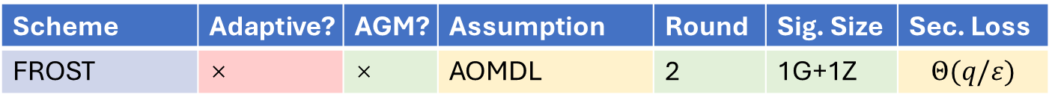
Adaptive TS in Pairing-Free DL Setting
Sparkle [Crites-Komlo-Maller’23]
  Threshold Schnorr
  Partially adaptively secure from interactive assumption
  Adaptively secure from interactive assumption + AGM
Scheme | Adaptive? | AGM? | Assumption | Round | Sig. Size | Sec. Loss
FROST | × | × | AOMDL | 2 | 1G+1Z | $$Θ(q/ε)$$
Scheme | Adaptive? | AGM? | Assumption | Round | Sig. Size | Sec. Loss
FROST | × | × | AOMDL | 2 | 1G+1Z | $$Θ(q/ε)$$
Sparkle | × | × | DL | 3 | 1G+1Z | $$Θ(q/ε)$$
 | $<t/2$ | × | AOMDL
 | √ | √ | AOMDL

Slide 6
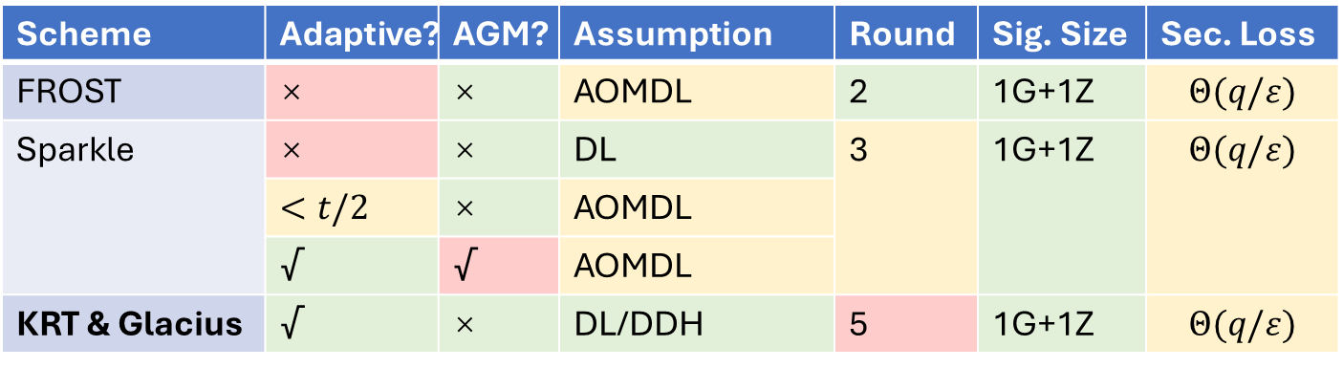
Adaptive TS in Pairing-Free DL Setting
Recently [Katsumata-Reichle-Takemure’24, Bacho-Das-Loss-Ren’25]
  Adaptively secure from standard assumption
  5-Round
Scheme | Adaptive? | AGM? | Assumption | Round | Sig. Size | Sec. Loss
FROST | × | × | AOMDL | 2 | 1G+1Z | $$Θ(q/ε)$$
Sparkle | × | × | DL | 3 | 1G+1Z | $$Θ(q/ε)$$
 | $<t/2$ | × | AOMDL
 | √ | √ | AOMDL
KRT & Glacius | √ | × | DL/DDH | 5 | 1G+1Z | $$Θ(q/ε)$$

Slide 7
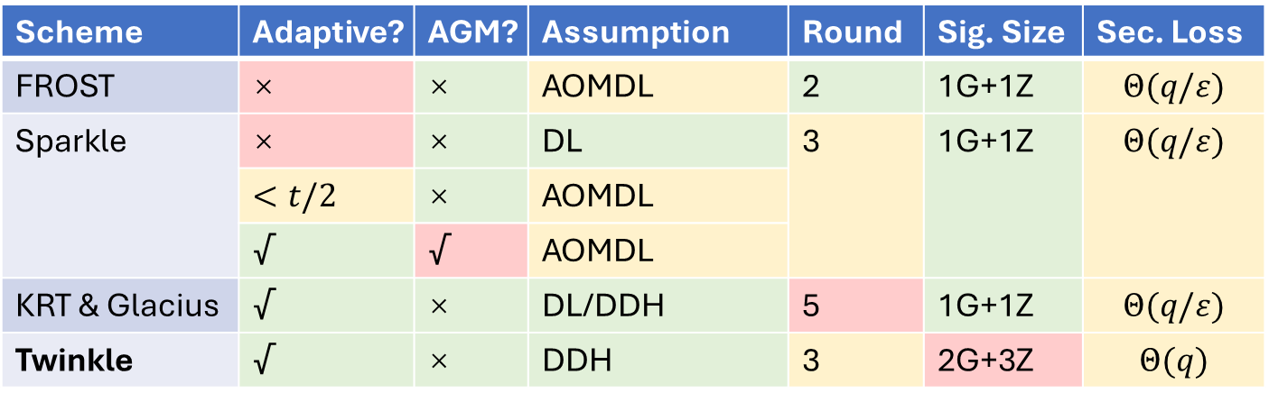
Adaptive TS in Pairing-Free DL Setting
Twinkle [Bacho-Loss-Tessaro-Wagner-Zhu’24]
  Not Schnorr
  Adaptively secure from DDH
Scheme | Adaptive? | AGM? | Assumption | Round | Sig. Size | Sec. Loss
FROST | × | × | AOMDL | 2 | 1G+1Z | $$Θ(q/ε)$$
Sparkle | × | × | DL | 3 | 1G+1Z | $$Θ(q/ε)$$
 | $<t/2$ | × | AOMDL
 | √ | √ | AOMDL
KRT & Glacius | √ | × | DL/DDH | 5 | 1G+1Z | $$Θ(q/ε)$$
Twinkle | √ | × | DDH | 3 | 2G+3Z | $$Θ(q)$$

Slide 8
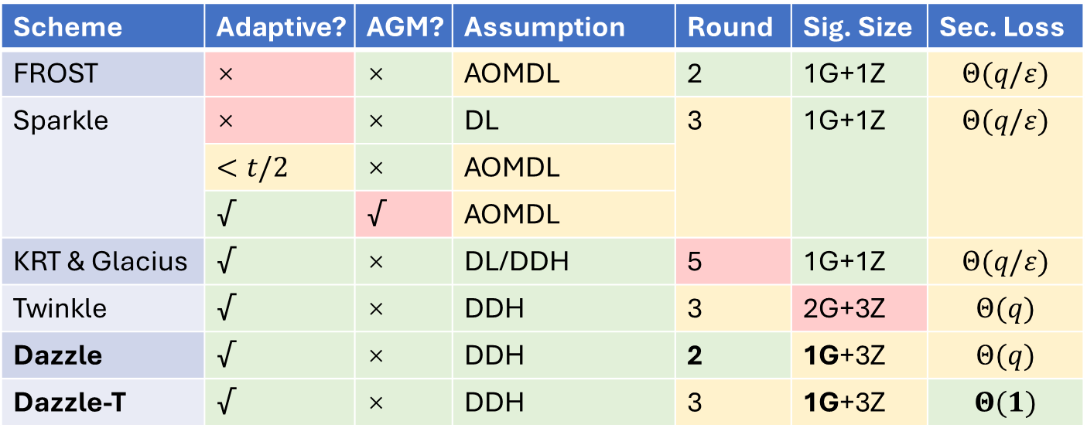
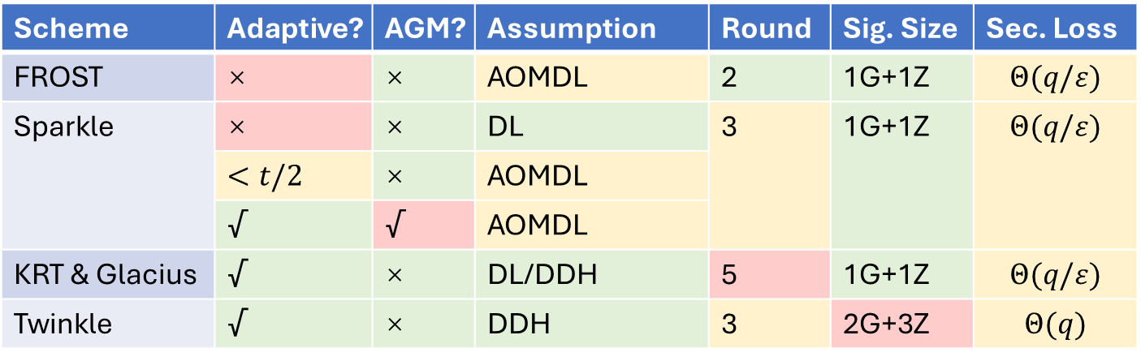
This Work
Dazzle and Dazzle-T
  Adaptively secure from DDH
  Smaller signatures
  Dazzle: 2-round
  Dazzle-T: fully tight
Scheme | Adaptive? | AGM? | Assumption | Round | Sig. Size | Sec. Loss
FROST | × | × | AOMDL | 2 | 1G+1Z | $$Θ(q/ε)$$
Sparkle | × | × | DL | 3 | 1G+1Z | $$Θ(q/ε)$$
 | $<t/2$ | × | AOMDL
 | √ | √ | AOMDL
KRT & Glacius | √ | × | DL/DDH | 5 | 1G+1Z | $$Θ(q/ε)$$
Twinkle | √ | × | DDH | 3 | 2G+3Z | $$Θ(q)$$
Scheme | Adaptive? | AGM? | Assumption | Round | Sig. Size | Sec. Loss
FROST | × | × | AOMDL | 2 | 1G+1Z | $$Θ(q/ε)$$
Sparkle | × | × | DL | 3 | 1G+1Z | $$Θ(q/ε)$$
 | $<t/2$ | × | AOMDL
 | √ | √ | AOMDL
KRT & Glacius | √ | × | DL/DDH | 5 | 1G+1Z | $$Θ(q/ε)$$
Twinkle | √ | × | DDH | 3 | 2G+3Z | $$Θ(q)$$
Dazzle | √ | × | DDH | 2 | 1G+3Z | $$Θ(q)$$
Dazzle-T | √ | × | DDH | 3 | 1G+3Z | $$Θ(1)$$

Slide 9
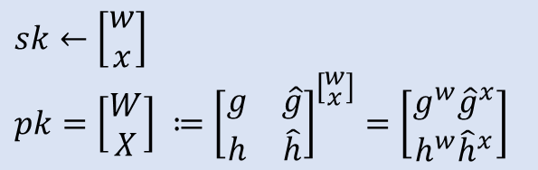
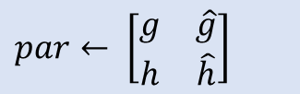
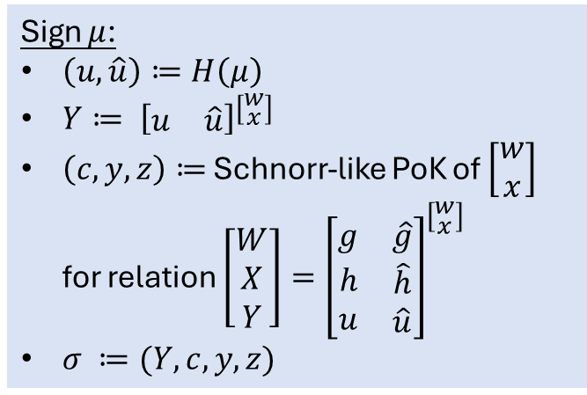
Underlying Standard Signature Scheme
$par← \left[\begin{matrix}g & \hat{g} \\ h & \hat{h}\end{matrix}\right]$
$sk←\left[\begin{aligned}w \\ x\end{aligned}\right]$
$pk=\left[\begin{aligned}W \\ X\end{aligned}\right] ≔{\left[\begin{matrix}g & \hat{g} \\ h & \hat{h}\end{matrix}\right]}^{\left[\begin{aligned}w \\ x\end{aligned}\right]}=\left[\begin{aligned}g^{w}{\hat{g}}^{x} \\ h^{w}{\hat{h}}^{x}\end{aligned}\right]$
Sign $μ$:
$\left(u, \hat{u}\right)≔H\left(μ\right)$
$Y≔ {\left[\begin{matrix}u & \hat{u}\end{matrix}\right]}^{\left[\begin{aligned}w \\ x\end{aligned}\right]}$
$\left(c, y, z\right)≔$ Schnorr-like PoK of $\left[\begin{aligned}w \\ x\end{aligned}\right]$ for relation $\left[\begin{aligned}W \\ X \\ Y\end{aligned}\right]={\left[\begin{matrix}g & \hat{g} \\ \begin{aligned}h \\ u\end{aligned} & \begin{aligned}\hat{h} \\ \hat{u}\end{aligned}\end{matrix}\right]}^{\left[\begin{aligned}w \\ x\end{aligned}\right]}$
$σ ≔(Y, c, y, z)$

Slide 10
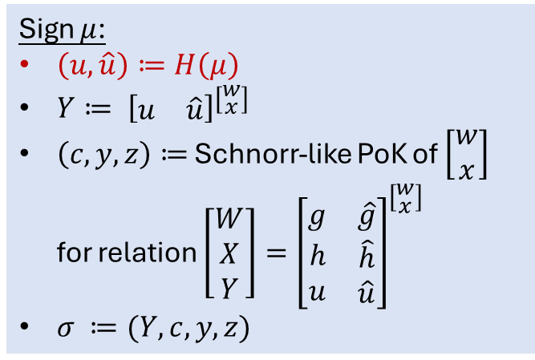
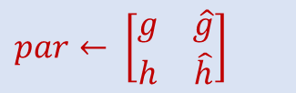
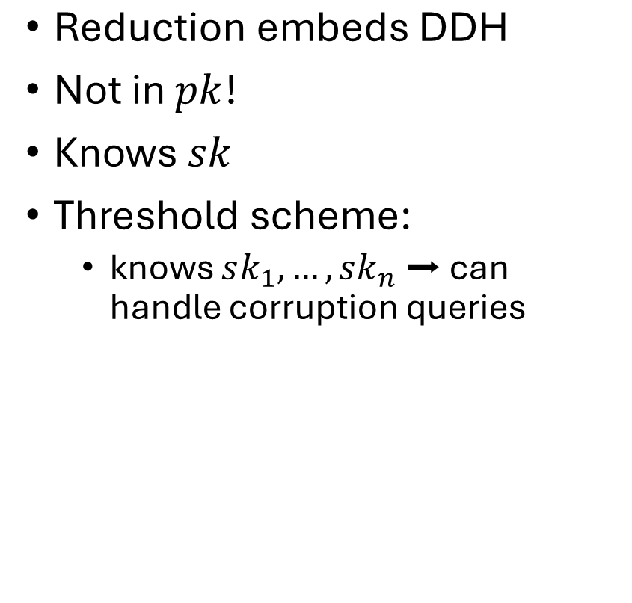
Security
$par← \left[\begin{matrix}g & \hat{g} \\ h & \hat{h}\end{matrix}\right]$
$sk←\left[\begin{aligned}w \\ x\end{aligned}\right]$
$pk=\left[\begin{aligned}W \\ X\end{aligned}\right] ≔{\left[\begin{matrix}g & \hat{g} \\ h & \hat{h}\end{matrix}\right]}^{\left[\begin{aligned}w \\ x\end{aligned}\right]}=\left[\begin{aligned}g^{w}{\hat{g}}^{x} \\ h^{w}{\hat{h}}^{x}\end{aligned}\right]$
$\text{R}\text{eduction} \text{embeds} \text{DDH}$
Not in $pk$!
Knows $sk$
Threshold scheme:
  knows $sk_{1}, …, sk_{n}$ ➡ can handle corruption queries
Sign $μ$:
$\left(u, \hat{u}\right)≔H\left(μ\right)$
$Y≔ {\left[\begin{matrix}u & \hat{u}\end{matrix}\right]}^{\left[\begin{aligned}w \\ x\end{aligned}\right]}$
$\left(c, y, z\right)≔$ Schnorr-like PoK of $\left[\begin{aligned}w \\ x\end{aligned}\right]$ for relation $\left[\begin{aligned}W \\ X \\ Y\end{aligned}\right]={\left[\begin{matrix}g & \hat{g} \\ \begin{aligned}h \\ u\end{aligned} & \begin{aligned}\hat{h} \\ \hat{u}\end{aligned}\end{matrix}\right]}^{\left[\begin{aligned}w \\ x\end{aligned}\right]}$
$σ ≔(Y, c, y, z)$

Slide 11


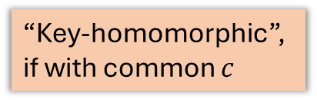

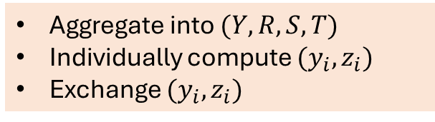
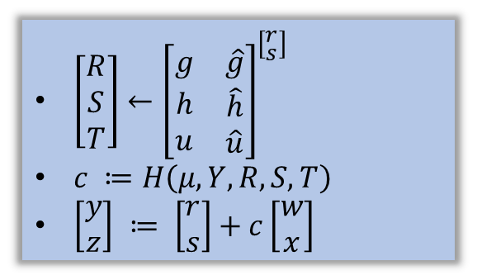
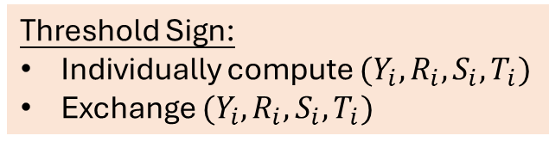
Dazzle: Threshold Scheme
$sk←\left[\begin{aligned}w \\ x\end{aligned}\right]$
$par← \left[\begin{matrix}g & \hat{g} \\ h & \hat{h}\end{matrix}\right]$
$sk←\left[\begin{aligned}w \\ x\end{aligned}\right]$
$pk=\left[\begin{aligned}W \\ X\end{aligned}\right] ≔{\left[\begin{matrix}g & \hat{g} \\ h & \hat{h}\end{matrix}\right]}^{\left[\begin{aligned}w \\ x\end{aligned}\right]}=\left[\begin{aligned}g^{w}{\hat{g}}^{x} \\ h^{w}{\hat{h}}^{x}\end{aligned}\right]$
$sk_{1}←\left[\begin{aligned}w_{1} \\ x_{1}\end{aligned}\right]$
…
$sk_{n}←\left[\begin{aligned}w_{n} \\ x_{n}\end{aligned}\right]$
Sign $μ$:
$\left(u, \hat{u}\right)≔H\left(μ\right)$
$Y≔ {\left[\begin{matrix}u & \hat{u}\end{matrix}\right]}^{\left[\begin{aligned}w \\ x\end{aligned}\right]}$
$\left(c, y, z\right)≔$ Schnorr-like PoK of $\left[\begin{aligned}w \\ x\end{aligned}\right]$ for relation $\left[\begin{aligned}W \\ X \\ Y\end{aligned}\right]={\left[\begin{matrix}g & \hat{g} \\ \begin{aligned}h \\ u\end{aligned} & \begin{aligned}\hat{h} \\ \hat{u}\end{aligned}\end{matrix}\right]}^{\left[\begin{aligned}w \\ x\end{aligned}\right]}$
$σ ≔(Y, c, y, z)$
“Key-homomorphic”, if with common $c$
$\left[\begin{aligned}R \\ S \\ T\end{aligned}\right]←{\left[\begin{matrix}g & \hat{g} \\ \begin{aligned}h \\ u\end{aligned} & \begin{aligned}\hat{h} \\ \hat{u}\end{aligned}\end{matrix}\right]}^{\left[\begin{aligned}r \\ s\end{aligned}\right]}$
$c ≔H\left(μ, Y, R, S, T\right)$
$\left[\begin{aligned}y \\ z\end{aligned}\right] ≔ \left[\begin{aligned}r \\ s\end{aligned}\right]+c\left[\begin{aligned}w \\ x\end{aligned}\right]$
Threshold Sign:
Individually compute $(Y_{i}, R_{i}, S_{i}, T_{i})$
Exchange $(Y_{i}, R_{i}, S_{i}, T_{i})$
Aggregate into $(Y, R, S, T)$
Individually compute $(y_{i}, z_{i})$
Exchange $(y_{i}, z_{i})$

Slide 12
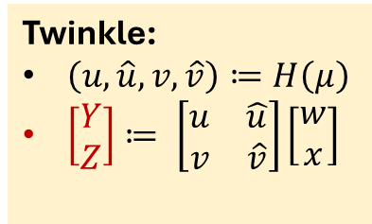
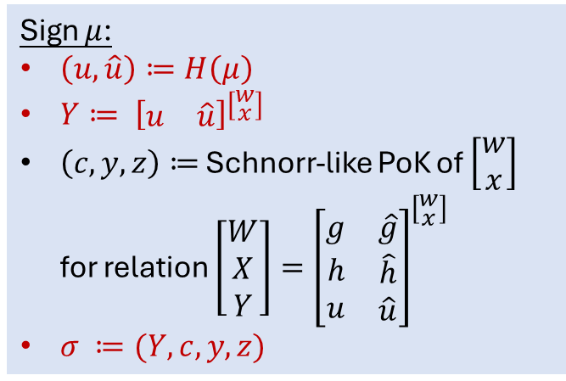
Improvements over Twinkle
$par← \left[\begin{matrix}g & \hat{g} \\ h & \hat{h}\end{matrix}\right]$
$sk←\left[\begin{aligned}w \\ x\end{aligned}\right]$
$pk=\left[\begin{aligned}W \\ X\end{aligned}\right] ≔{\left[\begin{matrix}g & \hat{g} \\ h & \hat{h}\end{matrix}\right]}^{\left[\begin{aligned}w \\ x\end{aligned}\right]}=\left[\begin{aligned}g^{w}{\hat{g}}^{x} \\ h^{w}{\hat{h}}^{x}\end{aligned}\right]$
Sign $μ$:
$\left(u, \hat{u}\right)≔H\left(μ\right)$
$Y≔ {\left[\begin{matrix}u & \hat{u}\end{matrix}\right]}^{\left[\begin{aligned}w \\ x\end{aligned}\right]}$
$\left(c, y, z\right)≔$ Schnorr-like PoK of $\left[\begin{aligned}w \\ x\end{aligned}\right]$ for relation $\left[\begin{aligned}W \\ X \\ Y\end{aligned}\right]={\left[\begin{matrix}g & \hat{g} \\ \begin{aligned}h \\ u\end{aligned} & \begin{aligned}\hat{h} \\ \hat{u}\end{aligned}\end{matrix}\right]}^{\left[\begin{aligned}w \\ x\end{aligned}\right]}$
$σ ≔(Y, c, y, z)$
Twinkle:
$\left(u, \hat{u}, v, \hat{v}\right)≔H\left(μ\right)$
$\left[\begin{aligned}Y \\ Z\end{aligned}\right]≔ \left[\begin{matrix}\begin{aligned}u \\ v\end{aligned} & \hat{\begin{aligned}u \\ \hat{v}\end{aligned}}\end{matrix}\right]\left[\begin{aligned}w \\ x\end{aligned}\right]$

Slide 13

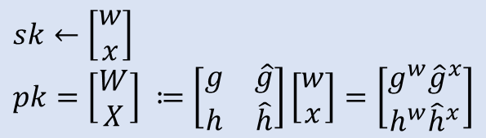
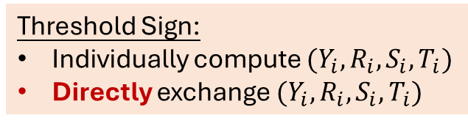
Improvements over Twinkle
$sk←\left[\begin{aligned}w \\ x\end{aligned}\right]$
$par← \left[\begin{matrix}g & \hat{g} \\ h & \hat{h}\end{matrix}\right]$
$sk←\left[\begin{aligned}w \\ x\end{aligned}\right]$
$pk=\left[\begin{aligned}W \\ X\end{aligned}\right] ≔\left[\begin{matrix}g & \hat{g} \\ h & \hat{h}\end{matrix}\right]\left[\begin{aligned}w \\ x\end{aligned}\right]=\left[\begin{aligned}g^{w}{\hat{g}}^{x} \\ h^{w}{\hat{h}}^{x}\end{aligned}\right]$
$sk_{1}←\left[\begin{aligned}w_{1} \\ x_{1}\end{aligned}\right]$
…
$sk_{n}←\left[\begin{aligned}w_{n} \\ x_{n}\end{aligned}\right]$
Sign $μ$:
$\left(u, \hat{u}\right)≔H\left(μ\right)$
$Y≔ \left[\begin{matrix}u & \hat{u}\end{matrix}\right]\left[\begin{aligned}w \\ x\end{aligned}\right]$
$\left(c, y, z\right)≔$ Schnorr-like PoK of $\left[\begin{aligned}w \\ x\end{aligned}\right]$ for relation $\left[\begin{aligned}W \\ X \\ Y\end{aligned}\right]=\left[\begin{matrix}g & \hat{g} \\ \begin{aligned}h \\ u\end{aligned} & \begin{aligned}\hat{h} \\ \hat{u}\end{aligned}\end{matrix}\right]\left[\begin{aligned}w \\ x\end{aligned}\right]$
$σ ≔(Y, c, y, z)$
$\left[\begin{aligned}R \\ S \\ T\end{aligned}\right]←{\left[\begin{matrix}g & \hat{g} \\ \begin{aligned}h \\ u\end{aligned} & \begin{aligned}\hat{h} \\ \hat{u}\end{aligned}\end{matrix}\right]}^{\left[\begin{aligned}r \\ s\end{aligned}\right]}$
$c ≔H\left(μ, Y, R, S, T\right)$
$\left[\begin{aligned}y \\ z\end{aligned}\right] ≔ \left[\begin{aligned}r \\ s\end{aligned}\right]+c\left[\begin{aligned}w \\ x\end{aligned}\right]$
Twinkle:
Exchange using commit-reveal
Threshold Sign:
Individually compute $(Y_{i}, R_{i}, S_{i}, T_{i})$
Directly exchange $(Y_{i}, R_{i}, S_{i}, T_{i})$
Aggregate into $(Y, R, S, T)$
Individually compute $(y_{i}, z_{i})$
Exchange $(y_{i}, z_{i})$

Slide 14
Commit-Reveal Or Not?
Needed if reduction uses HVZK simulator to sign
Solutions in previous work:
  AOMDL assumption
  Message-specific signing trapdoors
For us …
  Real secret key shares

Slide 15
Dazzle-T
Tight version of standard signature scheme
A direct transformation to 3-round threshold scheme …
  With a tweak to preserve tightness

Slide 16
Thanks!

