Slide 1
A Privacy-Preserving Aid Distribution System with Assessment Capabilities Or, a Case Study on Threat Modelling and System Design
Christian Knabenhans ^{EPFL}
Based on joint work with
Lucy Qin ^{Georgetown U.} Carmela Troncoso ^{EPFL+MPI-SP} Justinas Sukaitis ^{ICRC} Vincent Graf Narbel ^{ICRC}
in collaboration with

Slide 2
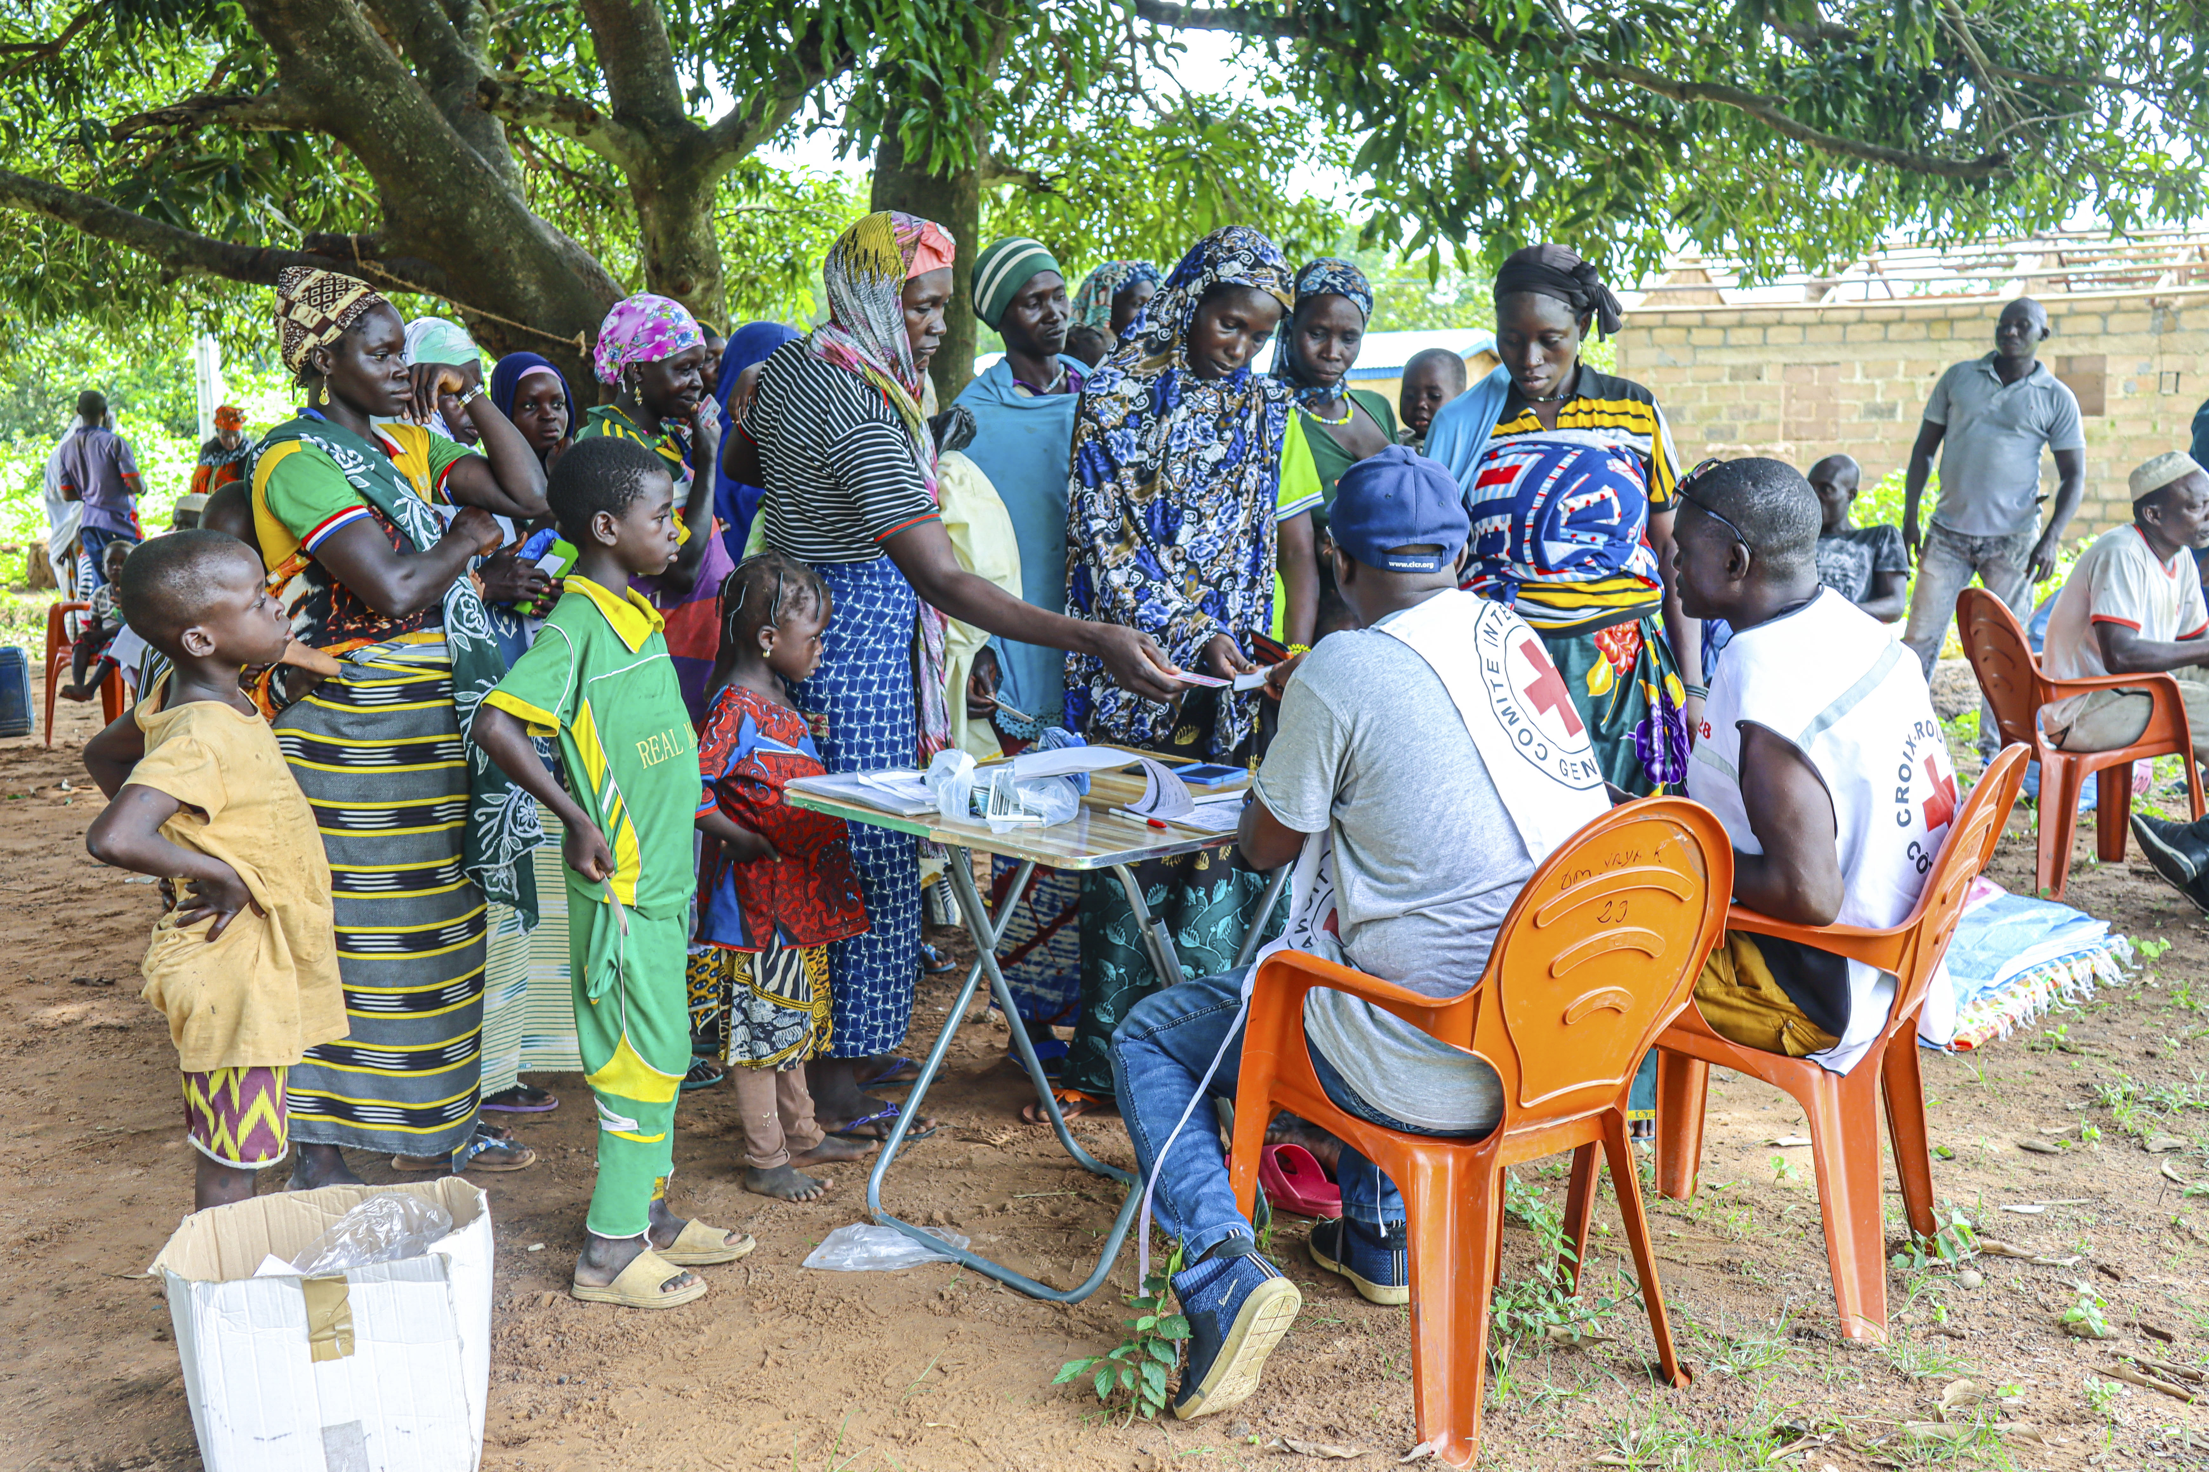
Historically a manual process, which may be slow, error-prone, and costly → strong push to digitalize
Tougbo subprefecture, 2023. The ICRC and the Red Cross Society of Côte d'Ivoire distribute essential household items to 509 households. © ICRC
Notes:
Our starting point is humanitarian aid distribution, where humanitarian organizations such as the International Committee of the Red Cross distribute aid (which can be food or medicine) to populations in need.
<CLICK> today, aid distribution is mostly a manual process with the help of pen-and-paper, which may be slow, error-prone, and costly.
So humanitarian aid organizations and donors have pushing for a digitalized aid distribution process, which they believe in turn allows them to make their aid distribution process more scalable, more impactful, and less risky for their employees and the aid recipient.
However, the aid distribution process might seem straightforward to digitalize,

Slide 3
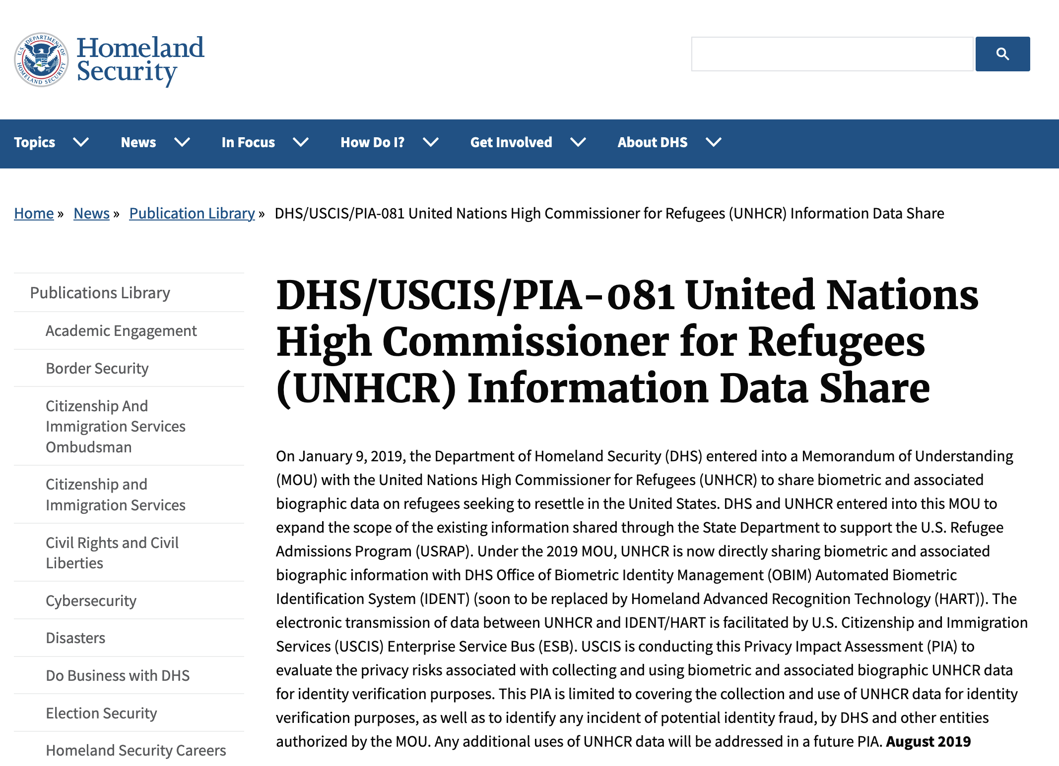
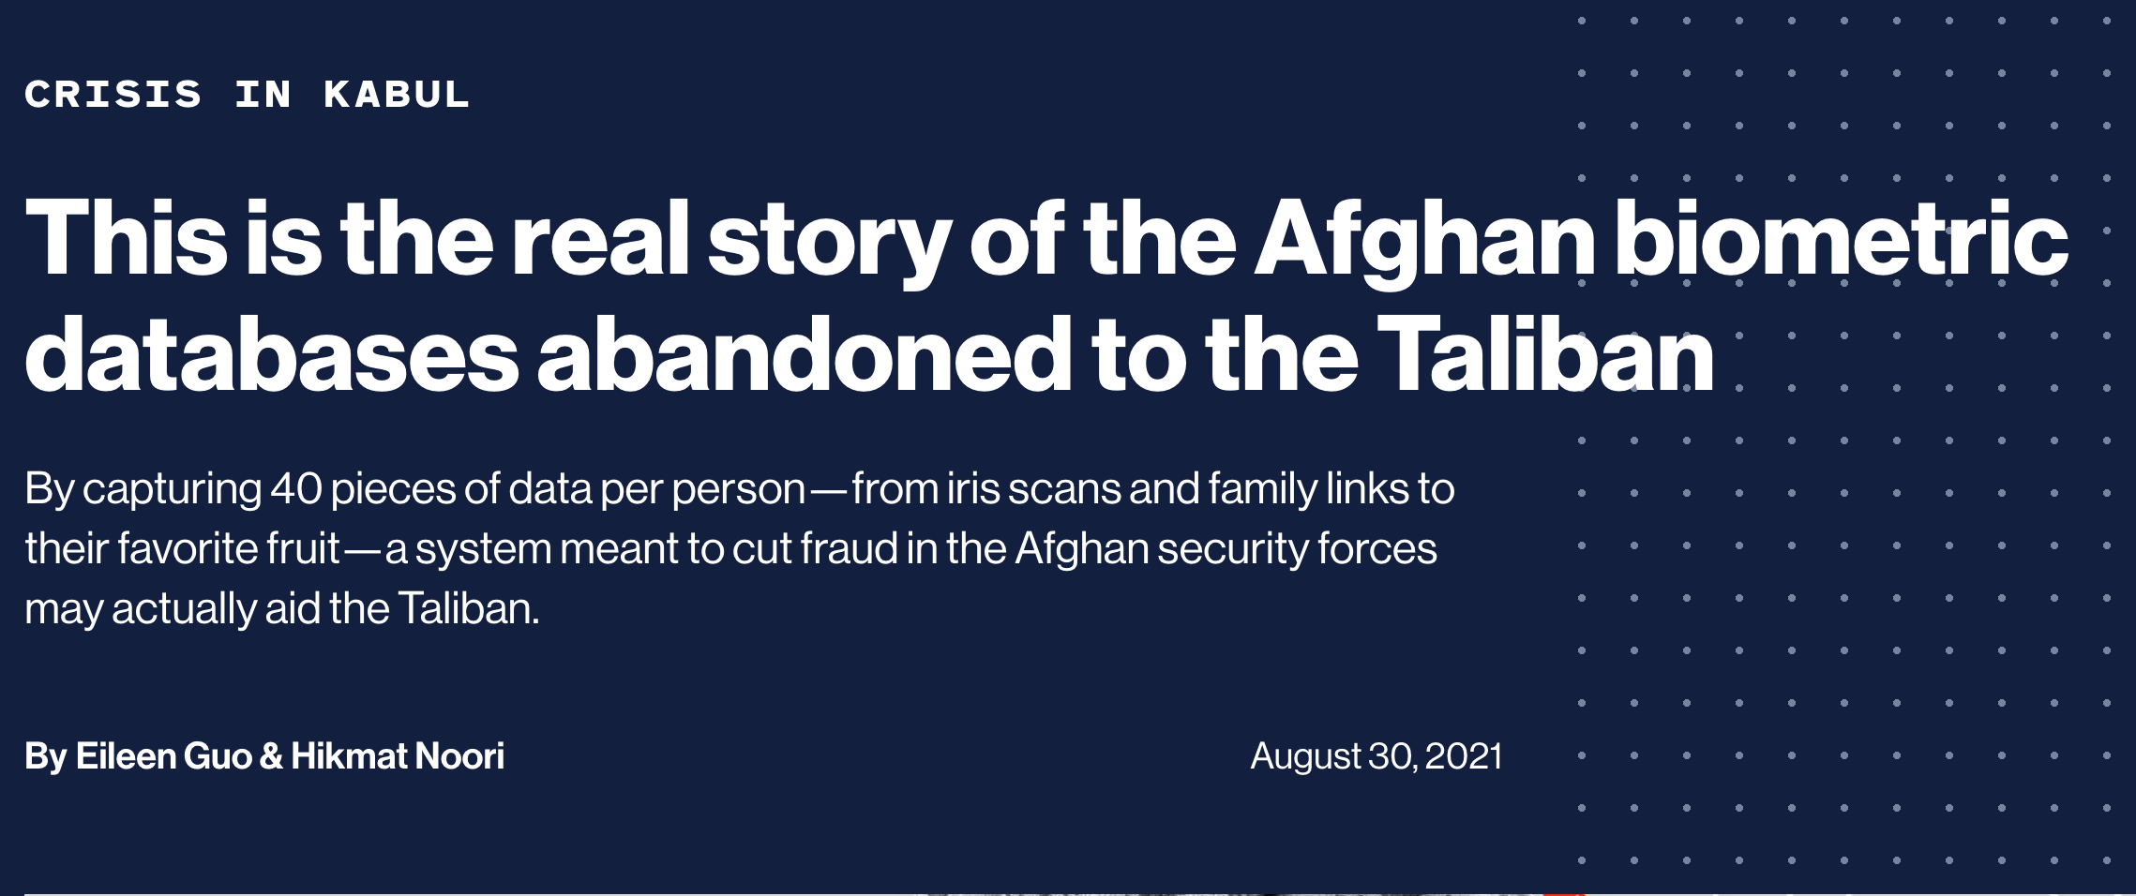
Digitalizing humanitarian action is risky
Notes:
Naïvely digitalizing existing workflows leads to enormous privacy risks and very concrete harms for aid recipients.
This is because humanitarian aid organizations are trusted by aid recipients, and have access to incredibly sensitive information about them (for example biometrics, but also marital status, pregnancy status, sexual orientation, membership in an ethnic minority). These informations, in turn, can be and have been used against the populations that the NGOs serve.

Slide 4
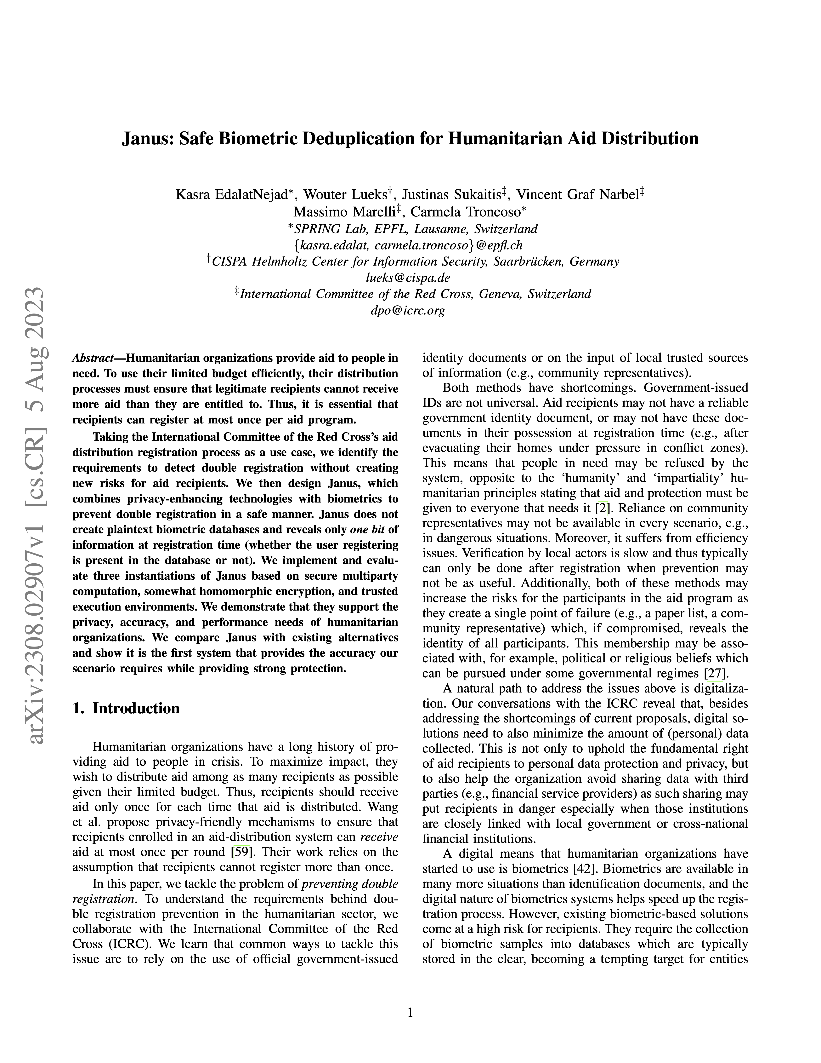
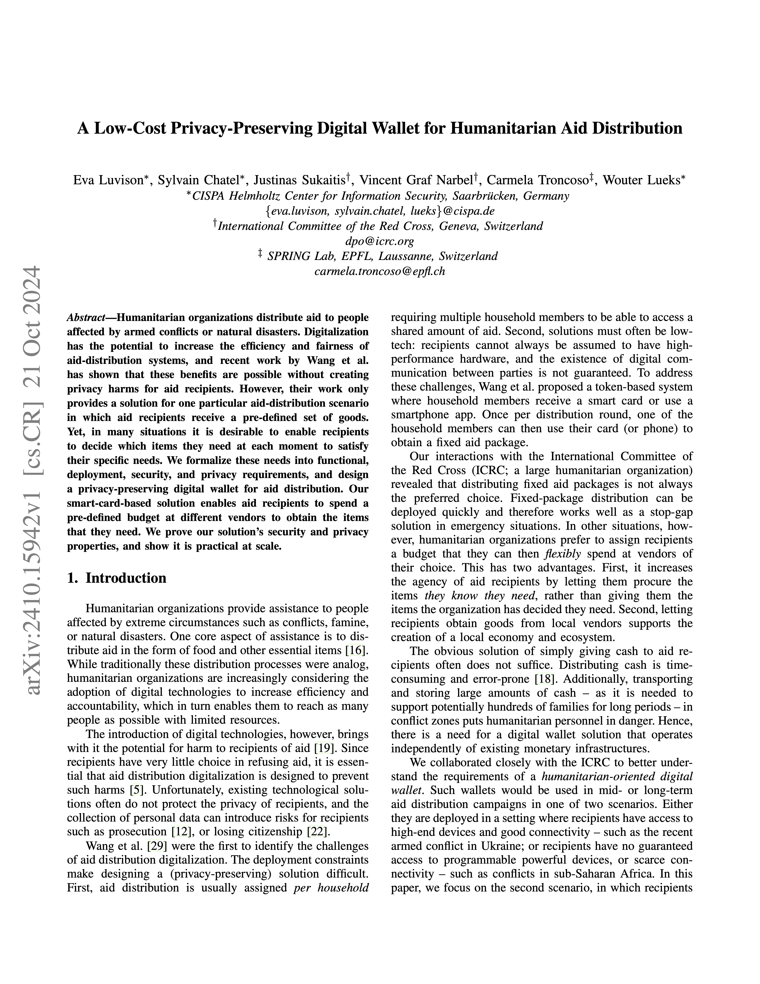
Privacy-preserving aid distribution
Anonymous credentials +blocklists
+biometrics
TEE / FHE
More anonymous credentials
Notes:
So in the past, some of former and current colleagues in Carmela Troncoso’s group have tackled this problem in collaboration with the International Committee of the Red Cross, by designing end-to-end systems that give strong security and privacy guarantees, while allowing for a more automated and scalable aid distribution process.

Slide 5
Privacy-preserving aid distribution is great, but needs assessments
“Optimal privacy is nice…
But also, we need to know whether our distribution - was successful - reached the right targets - does not discriminate“
ICRC
Notes:
The reaction of the ICRC was positive, however after some time, they came back with something like this:
“Optimal privacy is nice…
<CLICK>
But also, we need to know whether our distribution - was successful - reached the right targets - does not discriminate“

Slide 6
Real-world systems need assessments
hot take
Not an isolated case! Real-world deployments need assessments
Correctness debugging fully opaque systems is hard
Transparency towards users, donors, legislators
Planning to optimize or rectify deployments

Slide 7
Gathering requirements efficiently and from first principles

Slide 8
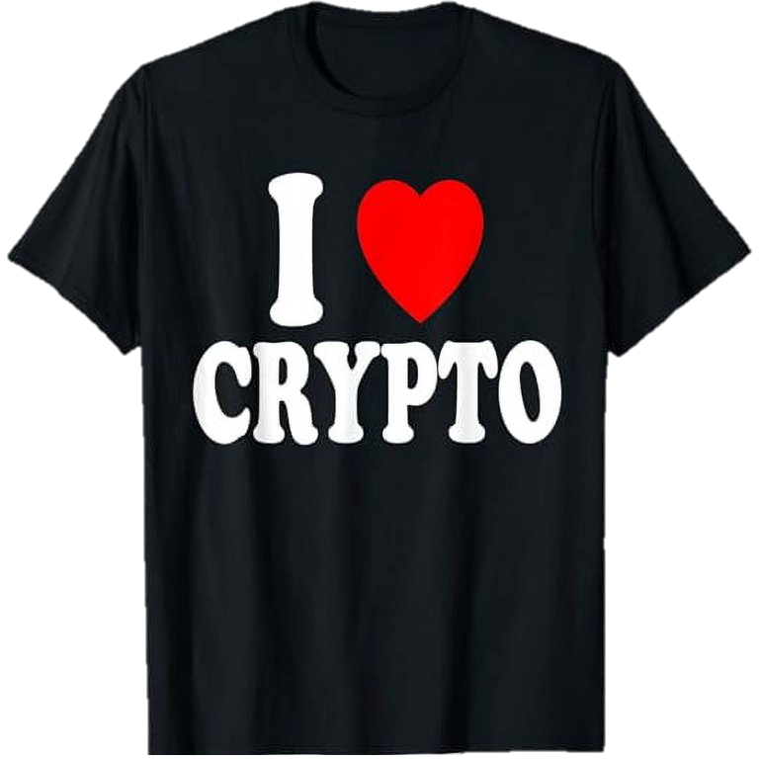
Gathering requirements
data management policies, compliance
ICRC
planning,
deployment
Data Protection Office
ICRC
aid distribution
ICRC
Program Managers
Field Employees
Notes:
So these will be the end users of our system but in general we would have loved to also speak to the aid recipients, which are also users of the system.
However, turns out that your university won’t let you go to an active disaster zone, so that will have to be for another time.

Slide 9
Gathering requirements Asking the right questions
hot take
What do you want?
Everything!
(and post-quantum please)
What do you need?
Exactly what we have now, but digital and “private”
ICRC

Slide 10
Gathering requirements Asking the right questions
hot take
How do you do things?
Functionality find out what information they actually need to do their job
Creativity cryptography is unintuitive to non-cryptographers
Boundaries we’re only designing a small part of a broader system; delineate where there should be a human-in-the-loop
Notes:
Instead, we found that asking «how do you do things?» to be much more useful. And this could be either shadowing them, really looking over their shoulder, or just precisely asking: so you arrive at the distribution station, you sit down at this plastic table. What do you do, exactly?

Slide 11
Gathering requirements Threat modelling
hot take
Privacy regulations
ICRC
What’s your threat model?
Data Protection Office
ICRC
Hunger, sickness
ICRC
Program Managers
Armed militias
Fact: people are bad at threat modelling (see: next two days of talks)
Field Employees

Slide 12
Gathering requirements Threat modelling
1. Who might interact with the system?
recipient
other recipients
auditors
nation-state
headquarters
non-state militia
other NGOs
ISP

Slide 13
Gathering requirements Threat modelling
2. What information might the system need?
biometrics
household_size
registration_date
is_pregnant
link_registration_distribution
entitlement
ethnic_group

Slide 14
Gathering requirements Threat modelling
3. What concrete harm may happen if info is available to party?
 | Parties
Info |  | + | - |  |  |  | ++ | ++ | ++
 |  |  |  |  |  | - |  | ++
 |  |  |  | + |  | - |  | ++
 |  |  |  | - |  |  | + | +
 | Parties
Info

Slide 15
Gathering requirements Threat modelling
No need to protect info, since it will leak anyway
Everything we deploy comes with some risk
Fundamental leakage, regardless of instantiation
 | Parties
Info |  | F | F |  |  |  | ++ | ++ | ++
 |  |  |  |  |  | - |  | ++
 |  |  |  | F |  | - |  | ++
 |  |  |  | F |  |  | + | +
 | Parties
Info
Risk analysis: do we want to deploy this?
Fundamental information leakage → Fundamental risk of harm
Other leakage → crypto / privacy-enhancing technologies!

Slide 16
Requirements

Slide 17
Functional requirements
registration station
distribution station
Simple assessments
“What percentage of pregnant aid recipient successfully claimed aid in this distribution?”
Full assessments
“What is the contact information of recipients above the age of 60 who haven’t claimed aid in the last 3 distribution?”
aid recipients

Slide 18
Deployment requirements Computation
registration station
distribution station
aid recipients

Slide 19
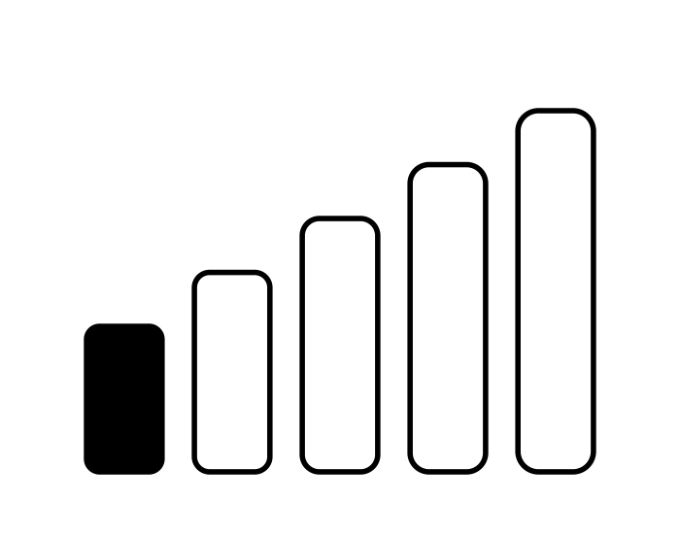
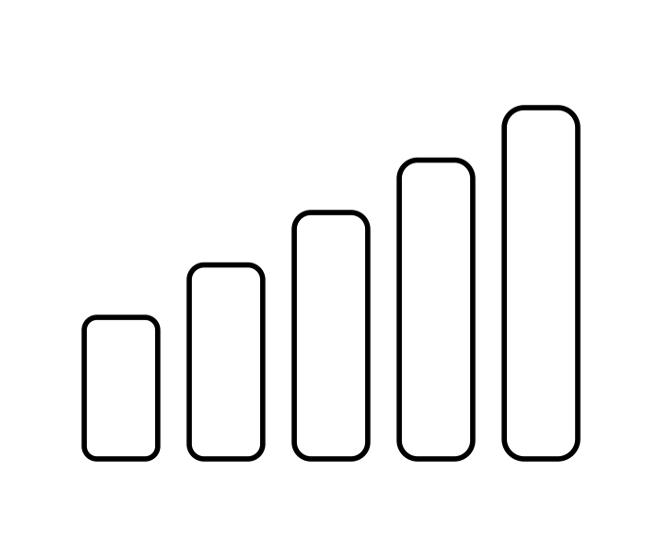
Deployment requirements Connectivity
registration station
distribution station
aid recipients

Slide 20
Deployment requirements Efficiency
registration station
distribution station
system needs to be fast → faster than distributing aid
aid recipients

Slide 21
Security requirements
Assessment unforgeability
Statistics reflect accurate distribution situation
Assessment privacy
Output parties only learn the intended statistics output

Slide 22
Meta-requirements
Agility
Threat model may be suddenly invalidated, but we might not want to deploy the strongest threat model to maximize utility
→ Need to be able to deploy strengthened protocol or safely shutdown rapidly and seamlessly
Graceful degradation
When threat model is invalidated, the system should not catastrophically collapse, but fail with minimum harm.
→ For each protocol, derive harm for all stronger threat models

Slide 23
Privacy-preserving humanitarian aid distribution with assessment capabilities

Slide 24
Adding assessments
Starting point: Functional Encryption (FE)
Attack: adversary invokes FE different subsets of inputs
Solution:
semi-honest: one-time functional encryption
malicious: bind crypto material to physical inventory, use predicate one-time functional encryption
Instantiation: PKE + signatures + {2PC, threshold HE}

Slide 25
A Privacy-Preserving Aid Distribution System with Assessment Capabilities Or, a Case Study on Threat Modelling and System Design
Christian Knabenhans ^{EPFL}
Based on joint work with
Carmela Troncoso ^{EPFL+MPI-SP} Lucy Qin ^{Georgetown U.} Justinas Sukaitis ^{ICRC} Vincent Graf Narbel ^{ICRC}
Thanks to
Boya Wang ^{EPFL+MPI-SP} Mathilde Raynal ^{EPFL} Theresa Stadler ^{EPFL} Saiid El Hajj Chehade ^{EPFL} Zayd Maradni ^{MPI-SP} Wouter Lueks ^{CISPA} Sylvain Chatel ^{CISPA} and many more…

Slide 26
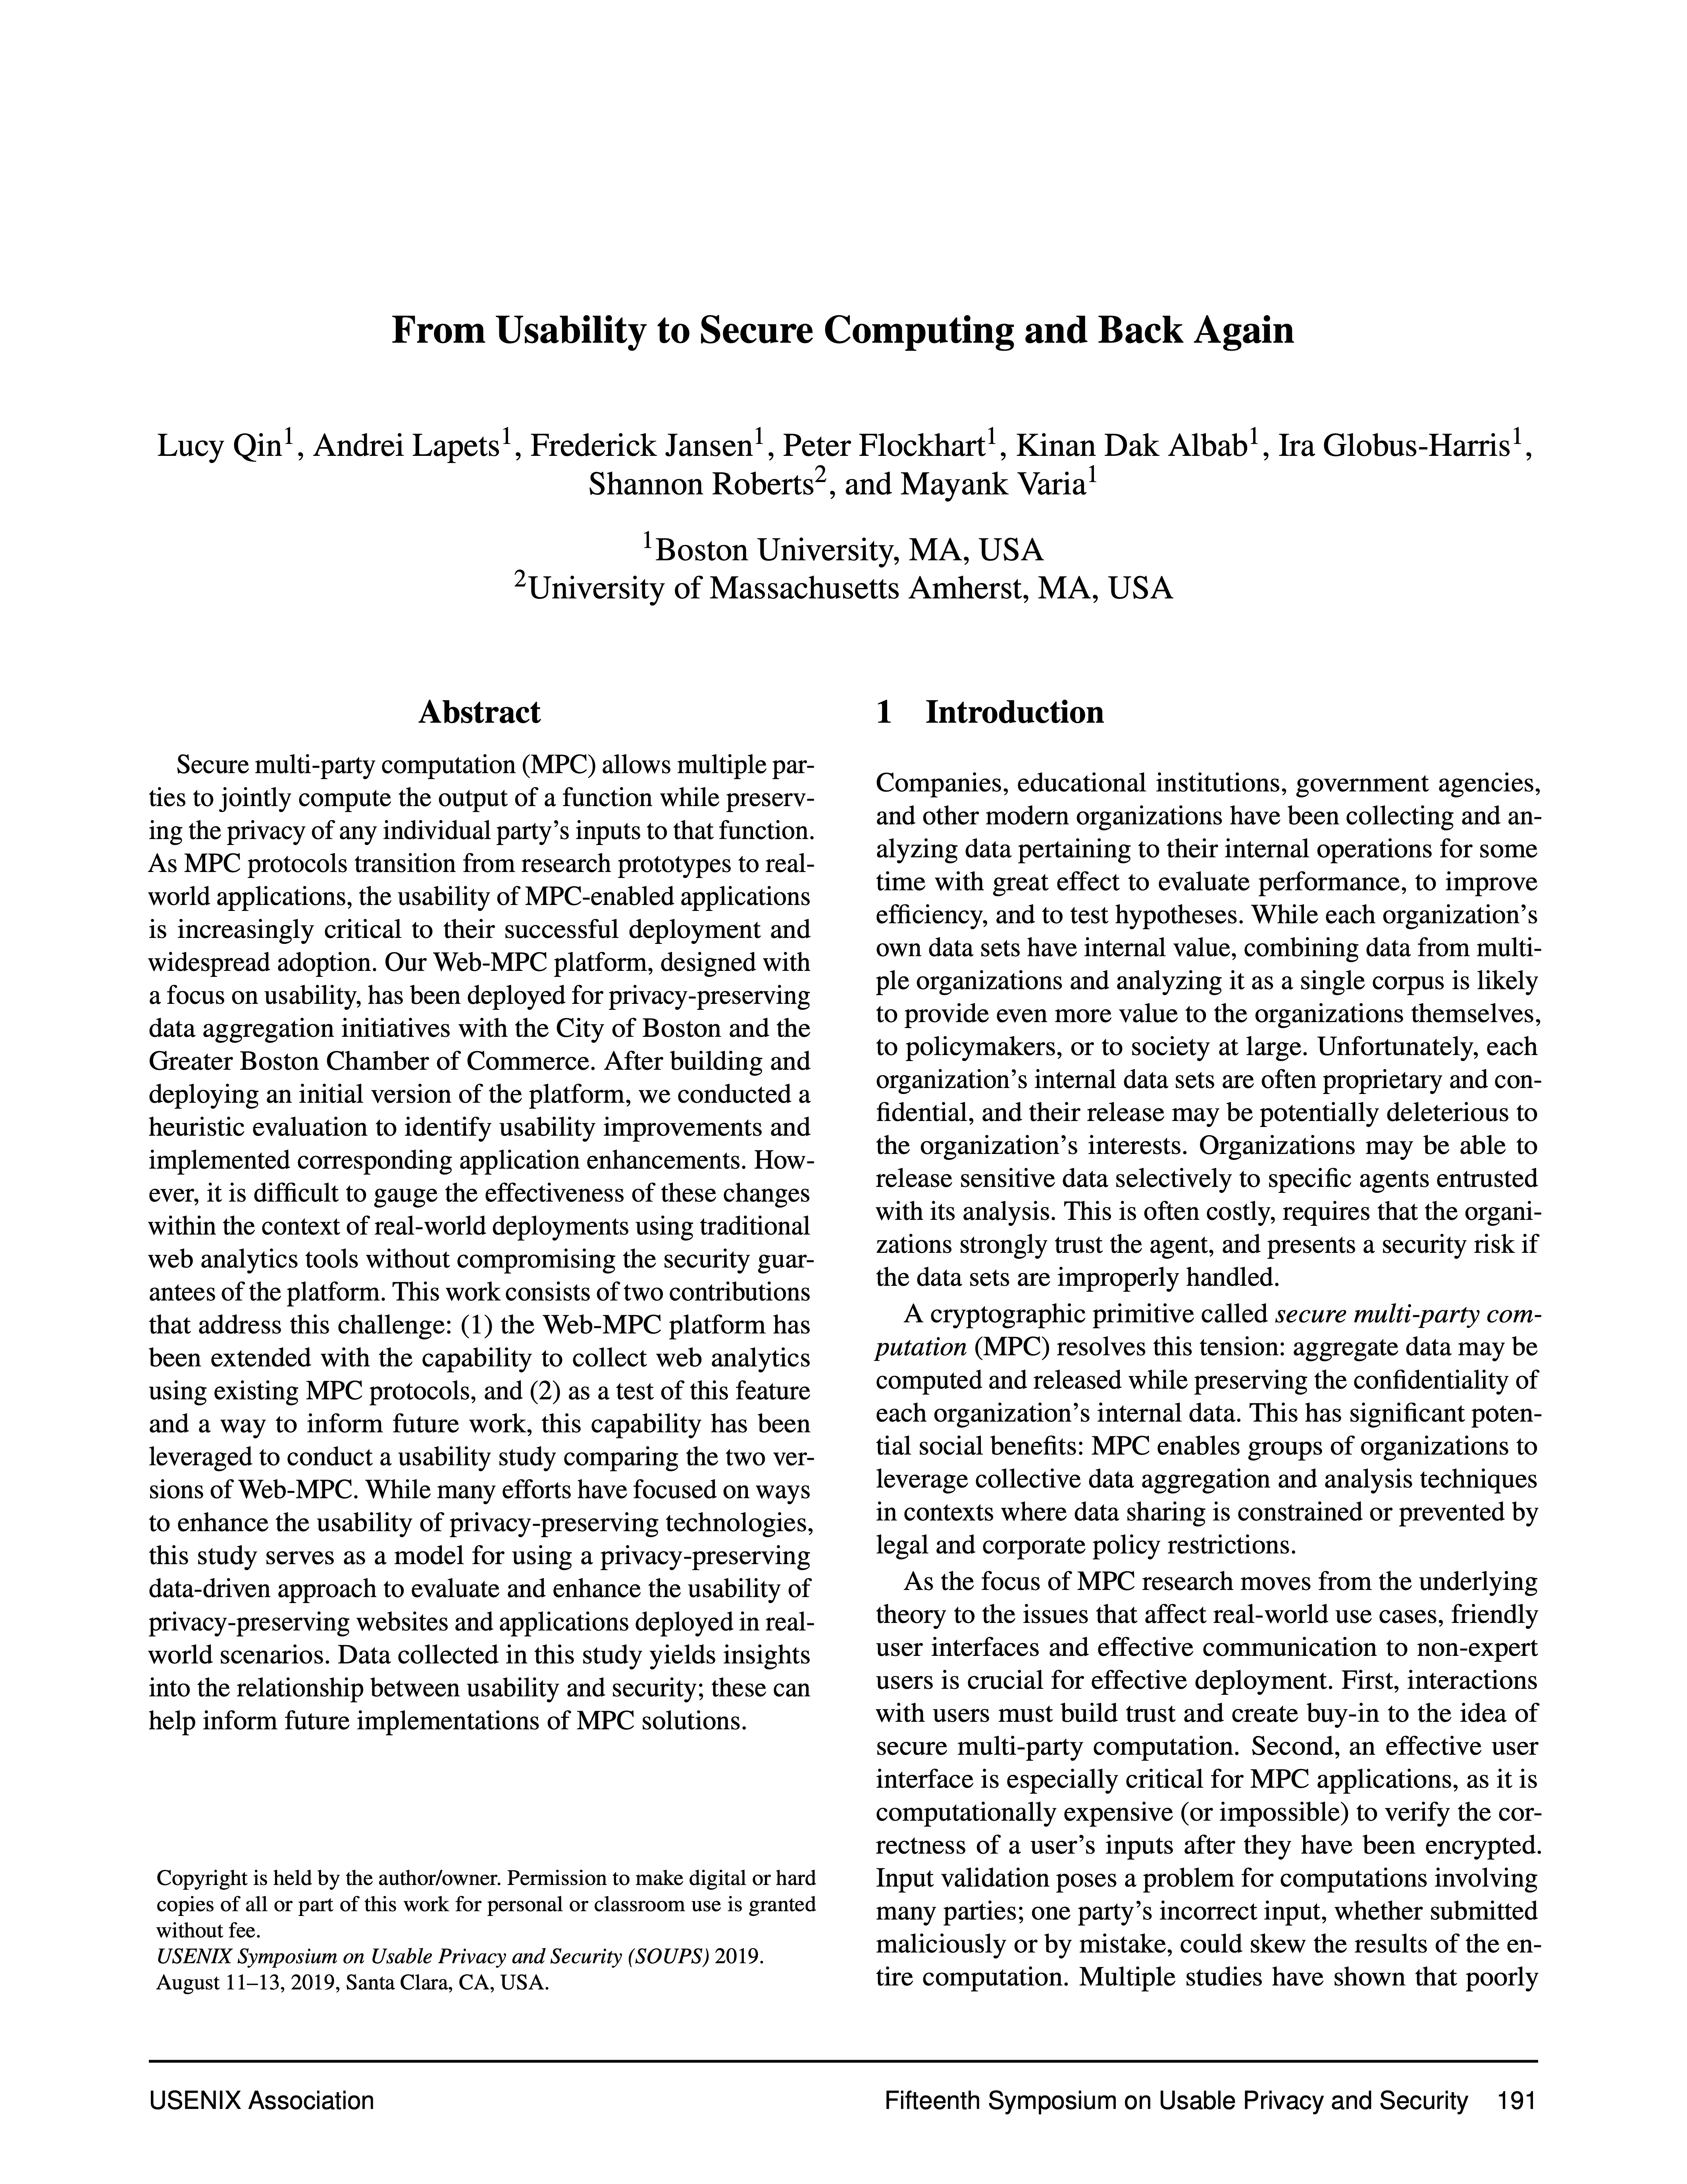
The need for assessments
#1
MPC to compute wage gap between men and women across over 100 institutions
No entity is able to view the underlying data in plaintext.
Incorrect data submission → skewed results
Mayor’s Office in Boston needed additional aggregate statistics to understand if/how mistakes may be occurring in the process of deployment to identify potential sources of error and improve the application.

Slide 27
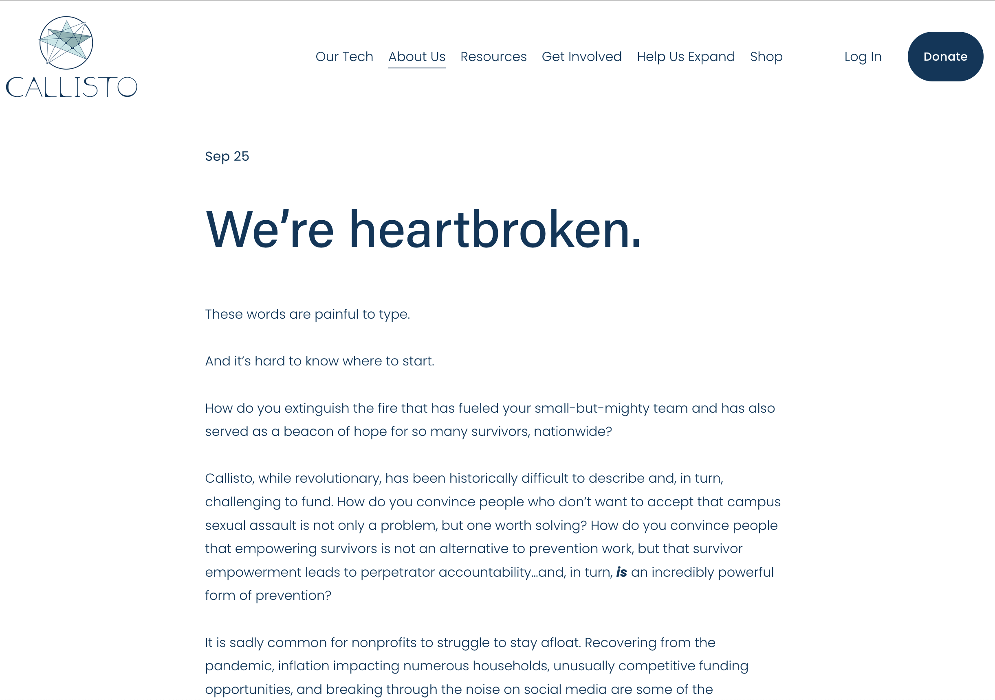
The need for assessments
#2
Securely document and match survivors of sexual assault
Strong privacy → no information about how many matches or which matches where pursued in court
Callisto almost had to shut down, because it was unable to convince its donors with impact reporting.
In some cases, perfect privacy means that the system is not deployed, leading to harm.

Slide 28
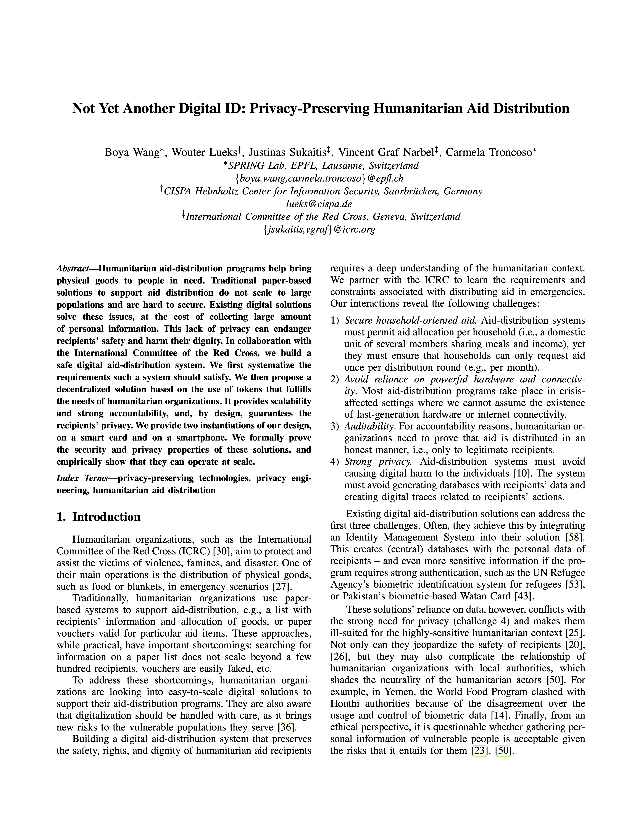
Base protocol
Recipients authenticate using biometrics
Registration station hands out anonymous credentials
At distribution, redeem credentials for aid
Blocklist to prevent double-spending

Slide 29
Adding assessments
Idea: Functional Encryption
Collect encrypted inputs during distribution, use FE to evaluate statistics.
Attack
Nothing stops the adversary of invoking FE many times for different inputs, learning more info!
→ Very generic attack, not limited to our setting

Slide 30
One-time functional encryption
1FE.Gen(1^{λ}, f) → (sk, pk)
1FE.Enc(ptxt, id, pk) → ctxt
1FE.Dec(ctxt, sk) → ptxt / ⊥
1FE.Dec(ctxt, sk):
ptxt, id = Dec(ctxt, sk)
If id has been queried before:
Output ⊥
Otherwise:
Output f(ptxt)
Inherently a stateful primitive!
For now: assume this primitive exists, will look at instantiations later

Slide 31
Protocols
Honest-but-curious station
Collect encrypted inputs during distribution, use 1FE to evaluate statistics.
Covert station
Bind cryptographic material to physical inventory, then run predicate-1FE
→ Station commits to inputs to external party and gets certificate; certificate is checked by predicate
Malicious station still sees a (single) evaluation

Slide 32
Extensions
Thresholding stats reduces leakage for single evaluation
Kill-switches HQ can decide to abort statistics (but continue distribution)
Malicious recipients add zero-knowledge proofs that recipient info is consistent with their credential

Slide 33
Realizing 1FE
2-Party Computation
Adversary is also communication channel → PKE
TTP can be instantiated by ICRC HQ; they need to keep state, but will not learn about inputs/intermediary steps
Threshold Homomorphic Enc.
Recipients act as a natural “one-time” mechanism
pk-encryption for input collection, homomorphically evaluate statistics

