Slide 1
Provably Secure End-to-End Encrypted Cloud Storage
Matilda Backendal¹, Hannah Davis², Felix Günther³, Miro Haller⁴, Kenny Paterson¹
¹ETH Zurich , ²Seagate Technology, ³IBM Research Zurich, ⁴UC San Diego
RWC, March 28, 2025

Slide 2
MEGA
Tokyo, 2023
Why E2EE Cloud Storage is hard
Lessons Learnt from
Attack 1: RSA key recovery
Attack 2: File key recovery
Attack 3: Integrity attack
Attack 4: Framing attack
Attack 5: Bleichenbacher
Malleable Encryption Goes Awry
$$≠$$
AES-ECB is bad!
Cryptanalysis of the MEGA Cloud Storage
by Miro Haller, Matilda Backendal & Kenny Paterson
Image credit: OpenClipart-Vectors from Pixabay. Based on Tux design by Larry Ewing and The GIMP., CC0, via Wikimedia Commons

Slide 3
Challenges of E2EE Cloud Storage
MULTIPLE DEVICES
BROWSER-BASED STATELESS CLIENTS
FILE SHARING
???
3
Multi-user setting
1
Key distribution
2
Password-based security

Slide 4
2025

Slide 5
E2EE Cloud Storage Providers
“WITH MEGA, YOU CONTROL THE ENCRYPTION”
INSECURE!
“ULTIMATE SECURITY”
300 MILLION USERS
[SP:BHP23]
[EC:AHMP23]
“EXCEPTIONALLY PRIVATE CLOUD”
“EUROPE'S MOST SECURE CLOUD STORAGE”
“FREE, ENCRYPTED, AND SECURE CLOUD STORAGE.
YOUR PRIVACY, SECURED BY MATH”
“THE STRONGEST ENCRYPTED CLOUD STORAGE IN THE WORLD”
“SUPPORTS CLIENT-SIDE END-TO-END ENCRYPTION”

Slide 6
E2EE Cloud Storage Providers
“WITH MEGA, YOU CONTROL THE ENCRYPTION”
INSECURE!
“ULTIMATE SECURITY”
300 MILLION USERS
[SP:BHP23]
[EC:AHMP23]
“EXCEPTIONALLY PRIVATE CLOUD”
“EUROPE'S MOST SECURE CLOUD STORAGE”
?
?
?
“FREE, ENCRYPTED, AND SECURE CLOUD STORAGE.
YOUR PRIVACY, SECURED BY MATH”
“THE STRONGEST ENCRYPTED CLOUD STORAGE IN THE WORLD”
“SUPPORTS CLIENT-SIDE END-TO-END ENCRYPTION”

Slide 7
E2EE Cloud Storage Providers
“WITH MEGA, YOU CONTROL THE ENCRYPTION”
INSECURE!
INSECURE!
“ULTIMATE SECURITY”
300 MILLION USERS
[BHP23]
[AHMP23]
[ABCP23]
“EXCEPTIONALLY PRIVATE CLOUD”
“EUROPE'S MOST SECURE CLOUD STORAGE”
INSECURE!
Jonas Hofmann & Kien Tuong Truong [HT24]
“FREE, ENCRYPTED, AND SECURE CLOUD STORAGE.
YOUR PRIVACY, SECURED BY MATH”
“THE STRONGEST ENCRYPTED CLOUD STORAGE IN THE WORLD”
“SUPPORTS CLIENT-SIDE END-TO-END ENCRYPTION”
NO IND-CCA SECURITY
Léa Micheloud [thesis]

Slide 8
Why Is It Actually Hard?
KEY DISTRIBUTION
FILE SHARING
PASSWORD-BASED SECURITY

Slide 9
Why Is It Actually Hard?
KEY DISTRIBUTION
FILE SHARING
PASSWORD-BASED SECURITY

Slide 10
Why Is It Actually Hard?
E2EE CLOUD STORAGE
ELUSIVE GOAL
KEY DISTRIBUTION
FILE SHARING
PASSWORD-BASED SECURITY
?
?
?

Slide 11
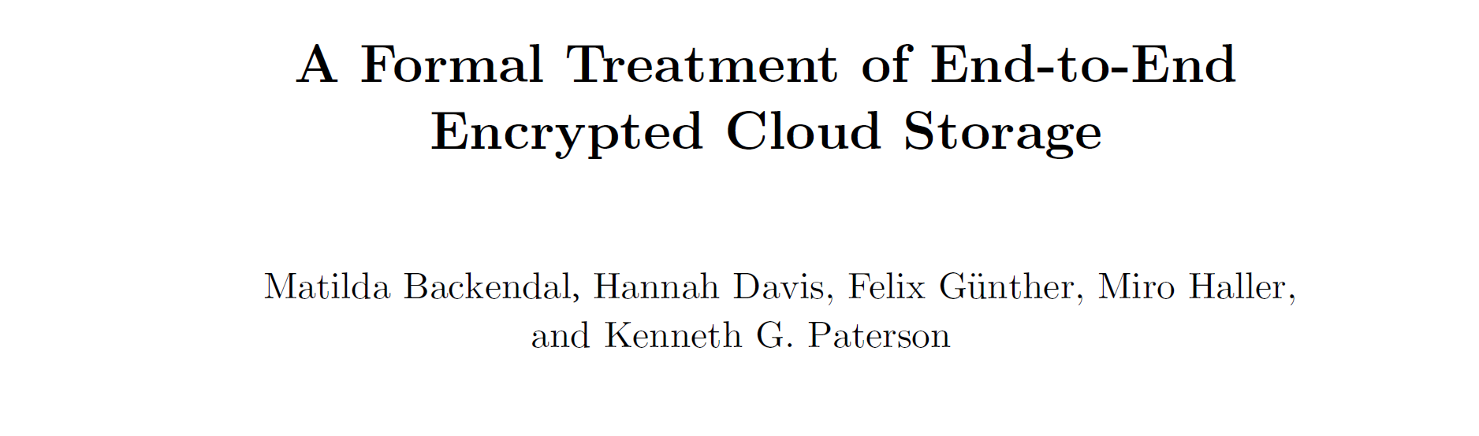
Our Goal
HAVE YOU HEARD OF PROVABLE SECURITY?
WE HAVE ZERO KNOWLEDGE!
??
1
Syntax
2
Security notions
3
Construction
CRYPTO 2024

Slide 12
Formalizing E2EE Cloud Storage

Slide 13
ZERO-KNOWLEDGE
CLOUD STORAGE

Slide 14
Modeling Cloud Storage
Core Functionality
Register (create account)
Authenticate (log in)
Put (upload a file)
Update (modify content)
Get (download)
Share
Accept (receive share)
similar to KEX
7 $×$ KEX?
client
server

Slide 15
Modeling Cloud Storage
Core Functionality
Register (create account)
Authenticate (log in)
Put (upload a file)
Update (modify content)
Get (download)
Share
Accept (receive share)
Register
Register
Register
Register

Slide 16
Modeling Cloud Storage
Core Functionality
Register (create account)
Authenticate (log in)
Put (upload a file)
Update (modify content)
Get (download)
Share
Accept (receive share)
Authenticate
Authenticate

Slide 17
Modeling Cloud Storage
Core Functionality
Register (create account)
Authenticate (log in)
Put (upload a file)
Update (modify content)
Get (download)
Share
Accept (receive share)
Get
Put
Authenticate
Put
Put
Get
Get
Non-atomic operations
Authenticate
Update

Slide 18
Modeling Cloud Storage
Core Functionality
Register (create account)
Authenticate (log in)
Put (upload a file)
Update (modify content)
Get (download)
Share
Accept (receive share)
Share
PKI
MESSAGING
PASSWORD
LINK SHARING
OOB
Accept
User-to-user interaction

Slide 19
Security
MINE TOO!
Setting:
Malicious cloud provider
Adversary controls client protocol steps
Guess password or compromise user
Register
SELECTIVE AND ADAPTIVE
guessed!
MY PW IS “123”
ORACLES
REGISTER
AUTH
NEXT!
CORRUPT
PUT
UPDATE
GET
SHARE
ACCEPT

Slide 20
Security
LOOKS GOOD!
Setting:
Malicious cloud provider
Adversary controls client protocol steps
Guess password or compromise user
Integrity:
Wins if adversary can, for an honest user, inject/modify a file
Get
INT-PTXT-STYLE GAME
ORACLES
Not INT-CTXT
REGISTER
REGISTER
AUTH
NEXT!
CORRUPT
PUT
UPDATE
GET
SHARE
ACCEPT

Slide 21
Security
LOOKS GOOD!
Setting:
Malicious cloud provider
Adversary controls client protocol steps
Guess password or compromise user
Integrity:
Wins if adversary can, for an honest user, inject/modify a file
Get
INT-PTXT-STYLE GAME
ORACLES
Not INT-CTXT
REGISTER
REGISTER
AUTH
NEXT!
CORRUPT
PUT
UPDATE
GET
SHARE
ACCEPT

Slide 22
Security
Setting:
Malicious cloud provider
Adversary controls client protocol steps
Guess password or compromise user
Integrity:
Wins if adversary can, for an honest user, inject/modify a file
Confidentiality:
Wins if adversary can, for an honest user, distinguish uploaded chosen files
1
1
2
AHA, FILE 1 WAS UPLOADED!
Put
[ ]
CHOSEN BY ADVERSARY
ORACLES
REGISTER
REGISTER
AUTH
NEXT!
CORRUPT
CHALL
IND-CCA-STYLE GAME
PUT
UPDATE
GET
SHARE
ACCEPT

Slide 23
Are We Done?
E2EE CLOUD STORAGE
Syntax ✓
Security notions ✓
ELUSIVE GOAL
?
?
?

Slide 24
Are We Done?
Syntax ✓
Security notions ✓
Construction
✓
CONFIDENTIALITY
INTEGRITY
✓
FORMALLY BROKEN
E2EE CLOUD STORAGE
“CSS”
“CSS”

Slide 25
Constructing E2EE Cloud Storage

Slide 26
CSS (Cloud Storage Scheme)
GLOBALLY UNIQUE
CHOSEN BY CLIENT
AT REGISTRATION
$$(pw, aid)$$
Client
Server
$
OPRF
AUTHENTICATION
PRF
$
ALLOWS PW ROTATION WITHOUT FILE KEY RE-ENCRYPTION
$$sid$$
_{kek}
_{mac}
MAC.Tag
MAC.Vfy
_{mac}
AEAD
$$τ$$
$
[ ]
SENT TO SERVER
AT REGISTRATION
_{mk}
_{mk}
AEAD
$
$
…
$
_{f}
_{f}
[ ]
_{f}
_{f}
AEAD
…
[ ]

Slide 27
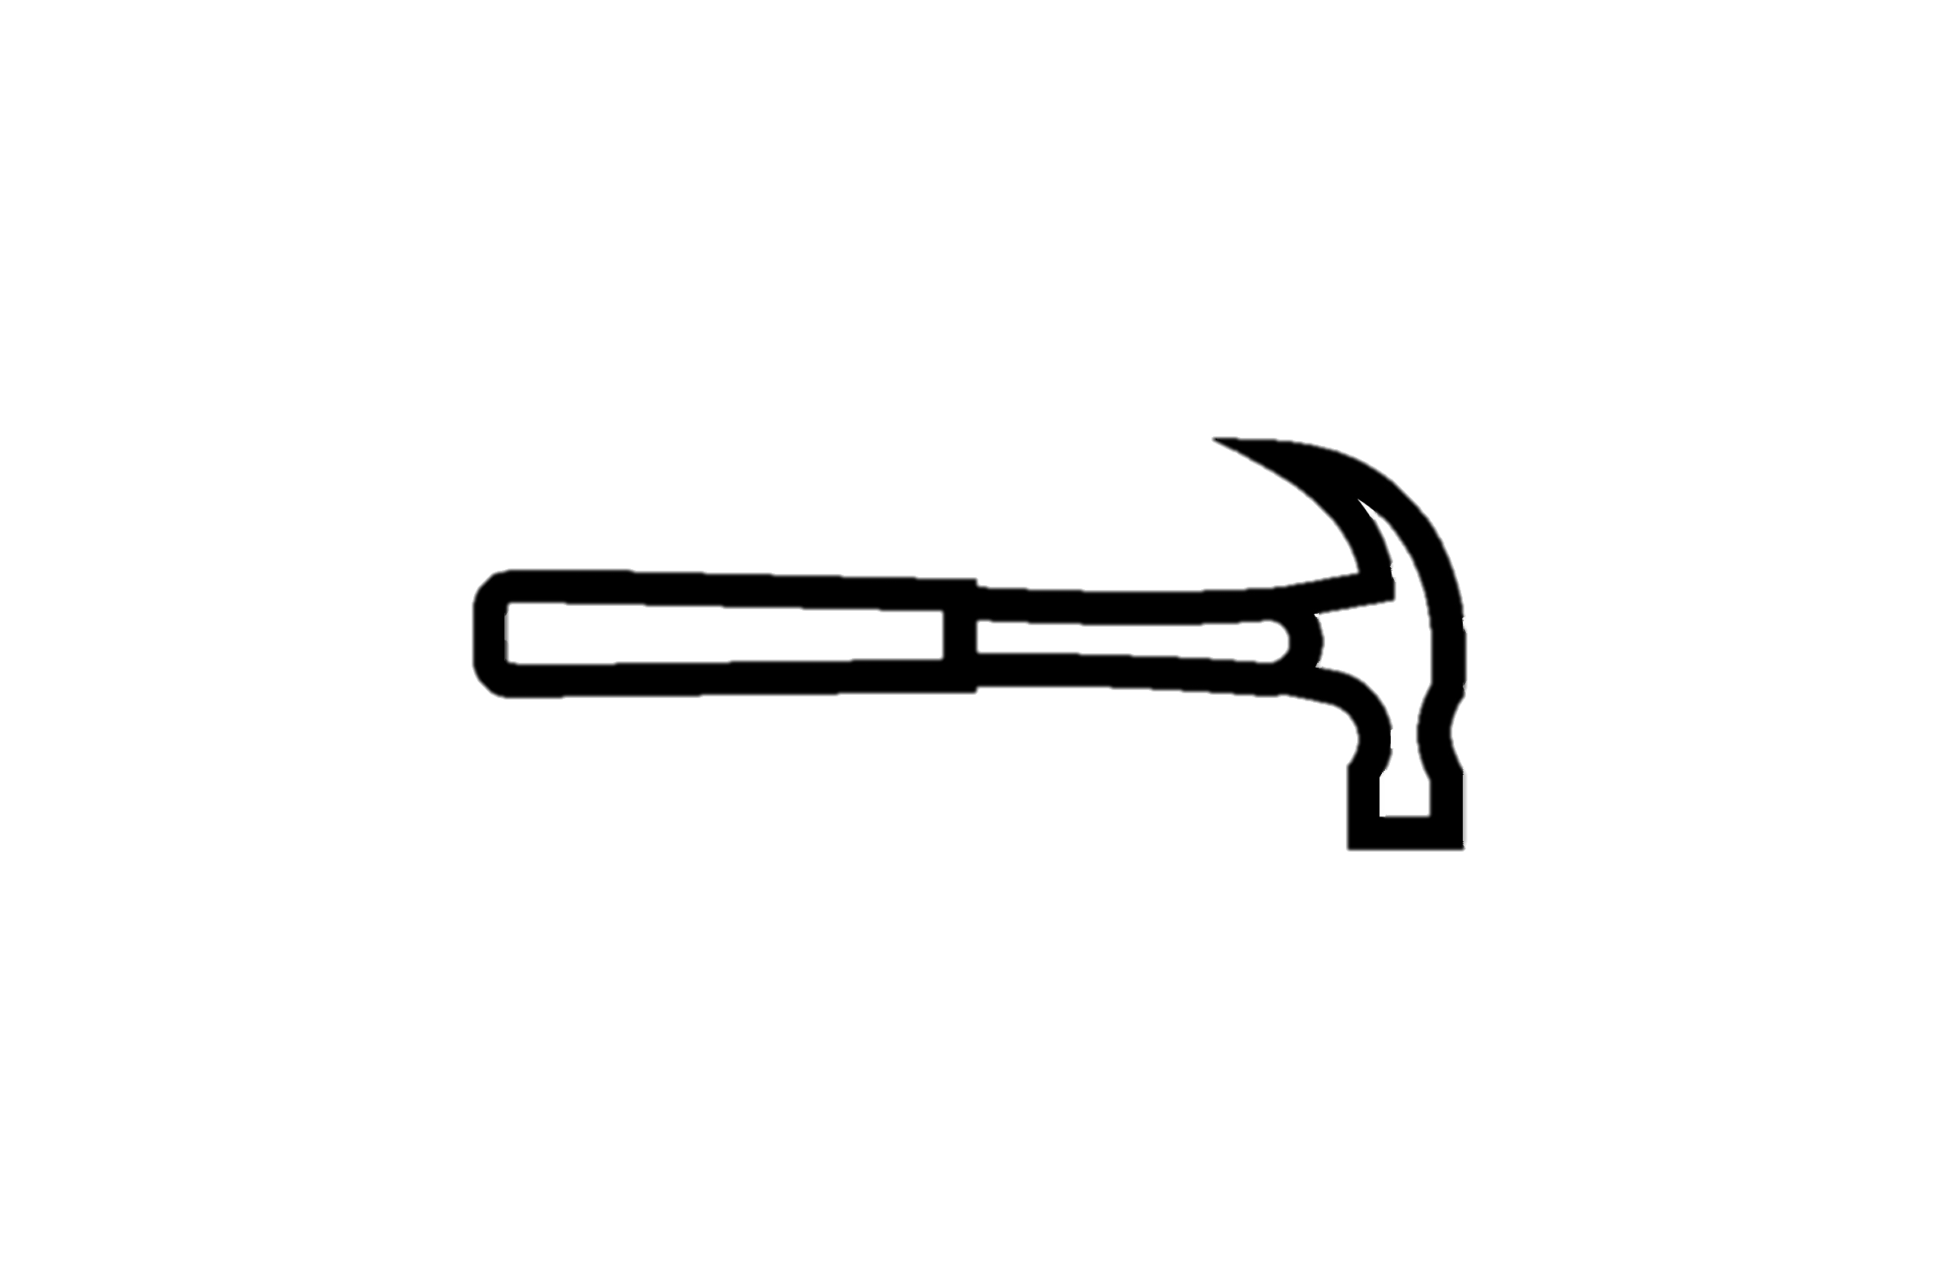
Are We Done Now?
BROKEN!
MEGA
[BHP22, AHMP23]
Syntax ✓
Security notions ✓
Construction ✓
2022
BROKEN!
2023
Nextcloud
[ABCP24]
E2EE CLOUD STORAGE
Still missing:
Implementation
Feedback, model extensions, features …
Adaptive security proof
BROKEN!
our model
[BDGHP24]
Sync, pCloud,
Icedrive, Seafile
[TH24]
2024
IT’S A START!
SECURE
CSS
[Your protocol?]
Theory
PROVABLY SECURE
E2EE CLOUD STORAGE
Practice

Slide 28
Provably Secure End-to-End Encrypted Cloud Storage
Matilda Backendal, Hannah Davis, Felix Günther, Miro Haller, Kenny Paterson
mbackendal@inf.ethz.ch
mhaller@ucsd.edu
IT’S A START!
CSS
Theory
PROVABLY SECURE
E2EE CLOUD STORAGE
Practice
eprint.iacr.org/2024/989
28

Slide 29
Bonus Slides!
Notes:
You’ve unlocked the extra slide material on the details of CSS!

Slide 30
CSS (Cloud Storage Scheme)
Registration
GLOBALLY UNIQUE
$$(pw, aid)$$
Client
Server
CHOSEN BY CLIENT
$$pw, aid$$
$
$$k_{s}$$
OPRF
STORE
$$rw$$
[ ]
$k$_{mk}
$User\left[aid\right]←$ $k_{s}$, $k$_{mac} ,
PRF
$k$_{mac}
$k$_{kek}
ALLOWS PW ROTATION WITHOUT FILE RE-ENCRYPTION
$
AEAD.Enc
$k$_{mk}
[ ]
$k$_{mk}
$aid$, $k_{s}$, $k$_{mac} ,
[ ]
$k$_{mk}

Slide 31
CSS (Cloud Storage Scheme)
Authentication
GLOBALLY UNIQUE
$$(pw, aid)$$
Client
PASSWORD HARDENING
Server
$$pw, aid$$
$$k_{s}$$
OPRF
CHALLENGE-RESPONSE AUTHENTICATION
FETCH
$$rw$$
$
$$sid$$
[ ]
$k_{s}$, $k$_{mac} , $k$_{mk} $←User[aid]$
$$sid$$
PRF
$k$_{mac}
MAC.Tag
$$τ$$
$$sid$$
$k$_{kek}
$$τ$$
$$τ$$
$k$_{mac}
MAC.Verify
$$⊥/⊤$$
AEAD.Dec
[ ]
(IF $⊤$)
$k$_{mk}
$k$_{mk}
[ ]
IF $⊤$:
STORE
$$Session\left[sid\right]←aid$$
$Cache$ $←k$_{mk} $, sid$
$k$_{mk}

Slide 32
CSS (Cloud Storage Scheme)
Put
GLOBALLY UNIQUE
Client
$$(file, fid)$$
Server
$k$_{mk} $, sid←Cache$
$k$_{f}
$
$$file$$
AEAD.Enc
$$fid$$
[ ]
$$file$$
FETCH
BOUND BY ASSOCIATED DATA
$$aid←Session\left[sid\right]$$
$$k\text{mk}$$
[ ]
[ ]
STORE
$file ,$ $k\text{f}$
$sid, fid,$
SHARED
[ ]
$$k\text{f}$$
AEAD.Enc
$$fid$$
$$File\left[fid\right]←$$
$$file$$
[ ]
UNIQUE PER USER
$$Key\left[aid,fid\right]←$$
$$k\text{f}$$
[ ]
$$k\text{f}$$

Slide 33
CSS (Cloud Storage Scheme)
Share
*SIMPLIFIED
RECIPIENT ACCOUNT ID
Client
$$(fid, raid)$$
Server
$k$_{mk} $, sid←Cache$
$$sid, fid, raid$$
FETCH
$$aid←Session\left[sid\right]$$
$$k\text{mk}$$
[ ]
$$←Key\left[aid,fid\right]$$
[ ]
$$k\text{f}$$
$$k\text{f}$$
[ ]
AEAD.Dec
$$fid$$
$$k\text{f}$$
$$k\text{f}$$
SEND TO: $raid$
OOB

Slide 34
CSS (Cloud Storage Scheme)
Accept
*SIMPLIFIED
Client
Server
$$(fid)$$
$k$_{mk} $, sid←Cache$
OOB
$$k\text{mk}$$
COULD INVOLVE DECRYPTION
$$k\text{f}$$
AEAD.Enc
$$fid$$
FETCH
[ ]
$$sid, fid,$$
$$k\text{f}$$
[ ]
$$aid←Session\left[sid\right]$$
RE-ENCRYPTION AVOIDS PUBLIC KEY OPERATIONS
$$k\text{f}$$
STORE
[ ]
$$Key\left[aid,fid\right]←$$
$$k\text{f}$$

