Slide 1




D(e)rive with Care
Lessons Learned from Analyzing Real-World Multi-Input Key Derivation Functions
Matilda Backendal¹, Sebastian Clermont², Marc Fischlin²,
Felix Günther³, Miro Haller⁴, Matteo Scarlata¹
¹ETH Zurich, ²TU Darmstadt, ³IBM Research Zurich, ⁴UC San Diego

Slide 2








Key Derivation Functions
Secret (σ)
Label (L)
length (l)
$$g^{xy}$$
“RWC key”
256 bit
Client
Server
$$g^{x}$$
Salt
KDF
$$g^{y}$$
010011
$$g^{xy}$$
$$g^{xy}$$
K
Not uniform
“Close” to uniform
Notes:
Establish common understanding of key derivation functions
- Used in virtually every protocol
- turns “raw key material” into close to uniform cryptographic key, including additional information context/label

Slide 3





KDFs in Hybrid Settings
Secret (σ)
Label (L)
length (l)
$$k?$$
$$g^{xy}$$
“RWC key”
256 bit
$$g^{x}, KEM.pk$$
$$g^{y},c$$
KDF
$$g^{xy}, k$$
$$g^{xy}, k$$
Additional Context?
K
Not uniform
“Close” to uniform
Notes:
Animation: Noch ein dritter Schlüssel, sagen. Dass wir uns jetzt auf 2kdf beschränken
Establish common understanding of key derivation functions
- Used in virtually every protocol
- turns “raw key material” into close to uniform cryptographic key, including additional information context/label

Slide 4
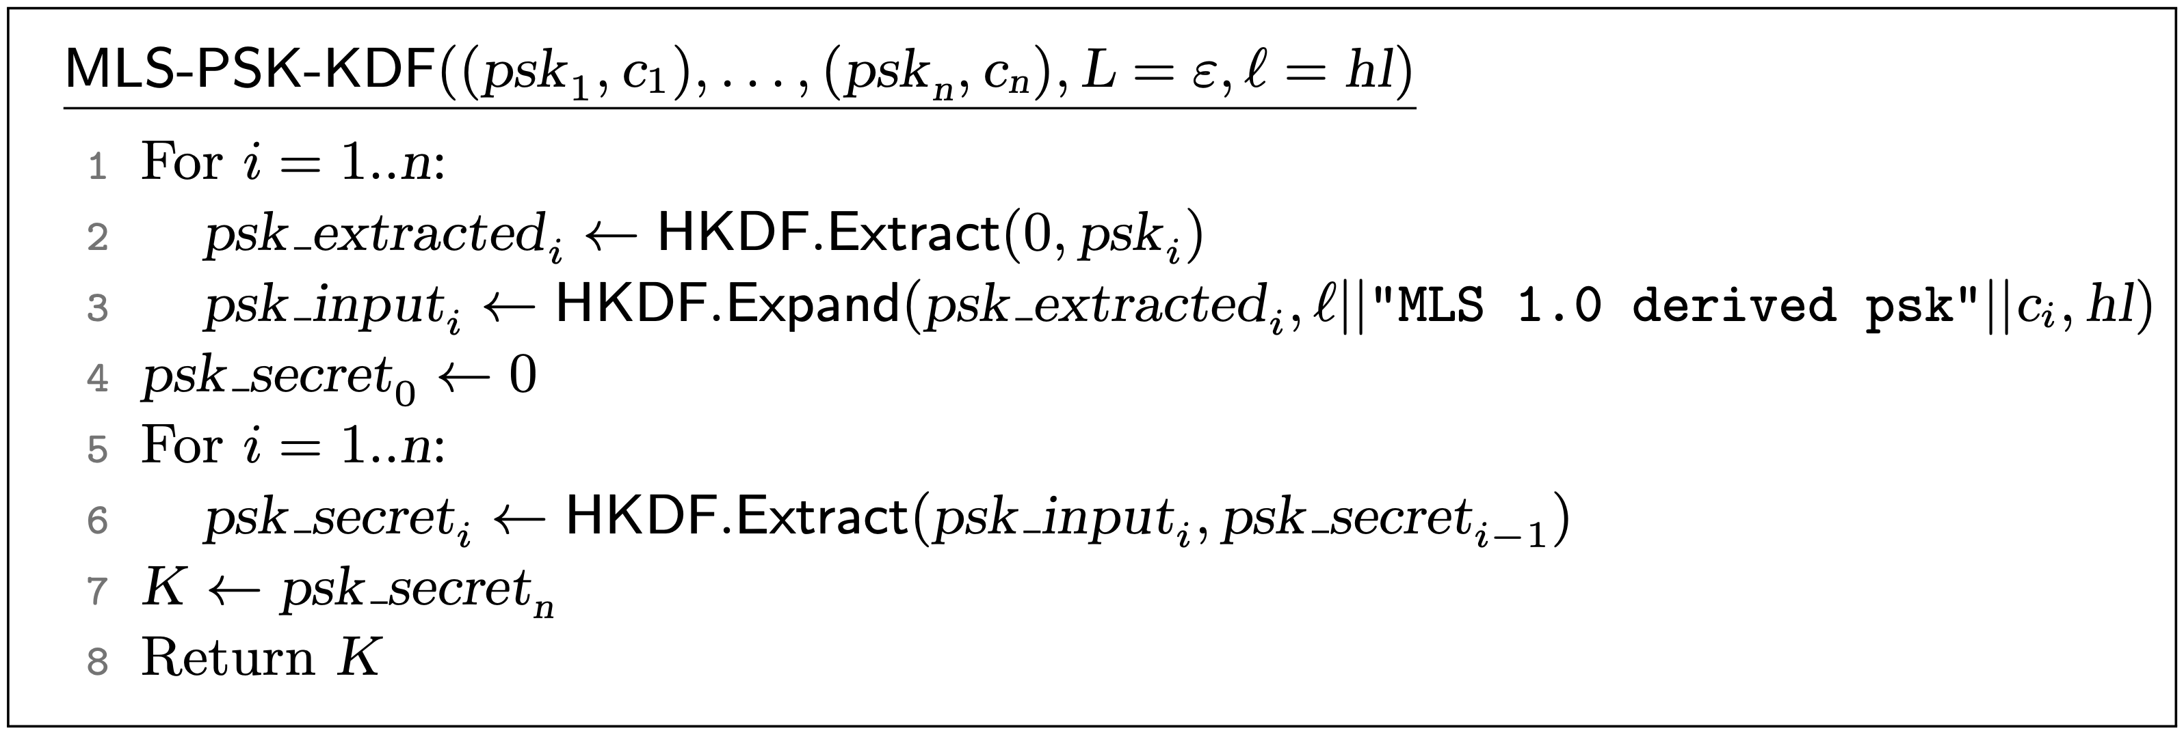
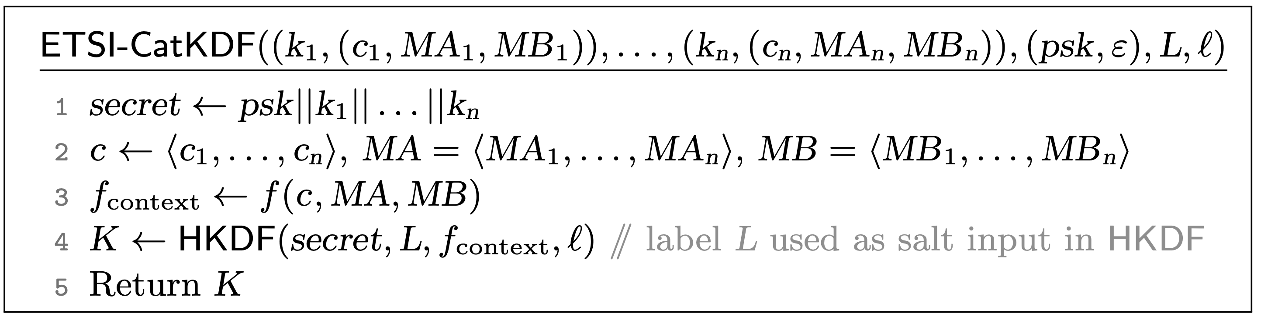
Multiple Inputs
Notes:
Auch: Inkonistente Verwendung von Labels
Salt ist hier auch mal wieder null
Research question: Multi input kdf from blackbox hkdf
Hier werden auch n-KDFs dargestellt, nicht nur 2KDFs

Slide 5




Labels and Contexts
One Label: Associated with final key
name of key, purpose of key (MAC, Enc, …)
“RWC enc key”
$$g^{x}, KEM.pk$$
Multiple Contexts:
Associated with component key
$$g^{y},c$$
public parameters, transcript
$$g^{xy}, k$$
$$g^{xy}, k$$
Notes:
Hier auch Protokoll auf zwei Pfeile reduzieren

Slide 6
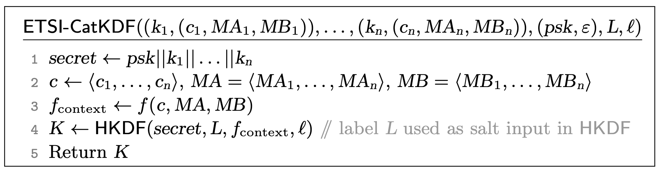
ETSI-CatKDF: Misusing Salts?

Slide 7
ETSI-CatKDF: Misusing Salts?
HKDF-Extract(salt, IKM) -> PRK
:= HMAC-Hash(salt, IKM)
(1) append zeros to the end of K (=salt)
It is easy to generate colliding labels
Notes:
Leute entwerfen Dinge, die nicht durch ein Modell abgedeckt sind und machen Fehler. ETSI hat nichtmal versucht Beweis zu machen, weil formales Modell fehlt(?)
Salt wird mit nullen aufgefüllt, daher collision, xor ist nicht relevant dafür

Slide 8
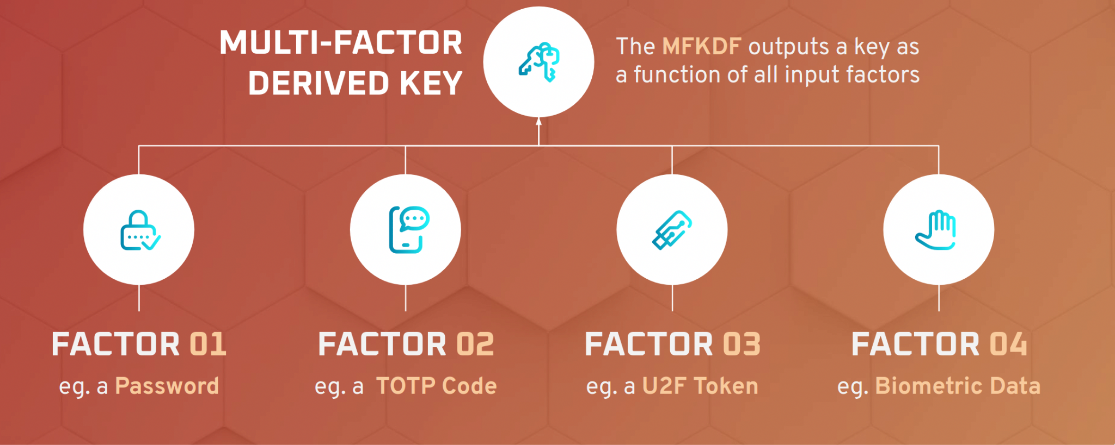
MFKDF
Vivek Nair, Dawn Song, USENIX Security '23

Slide 9

MFKDF
Password
~40 bits
HOTP
~30 bits
TOTP
~30 bits
K
~100 bits

Slide 10
MFKDF
Password
~40 bits
Password
~40 bits
HOTP
~30 bits
TOTP
~30 bits
3/4
Threshold
K
~100 bits

Slide 11


MFKDF
Shamir Secret Sharing
S₁
Random Final Key
K
S₂
2/3
S₃

Slide 12
MFKDF
Shamir Secret Sharing
S₁
Random Final Key
K
K
S₂
2/3
S₃

Slide 13
MFKDF
Shamir Secret Sharing
S₁
Random Final Key
K
S₂
2/3
K
S₃

Slide 14
MFKDF
Shamir Secret Sharing
S₁
Random Final Key
K
S₂
K
2/3
S₃

Slide 15
Password
HOTP
TOTP
F₁
F₂
F₃
KDF
K₁
K₂
K₃

Slide 16


Password
HOTP
TOTP
F₁
F₂
F₃
KDF
K₁
K₂
K₃
Shamir Secret Sharing
S₁
[S₁]
Random
Final Key
K₁
K
S₂
[S₂]
B
K₂
Public
State
2/3
S₃
[S₃]
Encrypt
K₃

Slide 17
Password
HOTP
F₁
F₂
KDF
K₁
K₂
Shamir Secret Sharing
S₁
[S₁]
Final Key
K₁
K
S₂
[S₂]
B
K₂
Public
State
2/3
Decrypt

Slide 18
Password
HOTP
TOTP
F₁
F₂
F₃
~40 bits
~30 bits
~30 bits
K₁
K₂
K₃
S₁
[S₁]
Decrypt
K₁
~60 bits
S₂
[S₂]
B
Decrypt
K₂
Public
State
S₃
[S₃]
Decrypt
K₃

Slide 19
Guess
Password
HOTP
TOTP
F₁
F₂
F₃
K₁
Correct Guess
S₁
Wrong Guess
[S₁]
⊥/$
Decrypt
K₁
B
Public
State

Slide 20
Password
HOTP
TOTP
F₁
F₂
F₃
~40 bits
~30 bits
~30 bits
K₁
K₂
K₃
2⁴⁰ guesses
S₁
[S₁]
Decrypt
K₁
2³⁰ guesses
S₂
[S₂]
B
Decrypt
K₂
Public
State
S₃
[S₃]
Decrypt
K₃

Slide 21
Password
HOTP
TOTP
F₁
F₂
F₃
~40 bits
~30 bits
~30 bits
K₁
K₂
K₃
2⁴⁰ + 2³⁰ << 2⁶⁰
S₁
[S₁]
Decrypt
K₁
S₂
[S₂]
B
Decrypt
K₂
Public
State
S₃
[S₃]
Decrypt
K₃

Slide 22
Password
~40 bits
Password
~40 bits
HOTP
~20 bits
TOTP
~20 bits
3/4
Threshold
K
~40 bits

Slide 23
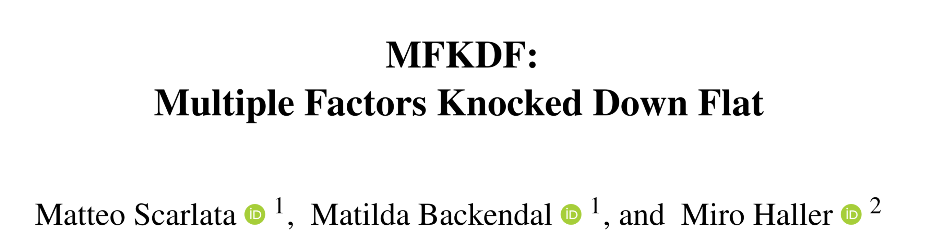
MFKDF falls short...
ia.cr/2024/935
K
What is a secure
n-KDF?
2/3

Slide 24
Security of n-KDFs
secret_{n,} context_{n}
secret₁
context₁
context₂
Label
length
secret₂
KDF
Looks Random
Notes:
Also mention other features of model: xof/nof, define freshness, support one-time keys, model hybrid setting, where break of single secret is expected,…
Modell erlaubt mehrfaches verwenden von secrets, gleiche secrets bei unterschiedlichen labeln. Idee der Requirements auf der Folie ergänzen

Slide 25


Security of n-KDFs
secret₁
context₁
context₂
Label
length
secret₂
KDF
Looks Random
Notes:
Also mention other features of model: xof/nof, define freshness, support one-time keys, model hybrid setting, where break of single secret is expected,…
Modell erlaubt mehrfaches verwenden von secrets, gleiche secrets bei unterschiedlichen labeln. Idee der Requirements auf der Folie ergänzen
„good input“ für honest input

Slide 26

Security of n-KDFs
secret (σ₁)
context (c₁)
secret (σ₂)
context (c₂)
Label (L)
length (l)
Hybrid Setting
KDF
secret (σ₁)
context (c₁)
secret (σ₂)
context (c₂)
Label (L)
length (l)
General Setting
KDF
Notes:
Also mention other features of model: xof/nof, define freshness, support one-time keys, model hybrid setting, where break of single secret is expected,…
Schranken werwähnen, im Hybrid setting gibt’s die besseren (minimum aller sources statt Summe)

Slide 27





Security of deployed constructions
CatKDF
PSK Combiner
X3DH KDF

Slide 28
Multi-Input KDF Blueprint
secret₁
Combine
Expand
context₁
PRK
K
secret₂
context₂
Label
length
Notes:
Combiner prf als titel einfach einblenden statt neuer Folie

Slide 29
Multi-Input KDF Blueprint
Combine
Expand
"combiner n-KDF"
PRF with variable output length
Notes:
For example
HKDF.expand
SHAKE

Slide 30
Combining without Hashing
secret₁
secret₂
secret₁
BC
BC
BC
0
K
Notes:
Design in Paradigma einbinden

Slide 31
Lessons Learned
Designing secure n-KDFs has pitfalls
Formal analysis helps validate constructions
Positive results on Signal and MLS in our new model
Sebastian Clermont
sebastian.clermont@tu-darmstadt.de
Matteo Scarlata
matteo.scarlata@inf.ethz.ch
MFKDF: Multiple Factors Knocked Down Flat
@Usenix 2024
Key Derivation Functions
Without a Grain of Salt
@Eurocrypt 2025

