Slide 1
How To Think About End-To-End Encryption and AI
Training, Processing, Disclosure, and Consent

Slide 2
How to Think About E2EE and AI
Mallory Knodel, New York University
Andrés Fábrega, Cornell University
Daniella Ferrari, New York University
Jacob Leiken, New York University
Betty Li Hou, New York University
Derek Yen, New York University
Sam de Alfaro, New York University
Kyunghyun Cho, New York University
Sunoo Park, New York University
Notes:
Intro– PhD student and law student at NYU, this is a collaboration between [first names] at NYU and Cornell.
Daniella Ferrari helped prepare this presentation.

Slide 3
Notes:
Our motivation… End-to-end encryption (E2EE) has become the gold standard for securing communications, bringing strong confidentiality and privacy guarantees to billions of users worldwide. However, the current push towards widespread integration of artificial intelligence (AI) models, including in E2EE systems, raises some serious security concerns.

Slide 4
Notes:
Three products we cover in the second version of the paper are: Apple Intelligence, Meta AI and Samsung AI…

Slide 5
Notes:
The tools already have the capability of processing E2EE data, at least in certain situations…

Slide 6
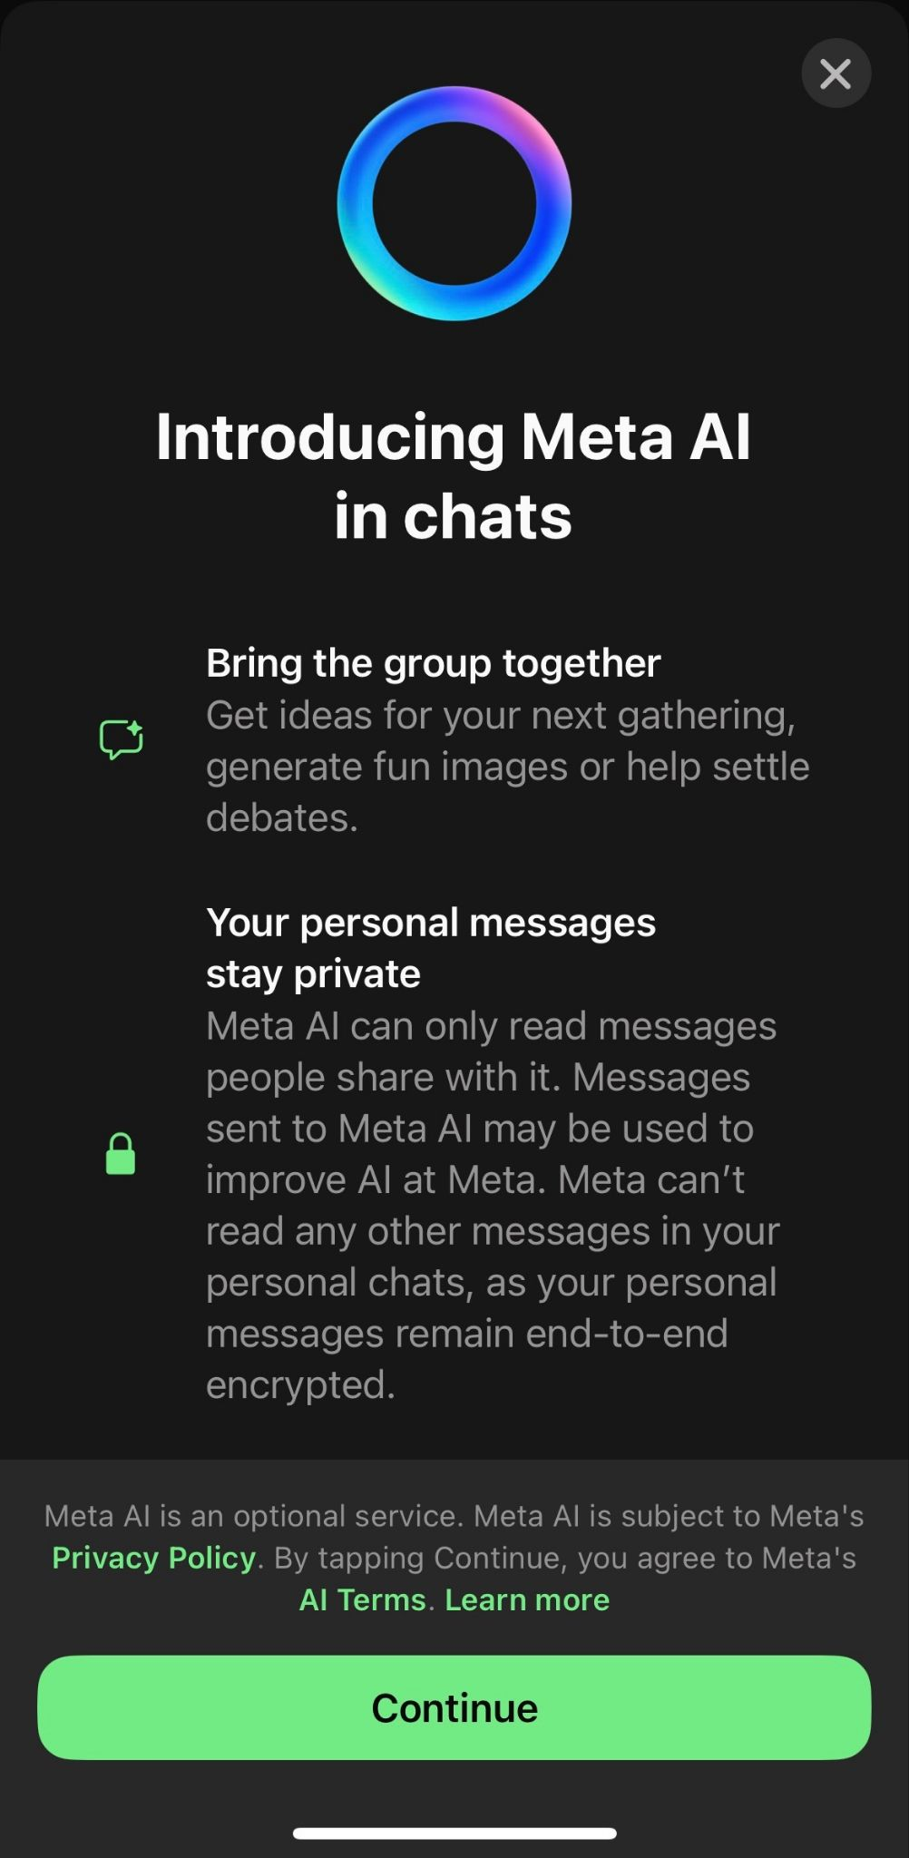
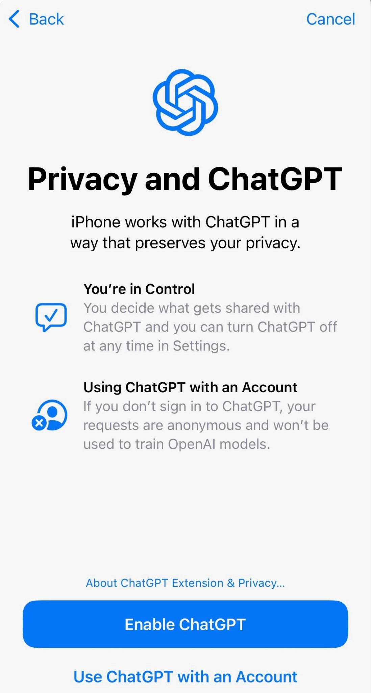
Notes:
All three have this capability but here are two examples…

Slide 7
Is processing of message content by integrated AI models compatible with end-to-end encryption?
(If so, to what extent and under what circumstances?)

Slide 8
Talk outline: Our recommendations
}
Training
Processing
Disclosure
Consent
Security considerations What kinds of AI integration are compatible with E2EE?
}
Legal & normative considerations Given the above, what would clear disclosure and meaningful consent look like?
Notes:
Set up what it implies from a technical point of view, this then informs the legal and normative considerations for these services.

Slide 9
Training
Recommendation #1

Slide 10
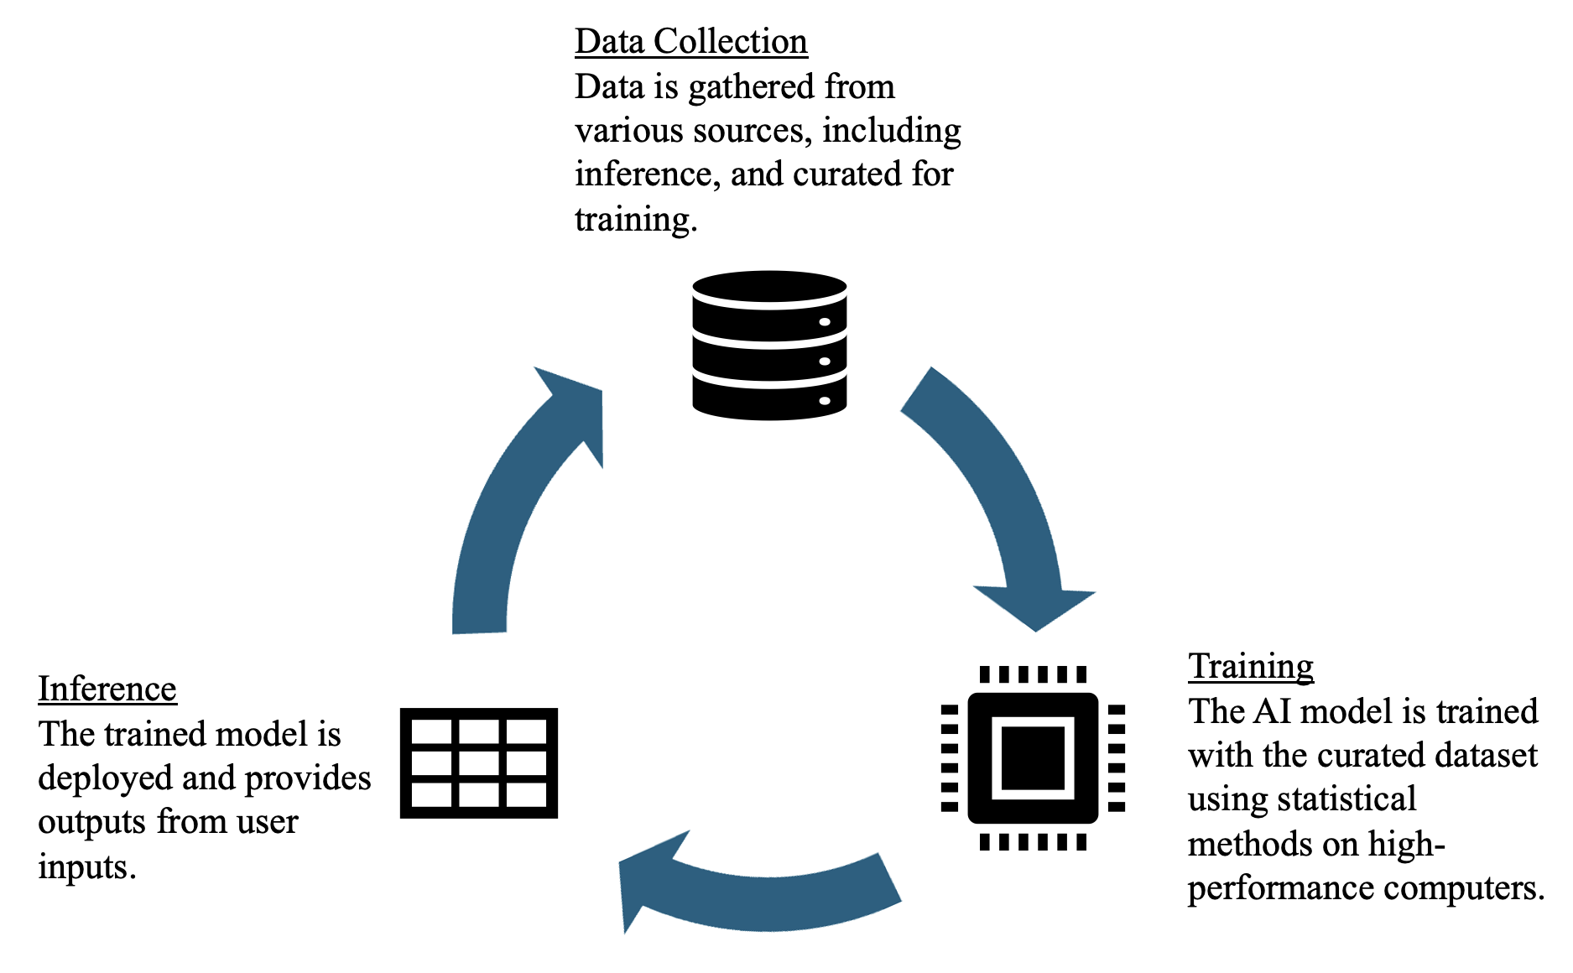
Background: AI
Notes:
TRAINING. Models have configurable parameters which are numerical values that determine how outputs are generated. The goal of training is to tune these parameters, over many iterations in order to capture more and more patterns. Models at the scale of commercial AI assistants contain billions or even trillions of parameters trained over months.
INFERENCE. Trained models are used to generate real-time responses to user inputs. One user query is processed through many steps using the model parameters to calculate an output. Continuous improvement is achieved with updates, additional training, or reinforcement learning with human feedback.

Slide 11
Background: AI
Notes:
Blue is users device and Yellow is cloud servers.
SP: Either way, model ends up dependent on/function of training data. (What is training data?)
How Is It Technically Possible for E2EE Data to Be Fed Into AI Assistants? (Possible script: To be clear, in either case, plaintext data is transferred from the device to the model.)

Slide 12
Recommendation #1: Training
Using end-to-end encrypted content to train shared AI models is not compatible with E2EE.
“Shared AI model” means a model that may be be used for inference by multiple users, and/or may be trained on multiple users’ queries.
Notes:
Stronger statement: There is no way.
SP: Just added a definition of shared AI model. I also thought it might be nice for the definition to be visually distinct from the recommendation text, consistently on this slide and Recommendation #2, so I tried putting in italics. Please revert if you disagree!

Slide 13
Processing
Recommendation #2

Slide 14
Background: E2EE vs. TEEs
Confidentiality of communication between users
Specification security relies on mathematical hardness
Implementation security relies on software and hardware supply chain
Confidentiality of compute, machine state between users and cloud
Specification security relies on hardware design
Implementation security relies on (different) hardware supply chain
E2EE goals
Trusted Hardware goals
Notes:
“We don’t cover encryption and trusted hardware background for this audience, but it’s in the paper.”
“Privacy against third parties, integrity and tamper resistance are goals of both.”
“E2EE and TEEs have different, orthogonal and incomparable security guarantees.”

Slide 15
Evaluation Framework & Analysis
Compatible with E2EE | On-device model, locally fine-tuned
 | Server-side inference under FHE without fine-tuning (not practical)
Not compatible with E2EE, but has some heightened security measures | Server-side inference on separate per-user fine-tuned models on TEEs
 | Apple Intelligence (uses TEE)
Most vulnerable | Server-side plaintext inference without fine-tuning
Notes:
PETs side bar. (SP: I think I explained it poorly on our call, but something like this is what I meant by a quick preview of the traffic light table. A possible script for this slide is below)
Our paper offers an analytical framework for evaluating real-world E2EE-AI integrations according to our recommendations.
For example, local models with local fine-tuning are E2EE-compatible (1st row),
but server-side plaintext inference is not compatible with E2EE even without fine-tuning (last row).
Please see the paper for more details.

Slide 16
Recommendation #2: Processing
Processing E2EE content for AI features (such as inference or training) may be compatible with end-to-end encryption only if the following recommendations are upheld:
(a) Prioritize endpoint-local processing whenever possible.
(b) If processing E2EE content for non-endpoint-local models,
(i) No third party can see or use any E2EE content without breaking encryption, &
(ii) A user’s E2EE content is exclusively used to fulfill that user’s requests

Slide 17
Recommendation #2: Processing
Processing E2EE content for AI features (such as inference or training) may be compatible with end-to-end encryption only if the following recommendations are upheld:
(a) Prioritize endpoint-local processing whenever possible.
(b) If processing E2EE content for non-endpoint-local models,
(i) No third party can see or use any E2EE content without breaking encryption, &
(ii) A user’s E2EE content is exclusively used to fulfill that user’s requests
“Content” includes any derivative of E2EE content (i.e., any non-trivial function of content).
“Cannot see/use without breaking encryption” may be achieved with some privacy-preserving technical configurations like FHE.

Slide 18
Disclosure & Consent
Recommendations #3 & #4
Notes:
SP: about 8 mins for this section? Legal shift

Slide 19
Areas of Law
Contract Law
Consumer Protection Law
Data Protection Law
Antitrust Law
Icons designed by FreePik
Notes:
There are 4 main areas of law that affect how messaging services can be regulated for privacy-related obligations: contract law, consumer protection, data protection, and antitrust.
We’ll be focusing mainly on the first 3 areas, which are more directly relevant to our focus.

Slide 20
User Consent
Company
Disclosure
… and problems with consent
Consumers do not read privacy policies or ToS
Company data practices and privacy harms are hard to understand
There are limited alternatives
User preference may change over time and may vary according to the context
Individual consent does not capture group settings
Notice-and-choice model
Messaging providers
Users
User
Consent
… but consent is legally valid!
Icons designed by FreePik
Notes:
One thing that these areas of law have in common is the reliance on user consent as an important part of how companies can justify collecting and using user data.
In the US, the “notice and choice” or “notice and consent” model is the dominant framework for how the law treats online consent. It’s seen as a two-way stream where digital services like messaging apps will give users some form of notice or disclosure of their terms – typically in a privacy policy or terms of service agreement – and users will consent to these terms by signing up and providing their information, by clicking on an “I agree” button, or simply by using the website.
Courts treat company disclosures as contracts where there is mutual agreement. The idea here is that if consumers don't agree with the terms, they can simply stop using the service or opt out.
[CLICK]
The problem is that the notice and choice model is notably flawed, and there is a clear asymmetry between company disclosure and user consent.
Consent is widely criticized by legal scholarship in the privacy field for not meaningfully representing consumers’ wishes, for several reasons.
Studies have shown that consumers do not actually read privacy policies and company disclosures
Even if consumers do read, understanding data privacy implications often requires technical expertise
Consumers often do not have a real choice between using a service or not, as there is a lack of reasonable alternatives
Consent mechanisms often do not capture how user preferences can change over time and in different contexts
And do not capture notions of collective privacy, such as group chats
[CLICK]
BUT, despite all these critiques pointing out that consent is a fiction, the fact is that these asymmetric contracts, determined by companies, are still legally valid and enforceable
So, what does this mean? It means that contract law likely can’t do much to protect consumers

Slide 21
US Consumer Protection and the FTC
The US Federal Trade Commission (FTC) investigates unfair or deceptive trade practices
Deceptive practices cover privacy/security misrepresentations – when companies’ disclosures do not match their practices
FTC v. Zoom (2020)
If app is marketed as having “E2EE”, must:
Use E2EE throughout the processing of the relevant data
Have E2EE on by default
Meet industry standards
Notes:
So what is a more promising way to hold companies accountable to consumers?
In the US, it’s consumer protection law. The Federal Trade Commission, known as the FTC, is the federal agency that investigates unfair or deceptive company practices.
The FTC can investigate security-related incidents as deceptive practices. The focus is on the disclosures and whether the company’s statements are misleading to consumers.
[CLICK]
For example, in 2020, the increased use of Zoom by consumers during the pandemic led to the discovery that Zoom was not protecting all video calls with the “end-to-end, 256-bit encryption” it advertised.
This and other FTC cases have set precedents that if a service is marketed as using “end-to-end encryption,” the service must implement end-to-end encryption throughout the processing of the relevant data, have E2EE on by default, and must meet industry standards for E2EE.

Slide 22
EU Data Protection Landscape
General Data Protection Regulation (GDPR) 2016
User consent is one of six possible legal bases for processing personal data
Consent requires an affirmative act i.e. opt-in consent
Other safeguards: data minimization, purpose limitation, DPO appointment, etc.
ePrivacy Directive 2002,
Digital Markets Act 2022,
AI Act 2024, etc.
Notes:
Another promising way to regulate companies is through data protection law, which generally sets rules for the handling of personal data
The US does not have a data protection law for consumer privacy at the federal level. While more and more US states have been adopting consumer privacy laws, these generally reinforce the notice-and-consent model by overly focusing on opt out.
In contrast, the EU is known for a more robust data protection landscape, in which the General Data Protection Regulation (or GDPR) is the prominent law.
The GDPR goes beyond notice and consent by imposing broader data obligations on all companies that offer services to people located in the EU.
For example, companies need to have a legal basis for any processing of personal data. User consent can be a legal basis but needs to be shown by an affirmative act of acceptance, such as by clicking a button. This is what we call opt-in consent.
[CLICK]
There are more EU laws besides the GDPR that touch on the regulation of personal data and require opt-in consent.
The ePrivacy Directive regulates the confidentiality of electronic communications and requires opt-in consent for storing or accessing information on a user’s terminal equipment.
The Digital Markets Act regulates competition and requires opt-in consent for merging data between a company’s different products and services.
The recent AI Act reinforces the GDPR and the ePrivacy Directive’s application to AI systems.
All of these interact with the GDPR in different ways and create a complex web of regulations.

Slide 23
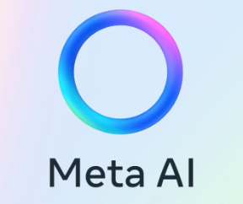
Ongoing Controversies
Non-consensual AI training in the EU
EU privacy regulators are questioning AI developers for violating the GDPR when training AI on personal data
ChatGPT was initially suspended by the Italian regulator for not collecting user consent, among other things
Meta AI, X’s Grok, Google’s PaLM 2 and Apple Intelligence have delayed/suspended releases in EU because of Irish regulator inquiries
Training on private chat data will raise more legal concerns
Notes:
So how does the EU’s data protection regime apply to AI models? That is an ongoing debate.
For the first time, EU regulators have begun investigating whether AI developers are complying with the GDPR when training AI models on personal data.
For example, the Irish regulator questioned Meta for updating its Privacy Policy to allow for AI training on public data, mentioning issues related to user consent.
So far, the investigated AI models have been training on publicly available data. If AI models start training on private user messages or E2EE content, this would likely raise more questions and legal concerns related to user consent.

Slide 24
Recommendation #3: Disclosure
Messaging providers should not make unqualified representations that they provide E2EE if the default for any conversation is that E2EE content is used (e.g., for AI inference or training) by any third party.
Notes:
Our third recommendation relates to disclosures made by messaging providers.
[Read the recommendation, without parenthesis]

Slide 25
Recommendation #4: Opt-in Consent
AI assistant features, if offered in E2EE systems, should generally be off by default and only activated via opt-in consent. Obtaining meaningful consent is complex, and requires careful consideration including but not limited to: scope and granularity of opt-in/out, ease and clarity of opt-in/out, group consent, and management of consent over time.
Notes:
Our fourth recommendation advocates for AI assistants to be off by default and only activated by a user’s opt-in consent.
Here, a well-implemented consent interface can make an important difference.
Users should be able to consent specifically to add on features such as AI assistants, and should be provided a clear and easy to find opt-out mechanism.

Slide 26
Talk outline: Our recommendations
}
Training
Processing
Disclosure
Consent
Security considerations What kinds of AI integration are compatible with E2EE?
}
Legal & normative considerations Given the above, what would clear disclosure and meaningful consent look like?
Notes:
Set up what it implies from a technical point of view, this then informs the legal and normative considerations for these services.

Slide 27
Is processing of message content by integrated AI models compatible with end-to-end encryption?
(If so, to what extent and under what circumstances?)
Notes:
SP: recap our central question (might be a reasonable place to say there’s a lot more in the paper)

Slide 28
Notes:
(SP: it’d be nice to re-emphasize here that these products are out in the wild now, multiple companies have launched AI assistants capable of processing E2EE content under limited circumstances)
Prompt: “create image of AI assistant reading private user messages”

Slide 29
What can users do?
Choose OS-level app permissions carefully
Review App Settings
Be Aware of What You’re Sharing
Beware of Opt-in Conditions
Opt out!
Talk to Your Contacts
Raise your voice about privacy features
Notes:
Choose OS-level app permissions carefully: Device-wide AI capabilities like Apple Intelligence mean that you need to be aware of which of your applications interact with AI features.
Review App Settings: Regularly check the privacy settings on your applications. If you're concerned about privacy, turn off AI-based features like message summarization or smart replies.
Be Aware of What You’re Sharing: Be mindful of the data you share with AI services, especially personal or sensitive information that could be used for training or other purposes. When applications tell you they might use your data for training AI, believe them. Passwords, contact information, and a wide variety of sensitive information might end up in an AI model and out of your control.
Beware of Opt-in Conditions: If you choose to invoke MetaAI or Apple Intelligence features in a private or confidential setting, be sure you understand the limitations– is it for all chats? Is it forever?
Talk to Your Contacts: If you are having sensitive conversations over E2EE services, have a conversation with relevant contacts, and make sure they aren’t inviting bots to the conversation.

Slide 30
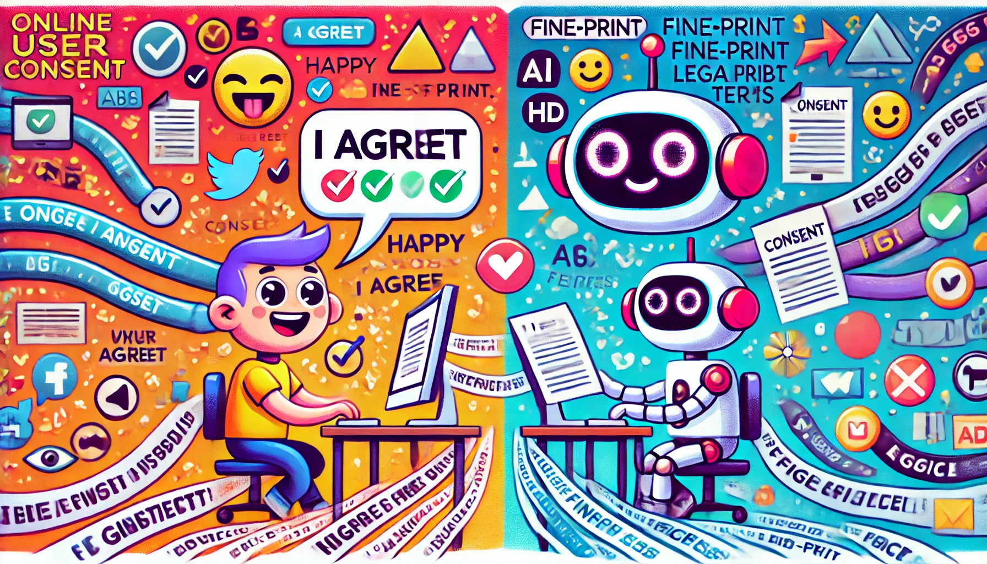
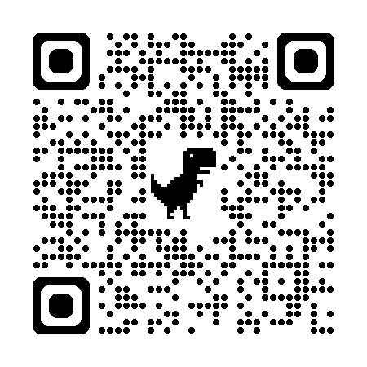
Thank you!
Mallory Knodel, mallory.knodel@nyu.edu
ia.cr/2024/2086
Notes:
SP: we’ll just keep the paper link and mention verbally that there are also blog post summaries, linked on the first page of the paper
SP: I pasted in the URL as well, I’d like us to have both QR and URL in case people don’t manage to scan the QR
SP: does it make sense to keep Daniella’s info here?

