Slide 1
Stronger Privacy for Existing Credentials
Christian Paquin, Guru Vamsi Policharla and Greg Zaverucha
Microsoft Research and UC Berkeley
RWC 2025

Slide 2
Digital Identity and Long-Lived Credentials
Mobile wallets are increasingly being used to store new long-lived identity credentials, for example:
Workplace and education credentials (W3C VCs)
Microsoft Authenticator + Entra Verified ID
Mobile driver’s license (mDL)
Deployed by 17 US states +15 in development
Privacy: Newer credentials like SD-JWT and mDL are adding some features for selective disclosure, but not unlinkability, falling short of anonymous credential systems like BBS
Most identity standards are not using anonymous credentials…
What can we do with existing credentials?

Slide 3
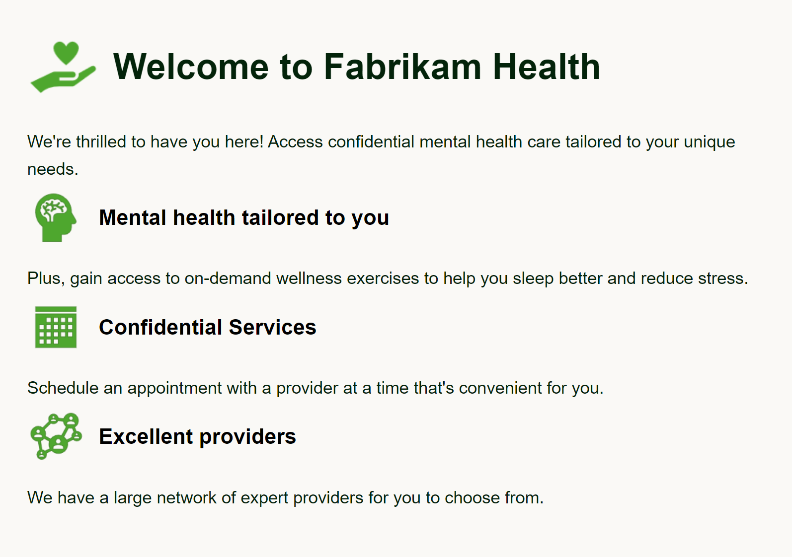
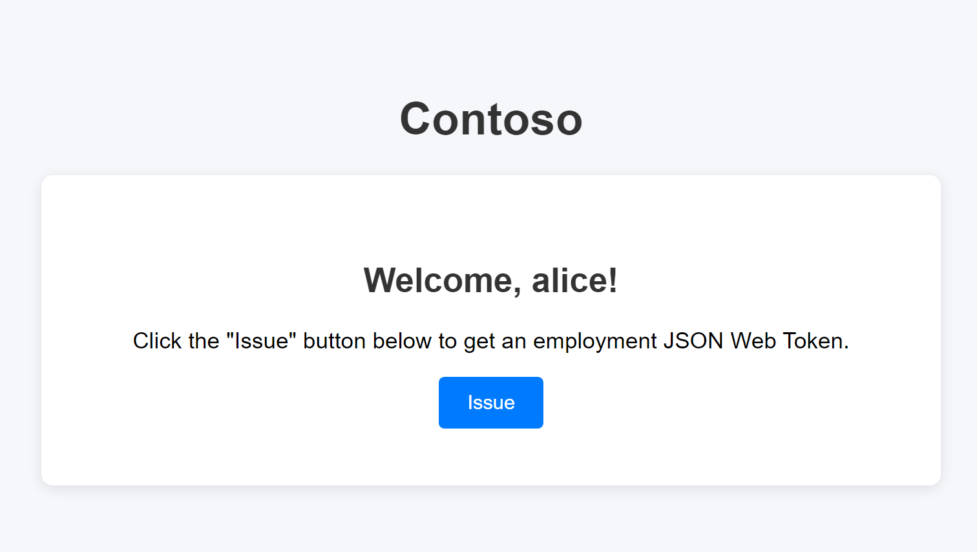
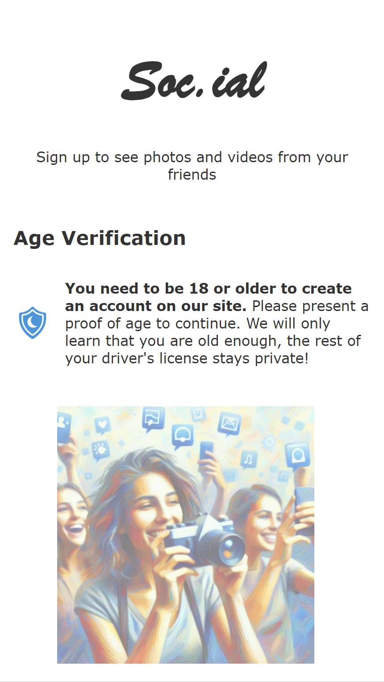
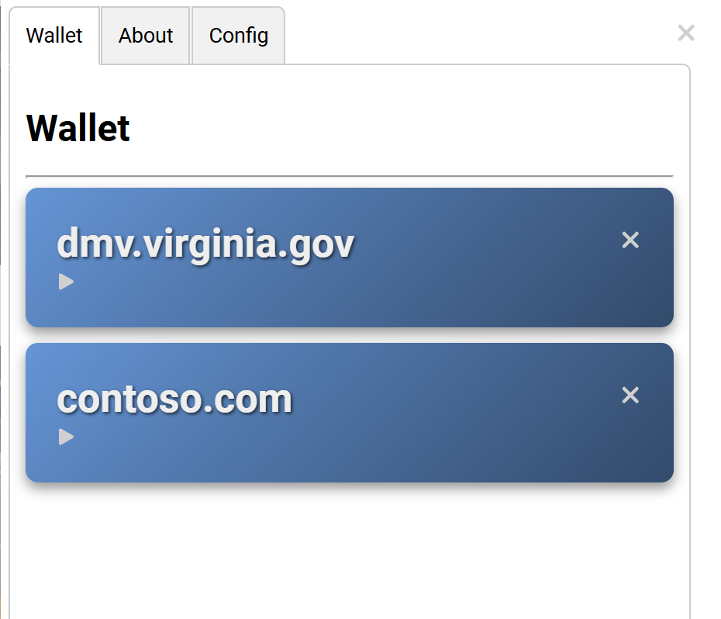
Crescent
Our design and implementation for adding strong privacy features to existing credentials
Fabrikam Health (Verifier)
Contoso Employer (Issuer)
Soc.ial (Verifier)
No changes are required from issuers, they may not even be aware of Crescent
Proof of Contoso employment
JWT
Over-18 proof
DMV (Issuer)
mDL
Crescent Library

Slide 4
Example Existing Credential – Workplace JWT
After base64 decoding
header.payload.signature
{
"typ": "JWT",
"alg": "RS256",
"kid": "crUsQUBhHRZaNUC3kS2nUZ_DVHf17oVfAO7ToaD8SJg"
}.{
"email": "alice@contoso.com",
"family_name": "Example",
"given_name": "Alice",
"name": "Alice Example",
"oid": "12345678-1234-abcd-1234-abcdef124567",
"onprem_sid": "S-1-2-34-5678901234-1234567890-1234567890-1234567", "aud": "relyingparty.example.com",
"exp": 1733507484,
"tenant_ctry": "US”
[…]
}.[Signature – RSA 2048, SHA256]
Proof of employment:
Reveal that email ends with contoso.com and that exp > now()

Slide 5
Using the Groth16 zk-SNARK
Circuit:
Verifies the issuer signature:
Hashes the credential
RSA verification equation
Base64-decodes the payload
Parses JSON to find relevant attributes
Applies predicates
Email ends with contoso.com
exp > now()
See zk{creds,login,email,passport}
Prover inputs
Prover params
Groth16
prover
Credential
Proof
Drawbacks
High proof generation time (tens of seconds)
Circuit is not very flexible

Slide 6
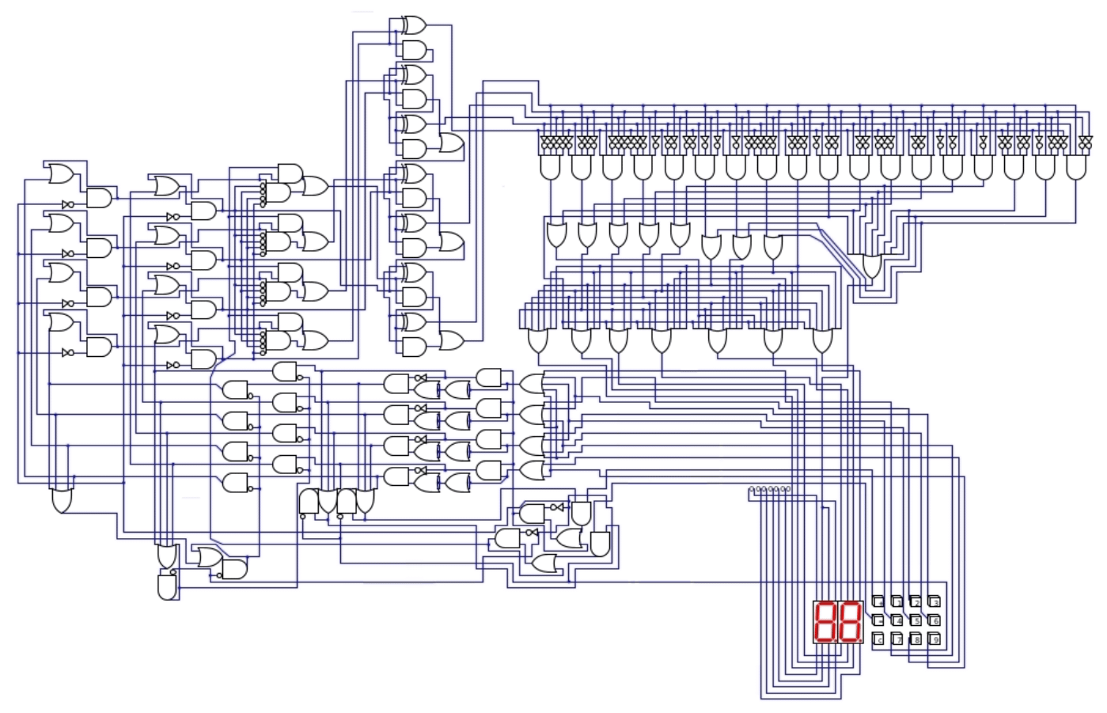
Our Approach
Observation: Long-lived credentials are presented many times, almost all of the prover work is repeated
Can we reuse the prover work and maintain unlinkability?
Phase 1
Prepare
Phase 2
Show
Zero-Knowledge
1.5m constraints
Done only once
Done each showing
Very efficient

Slide 7
Groth16 Zero-Knowledge Proofs
$(A,B,C)$: Proof
$L$: Commitment to circuit IOs
Verification equation:
Can re-randomize $(A,B,C,L)$ for unlinkability. [RWGM23]
Only need to pay the cost of proving once!

Slide 8
Proof Overview
Groth16
prover
$$(A, B, C,L)$$
Commitment
to attributes
Selective disclosure prover
Range
prover
Credential
Randomize
$$(A′, B′, C′)$$
$$L′=G_{1}^{m_{1}}G_{2}^{m_{2}}⋯H^{z^{′}}$$
$m_{1}=$ contoso.com
$m_{2}<$ now()
Prepare :
Done once per
credential
Show : Done every time the credential is used
$\left(A,B,C,L, \vec{m}\right)≈$ Signature on attributes, like BBS, CL, Brands, etc.

Slide 9
Device Bound Credentials
Long-lived credentials are often device-bound
e.g., mDL, X.509 and some JWTs
Credentials have an attribute encoding a public signing key, the secret key is in hardware
Goal: The credential cannot be presented without the device
Prevents credential theft, sharing, replay
We implemented support for device binding with ECDSA signatures
{"email": "alice@contoso.com",
"pubkey" :{
"jwk":{
"kty": "EC",
"use": "sig",
"crv": "P-256",
"x": "18wHLe…",
"y": "UaLMgP…"
},
…
}

Slide 10
Authentication with Device-Bound Credentials
Non-ZK Case
Crescent
Device
User
Verifier
Device
User
Verifier
$$pk,sk$$
$$m$$
Choose random challenge $m$
$$pk,sk$$
$m$
$$m$$
$$m$$
Sign(s$k, m)$
$$σ$$
$$σ$$
Sign(s$k, m)$
$$cred, σ$$
$$π_{1}, π_{2}$$
Use $pk$ in $cred$ to
Verify($pk, m, σ)$
$π_{1}$: Crescent proof
$π_{2}$: Sub-proof that
Verify($pk, m, σ)=1$
Challenges:
Verifier cannot learn $σ, pk$ (unlinkability)
Device cannot be changed
Need fresh $π_{2}$ for every use

Slide 11
Linking Sub-Provers
Proof system for device ECDSA signature
Want arithmetic circuits mod P256 to be efficient
Use Spartan on the T-256 curve [Set20, FLM21, WOPG25],
Scalar multiplication in $≈$2700 R1CS constraints
Need to link data between the Groth16 and Spartan groups
Commit to public key with both Pedersen and Poseidon (w/ fresh randomness)
Prove commitments have same message
$Σ$-proof + about 2000 constraints in the circuit
General technique, works for any proof system with an efficient hash (similar to [OKMZ24]). Maybe Bulletproofs?
We also describe an alternative that combines
a pre-computed SNARK about the public key, with
an efficient $Σ$-proof about the signature.
Device binding with only a tiny increase in online prover costs

Slide 12
Library and Demo
https://github.com/microsoft/crescent-credentials
Languages
Circom
Rust
Features
Selective disclosure
Range proofs
Device binding
Wasm support for Show()
End-to-end samples with JWT and mDL credentials
Dependencies
arkworks
Device binding:
Spartan
Neptune
bellpepper
Sig-pop T-256 (RWC 2025)
Circuits
circom-ecdsa-p256
zk-email
With contributions from Larry Joy, Tianyi Liu and Srinath Setty

Slide 13
Performance – Workplace Example
Crescent: JWT, RSA-2048, 2KB, 1.6M constraints
Procedure | BBS | Crescent
Proof Generation (offline) |  | 19.9 s
Credential Presentation | 10.21 ms | 29.2 ms
Verifier | 7.78 ms | 11.7 ms
Object Size
Proving params (offline) | 32 bytes | 580 MB
Presentation params | 32 bytes | 680 bytes
Verification params | 64 bytes | 680 bytes
Proof size | 1148 bytes | 1019 bytes
BBS estimates are shown for comparison, but BBS cannot be used with existing credentials – requires changes from issuers
CPU: 2017 Intel Xeon W-2133 @ 3.6 GHz, 6 cores

Slide 14
Performance – Workplace Example
Crescent: JWT, RSA-2048, 2KB, 1.6M constraints
Procedure | BBS | Crescent | With Device Binding
Proof Generation (offline) |  | 19.9 s
Credential Presentation | 10.21 ms | 29.2 ms | 315 ms
Verifier | 7.78 ms | 11.7 ms | 184 ms
Object Size
Proving params (offline) | 32 bytes | 580 MB
Presentation params | 32 bytes | 680 bytes
Verification params | 64 bytes | 680 bytes
Proof size | 1148 bytes | 1019 bytes | 15.1 KB

Slide 15
Areas for Future Work
Known problems, important for Crecent:
Lots of great ZK tools exist, combining them is nontrivial
Assurance of circuit correctness
Performance improvements (implementation & design)
Secure & private outsourcing of Groth16 proof generation
Further investigation of different deployment scenarios
Uncover interesting constraints and requirements

Slide 16
Conclusion
Crescent combines emerging techniques into a complete credential system – without new issuers
Promising approach to strong privacy with existing credentials
Efficiency tradeoffs are a good fit for long-lived credentials
Ongoing work, with open development, get involved!
Code: https://github.com/microsoft/crescent-credentials/
Paper: ePrint: 2024/2013

Slide 17
References
[Groth16] J. Groth. On the size of pairing-based non-interactive arguments. EUROCRYPT 2016.
[Set20] S. Setty. Spartan: Efficient and general-purpose zkSNARKs without trusted setup. CRYPTO 2020.
[FLM21] A. Faz-Hernandez, W. Ladd, and D. Maram. ZKAttest: Ring and group signatures for existing ECDSA keys. SAC 2021.
[RWGM23] M. Rosenberg, J. White, C. Garman, and I. Miers. zk-creds: Flexible anonymous credentials from zkSNARKs and existing identity infrastructure. IEEE S&P 2023.
[WOPG25] Efficient Proofs of Possession for Legacy Signatures. A. Woo, A. Ozdemir, C. Sharp, T. Pornin, P. Grubbs. IEEE S&P 2025. RWC 2025.
[OKMZ24] M. Orru, G. Kadianakis, M. Maller, and G. Zaverucha. Beyond the circuit: How to minimize foreign arithmetic in ZKP circuits. Cryptology ePrint Archive, Report 2024/265
Complete list in our paper: https://eprint.iacr.org/2024/2013.pdf

