Slide 1
Post-quantum Cryptographic Analysis of SSH
Varun Maram
Cybersecurity Group
SandboxAQ
: https://varun-maram.github.io/
: varun-maram-pqc
Joint work with Benjamin Benčina, Benjamin Dowling, and Keita Xagawa
Notes:
Hello everyone! Welcome to my talk on analyzing the SSH protocol in a post-quantum setting. I’m Varun, a postdoc at SandboxAQ. This talk is based on a joint work with Benjamin Bencina from Royal Holloway, Ben Dowling from King’s College, and Keita Xagawa from TII.

Slide 2
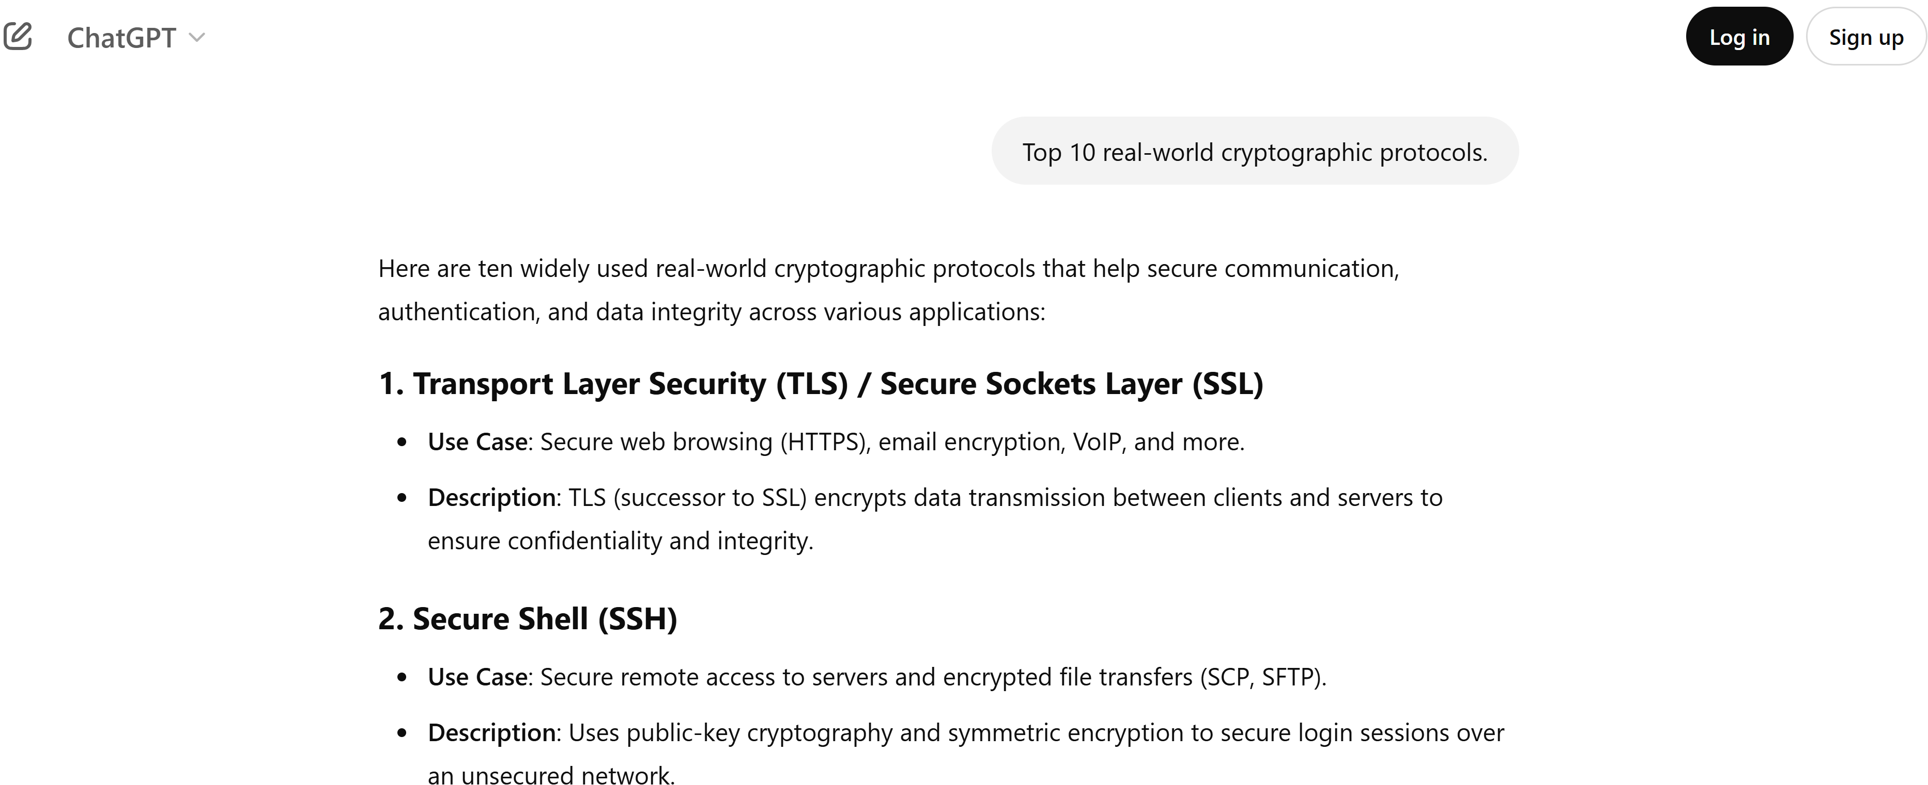
Why Analyze SSH?
Notes:
Now before I begin, why analyze SSH in the first place? Well, the answer is simple actually…

Slide 3
Why Analyze SSH?
Notes:
According to ChatGPT, SSH is the second-most important real-world cryptographic protocol, after TLS of-course. However, we believe SSH has received too little attention over the years—at-least compared to TLS. For example, if we consider the “Real World Crypto” symposium,…

Slide 4
Why Analyze SSH?
yze SSH?
Notes:
then across all the past editions starting from 2012, there were at-least 27 talks on TLS. What about SSH?

Slide 5
Why Analyze SSH?
Notes:
Only 2 talks. This is not fair, considering SSH’s status as the second “ranked” real-world cryptographic protocol by ChatGPT.

Slide 6
Why Analyze SSH?
Notes:
Anyways, all jokes aside, SSH is indeed an important security protocol on the Internet in its own right. As ChatGPT correctly/rightly mentions here, the protocol is widely used to get secure remote access to servers, used for encrypted file transfers, VPN access etc. SSH is also used across a wide range of professions—and not just people in IT—such as molecular biologists, as this meme suggests (which I found in the wild).

Slide 7
Why Analyze SSH?
Notes:
Now before discussing our analysis of SSH, let’s first see how the protocol works—at-least at a very high level. As ChatGPT again correctly says here, SSH indeed uses public-key cryptography and symmetric encryption.

Slide 8
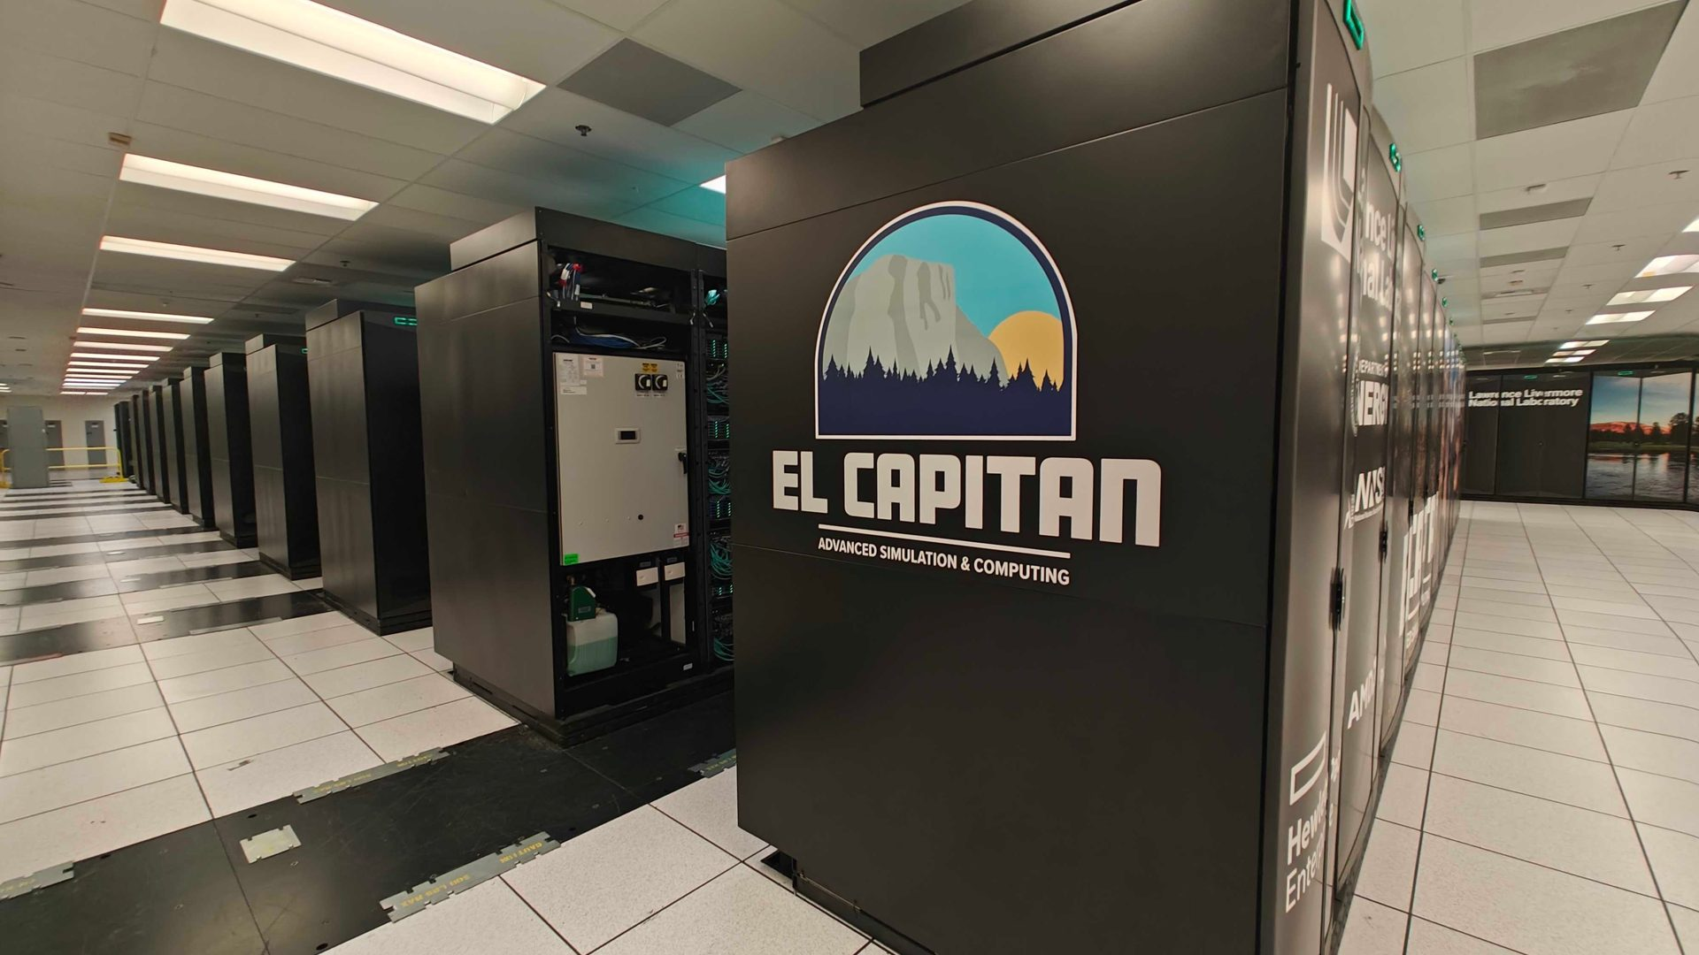
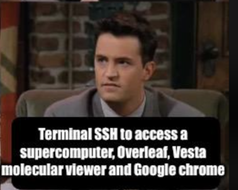
SSH Protocol
Server
Client
“Handshake Phase”
“Application Data Phase”
Notes:
In a bit more detail, the SSH client and the SSH server exchange messages/key-material at the start in a so-called “Handshake Phase”, and generate (identical) session keys (also with the server authenticating itself to the client, and optionally vice-versa) using public-key cryptography. Then the server and client use the session keys to communicate over a secure channel in the “Application Data Phase” using symmetric encryption.

Slide 9
SSH Protocol
Diffie-Hellman key-exchange, not secure against quantum attackers.
$$a$$
Server
Client
$$b$$
$$c$$
“Handshake Phase”
“Application Data Phase”
Notes:
Focusing on the public-key part, in older deployments of the SSH protocol, Diffie-Hellman key-exchange was used. But since it is not secure against attackers/adversaries who potentially have access to (large-scale) quantum computers,…

Slide 10
SSH Protocol
Diffie-Hellman key-exchange, not secure against quantum attackers.
“Hybridize” with (plausibly) quantum-secure KEM.
$$aA$$
Server
Client
$$bB$$
$$cC$$
“Handshake Phase”
“Application Data Phase”
Notes:
…current/newer versions of SSH adopt the so-called “hybrid methodology/paradigm”. In such a paradigm, the Diffie-Hellman key-exchange in the handshake phase is “hybridized”, or combined, with a quantum-secure key exchange mechanism or KEM. The basic idea here is that we want the overall hybrid key exchange in SSH to be secure as long as one of this red or green exchanges is secure. E.g., if the red part is broken by quantum computers in the future, then this hybrid key exchange should still be secure because of the green part. Conversely, if people find classical weaknesses in the KEM part (as was the case for SIKE a couple of years ago), then the SSH hybrid key exchange should at-least retain security against classical attackers/adversaries because of the (robust?) Diffie-Hellman component.
I believe Shannon will talk about such “hybrid” approaches in more detail in the next presentation.

Slide 11
SSH Protocol
Diffie-Hellman key-exchange, not secure against quantum attackers.
“Hybridize” with (plausibly) quantum-secure KEM.
$$aA$$
Server
Client
$$bB$$
$$cC$$
“Handshake Phase”
“Application Data Phase”
D. Miller, “OpenSSH PQC: Past, Present, Future”, RWPQC 2024
Notes:
In fact, SSH is one of the first (Internet) protocols to adopt this hybrid methodology on a large/wider scale, with certain implementations such as TinySSH adding support for hybrid key exchanges way back in 2018—when the NIST PQC standardization process was at an early stage—and OpenSSH making such hybrid key exchanges to be the default option in 2021.

Slide 12
Prior Analyses
$$aA$$
Server
Client
$$bB$$
$$cC$$
“Handshake Phase”
“Application Data Phase”
Notes:
However, if we look at prior analyzes of (these) post-quantum (versions of) SSH in the literature,…

Slide 13
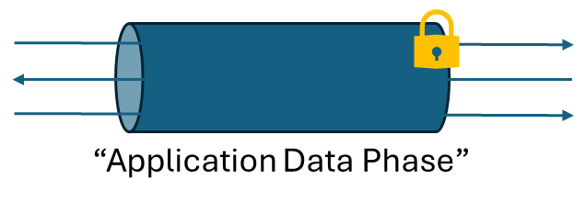
Prior Analyses
$$aA$$
Server
Client
$$bB$$
$$cC$$
“Handshake Phase”
Prior works either analyze the hybrid key exchange in isolation, or…
[ePrint ‘23]
Notes:
…then works such as the one by Petcher and Campagna either analyze this hybrid key exchange (during handshake) in isolation and do not extend their analysis to capture security of the overall protocol—e.g., whether this key exchange (or, obtained session key) guarantees confidentiality and integrity of messages sent in the application data phase (across multiple SSH sessions)—or…

Slide 14
Prior Analyses
$$aA$$
“Handshake Phase”
Server
Client
$$bB$$
$$cC$$
$$cC$$
“Handshake Phase”
“Application Data Phase”
Prior works either analyze the hybrid key exchange in isolation, or…
… analyze post-quantum SSH in unsuitable protocol models, such as “authenticated key exchange (AKE)”.
[ePrint ‘23]
[CSF ‘24]
Notes:
or prior analyzes that do consider security of the overall (PQ-)SSH protocol do not choose the right model. For example, the work by Blanchet and Jacomme model SSH as an authenticated key exchange in their (protocol-level) analysis. However in SSH, the handshake phase and application data phase are not (well-)separated as I showed previously but are “interleaved”. This makes it non-trivial—or even impossible—to analyze SSH in AKE models.

Slide 15
Our Contributions
Notes:
This brings us to our contributions in this work.

Slide 16
Our Contributions
#1: “Post-quantum SSH is cryptographically secure in practice.”
Notes:
A summary of our first contribution is that, we (formally) show current post-quantum versions of SSH as used in practice—e.g., OpenSSH, TinySSH—are indeed cryptographically secure against quantum attackers.

Slide 17
Our Contributions
#1: “Post-quantum SSH is cryptographically secure in practice.”*
(*Analysis does not cover low-level implementation details.)
Notes:
But there’s a small caveat here. Namely, our cryptographic analysis does not include some low-level implementation details, which for example,…

Slide 18
Our Contributions
#1: “Post-quantum SSH is cryptographically secure in practice.”*
(*Analysis does not cover low-level implementation details.)
Notes:
…were exploited in the recent “regreSSHion” attack against OpenSSH last year. At a very high-level, this attack worked because of an improper implementation in OpenSSH which resulted in a race condition, which in-turn would allow attackers to remotely execute code, and potentially gain root access on their targeted machines. Our cryptographic analysis, on the other hand, provides security guarantees on a “structural-level” of the protocol, and abstracts the “implementation-level” away. But we will revisit this implementation aspect in the final part of my talk.

Slide 19
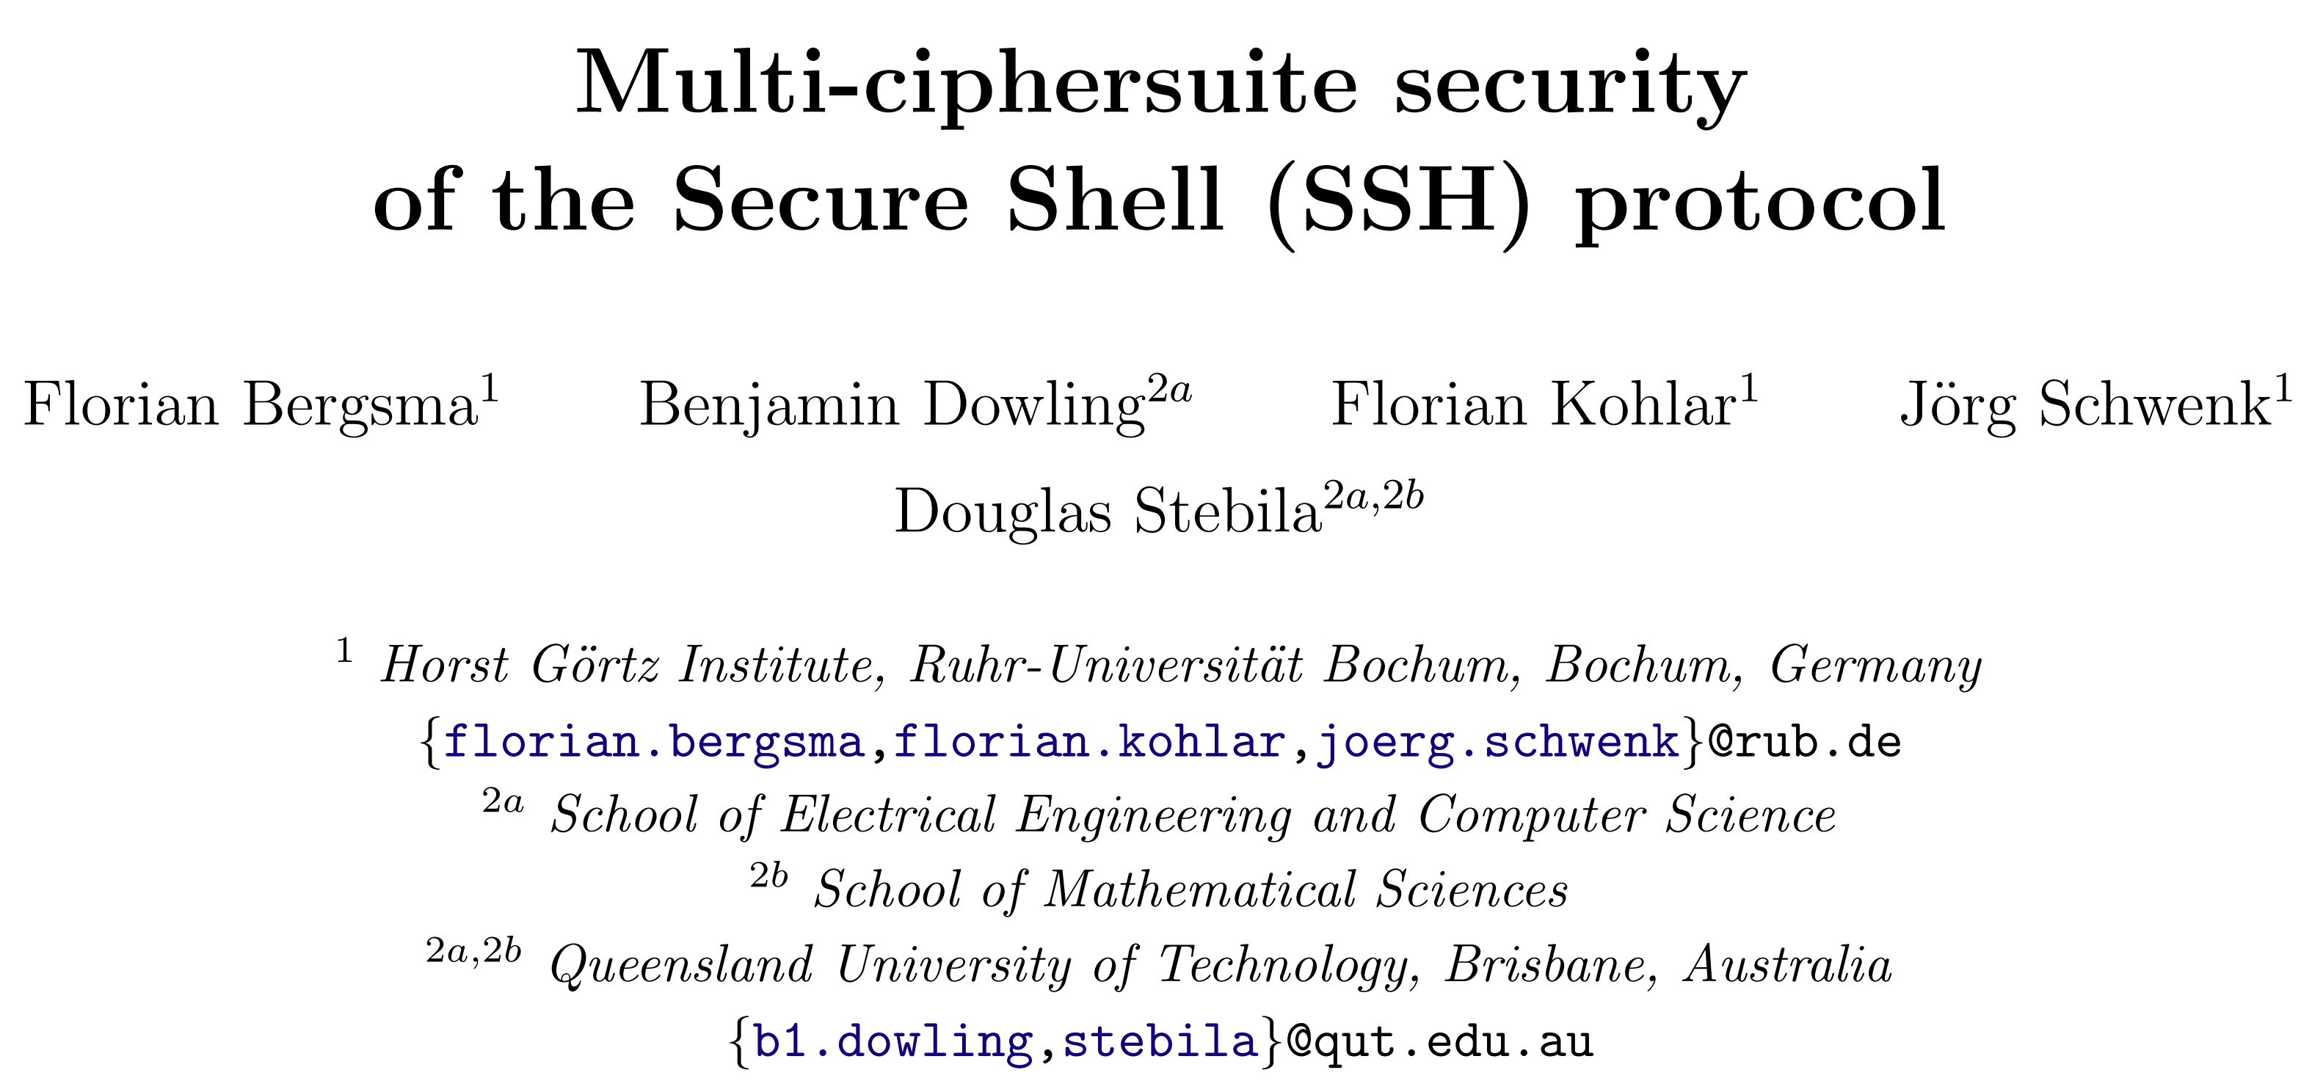
Our Contributions
Diffie-Hellman key-exchange, not secure against quantum attackers.
$$a$$
“Handshake Phase”
Server
Client
$$b$$
$$c$$
“Application Data Phase”
[BDKSS14] proves security of SSH in the “authenticated and confidential channel establishment (ACCE)” model.
However, analysis is in the classical Diffie-Hellman setting.
[CCS ‘14]
[BDKSS14]: F. Bergsma, B. Dowling, F. Kohlar, J. Schwenk, D. Stebila, “Multi-ciphersuite Security of the Secure Shell (SSH) Protocol”, CCS 2014
Notes:
Now towards our results, we first started with an earlier analysis of SSH by Bergsma, Dowling, Kohlar, Schwenk and Stebila in 2014. In their paper, the authors don’t analyze SSH in AKE-like models—because of this interleaving of phases as mentioned earlier—but instead prove security of the protocol in the so-called “authenticated and confidential channel establishment”, or ACCE, model.
However, their analysis only covers past/older versions of SSH which solely used Diffie-Hellman key-exchange in the Handshake Phase.

Slide 20
Our Contributions
Diffie-Hellman key-exchange, not secure against quantum attackers.
“Hybridize” with (plausibly) quantum-secure KEM.
$$aA$$
“Handshake Phase”
Server
Client
$$bB$$
$$cC$$
“Application Data Phase”
We establish security of SSH in a PQ-extension of ACCE model that accounts for “harvest now, decrypt later” attacks.
Analysis also captures forward secrecy (unlike the classical ACCE analysis in [BDKSS14]).
[CCS ‘14]
[S&P ‘25]
[BDKSS14]: F. Bergsma, B. Dowling, F. Kohlar, J. Schwenk, D. Stebila, “Multi-ciphersuite Security of the Secure Shell (SSH) Protocol”, CCS 2014
Notes:
So in our work, we extend their analysis to prove ACCE security of current post-quantum versions of SSH that use a hybrid key exchange. We first introduce a post-quantum extension of the original ACCE model that captures so-called “harvest now, decrypt later” attacks against the (SSH) protocol (at a high level, in our new model, (post-)quantum adversaries also get access to previously completed handshake transcripts/sessions). Then we formally established post-quantum security of SSH in our extended ACCE model. It’s worth pointing out that our analysis also captures forward secrecy, in contrast to the previous paper.

Slide 21
Our Contributions
Diffie-Hellman key-exchange, not secure against quantum attackers.
“Hybridize” with (plausibly) quantum-secure KEM.
$$aA$$
“Handshake Phase”
Server
Client
$$bB$$
$$cC$$
“Application Data Phase”
“PQ ACCE Security”
We establish security of SSH in a PQ-extension of ACCE model that accounts for “harvest now, decrypt later” attacks.
Analysis also captures forward secrecy (unlike the classical ACCE analysis in [BDKSS14]).
[BDKSS14]: F. Bergsma, B. Dowling, F. Kohlar, J. Schwenk, D. Stebila, “Multi-ciphersuite Security of the Secure Shell (SSH) Protocol”, CCS 2014
Notes:
In more detail, our post-quantum ACCE security proof/analysis for SSH relies…

Slide 22
Our Contributions
Diffie-Hellman key-exchange, not secure against quantum attackers.
“Hybridize” with (plausibly) quantum-secure KEM.
$$aA$$
“Handshake Phase”
Server
Client
$$bB$$
$$cC$$
“Application Data Phase”
“PQ ACCE Security”
We establish security of SSH in a PQ-extension of ACCE model that accounts for “harvest now, decrypt later” attacks.
Analysis also captures forward secrecy (unlike the classical ACCE analysis in [BDKSS14]).
Symmetric Encryption
Digital Signature
PRF
KEM
“Pseudo-
random”
“IND-CPA”
(passive security)
“BSAE”
(Buffered Stateful Authenticated Encryption)
“EUF-CMA”
(existentially unforgeable)
[BDKSS14]: F. Bergsma, B. Dowling, F. Kohlar, J. Schwenk, D. Stebila, “Multi-ciphersuite Security of the Secure Shell (SSH) Protocol”, CCS 2014
Notes:
…on the underlying building blocks—or primitives–of the protocol satisfying some standard notions of security. For example, we require the specific PRF used in SSH to derive session keys to be pseudorandom, the quantum-secure KEM used in SSH to be passively—or IND-CPA—secure, etc.

Slide 23
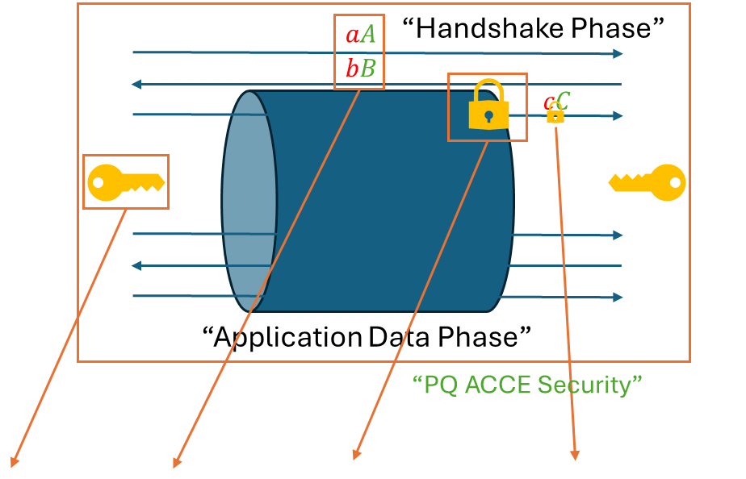
Our Contributions
Server
Client
We establish security of SSH in a PQ-extension of ACCE model that accounts for “harvest now, decrypt later” attacks.
Analysis also captures forward secrecy (unlike the classical ACCE analysis in [BDKSS14]).
We then prove corresponding PQ security properties of SSH primitives.
Symmetric Encryption
Digital Signature
PRF
KEM
“Pseudo-
random”
“IND-CPA”
(passive security)
“BSAE”
(Buffered Stateful Authenticated Encryption)
“EUF-CMA”
(existentially unforgeable)
[BDKSS14]: F. Bergsma, B. Dowling, F. Kohlar, J. Schwenk, D. Stebila, “Multi-ciphersuite Security of the Secure Shell (SSH) Protocol”, CCS 2014
Notes:
Then following a “top-down” approach, we proceeded to prove that concrete (post-quantum) instantiations of these SSH primitives in practice indeed satisfy these corresponding properties in the post-quantum setting. For example, we proved that the specific KEMs used in current versions of SSH—such as Streamlined NTRU Prime and ML-KEM—indeed satisfy IND-CPA security in the post-quantum setting.

Slide 24
Our Contributions
#2: “Post-quantum SSH can be more efficient, and eco(log|nom)ical.”
Notes:
Great! Now this brings me to our second contribution. After showing that current post-quantum versions of SSH are (indeed) provably secure, we then identify(-ied) ways to make the protocol more efficient while having it consume fewer resources. Of-course, our suggested changes to SSH still retain cryptographic security against quantum attackers.

Slide 25
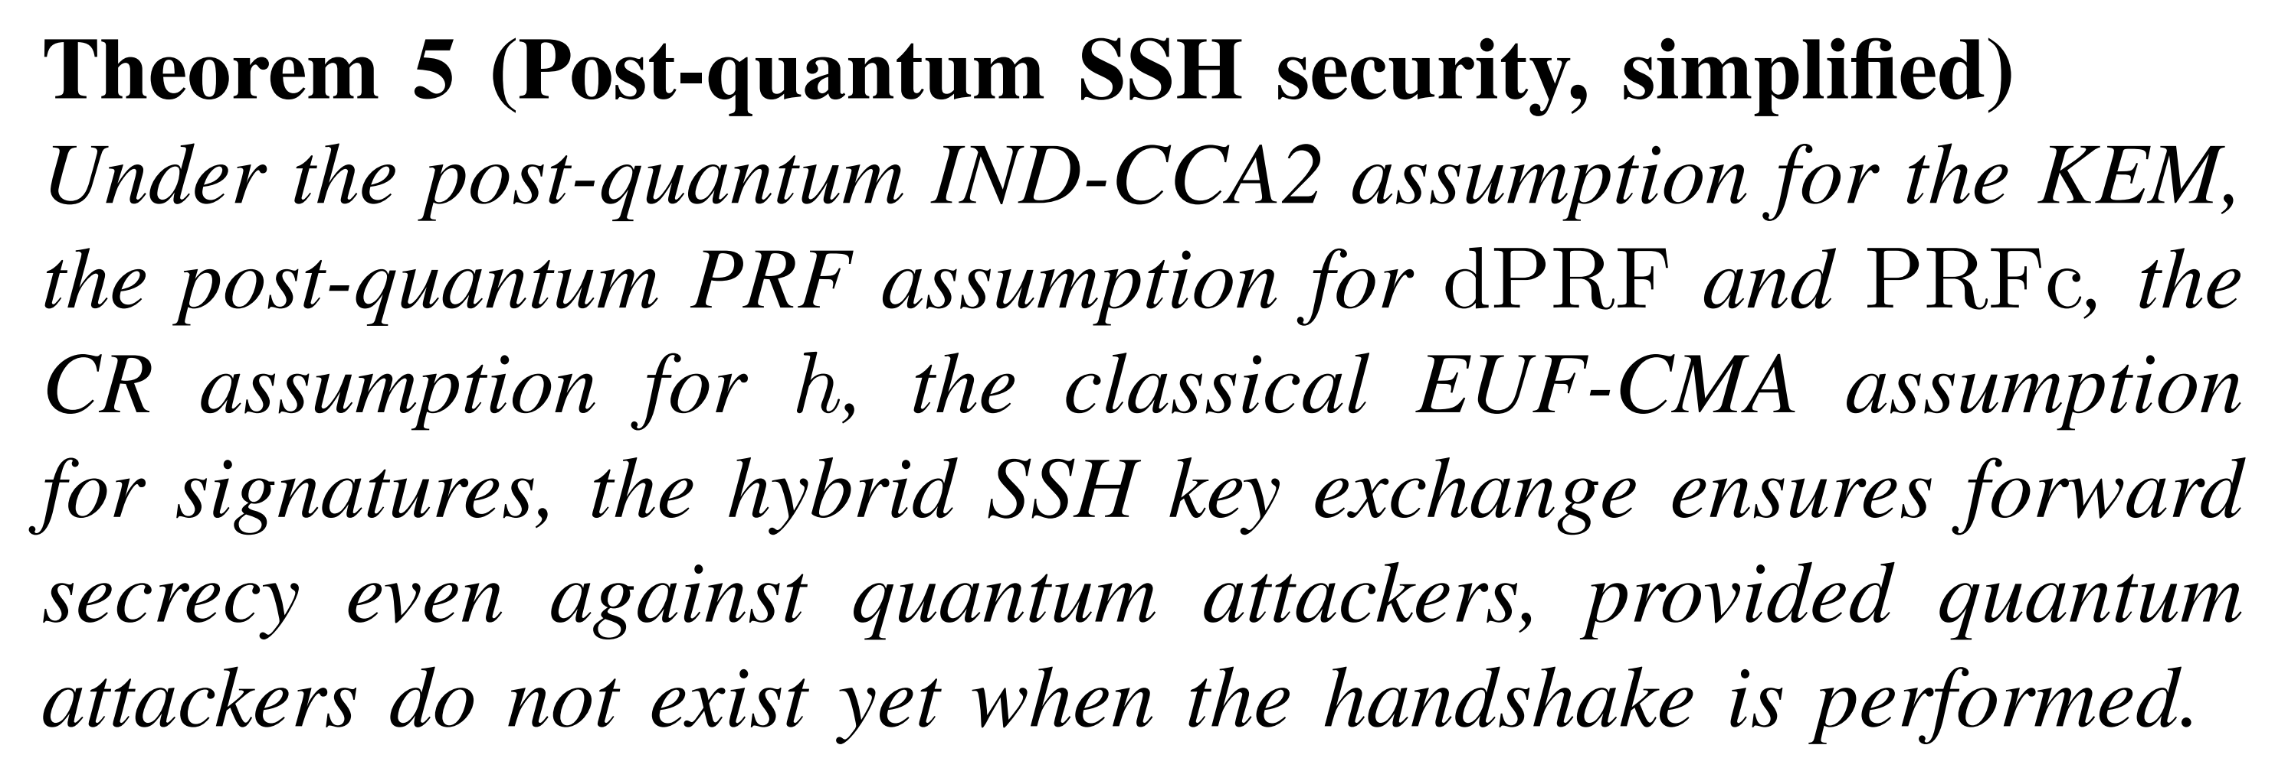
Our Contributions
Diffie-Hellman key-exchange, not secure against quantum attackers.
“Hybridize” with (plausibly) quantum-secure KEM.
$$aA$$
“Handshake Phase”
Server
Client
$$bB$$
$$cC$$
“Application Data Phase”
PQ-SSH analysis of [BlaJac24] relies on IND-CCA secure (ephemeral) KEMs.
KEM
“IND-CPA”
(passive security)
D. Miller, “OpenSSH PQC: Past, Present, Future”, RWPQC 2024
[BlaJac24]: B. Blanchet, C. Jacomme, “Post-quantum sound CryptoVerif
and verification of hybrid TLS and SSH key-exchanges”, CSF 2024
Notes:
To understand/explain our second contribution, let’s re-visit the work of Blanchet and Jacomme on post-quantum SSH. In their (protocol-level) analysis, the authors require the ephemeral quantum-secure KEMs in the handshake phase to be IND-CCA/actively secure. They say that this active IND-CCA security is needed to ensure forward secrecy against quantum attackers. However, as we discussed previously, Blanchet and Jacomme used the “Authenticated Key Exchange” (AKE) model, which is not suitable to analyze SSH.

Slide 26
(*honest reaction)
Notes:
So this was roughly our reaction after reading their paper. The authors did use some cool machine-aided tools/techniques in their analysis; however, the choice of their security model (aka AKE) led us to believe that perhaps the IND-CCA security requirement is just an artifact of their proofs.

Slide 27
Our Contributions
Diffie-Hellman key-exchange, not secure against quantum attackers.
“Hybridize” with (plausibly) quantum-secure KEM.
$$aA$$
“Handshake Phase”
Server
Client
$$bB$$
$$cC$$
“Application Data Phase”
“PQ ACCE Security”
PQ-SSH analysis of [BlaJac24] relies on IND-CCA secure (ephemeral) KEMs.
Symmetric Encryption
Digital Signature
PRF
KEM
“Pseudo-
random”
“IND-CPA”
(passive security)
“BSAE”
(Buffered Stateful Authenticated Encryption)
“EUF-CMA”
(existentially unforgeable)
D. Miller, “OpenSSH PQC: Past, Present, Future”, RWPQC 2024
[BlaJac24]: B. Blanchet, C. Jacomme, “Post-quantum sound CryptoVerif
and verification of hybrid TLS and SSH key-exchanges”, CSF 2024
Notes:
Fast forward to our analysis of SSH in the post-quantum ACCE model, that we saw a few slides ago,…

Slide 28
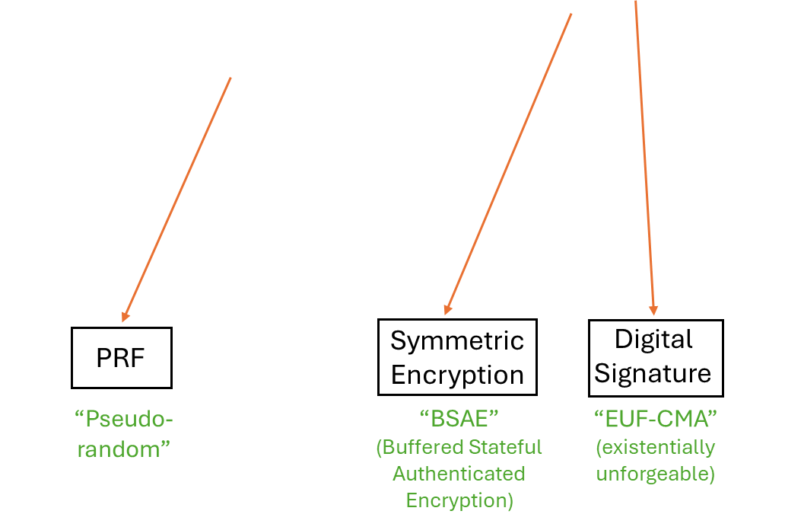
Our Contributions
Diffie-Hellman key-exchange, not secure against quantum attackers.
“Hybridize” with (plausibly) quantum-secure KEM.
$$aA$$
“Handshake Phase”
Server
Client
$$bB$$
$$cC$$
“Application Data Phase”
“PQ ACCE Security”
PQ-SSH analysis of [BlaJac24] relies on IND-CCA secure (ephemeral) KEMs.
Whereas our analysis relies on the weaker property of IND-CPA security.
KEM
“IND-CPA”
(passive security)
D. Miller, “OpenSSH PQC: Past, Present, Future”, RWPQC 2024
[BlaJac24]: B. Blanchet, C. Jacomme, “Post-quantum sound CryptoVerif
and verification of hybrid TLS and SSH key-exchanges”, CSF 2024
Notes:
… note that we only rely on the weaker notion of IND-CPA security—even for forward secrecy of the overall protocol. In other words, we formally show that IND-CCA security of the ephemeral KEMs is (technically) not required…

Slide 29
(*honest reaction)
Notes:
And now, we’re getting somewhere…

Slide 30
Our Contributions
Diffie-Hellman key-exchange, not secure against quantum attackers.
“Hybridize” with (plausibly) quantum-secure KEM.
$$aA$$
“Handshake Phase”
Server
Client
$$bB$$
$$cC$$
“Application Data Phase”
“PQ ACCE Security”
PQ-SSH analysis of [BlaJac24] relies on IND-CCA secure (ephemeral) KEMs.
Whereas our analysis relies on the weaker property of IND-CPA security.
Our analysis suggests FO transform is not needed, which in turn can lead to performance improvements in PQ-SSH.
KEM
KEM
KEM
“Fujisaki-Okamoto” transform
“IND-CPA”
(passive security)
“IND-CPA”
(passive security)
“IND-CCA”
(active security)
D. Miller, “OpenSSH PQC: Past, Present, Future”, RWPQC 2024
[BlaJac24]: B. Blanchet, C. Jacomme, “Post-quantum sound CryptoVerif
and verification of hybrid TLS and SSH key-exchanges”, CSF 2024
Notes:
Because note that in practice, the quantum-secure KEMs used in current versions of SSH, such as Streamlined NTRU Prime and the NIST standard ML-KEM, are designed to achieve the stronger notion of IND-CCA security via a generic technique called the “Fujisaki-Okamoto”, or FO, transform. Such a transform, at a very high-level, converts an IND-CPA secure KEM to an IND-CCA secure KEM, and incurs some performance overhead. So our analysis suggests that this FO transform is not needed after all in the context of post-quantum security of SSH, which in turn should lead to performance improvements in the KEMs during the handshake phase, and hence, improvements in the protocol overall.

Slide 31
(*honest reaction)
Notes:
As you can see here, we were quite excited by this idea. So we wanted to evaluate the (concrete) performance improvements (we would get/obtain) in SSH when replacing the FO transform in KEMs with a much simpler IND-CPA transform

Slide 32
Our Contributions
Notes:
However, the actual speedup/numbers we noticed in our experiments was/were…..not great. I mean we did have a 52% speedup in case of ML-KEM; but this was when we ran ML-KEM *in isolation*--and not as part of the SSH protocol—and that too in a “non-hybridized” form (i.e., not combined with a Diffie-Hellman-like exchange)

Slide 33
(*honest reaction)
Notes:
So expectedly, we were a bit bummed (“Why are you guys laughing? I’m crying over here!”), but I don’t think we cried…

Slide 34
Our Contributions
Small performance gains should accumulate in large scale SSH deployments.
Measurement w.r.t. a single SSH connection.
Notes:
But going back to our experiments, note that we only measured timings for a *single* SSH connection. And considering the large number of SSH connections that happen per day worldwide, these small speedups should add up (note to self: it rhymes).

Slide 35
Our Contributions
Small performance gains should accumulate in large scale SSH deployments.
IND-CCA $→$ IND-CPA leads to $≈$80% reduction in hash computations.
Measurement w.r.t. a single SSH connection.
Notes:
Just to give an example of this “amplification effect” (i.e.., how a seemingly small speedup can have noticeable effects in large scale deployments), let’s consider the number of hash computations in the ephemeral KEMs in SSH. Replacing the FO transform with a simpler transform leads to a 80% reduction (in number of hashes).

Slide 36
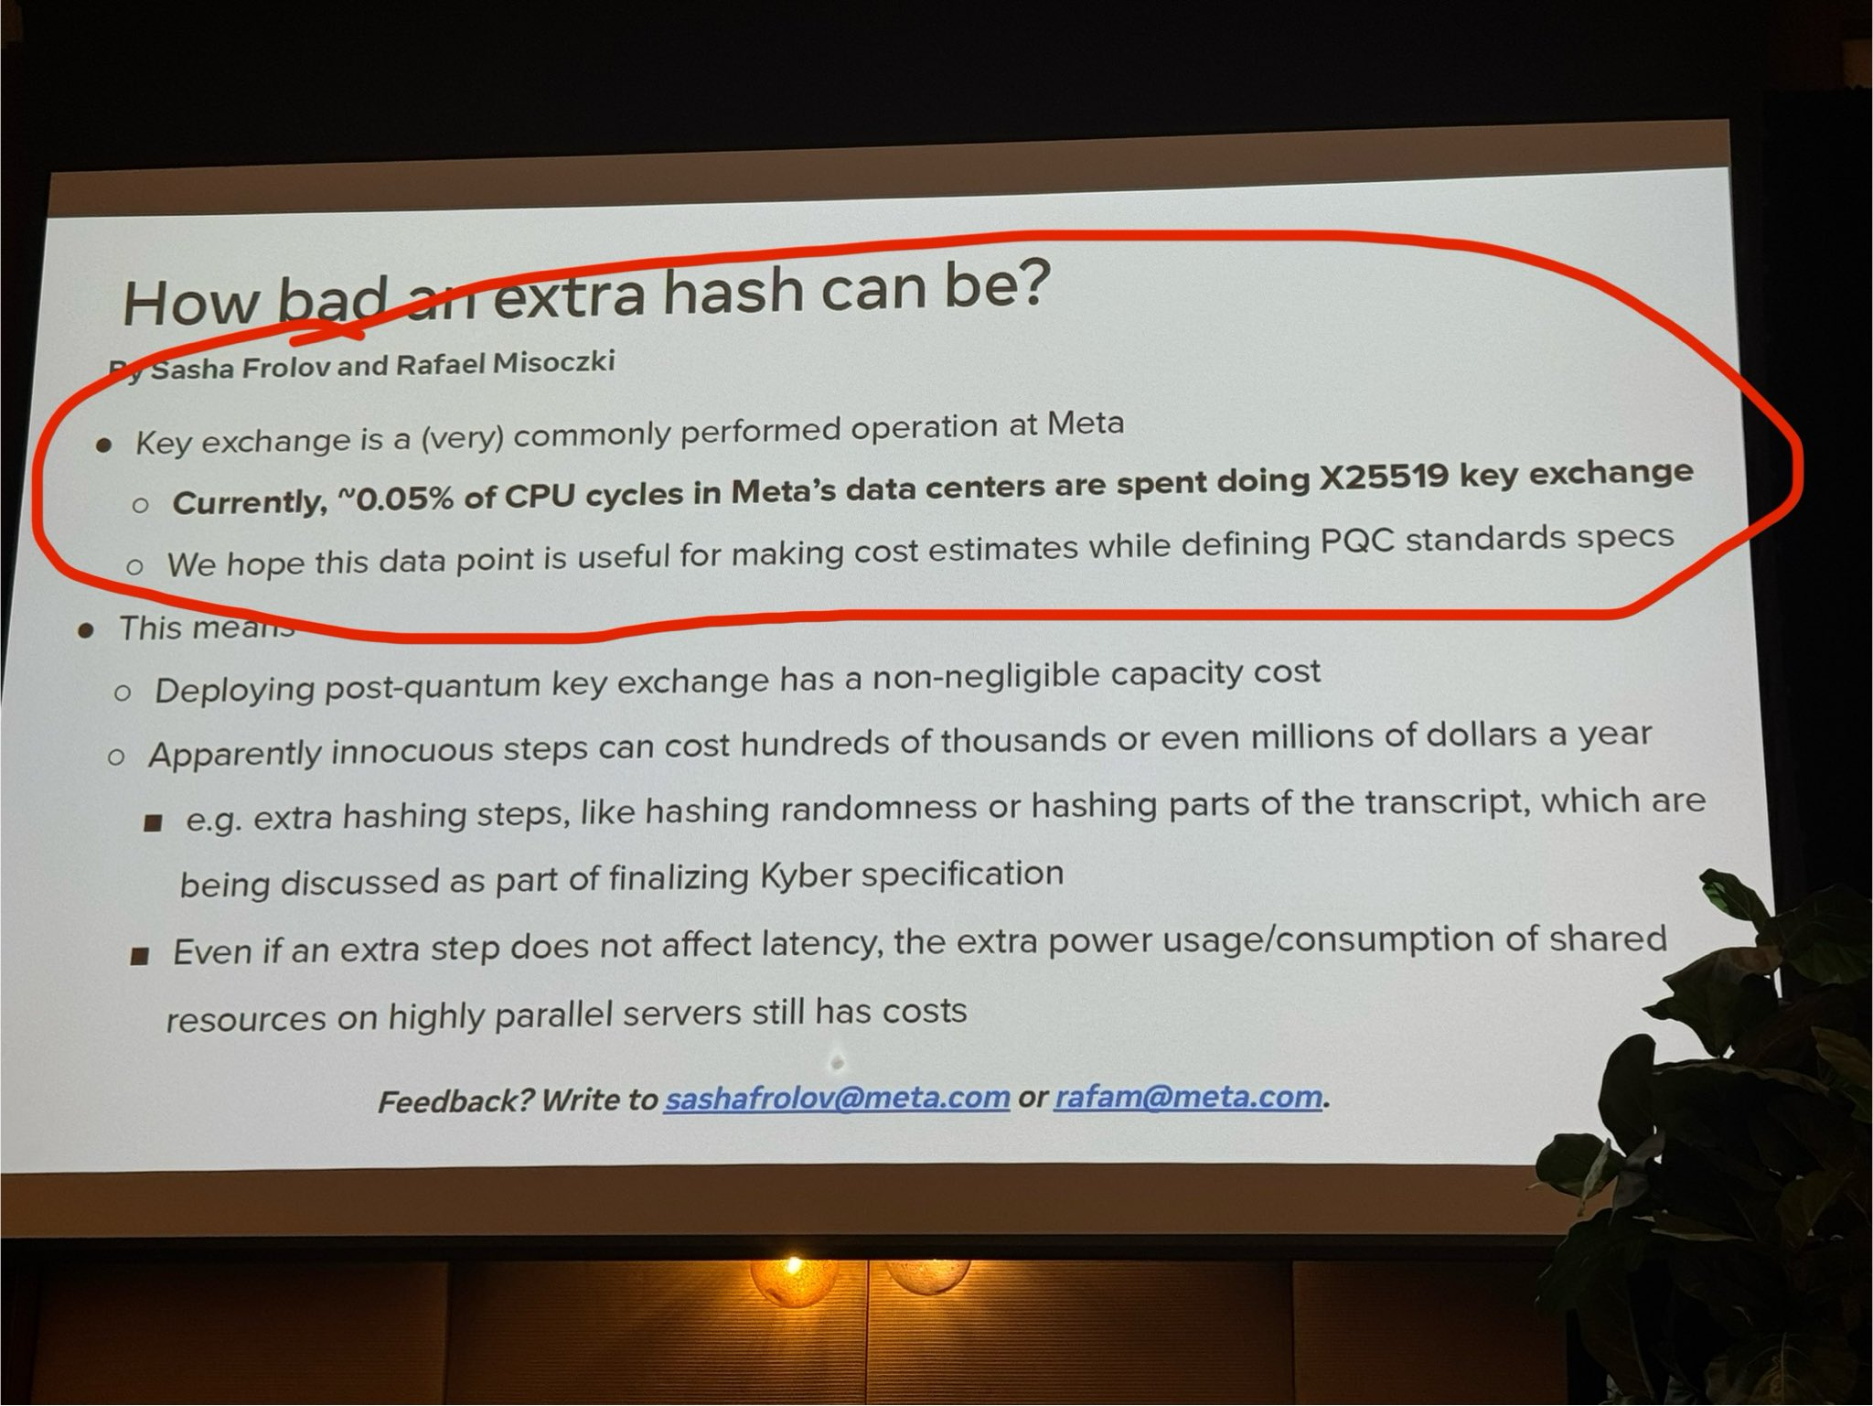
Our Contributions
Small performance gains should accumulate in large scale SSH deployments.
IND-CCA $→$ IND-CPA leads to $≈$80% reduction in hash computations.
Measurement w.r.t. a single SSH connection.
S. Frolov, R. Misoczki, “Meta PQC Updates”, RWPQC 2024 (https://x.com/bwesterb/status/1771958142147973390)
Notes:
And at the Real World Post-quantum Crypto Workshop last year, there was a presentation on PQC updates at Meta, where it was mentioned that “an extra hash” can cost “hundreds of thousands or even millions of dollars a year” along with the associated power usage/consumption in data centers. Disclaimer: we didn’t work out the exact costs, but I’m providing this example for reference

Slide 37
(*honest reaction)
Notes:
And yeah, we were kinda shocked—and also *very* excited–by these numbers. Because this showcases the potential of using simpler IND-CPA secure KEMs in post-quantum SSH to reduce ecologicial and financial costs significantly in the real-world.

Slide 38
Our Contributions
“TLS, and not SSH, represents the major workload for Meta.”
- Reviewer 2
Small performance gains should accumulate in large scale SSH deployments.
IND-CCA $→$ IND-CPA leads to $≈$80% reduction in hash computations.
Measurement w.r.t. a single SSH connection.
S. Frolov, R. Misoczki, “Meta PQC Updates”, RWPQC 2024 (https://x.com/bwesterb/status/1771958142147973390)
Notes:
However, when we described this in our paper, a reviewer--specifically, reviewer #2 (it’s always reviewer #2)—quickly gave us a reality check. They said “actually TLS, and not SSH, is a major workload for Meta.” So perhaps the reduction in costs for SSH would be much less. Btw on these slides, Meta is just a placeholder/example; we might as well replace Meta with other big organizations such as Google, Amazon, etc. Anyways, the reviewer did have a valid point. But now shall we talk about TLS? Let’s talk about TLS…

Slide 39
Our Contributions
IND-CPA secure ephemeral KEMs suffice for PQ-SSH!
[S&P ‘25]
Notes:
Note that our work shows IND-CPA secure ephemeral KEMs suffice for post-quantum security of the overall SSH protocol.

Slide 40
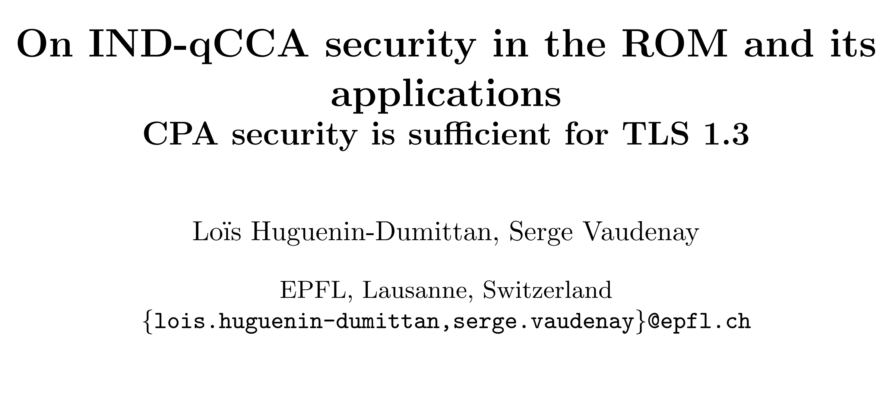
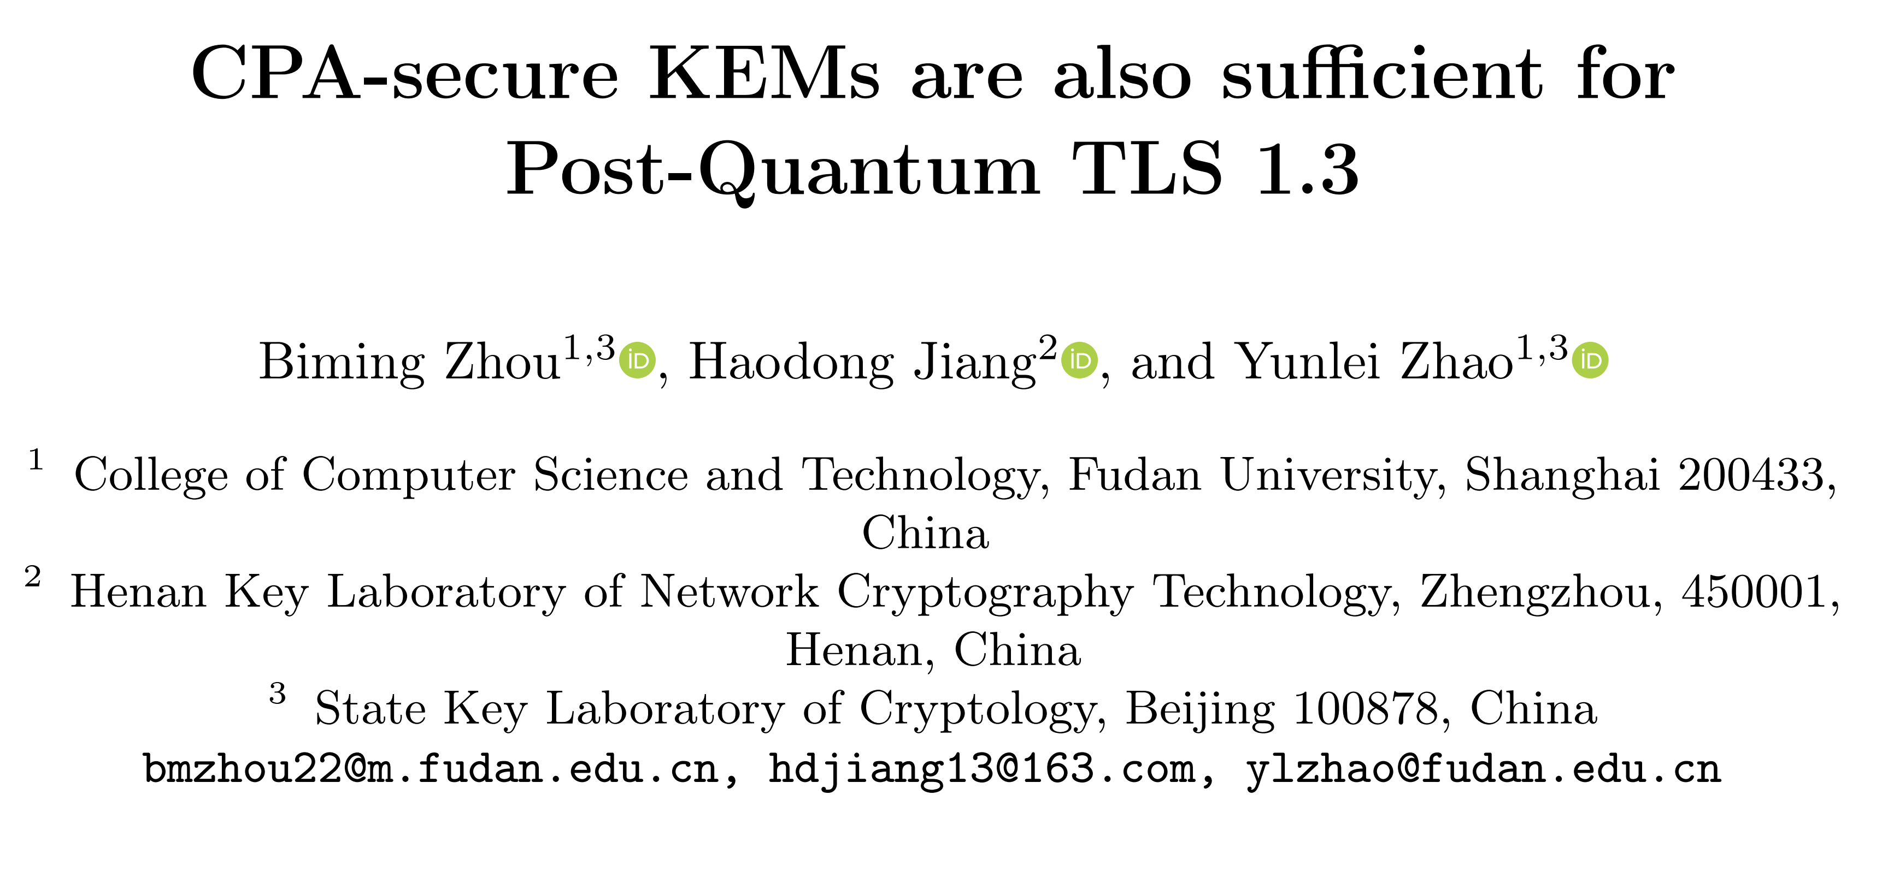
Our Contributions
IND-CPA secure ephemeral KEMs suffice for PQ-SSH!
[S&P ‘25]
IND-CPA secure ephemeral KEMs suffice for PQ-TLS too!
[Eurocrypt ‘22]
[Asiacrypt ‘24]
Notes:
But in fact, our results follow a couple of recent works shown here which also prove that IND-CPA secure (ephemeral) KEMs suffice for the security of post-quantum TLS too! (Though our SSH security proofs are tighter than their TLS ones…)

Slide 41
Discussion
Q: “Should post-quantum SSH/TLS be made efficient, and eco(log|nom)ical?”
Notes:
This brings me to the last part of my talk, which is about starting a discussion on whether we should indeed try to make SSH—or TLS—efficient as per our suggestion of replacing IND-CCA secure ephemeral KEMs with IND-CPA secure ones. Specifically, I’ll be discussing some main hurdles/obstacles against this change.

Slide 42
Discussion
“TLS, and not SSH, represents the major workload for Meta.”
- Reviewer 2
Small performance gains should accumulate in large scale SSH deployments.
IND-CCA $→$ IND-CPA leads to $≈$80% reduction in hash computations.
Measurement w.r.t. a single SSH connection.
S. Frolov, R. Misoczki, “Meta PQC Updates”, RWPQC 2024 (https://x.com/bwesterb/status/1771958142147973390)
Notes:
First, if we go back to reviewer #2’s comments on TLS being the major workload for Meta, and not SSH, interestingly…

Slide 43
Discussion
“TLS, and not SSH, represents the major workload for Meta.”
- Reviewer 2
“TLS, and not SSH, AI represents the major workload for Meta.”
- Reviewer 3
Small performance gains should accumulate in large scale SSH deployments.
IND-CCA $→$ IND-CPA leads to $≈$80% reduction in hash computations.
Measurement w.r.t. a single SSH connection.
S. Frolov, R. Misoczki, “Meta PQC Updates”, RWPQC 2024 (https://x.com/bwesterb/status/1771958142147973390)
Notes:
reviewer #3 said that it’s not TLS or SSH or any other cryptographic protocol (for that matter) that is the major workload for Meta, but it’s in-fact AI algorithms. This indeed seems to be the case given the current AI boom. So if cryptographic costs don’t matter much when compared to other technologies like AI, is it worth putting in considerable effort to make such protocols efficient? What’s the tradeoff here? (Btw I’m just asking provocative questions here for the sake of a discussion)
Propose open question of measuring SSH deployment in practice

Slide 44
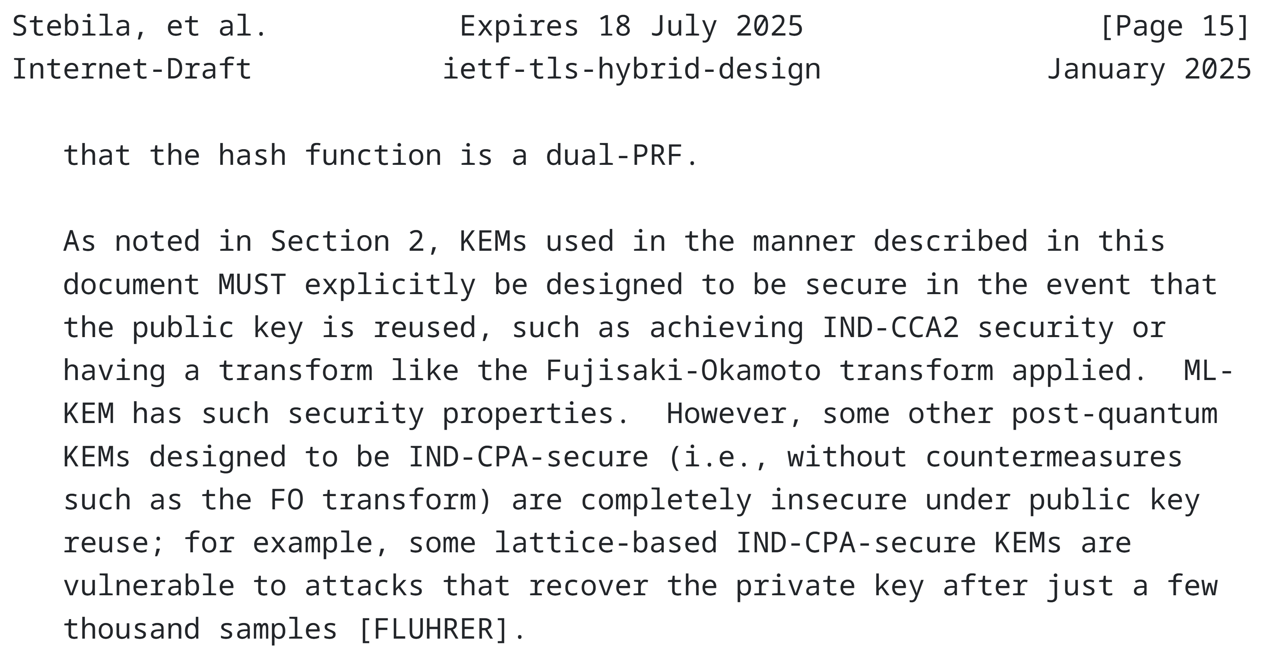
Discussion
IND-CCA secure KEMs defend against potential public key-reuse attacks in faulty TLS/SSH implementations.
Is there a way to retain IND-CPA efficiency, while preventing such implementation errors from happening?
Or, should we now formally analyze TLS/SSH in a “faulty/adversarial implementation” security model?
We might then have to rely on “stronger-than-IND-CCA” security of KEMs.
D. Stebila , S. Fluhrer , S. Gueron, “Hybrid key exchange in TLS 1.3” (https://datatracker.ietf.org/doc/draft-ietf-tls-hybrid-design/)
Notes:
Another reason why people would rather have IND-CCA secure KEMs over IND-CPA secure ones in (protocols like) TLS/SSH is that such KEMs—which are supposed to be ephemeral (i.e., whose public-key is supposed to be used only once to generate a session key)—might not be used as such; this could be because of some implementation errors. So as described in this IETF draft for post-quantum TLS, the stronger IND-CCA notion provides security guarantees in such scenarios.
But the question I’d like to ask here is that, instead of making changes to the protocol at a cryptographic/primitive level, can we make sure that such implementation errors do not happen in the first place—e.g., via stricter checks/guardrails? This would ensure that we can safely use the simpler and more efficient IND-CPA ephemeral KEMs, as suggested by current security proofs, in our TLS/SSH protocol.

Slide 45
Discussion
IND-CCA secure KEMs defend against potential public key-reuse attacks in faulty TLS/SSH implementations.
Is there a way to retain IND-CPA efficiency, while preventing such implementation errors from happening?
Or, should we now formally analyze TLS/SSH in a “faulty/adversarial implementation” security model?
We might then have to rely on “stronger-than-IND-CCA” security of KEMs.
D. Stebila , S. Fluhrer , S. Gueron, “Hybrid key exchange in TLS 1.3” (https://datatracker.ietf.org/doc/draft-ietf-tls-hybrid-design/)
Notes:
But taking a step back, note that we’re still pretty much talking about low-level implementation details here. And as I mentioned earlier on in my talk, our cryptographic analysis of SSH does not cover such details. So in practice/in the real-world, if cryptographic analyses/proofs are not sufficient and one needs to take care of the possibility of protocols being implemented wrongly/incorrectly, then why don’t we approach this issue in a more systematic and formal manner?

Slide 46
Discussion
IND-CCA secure KEMs defend against potential public key-reuse attacks in faulty TLS/SSH implementations.
Is there a way to retain IND-CPA efficiency, while preventing such implementation errors from happening?
Or, should we formally analyze TLS/SSH in a “faulty/adversarial implementation” (i.e., kleptographic) model?
We might then have to rely on “stronger-than-IND-CCA” security of KEMs.
D. Stebila , S. Fluhrer , S. Gueron, “Hybrid key exchange in TLS 1.3” (https://datatracker.ietf.org/doc/draft-ietf-tls-hybrid-design/)
Notes:
Namely, why don’t we extend our (existing) cryptographic analyses of (protocols like) TLS/SSH to a model which additionally allows an adversary to tweak with the protocol implementations in a subtle but malicious manner? This line of study is also known as kleptography in the literature. Who knows, maybe it turns out that IND-CCA secure KEMs are not sufficient, and we may need even more powerful and inefficient KEMs to defend against such kleptographic attacks?

Slide 47
Discussion
Efficient IND-CPA secure KEMs suffice for post-quantum SSH!
Notes:
And the final obstacle (for implementing this IND-CPA change) that I’ll be talking about goes back to a discussion we had with Damien Miller, a (lead) maintainer of OpenSSH. Following our (cryptographic) analysis of post-quantum SSH, I reached out to Damien saying that, in principle, the IND-CCA secure KEMs being used in OpenSSH—namely “Streamlined NTRU Prime” and “ML-KEM”—can be replaced by their more efficient IND-CPA secure counterparts.

Slide 48
Discussion
Efficient IND-CPA secure KEMs suffice for post-quantum SSH!
Cool! Are such IND-CPA secure KEMs FIPS-compliant?
Damien Miller
(OpenSSH Maintainer)
Notes:
Damien appreciated our analysis, and basically asked us whether our proposed IND-CPA secure KEMs are FIPS-compliant.

Slide 49
Discussion
Efficient IND-CPA secure KEMs suffice for post-quantum SSH!
Cool! Are such IND-CPA secure KEMs FIPS-compliant?
😶
Damien Miller
(OpenSSH Maintainer)
Notes:
*awkward silence*. But yeah, Damien indeed raised a valid point. Compliance with standard bodies such as NIST is another major factor for resisting such changes to adopt IND-CPA secure KEMs in (widely used protocols like) SSH/TLS.
(Practitioners would rather be compliant with NIST guidelines…)

Slide 50
Discussion
Efficient IND-CPA secure KEMs suffice for post-quantum SSH!
Cool! Are such IND-CPA secure KEMs FIPS-compliant?
😶
Damien Miller
(OpenSSH Maintainer)
Should NIST have an “on-ramp” process for IND-CPA secure KEMs w.r.t. key exchange protocols?
NIST, “Call for Proposals for Post-Quantum Cryptography Standardization”, December 2016
Notes:
Following this exchange, we revisited NIST’s original call for proposals to standardize post-quantum KEMs. There it was mentioned that for ephemeral key exchange protocols, NIST will consider standardizing KEMs that only provide passive/IND-CPA security. But this was back in 2016. Fast forward to the present time where NIST’s PQC standardization process is now over, the two chosen standards ML-KEM and HQC only satisfy IND-CCA security. So for applications using ephemeral key exchange such as TLS/SSH, should NIST have a separate “on-ramp” process (similar to the one for digital signatures that is currently on-going) to standardize IND-CPA secure KEMs?

Slide 51
Post-quantum Cryptographic Analysis of SSH
Varun Maram
Cybersecurity Group
SandboxAQ
: https://varun-maram.github.io/
: varun-maram-pqc
Joint work with Benjamin Benčina, Benjamin Dowling, and Keita Xagawa
Notes:
Anyways, thanks a lot for your attention! I’m happy to take any questions, or participate/looking forward to some discussions! (I know that I’ve been asking a lot of questions, for which I don’t have the answers. But hopefully some of you do.)

Slide 52
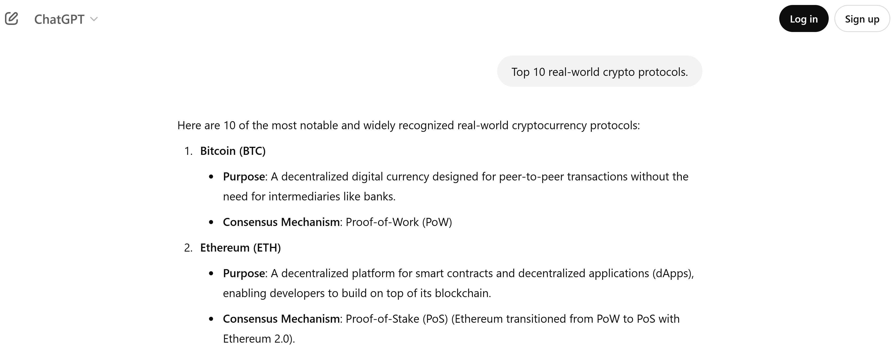
Why Analyze SSH?
Notes:
”Lemme just ask ChatGPT”. I asked ChatGPT in a very clickbait-y manner “What are the top 10 real-world crypto protocols (perhaps of all time)?”, since we’re at Real World Crypto after all. Could anyone guess what was the first one on the list?

Slide 53
Why Analyze SSH?
Notes:
Bitcoin! Followed by Ethereum., Solana, etc. (Unfortunately ChatGPT has the wrong notion of crypto, but I can’t blame it.)

Slide 54
Why Analyze SSH?
Notes:
And of course, Bitcoin again. Anyways,…

Slide 55
Prior Analyses
$$aA$$
Server
Client
$$bB$$
$$cC$$
“Handshake Phase”
“Application Data Phase”
Shows hybrid KEX primitive in SSH is secure against active attackers (i.e., IND-CCA security).
However, does not consider full quantum capabilities of attackers (i.e., the quantum “random oracle model”/ROM).
Also does not consider protocol-level adversaries.
[ePrint ‘23]
Notes:
I.e., adversaries who not only target the hybrid key exchange primitive (as considered in this paper), but who attempt to break security of the entire SSH protocol by potentially attacking multiple SSH sessions in an arbitrary fashion, such as eavesdropping and/or injecting messages, corrupting (long-term keys of) users, obtaining session keys in related sessions, etc.

Slide 56
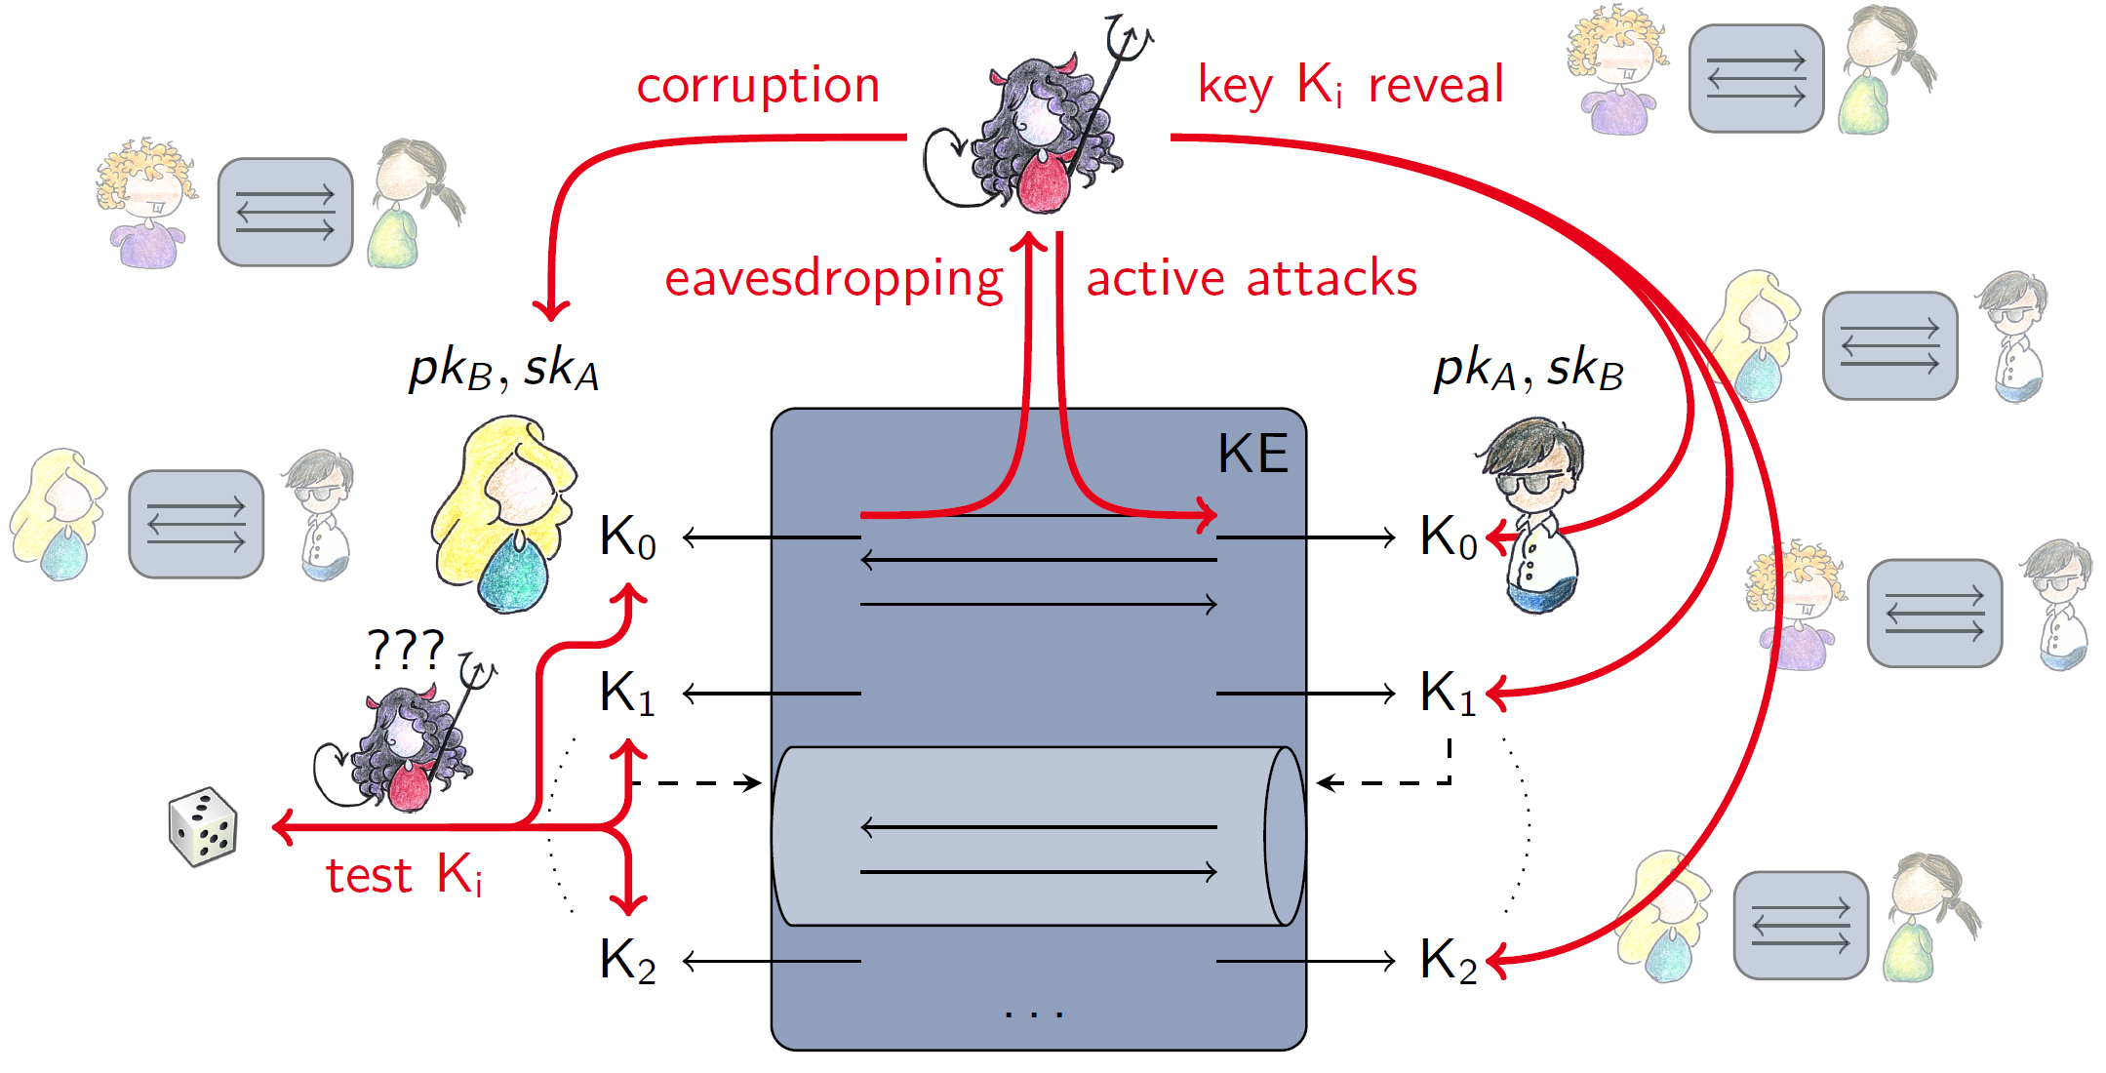
Prior Analyses
$$aA$$
Server
Client
$$bB$$
$$cC$$
“Handshake Phase”
“Application Data Phase”
Shows hybrid KEX primitive in SSH is secure against active attackers (i.e., IND-CCA security).
However, does not consider full quantum capabilities of attackers (i.e., the quantum “random oracle model”/ROM).
Also does not consider protocol-level adversaries.
[ePrint ‘23]
Slides by Felix Günther (https://www.felixguenther.info/talks/ecryptnetschool2018-09-19.pdf)
Notes:
I.e., adversaries who not only target the hybrid key exchange primitive (as considered in this paper), but who attempt to break security of the entire SSH protocol by potentially attacking multiple SSH sessions in an arbitrary fashion, such as eavesdropping and/or injecting messages, corrupting (long-term keys of) users, obtaining session keys in related sessions, etc.

Slide 57
Prior Analyses
$$aA$$
Server
Client
$$bB$$
$$cC$$
“Handshake Phase”
“Application Data Phase”
Provides formal security guarantees for PQ versions of SSH and TLS using a machine-aided approach.
However, SSH was analyzed in an “authenticated key exchange (AKE)”-like model.
As explained in [BDKSS14], AKE models are not appropriate for SSH.
[CSF ‘24]
[BDKSS14]: F. Bergsma, B. Dowling, F. Kohlar, J. Schwenk, D. Stebila, “Multi-ciphersuite Security of the Secure Shell (SSH) Protocol”, CCS 2014
Notes:
However, in their analysis, Blanchet and Jacomme model SSH as an authenticated key exchange, or AKE(, protocol). And as explained in previous works on SSH, AKE models are not appropriate to analyze security of the protocol. In more detail, note that, in practice, the handshake phase and application data phase in SSH are not nicely separated as shown on this slide,…

Slide 58
Prior Analyses
$$aA$$
“Handshake Phase”
Server
Client
$$bB$$
$$cC$$
“Application Data Phase”
In SSH, there’s an overlap between the “Handshake Phase” and the “Application Data Phase”.
Attacker can detect “real” or “random” key by decrypting the final handshake messages , thereby breaking session-key indistinguishability.
$$cC$$
[CSF ‘24]
Notes:
And this interleaving makes it difficult—or even impossible—to analyze SSH in an AKE security model. One of the reasons is that an attacker can trivially distinguish between real or random session keys by decrypting these final handshake messages—since the adversary has the real/random session key (which is allowed in the AKE model)—thereby breaking key-indistinguishability (as required by the notion of AKE security). (Note that these final handshake messages are also called “key confirmation” messages, and they are typically static/fixed (e.g., they may just say “Handshake Finished”) which in-turn help the attacker to distinguish).

Slide 59
Our Contributions
Diffie-Hellman key-exchange, not secure against quantum attackers.
“Hybridize” with (plausibly) quantum-secure KEM.
$$aA$$
“Handshake Phase”
Server
Client
$$bB$$
$$cC$$
“Application Data Phase”
Extended the original ACCE model to account for “harvest now, decrypt later” attacks (giving access to past handshakes).
Formally proved post-quantum security of SSH in this enhanced model.
Analysis also captures forward secrecy (unlike the classical ACCE analysis in [BDKSS14]).
[ePrint ‘25]
[BDKSS14]: F. Bergsma, B. Dowling, F. Kohlar, J. Schwenk, D. Stebila, “Multi-ciphersuite Security of the Secure Shell (SSH) Protocol”, CCS 2014
Notes:
So in our work, we extended their analysis to prove ACCE security of current versions of SSH that use a hybrid key exchange. Towards our analysis, we first extended the original ACCE model to account for so-called “harvest now, decrypt later” attacks against the (SSH) protocol; at a high level, in our new model, (post-)quantum adversaries also get access to previously completed handshake transcripts/sessions. Then we formally established post-quantum security of SSH in our enhanced ACCE model. It’s worth pointing out that our analysis also captures forward secrecy, in contrast to the previous paper.

Slide 60
Our Contributions
Diffie-Hellman key-exchange, not secure against quantum attackers.
“Hybridize” with (plausibly) quantum-secure KEM.
$$aA$$
“Handshake Phase”
Server
Client
$$bB$$
$$cC$$
“Application Data Phase”
“PQ ACCE Security”
Proved security of SSH’s “hybridizing” method in the post-quantum setting (i.e., the QROM).
Established IND-CPA (and IND-CCA) security of “Streamlined NTRU Prime” in the QROM (thereby addressing an open problem in [Xagawa22]).
KEM
“IND-CPA”
(passive security)
Notes:
So after establishing post-quantum ACCE security of SSH on a protocol-level, (that IND-CPA secure hybrid KEMs–along with other secure building blocks—result in SSH being a secure ACCE protocol in the post-quantum setting), we shifted our focus to prove IND-CPA security of the actual hybrid KEMs used in current versions/implementations of SSH at a primitive-level—essentially following a “top-down” approach in our analysis. Specifically, we were able to show that the way Diffie-Hellman (or other pre-quantum) key exchange and quantum-secure key exchanges are combined/”hybridized” in post-quantum SSH in practice can indeed result in IND-CPA secure hybrid KEMs in the quantum ROM (our result is in contrast to previous works on SSH that relied on classical ROM).

Slide 61
Our Contributions
Diffie-Hellman key-exchange, not secure against quantum attackers.
“Hybridize” with (plausibly) quantum-secure KEM.
$$aA$$
“Handshake Phase”
Server
Client
$$bB$$
$$cC$$
“Application Data Phase”
“PQ ACCE Security”
KEM
“IND-CPA”
(passive security)
[Xagawa22]: K. Xagawa, “Anonymity of NIST PQC Round 3 KEMs”, EUROCRYPT 2022
D. Miller, “OpenSSH PQC: Past, Present, Future”, RWPQC 2024
Notes:
Now of-course, to obtain IND-CPA secure hybrid KEMs, we also require the underlying quantum-secure KEM used in SSH to satisfy IND-CPA security (in the QROM as well). And if we look at SSH implementations in practice, such as OpenSSH and TinySSH, most of them instantiate the quantum-secure KEM with a scheme called “Streamlined NTRU Prime”. Streamlined NTRU Prime is a KEM which was submitted to NIST’s PQC standardization process.

Slide 62
Our Contributions
Diffie-Hellman key-exchange, not secure against quantum attackers.
“Hybridize” with (plausibly) quantum-secure KEM.
$$aA$$
“Handshake Phase”
Server
Client
$$bB$$
$$cC$$
“Application Data Phase”
“PQ ACCE Security”
Established IND-CPA (and IND-CCA) security of “Streamlined NTRU Prime” in the quantum random oracle model (addressing an open problem in [Xagawa22]).
KEM
“IND-CPA”
(passive security)
[Xagawa22]: K. Xagawa, “Anonymity of NIST PQC Round 3 KEMs”, EUROCRYPT 2022
D. Miller, “OpenSSH PQC: Past, Present, Future”, RWPQC 2024
Notes:
Hence, we (concretely) proved IND-CPA security of Streamlined NTRU Prime in the QROM with relatively tight bounds, and also describe a way to formally establish the stronger notion of IND-CCA security too. This result is relevant/important (on its own) because a prior work by Xagawa points out that it’s quite non-trivial to analyze Streamlined NTRU Prime in the QROM because of certain design choices in the KEM, and leaves it as an open problem. Hence, our analysis here overcomes those issues.

Slide 63
Our Contributions
Diffie-Hellman key-exchange, not secure against quantum attackers.
“Hybridize” with (plausibly) quantum-secure KEM.
$$aA$$
“Handshake Phase”
Server
Client
$$bB$$
$$cC$$
“Application Data Phase”
“PQ ACCE Security”
PQ-SSH analysis of [BlaJac24] relies on IND-CCA secure (ephemeral) KEMs.
Whereas our analysis relies on the weaker property of IND-CPA security.
Our analysis suggests FO transform is not needed, which in turn can lead to performance improvements in PQ-SSH.
KEM
KEM
KEM
“Fujisaki-Okamoto” transform
“IND-CPA”
(passive security)
“IND-CPA”
(passive security)
“IND-CCA”
(active security)
[BlaJac24]: B. Blanchet, C. Jacomme, “Post-quantum sound CryptoVerif and verification of hybrid TLS and SSH key-exchanges”, CSF 2024
Notes:
Used in sntrup and ML-KEM. (Also mention here(?) that sntrup uses a weird FO hence the open problem of analyzing the KEM in the QROM?)

Slide 64
(*honest reaction)

