Slide 1
007: End-to-End Encrypted Audio Calls via Blind Audio Mixing
Emad Heydari Beni, Lode Hoste, Geert Heyman, Paschalis Tsiaflakis, Barry van Leeuwen,
Robin Geelen, Marc Rivinius , Claudia Bartoli
Real World Crypto 2025,
Sofia, Bulgaria

Slide 2
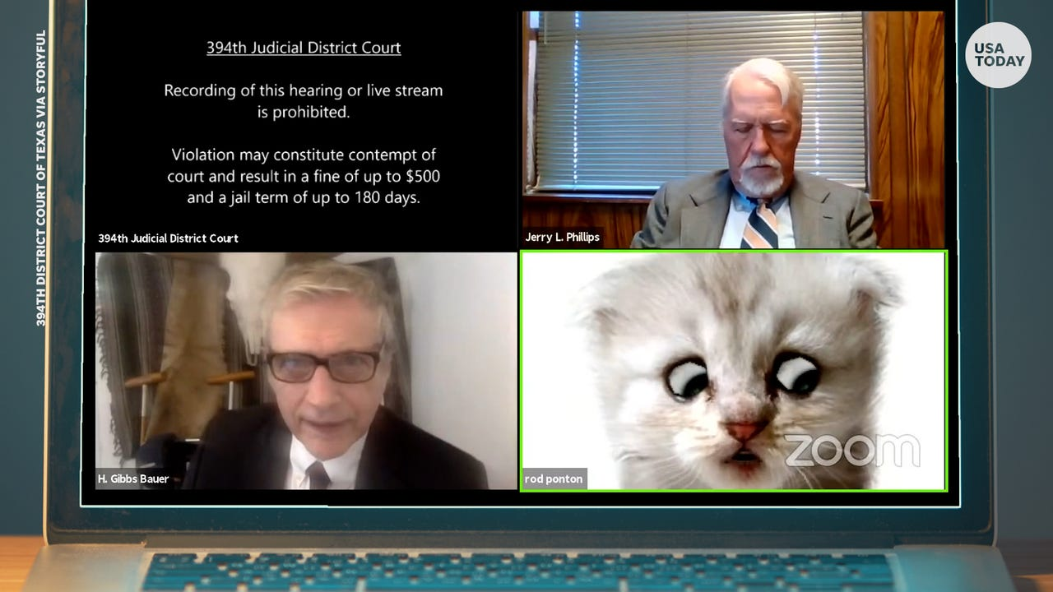
https://eu.usatoday.com/story/tech/2021/02/09/zoom-filter-warning-lawyer-cat-kitten-filter-virtual-hearing/4456097001/

Slide 3







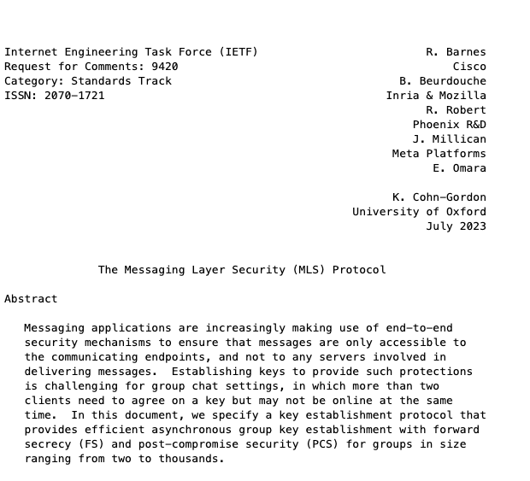
End-to-End Encryption
PGP
Messsage Layer Security (MLS)
IETF Standards Track
OTR
Signal Protocol
MTProto
Matrix Protocol

Slide 4

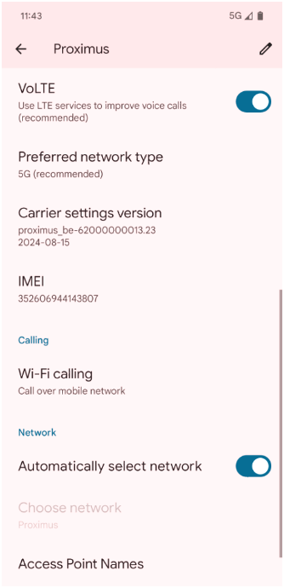

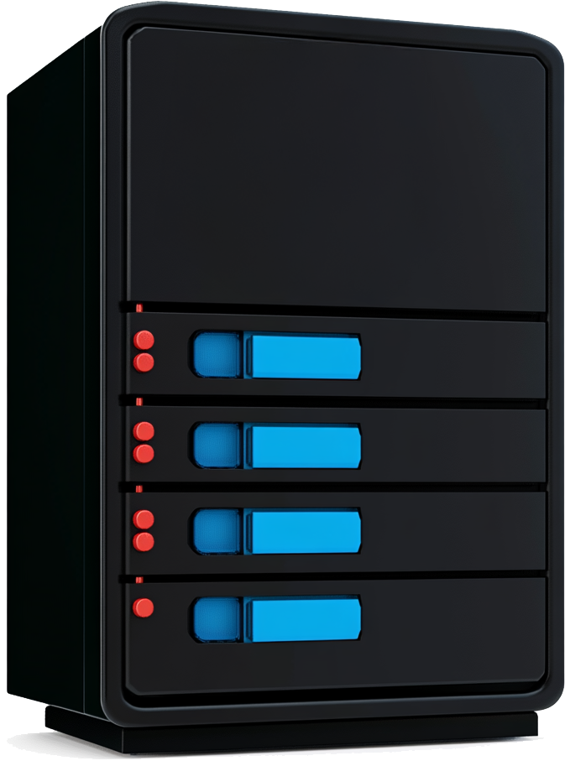




VoLTE carrier-grade encryption
3GPP TS 23.228 (IMS architecture)
3GPP TS 24.147 (Conferencing Application)

Slide 5


VoLTE carrier-grade encryption
“hop-by-hop”
3GPP TS 23.228 (IMS architecture)
3GPP TS 24.147 (Conferencing Application)

Slide 6
VoLTE carrier-grade encryption
“hop-by-hop”
3GPP TS 23.228 (IMS architecture)
3GPP TS 24.147 (Conferencing Application)

Slide 7
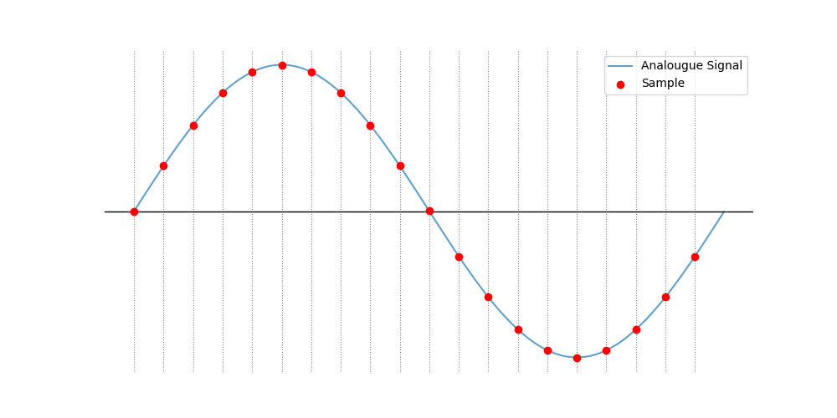
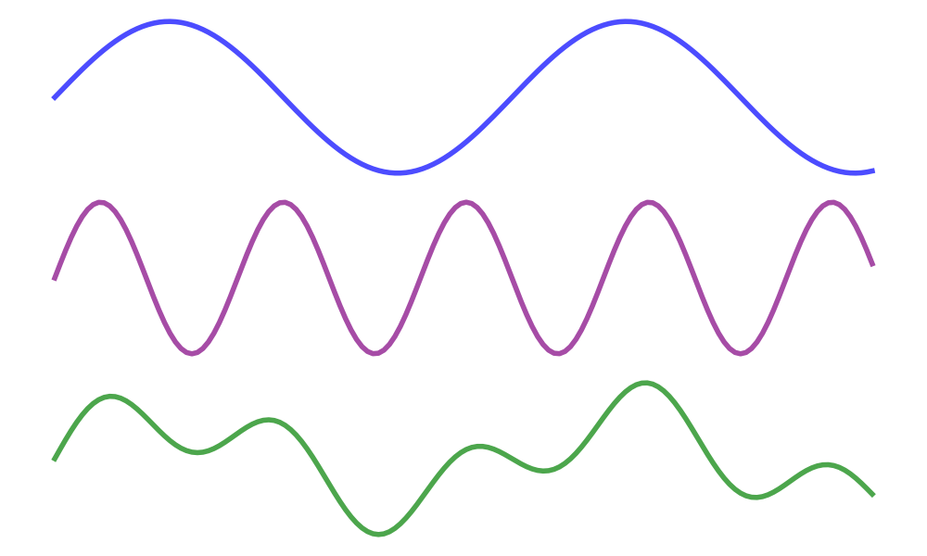
Audio Mixing
Signal 1
+
Signal 2
=
Mix

Slide 8


Audio Mixing

Slide 9





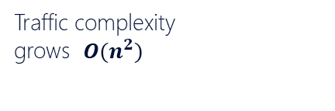
Audio Mixing
Traffic complexity
grows $O(n^{2})$

Slide 10
Audio Mixing
Traffic complexity
grows $O(n^{2})$

Slide 11

Audio Mixing

Slide 12

Audio Mixing
End-to-end encryption

Slide 13

Audio Mixing
End-to-end encryption
Traffic complexity
grows $O(n^{2})$
Audio synchronization
complexity
Limitations on audio
Enhancement techniques

Slide 14

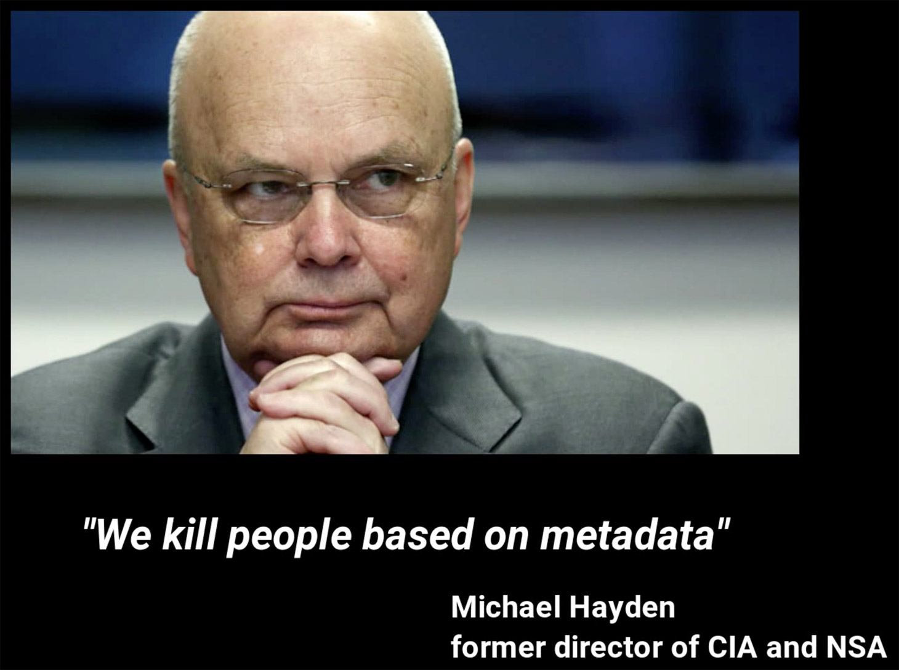
Audio Mixing
End-to-end encryption
Speaker anonymity

Slide 15
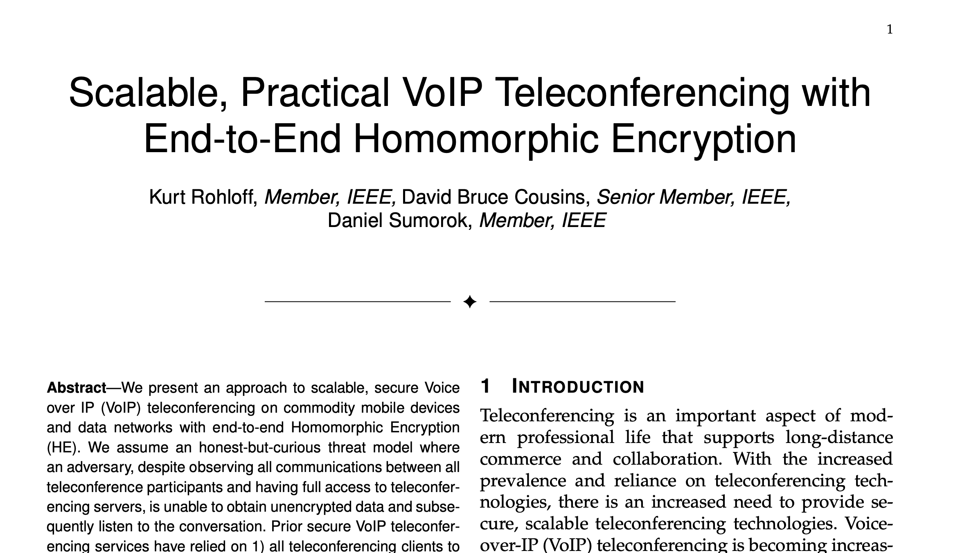
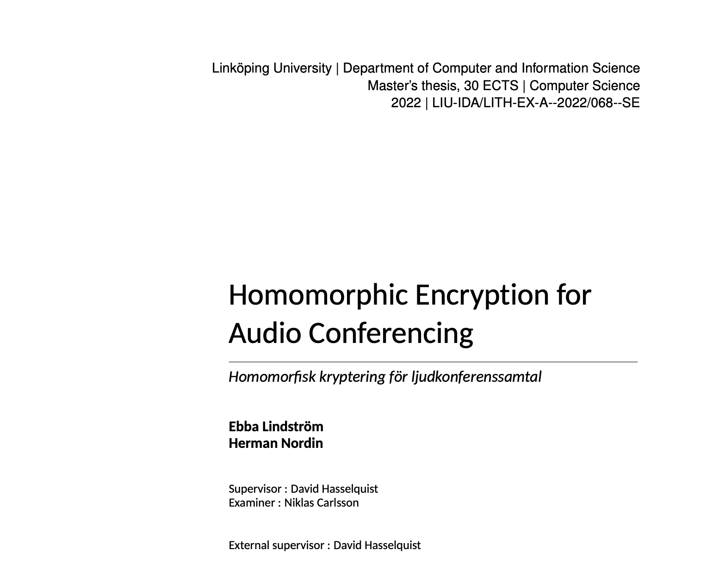
Audio Mixing
Ideal-world
End-to-end encryption

Slide 16
Blind audio mixing
xdfx
xdfx
Apply
FHE SIMD Addition
xdfx
xdfx
xdfx

Slide 17
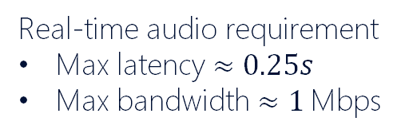
Blind audio mixing
Bandwidth limitations
Real-time audio requirement
Max latency $≈0.25s$
Max bandwidth $≈1$Mbps
Up to ~10x expansion
Encrypt

Slide 18

Compress then encrypt
Compress
Compress
Decrypt
Encrypt
FHE ADD
Encrypt

Slide 19


Decompress then Evaluate
Compress
Compress
Decrypt
Encrypt
FHE ADD
Encrypt
FHE Decompress
FHE Decompress

Slide 20
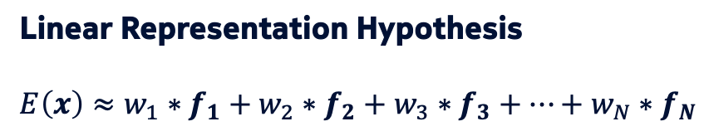
Additive-homomorphic Compression
Ideal-world crypto + AI
Can embeddings have homomorphism?
Text embeddings
king – man + woman ≈ queen
Paris – France + Poland ≈ Warsaw
Linear Representation Hypothesis
$$E\left(x\right)≈w_{1}∗f_{1}+w_{2}∗f_{2}+w_{3}∗f_{3}+…+w_{N}∗f_{N}$$
$$E\left(x_{s_{1}}+x_{s_{2}}\right)≈w_{1}∗f_{1}+w_{2}∗f_{2}+w_{3}∗f_{3}+…+w_{N}∗f_{N}$$
$E\left(x_{s_{1}}+x_{s_{2}}\right)≈E\left(x_{s_{1}}\right)+$ $E\left(x_{s_{2}}\right)$

Slide 21
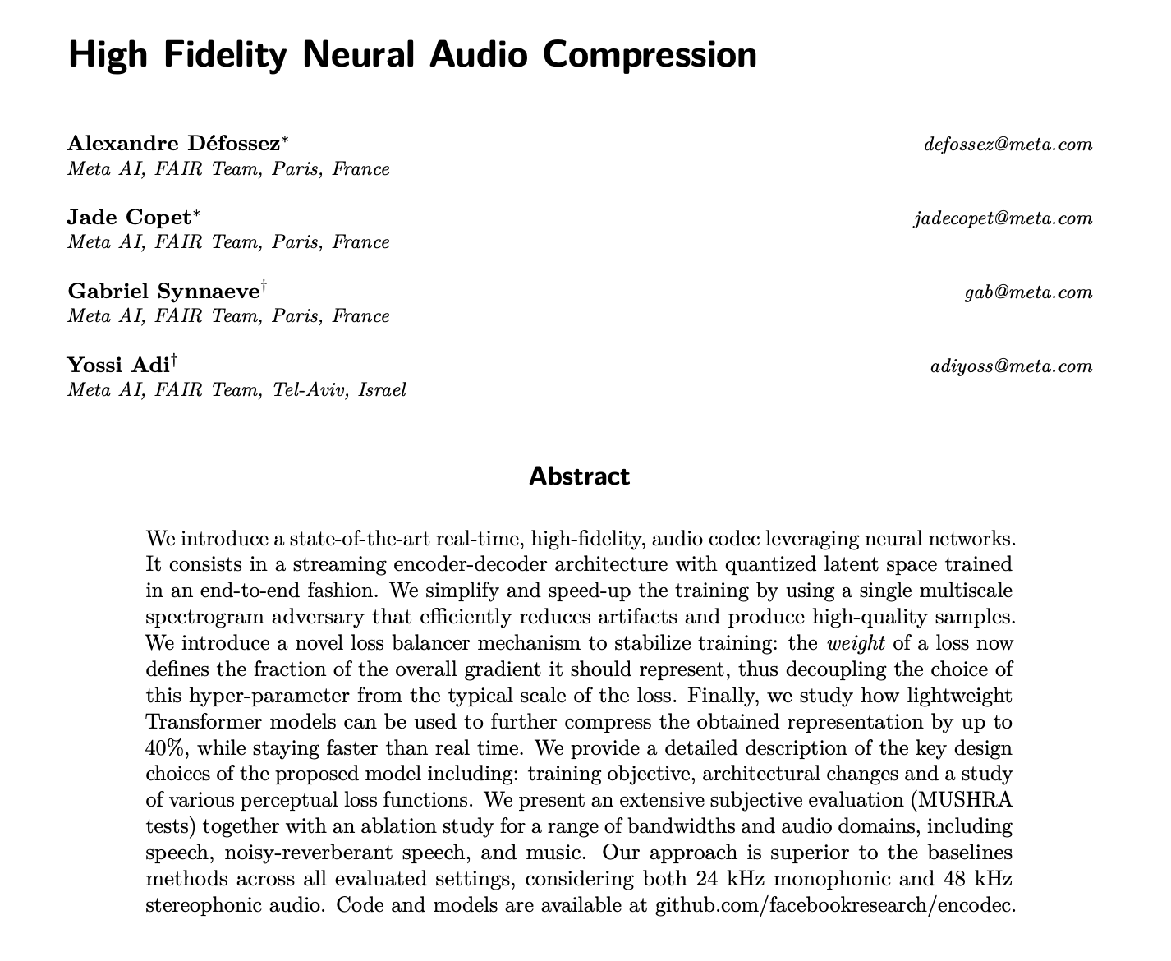
Can we do better?

Slide 22
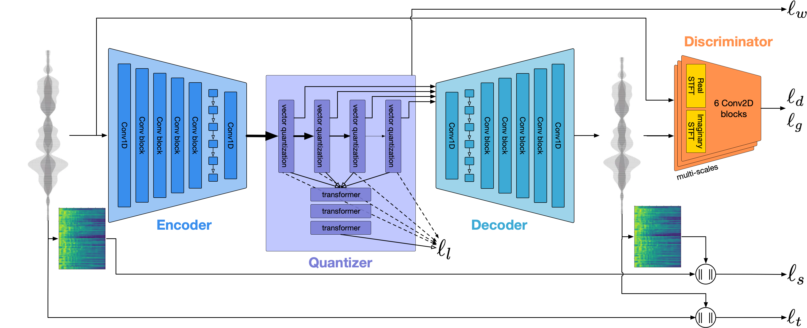

Slide 23

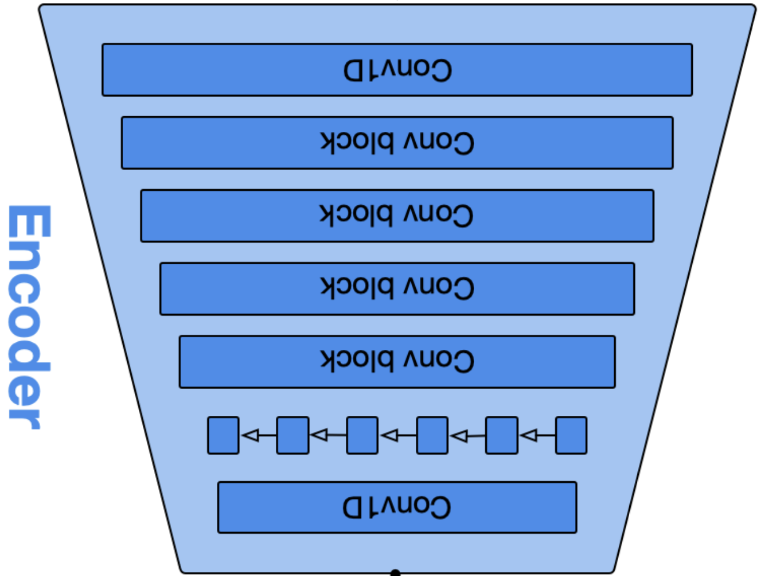
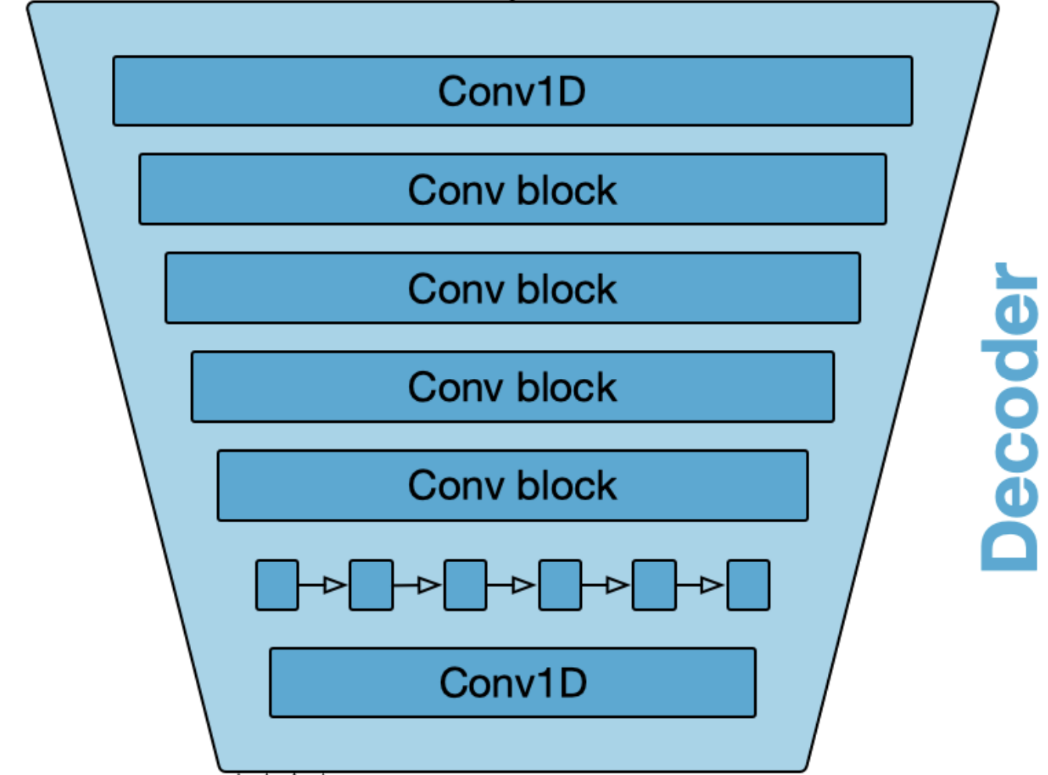
Embeddings
Truncate
Decrypt
Truncate
8-bit values
Encrypt
FHE ADD
Encrypt

Slide 24
Customisability towards Real-time Streams
Configurable:
Degree of compression
Embeddings/second
Trucation configurability
FHE Configurations
Lattice configurations
Circuit requirements
Realtime
Flexible
Secure
+
=
streams
Embeddings
Truncate
8-bit values
Encrypt
Blind mixing server

Slide 25
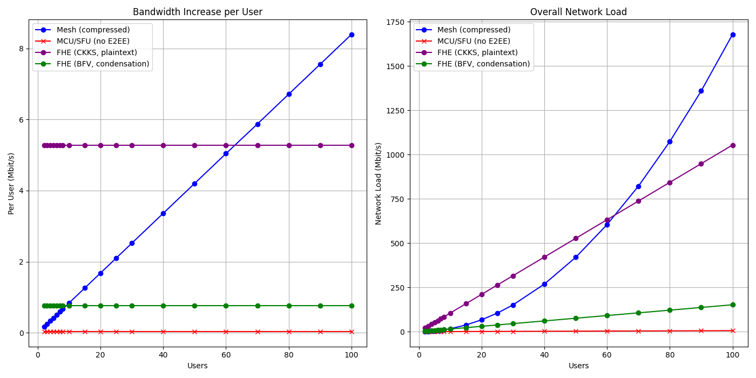

Evaluation: impact on network

Slide 26



Open Challenges
Hardware acceleration
For FHE
Example:
Audio DRC of
3 second audio takes
1 to 15 minutes
Optimising FHE bandwidth
Require more innovations
Example:
We need better
Transciphering schemes
FHE Standardization
acceleration
Example:
It is hard to incorporate FHE
into other specs.
Lawful interception
It’s 2025. It’s almost a law
in every country.
Where are we with this?

Slide 27

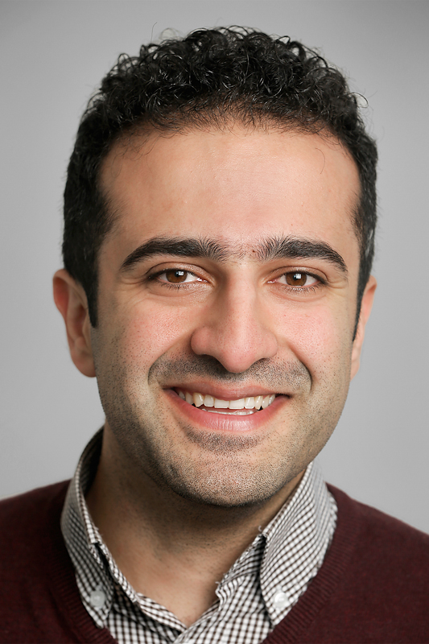


007: End-to-End Encrypted Audio Calls via Blind Audio Mixing
Real-time Demo:
Find us:
Emad Heydari Beni
Lode Hoste
@heydari_be
@emadbeni.bsky.social

