Slide 1
Flock: A Framework for Deploying On-Demand Distributed Trust
Previously at OSDI ‘24
Real World Crypto 2025
Darya Kaviani*
Sijun Tan*
Pravein Govindan Kannan
Raluca Ada Popa
UC Berkeley
UC Berkeley
IBM Research
UC Berkeley
* Denotes equal contribution

Slide 2
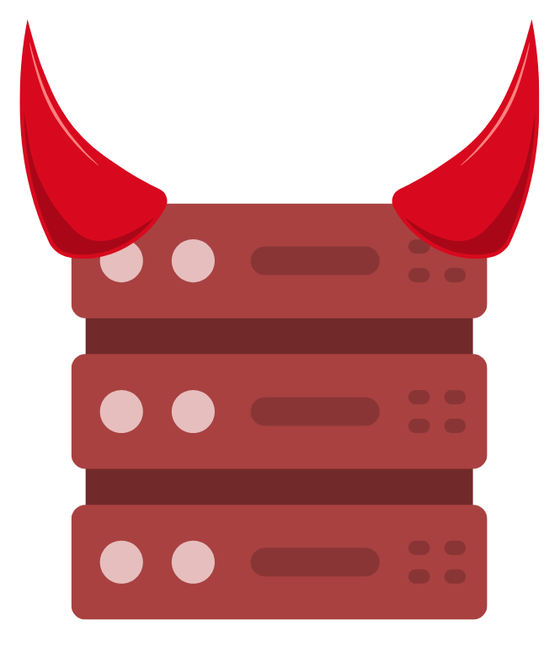
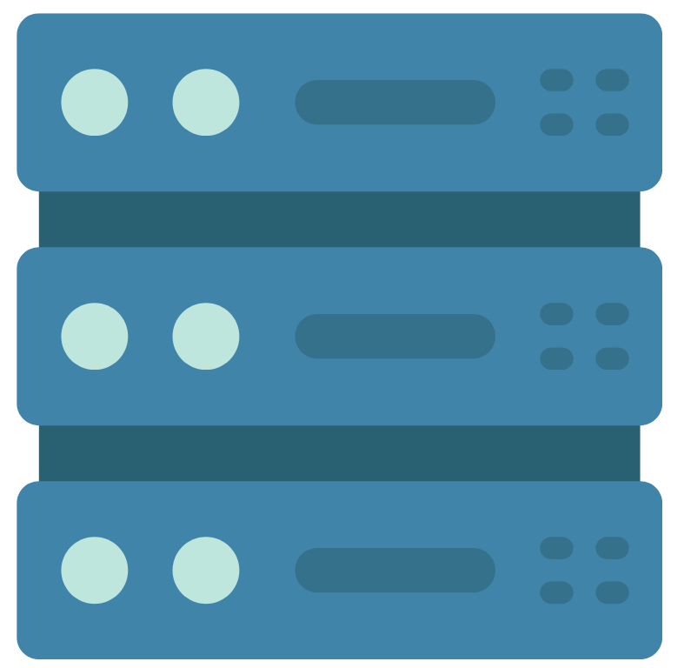
Why Distributed Trust?
Alice has a secret to store.
The server is a central point of attack.

Slide 3
Distributed Trust
Distributing the sensitive data avoids a central point of attack.

Slide 4
Distributed Trust
Adversaries must compromise $n$ servers for the secret.

Slide 5
Multi-Party Computation (MPC) [Yao ‘86, GMW ‘87, SPDZ ‘12]
$$s_{2}$$
Parties do not learn anything about each other’s input other than the final function result.
$$f(s_{1},s_{2},s_{3})$$
$$s_{1}$$
$$s_{3}$$

Slide 6
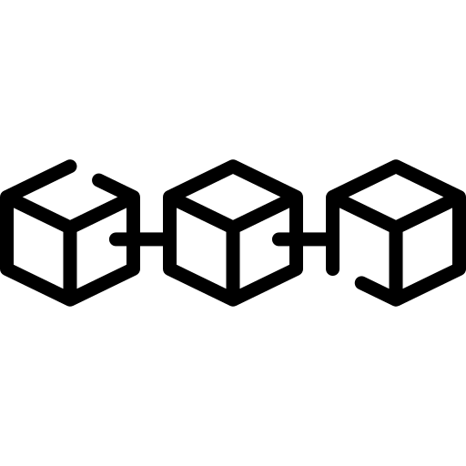
Digital Asset Custody
Where can Alice store her TX signing key?
TX
Billions have been stolen by compromising signing keys.

Slide 7
Digital Asset Custody: Distributed Trust
MPC: Signature Keygen

Slide 8
Digital Asset Custody: Distributed Trust
Secret share reveals nothing
TX
TX
TX
MPC: Signature Gen
No central point of attack!
TX

Slide 9
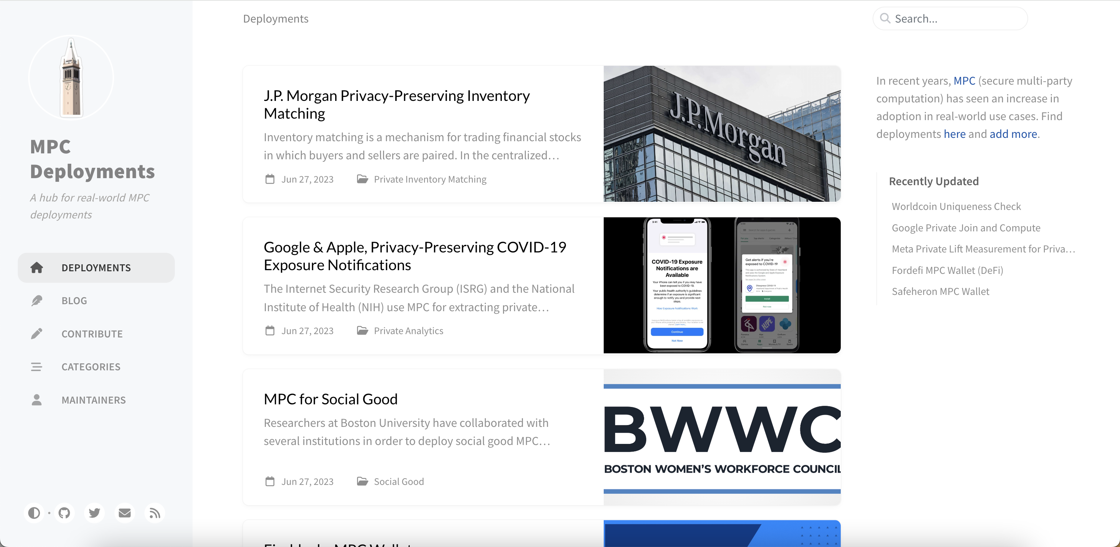
MPC Deployments
mpc.cs.berkeley.edu

Slide 10
How can an application provider, a single trust domain, deploy a multi-trust-domain system?
The Deployment Dilemma
A large class of prior work assumes $n$ distinct, non-colluding trust domains already exist!

Slide 11
Attempt 1: Application Provider’s Servers

Slide 12
Traditional Distributed Trust
Business Relationship
Business Relationship

Slide 13
Real-World Deployment Challenges
It is difficult to convince MPC parties to deploy, run, & maintain your application workload.
[LCG+ ‘23, DFC+ ‘22]
Private Advertising
Secret Key Recovery
Our goal: Enable anyone to automatically deploy distributed trust, even a single developer.
Private Analytics
Digital Asset Custody

Slide 14
A New Deployment Paradigm
Business Relationships
Automatic
Deployment
On-Demand Distributed Trust: Users are trusted with their own sensitive data, and can help conduct deployment for $n−1$parties.

Slide 15
Flock
Deploying on-demand distributed trust through user-driven deployment, using cloud providers as trust domains.
Reversing the approach to deploying distributed trust.
Designing a practical e2e system to realize this vision.
1
2
+

Slide 16
Applications
Secret Recovery
Secret Key Recovery
Signature Generation
Crypto Custody
Password Manager
Code Signing
PIR
Certificate Authority
Private Queries
Decryption
Data Freshness
Secure Data Sharing
Rollback Protection
16

Slide 17
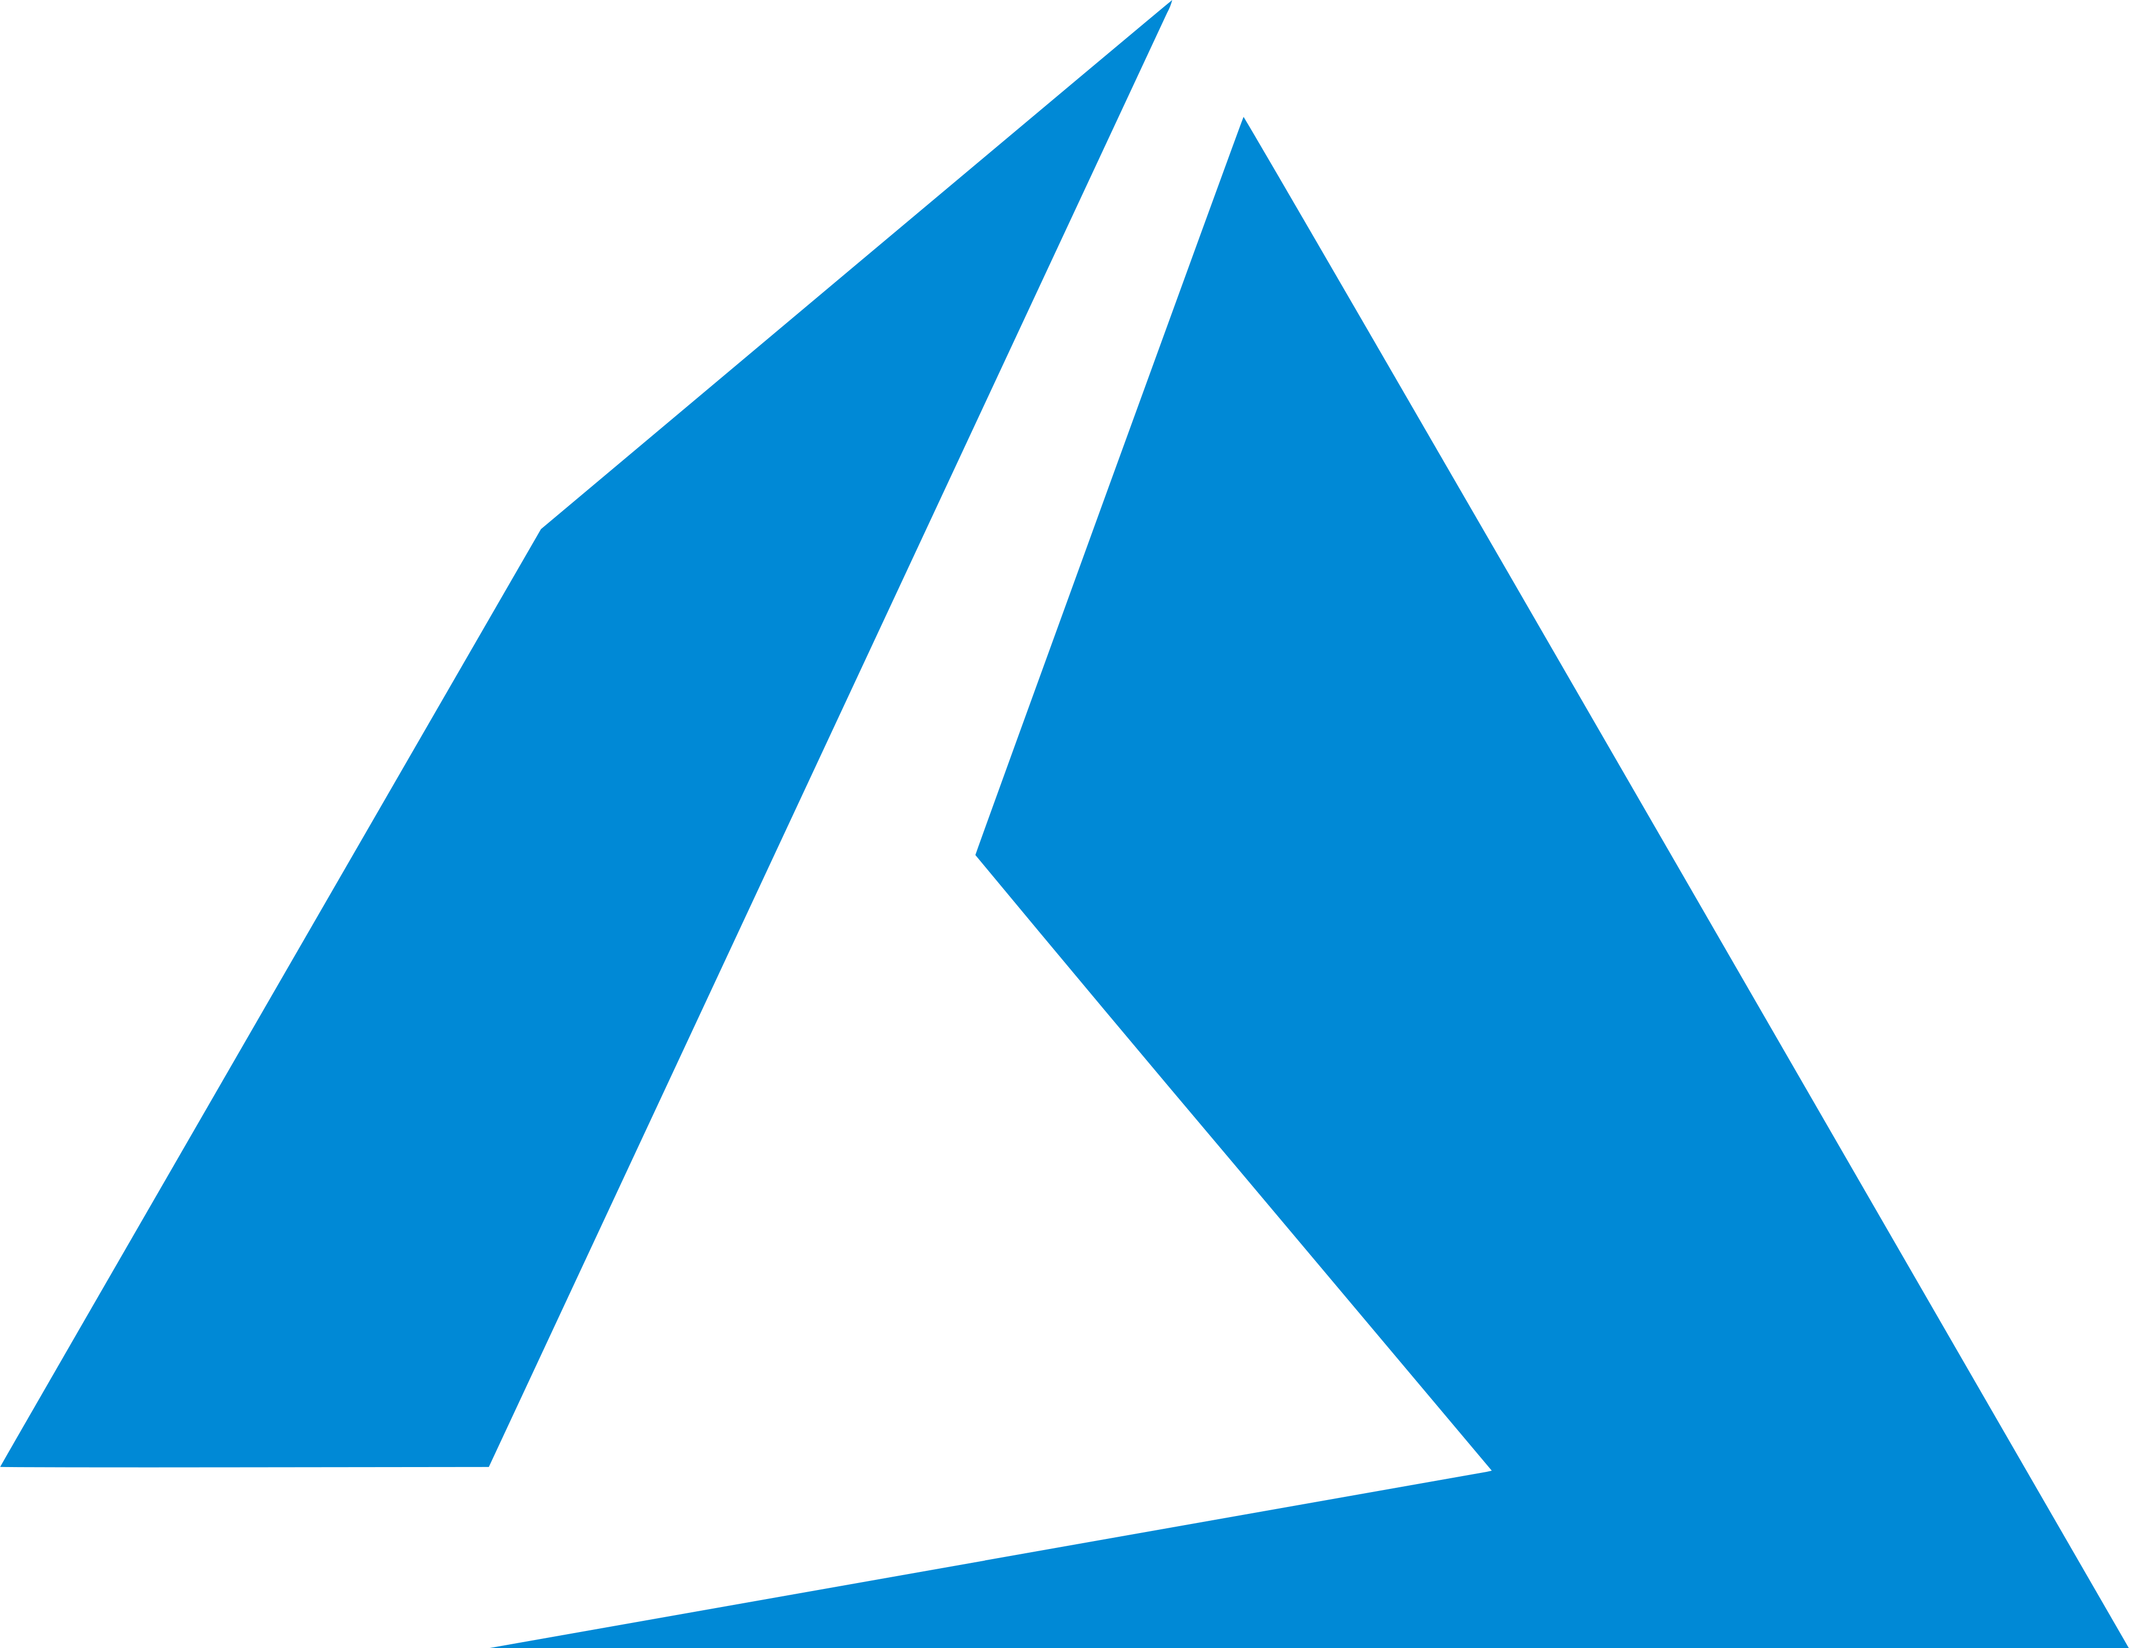
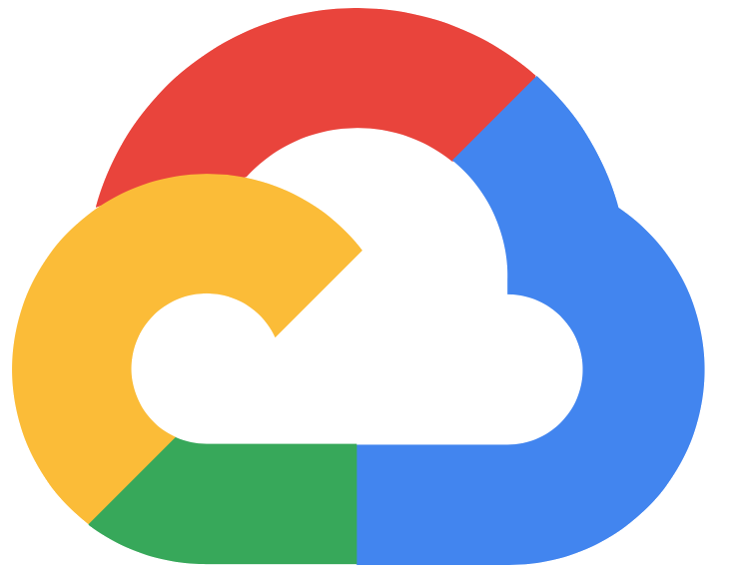
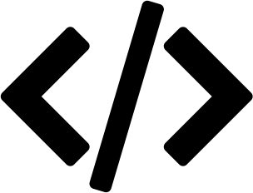
Threat Model
At least one cloud server is uncompromised.
Malicious security if app is malicious-secure.
Code is open-sourced and community-scrutinized.
Compromised clients cannot affect un-compromised clients.

Slide 18
Distributing Trust Among the Clouds
MPC Execution

Slide 19
A Scale Problem
1 VM/user/cloud is expensive for ephemeral workloads.
Tens of millions of users

Slide 20
Serverless Compute: Scaling Flock
Stateless compute that exclusively incurs cost at execution.
AWS Lambda
Google
Cloud Run
Serverless incurs no cost when the user is not performing operations.
Serverless containers are executed on-demand with low startup time.

Slide 21
Adding Serverless to Flock
$$s_{1}$$
MPC Execution
$$s_{2}$$

Slide 22
Serverless On-Demand Distributed Trust

Slide 23
Serverless Communication
x
NAT 1
NAT 2
TLS Connection
Serverless instances do not accept incoming connections.
How can we establish secure p2p serverless connections?

Slide 24
Application Provider as Untrusted Relay
x
NAT 1
NAT 2
Leverage untrusted relay to securely route messages.
E2E TLS connection over 2 consecutive TCP sockets.

Slide 25
3-Tier Authentication
User-driven distributed trust introduces new attack vectors.
Network
How can a provider secure a deployment it doesn’t control?
Application
Cloud

Slide 26
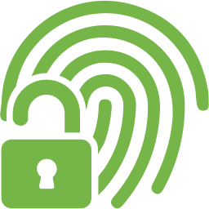
3-Tier Authentication
Application: MPCAuth
User authenticates to $n$ parties with the work of $1$.
Cloud: Access Keys
Clients store IAM access keys for invocation.
Network
Application
Network: Certificates
Parties authenticate with user-signed certificates.
Cloud

Slide 27
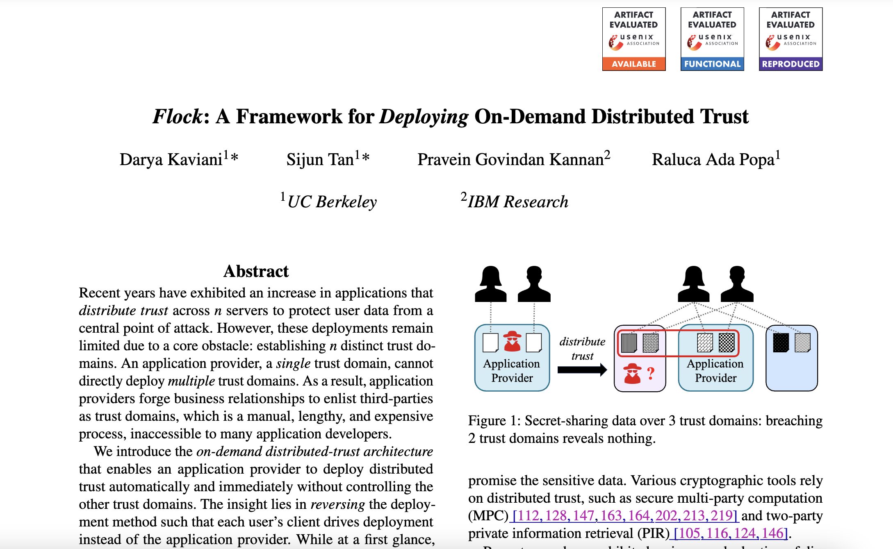
Resource Protection
How can the provider protect the deployment without controlling it?
See our paper for details!

Slide 28
Digital Asset Custody
TX

Slide 29
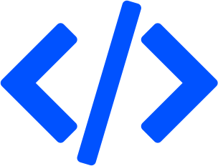
Digital Asset Custody with Flock
$$s_{1}$$
Programmatically deploy application
$$s_{2}$$

Slide 30
Digital Asset Custody with Flock
MPC: Signature Keygen
$$s_{1}$$
$$s_{2}$$

Slide 31
Digital Asset Custody with Flock
MPCAuth: auth via pin
≟
$$s_{1}$$
$$s_{2}$$

Slide 32
Digital Asset Custody with Flock
MPC: Signature Generation
$$s_{1}$$
TX
TX
TX
$$s_{2}$$
TX

Slide 33
Secret Recovery Today

Slide 34
Secret Recovery Today
Where can Alice store her encryption key?
But what if Alice’s device gets lost, stolen, or broken?

Slide 35
Secret Recovery Today
Where can Alice store her encryption key?

Slide 36
Secret Recovery Today
Where can Alice store her encryption key?
$Enc ($ )

Slide 37
Secret Recovery Today
Where can Alice store her encryption key?
Brute force dictionary attack!
$Dec (Enc ($ ))
$$=$$

Slide 38
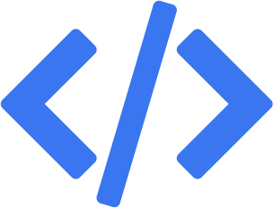
Secret Recovery with Flock
$$s_{1}$$
Programmatically deploy application
$$s_{2}$$

Slide 39
Secret Recovery with Flock
$$s_{1}$$
$$s_{2}$$

Slide 40
Secret Recovery with Flock
MPCAuth: auth via pin
≟
$$s_{1}$$
$$s_{2}$$

Slide 41
Implementation
Secret Recovery
~2000 lines of Go
Secret Key Recovery
Signature Generation
Crypto Custody
Password Manager
~2000 lines of Python
Code Signing
PIR
Certificate Authority
Private Queries
~2000 lines of C++
Decryption
Data Freshness
Secure Data Sharing
Rollback Protection
41

Slide 42
Evaluation Setup
Is Flock’s performance comparable to traditional distributed trust?
Baseline
Flock
VMs on AWS, GCP, Azure
2vCPU
Azure VM, AWS & GCP Serverless
2vCPU

Slide 43
Latency & Throughput
Flock
Baseline
Decryption Latency
Throughput (Normalized)
80
1.1
60
1.0
Latency (s)
Req/Min Ratio
40
0.9
20
0.8
0
0.7
2¹
2³
2⁵
2⁷
2⁹
Signing
PIR
Decryption
Freshness
Secret Recovery
File Size (Bytes)
1.05x latency
Comparable throughput

Slide 44
Cost Comparison
Cost Model: VMs have a fixed hourly cost, whereas serverless cost is per-request.
Cost Calculation: Estimate server’s per request cost from module’s max throughput.
Module | Network | Compute Baseline Flock |  | Total Baseline Flock
Signing | 0.0006 | 0.0083 | 0.0213 | 0.0089 | 0.0219
Decryption | 0.5219 | 0.1141 | 0.3340 | 0.6360 | 0.8559
2.5x overhead
1.3x overhead
Costs are for each invocation and measured in USD cents.

Slide 45
Cost Comparison
Cost Model: VMs have a fixed hourly cost, whereas serverless cost is per-request.
Cost Calculation: Estimate server’s per request cost from module’s max throughput.
Flock’s system cost overhead is negligible compared to the cost of setting up business relationships.

Slide 46
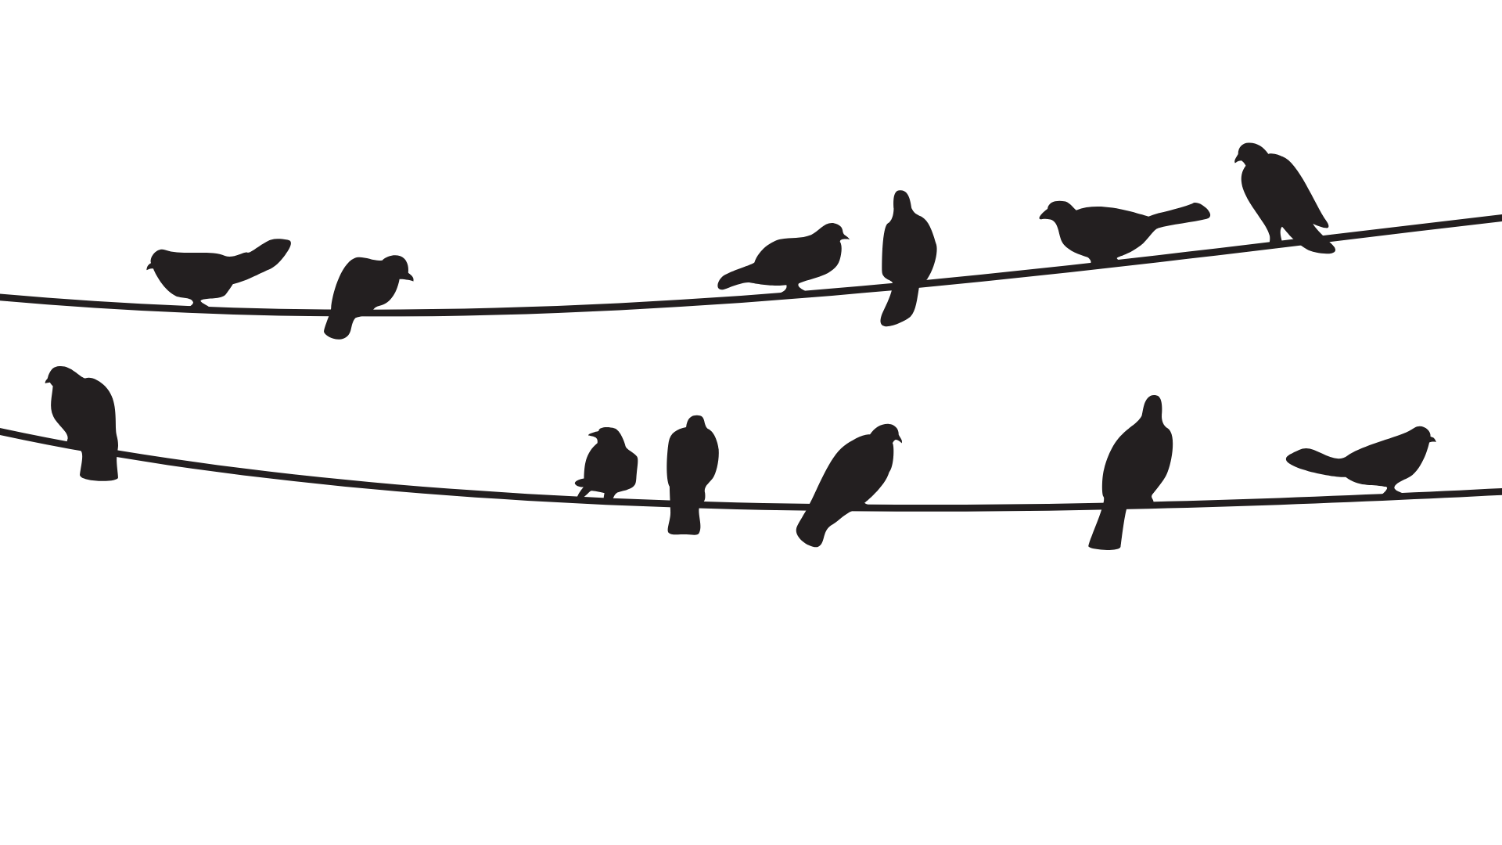
A Bird’s Eye View of Flock
Combines the security of the clouds
Reverses deployment to leverage users
eprint.iacr.org/2024/892
github.com/flock-org/flock
The first way for an application provider to automatically & immediately deploy distributed trust.
daryakaviani
daryakaviani@berkeley.edu
Thanks!

