Slide 1
Stealing Cryptographic Keys with Weird Gates
Chitchanok Eyal Yuval
Chuengsatiansup Ronen Yarom

Slide 2
Publications
The Gates of Time: Improving Cache Attacks with Transient Execution [Usenix 23]
Daniel Katzman
William Kosasih
Chitchanok Chuengsatiansup
Eyal Ronen
Yuval Yarom
Spec-o-Scope: Cache Probing at Cache Speed [CCS 24]
Gal Horowitz
Eyal Ronen
Yuval Yarom

Slide 3
Outline of the talk
Weird gates on microarchitectural state
Definition of the logical state of cache
Computing on the logical state with weird gates
Exploiting weird gates for fun and profit
Computation with weird gates
Weird gates Vs Coarse grain timers
Weird gates Vs S-Box based AES implementations

Slide 4
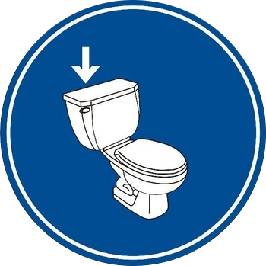
Logical State of the Microarchitectural Cache
Associate a logical Boolean value with each memory addresses
TRUE – address is cached
FALSE – address is not cached
Flushing sets a value to FALSE
Accessing memory sets a value to TRUE (may also set another to FALSE)
Measuring access time observes value (and set to TRUE)
What else?
Processor
Cache
F F F T F F F F T F F F F
F
T
Memory

Slide 5
Conditional access
if (*in == 0)
return;
out += 0;
out += 0;
a = *out
What is the cache state of *out after execution?
TRUE if *in != 0.
What if *in == 0?
Assume *in == 0

Slide 6
Speculative execution
Assume
*in == 0
if (*in == 0)
return;
out += 0;
out += 0;
a = *out
Evaluation of branch conditions can take time
The CPU predicts future execution
Correct prediction – win
Incorrect prediction – rollback
Microarchitectural state remains
Assume branch mispredicted
May be executed even if *in == 0

Slide 7
Conditional Speculative Execution
Assume
*in == 0
Branch mispredicted
if (*in == 0)
return;
out += 0;
out += 0;
a = *out
Load *in
Delay
Load *in
Delay
branch
Load *out
Load *out
branch
*in cached
*in not cached

Slide 8
Weird NOT gate
Assume
*in == 0
Branch mispredicted
if (*in == 0)
return;
out += 0;
out += 0;
a = *out
Load *in
Delay
Load *in
Delay
branch
*in | *out
TRUE | FALSE
FALSE | TRUE
Load *out
Load *out
branch
out ← NOT(in)
*in cached
*in not cached

Slide 9
Thinking about this
Probe
Load *in
Delay
Delay
branch
Control
Load *out
Signal
Chains

Slide 10
Combining Chains
if (*in1 + *in2 == 0)
return;
out += 0
a = *out
Load *in1
Load *in2
Delay
*in1 | *in2 | *out
FALSE | FALSE | TRUE
FALSE | TRUE | TRUE
TRUE | FALSE | TRUE
TRUE | TRUE | FALSE
Load *out
branch
Can be used to build any circut
out ← NAND(in1, in2)

Slide 11
Destructive Computation
In our gates, we always load the “in” addresses
Loading an address sets its value to True
We can only use an address as input once
After that, its value is destroyed
How can we build complex gates that require reusing the same value multiple times?

Slide 12
Multiple output NAND (fan out)
if (*in1 + *in2 == 0)
return;
t = delay()
a = *(out1 + t)
a = *(out2 + t)
...
a = *(outn + t)
Load *in1
Load *in2
Delay
Load *out1
Load *out2
branch

Slide 13
Minority Report
*in1 | *in2 | *in3 | *out
FALSE | FALSE | FALSE | TRUE
FALSE | FALSE | TRUE | TRUE
FALSE | TRUE | FALSE | TRUE
FALSE | TRUE | TRUE | FALSE
TRUE | FALSE | FALSE | TRUE
TRUE | FALSE | TRUE | FALSE
TRUE | TRUE | FALSE | FALSE
TRUE | TRUE | TRUE | FALSE
if (*in1 + *in2 == 0)
return;
if (*in2 + *in3 == 0)
return;
if (*in1 + *in3 == 0)
return;
a = *out
Error Correction
out ← NOT(MAJ(in1, in2, in3))

Slide 14
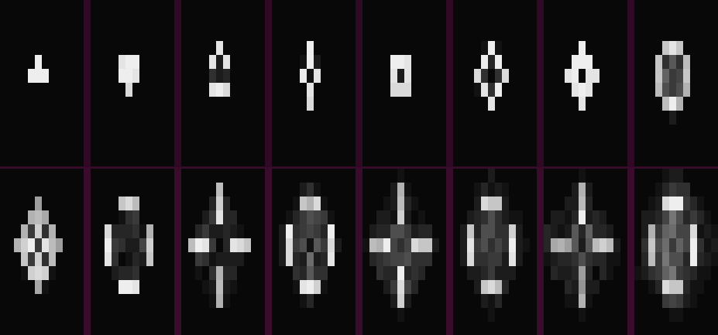
Circuits
4-bit ALU
1258 gates, 84-95% accuracy
SHA-1
One round: 2208 gates, 95% accuracy (67% with prefetcher)
Full (two blocks, with repetitions) 95% accuracy
Game of Life
7807 gates 73% accuracy for one generation, 25% for 20

Slide 15
Flush+Reload on Square-and-Multiply
Typical Clock Rates
Chrome 0.1ms
Safari 1ms
Firefox 2ms
TOR 100ms
Apple M1 42 ns
40ns

Slide 16
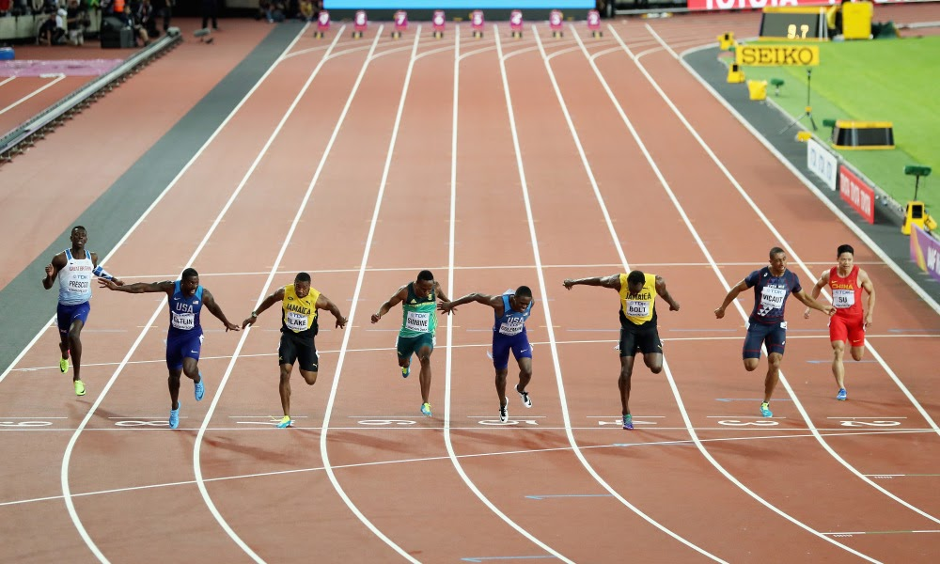
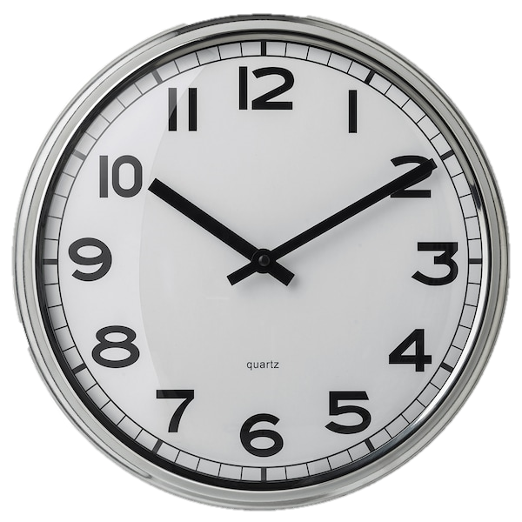
Reducing Timer Resolution
Measure this
With this

Slide 17
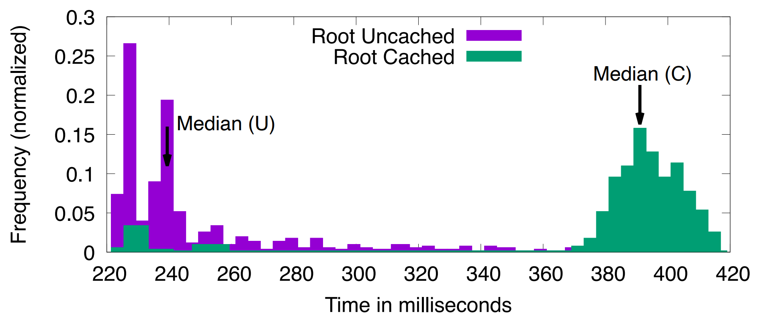
Overcome Low Res Timers with Amplification
if (*in == 0)
return;
a = *out1 + *out2 +
*out3 + *out4 +
*out5 + *out6 +
*out7 + *out8;
A NOT gate with a large fan-out amplifies the signal by a factor of 8
Two layers – 64
Three layers – 512
Four layers – 4096
Amplify to a resolution of 0.1 second

Slide 18
Amplification is half the job
40ns
25us

Slide 19
Prime+Store: High Resolution Prime+Probe
Prime+Probe is basically a NAND gate applied on the eviction set
Repeatedly probe our eviction set (apply a NAND gate)
Store each result in a different output address
Don’t measure the result
Amplify later
Decouples probing from time measurements
Attack square-and-multiply ElGamal with a 0.1ms clock

Slide 20
How Fast can we Probe?

Slide 21
How fast can we probe?
Probing the cache takes time
Limited temporal resolution
Thousands of cycles
Prime+Scope (CCS 2021) – 70 cycles.
Requires only one access to L1 cache.

Slide 22
Prime+Scope code
5 cycles
uint32_t scope(char * address) {
uint32_t start = rdtscp();
char t = *address;
uint32_t end = rdtscp();
return end – start;
}
30 cycles
5 cycles
30 cycles
Measuring time is an order of magnitude slower than a cache access

Slide 23
Using Prime+Store
Prime+Store is a hammer – let’s try it on this nail.
Result: 150 cycles – branch training is not cheap
Prime+Store with RET-based gates: 48 cycles.
48 < 70 Yay!
48 is still very slow

Slide 24
Tapped multi-probed gates
Load *in
Delay
Load *in
Delay
Load *in
Delay
return
Load *o3
Load *o2
Load *o2

Slide 25
Tapped multi-probed gates
Load *in
Delay
Load *in
Delay
Load *in
Delay
Load *o3
Load *o2
Load *o2
return

Slide 26
Tapped multi-probed gates
Load *in
Delay
Load *in
Delay
Load *in
Delay
Load *o2
Load *o2
return
Load *o3

Slide 27
5 Cycles Measurement resolution

Slide 28
Attacking S-Box based AES
S-Box based implementations are harder to attack
Only 4 cache lines, and more accesses
Need to distinguish precise AES round
Each rounds takes approximately 70 cycles
Need sample rate faster than 35 cycles!
Prior works need either
Non-trivial OS control
Utilize the deprecated Intel TSX
Modify the original code

Slide 29
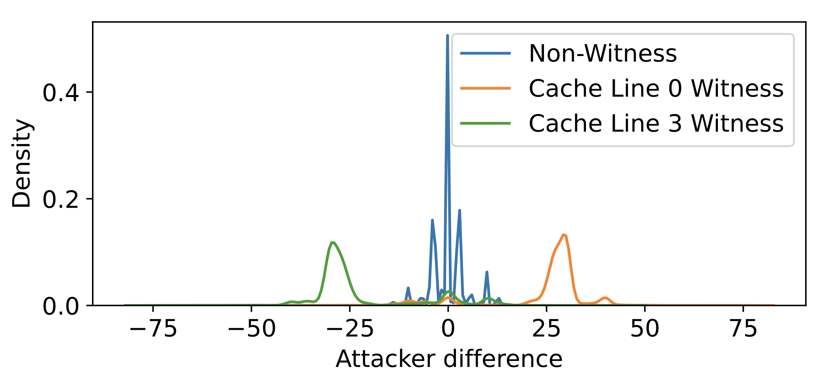
Attacking S-Box based AES
Need to measure exact round, i.e., exact time from start of AES
Try to measure diff from code at start of AES – too noisy
Instead measure diff between accesses to two S-Box cache lines

Slide 30
Attacking S-Box based AES
Full key recovery of AES128 using Spec-o-Scope
Requires ≈10,000 traces
Collected in less than 3 seconds

Slide 31
Summary
Microarchitectural weird machines are a thing
Can have security impact
New emerging area – much work to do

