Slide 1
Is Your Bluetooth Chip Leaking Secrets via RF Signals?
Yanning Ji, Elena Dubrova, Ruize Wang
School of Electrical Engineering and Computer Science
Royal Institute of Technology (KTH), Stockholm, Sweden

Slide 2
Introduction
Motivation:
  Millions of Bluetooth-enabled devices use cryptographic accelerators. Are they leaking secrets?
Key contribution:
  We demonstrate the first attack on a Bluetooth chip’s hardware AES accelerator via RF side channel
Why RF side channel matters?
  No physical modification of device ⇒ No tamper-evidence
  Remote attack

Slide 3
Prior RF side-channel attacks
Screaming channels attack (CCS'18):
  Extracted encryption key from software AES via RF
    Tiny AES in Cortex-M4 processor in a mixed-signal chip
 | Method | Distance | Environment | #Avg. | Enum. | #Traces
CCS’18 | Template | 10m | Anechoic chamber | 500 | No | 1428
 |  | 1m | Office |  |  | 52589
CHES’20 | Template | 15m | Office | 1000 | 2²³ | 5000
ASHES’20 | DL | 15m | Office | 100 | No | 11
 |  |  |  | 10 |  | 48
CPSS’21 |  |  |  | 1 |  | 341

Slide 4
Limitations of prior work
Could not break hardware AES accelerator
  Fully parallel implementation in Counter with CBC-MAC (CCM) authenticated encryption mode
  Runs at 16 MHz, different from the Cortex-M4 64 MHz clock
Our research question:
  Can encryption key of AES accelerator be extracted via RF?

Slide 5

Why mixed-signal circuits may leak secrets via RF?

Slide 6
Why mixed-signal circuits may leak secrets via RF?
Other digital blocks
Bus
Digital-to-Analog Converter
RF block
HW AES block
①
Voltage-
Controlled Oscillator
②
③
CPU core
Substrate
coupling
Capacitive
coupling
Digital part
Analog part
Current fluctuations in digital circuits induce noise in the shared silicon substrate, affecting analog components
RF signal generated by VCO may be affected
Notes:
VCO generates an RF signal at a frequency determined by an input control voltage

Slide 7
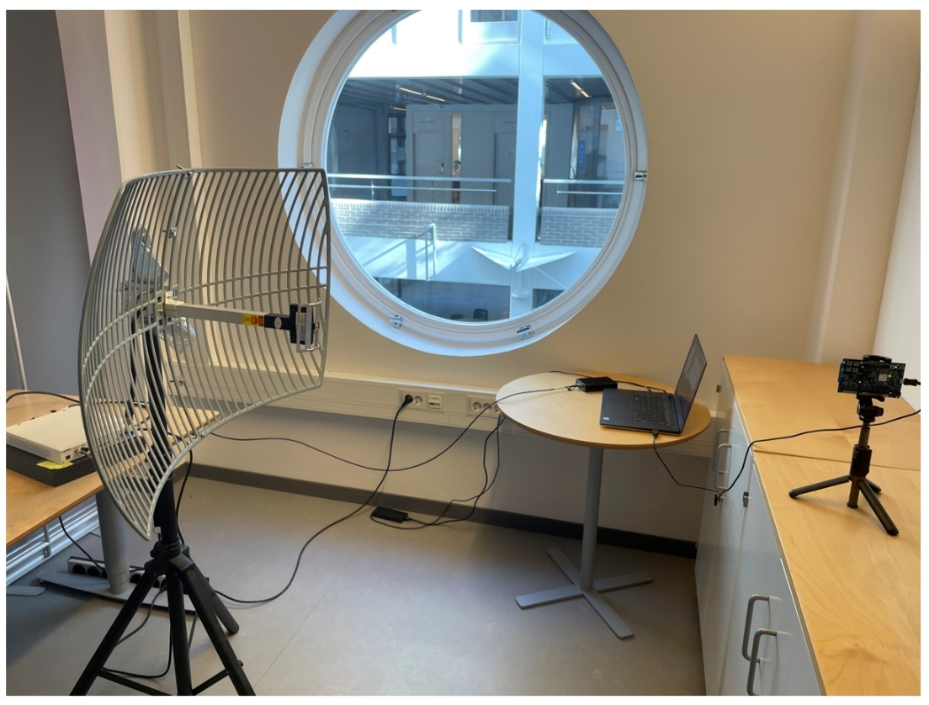
Attack setup
Target:
  Nordic Semiconductor nRF52832 Bluetooth system-on-chip
Measurement setup:
  Antenna at 1m distance captures RF signals
  Software-defined radio demodulates RF signals at 2.4GHz + n⋅16 MHz
Bluetooth band frequency
HW AES clock frequency

Slide 8
Key recovery methods
Correlation analysis (CA), non-profiled attack
Deep learning (DL), profiled attack
Plaintext, 16 bytes
SubBytes
Round 9
ShiftRow
Key, 16 bytes
MixColumn
AddRoundKey
Attack point
SubBytes
Round 1
ShiftRow
SubBytes
Round 10
MixColumn
Counter 1 encryption
ShiftRow
AddRoundKey
AddRoundKey
…
Ciphertext, 16 bytes

Slide 9
AES-CCM authenticated encryption mode
Counter block 0
Counter block 1
B₀
B₁
B_{n}
...
AES
K
AES
...
IV
+
+
+
Key K
Keystream S₀
Keystream S₁
AES
AES
AES
Attack point
K
K
K
+
Plaintext block 1
+
MAC
Ciphertext block 1
C₁
MAC
32-bit
Ciphertext block 0
C_{MAC}
Counter (CTR) mode
Cipher Block Chaining (CBC)-MAC mode

Slide 10
Results for 180,000 traces (18.9 days of capture)
Capture method | Key # | Device # | Attack method | # Incorrect key bytes, k | # Enum. | Enum. time
Cable | Key 1 | Device 1 | CA | 2 | 2^{22.9} | 0.1 sec
 | Key 2 | Device 2 | CA | 2 | 2^{22.9} | 0.1 sec
Antenna | Key 1 | Device 1 | CA | 3 | 2^{33.1} | 92.1 sec
 | Key 2 | Device 2 | CA | 4 | 2^{42.8} | 21.7 hrs
For CA attack, postions of incorrect bytes are unknown ⇒ #Enum. = $\left({16 \atop k}\right)$2^{8k}
RWC’2025

Slide 11
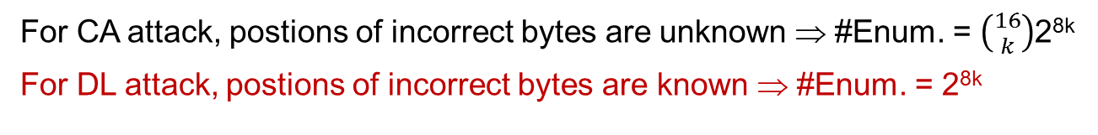
Results for 180,000 traces (18.9 days of capture)
Capture method | Key # | Device # | Attack method | # Incorrect key bytes, k | # Enum. | Enum. time
Cable | Key 1 | Device 1 | CA | 2 | 2^{22.9} | 0.1 sec
 |  |  | DL | 0 | 0 | 0
 | Key 2 | Device 2 | CA | 2 | 2^{22.9} | 0.1 sec
 |  |  | DL | 0 | 0 | 0
Antenna | Key 1 | Device 1 | CA | 3 | 2^{33.1} | 92.1 sec
 |  |  | DL | 1 | 2⁸ | 0.003 ms
 | Key 2 | Device 2 | CA | 4 | 2^{42.8} | 21.7 hrs
 |  |  | DL | 1 | 2⁸ | 0.003 ms
For CA attack, postions of incorrect bytes are unknown ⇒ #Enum. = $\left({16 \atop k}\right)$2^{8k}
For DL attack, postions of incorrect bytes are known ⇒ #Enum. = 2^{8k}

Slide 12
Results for 90,000 traces (9.4 days of capture)
Capture method | Key # | Device # | Attack method | # Incorrect key bytes, k | # Enum. | Enum. time
Cable | Key 1 | Device 1 | CA | 2 | 2^{22.9} | 0.1 sec
 | Key 2 | Device 2 | CA | 3 | 2^{33.2} | 92.1 sec
Antenna | Key 1 | Device 1 | CA | 7 | 2^{67.4} | -
 | Key 2 | Device 2 | CA | 8 | 2^{77.7} | -
RWC’2025

Slide 13
Results for 90,000 traces (9.4 days of capture)
Capture method | Key # | Device # | Attack method | # Incorrect key bytes, k | # Enum. | Enum. time
Cable | Key 1 | Device 1 | CA | 2 | 2^{22.9} | 0.1 sec
 |  |  | DA | 0 | 0 | 0
 | Key 2 | Device 2 | CA | 3 | 2^{33.2} | 92.1 sec
 |  |  | DA | 0 | 0 | 0
Antenna | Key 1 | Device 1 | CA | 7 | 2^{67.4} | -
 |  |  | DA | 1 | 2⁸ | 0.003 ms
 | Key 2 | Device 2 | CA | 8 | 2^{77.7} | -
 |  |  | DA | 1 | 2⁸ | 0.003 ms

Slide 14
Results for 45,000 traces (4.7 days of capture)
Capture method | Key # | Device # | Attack method | # Incorrect key bytes, k | # Enum. | Enum. time
Cable | Key 1 | Device 1 | CA | 4 | 2^{42.8} | 21.7 hrs
 | Key 2 | Device 2 | CA | 5 | 2^{52.1} | 1.53 yrs
Antenna | Key 1 | Device 1 | CA | 11 | 2^{102.1} | -
 | Key 2 | Device 2 | CA | 12 | 2^{106.8} | -
RWC’2025

Slide 15
Results for 45,000 traces (4.7 days of capture)
Capture method | Key # | Device # | Attack method | # Incorrect key bytes, k | # Enum. | Enum. time
Cable | Key 1 | Device 1 | CA | 4 | 2^{42.8} | 21.7 hrs
 |  |  | DL | 1 | 2⁸ | 0.003 ms
 | Key 2 | Device 2 | CA | 5 | 2^{52.1} | 1.53 yrs
 |  |  | DL | 2 | 2¹⁶ | 0.66 ms
Antenna | Key 1 | Device 1 | CA | 11 | 2^{102.1} | -
 |  |  | DL | 2 | 2¹⁶ | 0.66 ms
 | Key 2 | Device 2 | CA | 12 | 2^{106.8} | -
 |  |  | DL | 2 | 2¹⁶ | 0.66 ms

Slide 16
Mitigation strategies

Slide 17
Mitigation strategies
  Circuit-level: Reduce coupling between the digital and analog parts of a mixed-signal circuit at the design stage
    Use layout optimization and isolation techniques
  Algorithm-level: Apply countermeasures
  Masking (randomize intermediate states)
  Shuffling (randomize execution order)
  Clock randomization with duplication
  Protocol-level:
    Update key frequently
    Force fresh nonce for each encryption

Slide 18
Ethical considerations
Responsible disclosure:
  Notified Nordic Semiconductor before publication
  Provided our scripts and data for independent evaluation

Slide 19
Summary
Main contribution:
  First successful RF-based side-channel attack on AES-CCM hardware accelerator
Security implications:
  Attack is challenging but feasible with sufficient resources
  Not limited to Bluetooth devices
Key takeaway:
  Need proactive defenses against RF-based side-channel attacks before they scale

Slide 20



Thank you!
20

