Slide 1
How to Properly Open Source Code:
Lessons Learned from the Linux Foundation
Hart Montgomery
Linux Foundation
Notes:
Hello everyone! I’m Hart and today I’ll be talking about how to properly open source code!

Slide 2
Talk Outline
Open Source Background
Open Source Table Stakes
Open Governance and Communities
Why open source?
The Linux Foundation, or why you should care about my opinion
Open source software licensing
IP protections for software
Basic best security practices
Open source governance
Building an open community
Assumption: you want people to use your code in the real world. This is RWC!
Usual Disclaimer: I’m not a lawyer, this is not legal advice, and opinions are my own.

Slide 3
Group Actions
Why Do We Open Source Code?
So others can examine, verify, and learn from our code:
Verifying the software allows outside people to trust it.
Open sourcing has many benefits for things like software security, where others can report bugs and vulnerabilities.
You wouldn’t trust a cryptosystem without a publicly available paper.
Why would you trust cryptographic software without a publicly verifiable implementation?
So others can use and even contribute to our code:
There are many economic efficiencies of open source: working together in the open, we can build core technology more efficiently, even if we are still competing!
A large ecosystem around a piece of open source code ensures that even if one organization goes away, development continues. This is extremely important for practical security!

Slide 4
10%
custom code
90%
of a modern application’s code base is open source²
^{1,2} Sonatype, 2024 report
Notes:
the scale of open source is unfathomable. We also know that commercial state-of-the-art software is built from as much as 90% open source code,-
see page 50 here in the 2024 report https://www.sonatype.com/hubfs/SSCR-2024/SSCR_2024-FINAL-10-10-24.pdf

Slide 5
Group Actions
Building a Modern Platform or Application
Use Open Source
Libraries to Solve Problems
Open Source Code (~70%)
Write Custom Code
Custom Code (~10%)
Choose a Framework
Open Source Code (~20%)
Notes:
On the other hand, in quantum lightning, the adversary wins if they generate two banknotes that verify under a serial number of their choice.

Slide 6
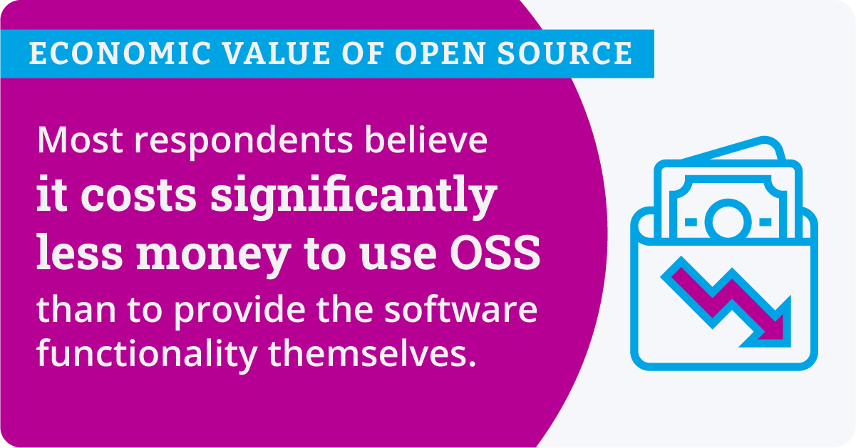
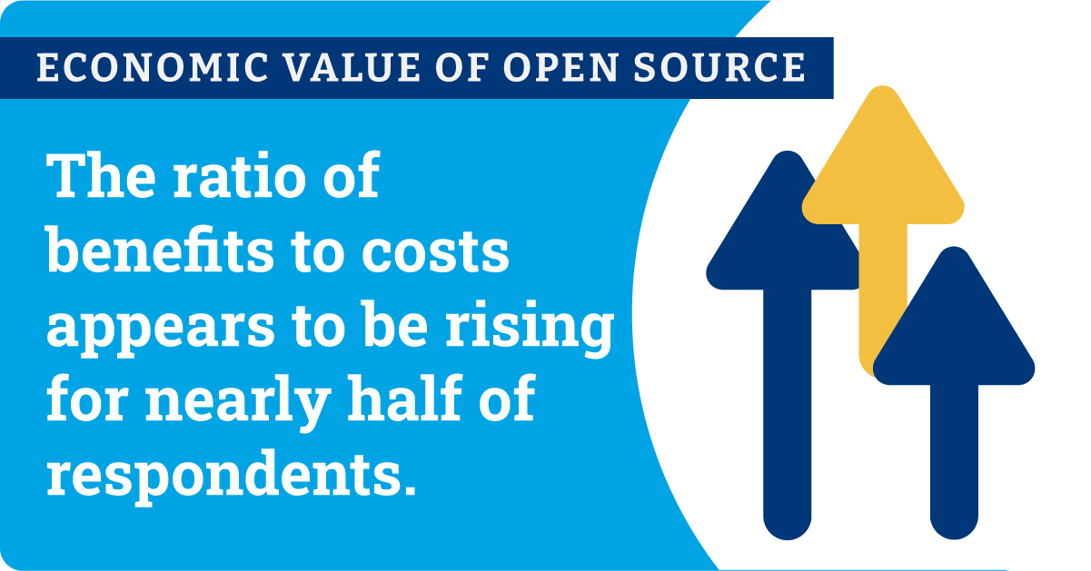
Group Actions
Economic Value of Open Source
Source: Economic Value of Open Source, Global Spotlight 2023

Slide 7
The Linux Foundation solves decentralized development for open source code.
When multiple companies, entities, or individuals want to collaborate on open source software but don’t trust one single party to own the code, they turn to the Linux Foundation.

Slide 8
The Linux Foundation solves decentralized development.
When multiple companies, entities, or individuals want to collaborate on open source software but don’t trust one single party to own the code, they turn to the Linux Foundation.
Notes:
I do want to show you all some facts and figures, so that you all know that we have a lot of data and experience backing the recommendations I’m going to make later in the talk.

Slide 9
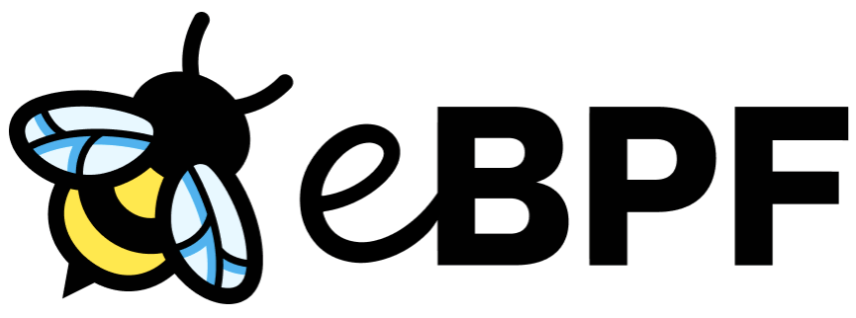
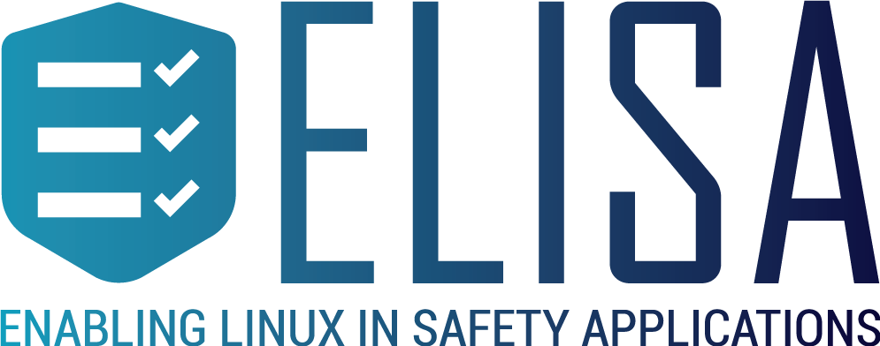
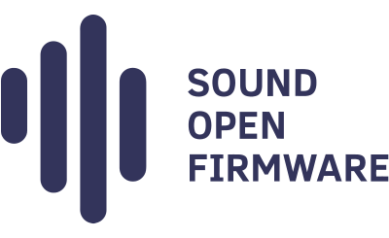
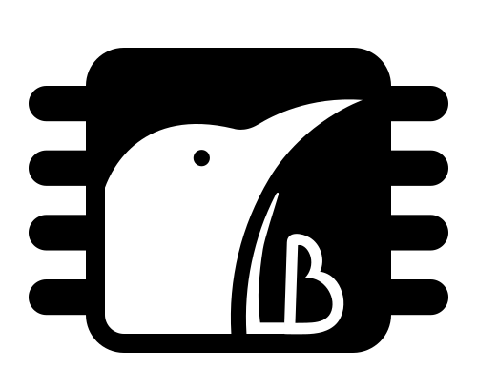
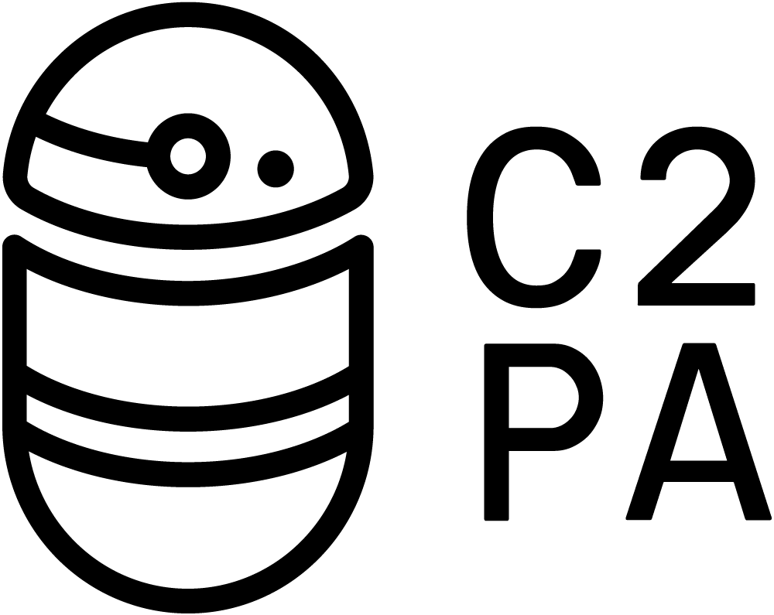
We are behind some of the most critical projects in the world
Vertical Industry
Security
AI & Data
Cloud
Networking
Edge & IoT
Web
Visual Effects
Sustainability
Digital Trust
Hardware
Standards
LinuxBoot
Electron

Slide 10
Across our foundations: hundreds of projects, lines of code in the billions
11.7M
Lines of Code Added Weekly
9.4M
Lines of Code Removed Weekly
208,660
Contributing
Developers
12,435
Contributing
Companies
16,618
Repositories
9.1M
Commits
960,610
Pull Requests
1.3M
Builds Monitored
859,150
Logged Issues
5.2B
Container Downloads
1.6M
Group Chat Messages
3.6M
Group Email Messages
4,532
Scanned Repositories
282,342
Open Vulnerabilities
62,379
Recommended Fixes
36,163
Vulnerabilities
Fixed
31,496
CLA Contributors
26,998
Community Meetings
Notes:
ETH: 8k monthly contributors (some double-counting with us!)

Slide 11
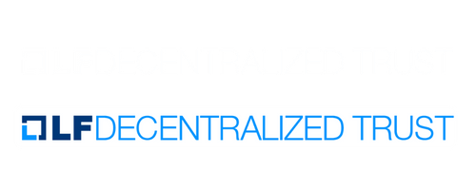
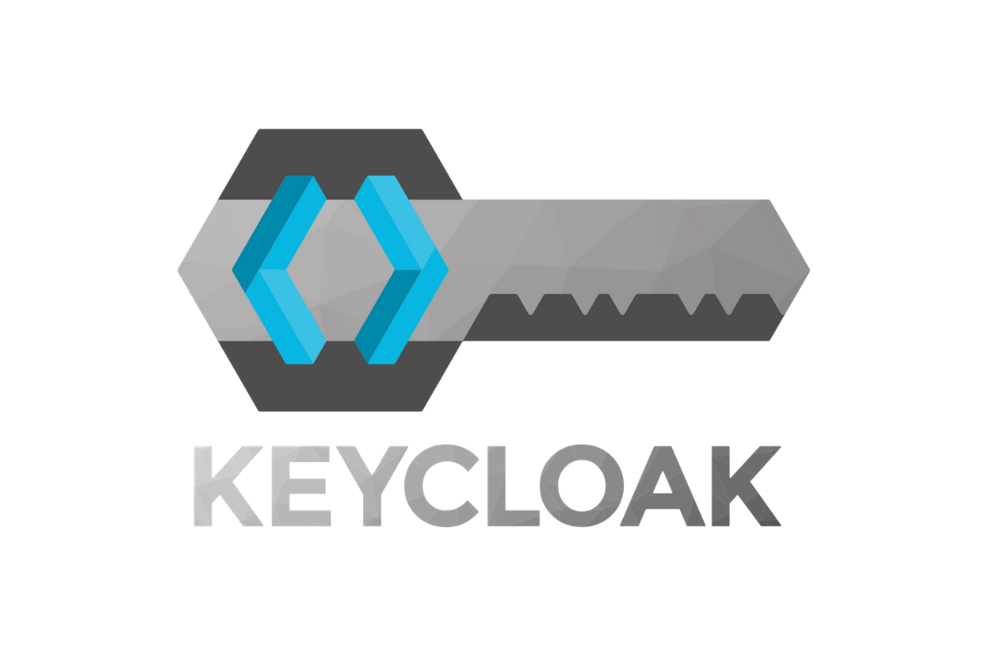
Cryptography at the Linux Foundation
Post-Quantum Crypto
MPC/Threshold Crypto
Identity + Authentication
PQ Code Package
Identity + Anonymous Creds
Identity + Anon Creds
Identity + Anonymous Creds
Credo

Slide 12
Open Source Software:
Table Stakes

Slide 13
What Is Open Source Software?
Open source software (OSS) is a type of computer software in which source code is released under a license in which the copyright holder grants users the rights to study, change, and distribute the software to anyone and for any purpose. Open source software may be developed in a collaborative public manner.
License is a legal document that records and formally expresses a set of legally enforceable acts, processes, or contractual duties, obligations, or rights related to the software and/or source code.

Slide 14
Open Source Licensing: Three Types
Business (e.g. BSL)
Very restrictive software licenses that may require payments to a developing company for use.
Copyleft (e.g. GPL)
Modifying the software requires you to contribute back any “derivative works”.
You can use and modify the software in essentially any way that you like.
Permissive (e.g. Apache)

Slide 15
Business Source License (BSL)
Technically a source-available license, not an open source license. The source code is public but use is limited to certain users.
After a certain amount of time the code converts to a standard open source license.
Viewed as a compromise between proprietary software and open source. Treat software under this license as proprietary, but with the extra added benefit that you (and others) can review the source code.
Notable examples: BUSL
Notable Projects: MariaDB MaxScale, Hashicorp Terraform, Arbitrum Nitro

Slide 16
Business Source License (BSL)
Technically a source-available license, not an open source license. The source code is public but use is limited to certain users.
After a certain amount of time the code converts to a standard open source license.
Viewed as a compromise between proprietary software and open source. Treat software under this license as proprietary, but with the extra added benefit that you (and others) can review the source code.
Notable examples: BUSL
Notable Projects: MariaDB MaxScale, Hashicorp Terraform, Arbitrum Nitro
Use a BSL license when:
You want to be able to control who uses your code (like it were closed source)
…but you want people to be able to independently verify and study your code.

Slide 17
Copyleft License
Open source licenses that require users to make available all derivative works. In other words, if you modify the code and use it in something, you typically have to make the source of that “something” available for free.
Very hard to use commercially–often you must release to the public code that you wish to keep private!
Notable Examples: GPL, MPL, LGPL Notable Projects: Linux Kernel, Mozilla Firefox, Geth
“GNU is not in the public domain. Everyone will be permitted to modify and redistribute GNU, but no distributor will be allowed to restrict its further redistribution. That is to say, proprietary modifications will not be allowed. I want to make sure that all versions of GNU remain free.”
–Richard Stallman, GNU Manifesto

Slide 18
Copyleft License
Open source licenses that require users to make available all derivative works. In other words, if you modify the code and use it in something, you typically have to make the source of that “something” available for free.
Very hard to use commercially–often you must release to the public code that you wish to keep private!
Notable Examples: GPL, MPL, LGPL Notable Projects: Linux Kernel, Mozilla Firefox, Geth
Copyleft goal: increase contributions by legally requiring them.
Unfortunate reality: people just won’t use your code if there are any viable alternatives due to the potentially cumbersome legal requirements.
It is VERY hard to relicense to a permissive license.
“GNU is not in the public domain. Everyone will be permitted to modify and redistribute GNU, but no distributor will be allowed to restrict its further redistribution. That is to say, proprietary modifications will not be allowed. I want to make sure that all versions of GNU remain free.”
–Richard Stallman, GNU Manifesto

Slide 19
Permissive License
An open source license that lets you modify and use the code freely. Essentially “do whatever you want” with few extra restrictions.
Most commercially used open source code and most Linux Foundation codebases are licensed with a permissive license. It’s by far the easiest kind of code to use.
We recommend using code with a permissive license if you want others to use your code because it is by far the easiest to use without any legal repercussions.
Notable examples: Apache 2.0, MIT License
Notable projects: Chromium, Kubernetes, most LF projects, Besu

Slide 20
Permissive License
An open source license that lets you modify and use the code freely. Essentially “do whatever you want” with few extra restrictions.
Most commercially used open source code and most Linux Foundation codebases are licensed with a permissive license. It’s by far the easiest kind of code to use.
We recommend using code with a permissive license if you want others to use your code because it is by far the easiest to use without any legal repercussions.
Notable examples: Apache 2.0, MIT License
Notable projects: Chromium, Kubernetes, most LF projects, Besu
Recommendation: default to permissive licenses for research code, or code you don’t have plans to monetize.
Permissive licensing typically maximizes the number of people who can use your code.

Slide 21
Common Licensing Pitfalls
markanddraw

Slide 22
Be Careful with Code You Use (Dependency Traps)!
When building a "combined work" with LGPL code in addition to other code: Section 4.d requires you to either LGPL license a "Minimal Corresponding Source" version of your code under LGPL, or
"Use a suitable shared library mechanism for linking with the Library. A suitable mechanism is one that (a) uses at run time a copy of the Library already present on the user's computer system, and (b) will operate properly with a modified version of the Library that is interface-compatible with the Linked Version."
This requirement generally implies that you need to be very careful if you have compile-time dependencies for LGPL code.

Slide 23
Be Careful with Licenses that Don’t Have IP Protections!
“[Company XYZ] open-source products uses the BSD-3-clear license, which is a common, highly permissive open source license. However, this license does not explicitly cover patents, which is why we added an exemption that gives you the right to use our code (including the patents contained in it) for free for research, evaluation and prototyping purposes, as well as for your personal projects. The exemption does not grant any rights for commercial purposes. Therefore, if you want to use [Product] in a commercial product, you will need to purchase a separate commercial license by emailing us at [Company XYZ email].”
This company is actually very transparent! If you use code from less ethical and transparent people, you may be rolling the dice on a lawsuit!

Slide 24
Pay close attention to the licenses and licensing requirements of the open source projects that you use and to which you potentially contribute!
Recommendation: use Apache 2.0, which is a permissive license and has an explicit patent grants, for open source cryptography projects, particularly if you aren’t trying to monetize your code.
If you want to make a proprietary codebase visible to others, a BSL license may be suitable.

Slide 25
Other Legal/IP and Copyright Protections

Slide 26
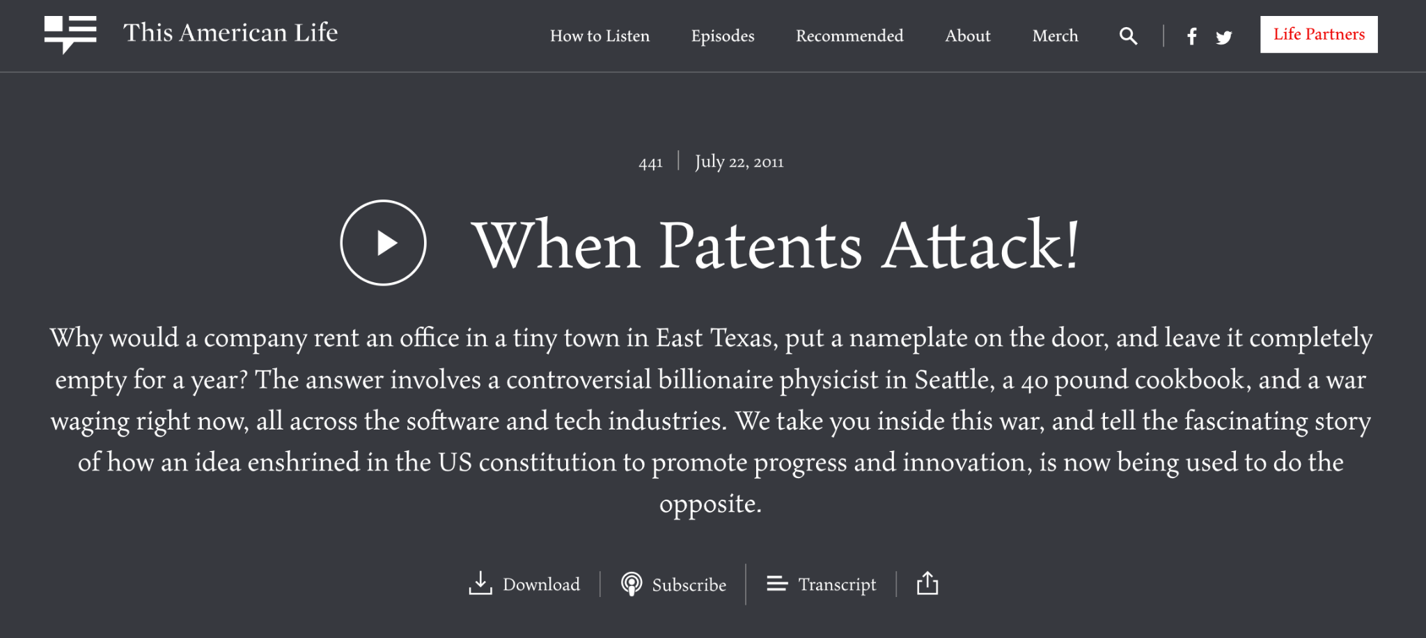
Problem: IP-Protected Code?
Contributors to open source software may unintentionally or maliciously add code that has some form of IP protection (like patents) to your open source project.

Slide 27
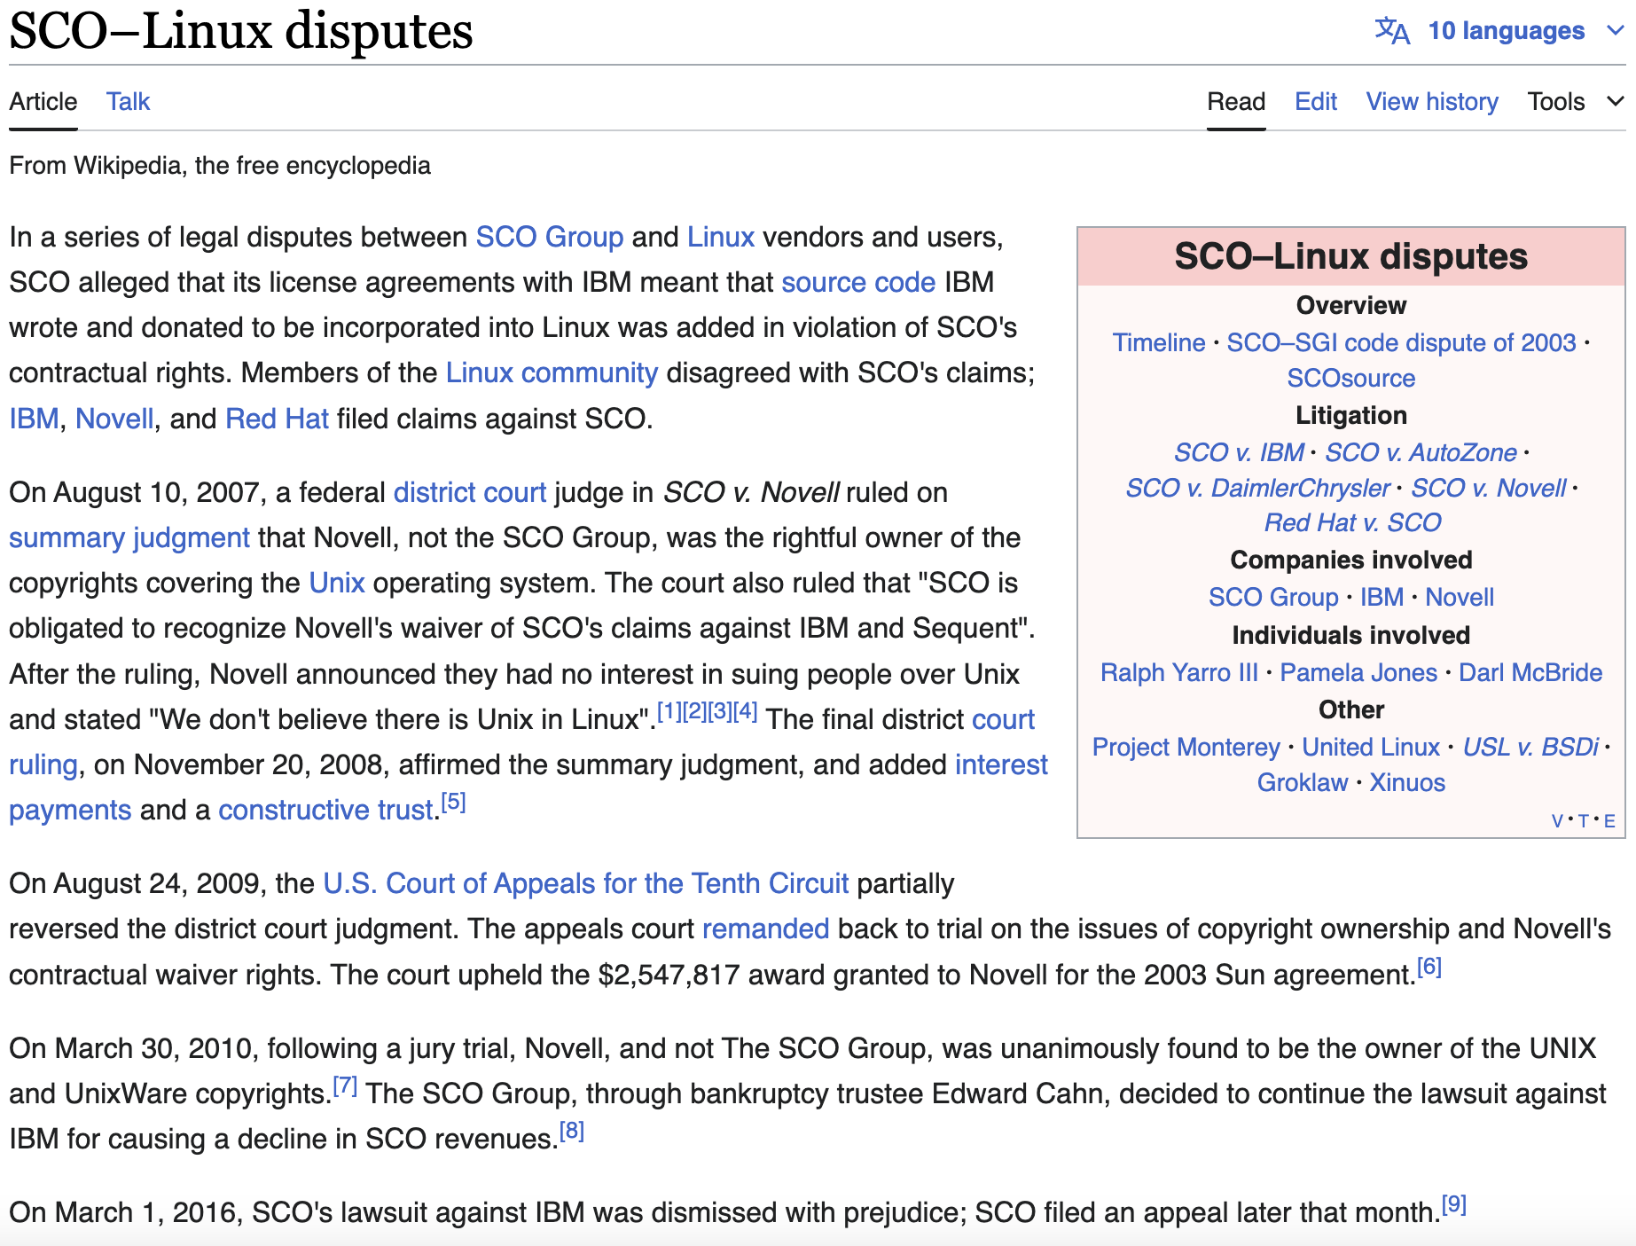

Slide 28
Protect Yourself from IP Trolls!
We recommend that your project either use the Developer Certificate of Origin (DCO) or a Contributor License Agreement (CLA).
It is important to have appropriate legal frameworks around your codebase so that users of the code cannot get frivolously sued! This is especially important if you allow contributions from people outside of a single company.

Slide 29
Developer Certificate of Origin
Version 1.1
Copyright (C) 2004, 2006 The Linux Foundation and its contributors.
1 Letterman Drive
Suite D4700
San Francisco, CA, 94129
Everyone is permitted to copy and distribute verbatim copies of this license document, but changing it is not allowed.
Developer's Certificate of Origin 1.1
By making a contribution to this project, I certify that:
(a) The contribution was created in whole or in part by me and I have the right to submit it under the open source license indicated in the file; or
(b) The contribution is based upon previous work that, to the best of my knowledge, is covered under an appropriate open source license and I have the right under that license to submit that work with modifications, whether created in whole or in part by me, under the same open source license (unless I am permitted to submit under a different license), as indicated in the file; or
(c) The contribution was provided directly to me by some other person who certified (a), (b) or (c) and I have not modified it.
(d) I understand and agree that this project and the contribution are public and that a record of the contribution (including all personal information I submit with it, including my sign-off) is maintained indefinitely and may be redistributed consistent with this project or the open source license(s) involved.

Slide 30
Developer Certificate of Origin
Version 1.1
Copyright (C) 2004, 2006 The Linux Foundation and its contributors.
1 Letterman Drive
Suite D4700
San Francisco, CA, 94129
Everyone is permitted to copy and distribute verbatim copies of this license document, but changing it is not allowed.
Developer's Certificate of Origin 1.1
By making a contribution to this project, I certify that:
(a) The contribution was created in whole or in part by me and I have the right to submit it under the open source license indicated in the file; or
(b) The contribution is based upon previous work that, to the best of my knowledge, is covered under an appropriate open source license and I have the right under that license to submit that work with modifications, whether created in whole or in part by me, under the same open source license (unless I am permitted to submit under a different license), as indicated in the file; or
(c) The contribution was provided directly to me by some other person who certified (a), (b) or (c) and I have not modified it.
(d) I understand and agree that this project and the contribution are public and that a record of the contribution (including all personal information I submit with it, including my sign-off) is maintained indefinitely and may be redistributed consistent with this project or the open source license(s) involved.
That’s it!
DCO is very easy to set up on Github using commits signed with the “-s” flag.

Slide 31
Be sure to have legal protections for your code if you have any ambitions for it beyond research! If you don’t, people will (justifiably) be less likely to use your code!
We require this for all LF projects, and should should too for your OSS!
We like to use the DCO at the Linux Foundation because we find it has less contributor friction than a CLA, but a CLA (e.g. the Apache CLA) is a perfectly adequate solution too!

Slide 32
Open Source Security

Slide 33
Security Can Be Different in OSS!
Placing a priority on security is essential for any open source project!
But you already knew that.
Some things that are different for open source:
Vulnerability disclosures and a security reporting pipeline are very important and different from closed-source software.
A software bill of materials (SBOM) is essential for making sure your software is secure when building with and in open source.
Authenticating your software and artifacts is important for users.

Slide 34
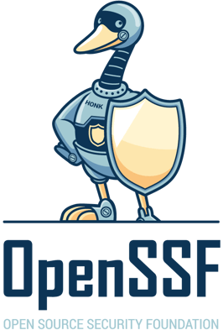
Open Source Security Foundation
The Open Source Security Foundation (OpenSSF) is a community of software developers, security engineers, and more under the Linux Foundation who are working together to secure open source software for the greater public good.
The OpenSSF has answers and guidelines for all of the things you need to be doing for basic open source software security. Check it out for more details!

Slide 35
Security Vulnerability Disclosures/Pipelines
An advantage of open source software is that community members can find and report bugs. You want to make this as easy as possible for them. Contributor friction for bug reporting may cause you to miss a big bug!
Form a security response team that can quickly respond to and handle bugs.
It doesn’t matter too much the exact method you prefer for reporting, as long as it is easy to find and follow.
Recently in the Linux Foundation, many of our projects have been using the Github tooling for security bugs.
On the other hand, Besu has 7 reporting channels!

Slide 36
Group Actions
Recall: Building a Modern Platform or Application
Use Open Source
Libraries to Solve Problems
Open Source Code (~70%)
Write Custom Code
Custom Code (~10%)
Choose a Framework
Open Source Code (~20%)
Notes:
On the other hand, in quantum lightning, the adversary wins if they generate two banknotes that verify under a serial number of their choice.

Slide 37
Software Supply Chain Attacks
Github Actions Attack
(No Logo Yet!)

Slide 38
Software Bill of Materials (SBOM)
Keep track of all of the code you pulled in to your OSS project. If there are bugs you need to fix them and update quickly!
Carefully examine the code you do use to make sure it’s well-maintained.
Well-run open source projects are careful with the dependencies they use!
There are a lot of good tools to help with this!

Slide 39
Software and Artifact Authentication
If you build a popular open source project, people will attempt to impersonate you!
This constantly happens for Linux Foundation projects (e.g. people attempt to create fake npm packages that look like those of official LF projects).
There are plenty of tools that you can use to sign and authenticate code; use them!

Slide 40
Building an Open Community

Slide 41
What Is Open Source Software?
Open source software (OSS) is a type of computer software in which source code is released under a license in which the copyright holder grants users the rights to study, change, and distribute the software to anyone and for any purpose. Open source software may be developed in a collaborative public manner.
Collaborative Public Manner is important here because the freedoms provided by the license allow for large and diverse communities to form around popular open source software, helping drive innovation and allowing companies to both contribute to and reap the benefits of these software projects. Linux is a key example of one such community, but there are many others like the Apache Web Server, Kubernetes and OpenStack.

Slide 42
What Do We Mean by…
Open Source
A public repository of code that anyone can use, evaluate, contribute to and build upon for any purpose.
Open Development
There is a community actively building open source code in the open.
Procedures and roles for the community, how decisions and priorities are made for the project, and the roadmap are openly defined and managed.
Open Governance

Slide 43
Open Source Governance
Benevolent Dictator
Openly Governed
Public Demonstration
Open Product
The code is open source, but it is just simply publishing the code publicly. It is updated arbitrarily.
There is not necessarily a roadmap, and the main purpose of open-sourcing is to allow others to view, verify, and potentially use code that has been developed.
A company or entity open sources a piece of software that constitutes a product.
It doesn’t allow outside contributions, but keeps a roadmap, regular releases, and follows best security practices.
An organization or individual open sources their code and allows contributions from external contributors.
Ultimate authority on merging code is always the “benevolent” org.
Contributors may be anyone, but maintainers are only from the “benevolent” organization and there’s no clear path to influence.
Code with transparent documentation and decentralized meritocratic governance
Hosted under a third party non-profit entity which stewards IP, trademark, etc.
Anyone can join and contribute - inclusive
clear, public process for leadership with no organizational or payment restrictions for maintainership or other roles.

Slide 44
Any Questions?

