Slide 1
Cache Timing Leakages in Zero-Knowledge Protocols
Shibam Mukherjee, Christian Rechberger, Markus Schofnegger
27th March 2025
Sofia, Bulgaria

Slide 2
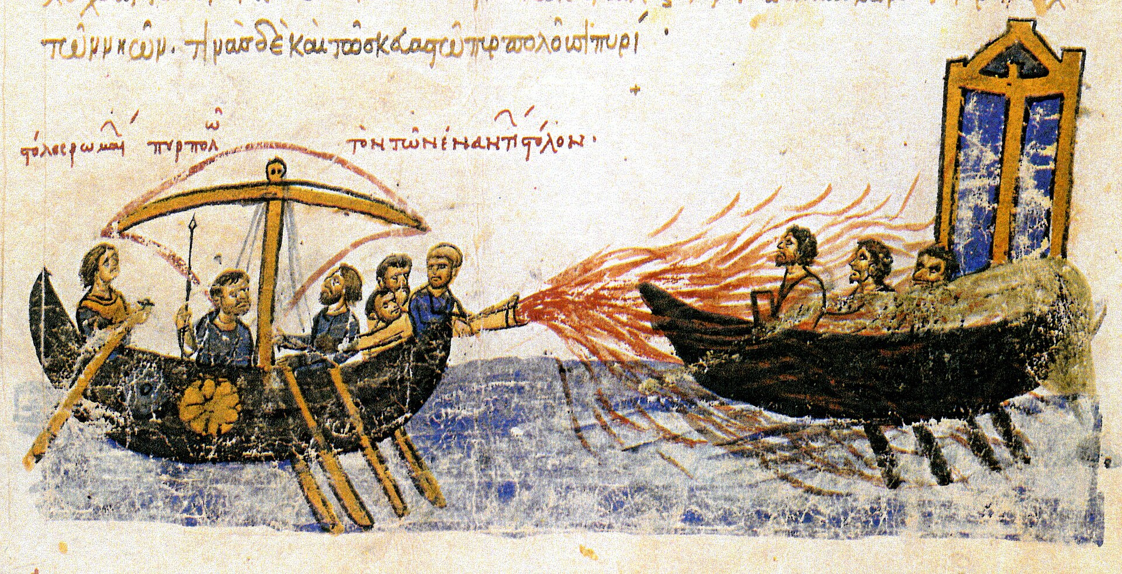
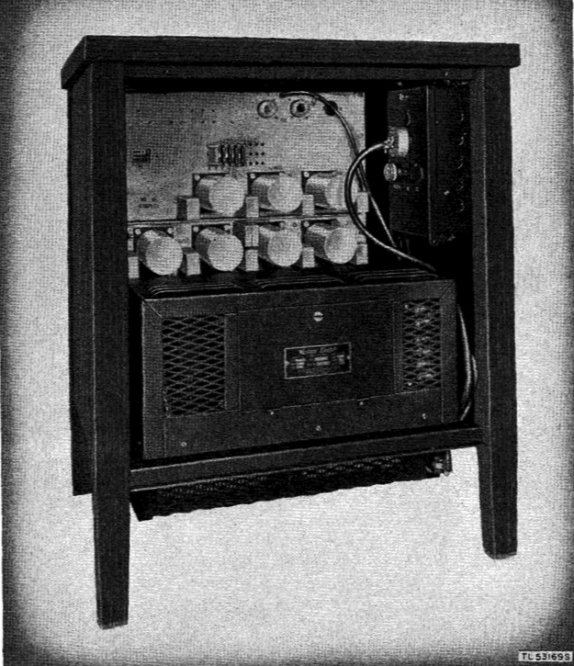
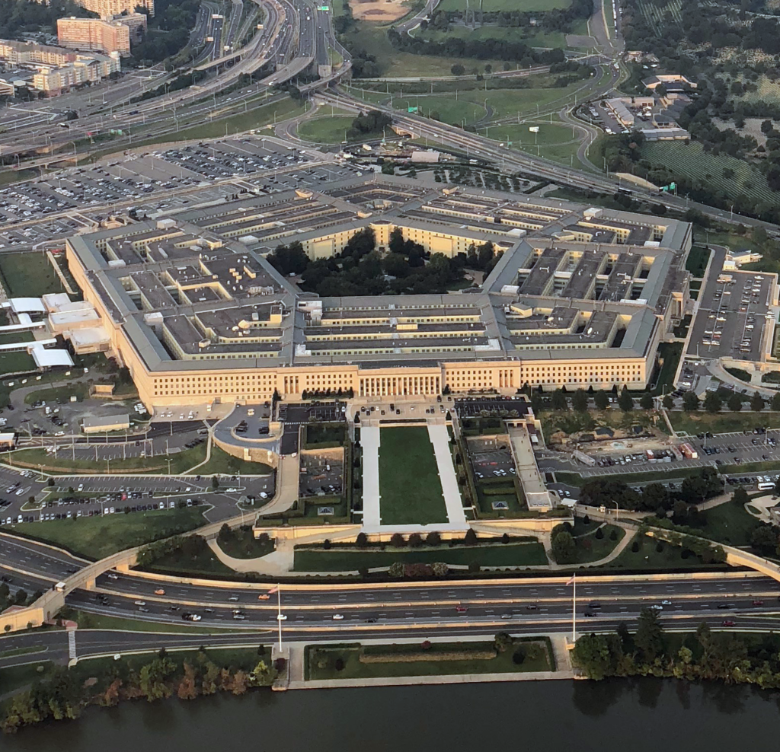
Greek fire (Wikipedia)
Side channels are everywhere!
Bell 131B2 mixer (Wikipedia)
Thieves looking into a house (Bing Image Creator)
The Pentagon pizza order (Wikipedia)

Slide 3
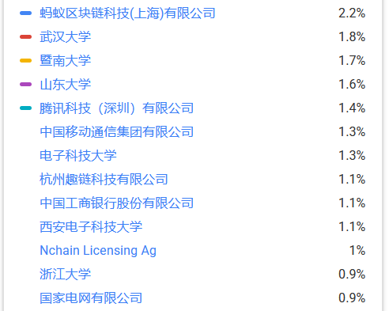
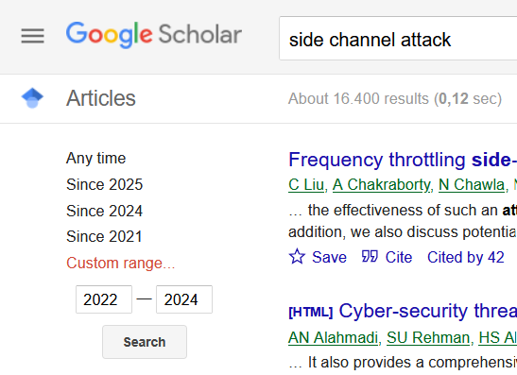
Side Channel Attacks and Zero Knowledge Protocols
Lot of Activity In The Past Two Years….

Slide 4
Side Channel Attacks and Zero Knowledge Protocols (Cont.)
Zero Knowledge Protocol
Remote Side-Channel attacks on anonymous transactions, Tramèr, Boneh, and Paterson (2020) [11]
Found side channel leakage due to different communication patterns
9 ZK companies/products/opensource-projects affected due to this trickling effect
Field Arithmetic Libraries
Non-constant time implementation found
5 standard libraries
2 custom implementations
Potential cache timing leakage?
Hash Functions
Case-study: Poseidon hash
Our Work!
Cache Timing Leakages in Zero-Knowledge Protocols, Mukherjee, Rechberger, and Schofnegger (2024) [13]
Cache-based timing side channel attack

Slide 5
ZK Proofs and Merkle Trees
Merkle trees used in ZK proofs
Pairing based ZK [14,15,16] and FRI protocols [17]
Leaves contain secret witness (directly or indirectly)
ZK-friendly hash functions H for tree construction
Key observations :-
Several field arithmetic libraries used to implement ZK protocol lack constant time implementation
H implementations use these leaky libraries, potential cache timing attack leaking the witness
Certain ZK-friendly H families leaks witness due to use of LUT in plain as a design choice
root
H
H
H
H
H
H
witness 1
witness 2
witness 3
witness 4
⚡
⚡

Slide 6
ZK-friendly Hash Family
Reinforced Concrete [19]
First LUT based ZK friendly hash function
Leakage due to LUT in plain (expected!)
Poseidon [18]
Widely used in ZK applications
Leakage in field arithmetic libraries used to implement Poseidon (more surprising for us!)
Pedersen
MiMc
Non LUT-based
Poseidon
LUT-based
Monolith
Anemoi
Rescue
Reinforced Concrete
Poseidon2
Sinsemilla
Tip4
Griffin
Tip5
Skyscraper

Slide 7
Threat Models
1. Proof generated on personal machine
⚡⏱️
🧑🖥️ Independent Prover
👹
Adversary
secret witness $$$
📃 Cache timing exploit
📝 ZK Proof

Slide 8
Threat Models (Cont.)
2. Proof generated on Cloud
⚡⏱️
Cache timing exploits
Secure enclave exploits
encrypted witness
🧑🖥️ Witness Holder
plain witness
🖥️
Cloud Prover
👹
Adversary
👹
(Adversary)
secret witness $$$
secret witness $$$
📃 Cache timing exploit
📝 ZK Proof

Slide 9
Pairing-based ZK and FRI with ZK
Uses elliptic curves to support efficient verification of pairing-based proofs
Prover P holds secret input (say, a coin ownership) witness, fixed by the Merkle root
P proves correct execution of H
Timing leakage in H when generating the proof leaks secret witness
P+P [3] and F+R [5] cache-based timing attacks
Low resolution attacks like P+P and F+R inadequate against FRI with ZK
Insufficient pre-image bits prevent efficient inverse-interpolation to leak the witness, higher resolution attack required! [20][10]
Pairing-based ZK more vulnerable than FRI with ZK!
root
⚡
H
H
H
H
H
H
witness 1
witness 2
witness 3
witness 4

Slide 10
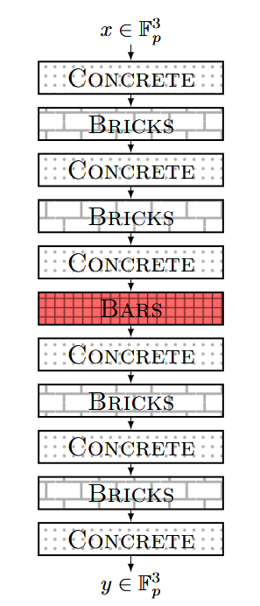
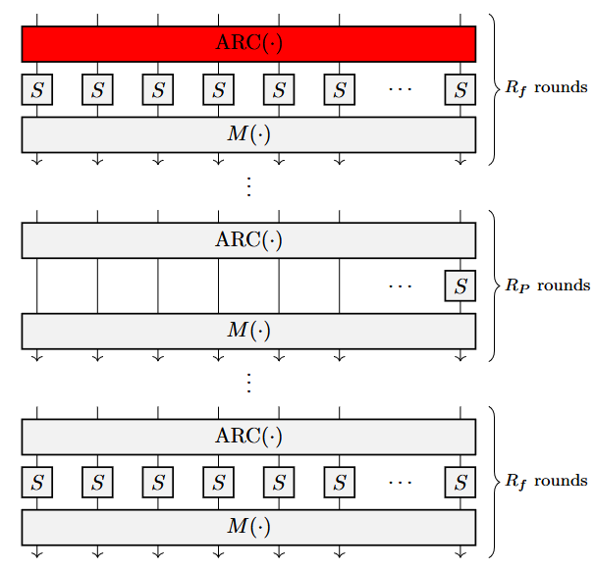
Leakage Targets and Numbers
Side Channel Attack Targets
Reinforced Concrete (BLS12, BN254, ST)
BARS S-box LUT
3.4% - 49.8% (mean), 24.55% - 100% (best) bits leaked
Best case (BN254) occurs with a high prob. ≈(2^{9.3})⁻¹
Poseidon (Mersenne, Goldilocks)
ARC(.) add round constant with modulo reduction
1.56% - 3.22% (mean), 14.06% - 29.03% (best) bits leaked
Round constant which “deviate from random” give more leakage!
⚡
⚡
The REINFORCED CONCRETE permutation
The POSEIDON^{π} permutation

Slide 11
Leakage Warnings Often Do Not Trickling Through Software Supply-chain Well
Field Arithmetic Libraries
ff⚠️ | ff-ce⚠️ | ark-ff⚠️ | python galois⚠️ | jdk⚠️ | Custom Lib. Implementation
Poseidon Hash
ZK Libraries
Lurk Labs (Turing-complete ZK programming language) - neptune-poseidon📒 | Matter Labs (Blockchain ZK) - rescue-poseidon | Light Protocol (ZK layer on Solana) - Light Protocol → light-poseidon📒 Mina Protocol (Decentralized Apps) - O1-labs/proof-systems | Ingonyama poseidon-hash (Hardware acceleration for ZKP) - poseidon-hash | Sui (ZK login and authentication) – Sui → poseidon-lite⚠️ Panther (Virtual asset private trading) – Panther → circomlibjs → ffjavascript → jdk (BigInt) | ZK-kit (General ZK library for developing various applications) Plonky2/3 (Blockchain ZK) - Plonky2/3* 📒🚀⏲️ *Leakage with small probability
Audited – 📒 Constant time implementation not part of audit - ⏲️ No constant time guarantees, not for production – ⚠️ Ready for production - 🚀

Slide 12
On Mitigation of Leakages
LUT-based hashes like Reinforced Concrete leak in plain evaluation (as expected!)
Constant time eval. of S-Box too expensive due to design choice
Use newer LUT-based hashes like Monolith [22], Skyscraper [21]
Allows efficient plain constant time evaluation instead of using LUT
Leakage in Poseidon more surprising!
Constant-time implementation of field arithmetic libraries
A slow down between 7% - 16% (not bad!)

Slide 13
End-to-End Attack
How practical are end-to-end attacks?
We think…
Pure research often bottlenecked with less “person years” funding
Big money at stake (similar to other industries)
More motivation, more engineers!
Mitigation against cache timing is not expensive (not always the case)
Better buy system-level Zero-Day exploits if attacker already sharing the CPU
Targets look promising
Several attack vectors open
Mostly engineering problem
Side-channel community
A side-channel veteran
Unsure how practical an end-to-end attack is…
ZK community

Slide 14
Key Take Aways and Future Directions
As ZK use-cases mature, side-channel protection will be crucial
Several field libraries show timing vulnerabilities affecting ZK protocols
Constant-time implementation, easy to patch and low runtime overhead!
If already using Tip4/5 or Reinforced Concrete, switch to newer hashes like Skyscraper [21]
High-res cache timing / (remote) power attacks?
Constant-time hardware implementation?
MPC + ZK = coSNARKs?
Generic SCA countermeasures for full protocol, including hash function?
Write that down. (imgflip.com)

Slide 15
Find the full paper here :)
https://eprint.iacr.org/2024/1390
Questions?

Slide 16
Bibliography
[1] Kocher, P. C. (1996). Timing attacks on implementations of Diffie-Hellman, RSA, DSS, and other systems. In Advances in Cryptology—CRYPTO’96: 16th Annual International Cryptology Conference Santa Barbara, California, USA August 18–22, 1996 Proceedings 16 (pp. 104-113). Springer Berlin Heidelberg.
[2] Brumley, D., & Boneh, D. (2005). Remote timing attacks are practical. Computer Networks, 48(5), 701-716.
[3] Bernstein, D. J. (2005). Cache-timing attacks on AES.
[4] Osvik, D. A., Shamir, A., & Tromer, E. (2006). Cache attacks and countermeasures: the case of AES. In Topics in Cryptology–CT-RSA 2006: The Cryptographers’ Track at the RSA Conference 2006, San Jose, CA, USA, February 13-17, 2005. Proceedings (pp. 1-20). Springer Berlin Heidelberg.
[5] Yarom, Y., & Falkner, K. (2014). {FLUSH+ RELOAD}: A high resolution, low noise, l3 cache {Side-Channel} attack. In 23rd USENIX security symposium (USENIX security 14) (pp. 719-732).
[6] Lipp, M., Schwarz, M., Gruss, D., Prescher, T., Haas, W., Mangard, S., ... & Hamburg, M. (2018). Meltdown.

Slide 17
Bibliography
[7] Kocher, P., Horn, J., Fogh, A., Genkin, D., Gruss, D., Haas, W., ... & Yarom, Y. (2020). Spectre attacks: Exploiting speculative execution. Communications of the ACM, 63(7), 93-101.
[8] Chen, B., Wang, Y., Shome, P., Fletcher, C. W., Kohlbrenner, D., Paccagnella, R., & Genkin, D. (2024). GoFetch: Breaking constant-time cryptographic implementations using data memory-dependent prefetchers.
In Proc. USENIX Secur. Symp (pp. 1-21).
[9] Moghimi, D. (2023). Downfall: Exploiting speculative data gathering.
In 32nd USENIX Security Symposium (USENIX Security 23) (pp. 7179-7193).
[10] Sieck, F., Zhang, Z., Berndt, S., Chuengsatiansup, C., Eisenbarth, T., & Yarom, Y. (2024). TeeJam: Sub-Cache-Line Leakages Strike Back.
IACR Transactions on Cryptographic Hardware and Embedded Systems, 2024(1), 457-500.

Slide 18
Bibliography
[11] Tramèr, Florian, Dan Boneh, and Kenny Paterson. Remote Side-Channel attacks on anonymous transactions.
29th USENIX security symposium (USENIX security 20). 2020.
[12] Chaliasos, S., Ernstberger, J., Theodore, D., Wong, D., Jahanara, M., & Livshits, B. (2024). SoK: What don't we know? Understanding Security Vulnerabilities in SNARKs.
arXiv preprint arXiv:2402.15293.
[13] Mukherjee, S., Rechberger, C., & Schofnegger, M. (2024). Cache Timing Leakages in Zero-Knowledge Protocols.
Cryptology ePrint Archive.
[14] Chiesa, A., Hu, Y., Maller, M., Mishra, P., Vesely, N., & Ward, N. (2020). Marlin: Preprocessing zkSNARKs with universal and updatable SRS.
In Advances in Cryptology–EUROCRYPT 2020: 39th Annual International Conference on the Theory and Applications of Cryptographic Techniques, Zagreb, Croatia, May 10–14, 2020, Proceedings, Part I 39 (pp. 738-768). Springer International Publishing.

Slide 19
Bibliography
[15] Ambrona, M., Beunardeau, M., Schmitt, A. L., & Toledo, R. R. (2023, August). a P lon K: Aggregated P lon K from Multi-polynomial Commitment Schemes.
In International Workshop on Security (pp. 195-213). Cham: Springer Nature Switzerland.
[16] Groth, J. (2016). On the size of pairing-based non-interactive arguments.
In Advances in Cryptology–EUROCRYPT 2016: 35th Annual International Conference on the Theory and Applications of Cryptographic Techniques, Vienna, Austria, May 8-12, 2016, Proceedings, Part II 35 (pp. 305-326). Springer Berlin Heidelberg.
[17] Ben-Sasson, E., Bentov, I., Horesh, Y., & Riabzev, M. (2018). Fast reed-solomon interactive oracle proofs of proximity.
In 45th international colloquium on automata, languages, and programming (icalp 2018). Schloss Dagstuhl-Leibniz-Zentrum fuer Informatik.
[18] Grassi, L., Khovratovich, D., Rechberger, C., Roy, A., & Schofnegger, M. (2021). Poseidon: A new hash function for {Zero-Knowledge} proof systems.
In 30th USENIX Security Symposium (USENIX Security 21) (pp. 519-535).

Slide 20
Bibliography
[19] Grassi, L., Khovratovich, D., Lüftenegger, R., Rechberger, C., Schofnegger, M., & Walch, R. (2022, November). Reinforced concrete: a fast hash function for verifiable computation.
In Proceedings of the 2022 ACM SIGSAC Conference on Computer and Communications Security (pp. 1323-1335).
[20] Yarom, Y., Genkin, D., & Heninger, N. (2017). CacheBleed: a timing attack on OpenSSL constant-time RSA.
Journal of Cryptographic Engineering, 7, 99-112.
[21] Bouvier, C., Grassi, L., Khovratovich, D., Koschatko, K., Rechberger, C., Schmid, F. and Schofnegger, M., 2025. Skyscraper: Fast Hashing on Big Primes. Cryptology ePrint Archive.
[22] Grassi, L., Khovratovich, D., Lüftenegger, R., Rechberger, C., Schofnegger, M. and Walch, R., 2024. Monolith: Circuit-friendly hash functions with new nonlinear layers for fast and constant-time implementations. IACR Transactions on Symmetric Cryptology, 2024(3), pp.44-83.

Slide 21
Some Additional Slides...

Slide 22
Timing Attacks on Implementations of Diffie-Hellman, RSA, DSS, and Other Systems, Paul C. Kocher (1996) [1]
2000 - 2015
2015 - 2024
Meltdown Lipp, M., Schwarz, M., Gruss, D., Prescher, T., Haas, W., Mangard, S., Kocher, P., Genkin, D., Yarom, Y. and Hamburg, M. (2018) [6]
Remote Timing attacks are Practical David Brumley and Dan Boneh (2005) [2]
Cache-timing attacks on AES Daniel J. Bernstein (2005) [3]
Spectre attacks: Exploiting speculative execution, Kocher, Paul, et al. (2020) [7]
Cache Attacks and Countermeasures: the Case of AES, Dag Arne Osvik, Adi Shamir and Eran Tromer (2005) [4]
Downfall: Exploiting Speculative Data Gathering, Daniel Moghimi (2023) [9]
Gofetch: Breaking constant-time cryptographic implementations using data memory-dependent prefetchers, Chen et al. (2024) [8]
FLUSH+RELOAD: A high resolution low noise, L3 cache side-channel attack, Yuval Yarom and Katrina Falkner (2014) [5]
Teejam: Sub-cache-line leakages strike back, Sieck, F., Zhang, Z., Berndt, S., Chuengsatiansup, C., Eisenbarth, T. and Yarom, Y. (2024) [10]
Constant time implementation Somewhat easy fix!
🙂
CPU dependent No easy microcode update fix!
😐

Slide 23
Leakage use-case example
Telephone number Poseidon mod reduction branching
Falkland island +500 (5 digits, at most 17 bits)
Norway +47 (8 digits, at most 27 bits)
Similar for Reinforced Concrete look-up table!
root
H
H
Round Const.
Tel. No.
No mod reduction!
Prime modulo
H
H
H
H
Round Const.
Tel. No.
+47…
+500…
+47…
+500…
mod reduction!
Prime modulo
https://worldpopulationreview.com/country-rankings/phone-number-length-by-country

Slide 24
Proof generated on Cloud (Cloud is the adversary) – More Detailed Threat Model
🧑
encrypted witness
🖥️
Cloud Prover (Adversary)
Witness Holder
Memory
📝
👹
zk proof
ZK Proof
Application Processor
Cache timing attacks Secure Enclave exploits
⚡⏱️
decrypted witness
Secure Enclave (Enc/Dec)
encrypted witness
Cloud SOC

Slide 25
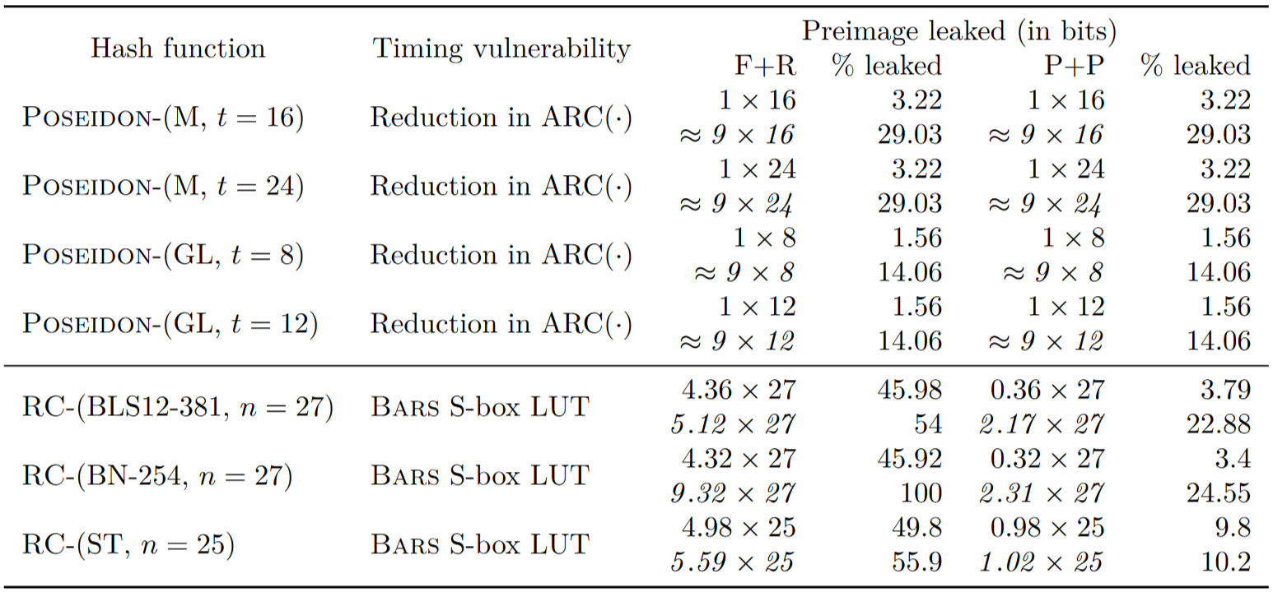
Preimage recovery complexity after F+R and P+P attacks on the REINFORCED CONCRETE and POSEIDON hash functions. The table shows the average and the best case input recovery complexity, where the best case occurs with a fairly large probability. The pre-image leakage is given in terms if equivalent bits of information learnt from the full state of the hash function.

Slide 26
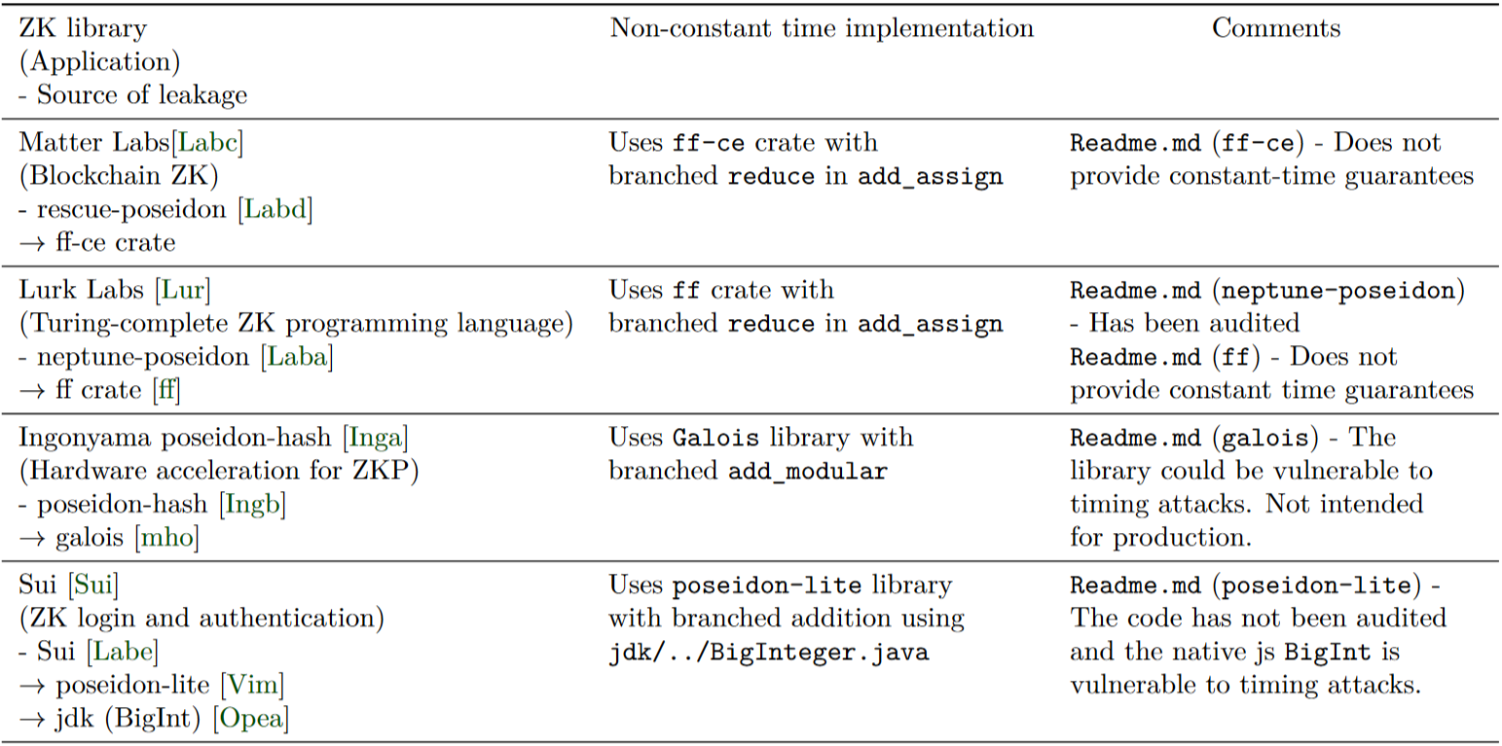
A summary of the ZK frameworks (non-exhaustive list) that may contain potential witness leakages due to F+R and P+P timing attacks on the various non-constant time POSEIDON hash function implementations. (Part 1)

Slide 27
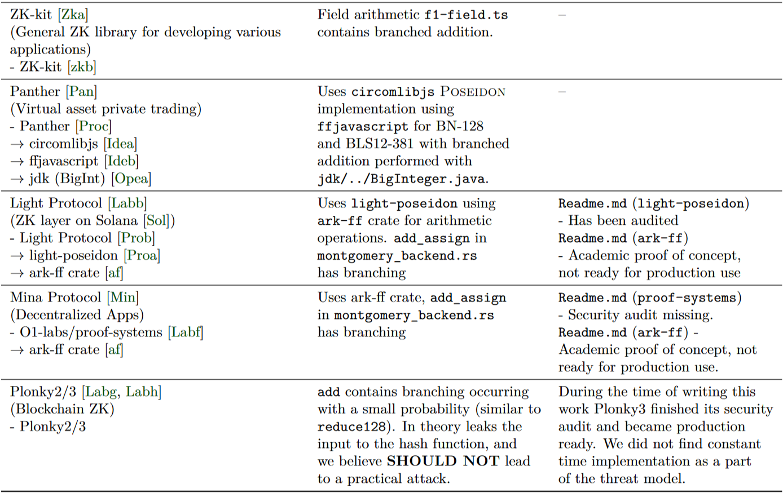
A summary of the ZK frameworks (non-exhaustive list) that may contain potential witness leakages due to F+R and P+P timing attacks on the various non-constant time POSEIDON hash function implementations. (Part 2)

Slide 28
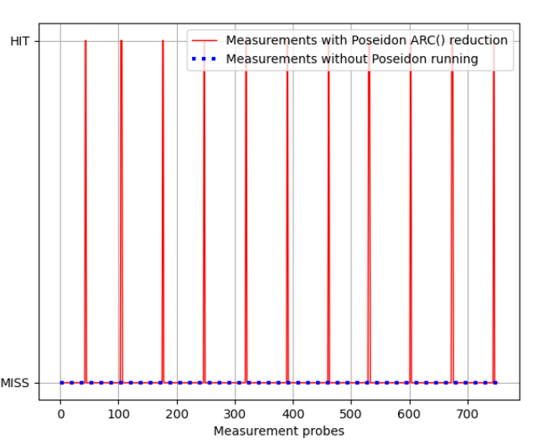
Cache-hit and cache-miss ratio of POSEIDON-GL hash function with F+R attack. Every 100th hash function call was set to modulo reduction in the ARC().

Slide 29
Poseidon hash in plain constant time implementation vs non-constant time implementation trade-off

