Slide 1
What happened to the ZK Dream?
Muthu Venkitasubramaniam
Co-founder/CEO, Ligero Inc.
Notes:
Making the accessible and usable winning the technical game against the censor

Slide 2
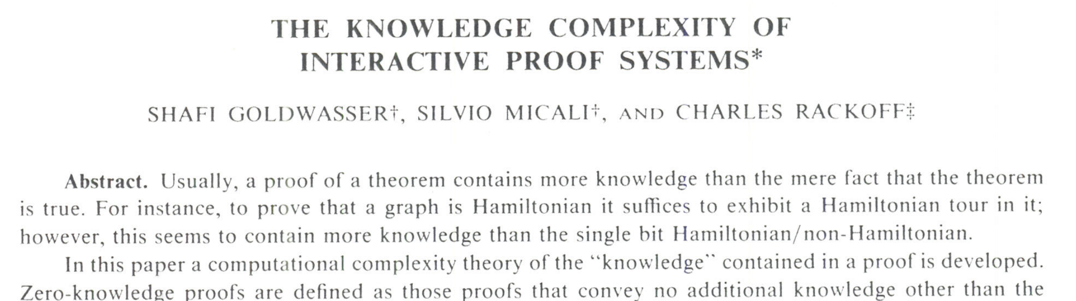
Where it all began

Slide 3
Where it all began

Slide 4
Taxonomy of ZK Proof Systems
Interactive vs Non-interactive
Trusted setup vs No setup (transparent)
ZK vs (only) Integrity
Succinct vs Non-succinct
Public-Key Crypto vs (only) Symmetric-Key Crypto
ZKS(T)NARKs provide the most useful form of proofs!
Transparent
ZKSNARK
ZK
NIZK
ZKSNARK
IP
SNARG
SNARK

Slide 5
Classifying ZK-S(T)NARK Applications
Privacy <> Client-side
Delegation <> Server-side
Anonymous credentials
“Fog of War” games
Image transformations
Blockchain scalability
Verifiable AI
FHE
Need ZK
SNARKs sufficient

Slide 6
Challenges in Building/Deploying ZK Apps
Data needs to be attested
Standard toolchain for developers
Lightweight to run client-side

Slide 7
1. Data Attestation
Need: Private/sensitive inputs to ZK Application needs to be authenticated
Problem: Lack of trusted institutions that provide attestation
Solution:
zk Email: proof of a DKIM signature (e.g., Venmo)
zk Login: proof of an Oauth signature (e.g., from Google)
zk TLS: proof of a TLS session (e.g., from Bank)
All deployed in production
*slides borrowed from Dan Boneh

Slide 8
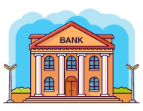
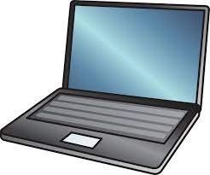
zkTLS or aka how to attest to TLS payload
TLS Protocol
browser
HTTPS web server
TLS handshake
(signed by web server)
TLS HTML payload
session-key
(encrypted with session key)
session-key
TLS Payload is not authenticated
=> enc. payload can be forged by client
*slides borrowed from Dan Boneh

Slide 9
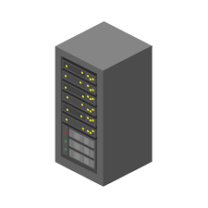
zkTLS or aka how to attest to TLS payload
browser
web proxy
HTTPS web server
HTTPS request
signed HTTPS response by proxy
signing key
Browser generates zk-SNARK that:
HTTPS handshake is signed by bank
encrypted payload signed by proxy
decrypted payload says balance > X
A network attack:
cause proxy to sign incorrect encrypted TLS frame
Solution 1: Proxy
*slides borrowed from Dan Boneh

Slide 10
zkTLS or aka how to attest to TLS payload
notary
browser
HTTPS web server
HTTPS request
HTTPS response
signing key
TLS session key is split between browser and notary
⇒ TLS in a 2PC
Browser generates zk-SNARK that:
HTTPS handshake is signed by bank
TLS 2PC transcript is signed by notary
decrypted payload says balance > X
Solution 2: Notary
*slides borrowed from Dan Boneh

Slide 11
1. Data Attestation
Now: zk proof that Bob’s Gmail account is > 10 years old
zk proof that Bob’s bank account balance > X
zk Email: proof of a DKIM signature (e.g., Venmo)
zk Login: proof of an Oauth signature (e.g., from Google)
zk TLS: proof of a TLS session (e.g., from Bank)
*slides borrowed from Dan Boneh

Slide 12
2. Specifying ZK
At the beginning: NP-complete problems (eg, Graph 3COL)
Then: Boolean and Arithmetic circuits
Since Blockchains: R1CS, Circom, Cairo, Gnark, etc…
Today: zkVMs

Slide 13
3. Running Client-Side
Bottleneck: Space-Time tradeoff for error-correcting codes
Theorem (Informal): FFT on n elements (i.e. $n\log{(n)}$ time) requires storage at least $n/\log{(n)}$
Lower bound can be extended to error-correcting codes [BTRS02,BBHV22]

Slide 14
SOTA ZK Falls Short
ZK-SNARKs (eg, Groth16) require huge memory
STARK-based ZK don’t run client-side yet*
Most ZK’s are built only for verifiability
ZKs that offer privacy for client-side require tailor-made DSLs

Slide 15
Today, ZK comes with tradeoffs!
Privacy vs Compliance
Does privacy require trading off regulatory compliance?
Privacy vs Cost
Does privacy require access to heavy infrastructure?
Privacy vs Usability
Do we need specialized toolchains to develop privacy solutions?
Privacy vs Trust
Does privacy require trusted intermediaries?

Slide 16
Our Vision
Useful and Usable Privacy Tools
w/ zero infra cost

Slide 17
Our Vision
Useful and Usable Privacy Tools
w/ zero additional infra cost
ON YOUR DEVICE

Slide 18
What can you prove from a browser?
1K – Fibonacci (25)
1M – Keyless login (Oauth)
5M – Proof of Twitter email
50M – 5K EdDSA verifications
200M – 1M Poseidon hashes
1B – Ethereum block proving
100B – LLM inference

Slide 19
Useful Privacy
Privacy for Individuals = Client-side proving
Seamless Logins and Authentication (zkLogin, zkEmail)
Disclosure with Maximal Privacy (zkTLS)
Verifiable credentials (investor accreditation, EUID, DPP)
Privacy for Orgs = zkValidiums
Asset Tokenization
Offchain Compute

Slide 20
Usable Privacy
Standard toolchain => zkVM
Affordable hardware => on your device!
Portable implementation => run on any device
Privacy-default approach => not just a SNARK, a ZK-SNARK

Slide 21
Introducing the Ligero ZK Platform

Slide 23
Ligetron ZK

Slide 24
Ligetron ZK by Ligero Inc.
Ligetron ZK* is (the only) memory-efficient hash-based ZK
Ligetron is ZK by default
Ligetron is a zkVM = zkWASM
A scalable/portable implementation using WebGPUs
* Published at 2024 IEEE Symposium on Security and Privacy

Slide 25
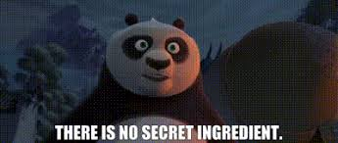
What’s the secret ingredient?
Hash-based
Code interleaving
Sharding without recursive composition
Memory-efficiency
Witness and constraints can be streamed

Slide 26
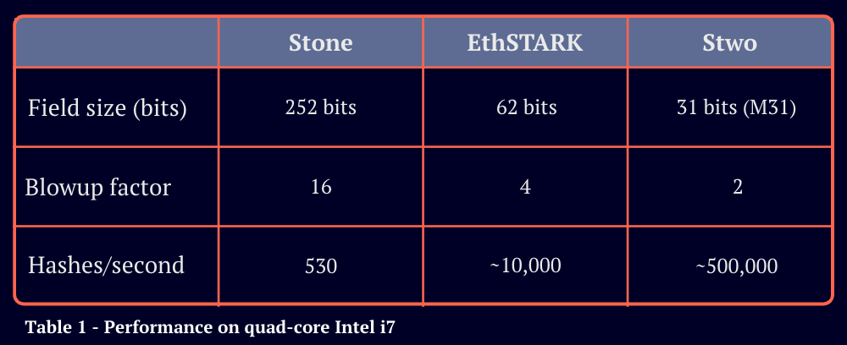
Ligero (Browser)
254 bits
27,000

Slide 27
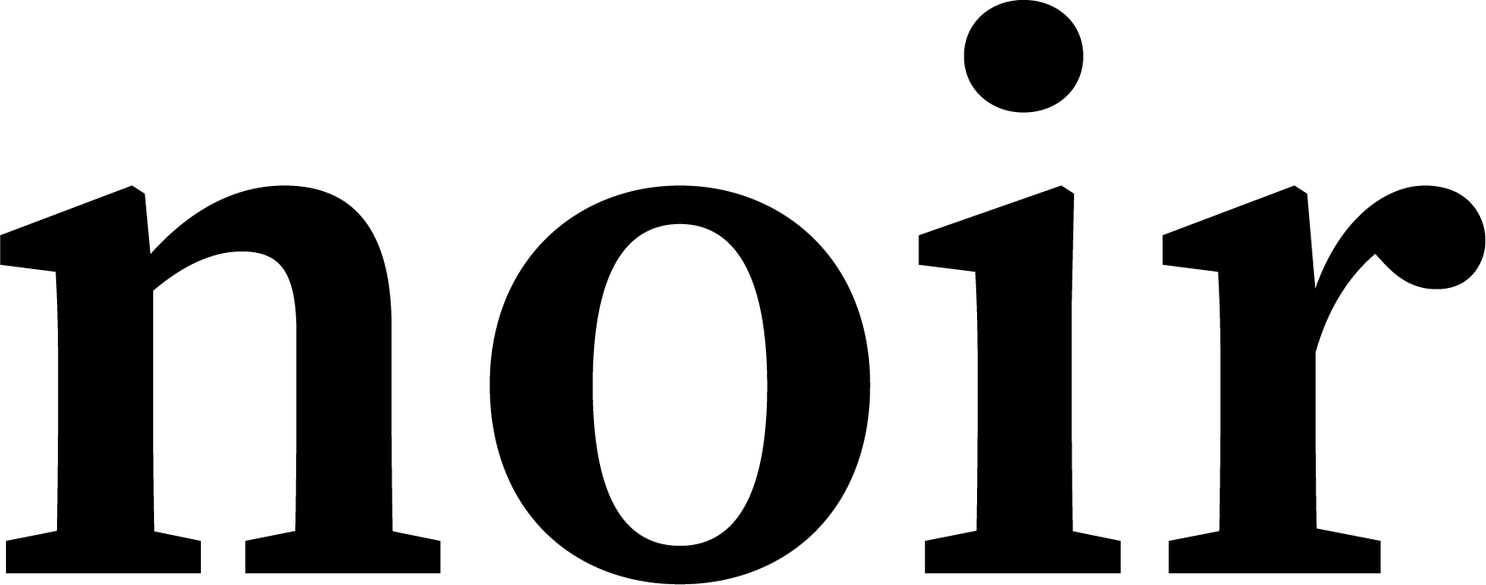
Comparison
1 GB
prover key
M1: 44 KHz
M1: 250 KHz – 1 MHz
M4: 500 KHz – 6 MHz
*Hz measures constraints per second

Slide 28
Our Roadmap
Today, build end-to-end ZK Apps from your browser using C++, Rust
Coming Soon
Plug-and-play identity (integrate Circom)
Scalable privacy: zkValidiums w/ offchain private compute
Next, Phase
Cross-linking zk languages (Noir, Cairo)
Ethereum block proving
Arbitrary AI computation (Onnx)
STAY TUNED!

Slide 29
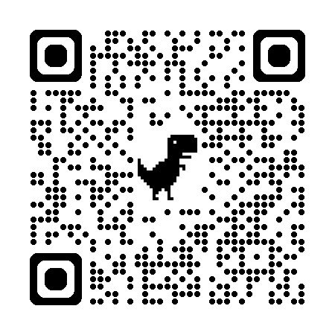
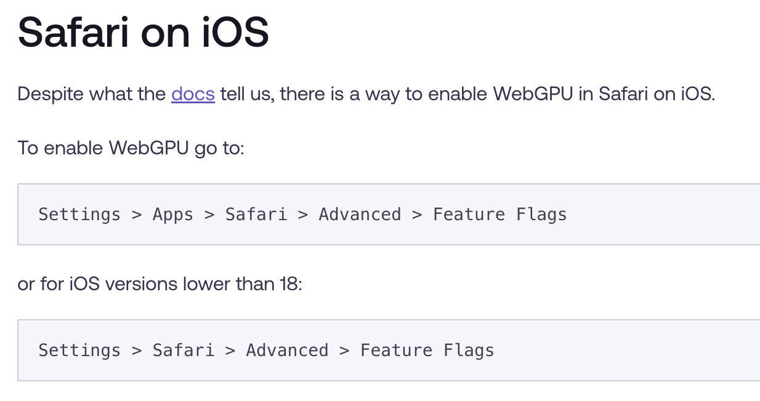
Want to test how fast your browser can generate Ligero proofs?
Open platform.ligetron.com/speedtest

Slide 30
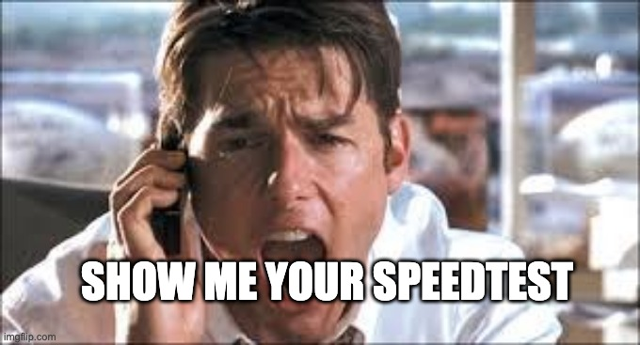
Want to test how fast your browser can generate Ligero proofs?
Open platform.ligetron.com/speedtest

Slide 31
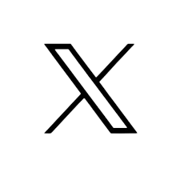
Ligetron ZK Development Platform
Build Anywhere – All you need is a browser.
Build in Any Language – C/C++, Rust, Circom
Run Everywhere – Mobile, Laptop, Server, Raspberry PI
ZK Anywhere Everywhere
platform.ligetron.com
www.ligero-inc.com
@ligero_inc

