Slide 1

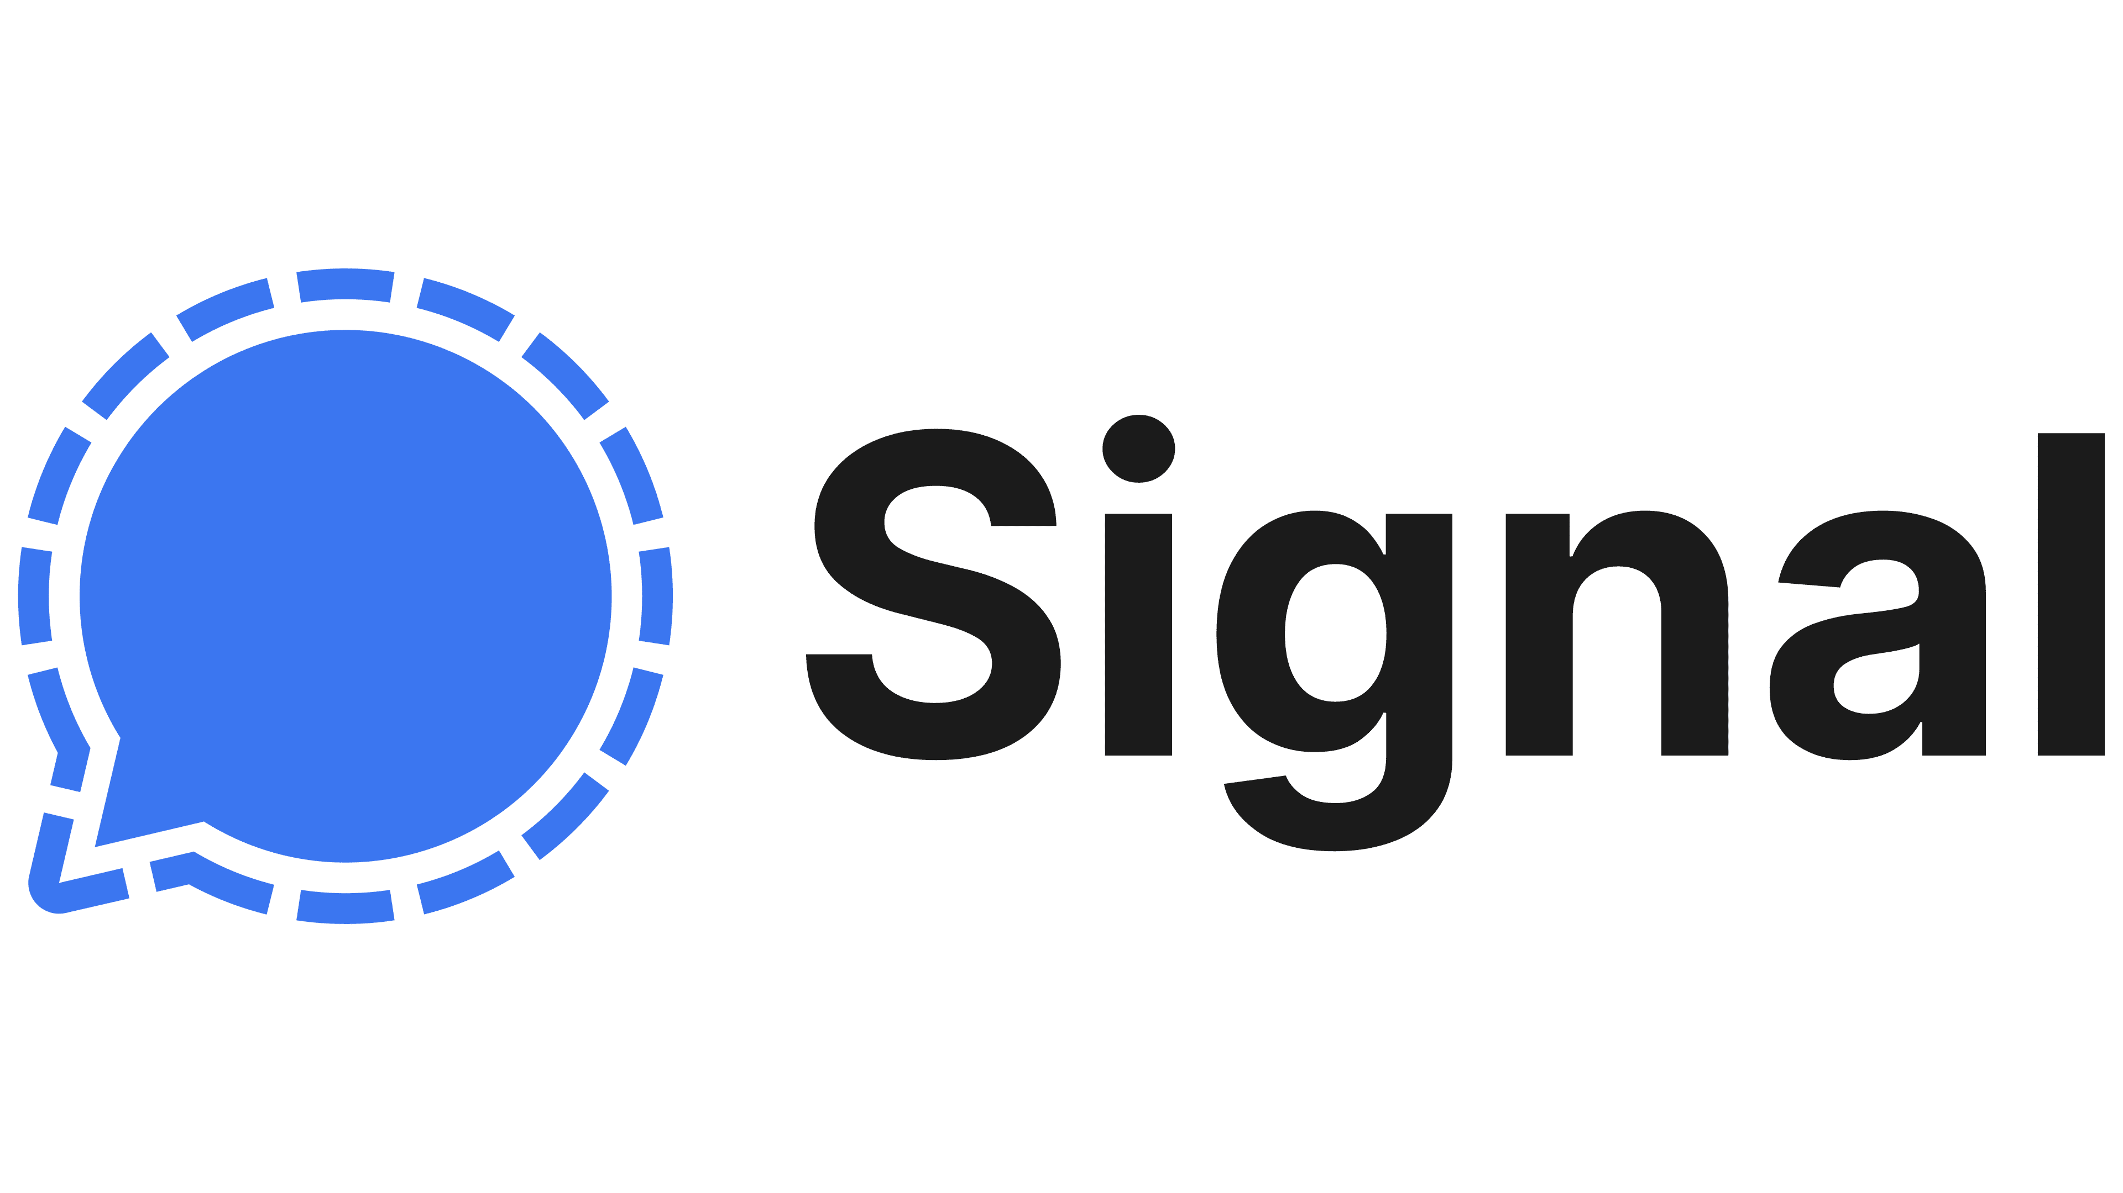


The Triple Ratchet Protocol:
A Bandwidth Efficient Hybrid-Secure Signal Protocol
Benedikt
Auerbach
Yevgeniy
Dodis
Shuichi
Katsumata
Daniel
Jost
Thomas
Prest
Rolfe
Schmidt

Slide 2
Takeaway
Signal’s
Double Ratchet
Triple Ratchet
PQ Ratchet
Our bandwidth efficient PQ Ratchet relies on…
A lattice-based Ratcheting KEM called KATANA ⚔️
Erasure codes
Opportunistic sending
Focus of our talk
Triple Ratchet is a natural composition of the Double and PQ Ratchets ☺

Slide 3
1. Background

Slide 4
The Signal Protocol
Gold standard for two-user secure messaging (SM).
Forward secrecy and post-compromise security.
Protocol used within Signal, WhatsApp, Google Messages…
Mainly relies on hardness of Diffie-Hellman.

Slide 5


Signal = X3DH + Double Ratchet
Signal Protocol
① X3DH
“Establish shared secret key”
①
② Double Ratchet
“Encrypted communication
w/ continuous key updates”
=> Strong PCS guarantees
(1)
(1)
②
(2)
(2)
…

Slide 6

Transitioning to PQ Security
Classical Signal
No PQ security
① X3DH
② Double Ratchet

Slide 7

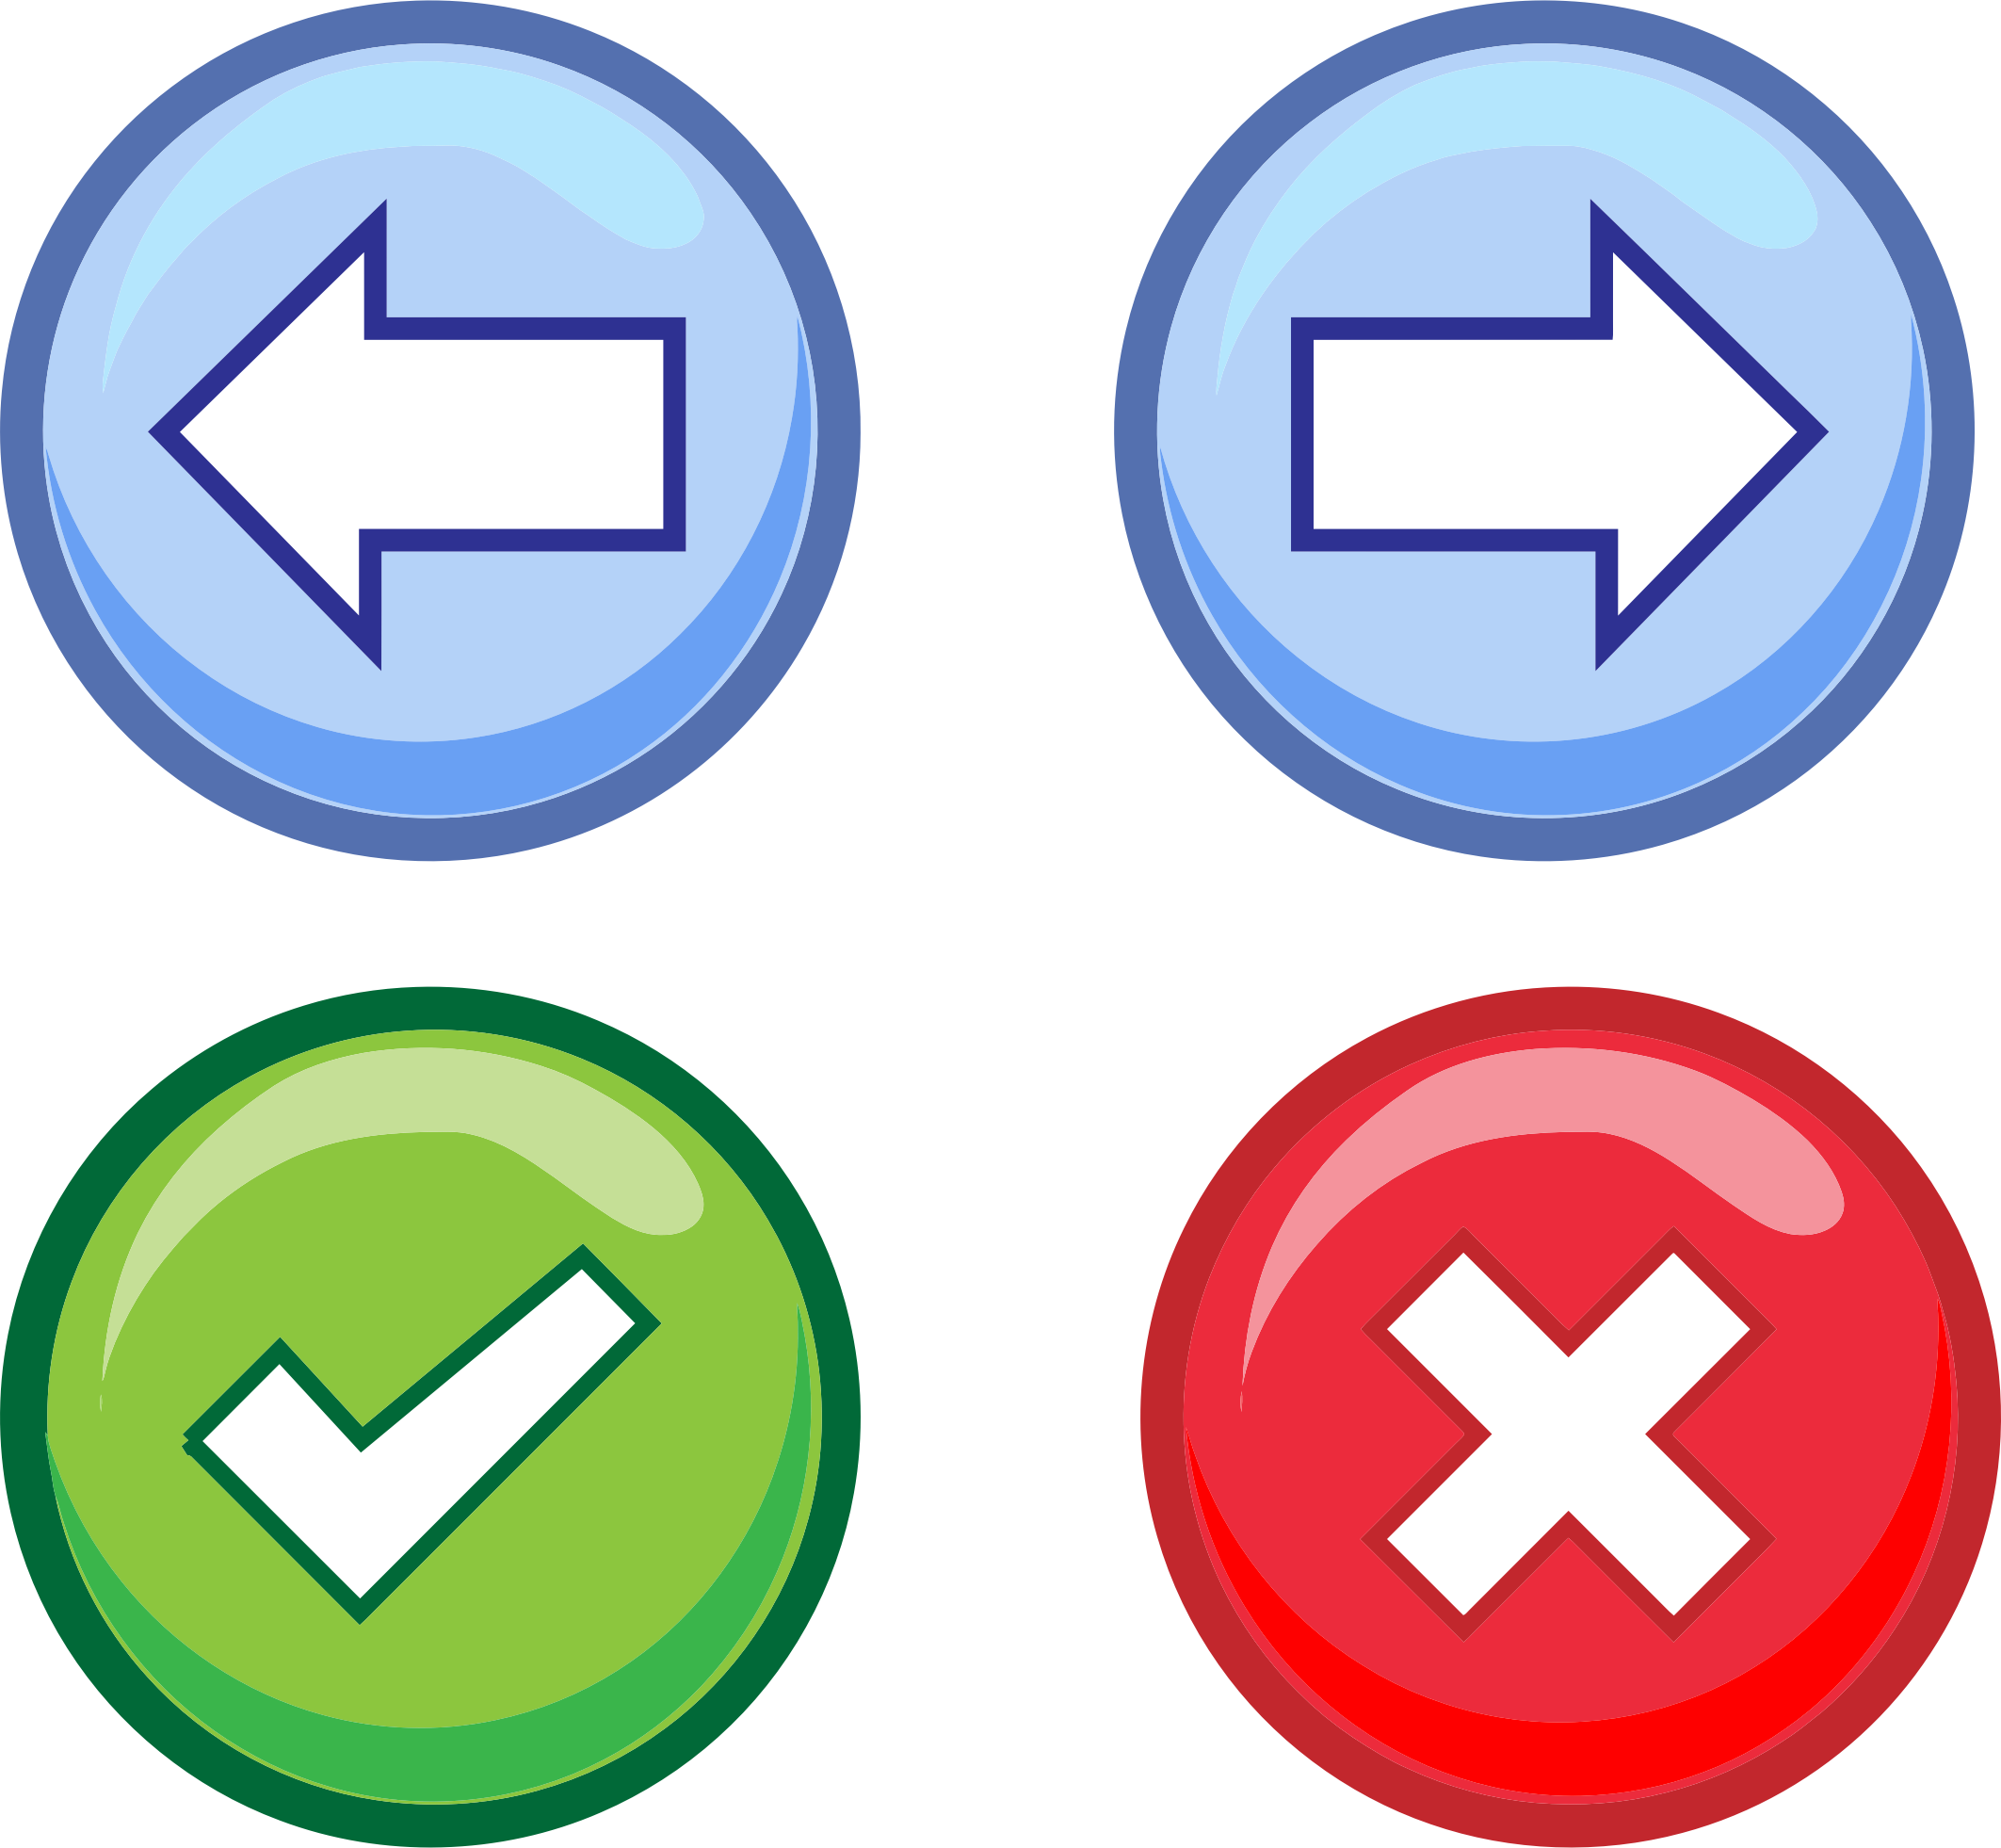
Transitioning to PQ Security
Classical Signal
Towards PQ Signal
No PQ security
Sep. 2023
Harvest-now decrypt-later security
① X3DH
① PQX3DH*
② Double Ratchet

Slide 8
Transitioning to PQ Security
Classical Signal
Towards PQ Signal
No PQ security
Sep. 2023
Harvest-now decrypt-later security
① X3DH
① PQX3DH*
② Double Ratchet
② Double Ratchet

Slide 9
Transitioning to PQ Security
Classical Signal
Towards PQ Signal
No PQ security
Sep. 2023
Harvest-now decrypt-later security
① X3DH
① PQX3DH*
② Double Ratchet
② Double Ratchet
This Talk
How can we make an efficient PQ Double Ratchet?

Slide 10
The Double Ratchet Protocol
Diffie-Hellman
(Public) Ratchet
Signal’s
Double Ratchet
Symmetric Ratchet

Slide 11
The Double Ratchet Protocol
Diffie-Hellman
(Public) Ratchet
Signal’s
Double Ratchet
*Guarantees PCS
⇨ heals state after compromise.
Symmetric Ratchet
*Guarantees FS
⇨ past messages remain secure when compromised.

Slide 12
The Double Ratchet Protocol
Diffie-Hellman
(Public) Ratchet
Signal’s
Double Ratchet
*Guarantees PCS
⇨ heals state after compromise.
Symmetric Ratchet
*Guarantees FS
⇨ past messages remain secure when compromised.
Theoretically, PQ Public Ratchet can be constructed using KEMs.
Practically, incompatible with Signal’s constraints ☹

Slide 13


The Diffie-Hellman Ratchet
DH Ratchet is a Continuous Key Agreement (CKA) [EC:ACD19]
$$g^{b_{0}}$$
$$b_{0}∈ℤ_{p}$$

Slide 14





The Diffie-Hellman Ratchet
DH Ratchet is a Continuous Key Agreement (CKA) [EC:ACD19]
$$g^{b_{0}}$$
$$b_{0}∈ℤ_{p}$$
$$g^{a_{1}}$$
$$a_{1}←ℤ_{p}$$
$$k_{1}=g^{a_{1}b_{0}}$$
$$k_{1}=g^{a_{1}b_{0}}$$

Slide 15




The Diffie-Hellman Ratchet
DH Ratchet is a Continuous Key Agreement (CKA) [EC:ACD19]
$$g^{b_{0}}$$
$$b_{0}∈ℤ_{p}$$
$$g^{a_{1}}$$
$$a_{1}←ℤ_{p}$$
$$k_{1}=g^{a_{1}b_{0}}$$
$$k_{1}=g^{a_{1}b_{0}}$$
$$g^{b_{1}}$$
$$b_{1}←ℤ_{p}$$
$$k_{2}=g^{a_{1}b_{1}}$$
$$k_{2}=g^{a_{1}b_{1}}$$

Slide 16




The Diffie-Hellman Ratchet
DH Ratchet is a Continuous Key Agreement (CKA) [EC:ACD19]
$$g^{b_{0}}$$
$$b_{0}∈ℤ_{p}$$
$$g^{a_{1}}$$
$$a_{1}←ℤ_{p}$$
$$k_{1}=g^{a_{1}b_{0}}$$
$$k_{1}=g^{a_{1}b_{0}}$$
$$g^{b_{1}}$$
$$b_{1}←ℤ_{p}$$
$$k_{2}=g^{a_{1}b_{1}}$$
$$k_{2}=g^{a_{1}b_{1}}$$
$$a_{2}←ℤ_{p}$$
$$g^{a_{2}}$$
$$k_{3}=g^{a_{2}b_{1}}$$
$$k_{3}=g^{a_{2}b_{1}}$$

Slide 17
The Diffie-Hellman Ratchet
DH Ratchet is a Continuous Key Agreement (CKA) [EC:ACD19]
$$g^{b_{0}}$$
$$b_{0}∈ℤ_{p}$$
$$g^{a_{1}}$$
$$a_{1}←ℤ_{p}$$
$$k_{1}=g^{a_{1}b_{0}}$$
$$k_{1}=g^{a_{1}b_{0}}$$
$$g^{b_{1}}$$
$$b_{1}←ℤ_{p}$$
$$k_{2}=g^{a_{1}b_{1}}$$
$$k_{2}=g^{a_{1}b_{1}}$$
$$a_{2}←ℤ_{p}$$
$$g^{a_{2}}$$
$$k_{3}=g^{a_{2}b_{1}}$$
$$k_{3}=g^{a_{2}b_{1}}$$

Slide 18
The Diffie-Hellman Ratchet
DH Ratchet is a Continuous Key Agreement (CKA) [EC:ACD19]
$$g^{b_{0}}$$
$$b_{0}∈ℤ_{p}$$
$$g^{a_{1}}$$
$$a_{1}←ℤ_{p}$$
$$k_{1}=g^{a_{1}b_{0}}$$
$$k_{1}=g^{a_{1}b_{0}}$$
$$g^{b_{1}}$$
$$b_{1}←ℤ_{p}$$
$$k_{2}=g^{a_{1}b_{1}}$$
$$k_{2}=g^{a_{1}b_{1}}$$
$$a_{2}←ℤ_{p}$$
$$g^{a_{2}}$$
$$k_{3}=g^{a_{2}b_{1}}$$
$$k_{3}=g^{a_{2}b_{1}}$$

Slide 19
The Diffie-Hellman Ratchet
DH Ratchet is a Continuous Key Agreement (CKA) [EC:ACD19]
$$g^{b_{0}}$$
$$b_{0}∈ℤ_{p}$$
$$g^{a_{1}}$$
$$a_{1}←ℤ_{p}$$
$$k_{1}=g^{a_{1}b_{0}}$$
$$k_{1}=g^{a_{1}b_{0}}$$
$$g^{b_{1}}$$
$$b_{1}←ℤ_{p}$$
$$k_{2}=g^{a_{1}b_{1}}$$
$$k_{2}=g^{a_{1}b_{1}}$$
“heals”
$$a_{2}←ℤ_{p}$$
$$g^{a_{2}}$$
$$k_{3}=g^{a_{2}b_{1}}$$
$$k_{3}=g^{a_{2}b_{1}}$$

Slide 20
The Diffie-Hellman Ratchet
DH Ratchet is a Continuous Key Agreement (CKA) [EC:ACD19]
$$g^{b_{0}}$$
$$b_{0}∈ℤ_{p}$$
$$g^{a_{1}}$$
$$a_{1}←ℤ_{p}$$
$$k_{1}=g^{a_{1}b_{0}}$$
$$k_{1}=g^{a_{1}b_{0}}$$
$$g^{b_{1}}$$
$$b_{1}←ℤ_{p}$$
$$k_{2}=g^{a_{1}b_{1}}$$
$$k_{2}=g^{a_{1}b_{1}}$$
“heals”
$$a_{2}←ℤ_{p}$$
$$g^{a_{2}}$$
[EC:ACD19] proposed a PQ Ratchet based on any KEMs.
“Healing” is inherently a heavy public key operation.
$$k_{3}=g^{a_{2}b_{1}}$$
$$k_{3}=g^{a_{2}b_{1}}$$

Slide 21








“Naïve” (simplified) Double Ratchet
= KDF
$$g^{b_{0}}$$
$$b_{0}∈ℤ_{p}$$
$$⊥$$
$$g^{a_{1}}$$
$$a_{1}←ℤ_{p}$$
$$k_{1}=g^{a_{1}b_{0}}$$
$$k_{1}=g^{a_{1}b_{0}}$$
$${mk}_{1}$$

Slide 22


“Naïve” (simplified) Double Ratchet
= KDF
$$g^{b_{0}}$$
$$b_{0}∈ℤ_{p}$$
$$⊥$$
$$g^{a_{1}}$$
$$a_{1}←ℤ_{p}$$
$$k_{1}=g^{a_{1}b_{0}}$$
$$k_{1}=g^{a_{1}b_{0}}$$
$$Enc(sk_{1},M_{1})$$
$${mk}_{1}$$
$${sk}_{1}$$

Slide 23




“Naïve” (simplified) Double Ratchet
= KDF
$$g^{b_{0}}$$
$$b_{0}∈ℤ_{p}$$
$$⊥$$
$$g^{a_{1}}$$
$$a_{1}←ℤ_{p}$$
$$k_{1}=g^{a_{1}b_{0}}$$
$$k_{1}=g^{a_{1}b_{0}}$$
$$Enc(sk_{1},M_{1})$$
$${mk}_{1}$$
$${sk}_{1}$$
$$Enc(sk_{2},M_{2})$$
$${sk}_{2}$$
$$Enc(sk_{3},M_{3})$$
$${sk}_{3}$$
Symmetric Ratchet

Slide 24







“Naïve” (simplified) Double Ratchet
= KDF
$$g^{b_{0}}$$
$$b_{0}∈ℤ_{p}$$
$$⊥$$
$$g^{a_{1}}$$
$$a_{1}←ℤ_{p}$$
$$k_{1}=g^{a_{1}b_{0}}$$
$$k_{1}=g^{a_{1}b_{0}}$$
$$Enc(sk_{1},M_{1})$$
$${mk}_{1}$$
$${sk}_{1}$$
$$Enc(sk_{2},M_{2})$$
$${sk}_{2}$$
$$Enc(sk_{3},M_{3})$$
$${sk}_{3}$$
$$g^{b_{1}}$$
$$b_{1}←ℤ_{p}$$
$$k_{2}=g^{a_{1}b_{1}}$$
$$k_{2}=g^{a_{1}b_{1}}$$
$$Enc(s{k′}_{1},{M′}_{1})$$
$${mk}_{2}$$
$${sk}_{1}′$$

Slide 25

“Naïve” (simplified) Double Ratchet
= KDF
$$g^{b_{0}}$$
$$b_{0}∈ℤ_{p}$$
$$⊥$$
$$g^{a_{1}}$$
$$a_{1}←ℤ_{p}$$
$$k_{1}=g^{a_{1}b_{0}}$$
$$k_{1}=g^{a_{1}b_{0}}$$
$$Enc(sk_{1},M_{1})$$
If DH Ratchet message arrives out of order or gets lost, Bob loses immediate decryption ☹
$${mk}_{1}$$
$${sk}_{1}$$
$$Enc(sk_{2},M_{2})$$
$${sk}_{2}$$
$$Enc(sk_{3},M_{3})$$
$${sk}_{3}$$
$$g^{b_{1}}$$
$$b_{1}←ℤ_{p}$$
$$k_{2}=g^{a_{1}b_{1}}$$
$$k_{2}=g^{a_{1}b_{1}}$$
$$Enc(s{k′}_{1},{M′}_{1})$$
$${mk}_{2}$$
$${sk}_{1}′$$

Slide 26
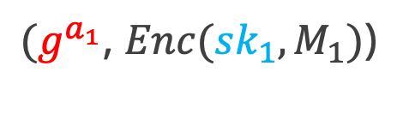
In Practice…
= KDF
$$g^{b_{0}}$$
$$b_{0}∈ℤ_{p}$$
$$⊥$$
$$a_{1}←ℤ_{p}$$
$$k_{1}=g^{a_{1}b_{0}}$$
Send together
$$k_{1}=g^{a_{1}b_{0}}$$
$(g^{a_{1}}$, $Enc(sk_{1},M_{1})$)
$${mk}_{1}$$
$${sk}_{1}$$

Slide 27
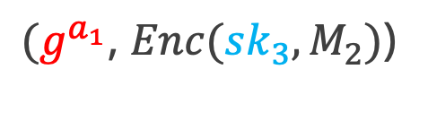
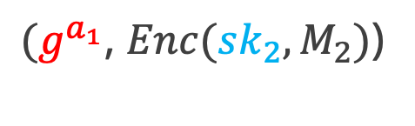
In Practice…
= KDF
$$g^{b_{0}}$$
$$b_{0}∈ℤ_{p}$$
$$⊥$$
$$a_{1}←ℤ_{p}$$
$$k_{1}=g^{a_{1}b_{0}}$$
Send together
$$k_{1}=g^{a_{1}b_{0}}$$
$(g^{a_{1}}$, $Enc(sk_{1},M_{1})$)
$${mk}_{1}$$
$${sk}_{1}$$
$(g^{a_{1}}$, $Enc(sk_{2},M_{2})$)
$${sk}_{2}$$
$(g^{a_{1}}$, $Enc(sk_{3},M_{2})$)
$${sk}_{3}$$
As Bob always receive $g^{a_{1}}$, it can immediately decrypt any message.
DH Ratchet message is continuously resent; not bad in classical.

Slide 28
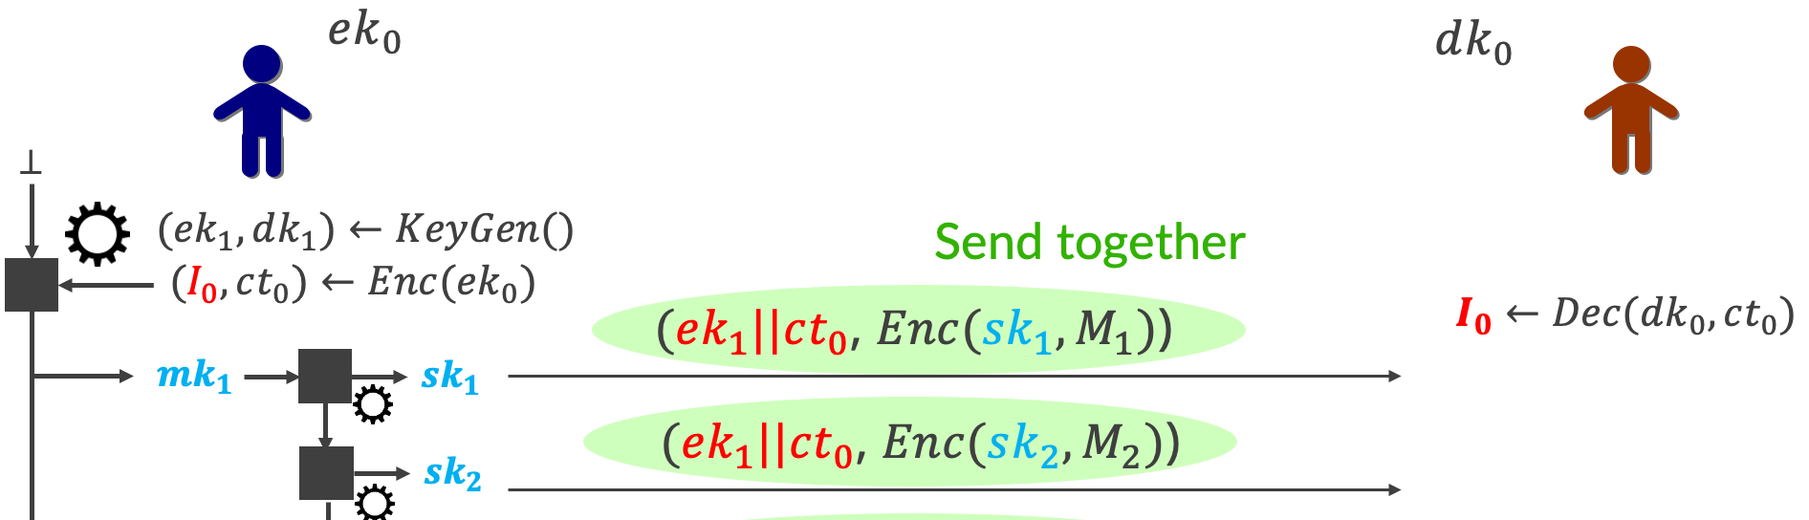
Why PQ Ratchet Has Been Theoretical
[EC:ACD19] PQ Ratchet Based on PQ KEM
KEM

Slide 29
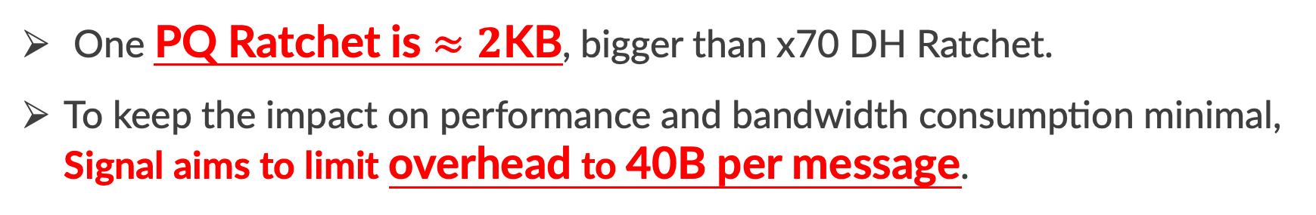
Why PQ Ratchet Has Been Theoretical
[EC:ACD19] PQ Ratchet Based on PQ KEM
KEM
One PQ Ratchet is $≈2$KB, bigger than x70 DH Ratchet.
To keep the impact on performance and bandwidth consumption minimal, Signal aims to limit overhead to 40B per message.

Slide 30
2. Our Efficient PQ Ratchet

Slide 31

Recipe for Our Efficient PQ Ratchet
Idea 1: Ratcheting KEM: Katana ⚔️
Better PQ Ratchet than running two KEMs in parallel.
Idea 2: Chunking with Erasure Codes
Forcing smaller bandwidth but with worse PCS security.
Idea 3: Opportunistic Sending
Boosting PCS with a better sending strategy.

Slide 32
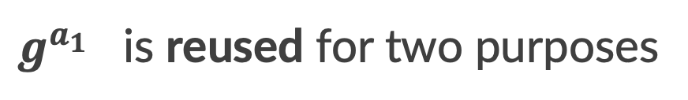
Idea 1: Ratcheting KEM (Katana⚔️)
Signal’s DH Ratchet
$g^{a_{1}}$ is reused for two purposes
Receiver message of a DH KEX.
Sender message of a DH KEX.

Slide 33
Idea 1: Ratcheting KEM (Katana⚔️)
Signal’s DH Ratchet
$g^{a_{1}}$ is reused for two purposes
Receiver message of a DH KEX.
Sender message of a DH KEX.
For KEMs, ek or ct can’t be reused ☹
This is why [EC:ACD19] requires two KEMs.

Slide 34
Idea 1: Ratcheting KEM (Katana⚔️)
Introducing Ratcheting KEM
A special KEM where ek can be reused as part of ct.

Slide 35
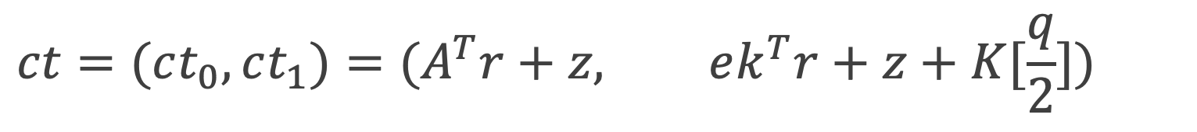
Idea 1: Ratcheting KEM (Katana⚔️)
Introducing Ratcheting KEM
A special KEM where ek can be reused as part of ct.
A common lattice-based KEM
$$ek=As+x$$
$$ct=(ct_{0},ct_{1})=(A^{T}r+z, ek^{T}r+z+K[\frac{q}{2}])$$

Slide 36
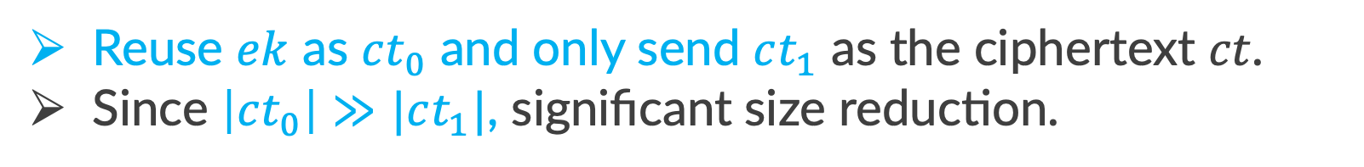
Idea 1: Ratcheting KEM (Katana⚔️)
Introducing Ratcheting KEM
A special KEM where ek can be reused as part of ct.
A common lattice-based KEM
$$ek=As+x$$
$$ct=(ct_{0},ct_{1})=(A^{T}r+z, ek^{T}r+z+K[\frac{q}{2}])$$
Reuse $ek$ as $ct_{0}$ and only send $ct_{1}$ as the ciphertext $ct$.
Since $\left|ct_{0}\right|≫|ct_{1}|$, significant size reduction.

Slide 37
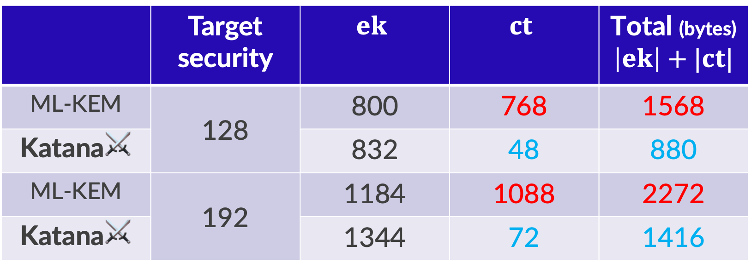
Size Reduction
 | Target security | $$ek$$ | $$ct$$ | Total (bytes) $$\left|ek\right|+|ct|$$
ML-KEM | 128 | 800 | 768 | 1568
Katana⚔️ |  | 832 | 48 | 880
ML-KEM | 192 | 1184 | 1088 | 2272
Katana⚔️ |  | 1344 | 72 | 1416
*The parameters are slightly different due to a subtlety in the security proof.
** Similar construction are found in [EC:ACD19,ACCESS:LKS23], but the security proofs are incorrect
and the scheme becomes insecure for certain parameters.

Slide 38
Idea 2: Chunking
BUT… Katana⚔️ isn’t enough!!
Signal aims to limit overhead to 40B per message.

Slide 39
Idea 2: Chunking
BUT… Katana⚔️ isn’t enough!!
Signal aims to limit overhead to 40B per message.
Use Erasure Codes to chunk (ek, ct) into smaller pieces.
ek
ct
…
ch1
ch2
ch3
ch4
ch5
ch6
ch7
ch8
< 40B
< 40B
…

Slide 40
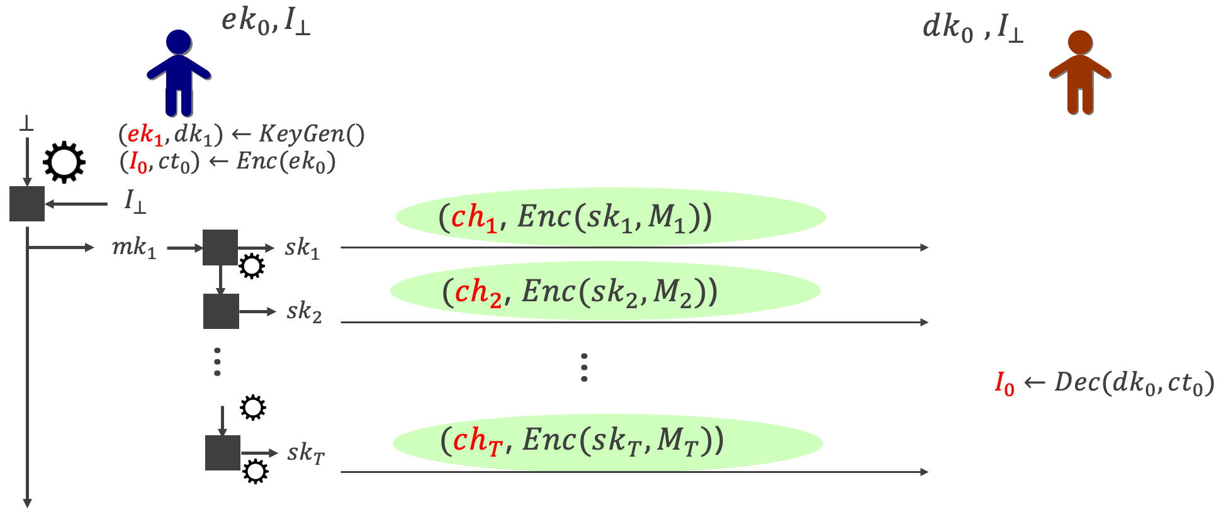
Pros
= KDF
Overhead per message is small and fixed.
Alice does not waste bandwidth when Bob is offline for a while.

Slide 41
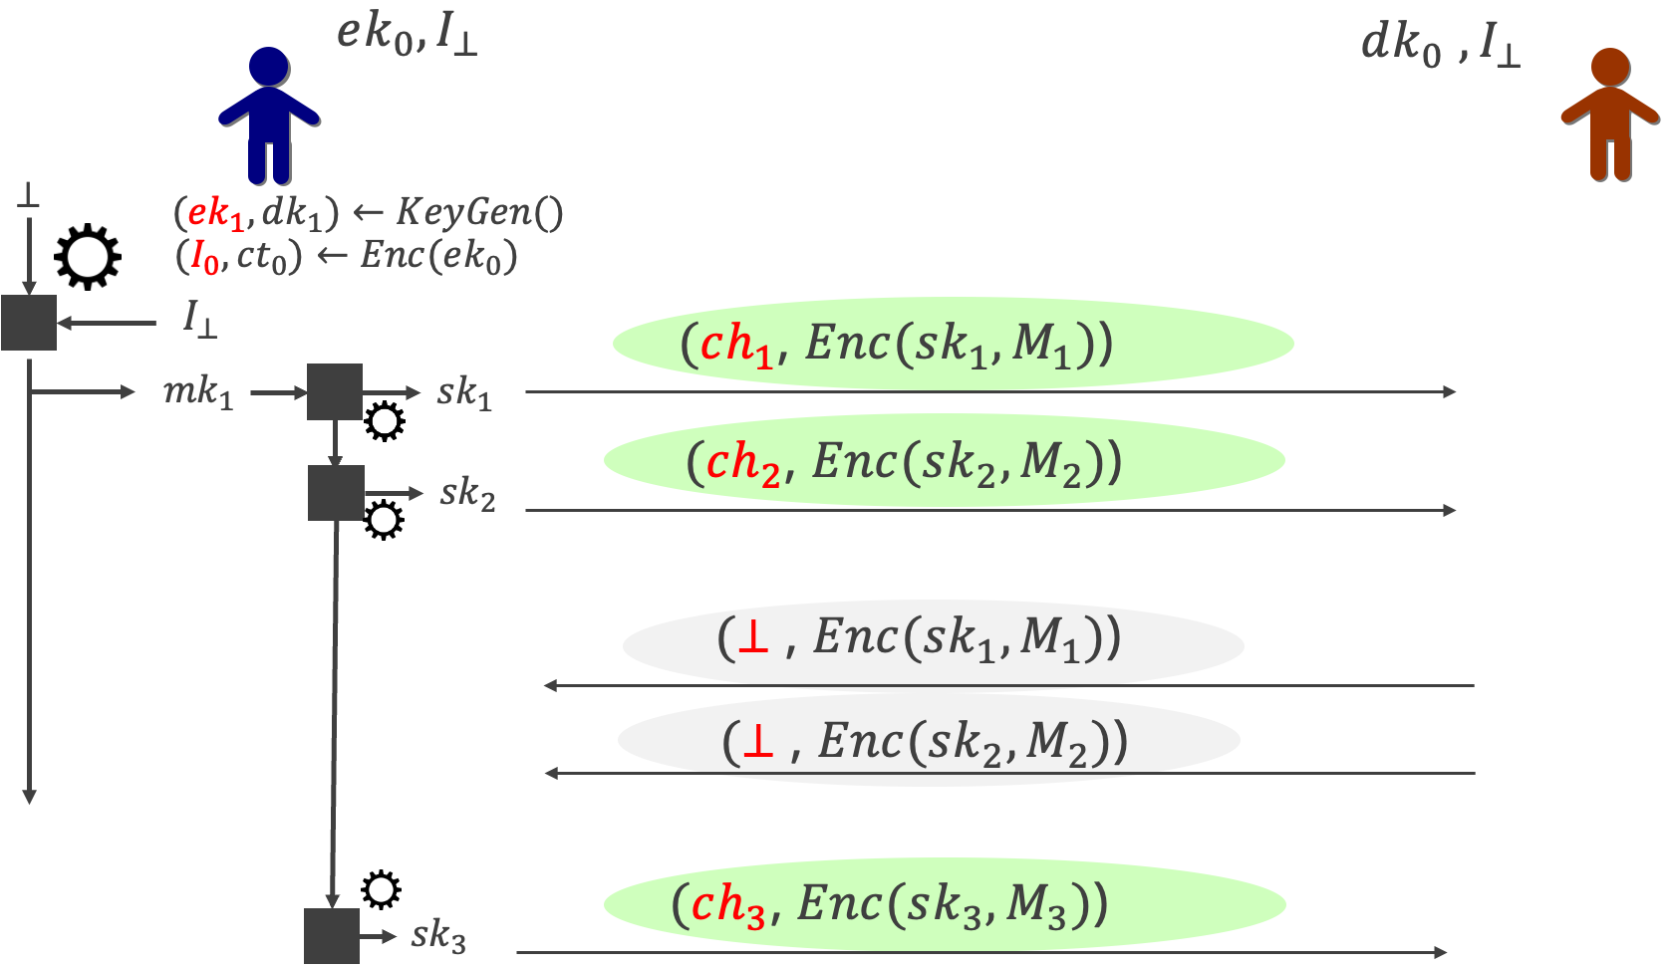
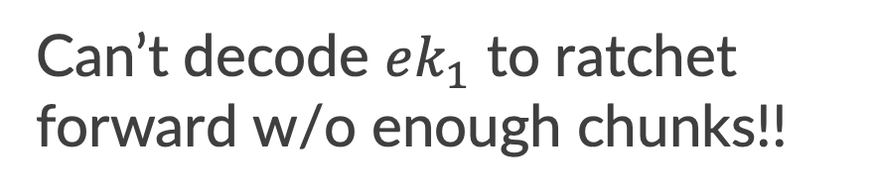
Cons
Can’t decode $ek_{1}$ to ratchet forward w/o enough chunks!!

Slide 42
Cons
Can’t decode $ek_{1}$ to ratchet forward w/o enough chunks!!
In active conversations,
Bob wastes bandwidth ☹
PCS kicks in slower ☹

Slide 43
Idea 3: Opportunistic Sending
YOCHO: You send CHunks Opportunistically

Slide 44

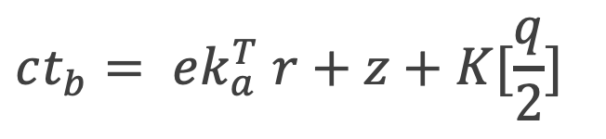
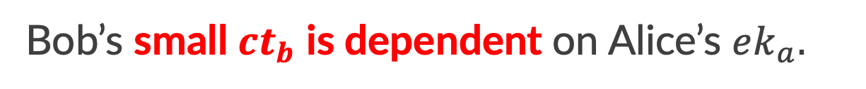
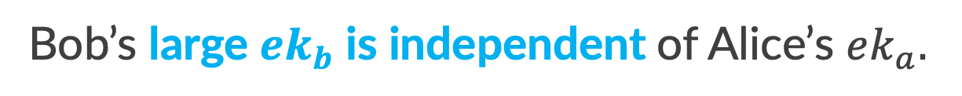
Idea 3: Opportunistic Sending
YOCHO: You send CHunks Opportunistically
Bob’s sending strategy with Katana⚔️
$$ek_{b}=As+x$$
Bob’s large $ek_{b}$ is independent of Alice’s $ek_{a}.$
$$ct_{b}= ek_{a}^{T} r+z+K[\frac{q}{2}]$$
Bob’s small $ct_{b}$ is dependent on Alice’s $ek_{a}.$

Slide 45

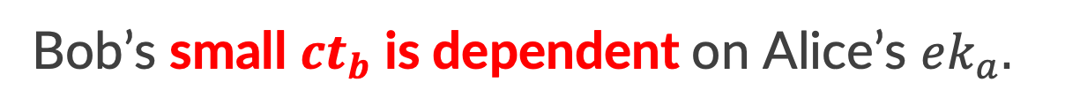

Idea 3: Opportunistic Sending
YOCHO: You send CHunks Opportunistically
Bob’s sending strategy with Katana⚔️
$$ek_{b}=As+x$$
Bob’s large $ek_{b}$ is independent of Alice’s $ek_{a}.$
$$ct_{b}= ek_{a}^{T} r+z+K[\frac{q}{2}]$$
Bob’s small $ct_{b}$ is dependent on Alice’s $ek_{a}.$
Alice and Bob send large $ek$ concurrently.
No waste in bandwidth and better PCS.

Slide 46
3. “Preliminary” Benchmarking

Slide 47
Benchmarking is a Whole Other Talk
Which scheme is the “best” depends on…
Allowed bandwidth budget.
Communication pattern:
Balanced communication?
How often are devices on/offline?
Active conversations?
Our comparison criteria:
Number of exposed messages under corruption.
*messages the adversary can read with the compromised keys

Slide 48
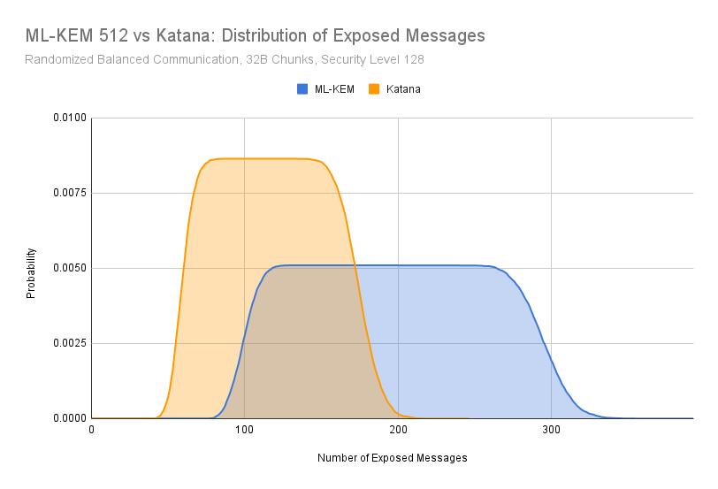
Performance: ML-KEM vs Katana ⚔️
32B Chunks
Randomized Balanced Communication
Katana⚔️ has about
60% less exposed messages.
*Chunking optimization is done for both protocols.

Slide 49
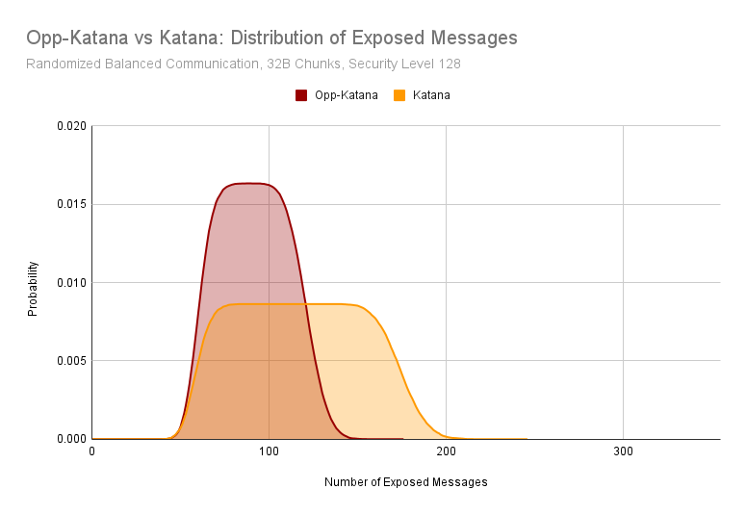
Performance: Katana ⚔️ vs Opp-Katana ⚔️
32B Chunks
Randomized Balanced Communication
By YOCHO-ing, we further get 25% less exposed messages.
*Chunking optimization is done for both protocols.
**Many opportunistic choices and the result is for a simple one.

Slide 50

Thank You!
Further info
Talk based on [EC:DJKPS25] but with new results.
We’ll be talking at EC25 and affiliated event (CAW) ☺
Eprint link to [EC:DJKPS25]
From Signal
A PQ Ratchet IS in development!
Current plans include many of today’s ideas, but with slight differences.
Key difference: Use an ML-KEM based protocol for a first step.
Hope to use optimizations like Katana ⚔️ in the future ☺

Slide 51


(*) Apple’s PQ3 Protocol
Apple rolled out a PQ continuous key agreement.
It uses amortization to save bandwidth.
Only send PQ ratchet keys every 50 messages.
BUT, not compatible with Signal’s restrictions.
Under restricted bandwidth, even sending one PQ ratchet key deteriorates performance.
Lose immediate decryption, unless we continuously resend PQ key.
On a bad network + device offline for a while ⇨

Slide 53




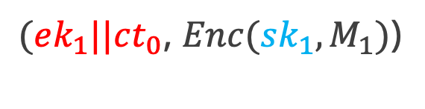
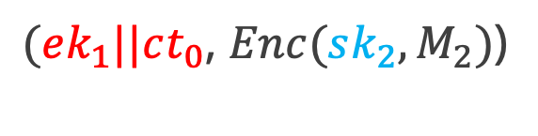
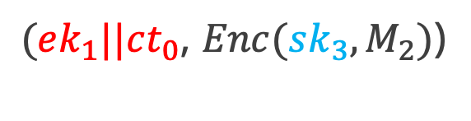

How Immediate Decryption is Handled
= KDF
$$ek_{0}$$
$$dk_{0}$$
$$⊥$$
$$(ek_{1}, dk_{1})←KeyGen()$$
Send together
$$(I_{0}, ct_{0})←Enc(ek_{0})$$
$(ek_{1}||ct_{0}$, $Enc(sk_{1},M_{1})$)
$I_{0}$ $←Dec(dk_{0},ct_{0})$
$${mk}_{1}$$
$${sk}_{1}$$
$(ek_{1}||ct_{0}$, $Enc(sk_{2},M_{2})$)
$${sk}_{2}$$
$(ek_{1}||ct_{0}$, $Enc(sk_{3},M_{2})$)
$${sk}_{3}$$
As Bob always receive $g^{a_{1}}$, it can decrypt any message.
DH Ratchet message needs to be repeated; not bad in classical.

Slide 54




























The Diffie-Hellman Ratchet
DH Ratchet is a Continuous Key Agreement (CKA) [EC:ACD19]
$$g^{b_{0}}$$
$$b_{0}∈ℤ_{p}$$
$$ek_{0}$$
$$dk_{0}$$
$$g^{a_{1}}$$
$$ek_{1}||ct_{0}$$
$$a_{1}←ℤ_{p}$$
$$k_{1}=g^{a_{1}b_{0}}$$
$$(ek_{1}, dk_{1})←KeyGen()$$
$I_{0}$ $←Dec(dk_{0},ct_{0})$
$$(I_{0}, ct_{0})←Enc(ek_{0})$$
$$k_{1}=g^{a_{1}b_{0}}$$
$$g^{b_{1}}$$
$$b_{1}←ℤ_{p}$$
$$ek_{2}||ct_{1}$$
$$(ek_{2}, dk_{2})←KeyGen()$$
$$k_{2}=g^{a_{1}b_{1}}$$
$$k_{2}=g^{a_{1}b_{1}}$$
$I_{1}$ $←Dec(dk_{1},ct_{1})$
$$(I_{1}, ct_{1})←Enc(ek_{1})$$
$$a_{2}←ℤ_{p}$$
$$g^{a_{2}}$$
$$(ek_{3}, dk_{3})←KeyGen()$$
$$ek_{3}||ct_{2}$$
$$k_{3}=g^{a_{2}b_{1}}$$
$$k_{3}=g^{a_{2}b_{1}}$$
$$(I_{2}, ct_{2})←Enc(ek_{2})$$
$I_{2}$ $←Dec(dk_{2},ct_{2})$

Slide 55

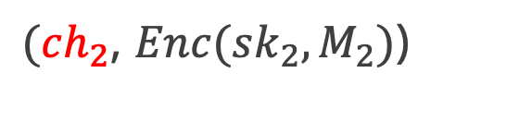
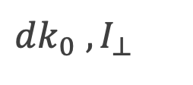

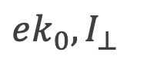



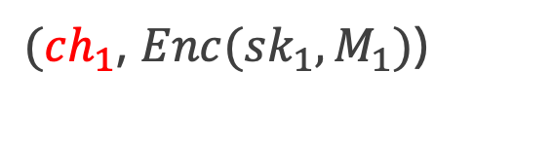
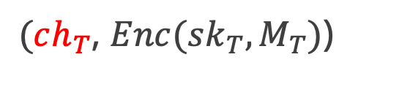




Pros
= KDF
$$ek_{0},I_{⊥ }$$
$dk_{0}$ $,I_{⊥ }$
$$⊥$$
$$(ek_{1}, dk_{1})←KeyGen()$$
$$(I_{0}, ct_{0})←Enc(ek_{0})$$
$$I_{⊥ }$$
$(ch_{1}$, $Enc(sk_{1},M_{1})$)
$${mk}_{1}$$
$${sk}_{1}$$
$(ch_{2}$, $Enc(sk_{2},M_{2})$)
$${sk}_{2}$$
…
…
$I_{0}$ $←Dec(dk_{0},ct_{0})$
$(ch_{T}$, $Enc(sk_{T},M_{T})$)
$${sk}_{T}$$

Slide 56




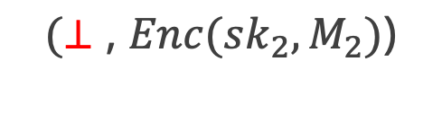
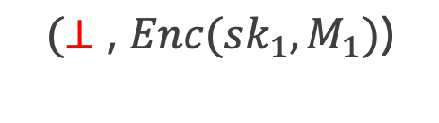
$$(⊥\text{,} Enc(sk_{3},M_{3})\text{)}$$
Pros
= KDF
$$ek_{0},I_{⊥ }$$
$dk_{0}$ $,I_{⊥ }$
$$⊥$$
$$(ek_{1}, dk_{1})←KeyGen()$$
$$(I_{0}, ct_{0})←Enc(ek_{0})$$
$$I_{⊥ }$$
$(ch_{1}$, $Enc(sk_{1},M_{1})$)
$${mk}_{1}$$
$${sk}_{1}$$
$(ch_{2}$, $Enc(sk_{2},M_{2})$)
$${sk}_{2}$$
$$(⊥\text{,} Enc(sk_{1},M_{1})\text{)}$$
$$(⊥\text{,} Enc(sk_{2},M_{2})\text{)}$$
$(ch_{3}$, $Enc(sk_{3},M_{3})$)
$${sk}_{3}$$

Slide 57














The Diffie-Hellman Ratchet
$$ek_{0}$$
$$dk_{0}$$
$$(ek_{1}, dk_{1})←KeyGen()$$
$$(ch_{1}\text{,} Enc(sk_{1},M_{1})\text{)}$$
$$(I_{0}, ct_{0})←Enc(ek_{0})$$
$I_{0}$ $←Dec(dk_{0},ct_{0})$
$$ek_{2}||ct_{1}$$
$$(ek_{2}, dk_{2})←KeyGen()$$
$$(I_{1}, ct_{1})←Enc(ek_{1})$$
$I_{1}$ $←Dec(dk_{1},ct_{1})$
$$ek_{3}||ct_{2}$$
$$(ek_{3}, dk_{3})←KeyGen()$$
$I_{2}$ $←Dec(dk_{2},ct_{2})$
$$(I_{2}, ct_{2})←Enc(ek_{2})$$

