Slide 1
Compressing Proofs using Cryptography:
A Triumph of Theory and Practice
Yael Tauman Kalai
MIT

Slide 2
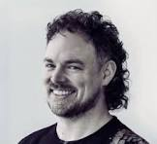
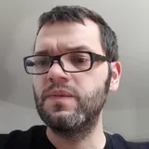
“We would like to invite you to give a talk at RWC 2025”
Is this a joke??
Notes:
Martin and Nick

Slide 3
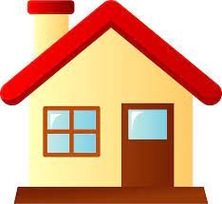
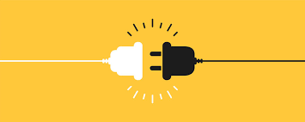
Math and
Theoretical CS
Ideal world
Real world

Slide 4
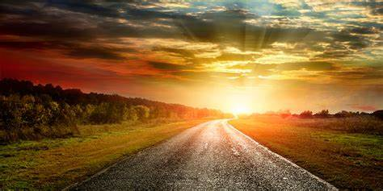
My Journey: Succinct proofs

Slide 5
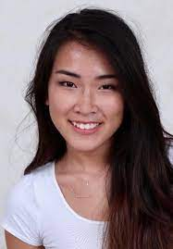
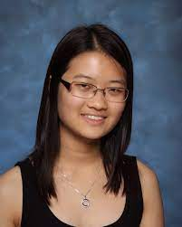
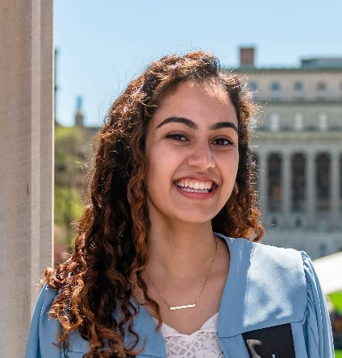
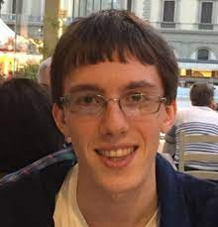
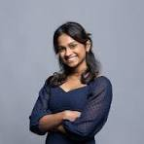
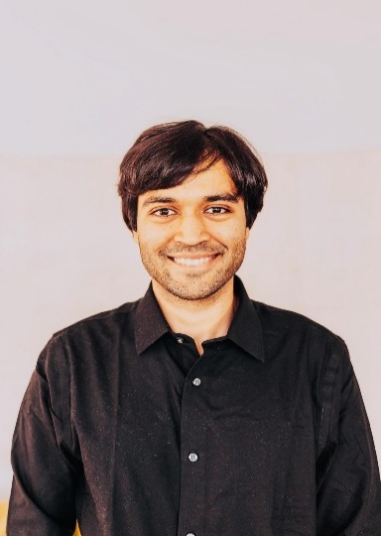
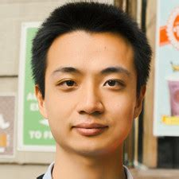
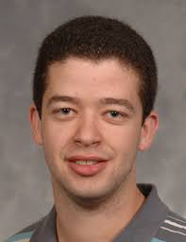
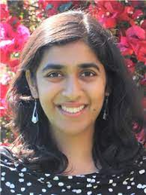
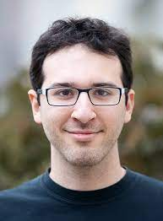
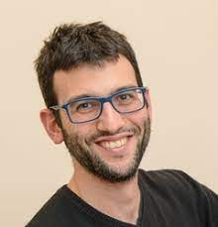
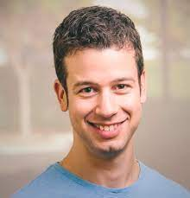
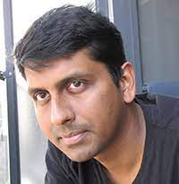
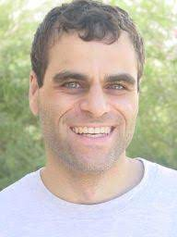
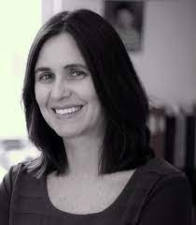

Slide 6
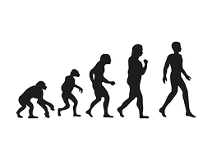
Evolution of Proofs in Computer Science

Slide 7
Classical Proofs

Slide 8
Interactive Proofs [Goldwasser-Micali-Rackoff85, Babai85]
$$P$$
$$V$$
Soundness: Every false $x$ is accepted with negligible probability
Notes:
Due to concentration bounds

Slide 9
Interactive Proofs are More Efficient! [Lund-Fortnow-Karloff-Nissan90, Shamir90]
Correctness of any computation can be proved:
Time to verify
$$≈$$
Space required to do the computation
IP = PSPACE

Slide 10
Multi-Prover Interactive Proofs [BenOr-Goldwasser-Kilian-Wigderson88]
$$P_{1}$$
$$P_{2}$$
$$q_{1}$$
$$q_{2}$$
$$a_{1}$$
$$a_{2}$$
$$V$$
[Babai-Fortnow-Lund90]: Any proof can be made exponentially shorter with a 2-prover interactive proof!
MIP = NEXP

Slide 11
[Fortnow-Rompel-Sipser88]:
$$a_{1}$$
$$a_{2}$$
$$a_{3}$$
$$a_{4}$$
$$P_{1}$$
$$P_{2}$$
$$a_{1}$$
$$a_{2}$$
$$a_{3}$$
$$a_{4}$$
$$V$$
[Babai-Fortnow-Lund90]: Any proof can be made exponentially shorter with a 2-prover interactive proof!
MIP = NEXP

Slide 12
[Fortnow-Rompel-Sipser88]:
$$V$$
PCP Theorem:
Every proof can be converted to a probabilistically checkable one
(of almost same size) that can be verified by reading only three bits!
[Feige-Goldwasser-Lovasz-Safra-Szegedy91, Babai-Fortnow-Levin- Szegedy91, Arora-Safra92,
Arora-Lund-Mutwani-Sudan-Szegedy92]

Slide 13
Classical proofs
Interactive proofs
(IP)
Multi-prover interactive proofs
(MIP)
Probabilistically checkable proofs
(PCP)

Slide 14
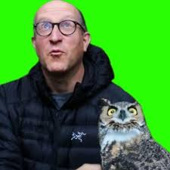
“Beautiful ideas will eventually have an impact”
[2006]
Eli Ben-Sasson
What motivates you?
PCPs are so inefficient, they will never be used in practice!

Slide 15
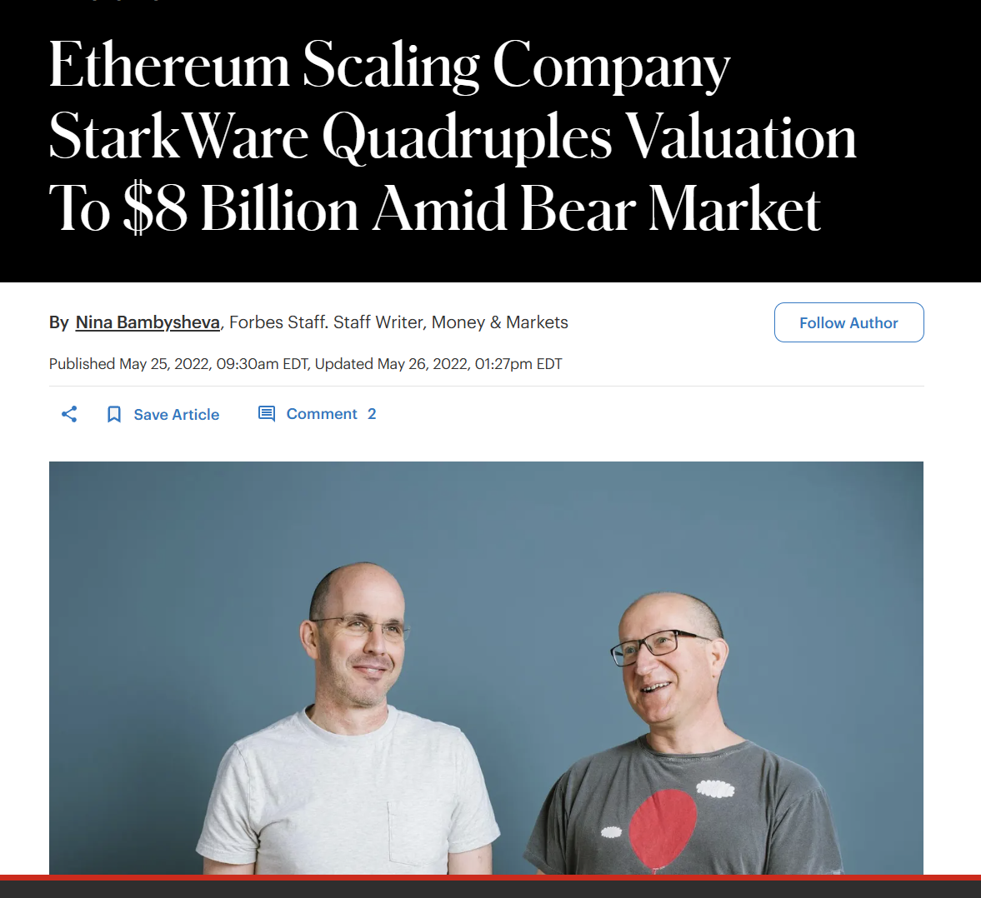

Slide 16
Evolution of Proofs in Computer Science
Verifier: polynomial time
Prover: all powerful
IP = PSACE [Shamir90]:
To prove correctness of time $T$space $S$computation, prover runtime is $2^{S^{2}}$

Slide 17
Doubly Efficient Interactive Proofs [Goldwasser-K-Rothblum08]
Doubly Efficient Interactive proof:
Very easy to verify
Not too hard to prove: Time $T$computation can be proven correct in time $≈T$
Notes:
Recall our goal was to construct a SNARG.
This is almost there (at least for small space computations). There are two caveats: First it is interactive.

Slide 18
Interactive Proof for Low Depth Computations [GKR]
1
.
.
.
$$x1$$
$$x2$$
$$x3$$
$$xn$$
Verifier catches a cheating prover with prob. $2^{−depth}$

Slide 19
Interactive Proof for Low Depth Computations [GKR]
1
Reduction:
If claim is false
then whp $v_{D−1}$ is not correct
$$v_{D−1}$$
.
.
.
ECC
ECC
ECC
Error Correcting Code:
If one element is incorrect then most elements are incorrect.
$$x1$$
$$x2$$
$$x3$$
$$xn$$

Slide 20
Interactive Proof for Low Depth Computations [GKR]
1
$$v_{D−1}$$
Reduction:
If $v_{D−1}$is not correct
then whp $v_{D−2}$ is not correct
$$v_{D−2}$$
.
.
.
ECC
ECC
$$v_{0}$$
ECC
$$x1$$
$$x2$$
$$x3$$
$$xn$$
Verifier can check on her own

Slide 21
Succinct Interactive Arguments for NP
$$com(w)$$
1
$$v_{D−1}$$
Reduction:
If $v_{D−1}$is not correct
then whp $v_{D−2}$ is not correct
$$v_{D−2}$$
.
.
.
ECC
ECC
$$v_{0}$$
ECC
$$x1$$
$$x2$$
$$x3$$
$$xn$$
Verifier can check on her own
$$x,w$$
Prover reveals

Slide 22
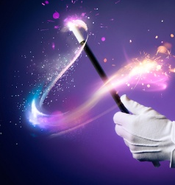
Succinct Interactive Arguments for NP
Fiat-Shamir Heuristic for eliminating interaction
Succinct Non-Interactive Arguments for NP
(SNARGs)

Slide 23
Is the Fiat-Shamir (FS) Heuristic Secure?
In practice:
One of the most widely used signature schemes (ECDSA) is based on this heuristic
In theory:
Notes:
BitCoin uses ECDSA, and iphone

Slide 24
Is the Fiat-Shamir (FS) Heuristic Secure?
In practice:
One of the most widely used signature schemes (ECDSA) is based on this heuristic
In theory:
[Barak01, GoldwasswerK03]
[Jawale-K-Khurana-Zhang21]:
FS is sound when applied to GKR under LWE!
[Khovratovich-Rothblum-Soukanov25]:
FS is not sound when applied to GKR for NP
Notes:
BitCoin uses ECDSA, and iphone

Slide 25
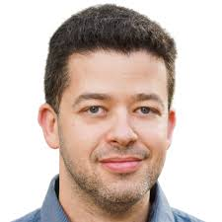
Succinct

Slide 27
Success for theory of cryptography!
K-Raz09, Groth10, Gennaro-Gentry-Parno2010 , Chung-K-Vadhan2010, Applebaum-Ishai-Kushilevitz2010, Parno-Raykova-Vaikuntanathan2011,Goldwasser-Lin-Rubinstein11, Damgard-Faust -Hazay11, Lipma12, Bitanski-Canetti12, Gennaro-Gentry-Parno-Raykova12, Bitansky-Canetti-Chiesa-Tromer12a, Bitansky-Canetti-Chiesa-Tromer12b, Bitansky-Chiesa-Ishai-Ostrovsky-Paneth13, K-Raz-Rothblum13, Thaler13, K-Raz-Rothblum14, Bitansky-Sanjam-Lin-Pass-Telang14, Canetti-Holmgren-Jain-Vaikuntanathan14, Koppula-Lewko-Waters14,K-Paenth15, Canetti-Holmgren16, Chen-Chow-Chung-Lai16, Bootle-Cerulli-Chaidos-Growth-Petit16, Giacomelli-Madsen-Orlandi16, K-Rothblum-Rothblum16, Paneth-Rothblum17, Wahby-Ji-Blumberg-shelat-Thaler-Walfish-Wies17, Ames-Hazay-Ishai-Venkitasubramaniam17 Brakerski-Holmgren-K17, Holmgren-Rothblum17, Zhang-Genkin-Katz-Papadopoulos-Papamanthou17 ,Reingold-Rothblum-Rothblum17, Badrinarayanan-K-Khurana-Sahai-Wichs18, Bunz-Bootle-Boneh-Poelstra-Wuille-Maxwell18, Canetti-Chen-Reyzin-Rothblum18, Zhang-Genkin-Katz-Papadopoulos-Papamanthou18, Wahby-Tzialla-shelat-Thaler-Walfish18, Katz-Kolesnikov-Wang18, Holmgren-Lombardi18, Bootle-Lyubashevsky-Seiler19, Canetti-Chen-Holmgren-Lombardi-Rothblum-Rothblum-Wichs19, K-Paneth-Yang19, Ben-Sasson-Bentov-Horesh-Riabzev19, Xie-Zhang-Zhang-Papamanthou-Song19, Ben-Sasson-Chiesa-Riabzev-Spooner-Virza-Ward19, Boschini-Camenisch-Ovsiankin-Spooner20, Chiesa-Ojha-Spooner20, Baum-Nof20, Setty-Lee20, Bhadauria-Fang-Hazay-Venkitasubramaniam-Xie-Zhang20, Setty20, Esgin-Nguyen-Seiler20, Zhang-Xie-Zhang-Song20, Bunz-Fisch-Szepieniec20, Chiesa-Hu-Maller-Mishra-Vesely-Ward20,Boneh-Drake-Fisch-Gabizon21, Baum-Malozemoff-Rosen-Scholl21, Dittmer-Ishai-Ostrovsky21, Jawale-K-Khurana-Zhang21, K-Vaikuntanathan-Zhang21, Weng-Yang-Katz-Wang21, Zhang-Liu-Wang-Zhang-Song-Xie-Zhang21, Chiesa-Yogev21,…

Slide 28
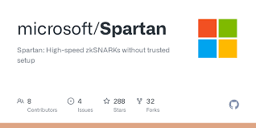
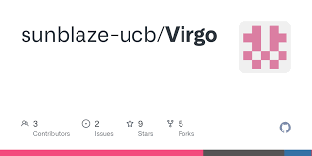
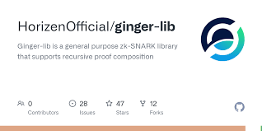
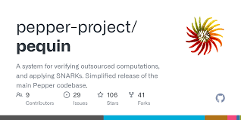
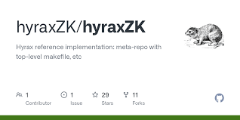
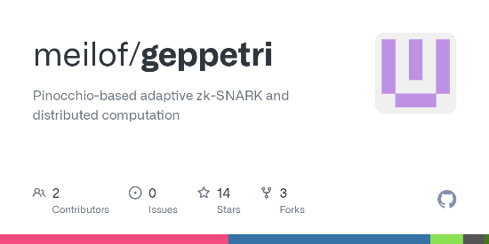
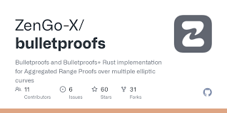
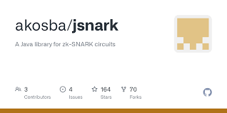
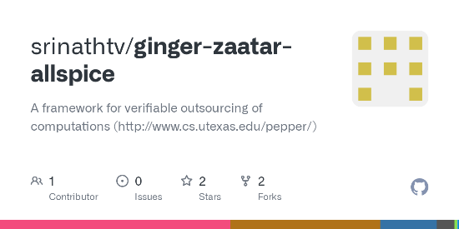
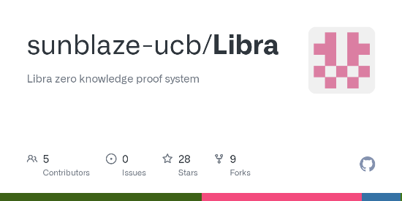
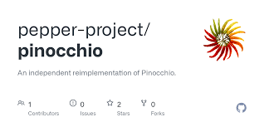
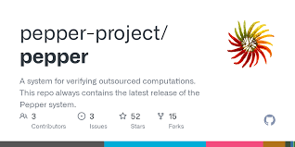
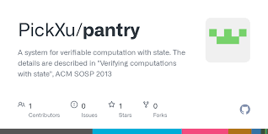
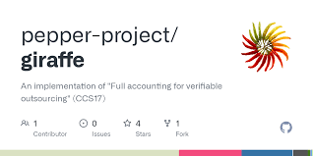
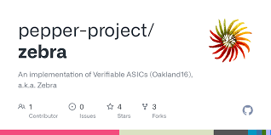
From Theory to Practice
Notes:
Many of the SNARG constructions have been implemented.

Slide 29
From Theory to Deployment
Notes:
Beyond all the implementations mentioned above, these SNARGs are currently widely deployed.
Many blockchain companies use these SNARGs, starting with companies who were founded by our friends, such as Zchash and STARKWARE, and culminating with some of the most prominent blockchain companies, such as Ethereum.
In addition, DARPA, which is one of the biggest security funding agencies, has an immense project on SNARGs.

Slide 30
Notes:
Dmitry, Ron D. Rothblum, Lev Soukhanov:

