Slide 1
How to Securely Implement Cryptography in Deep Neural Networks
Adi Shamir
Computer Science Dept
Weizmann Institute of Science
Israel
Joint work with David Gerault (TII), Anna Hambitzer (TII), and Eyal Ronen (Tel Aviv University)

Slide 2
There are two major research areas in CS with almost no intersection so far:
Cryptography
(essentially digital, mapping bit strings to bit strings)
Deep learning
(essentially analog, mapping real numbers to real numbers)
Notes:
M. Barreno, B. Nelson, R. Sears, A. D. Joseph, and J. D. Tygar, “Can machine learning be secure?” in Proceedings of the 2006 ACM Symposium on Information, computer and communications security. ACM, 2006, pp. 16–25.
Anthony and P. L. Bartlett, Neural network learning: Theoretical foundations. cambridge university press, 2009.

Slide 3
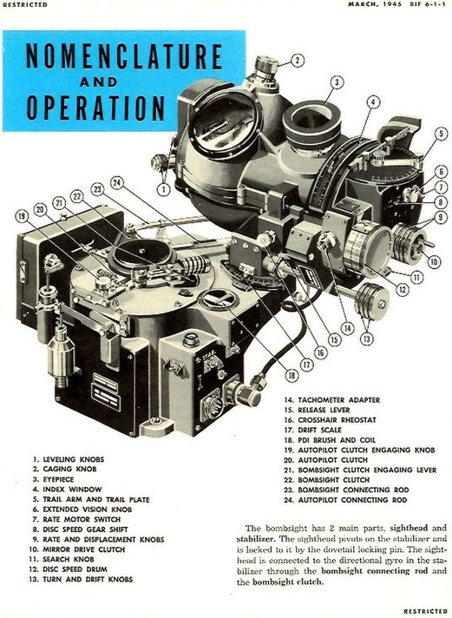
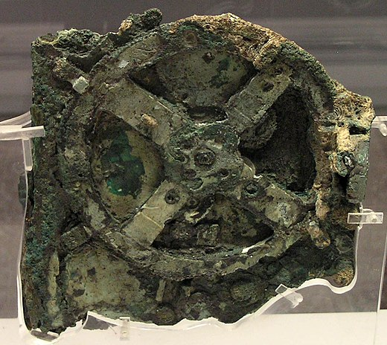
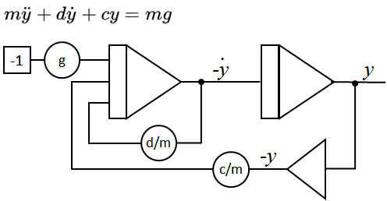
For 2000 years, we used analog computers
Antikythera mechanism
Solving differential equations
The Norden bomb sight
Notes:
M. Barreno, B. Nelson, R. Sears, A. D. Joseph, and J. D. Tygar, “Can machine learning be secure?” in Proceedings of the 2006 ACM Symposium on Information, computer and communications security. ACM, 2006, pp. 16–25.
Anthony and P. L. Bartlett, Neural network learning: Theoretical foundations. cambridge university press, 2009.

Slide 4
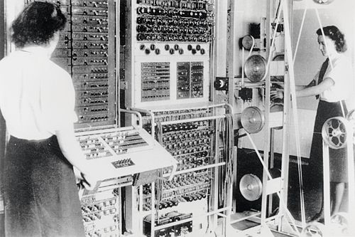
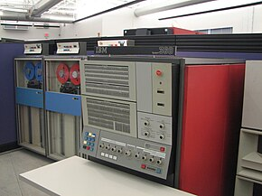
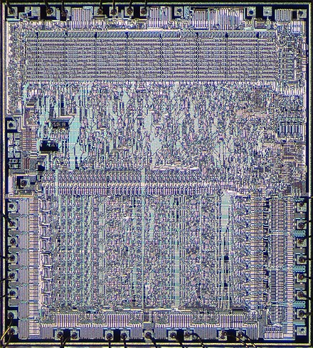
About 70 years ago, we completely switched to digital computers
The Colossus code breaking computer
IBM System 360
Microprocessors
Notes:
M. Barreno, B. Nelson, R. Sears, A. D. Joseph, and J. D. Tygar, “Can machine learning be secure?” in Proceedings of the 2006 ACM Symposium on Information, computer and communications security. ACM, 2006, pp. 16–25.
Anthony and P. L. Bartlett, Neural network learning: Theoretical foundations. cambridge university press, 2009.

Slide 5
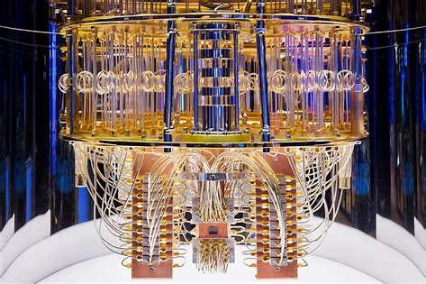
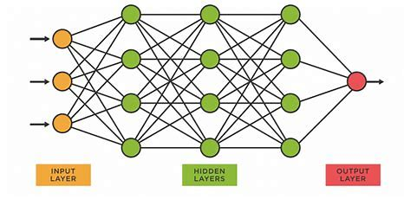
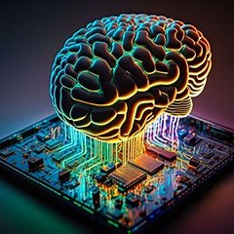
They are back! The MAGA movement of the last 20 years (Make Analog Great Again)
Quantum computers
(with complex valued superpositions in qubits)
Deep Neural Networks (with real valued inputs and weights)
Neuromorphic computers (with time-coded spiking networks)
Notes:
M. Barreno, B. Nelson, R. Sears, A. D. Joseph, and J. D. Tygar, “Can machine learning be secure?” in Proceedings of the 2006 ACM Symposium on Information, computer and communications security. ACM, 2006, pp. 16–25.
Anthony and P. L. Bartlett, Neural network learning: Theoretical foundations. cambridge university press, 2009.

Slide 6
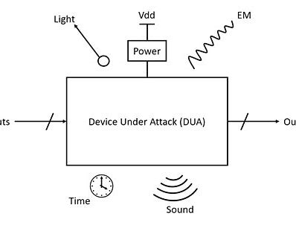
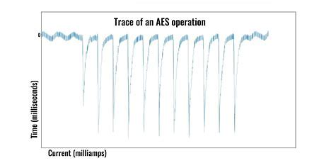
Even our digital computers have analog characteristics, used in side channel attacks
Various emanations from digital computers
Cryptanalysis of AES by analyzing power traces
Fault attacks with modified clock pulses
Notes:
M. Barreno, B. Nelson, R. Sears, A. D. Joseph, and J. D. Tygar, “Can machine learning be secure?” in Proceedings of the 2006 ACM Symposium on Information, computer and communications security. ACM, 2006, pp. 16–25.
Anthony and P. L. Bartlett, Neural network learning: Theoretical foundations. cambridge university press, 2009.

Slide 7
The landscape of analog/digital security
users
digital data, digital computer
digital data, leaky computer
digital data, analog computer
digital
attack
standard cryptography
unreasonable restriction
unreasonable restriction
adversaries
meaningless
side channel attacks
this paper
analog
attack
Notes:
M. Barreno, B. Nelson, R. Sears, A. D. Joseph, and J. D. Tygar, “Can machine learning be secure?” in Proceedings of the 2006 ACM Symposium on Information, computer and communications security. ACM, 2006, pp. 16–25.
Anthony and P. L. Bartlett, Neural network learning: Theoretical foundations. cambridge university press, 2009.

Slide 8
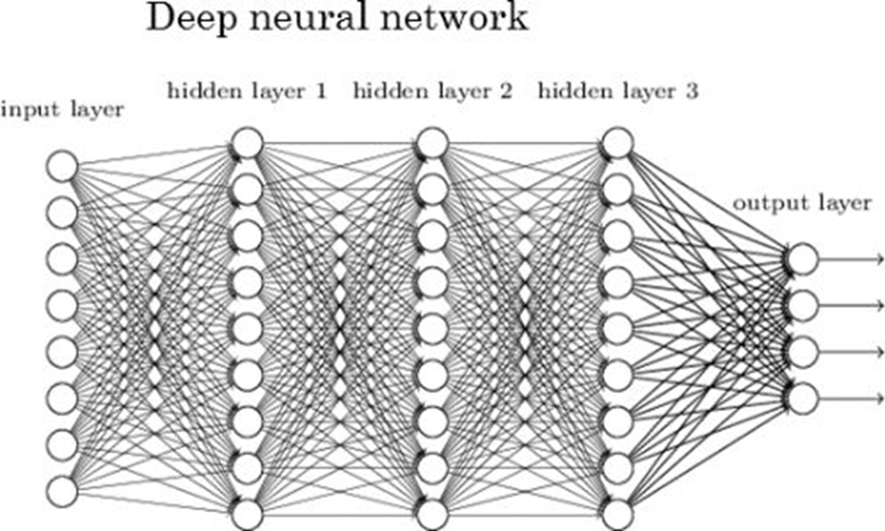
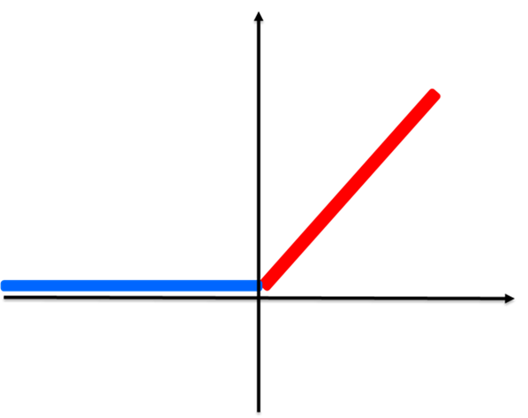
The layered structure of DNN computers
Deep neural networks have multiple layers, where each layer typically consists of a linear mapping with real valued coefficients followed by the ReLU activation functions applied to all its outputs
ReLU(x)=MAX(x,0)
Notes:
M. Barreno, B. Nelson, R. Sears, A. D. Joseph, and J. D. Tygar, “Can machine learning be secure?” in Proceedings of the 2006 ACM Symposium on Information, computer and communications security. ACM, 2006, pp. 16–25.
Anthony and P. L. Bartlett, Neural network learning: Theoretical foundations. cambridge university press, 2009.

Slide 9
Can we implement digital cryptography on such an analog computational model?
ReLU-based DNN’s are digitally universal, since they can easily implement the basic Boolean functions of “AND” “OR” and “NOT”
ReLU-based DNN’s are also analogly universal, since they can approximate any continuous real-valued function using a sufficiently wide network with one hidden layer
While we already know that DNN’s can correctly implement any digital cryptographic function, the question whether such implementations are secure had not been analyzed so far
Notes:
M. Barreno, B. Nelson, R. Sears, A. D. Joseph, and J. D. Tygar, “Can machine learning be secure?” in Proceedings of the 2006 ACM Symposium on Information, computer and communications security. ACM, 2006, pp. 16–25.
Anthony and P. L. Bartlett, Neural network learning: Theoretical foundations. cambridge university press, 2009.

Slide 10
This is a totally new security playground with new rules and new techniques
For example, the attacker can ask the DNN to encrypt the “plaintext” P whose “bits” are (0.3, -7, $Π$, …) and obtain the “ciphertext” (-2.7, √2,…)
For example, the attacker can apply a jitter attack, in which he increases or decreases the value of one “bit” by ±ε, and observe whether the “ciphertext” changes or not. This is a stronger form of differential cryptanalysis, where the attacker can only flip 0/1 values
For example, the attacker can analyze the piecewise linear output as the input follows a straight line between two plaintexts P1 and P2, as I did in a Eurocrypt’24 paper on extracting the parameters of DNN’s
Notes:
M. Barreno, B. Nelson, R. Sears, A. D. Joseph, and J. D. Tygar, “Can machine learning be secure?” in Proceedings of the 2006 ACM Symposium on Information, computer and communications security. ACM, 2006, pp. 16–25.
Anthony and P. L. Bartlett, Neural network learning: Theoretical foundations. cambridge university press, 2009.

Slide 11
How secret keys are handled in the DNN
The secret key can be provided as a sequence of additional inputs; we assume that the adversary cannot see or change these inputs
K
E
P
C
K
Notes:
M. Barreno, B. Nelson, R. Sears, A. D. Joseph, and J. D. Tygar, “Can machine learning be secure?” in Proceedings of the 2006 ACM Symposium on Information, computer and communications security. ACM, 2006, pp. 16–25.
Anthony and P. L. Bartlett, Neural network learning: Theoretical foundations. cambridge university press, 2009.

Slide 12
How to implement Cryptography on DNN’s: The example of AES
Everything in AES can be implemented with just two types of operations: Mapping 8-bit inputs to 8-bit outputs (Sbox, multiplication of a byte by the constants 2 and 3 in the AES finite field), and mapping 2-bit inputs to 1-bit outputs (XOR’s of subkeys, and XOR’s in the linear mixing)
There is a simple way to implement any Boolean function with a small number of input bits as a ReLU-based DNN
Notes:
M. Barreno, B. Nelson, R. Sears, A. D. Joseph, and J. D. Tygar, “Can machine learning be secure?” in Proceedings of the 2006 ACM Symposium on Information, computer and communications security. ACM, 2006, pp. 16–25.
Anthony and P. L. Bartlett, Neural network learning: Theoretical foundations. cambridge university press, 2009.

Slide 13
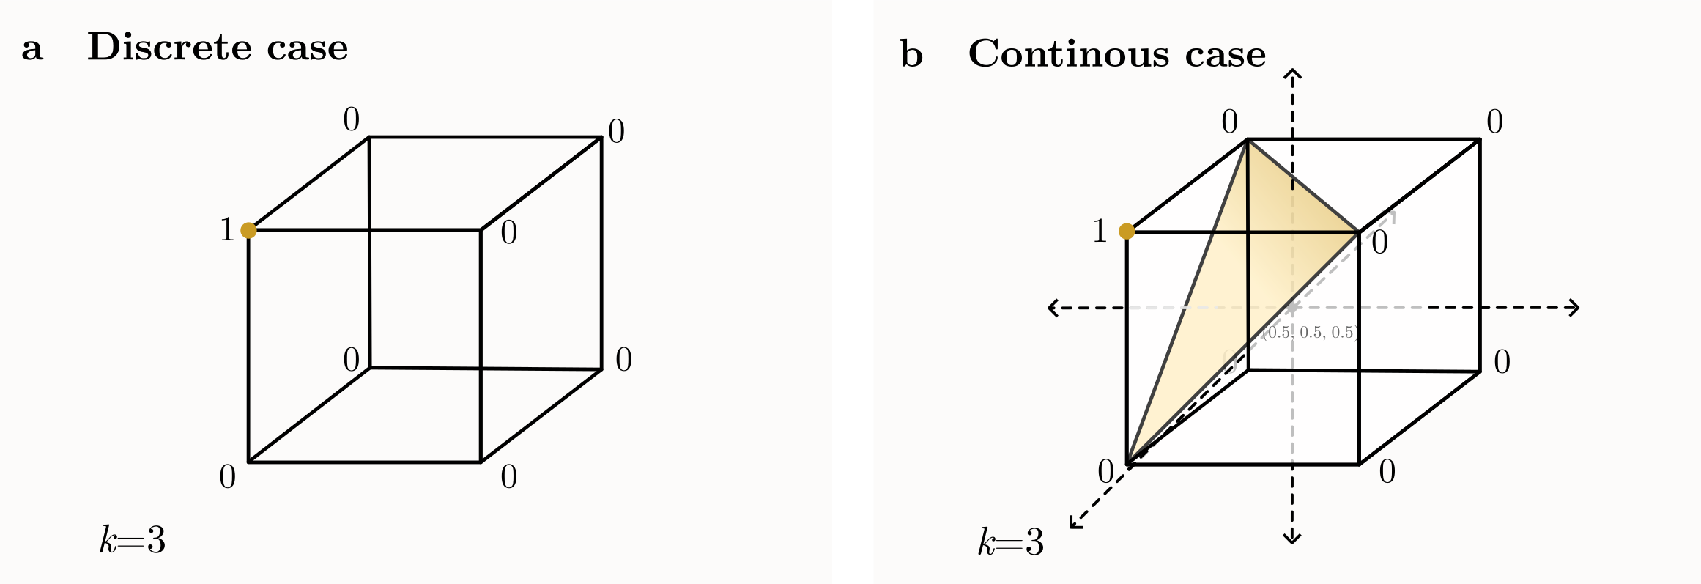
To implement Sbox, use corner functions
Consider an 8-dimensional Boolean cube with a single 1 at one of its corners, and 0’s at all the other corners. We can easily implement this function with a single ReLU applied to a linear combination of its inputs
For example, if the single 1 output is at corner 101, use the corner function as ReLU(x1-x2+x3-1) which is 0 at all corners except 101
Notes:
M. Barreno, B. Nelson, R. Sears, A. D. Joseph, and J. D. Tygar, “Can machine learning be secure?” in Proceedings of the 2006 ACM Symposium on Information, computer and communications security. ACM, 2006, pp. 16–25.
Anthony and P. L. Bartlett, Neural network learning: Theoretical foundations. cambridge university press, 2009.

Slide 14
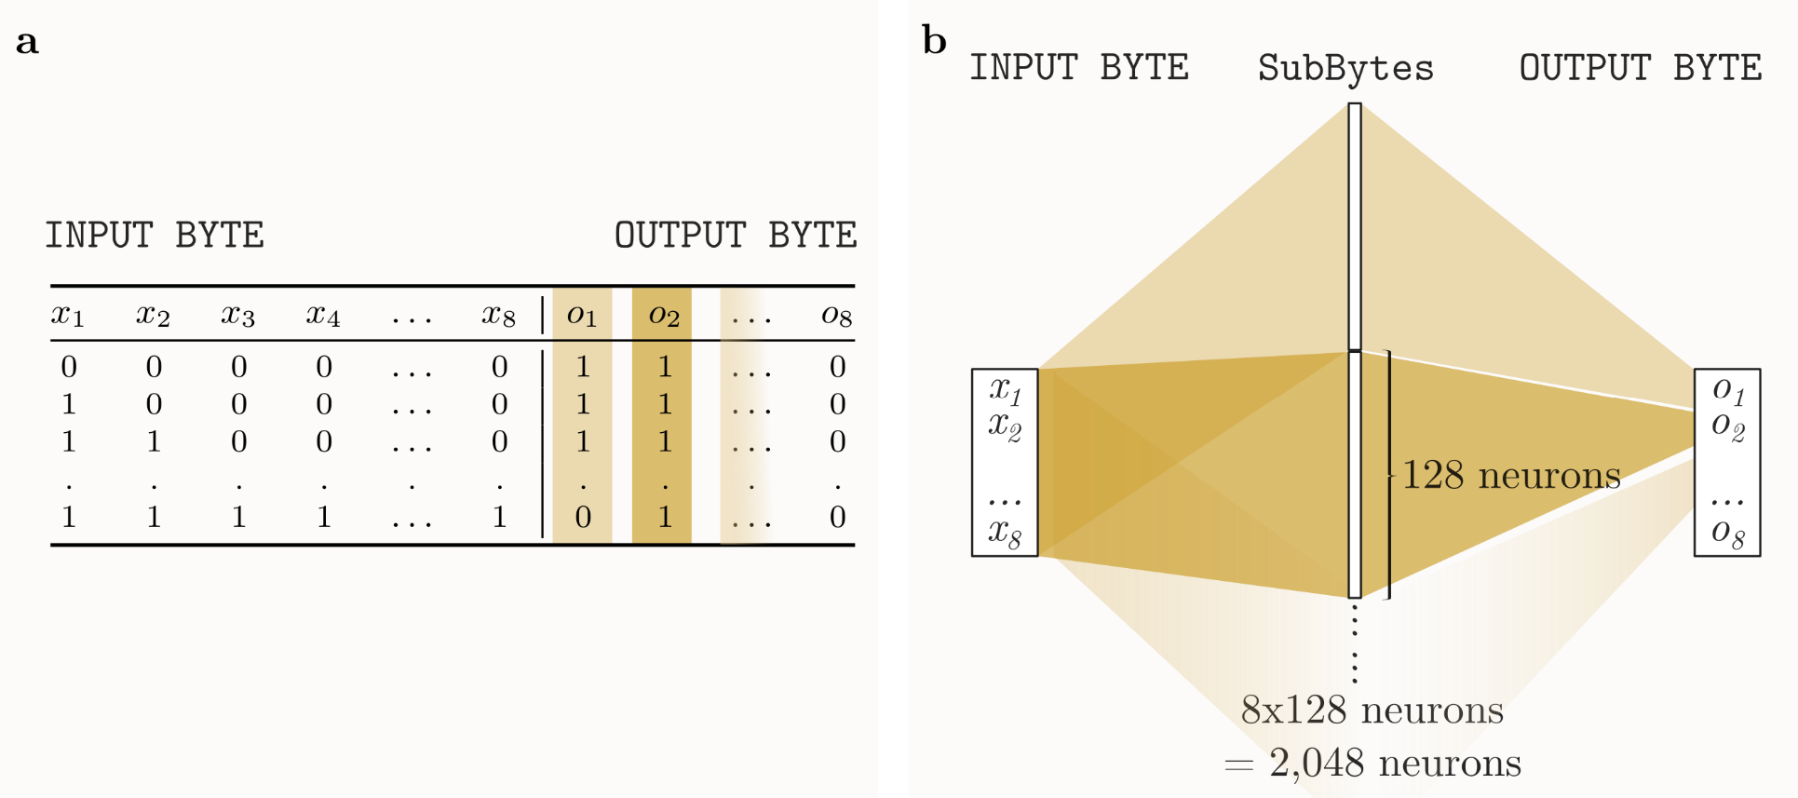
To implement Sbox, use corner functions
Each output bit of the Sbox can be implemented as the sum of 128 corner functions for the 128 out of 256 corners which output 1. This requires one hidden layer with 128 neurons
To implement all 8 output bits, place 8x128=1024 neurons in parallel in the same hidden layer, and sum each group of 128 separately
Notes:
M. Barreno, B. Nelson, R. Sears, A. D. Joseph, and J. D. Tygar, “Can machine learning be secure?” in Proceedings of the 2006 ACM Symposium on Information, computer and communications security. ACM, 2006, pp. 16–25.
Anthony and P. L. Bartlett, Neural network learning: Theoretical foundations. cambridge university press, 2009.

Slide 15
To implement each XOR, use 2 neurons
The definition XOR(x1,x2) = ReLU(x1-x2) + ReLU(x2-x1) is a special case of the general Boolean cube construction since XOR(x1,x2) is 2-dim cube with two corners outputing 0 and two corners outputing 1
We can thus implement everything in AES as sums of corner functions
We call this the natural implementation of AES in a DNN
It is correct in the sense that it computes the correct 0/1 outputs for any collection of 0/1 inputs; it computes something weird otherwise
Notes:
M. Barreno, B. Nelson, R. Sears, A. D. Joseph, and J. D. Tygar, “Can machine learning be secure?” in Proceedings of the 2006 ACM Symposium on Information, computer and communications security. ACM, 2006, pp. 16–25.
Anthony and P. L. Bartlett, Neural network learning: Theoretical foundations. cambridge university press, 2009.

Slide 16
Is this natural implementation secure when the adversary can use real valued inputs?
The answer is that these implementations can be easily broken
Almost any secret key block cipher (including AES) starts by XOR’ing each input bit xi with some key bit ki
We will now show how to recover all the ki bits used in the first round of the encryption via a simple jitter attack
Notes:
M. Barreno, B. Nelson, R. Sears, A. D. Joseph, and J. D. Tygar, “Can machine learning be secure?” in Proceedings of the 2006 ACM Symposium on Information, computer and communications security. ACM, 2006, pp. 16–25.
Anthony and P. L. Bartlett, Neural network learning: Theoretical foundations. cambridge university press, 2009.

Slide 17
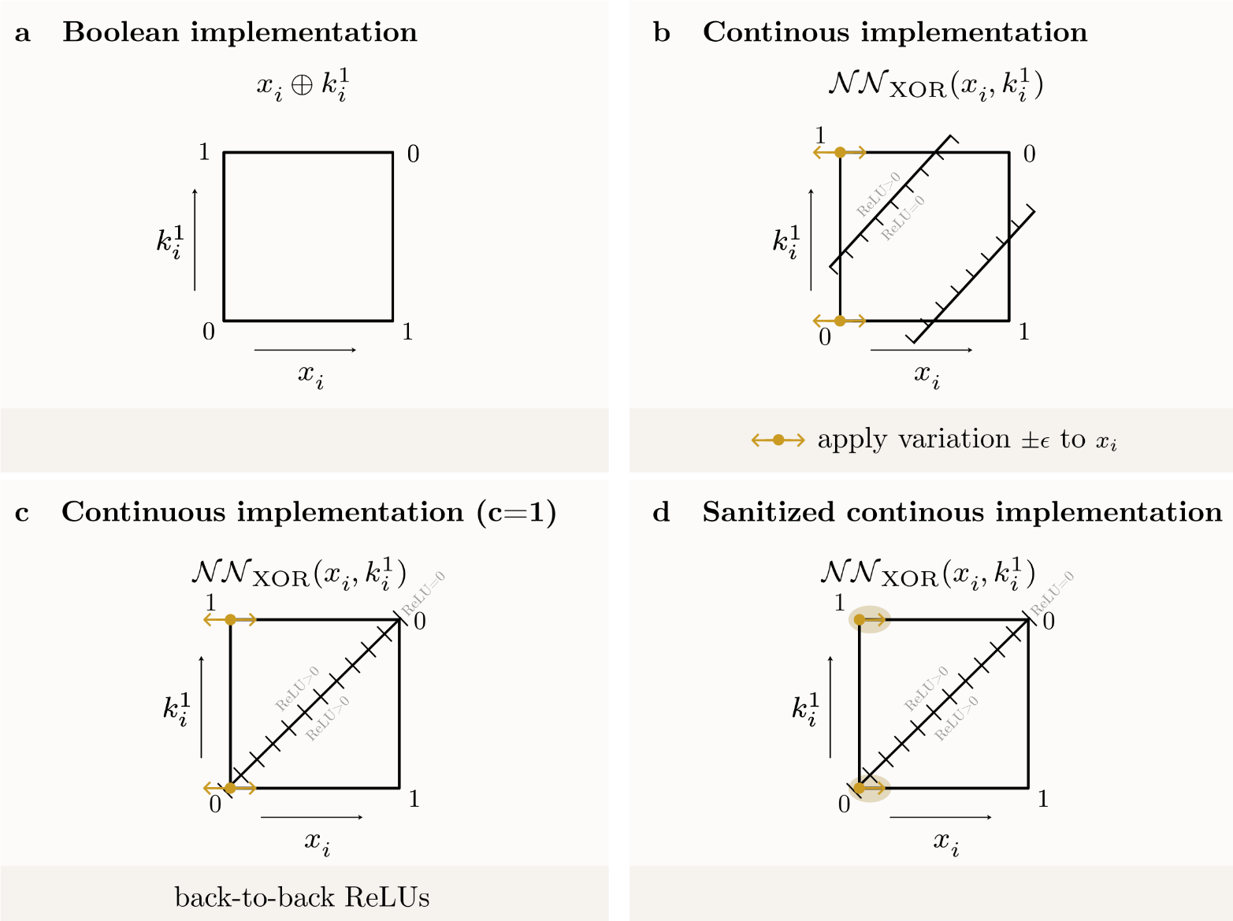
Attacking the natural implementation of XOR
When implemented XOR as the sum of two separated corner functions:
We can use xi=0, and distinguish between ki=0 and ki=1 by jittering xi: If ki=0 the output is always stable, while if ki=1 the output (usually) jitters
Notes:
M. Barreno, B. Nelson, R. Sears, A. D. Joseph, and J. D. Tygar, “Can machine learning be secure?” in Proceedings of the 2006 ACM Symposium on Information, computer and communications security. ACM, 2006, pp. 16–25.
Anthony and P. L. Bartlett, Neural network learning: Theoretical foundations. cambridge university press, 2009.

Slide 18
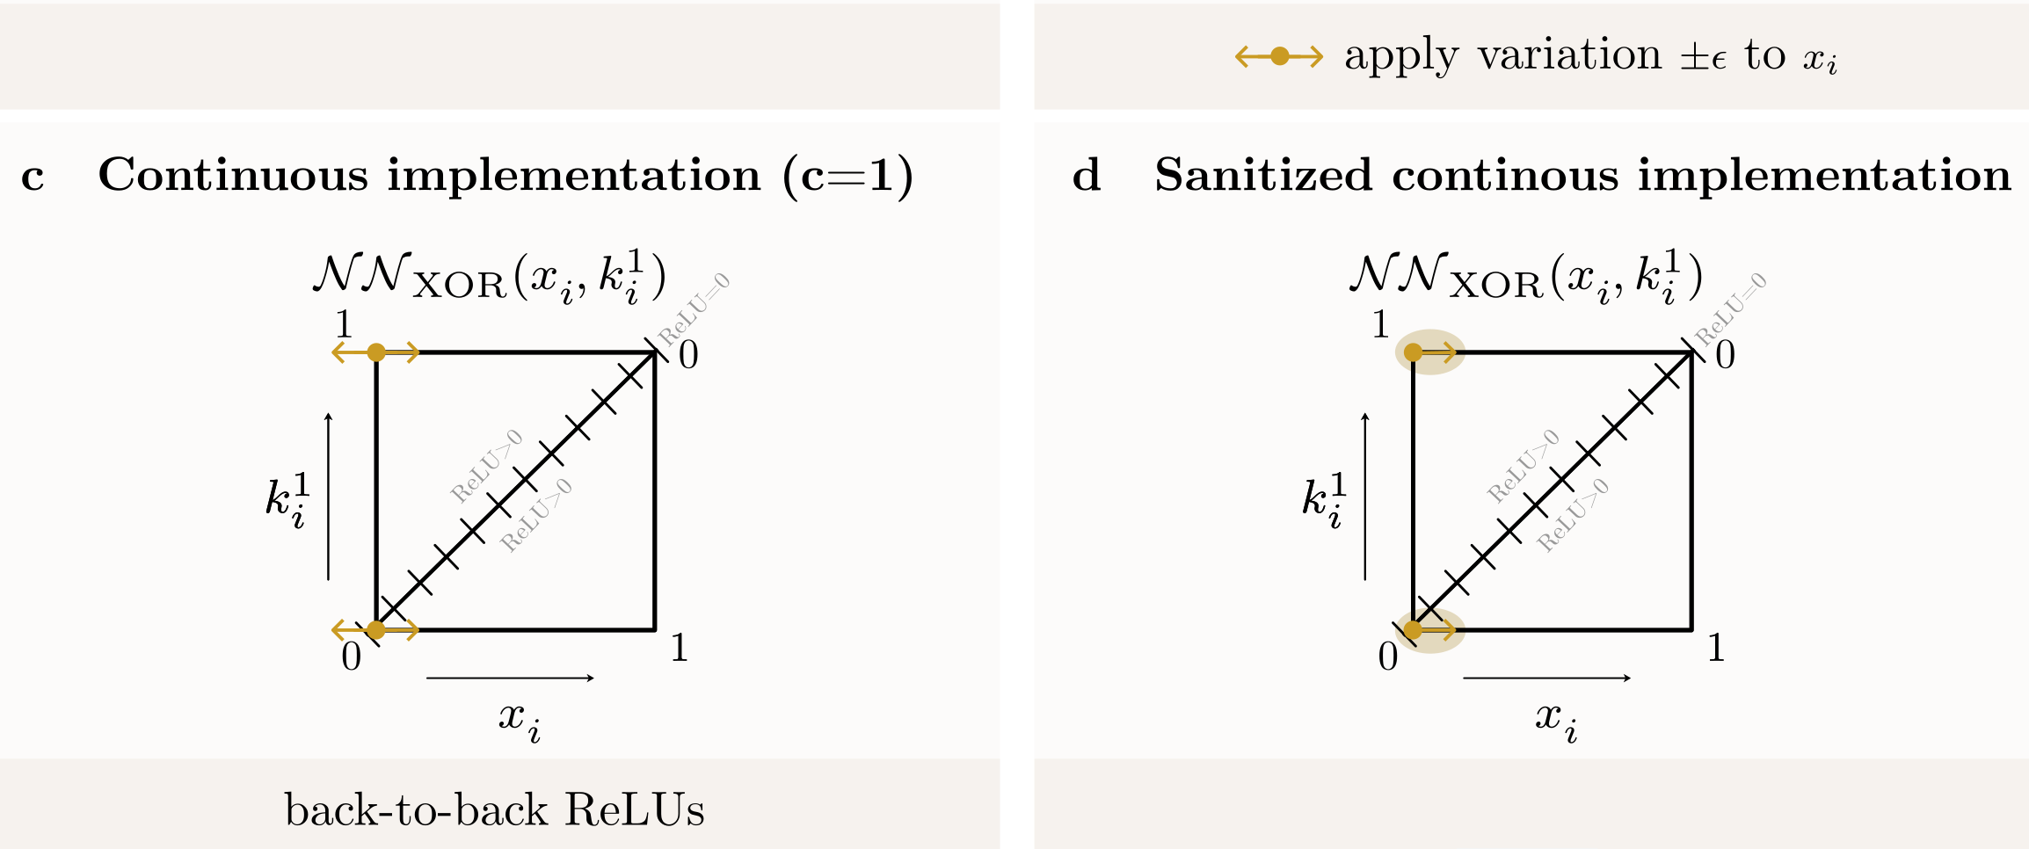
The natural implementation of bitwise XOR
Implementing XOR as the sum of two back-to-back corner functions:
XOR(xi,ki) = ReLU(xi-ki) + ReLU(ki-xi)
In case (c) we look for jitter symmetry; in the input-sanitized case (d) we can’t jitter in both directions so we need a different kind of attack
Notes:
M. Barreno, B. Nelson, R. Sears, A. D. Joseph, and J. D. Tygar, “Can machine learning be secure?” in Proceedings of the 2006 ACM Symposium on Information, computer and communications security. ACM, 2006, pp. 16–25.
Anthony and P. L. Bartlett, Neural network learning: Theoretical foundations. cambridge university press, 2009.

Slide 19
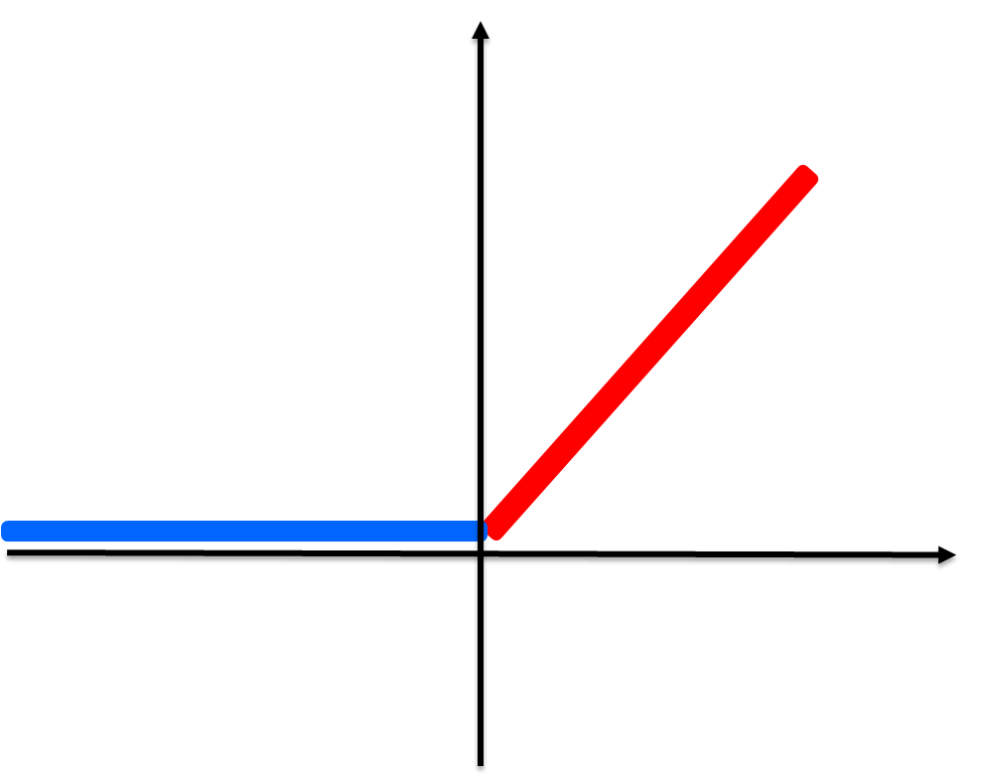
A potential solution: try to sanitize all input values to restrict the power of the adversary
Perfect sanitization, can’t be implemented with ReLU’s
Perfect sanitization, can’t be implemented with ReLU’s
Partial sanitization can be realized with a simple DNN:
STEP(x)=ReLU(x)-ReLU(x-1)
Attacker can only use input values in the range [0,1]
1
1
1
1
1/2
0
1
Notes:
M. Barreno, B. Nelson, R. Sears, A. D. Joseph, and J. D. Tygar, “Can machine learning be secure?” in Proceedings of the 2006 ACM Symposium on Information, computer and communications security. ACM, 2006, pp. 16–25.
Anthony and P. L. Bartlett, Neural network learning: Theoretical foundations. cambridge university press, 2009.

Slide 20
Attacking the input-sanitized version of AES
In AES, after XOR’ing a group of 8 input bits x1…x8 with 8 key bits k1,…k8, we map the resultant 8 bits y1,…y8 to z1…z8 via an 8-bit to 8-bit Sbox (i.e., z1…z8=Sbox( x1…x8 XOR k1…k8 ) )
Assume that each output bit zi of the Sbox is naturally implemented as a sum of 128 corner functions over the 8-dimensional cube of yi values
Notes:
M. Barreno, B. Nelson, R. Sears, A. D. Joseph, and J. D. Tygar, “Can machine learning be secure?” in Proceedings of the 2006 ACM Symposium on Information, computer and communications security. ACM, 2006, pp. 16–25.
Anthony and P. L. Bartlett, Neural network learning: Theoretical foundations. cambridge university press, 2009.

Slide 21
Attacking the input-sanitized version of AES
When we jitter the input y1,…,y8 around any combination of 0/1 values, an output bit zi remains stable if and only if zi=0 for that input
When we concatenate the 8 output bits z1,…z8, all of them remain stable simultaneously if and only if the 0/1 output of the Sbox is 0…0
If at least one of the eight 0/1 outputs of the Sbox is not 0, the 8 output values of the Sbox will jitter, and this jitter is likely to avalanche all the way to the ciphertext values, which will also jitter
Notes:
M. Barreno, B. Nelson, R. Sears, A. D. Joseph, and J. D. Tygar, “Can machine learning be secure?” in Proceedings of the 2006 ACM Symposium on Information, computer and communications security. ACM, 2006, pp. 16–25.
Anthony and P. L. Bartlett, Neural network learning: Theoretical foundations. cambridge university press, 2009.

Slide 22
Attacking the input-sanitized version of AES
We now have a way to test if the output of any particular Sbox in the first round of AES is z1,…,z8=00000000 ; this happens if and only if the input to this Sbox is y1,…,y8=01010010 . Since we know the plaintext bits x1…x8, we can now recover the 8 corresponding key bits as
k1…k8 = x1…x8 XOR 01010010
Repeating for all the 16 Sboxes in the first round of AES recovers the full 128 bit key
This attack was experimentally verified using negligible time with 100% success rate
Notes:
M. Barreno, B. Nelson, R. Sears, A. D. Joseph, and J. D. Tygar, “Can machine learning be secure?” in Proceedings of the 2006 ACM Symposium on Information, computer and communications security. ACM, 2006, pp. 16–25.
Anthony and P. L. Bartlett, Neural network learning: Theoretical foundations. cambridge university press, 2009.

Slide 23
Can we find a different implementation of AES which is secure against any such attack?
At first we were skeptical, since attackers have so much additional power in this analog model of computation (as in the case of side channel attacks, where no perfectly secure solutions are known)
However, after thinking hard, we found a provably secure way to implement any cryptographic functionality in a ReLU-based DNN
Notes:
M. Barreno, B. Nelson, R. Sears, A. D. Joseph, and J. D. Tygar, “Can machine learning be secure?” in Proceedings of the 2006 ACM Symposium on Information, computer and communications security. ACM, 2006, pp. 16–25.
Anthony and P. L. Bartlett, Neural network learning: Theoretical foundations. cambridge university press, 2009.

Slide 24
First step: sanitize the inputs more tightly
Apply a tighter step function to each input separately:
1
1
0
1
0
0.33
0.66
1
OLD-STEP(x)=ReLU(x)-ReLU(x-1)
STEP(x)=3*ReLU(x-0.33)-ReLU(x-0.66))
Notes:
M. Barreno, B. Nelson, R. Sears, A. D. Joseph, and J. D. Tygar, “Can machine learning be secure?” in Proceedings of the 2006 ACM Symposium on Information, computer and communications security. ACM, 2006, pp. 16–25.
Anthony and P. L. Bartlett, Neural network learning: Theoretical foundations. cambridge university press, 2009.

Slide 25
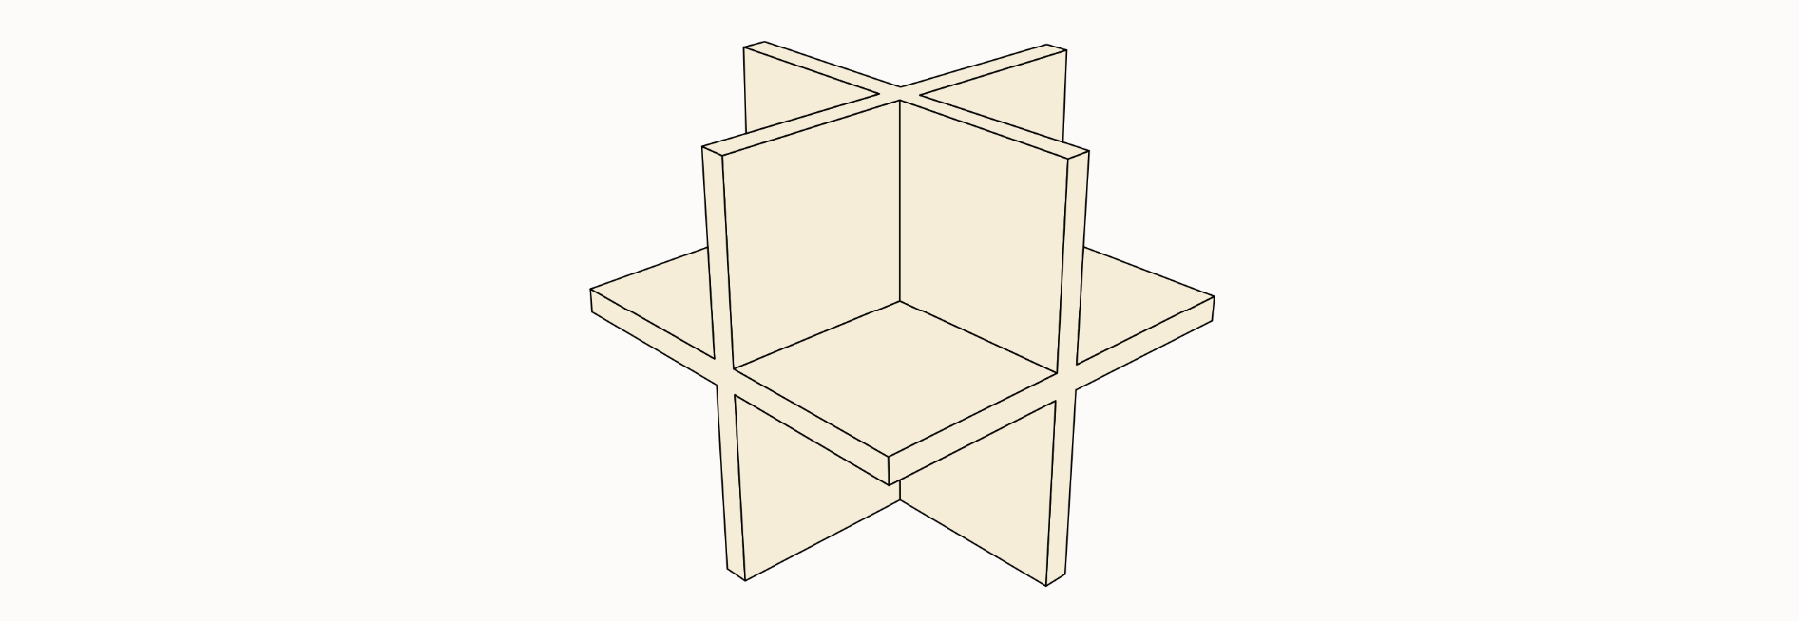
Second step: Identify the “danger zone”
Consider the multiwall in the input space, which is the high dimensional cross where at least one input coordinate lies between 0.33 to 0.66
This is the “danger zone” where the sanitized inputs may not be 0 or 1
In each orthant (separated from all other orthants by the multiwall), the sanitized inputs are a constant binary strings of just 0’s and 1’s
Notes:
M. Barreno, B. Nelson, R. Sears, A. D. Joseph, and J. D. Tygar, “Can machine learning be secure?” in Proceedings of the 2006 ACM Symposium on Information, computer and communications security. ACM, 2006, pp. 16–25.
Anthony and P. L. Bartlett, Neural network learning: Theoretical foundations. cambridge university press, 2009.

Slide 26
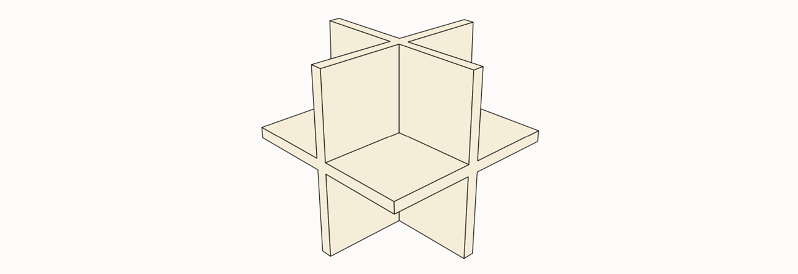
Third step: force all outputs for inputs in the “danger zone” to be identically zero
Problem: we have to continuously connect these zero values on the multiwall with the correct non-zero values required at the unique binary point in each orthant, using only ReLU’s and linear functions
This smooth interpolation should not leak any information on the key
Notes:
M. Barreno, B. Nelson, R. Sears, A. D. Joseph, and J. D. Tygar, “Can machine learning be secure?” in Proceedings of the 2006 ACM Symposium on Information, computer and communications security. ACM, 2006, pp. 16–25.
Anthony and P. L. Bartlett, Neural network learning: Theoretical foundations. cambridge university press, 2009.

Slide 27
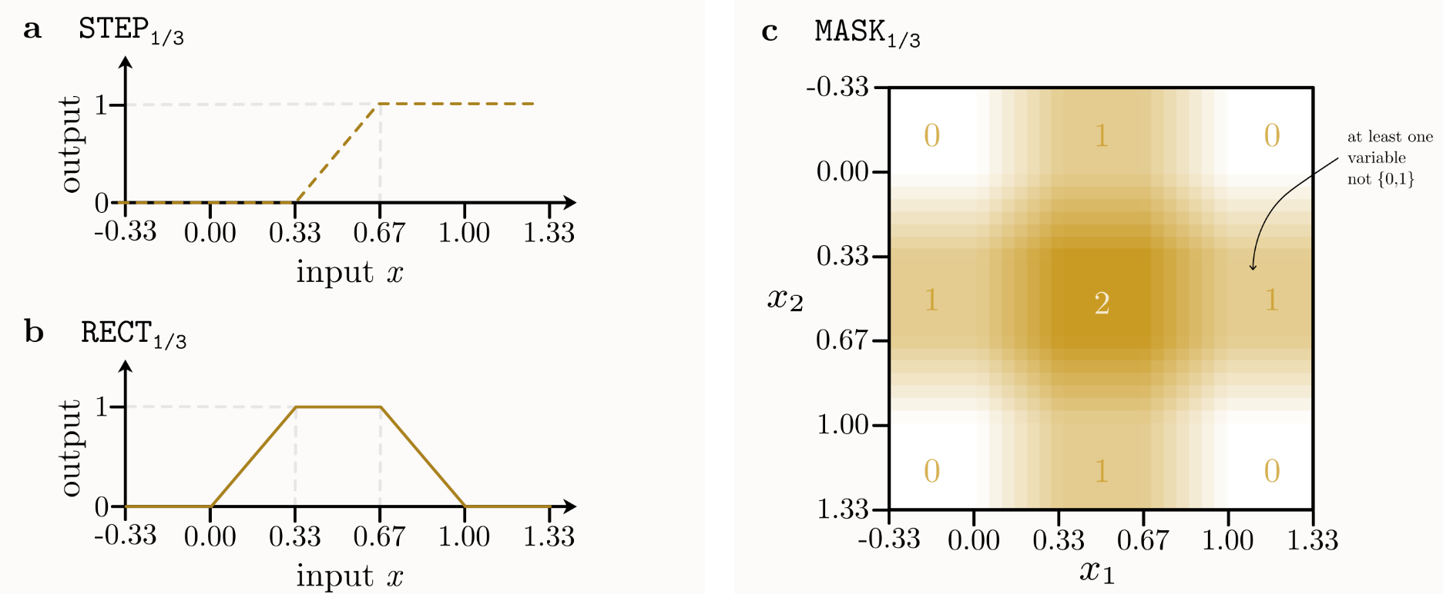
Third step: force all outputs for inputs in the “danger zone” to be identically zero
In addition to the tighter STEP function, we introduce a new function RECT(x)=ReLU(x)-ReLU(x-0.33)-ReLU(x-0.66)+ReLU(x-1)
We then define MASK(x1,…,xn) = ∑RECT(xi) for i=1,…,n
Notes:
M. Barreno, B. Nelson, R. Sears, A. D. Joseph, and J. D. Tygar, “Can machine learning be secure?” in Proceedings of the 2006 ACM Symposium on Information, computer and communications security. ACM, 2006, pp. 16–25.
Anthony and P. L. Bartlett, Neural network learning: Theoretical foundations. cambridge university press, 2009.

Slide 28
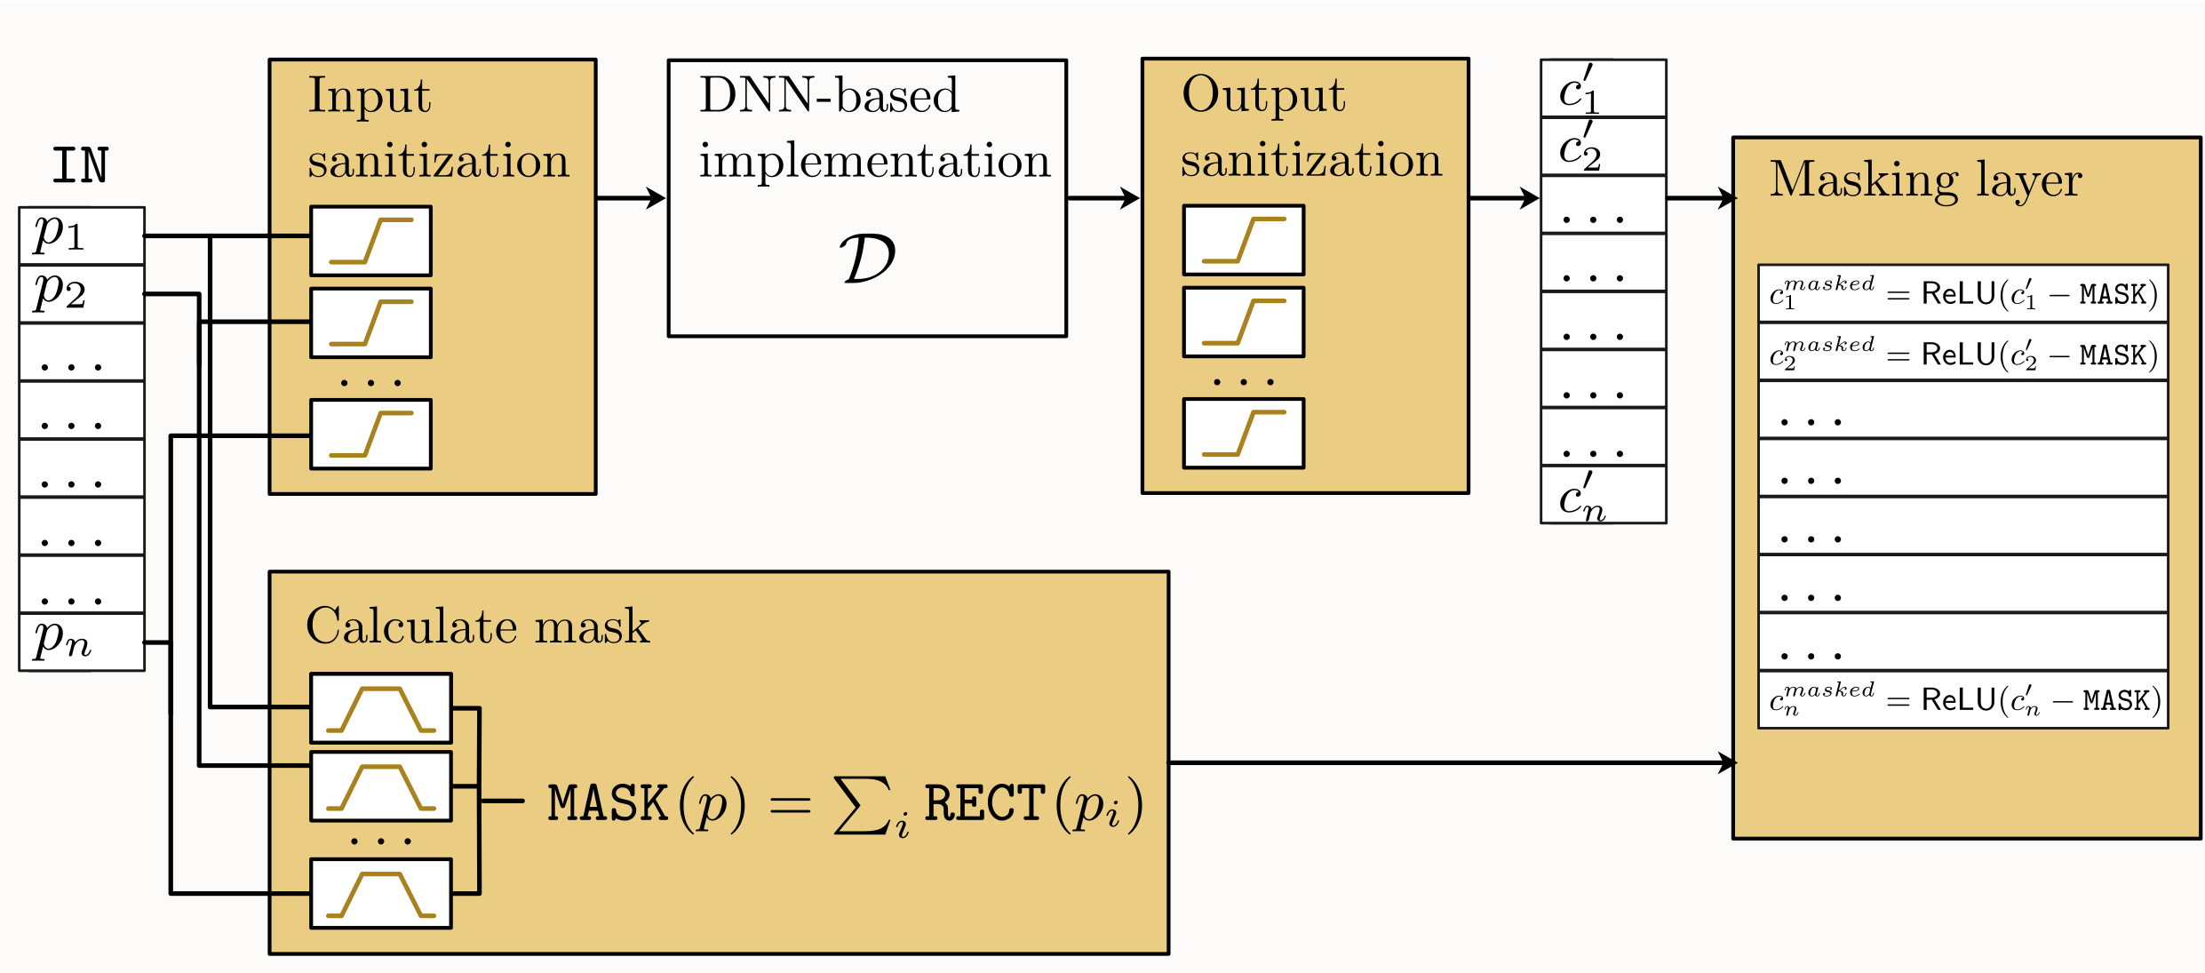
The final DNN implementation
Combines all the previously defined filter functions, where each one of them is crucial
Notes:
M. Barreno, B. Nelson, R. Sears, A. D. Joseph, and J. D. Tygar, “Can machine learning be secure?” in Proceedings of the 2006 ACM Symposium on Information, computer and communications security. ACM, 2006, pp. 16–25.
Anthony and P. L. Bartlett, Neural network learning: Theoretical foundations. cambridge university press, 2009.

Slide 29
Third step: force all outputs for inputs in the “danger zone” to be identically zero
MASK(x1,…,xn) is a smoothed continuous version of the multiwall
It has a value of at least 1 at any point in the multiwall
It has a value of 0 at any binary point in the input space (with just 0/1)
Notes:
M. Barreno, B. Nelson, R. Sears, A. D. Joseph, and J. D. Tygar, “Can machine learning be secure?” in Proceedings of the 2006 ACM Symposium on Information, computer and communications security. ACM, 2006, pp. 16–25.
Anthony and P. L. Bartlett, Neural network learning: Theoretical foundations. cambridge university press, 2009.

Slide 30
Why this DNN implementation is correct
For any binary vector of 0/1 values, the initial input sanitization leaves the inputs unchanged
The (potentially insecure) AES implementation then provides the correct 0/1 output values
These outputs are again left unchanged by the final STEP sanitizations
The sanitized outputs are not affected by the zero-valued MASK
Notes:
M. Barreno, B. Nelson, R. Sears, A. D. Joseph, and J. D. Tygar, “Can machine learning be secure?” in Proceedings of the 2006 ACM Symposium on Information, computer and communications security. ACM, 2006, pp. 16–25.
Anthony and P. L. Bartlett, Neural network learning: Theoretical foundations. cambridge university press, 2009.

Slide 31
Why this implementation is provably secure
We want to show that real valued queries do not leak any information about the secret key that is not already leaked via binary valued queries to the primitive.
Intuition: Any input within the danger zone yields only zero outputs
For any input in a particular orthant which is not in the danger zone, the output is completely determined by the output of AES at the unique binary input contained in that orthant, interpolated smoothly by the MASK of the known values of the plaintext “bits”. This can be computed without any knowledge of the secret key bits!
Notes:
M. Barreno, B. Nelson, R. Sears, A. D. Joseph, and J. D. Tygar, “Can machine learning be secure?” in Proceedings of the 2006 ACM Symposium on Information, computer and communications security. ACM, 2006, pp. 16–25.
Anthony and P. L. Bartlett, Neural network learning: Theoretical foundations. cambridge university press, 2009.

Slide 32
The extra cost of securing a DNN implementation
To obtain our secure DNN implementation of a cryptographic functionality, we can start with any (potentially insecure) DNN implementation such as the easily breakable natural implementation described above
We can then make it secure by adding a constant number of additional layers and a linear number of additional ReLU-based neurons (as a function of the number of input and output values)
This is a negligible cost for any nontrivial DNN, and thus our construction is very easy and completely practical
Notes:
M. Barreno, B. Nelson, R. Sears, A. D. Joseph, and J. D. Tygar, “Can machine learning be secure?” in Proceedings of the 2006 ACM Symposium on Information, computer and communications security. ACM, 2006, pp. 16–25.
Anthony and P. L. Bartlett, Neural network learning: Theoretical foundations. cambridge university press, 2009.

Slide 33
How to secure other cryptographic functionalities
Consider, for example, the case of public key signature verification
This functionality has no secret key, so our security guarantee (of not leaking any information about it) is meaningless
The functionality should accept a message M and a signature S, and compute a function VERIFY(M,S) which should output 1 when the signature is valid and 0 when the signature is not valid.
Given a DNN implementation of VERIFY, the attacker wins if he can produce some real-valued S’ which makes Verify(M,S’)=1
Notes:
M. Barreno, B. Nelson, R. Sears, A. D. Joseph, and J. D. Tygar, “Can machine learning be secure?” in Proceedings of the 2006 ACM Symposium on Information, computer and communications security. ACM, 2006, pp. 16–25.
Anthony and P. L. Bartlett, Neural network learning: Theoretical foundations. cambridge university press, 2009.

Slide 34
How to secure other cryptographic functionalities
The security of the signature scheme in the binary case does not imply that its DNN implementation is also secure for real valued signatures
We can use our sanitization techniques to force the output of VERIFY to be 0 for any real valued signature in the danger zone
This makes our DNN implementation provably secure in the sense that any attacker which can find a real valued S’ satisfying the DNN version of VERIFY can also find a binary S satisfying the original (binary) version of VERIFY
Notes:
M. Barreno, B. Nelson, R. Sears, A. D. Joseph, and J. D. Tygar, “Can machine learning be secure?” in Proceedings of the 2006 ACM Symposium on Information, computer and communications security. ACM, 2006, pp. 16–25.
Anthony and P. L. Bartlett, Neural network learning: Theoretical foundations. cambridge university press, 2009.

Slide 35
Conclusions
In this talk I defined the new research area of how to implement digital cryptography in an analog computer
I defined the notion of natural implementation of schemes
I demonstrated the insecurity of such natural implementations
I described a different implementation which is provably secure

