Slide 1
Directions in
Practical Lattice Cryptography
Vadim Lyubashevsky
IBM Research – Zurich

Slide 2
“Look back to where you have been, for a clue to where you are going.”
- Proverb

Slide 3

The Dark Ages ( 1978 – 1995)
Similar to Five Dynasties and Ten Kingdoms period (after the Tang dynasty)
A continuous circle of ad-hoc constructions followed by attacks

Slide 4
Knapsack Problem
…
a₁
a₂
a_{n}
t
mod q
t=Σa_{i}x_{i} mod q x_{i} in {0,1}
Find x_{i}

Slide 5
Vector Knapsack Problem
…
a₁
a₂
a_{n}
t
mod q
t=Σa_{i}x_{i} mod q x_{i} in {0,1}
Find x_{i}

Slide 6
Vector Knapsack Problem
…
a₁
a₂
a_{n}
t
mod q
t=Σa_{i}x_{i} mod q x_{i} “small” (<<q)
Find x_{i}

Slide 7
Vector Knapsack Problem
A
x
t
=
mod q
For which parameters is the problem hard?

Slide 8
Vector Knapsack Problem
A
x
t
NOT HARD!
=
mod q
(Gaussian Elimination)
For which parameters is the problem hard?

Slide 9
Vector Knapsack Problem
q is “exponentially” larger than x_{i}
A
x
t
=
mod q
NOT HARD!
(LLL and Lattice Reduction)
For which parameters is the problem hard?

Slide 10
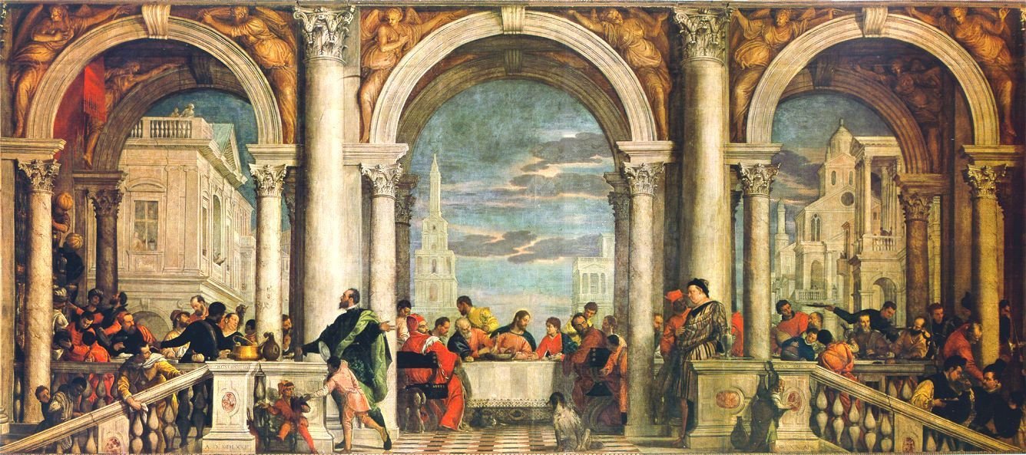
The Renaissance (1996 – 2007)
Worst-Case to Average-Case reductions illuminate the correct way to securely instantiate knapsack/lattice cryptography [Ajt ‘96, Reg ‘05]
Use of polynomial lattices gives hope for efficient lattice cryptography
[HPS ‘97, Mic ’02, PR ‘06, LM ‘06]

Slide 11
Vector Knapsack Problem
x
t
B⁻¹
A
B
B⁻¹
=

Slide 12
Vector Knapsack Problem
x
B⁻¹A
I
=
B⁻¹t

Slide 13
Vector Knapsack Problem
I
x
A
I
=
t

Slide 14
Learning with Errors
n
A
I
t
Regev [‘05]:
Solving for x in this family of instances → Finding short vectors in all lattices via a quantum algorithm
A
I
t
A
I
t

Slide 15
Learning with Errors
n
I
s
t
=
t
+
=

Slide 16
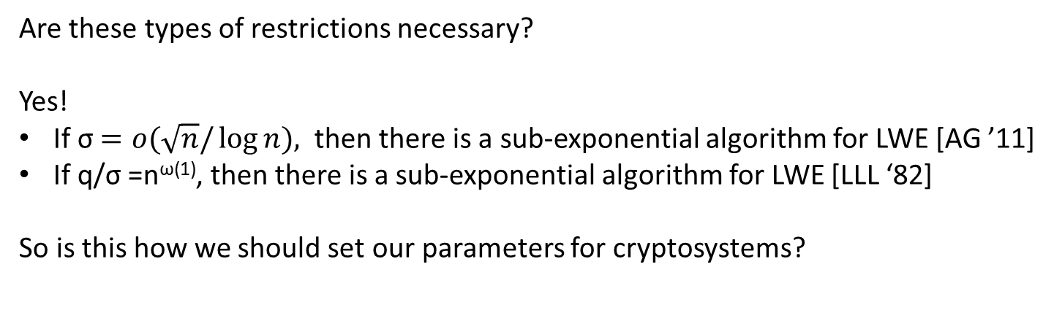
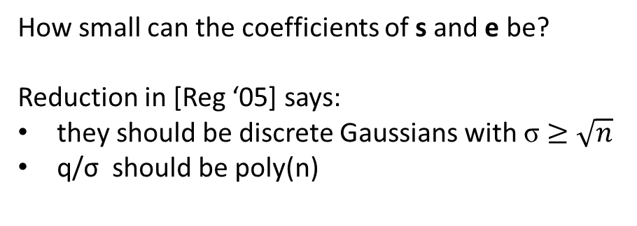
Learning with Errors
n
How small can the coefficients of s and e be?
Reduction in [Reg ‘05] says:
they should be discrete Gaussians with σ $≥$ $\sqrt{n}$
q/σ should be poly(n)
A
s
e
t
+
=
mod p
Are these types of restrictions necessary?
Yes!
If σ $=o(\sqrt{n}/\log{n),}$ then there is a sub-exponential algorithm for LWE [AG ’11]
If q/σ =n^{ω(1)}, then there is a sub-exponential algorithm for LWE [LLL ‘82]
So is this how we should set our parameters for cryptosystems?

Slide 17

Getting to the Beach in Hawaii

Slide 18
Getting to the Beach
The ad-hoc approach:
Just start walking in the direction of the beach
  May get lost in the forest
  May end up climbing a mountain
  Could fall into the volcano
The safer (provably-secure) approach:
Follow roads to the beach
  Beach may not be accessible by road
  Chance of a car accident

Slide 19

Getting to the Beach

Slide 20
Using Common Sense
To get to the beach:
Use roads to get as close as possible to the beach
Get out of the car and try to find a safe way down
To construct a secure public key scheme:
Get as close as possible using provable security
Try to make the scheme more efficient, without exposing it to attacks

Slide 21
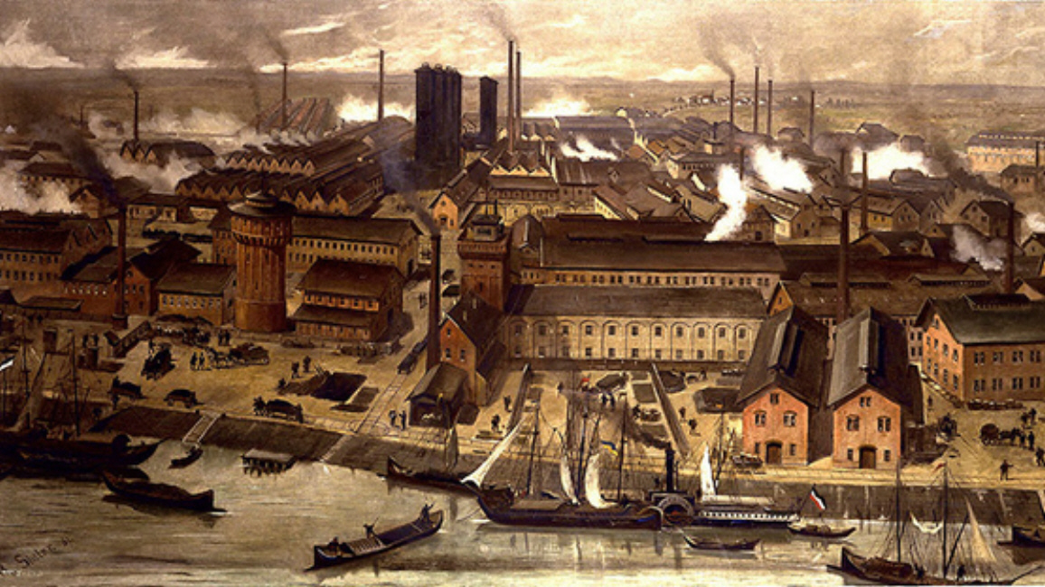
The Industrial Revolution (2008 – 2010)
Digital Signatures – [LM ‘08, GPV ‘08, Lyu ‘09]
Identity-Based Encryption – [GPV ‘08]
Virtually any cryptographic primitive can be built from lattices
FHE – [Gen ‘09]
Ring-LWE – [LPR ‘10]

Slide 22
People started seeing parallels between lattice schemes and number theory/pairing-based schemes

Slide 23
Domains in Crypto Protocols
“Discrete Log”: Hard problems in ring (Z_{p},+,*)
for large p
“Factoring” : Hard problems in ring (Z_{N},+,*)
for N=pq
Other domains?

Slide 24
Polynomial Ring Z_{q}[x]/(x^{n} + 1)
Elements are z(x)=z_{n-1}x^{n-1}+ … +z₁x+z₀ where z_{i} are integers mod q
Addition is the usual coordinate-wise addition
Multiplication is the usual polynomial multiplication followed by reduction modulo x^{n}+1

Slide 25
A Hard Problem (Ring-LWE)
Given g,t in R such that t=gs+e where s and e have “small” coefficients, find s (and e).
Example in R=Z₁₇[x]/(x⁴+1):
g = 4x³ – 6x² + 7x + 2
t = -5x³ + x² – 5x – 2
t = g * (x³ – x + 1) + x² + x – 1
(Should remind you of the discrete log problem)

Slide 26
The Decisional Version
Given g,t in R, determine whether
  there exist s and e with “small” coefficients such that t=gs+e or
  g, t are uniformly random in R
(Should remind you of the DDH problem)

Slide 27
Decision
Learning With Errors over Rings
World 1
World 2
a₁
s
b₁
a₁
b₁
a₂
b₂
a₂
b₂
a₃
b₃
a₃
b₃
+
=
…
…
…
…
a_{m}
b_{m}
a_{m}
b_{m}
Theorem [LPR ‘10]: In cyclotomic rings, there is a quantum reduction from solving worst-case problems in ideal lattices to solving Decision-RLWE

Slide 28
Practical
Impractical
Cryptographic Protocols
Authen-tication
Identity-Based Encryption
Fully-Homomorphic Encryption
…
Blind Signatures
Group Signatures
Encryption
Key Exchange
Basic Internet Security
Advanced Privacy Enhancement
“Interface for lattice cryptography”
(Ring)-LWE Problem
Hard Lattice Problems
Notes:
Virtually every lattice primitive uses (Ring)-LWE as an intermediate problem. This is how everyone builds lattice protocols today.
(Ring LWE) is a more “efficient” version of LWE.
This approach is OK for basic primitives, but advanced primitives are too inefficient.
Impracticality usually refers to the sizes of keys and outputs. Often the impractical schemes

Slide 29

The Modern Era (2011 – )
Lattice cryptography goes mainstream
Theoretical constructions become practical
Impossible constructions become theoretical

Slide 30
LWE Encryption
n
A
S
E
T
Key Generation
n
+
=
mod p
r
A
T
Encryption
Encrypting b bits
Ciphertext Length: small
Secret Key Length: can be very small
S=H(s), E=H(e)
Public Key Length: big
no way to compress T
+
e
+
0
m
=
u
v
mod p

Slide 31
Ring-LWE Encryption
Key Generation
a
s
+
e
=
t
mod p
Encryption
Encrypting n bits
Ciphertext Length: small
Secret Key Length: small
Public Key Length: small
r
a
+
=
u
mod p
r
t
+
+
m
=
v
mod p

Slide 32
LWE Digital Signatures
n
A
S
E
T
Key Generation
m
+
=
mod p
c
A
u
v
Signing
= H
+
mod p
, msg
Security parameter b
Signature Length: small
Secret Key Length: small
Public Key Length: big
no way to compress T
z
S
c
u
+
=
E
v
Use rejection sampling to make z independent of (S,E)

Slide 33
Ring-LWE Signatures
Key Generation
a
s
+
e
=
t
mod p
c
= H
a
u
+
v
mod p
, msg
Signing
Security parameter b < n
Signature Length: small
Secret Key Length: small
Public Key Length: small
z₁
s
c
u
=
+
z₂
e
v
Use rejection sampling to make z_{i} independent of (s,e)

Slide 34
Concrete Parameters
128-bit quantum security
 | Public Key | Secret Key | Output Size
Encryption (of 256 bits) | LWE: 200 – 400 KB Ring-LWE: 1 – 2 KB | LWE: < 1 KB Ring-LWE: < 1 KB | LWE: 1 – 2 KB Ring-LWE: 1 – 2 KB
Signature | LWE: 100 – 200 KB Ring-LWE: 1 – 2KB | LWE: < 1 KB Ring-LWE: < 1 KB | LWE: 1 – 2 KB Ring-LWE: 1 – 2 KB

Slide 35
Generic Forward-Secure Authenticated Key Exchange from a
1-Way KEM and a Signature
vk
vk
pk, Sign(pk)
(sk,pk)← KeyGen
c, Sign(c)
(c,m)← Enc_{pk}(.)
H(Dec_{sk}(c),View)
=
H(m,View)
Need pk, signatures, and ciphertext to be small

Slide 36
From provable security
to
practical constructions

Slide 37
Case Study 1: (Ring)-LWE Encryption
Secret Key
Encryption
a
s
+
e
=
t
r
a
+
e₁
=
u
r
t
+
e₂
+
m
=
v
Public Key
For efficiency, want s, e, e₁, e₂ to be as small as possible.
But [AG ‘11] says that if they are too small, then (Ring)-LWE is easy.
But … the attack in [AG ’11] requires many linear equations – in the cryptosystem, we only have 2n equations.
So, is it safe to take very small (say 0/1) coefficients if q is not too large?

Slide 38
Case Study 1: (Ring)-LWE Encryption
Secret Key
Encryption
a
s
+
e
=
t
r
a
+
e₁
=
u
r
t
+
e₂
+
m
=
v
Public Key
So, is it safe to take very small (say 0/1) coefficients if q is not too large?
We thought so. And later, some evidence appeared
[MP ‘13] says that it is safe to use smaller LWE coefficients if there are few samples
[DM ‘13, MP ‘13] say that taking secret/errors from a non-Gaussian distribution is OK
But these results apply to LWE, and not to Ring-LWE for technical reasons
We still think it’s safe

Slide 39
Case Study 2: Key Generation for (Ring)-LWE
A
s
t
n
=
mod p
m
Would like (A,t) to be indistinguishable from uniform and have ||s|| small
Can have s in {0,1}^{m} for m > nlog(p) → (A,t) actually uniform by LHL.
||s|| = nlog(p) = O(nlog(n))

Slide 40
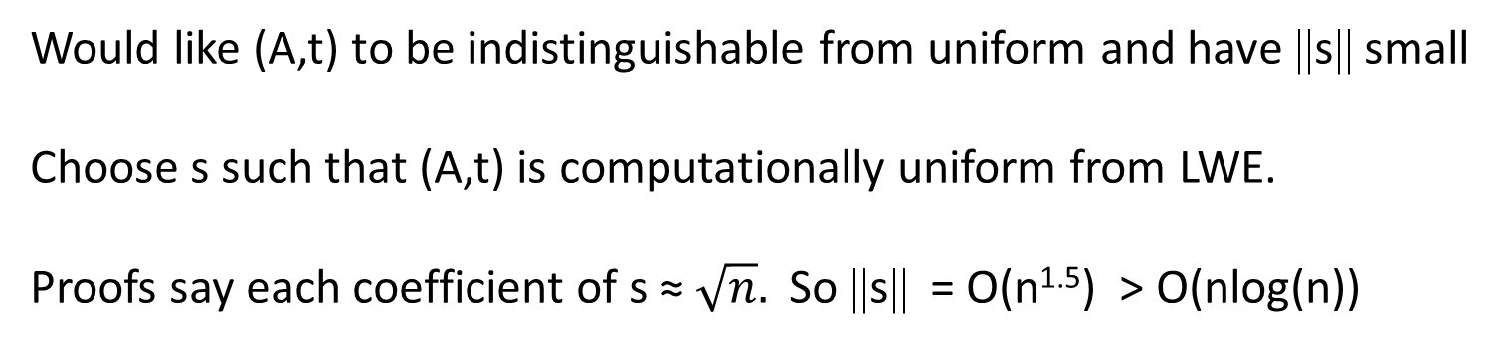
Case Study 2: Key Generation for (Ring)-LWE
A
I
s
t
n
=
mod p
2n
Would like (A,t) to be indistinguishable from uniform and have ||s|| small
Choose s such that (A,t) is computationally uniform from LWE.
Proofs say each coefficient of s ≈ $\sqrt{n}.$ So ||s|| = O(n^{1.5}) > O(nlog(n))

Slide 41
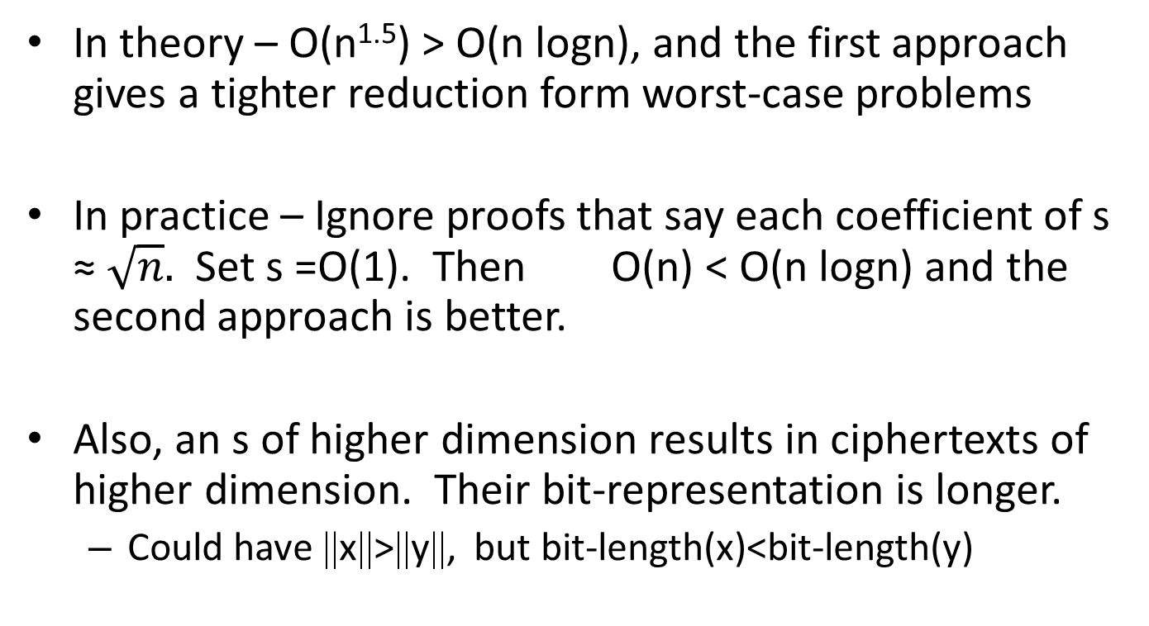
Case Study 2: Key Generation for (Ring)-LWE
In theory – O(n^{1.5}) > O(n logn), and the first approach gives a tighter reduction form worst-case problems
In practice – Ignore proofs that say each coefficient of s ≈ $\sqrt{n}.$ Set s =O(1). Then O(n) < O(n logn) and the second approach is better.
Also, an s of higher dimension results in ciphertexts of higher dimension. Their bit-representation is longer.
  Could have ||x||>||y||, but bit-length(x)<bit-length(y)

Slide 42
Possible Takeaways from Case Studies 1 and 2
Average-Case to Worst-Case reductions just tell us what the hard knapsacks look like
Set the parameters so that the knapsack problem is hard in practice

Slide 43
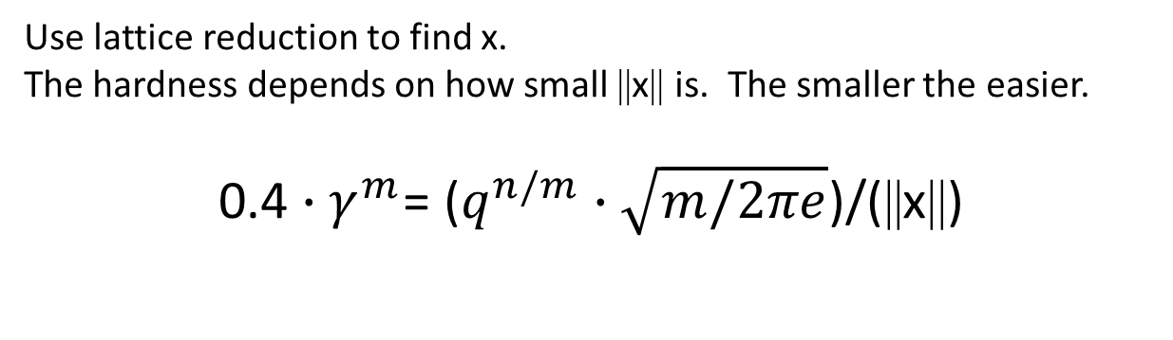
Setting Parameters
I
x
n
A
I
mod q
=
t
m
Use lattice reduction to find x.
The hardness depends on how small ||x|| is. The smaller the easier.
0.4 ${∙γ}^{m}$= ($q^{n/m}∙\sqrt{m/2πe}$)/(||x||)

Slide 44
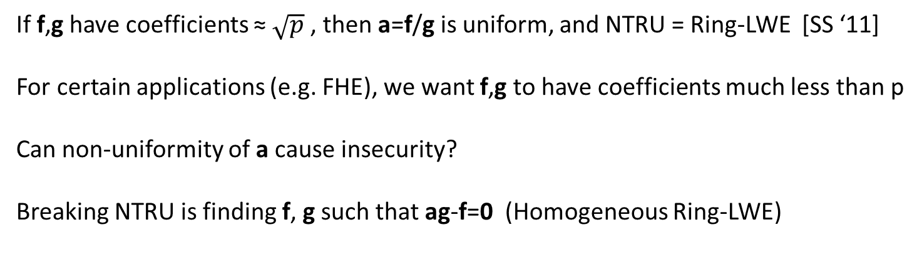
Case Study 3: NTRU
f
g
- Very small
f
=
a
mod p
u
=
2
a
r
+
e
mod p
g
If f,g have coefficients ≈ $\sqrt{p}$ , then a=f/g is uniform, and NTRU = Ring-LWE [SS ‘11]
For certain applications (e.g. FHE), we want f,g to have coefficients much less than p
Can non-uniformity of a cause insecurity?
Breaking NTRU is finding f, g such that ag-f=0 (Homogeneous Ring-LWE)

Slide 45
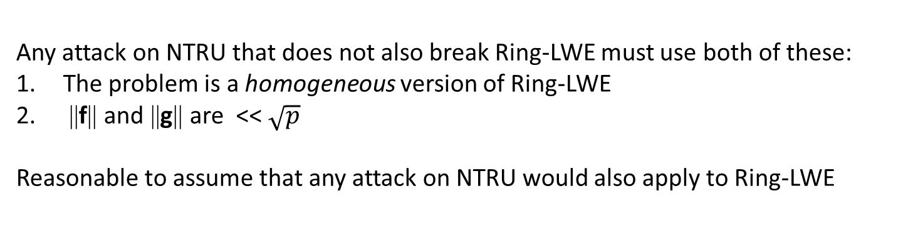
Case Study 3: NTRU
f
g
- Very small
f
=
a
mod p
u
=
2
a
r
+
e
mod p
g
Any attack on NTRU that does not also break Ring-LWE must use both of these:
The problem is a homogeneous version of Ring-LWE
||f|| and ||g|| are << $\sqrt{p}$
Reasonable to assume that any attack on NTRU would also apply to Ring-LWE

Slide 46
“It isn’t what you don’t know that gets you into trouble. It’s what you know for sure that just isn’t so.”
- Mark Twain

Slide 47
Attacking NTRU [ABD ’16, CJL ‘16]
R=Z[x]/(x^{n}+1)
For any d | n,
Subring of R: {a₀+a₁x^{d}+a₂x^{2d}+ … + a_{n/d-1}x^{n-d} : a_{i} in Z, same operations as R}
Such subrings of R are isomorphic to R’=Z[x]/(x^{n/d}+1)
The algebraic norm N: R → R’ has the following properties:
For s,t in R, N(s)N(t)=N(st)
||N(s)||<(||s||∙poly(n))^{d}
Notes:
Cheon , Jeong, Lee

Slide 48
Attacking NTRU
Idea for attacking NTRU.
a=f/g ➔ N(a)N(g)-N(f)=0 mod p
Lattice of dimension 2n/d
L={(g’,f’) : N(a)g’-f’=0 mod p}
Find a short vector in this lattice – If ||(N(g),-N(f))|| is small, the solution will be a multiple of it. Then lift up to find (g,f).

Slide 49
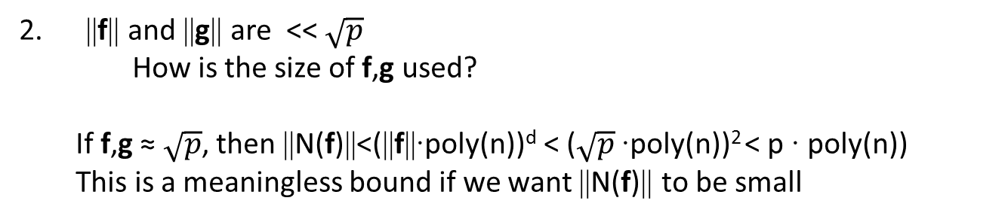
Does the Attack Work for Ring-LWE?
Any attack on NTRU that does not also break Ring-LWE must use both of these:
The problem is a homogeneous version of Ring-LWE
How is homogeneity used?
NTRU
ag-f=0 ➔ N(a)N(g)-N(f)=0 mod p
Can hope that (N(g),-N(f)) is a short vector in L.
Ring-LWE
as+e=b ➔ N(a)N(s)-N(b-e)=0 mod p
(N(s),N(b-e)) is not a short vector in L. It’s unclear how one could find such a vector.
2. ||f|| and ||g|| are << $\sqrt{p}$
  How is the size of f,g used?
  If f,g ≈ $\sqrt{p}$, then ||N(f)||<(||f||∙poly(n))^{d} < ($\sqrt{p}$∙poly(n))² < p ∙ poly(n))
  This is a meaningless bound if we want ||N(f)|| to be small

Slide 50
Possible Takeaways from Case Study 3
Proofs are magical!
Everything that has a worst-case hardness proof is secure and will remain secure.
The fact that similar schemes without proofs get broken is further evidence of this.
or …
Chinks in the armor have been found.
  Breaking schemes with proofs is a deeper result – need more time for that. And besides, why should the worst-case problems be hard?
Notes:
There has, in fact, not been a single attack on a “provably-secure” version of Ring-LWE

Slide 51
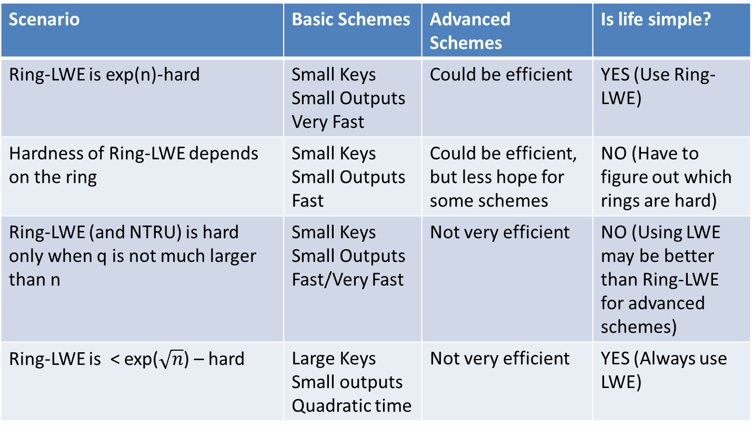
Some Possible Scenarios
Scenario | Basic Schemes | Advanced Schemes | Is life simple?
Ring-LWE is exp(n)-hard | Small Keys Small Outputs Very Fast | Could be efficient | YES (Use Ring-LWE)
Hardness of Ring-LWE depends on the ring | Small Keys Small Outputs Fast | Could be efficient, but less hope for some schemes | NO (Have to figure out which rings are hard)
Ring-LWE (and NTRU) is hard only when q is not much larger than n | Small Keys Small Outputs Fast/Very Fast | Not very efficient | NO (Using LWE may be better than Ring-LWE for advanced schemes)
Ring-LWE is < exp($\sqrt{n}$) – hard | Large Keys Small outputs Quadratic time | Not very efficient | YES (Always use LWE)
(All scenarios assume that LWE stays exp(n)-hard)
Notes:
Mention that it is not really fair to say that the NTRU scheme becomes easy

Slide 52
Recommended Research Directions
Understand the algebraic structure of Ring-LWE
  Cyclotomic rings
  Some other “natural” rings e.g. Z[x]/(x^{p}-x-1)
Construct Practical advanced primitives
  Asymptotics can be misleading
  Improve schemes with actual parameters

Slide 53
What I Don’t Recommend Working On
Efficiency “improvements” of inefficient schemes that ignore the main obstacle
“Enhancing” inefficient schemes with features
… and please, do not use adjectives “efficient”, “practical”, “real-world”, “small”, etc. unless you actually propose concrete parameters … it’s confusing

Slide 54
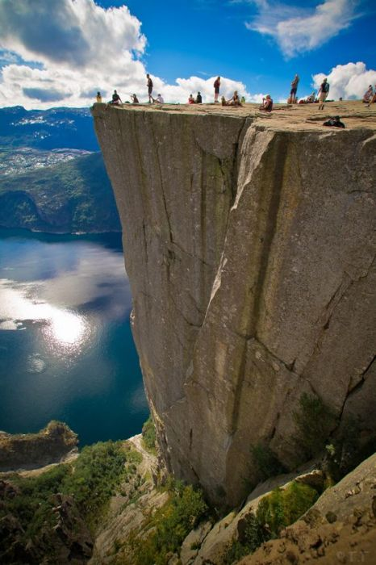
Ignoring the Main Obstacle
Getting closer to the edge of this cliff
does not
get you closer to getting to the water

Slide 55

Adding Features to Inefficient Schemes
This is a solar-powered airplane
Flight from Japan to Hawaii took 5 Days
Notes:
Solar impulse

Slide 56
A Submission to a Conference on
“Post-Oil Transportation”
Abstract
In a seminal achievement, André Borschberg constructed a solar plane that flew from Japan to Hawaii in 5 days. In this work, we construct an equally efficient solar plane that additionally contains a touch-screen video-entertainment system. Because these devices are considered essential by today’s flying public, we believe that this is an important step towards the eventual mainstream adaptation of solar aircraft.
This is silly, but happens in cryptography all the time.

Slide 57
Conclusions
Lattice cryptography is very promising for basic quantum-safe schemes
Lattice cryptography is the only approach we know for advanced quantum-safe schemes
Definitely a topic that is worth researching, especially with NIST announcing a quantum-safe crypto contest
To build practical schemes, it is not enough to just work on “provably-secure” constructions – one needs to understand the underlying knapsack problems

Slide 58
Thank You

