Slide 1

How to Use Bitcoin to Design
Fair Protocols
Iddo Bentov (Technion)
Ranjit Kumaresan (Technion)
ePrint 2014/129

Slide 2




Fairness in Secure Computation
Tough luck
buddy
Fair coin tossing is impossible
[Cle86]
Notes:
Instead of picking on the wimpy functions we go after the toughest functions on the block.

Slide 3


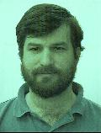
Fair Exchange
Tough luck
buddy
Fair exchange is impossible
[Cle86,BN00]
Notes:
Instead of picking on the wimpy functions we go after the toughest functions on the block.

Slide 4

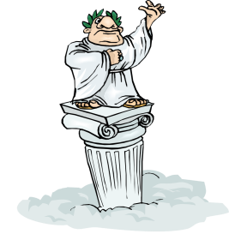

Workarounds
Let’s release output gradually…
Let’s do partial fairness?
Let’s be optimistic!
Notes:
Instead of picking on the wimpy functions we go after the toughest functions on the block.

Slide 5

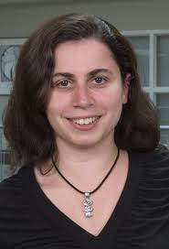
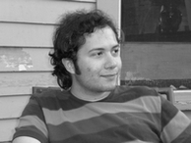


Let’s compensate the poor guy with some money!
If only there was a better middle ground…
Notes:
Instead of picking on the wimpy functions we go after the toughest functions on the block.

Slide 6

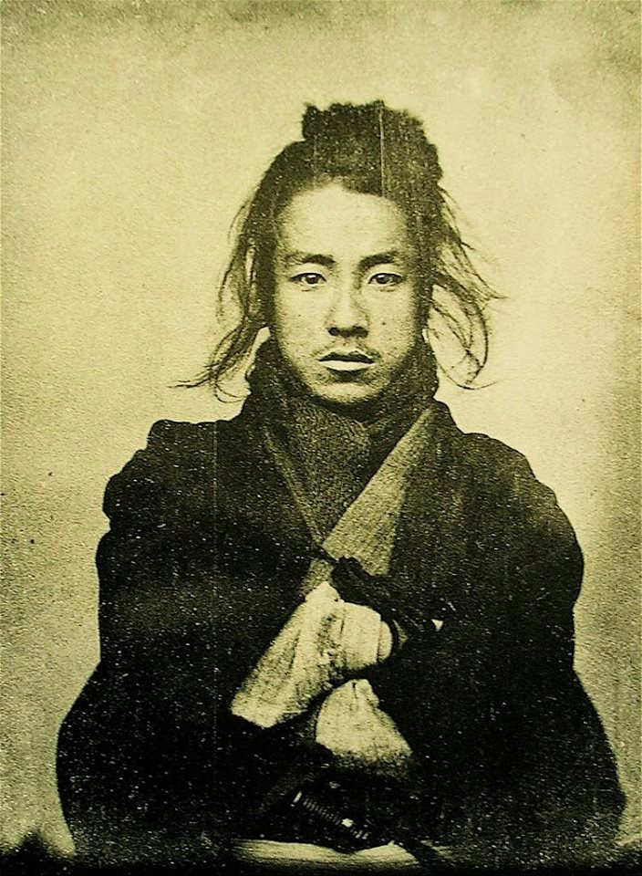


Defn.1: A cryptosystem is secure if my bank uses it and I’m not losing money
Notes:
Instead of picking on the wimpy functions we go after the toughest functions on the block.

Slide 7


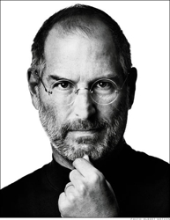
Get it??
Notes:
Instead of picking on the wimpy functions we go after the toughest functions on the block.

Slide 8

Missing Pieces
Security definition??
Abstraction of what you want from Bitcoin??
Notes:
Instead of picking on the wimpy functions we go after the toughest functions on the block.

Slide 9
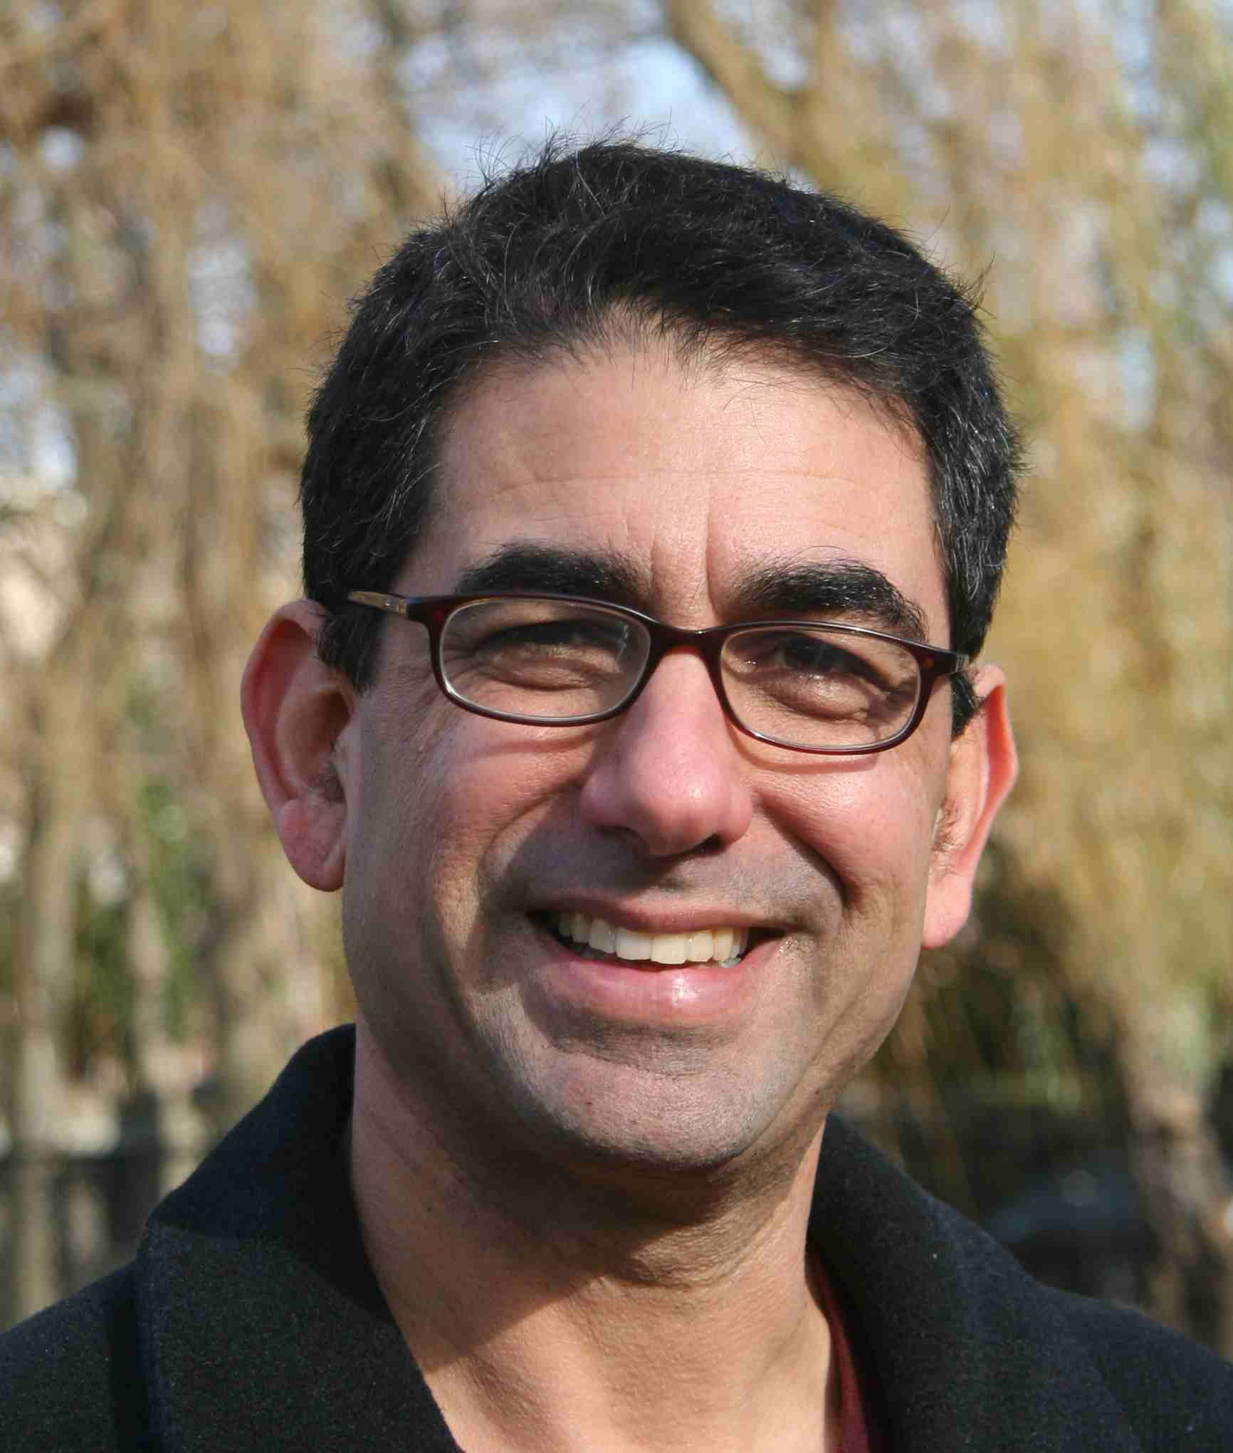



Standard Security Definitions
≈
REAL
IDEAL
Notes:
Instead of picking on the wimpy functions we go after the toughest functions on the block.

Slide 10

Where is the money???
Notes:
Instead of picking on the wimpy functions we go after the toughest functions on the block.

Slide 11
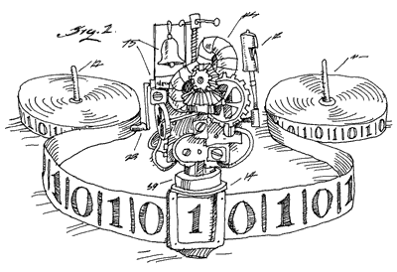

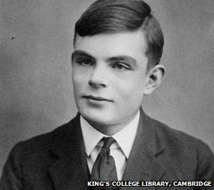
Match??
Notes:
Instead of picking on the wimpy functions we go after the toughest functions on the block.

Slide 12
Standard Security Definitions
≈
REAL
IDEAL
Notes:
Instead of picking on the wimpy functions we go after the toughest functions on the block.

Slide 13



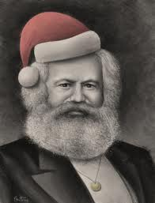

Security with “coins”
≈
REAL
IDEAL
Notes:
Instead of picking on the wimpy functions we go after the toughest functions on the block.

Slide 14
Abstraction of Bitcoin Functionality
Notes:
Instead of picking on the wimpy functions we go after the toughest functions on the block.

Slide 15

Ladder Protocols
Multiparty fair secure computation & fair lottery
Provably Secure
Also, more efficient than prior ad-hoc constructions [ADMM13,14]
Notes:
Instead of picking on the wimpy functions we go after the toughest functions on the block.

Slide 16
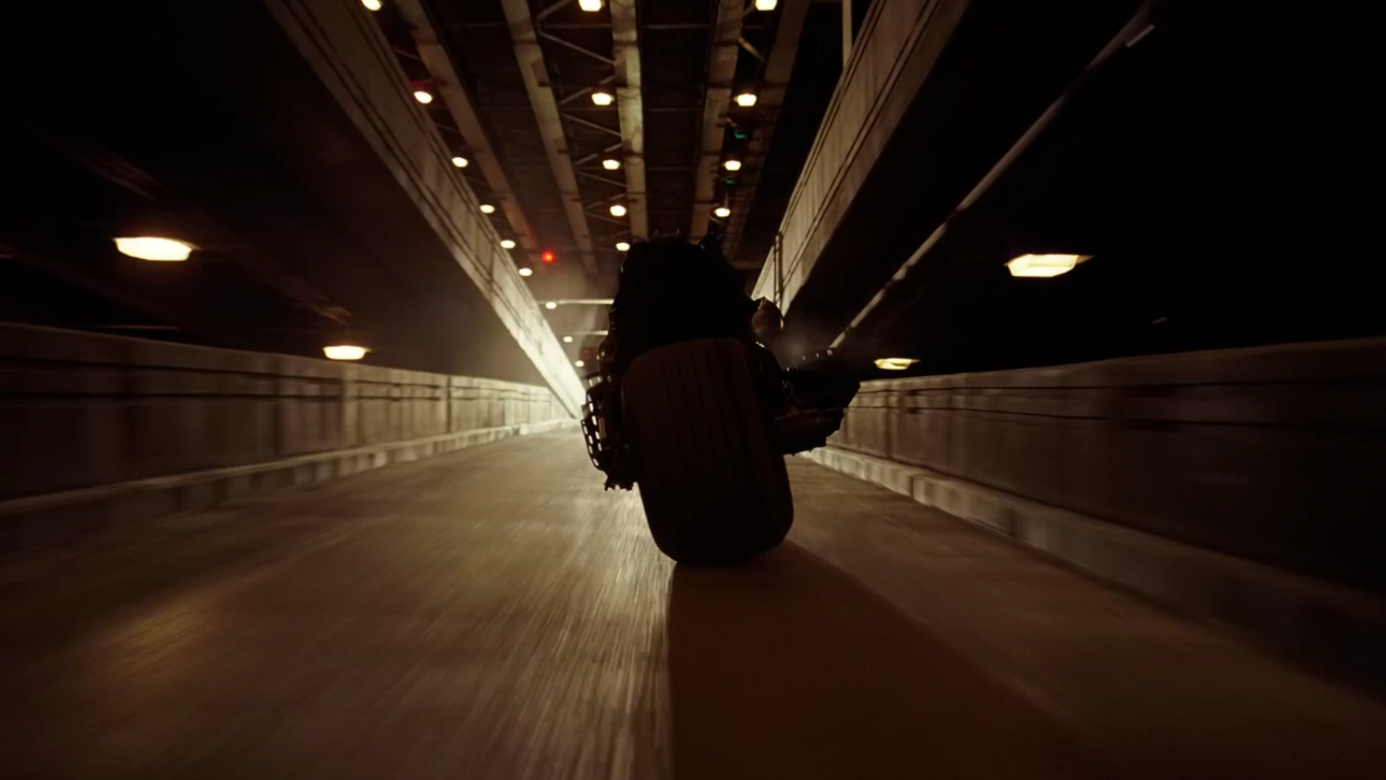
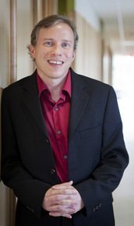
Killer App for MPC?
People don’t seem to care much about privacy…
MPC has to provide something that people really need right now…
Fair exchange?
Fair lottery?
REAL poker over the internet?
Thank You!!
ePrint 2014/129
Notes:
Instead of picking on the wimpy functions we go after the toughest functions on the block.

Slide 17
Thank You!

Slide 18
The research leading to these results has received funding from the European Union's Seventh Framework Programme (FP7/2007-2013) under grant agreement no. 259426 – ERC – Cryptography and Complexity

